Slide 1
Welcome!
Robert Zwaska
23 November 2015
Workshop on Booster Performance and Enhancements

Slide 2
Workshop Purpose
The Proton Improvement Plan is at an important mid-point
  Many upgrades have been implemented
    Several major items still underway
  Now is the time to exploit these upgrades and double the flux
What more can be done with Booster ?
  Several years of running in the PIP configuration
  Several more years of running in the PIP-II configuration
  PIP-III will use experience and even major systems from the Booster
  Experimental program keeps growing (neutrinos, muons)
Talks from the project and guests
  Understand what we have done, and what more can be done
  Gain from the experience of others

Slide 3
Some Logistics
Please sign-in at the registration desk
  Suzanne Weber and Melody Saperston, Conference Office
  Please feel free to ask questions of them - if they don't know the answer they will likely be able to direct you to someone who does.
Speakers: please upload talks to Indico
  Alternatively, email to Bob, Bill, or Tan
  Please stay to time – chairs will help
    Talk times include questions
Workshop photo today @ 9:45 in front of atrium
  Do photo before getting coffee
  We must be on time for this

Slide 4
NBI Basics
We will have an opening day reception todey, November 23, at 5:30pm on the 2nd floor crossover. Drinks and appetizers will be served. There is no additional cost for this reception.
Lunch (and breakfast) are available from the Fermilab cafeteria. It opens at 7:30am.
  We will have lunch today at 12:20
  The workshop program is will conclude at 12:40 tomorrow, before lunch.
There will be an associated seminar on the J-PARC complex at 4pm on Tuesday, November 24 by Michikazu Kinsho

Slide 5
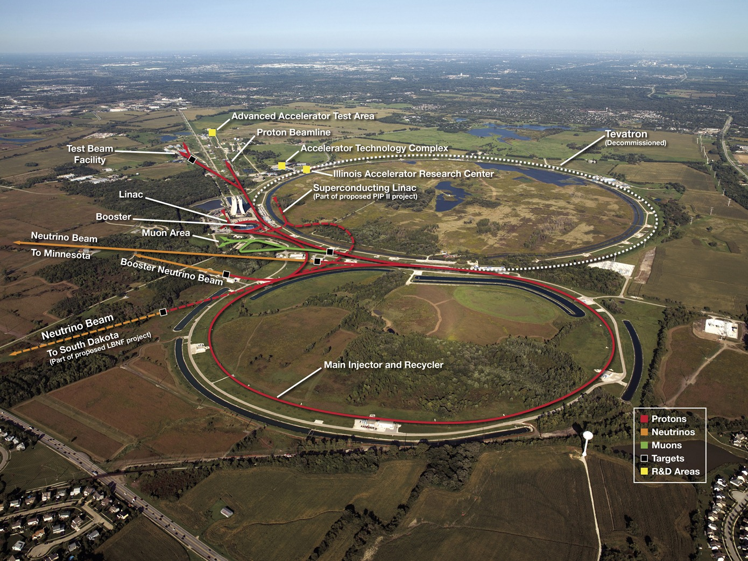
Fermilab Accelerator Complex

Slide 6
Goals for the Proton Improvement Plan
The Proton Improvement Plan should enable Linac/Booster operation capable of
  Delivering 2.3E17 protons/hour (at 15 Hz)
  while
  Maintaining Linac/Booster availability > 85%, and
  Maintaining residual activation at acceptable levels
and also ensuring a useful operating life of the linac through 2023, and Booster through 2030 or later
The scope of the Proton Improvement Plan includes
  Upgrading (or replacing) components to increase the Booster repetition rate
  Replacing components that have (or will have) poor reliability
  Replacing components that are (or will soon become) obsolete
  Studying beam dynamics to diagnose performance limitations
  Implementing operational changes to reduce beam loss
http://www-ad.fnal.gov/proton/PIP/PIP_index.html

Slide 7
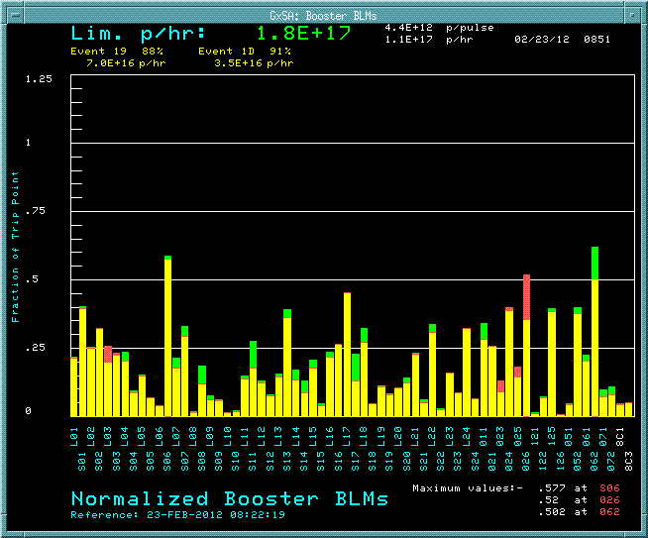
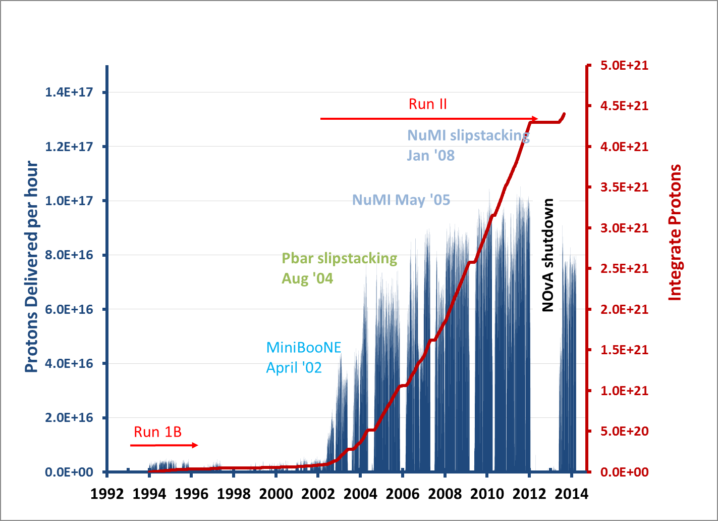
Booster
loss profile
Where PIP started
Loss limited until 2010
then cycle rate limited

Slide 8
PIP – Task Structure and Status
PIP has 33 Tasks
18 are completed and closed
Several more ending now with startup
Completed

Slide 9
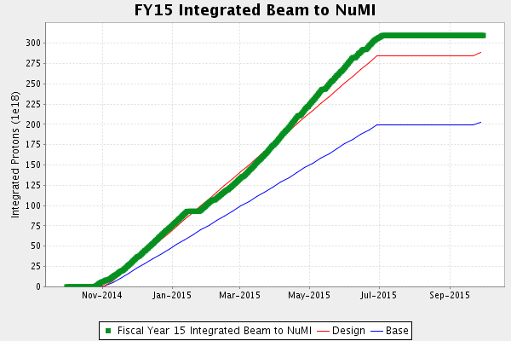
Beam delivery in FY15 exceeded goals
Good up-time, and reached higher-power a little ahead of schedule

Slide 10
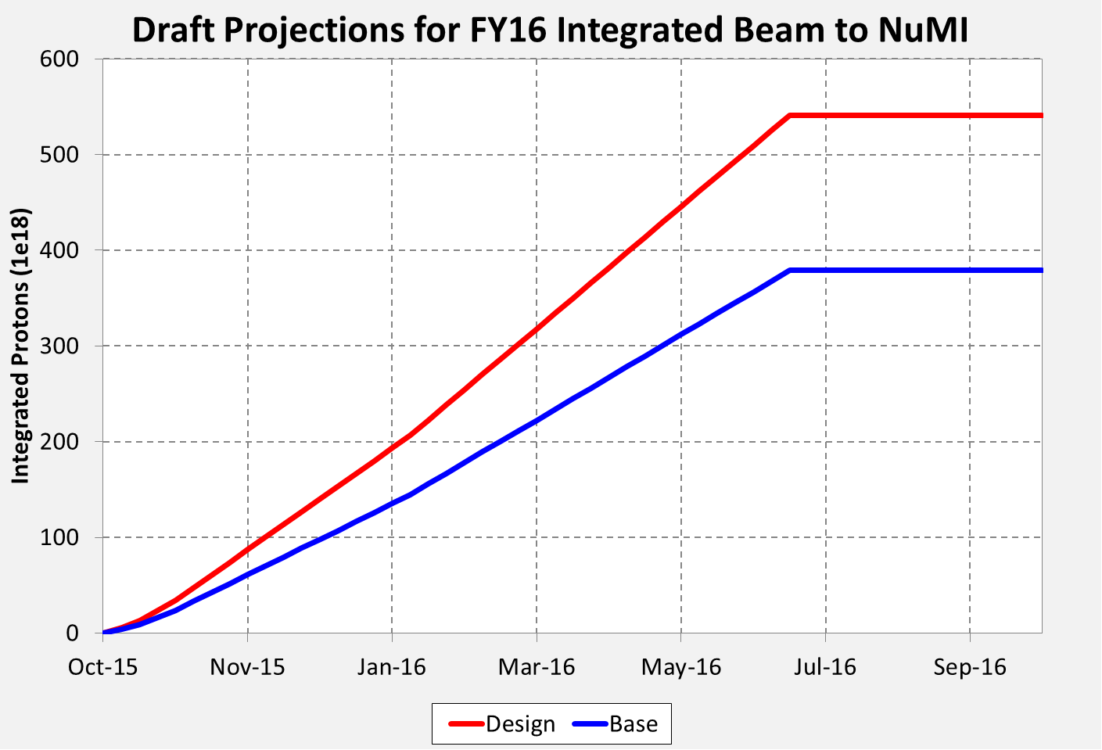
FY16 NuMI POT Projection
Goals roughly doubled for FY16 (reach 700 kW in spring)
Will only increase an additional 10-30% until further upgrades

Slide 11
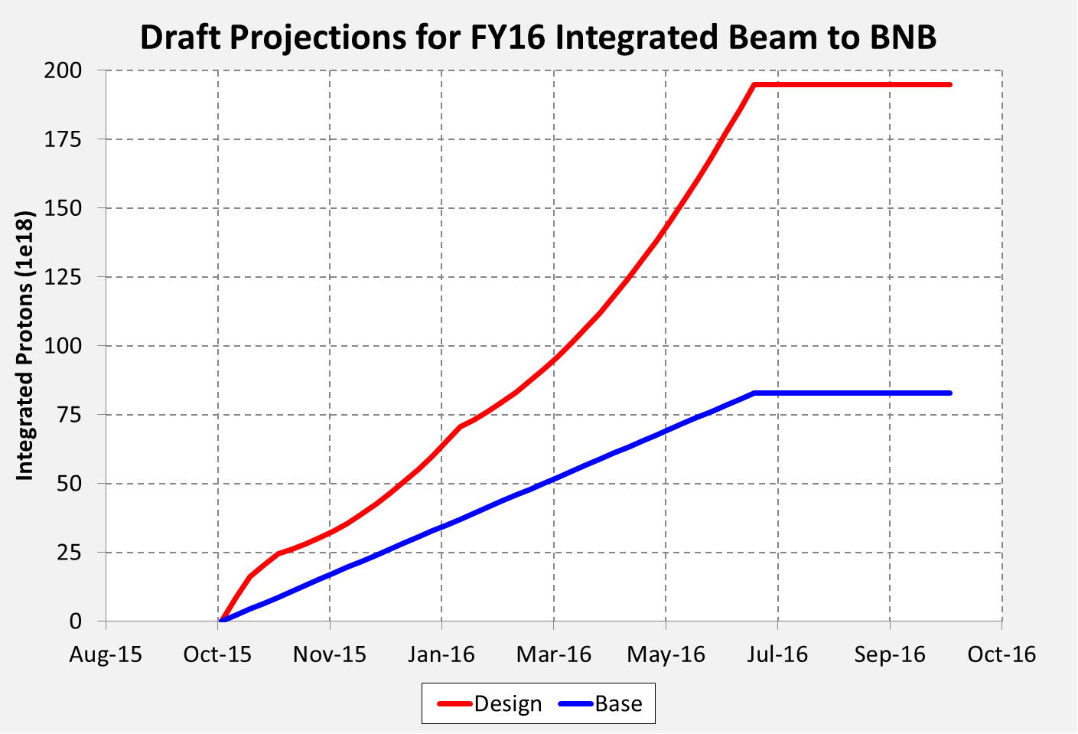
FY16 BNB POT Projections

Slide 12
Proton Delivery Scenario with PIP
(Schematic – not accounting for long shutdowns)
15 Hz
Total beam thru Booster
Ramp up flux – tuning/loses
POT/quarter, (x10²⁰)
7.5 Hz
NuMI / 120 GeV ν
g-2
BNB
Summer Shutdown
Mu2e
SY120
FY

Slide 13
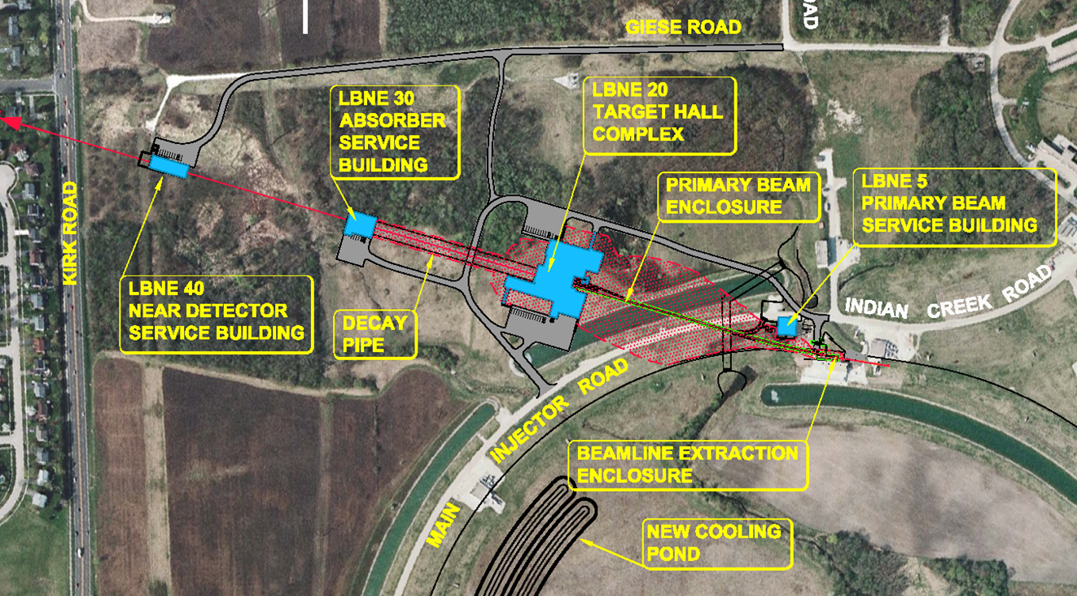
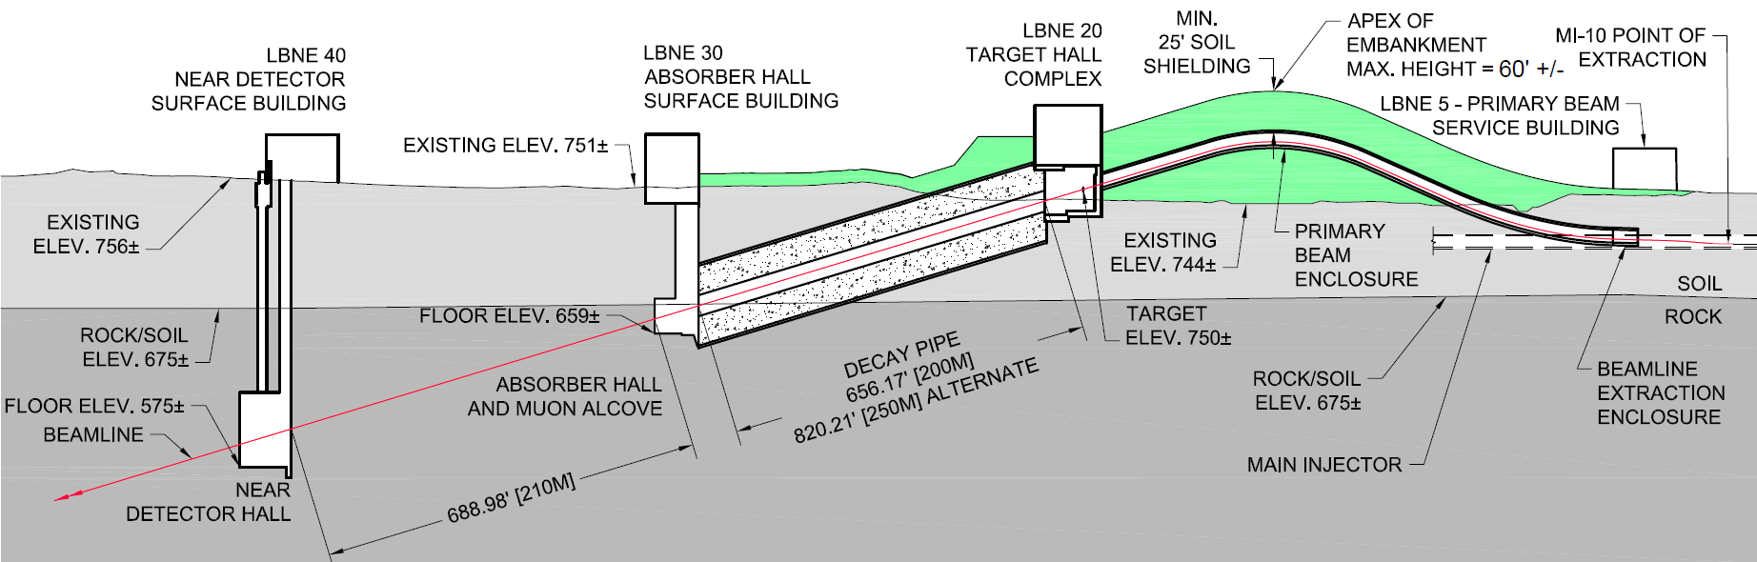
Beamline for a new Long-Baseline Neutrino Facility
Main
Injector

Slide 14
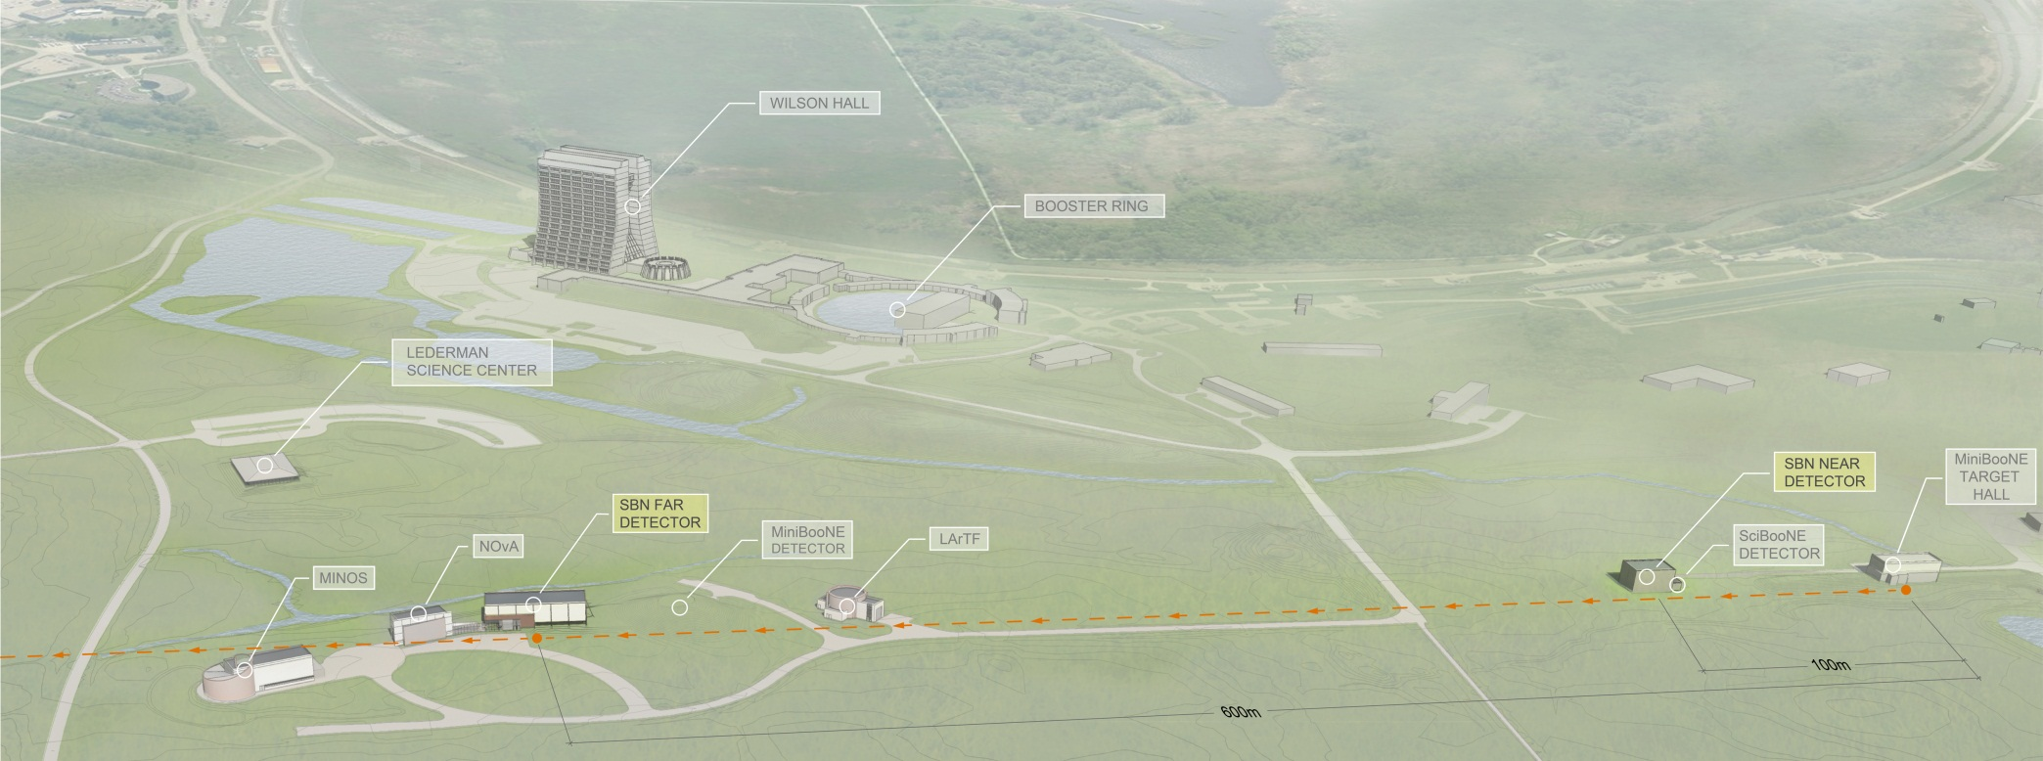
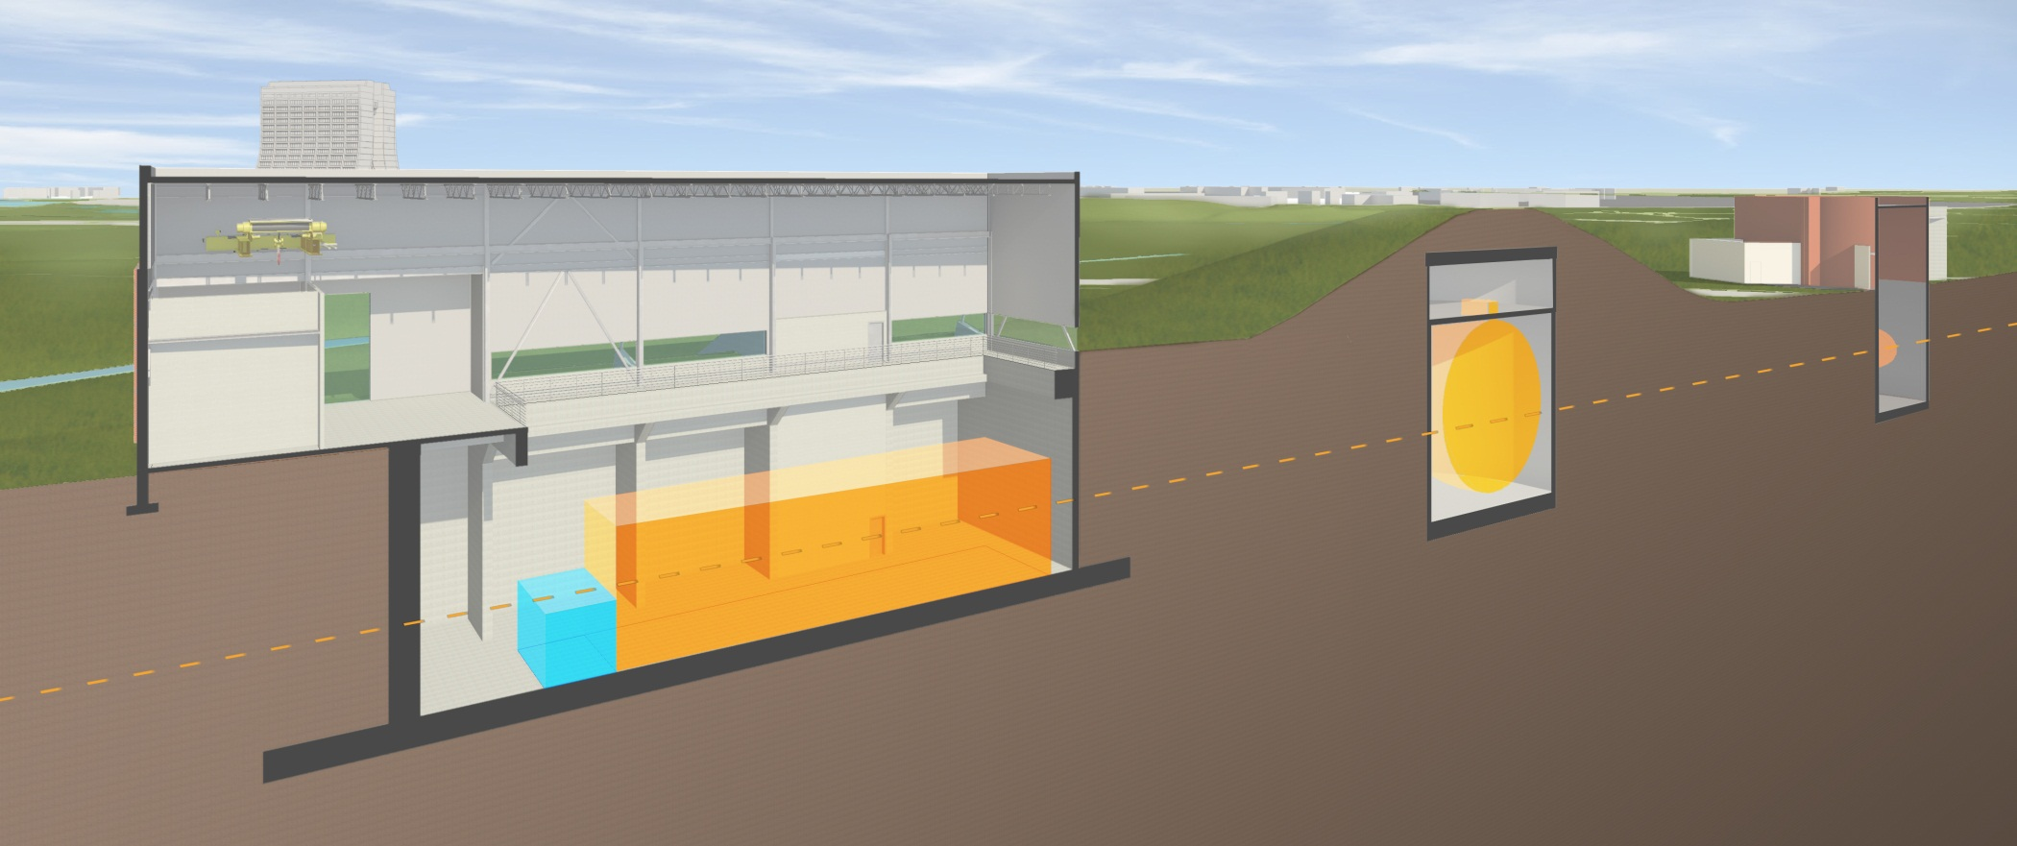
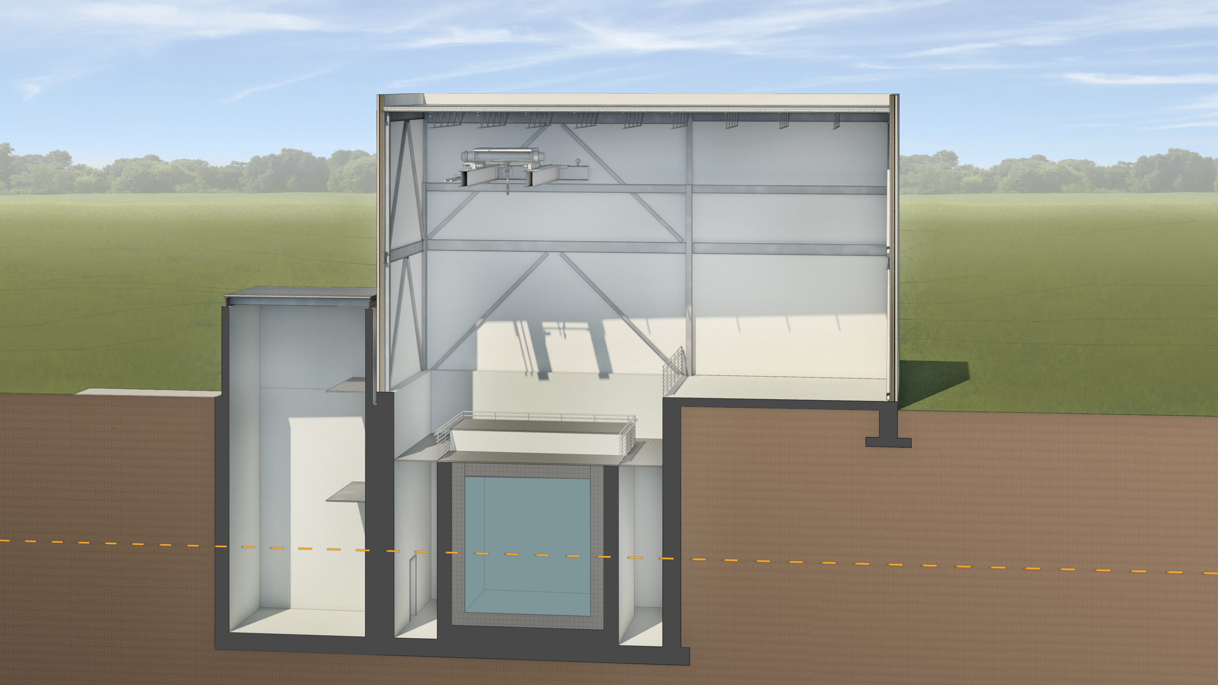
SBN Program Layout
MINOS
MI-12
MicroBooNE (existing)
170t LAr
MiniBooNE
Near Detector SBND
180t LAr

Slide 15
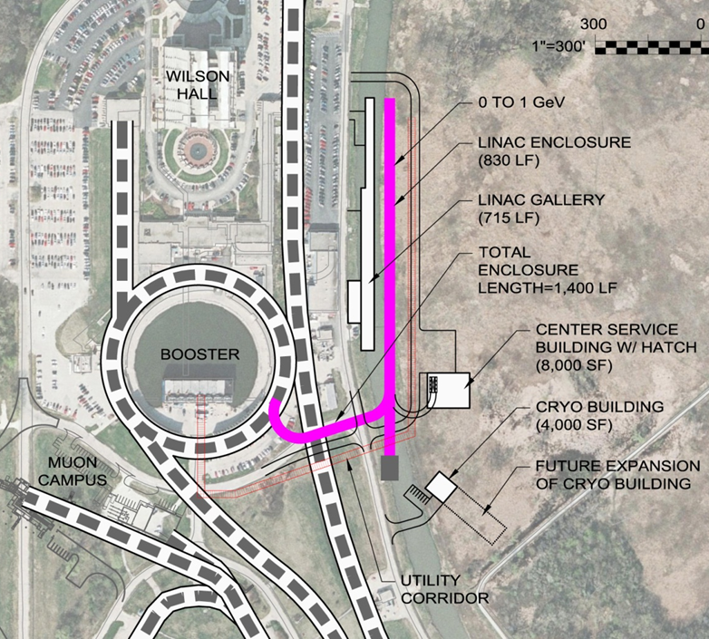
Proton Improvement Plan II (PIP-II)
Goal is to increase Main Injector beam power to 1.2 MW.
  Replace the existing 400 MeV linac with a new 800 MeV superconducting linac => 50% increase in Booster intensity.
  Shorten Main Injector cycle time 1.33 → 1.2 sec.
Build this concurrently with LBNF
=> 1.2 MW to LBNF from t = 0.
This plan is based on well-
developed SRF technology.
Developing an international
partnership for its construction
Strong support from DOE
and P5
http://pip2.fnal.gov/

Slide 16
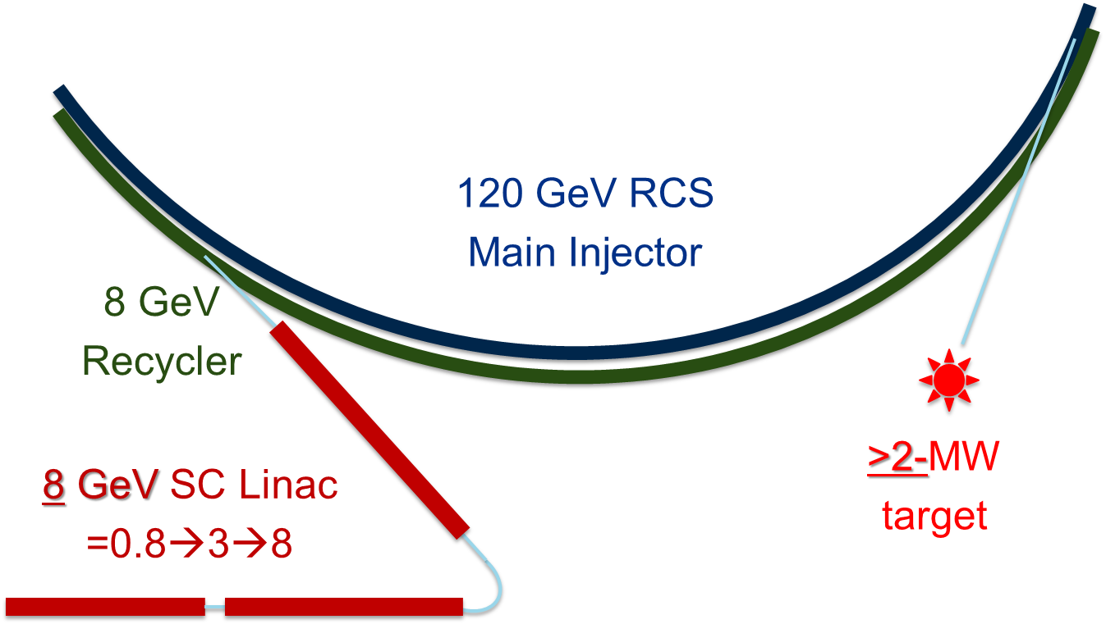
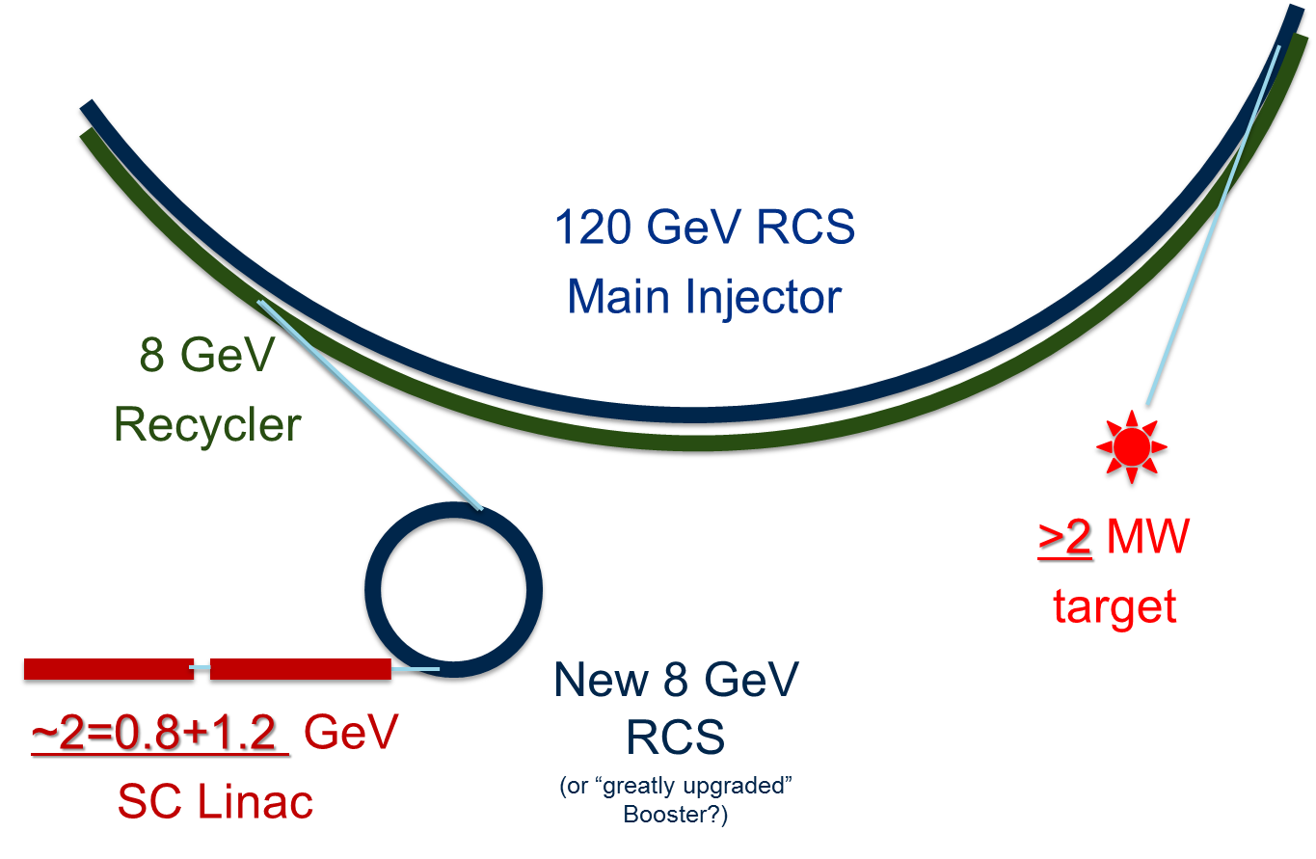
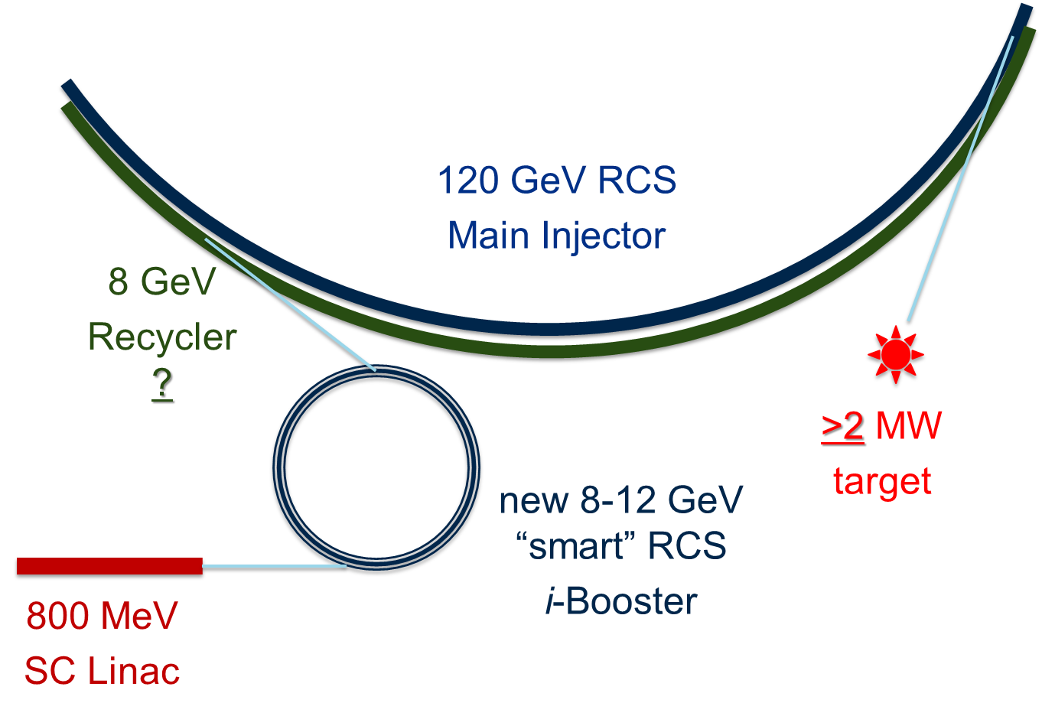
Future Directions – PIP-III
PIP-III concepts to provide 2-5 MW of beam power for future experiments
Three generalized options:
  Extend Linac to 8 GeV, inject directly to MI/RR
  Extend Linac to ~ 2 GeV, inject into new RCS (or upgraded Booster)
  Develop novel technologies to beat the space charge limit
The strategy will be determined by technical and financial factors once PIP-II construction is underway
Booster, or major Booster components will be used for RCS options

Slide 17
Big Questions for this Workshop
How do we get the most out of what we have done?
  Losses, efficiency, up-time
What is left to be done on PIP?
  Will all the work we plan to do meet the high-level goals?
What more can be done before PIP-II, or in anticipation?
  What beam intensity can the Booster produce?
  Using the solid-state RF with more cavities?
We have long horizon, so short-, medium-, and long-term opportunities are all valuable.

Slide 18
Welcome!
Robert Zwaska
23 November 2015
Workshop on Booster Performance and Enhancements

