Slide 1
High Intensity Booster Operations
William Pellico
Booster Beam Physics Workshop
Nov. 23rd 2015

Slide 2
Outline
Overview of present Booster
Booster beam demands
Ramp up of Booster
Loss profile (time and locations)
Planned effort to address beam loss (highlights)
PIP tasks to reach flux goals – look at loss points of cycle
PIP Booster physics

Slide 3
Road map to higher flux (and higher intensity)
PIP (and earlier upgrades)
Series of upgrades and improvements to address immediate needs and aligned to longer term goals
Immense progress has been made in Booster over past 10 years
Flux has gone up by 10X
Uncontrolled loss have been greatly reduced (>20% - cogging…)
Activation has been reduced even at higher pph (new notch sys.)
The goal is to now double the flux but not increase the activation (remain at 2012 levels)
Increase beam cycle repetition rate to 15 Hz – first step done
Maintain uptime >85% - time will tell but many items addressed
Reduce losses by another 50% - lots of ideas and plans

Slide 4
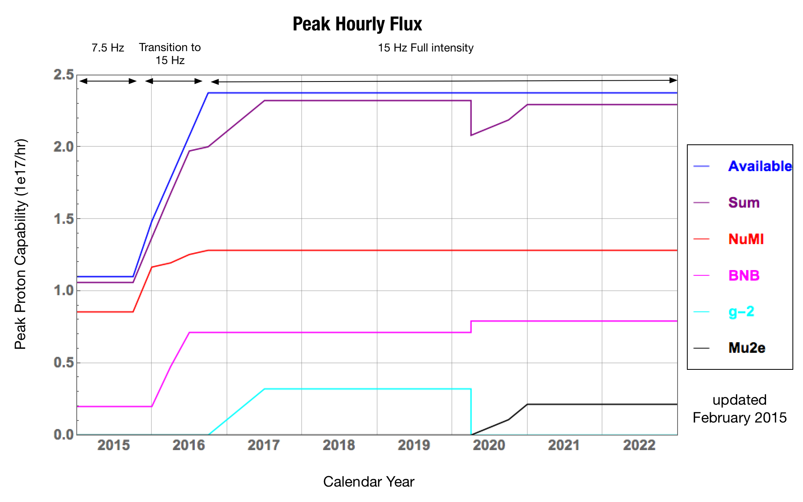
Program Planning Flux Timetable

Slide 5
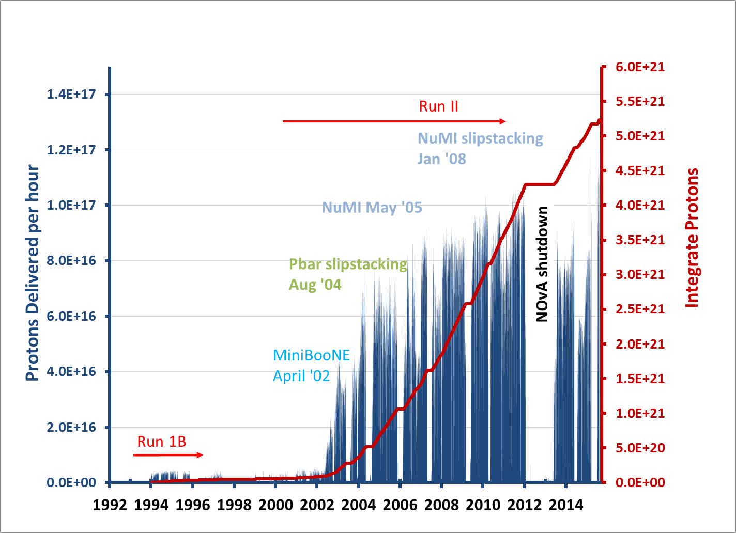
Now – 1.4 to 1.5 E17 pph

Slide 6
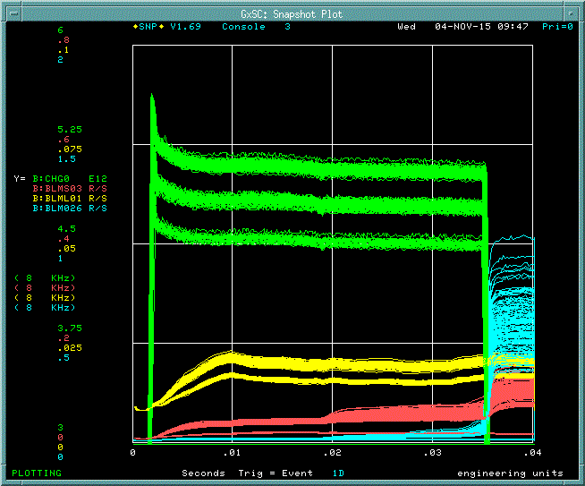
Present Booster Loss Profile – Higher Intensity
Booster has three loss points
during the cycle:
Injection/start of acceleration
Largest fraction of loss
400 to 800 MeV
Several components
Transition
RF voltage issue
Orbit control
Space charge ?
Bucket matching
Extraction
Limited aperture
Kicker rise time
RF manipulations
Injection
Transition
Extraction

Slide 7
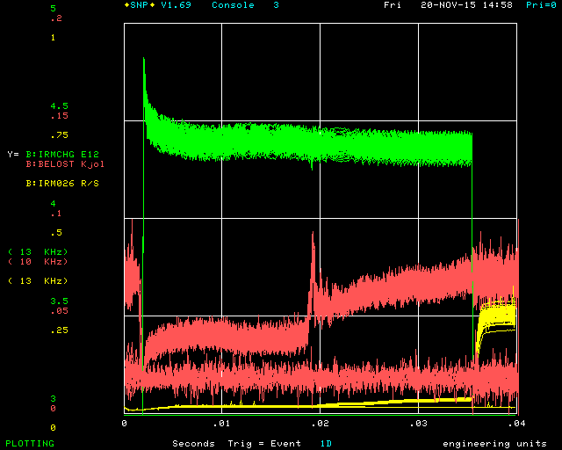
Booster charge signal (nominal intensity) and power loss
Lots of improvements
Beam loss (watts) down ~ 15 %
Booster calculated beam power loss
Transition
Extraction beam loss at Septa
No beam baseline
Booster Beam Physics Workshop

Slide 8
Acceptable trip value
based upon radiation surveys and historic work activates
when one of these scaled BLM readings reach 1 beam is inhibited
Booster also has a running sum average loss of 525 watts
uses the Booster beam toroid
this is a Proton Source department safety net
Plot is of normalized BLMs to trip point value
Collimator
Notch beam
absorber
Extraction
Tunnel Locations
Above plot is for 1.5E17 pph – 4.3e12/pulse at ~10 Hz

Slide 9
Recent radiation survey
Surveys reflect the BLM data and are used to set the trip points of the BLM system
Note: the BLM system is not part of the shielding protection
Try to protect RF cavities10 long straights
Collimators
Extraction
Injection
Notch beam
absorber
RF
RF

Slide 10
Booster hardware and beam physics improvements (Booster was loss limited but became cycle rate limited)
Booster pph for the past 8 years
Average has gone up as improvements have been made
like collimators, correctors, notching system, apertures, dampers…
Refurbishing of Booster cavities – required reduced intensity
Jump at the end of FY15 is Booster achieving 15 Hz
FY16 ramping up

Slide 11
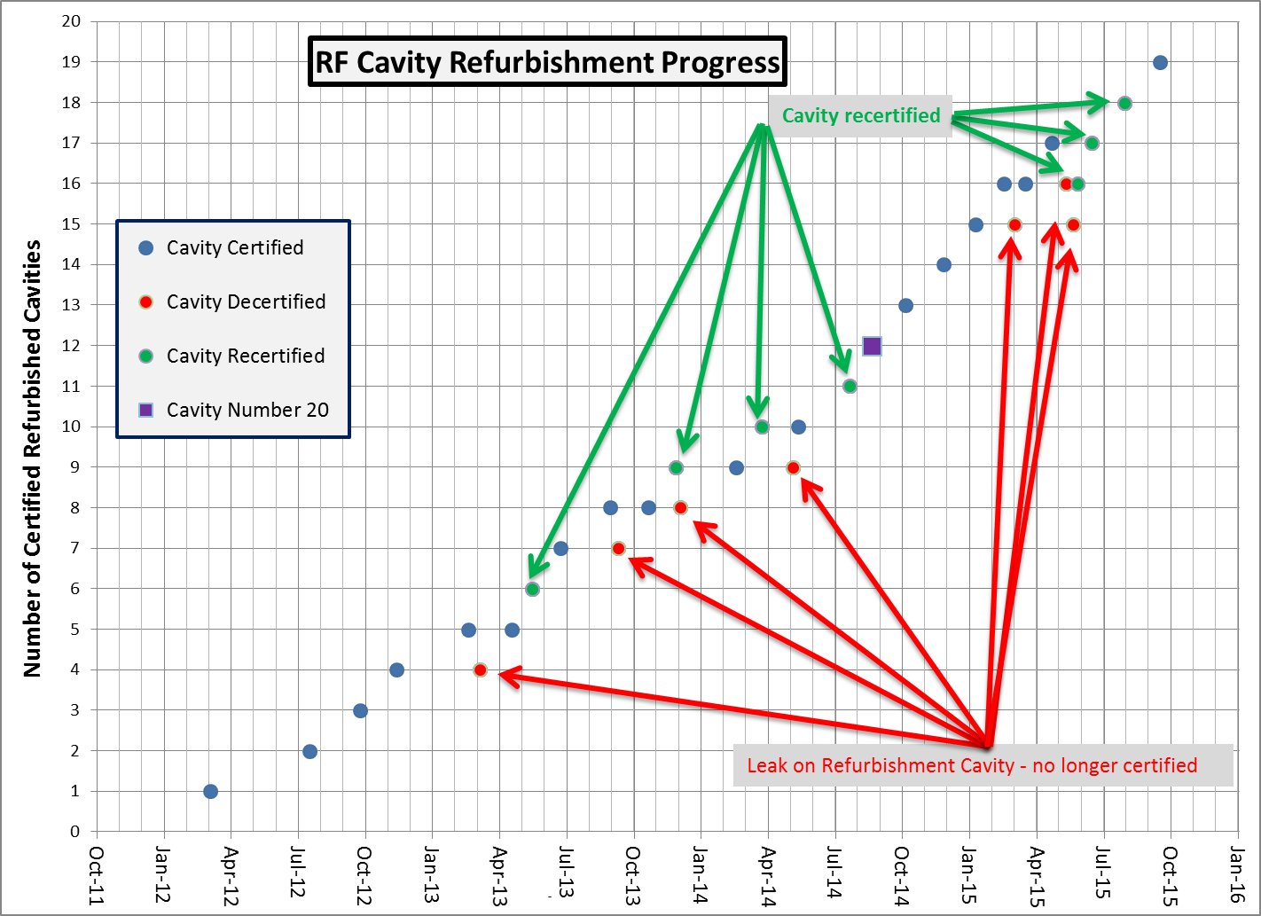
20th cavity
Ramp rate push and higher flux

Slide 12
Looking at the three beam loss points in the cycle Injection and start of ramp – 1st loss point in cycle
Injection/Capture and start of ramp
Paraphase RF capture ( ‘A’ and ‘B’ stations)
Working on new low level controls that will allow for better balancing of the two RF
Additional RF stations will allow for adjustments to accommodate failed stations
Working on an early injection scheme that simulations say will reduce longitudinal growth and some beam loss
2nd harmonic cavity to mitigate space charge and lower loss
Orbit control/LOCO – adjusting corrector break points and beta beating
GMPS regulation – improve our injection bend field/orbit and reduce beam loss
Still some improvements to notching – capture of losses in absorber
Move notch creation from Booster to the 750 KeV injector line

Slide 13
Examples of early injection studies
B dot– measured at reference magnet
Injection typically near zero crossing
Goal: Improve capture of the Linac beam, preserving the longitudinal emittances and reducing capture loss
(See Chandra’s talk)
Beam pickup
RF Envelope
Moved early 150us

Slide 14
Early in cycle Booster beam loss
Notch created 100us after capture
most of beam is kicked into new absorber but some gets lost around the ring
expectation is to move this process to the 750 KeV line using laser notching
small orbit variations also impact loss profiles
mostly due to energy and bend field variations

Slide 15
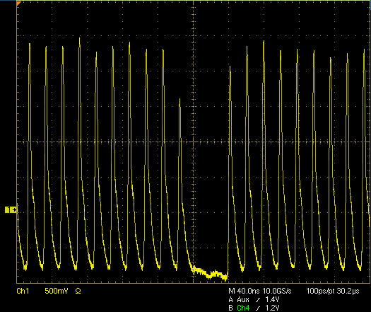
Booster Notch
Notch ‘cleaned out’ – by extraction time
Lost in Booster at horizontal apertures
Notch created at 400 MeV injection
Limitations of making notch in Booster (Talk by Salah, Rick)
could not kick the beam out cleanly
much improved over previous system
Linac notch will remove most of this loss from the tunnel

Slide 16
Orbit control
Smoothing orbits on regular basis
Frist required aperture scans be complete (see Kiyomi talk)
Magnet/Girder mover (see Kiyomi talk)
Orbit break points
Match to time in cycle issues/constraints
Data stored several times a day to understand motion/variability
Improving BPM system (fixing present system – new digital FY16)
Improved GMPS feedback to deal with line voltage bounce
MI and Booster on one feeder due to maintenance
Moved away from radial cogging to magnetic cogging
Uses Booster correctors to control gap trajectory through cycle

Slide 17
Booster Gradient Magnet Power Supply (GMPS)
A new regulator card is being developed - learning abilities
GMPS regulation is important to
orbit stabilization,
losses,
for extraction energy control for Recycler/MI.
No GMPS feedforward
MI ramp
GMPS feedforward pulses
Booster GMPS bend error at injection

Slide 18
Booster/PIP efficiency plot with two planned improvements
Booster Efficiency % | Booster Intensity/Pulse E12 | Pre-Acc laser Notch (Clean out in Booster) | Modified Capture Longer Injection | Final Efficiency
.94 | 3.3 | .025 | .008 | .973
.93 | 3.6 | .025 | .008 | .963
.927 | 3.9 | .025 | .008 | .96
.92 | 4.2 | .025 | .008 | .953
.915 | 4.5 | .025 | .008 | .948
.91 | 4.75 | .025 | .008 | .943
.905 | 5.1 | .025 | .008 | .938
.895 | 5.3 | .025 | .008 | .928
With planned improvements
Booster/PIP goal is to delivery 4.3E12/pulse at 15 Hz or 2.3E17 pph. To achieve that and remain at our present activation levels Booster needs to operate at around 94% efficiency.

Slide 19
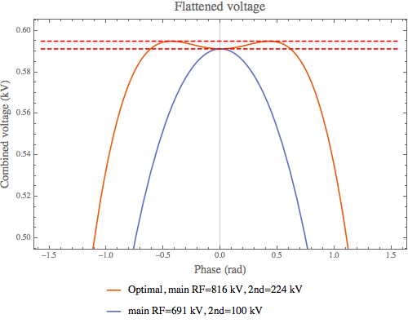
Transition – 2nd loss point in cycle
Transition
Additional fundamental mode RF cavities
Helps Quad damper
Allows for some RF over focusing bumps (balancing SC effect)
Considering adding a 2nd harmonic cavity
Focus free transition crossing (FFTC) – reduce bucket mismatch
Additional volts – negative mass instabilities
Low level controls upgrade to allow for better phase control

Slide 20
Extraction – 3rd loss point
This loss point has the typical issues: septa magnet aperture, kicker rise times
Additional issues with RF manipulations required for downstream machines
bunch rotation
phase lock process and the required radial position motion
This represents a very small beam loss
occurs every cycle at 8 GeV
needs to be cleaned up for the higher cycle rate / higher intensity operations

Slide 21
Beam Quality
While we have focused on ramping up the cycle rate and loss control, beam quality is a requirement we need to keep in mind. Beam quality has never been better – lower transverse emittances and longitudinal phase errors. These improvements have not been tested at higher intensities (above operating levels.)
Improved higher order beam dynamics (tunes, chromaticity, coupling and beta beating)
Improved beam dampers
New digital transverse and longitudinal
Improved quad damping at transition

Slide 22
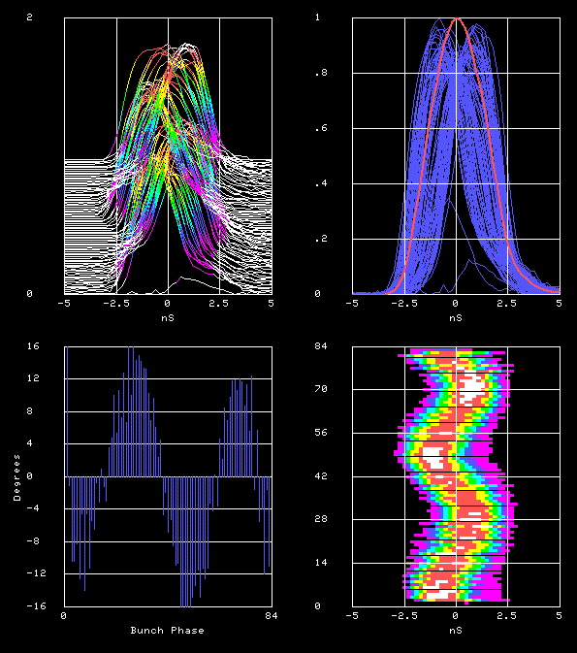
Booster Beam Physics WBS 1.02.02
Bunches
16
-16
Bunches
Phase error
Bunch Phase
Beam measurements in the MI-8 line which show amplitude and phase of extracted Booster bunches
With the new digital dampers working – phase errors look excellent and should help reduce loses in downstream machines (see Nathan talk)

Slide 23
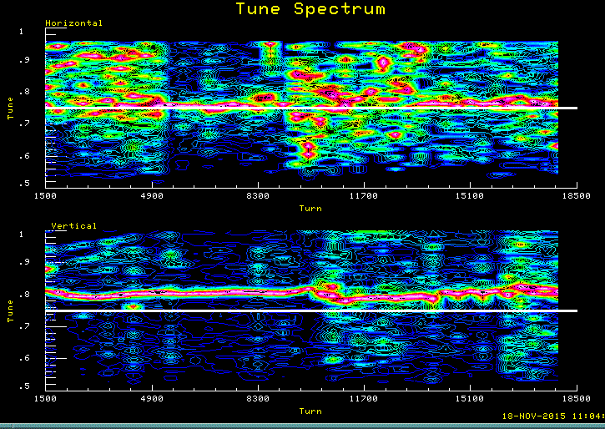
Operating tunes in Booster
Using transvers dampers to measure tunes
Plan is to scan tune space/ stop bands
New software developed to make tune scans easier
Horizontal S/N due to pickup pinger in low H beta.

Slide 24
Planned Studies – Scheduled for FY16
Booster studies
Doubling over previous high operating point – from 1.1E17 pph to ~2.3E17 pph
A lot of PIP plans are in the works but beam physics is at the top of our list.
Studies | People - Contact
Magnet Moves | Kiyomi, Todd
Collimator | Kapin, Rick, Todd
Lattice/Tunes/LOCO | Tan, Kiyomi, Kent
Transition | Tan, Chandra
Injection | Chandra
Aperture Scans | Kiyomi, Ops
Corr, Bex | Kent, Salah
GMPS Regulation | Bill, Kiyomi, Kent
Orbit Smoothing | Kiyomi, Kent, Todd
Extraction studies | Kiyomi, Craig
Foil Scans - check | Salah
Absorber Scans | Salah, Bill
Tune/Band scans | ?
RF - low level ctrls | Craig, Brian

Slide 25
Summary
PIP Goal::
PIP should enable Linac/Booster to:
Deliver 2.3E17 protons per hour @ 15 Hz
while maintaining Linac/Booster availabilty > 85%
and residual activation at acceptable levels.
S. Nagaitsev, Sept. 2014
Transition from PIP to PIP-II::
In addition, the plan should anticipate a transition to the new PIP-II Linac in 2023,
with which Booster will be expected to deliver 4.7E17 protons per hour @ 20 Hz.
S. Nagaitsev, Sept. 2014
PIP has been going since 2012 and we have made lots of progress but we have long way to go to reach our goals. We hope that discussions we have will provide insight into some of the issues we are and will face moving forward.

