Slide 1
Booster alignment and aperture
Kiyomi Seiya
Workshop on Booster Performance and Enhancements
23 November 2015

Slide 2
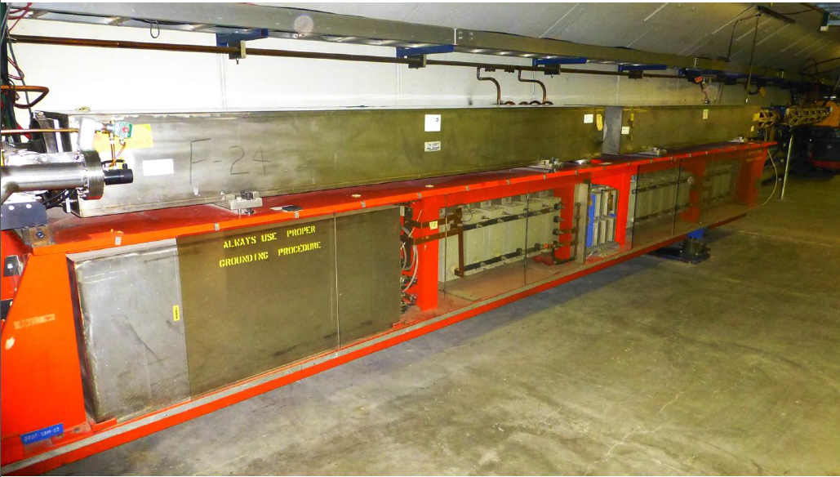
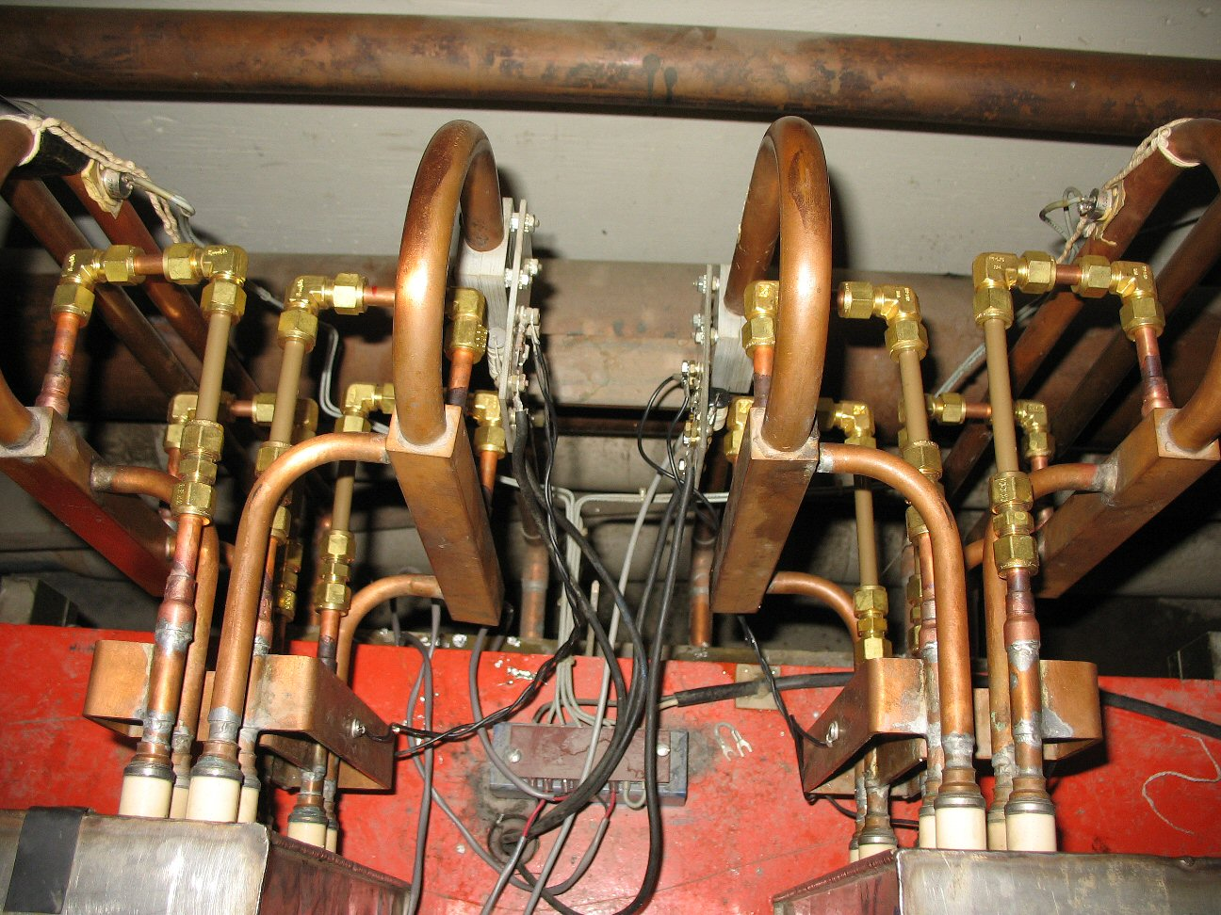
Goal: Move magnets to open up apertures

Slide 3
Outline
Aperture Scan Program
Components in the Booster and Their Aperture
Process of Magnet Realignment
Results of the Magnet Realignment
Status of the Aperture and Orbit
Plan
S. Chaurize
W. Marsh
W. Pellico
K. Seiya
T. Sullivan
K. Triplett
A. Waller

Slide 4
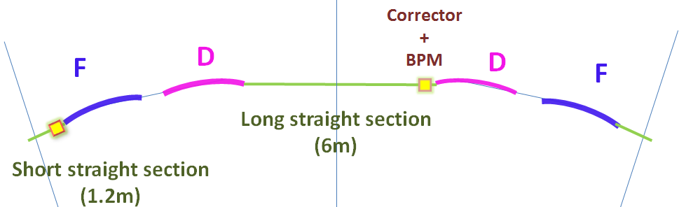
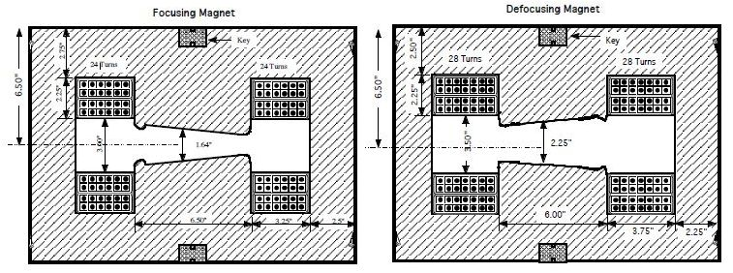
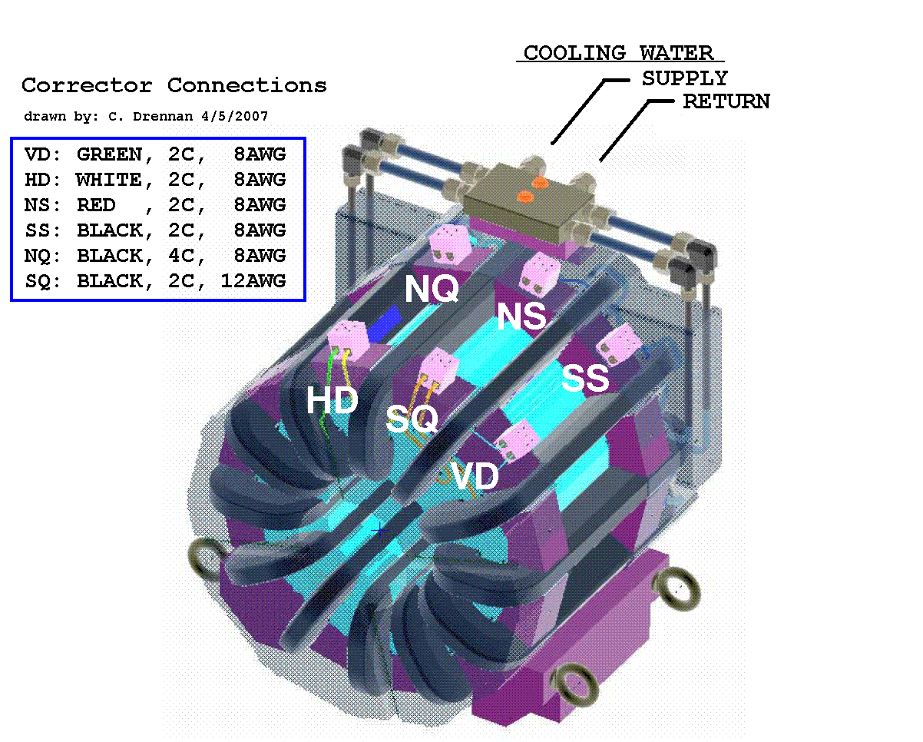
Booster lattice
F Magnet
D Magnet
Combined function magnets: F, D
FDOODF x 24 periods
Corrector packages at short and long
Corrector package (12 poles) includes
H & V dipoles, quad, skew quad, sextupole, skew sextupole
and H & V BPMs.
Corrector Package

Slide 5
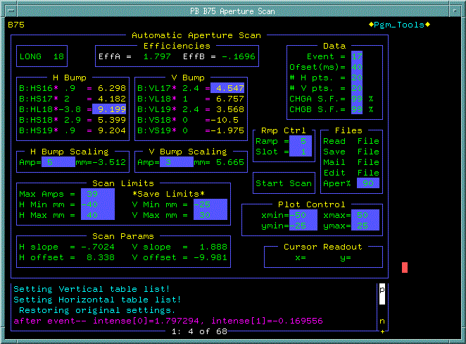
Aperture scan with B75 application
3bump
Changes corrector current at injection
5bump

Slide 6
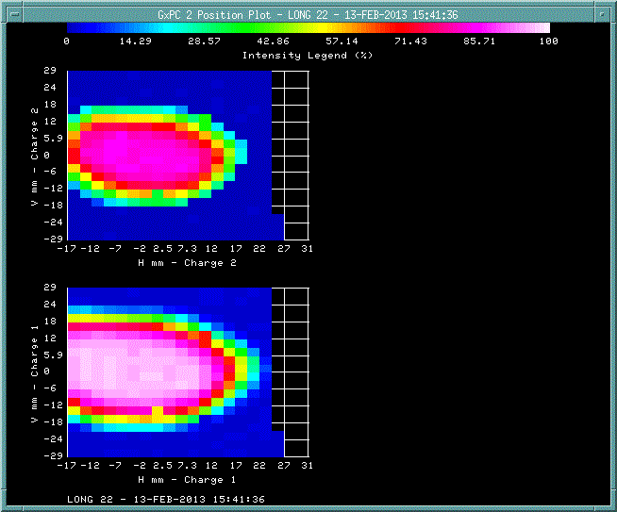
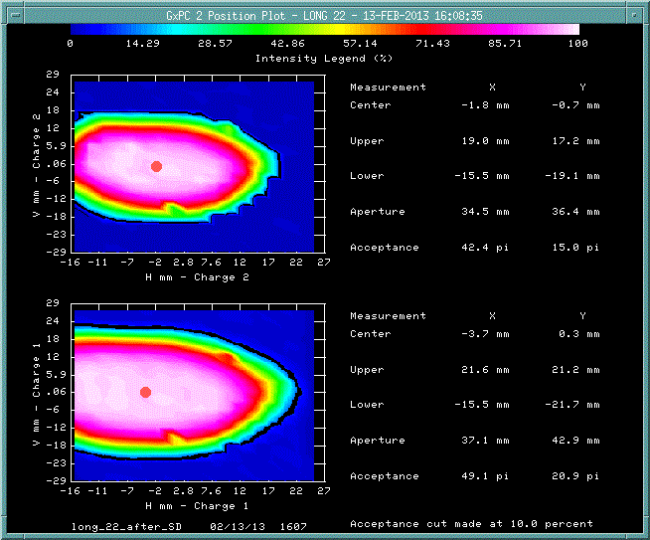
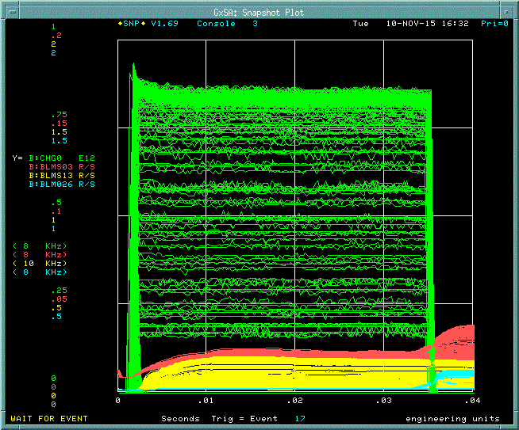
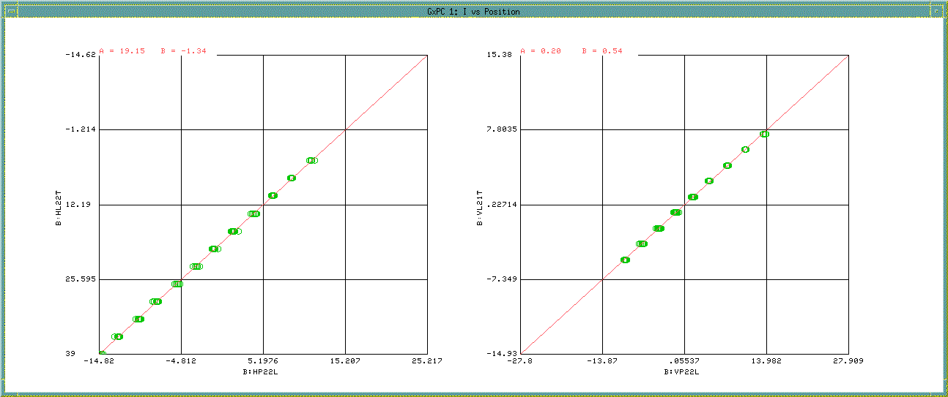
Aperture scan with B75 application #2
Int@ext/int@400MeV
I_V [A]
Int@inj/Int@400MeV
BPM_V [mm]
I_H [A]
BPM_H [mm]
Intensity
BPM position
H Corrector current
V Corrector current

Slide 7
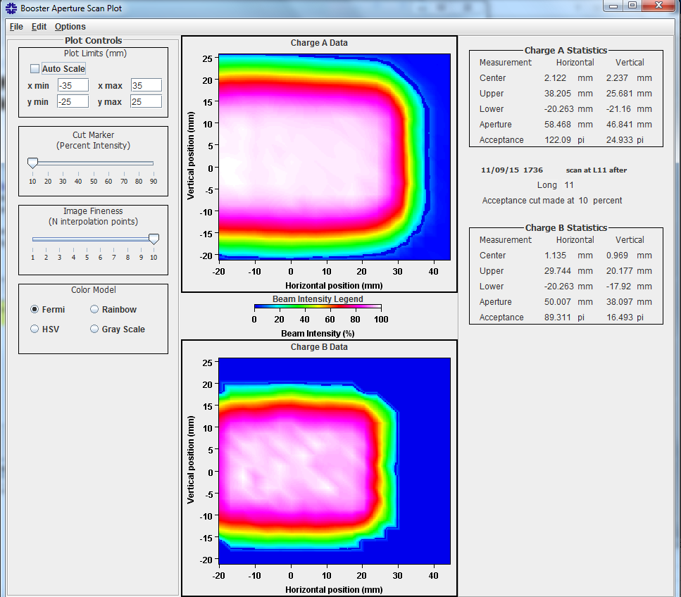
Offline analysis with Java program

Slide 8
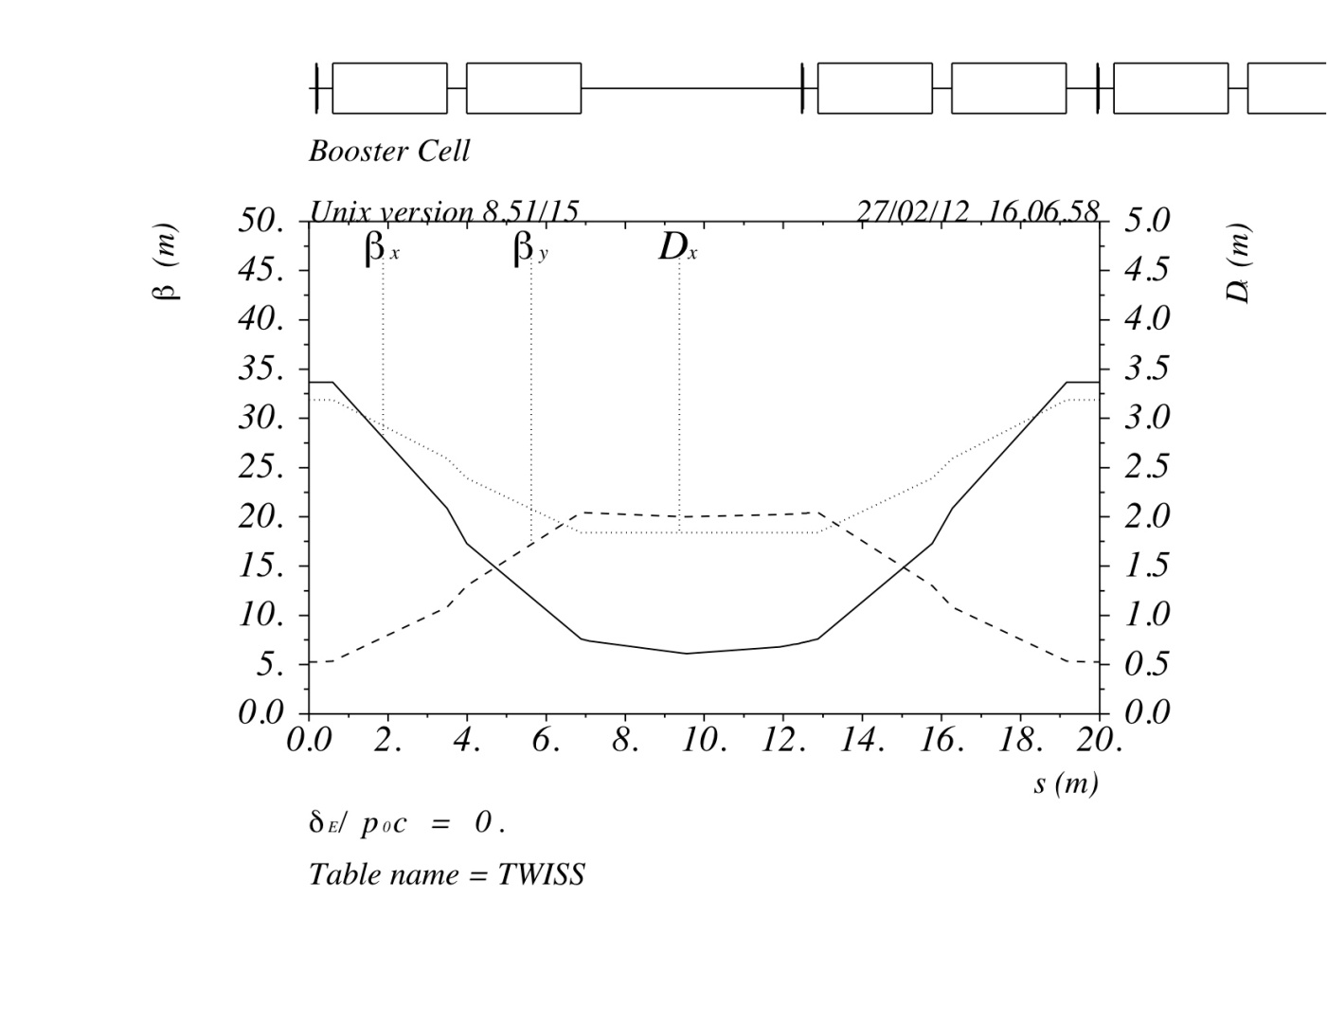
Booster lattice and beam size
LONG straight
SHORT straight
βx @short = 33.7
βx @long = 6.1
βy @short = 5.3
βy @long = 20.4
@ SHORT straight
@ LONG straight
beam size
+/-17.9mm
H_emittance(95%) = 14π mmmrad
V_emittance(95%) = 16 π mmmrad
+/-9.12 mm
+/-21.5 mm
+/-9.15mm

Slide 9
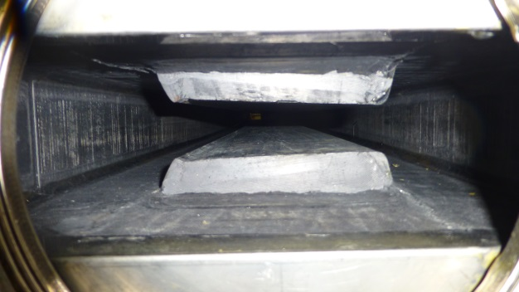
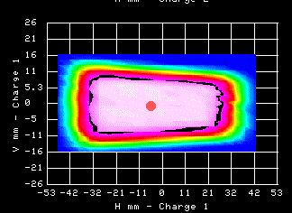
Aperture at Short straight sections
F magnet
114.3mm
1.64 inch gap
41.66mm
4.5 inch beam pipe and corrector

Slide 10
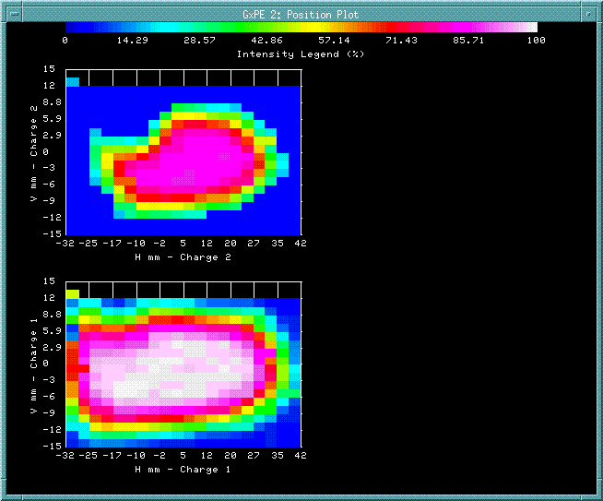
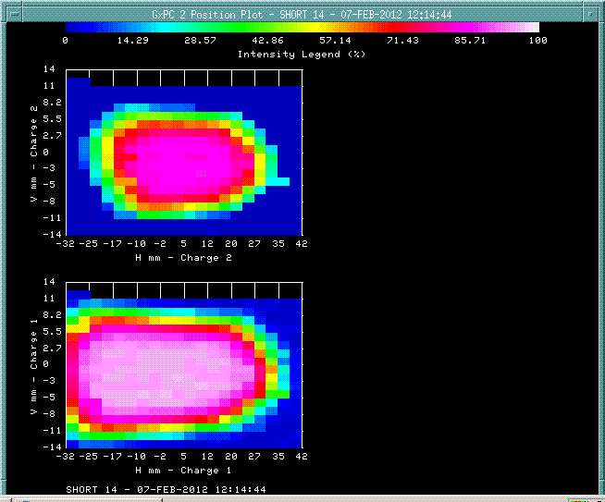
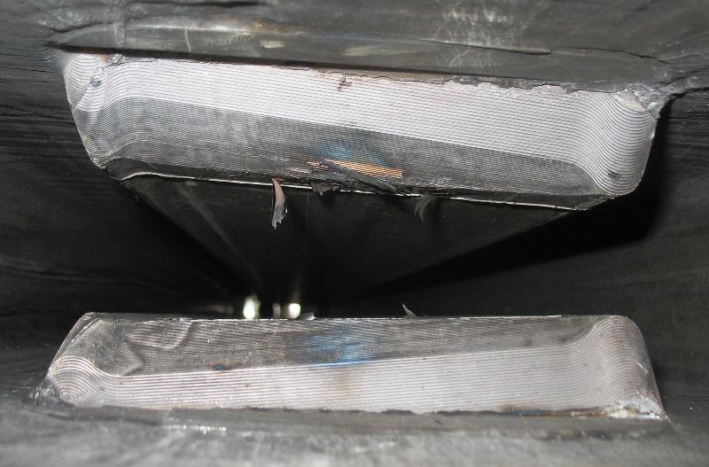
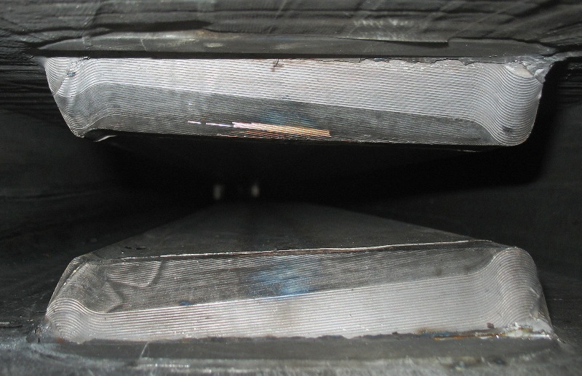
Aperture restriction at S14

Slide 11
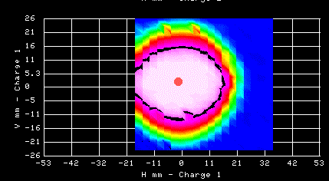
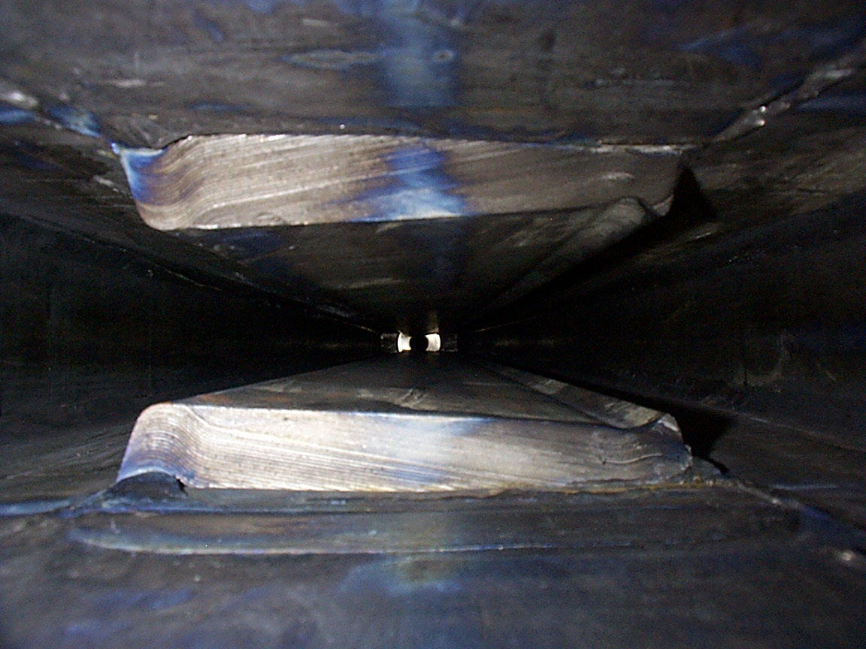
Aperture at Long straight sections
D magnet
57.17mm
2.25 inch gap
57.17mm

Slide 12
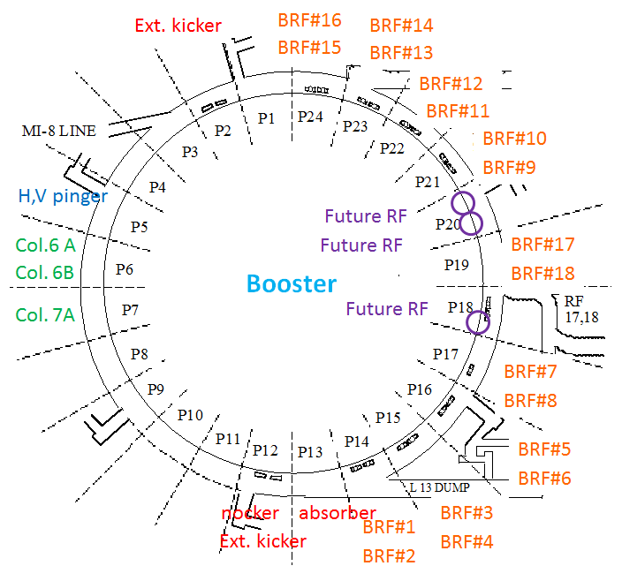
Components at the Long straight section
RF beam pipe has
smallest diameter.

Slide 13
Magnet Move at L16
Four magnets were realigned on Aug. 6, 2013
15-3 upstream: 0mm 15-3 downstream: +0.6mm
15-4 upstream: +0.7mm 15-4 downstream: +1.3mm
16-1 upstream: -1.3mm 16-1 downstream: -1.3mm
16-2 upstream: -1.3mm 16-2 downstream: -1.3mm
+5mm
0
-5mm
#1
#2
#3
#4
#5
#6
#7
#8
#9
#10
#11
#12
D F F D D F F D
D F F D D F F D
D F F D D F F D
D F F D D F F D
D F F D D F F D
D F F D D F F D
1.3 mm
+5mm
0
-5mm
#13
#14
#15
#16
#17
#18
#19
#20
#21
#22
#23
#24
D F F D D F F D
D F F D D F F D
D F F D D F F D
D F F D D F F D
D F F D D F F D
D F F D D F F D
1.3 mm

Slide 14
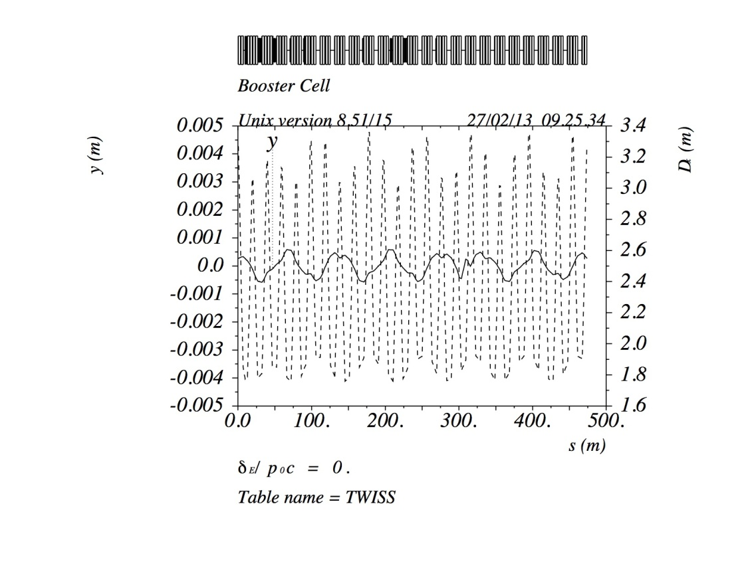
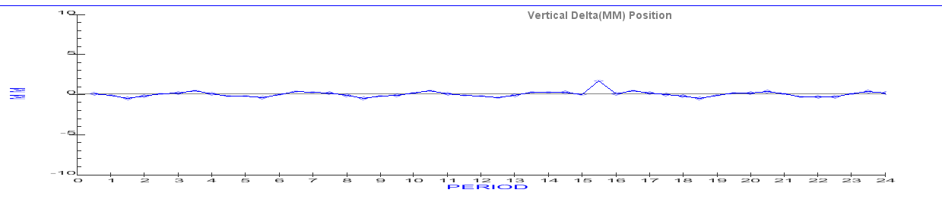
Orbit difference before and after Magnet Move (simulation)
MAD
+/-0.6mm
Magnet Move program

Slide 15
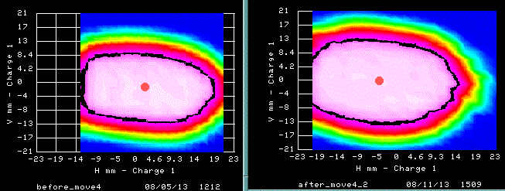
Aperture at L16 before and after the Magnet Move
Before Move4
After Move4

Slide 16
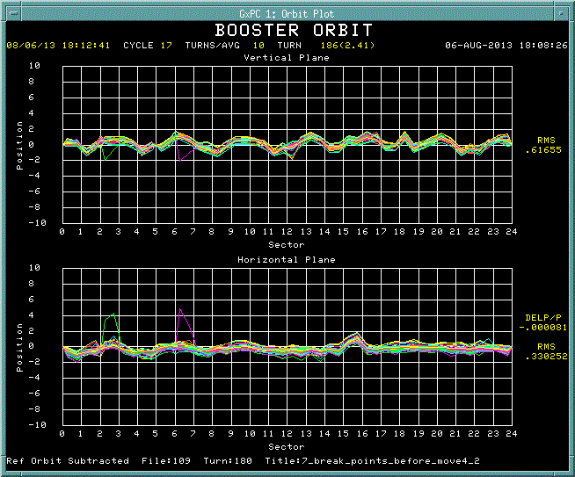
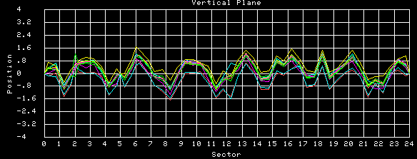
Orbit difference before and after Magnet Move (measurement)
Vertical
Horizontal
+/-0.8mm

Slide 17
Vertical magnet position after Magnet Move

Slide 18
Vertical aperture before and after alignments and Magnet Move
Long
Short
Collimators
Collimators

Slide 19
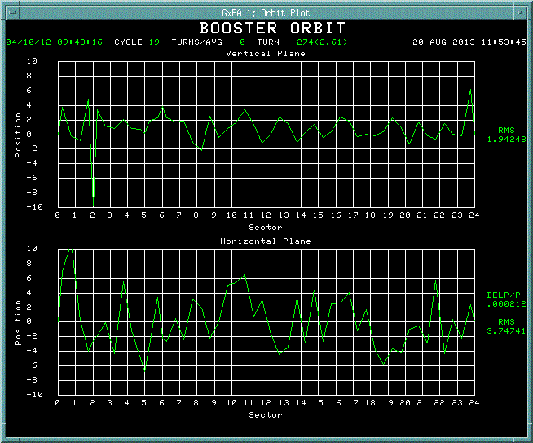
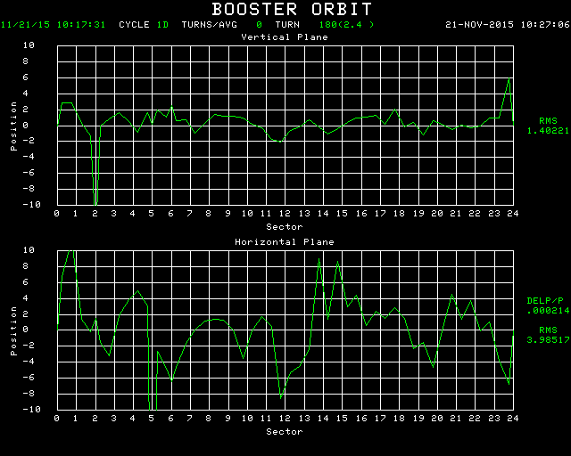
Smoothing orbits
November, 2015
April, 2012 ($19 operation cycle)
10
0
-10
V [mm]
10
0
-10
H [mm]

Slide 20
Orbit compared to the central aperture at injection
Orbit has large angle at collimators and absorber.
There was more beam loss at the central aperture.

Slide 21
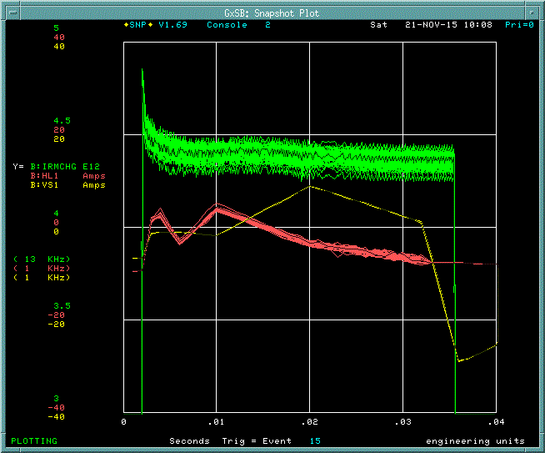
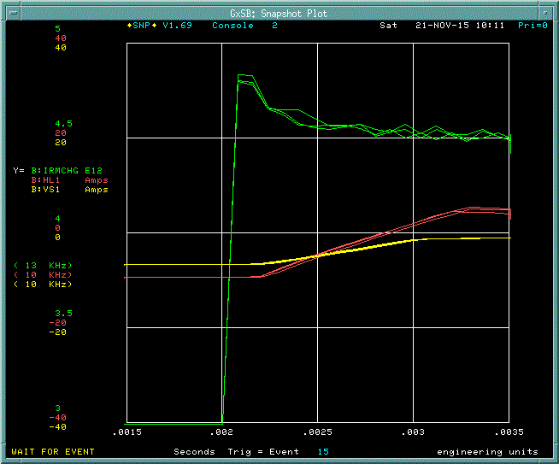
7 break points on the corrector ramp
Corrector current
Intensity
#1(3msec)
#4(20msec)
#5(32msec)
#1(3msec)
#0(2.2msec)
#3(10msec)
#2(6msec)
#0(2.2msec)
#6(35msec)
Notch at 2.17 msec
Break points
#7(60msec)
Moved 1st break point from 2msec to 2.2msec.
Corrector current is flat during injection.
Notch happens before 2nd break point.
Orbit should be at center after 3msec.

Slide 22
Summary and Plan
Aperture scan was performed with B75.
B75 is operational
Magnets were moved at 5 locations.
Understood how to move magnets based on simulation results.
Vertical aperture was improved.
Plan
Optimizing orbit at collimators and absorber
Smoothing orbits on regular basis
Acknowledgements
Alignment Group
F. Ostiguy

Slide 23
Aperture scan with 3 bump and 5 bump
Corrector
+
BPM
D
RF
F
Scan @ SHORT
Scan @ LONG

Slide 24
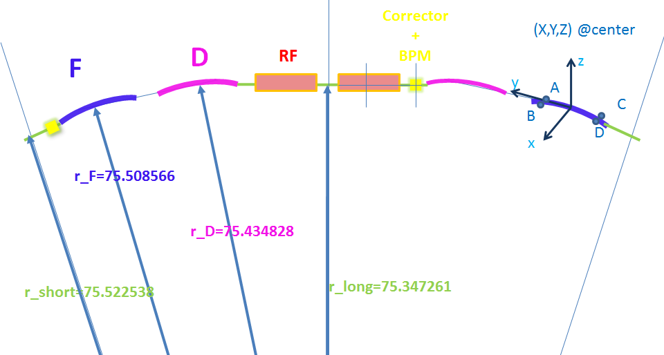

Slide 25
r_F(design)=75.508566m+0.053inch
r_D(design)=75.434828m-0.040inch
need reference position for each component

