Slide 1
Booster Injection (girder and foils)
David Johnson and Salah Chaurize
Workshop on Booster Performance and Enhancements
23-24 November 2015

Slide 2
Outline
Goals/Constraints/Issues for 800 MeV Injection
The FNAL Booster
Injection Foils
The Initial Conceptual Straight section layout
A revised straight section layout
Other Considerations
Next Steps

Slide 3
Goals/Constraints/Issues for 800 MeV Injection Straight
Goals
  ALARA (Most important)
    Minimize absorbed dose in components
    Minimize activation of components (residual activation)
    Minimize prompt radiation outside tunnel & tritium production
  Maximize injection efficiency (tied with the first goal)
  Simplify installation and operation (KISS)
  Minimize civil construction
  Re-use components (if possible)
  Keep Harmonic corrector in straight (if possible)
  Minimize cost
Constraints
  Fit the new injection system within the existing straight section length (5.68 m (flange to flange)
  Increased beam power (x7) → requires well shielded injection dump
  Limit fields that the H- see to about 4 kG or below (loss rate 7.4E-6/m)
Issues
  Can current SS length accommodate injection components & absorber ?

Slide 4
FNAL Booster
Circa 1967- 68: Booster Design
  Combined-function FOFDOOD structure, 24-cell symmetry
  6m “long straight” chosen to accommodate 2 RF cavities (also thought to ease constraints for injection extraction inserts)
  200 MeV proton Injection (3.5E12 protons/pulse)
May 1971 : 8 BeV “full design energy” reached (44+ years ago)
Circa 1978- 79: Booster switches to H- multi-turn injection
  No phase space painting
1993: Injection Energy raised to 400 MeV with the Linac and transport line upgrade
2002: Proposal to raise Injection Energy to 600 MeV
  “A Linac Afterburner to Supercharge the Fermilab Booster” C. Ankenbrandt, et. al.(TM-2187 Oct 2002)
2006: New H- injection insert (3-bump) installed
  “A Proposed H-Injection System fro the Fermilab Booster” M. Popovic, et. al. , Beams-doc 1784-v1 (April 2005)
  “Operation and performance of the new Fermilab Booster H- injection system, J. Lackey, et. al. PAC 2007.
2014-Present: Proton Improvement Plan (Goal deliver 5E12/pulse @15Hz to MI)

Slide 5
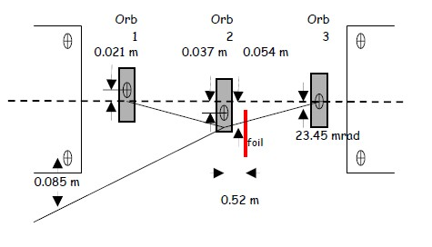
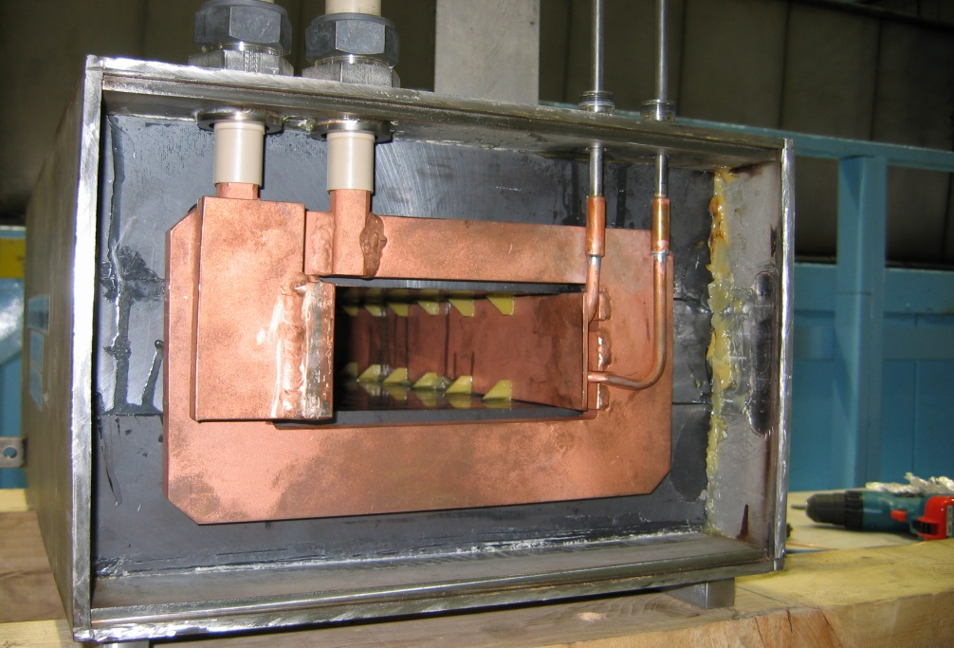
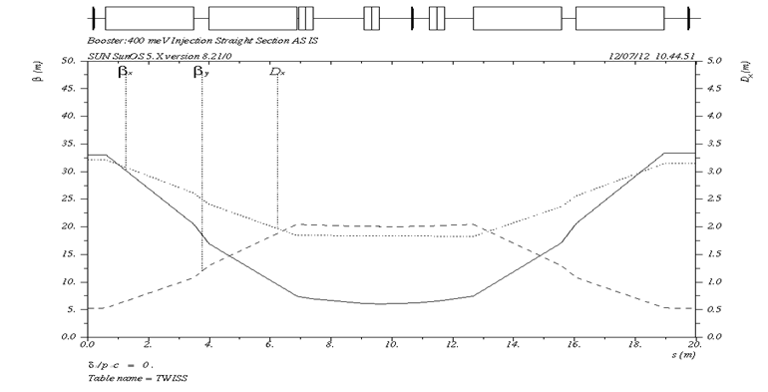
Current Booster Injection Insert
6m
Power leads
Cooling water leads
Ferrite core
Single turn conductor
Vacuum skin
Asymmetry produces gradient
Jim Lackey, et. al.
Courtesy of D. Harding
B_{max} @ 15 kA = 3 kG
L_{eff} = 0.558 m L _{f-f} = 0.731m
Aperture 65x 135 mm
Ferrite saturates @ corners by conductor
SNS (1 GeV inj) 12.3m
4 bump chicane
2nd foil to convert waste to P
External injection absorber
β_{x} | 4.88 m
β_{y} | 18.52 m
D_{x} | 1.73 m

Slide 6
Layout of current injection girder
5.68 m (f-f)
ORBUMPS
Harmonic corrector
BPM
vacuum bypass
Inj beam
diagnostics
foil changer

Slide 7
Booster in PIP-II Era
Linac (pulsed)
  Kinetic energy 800 MeV
  Bunch frequency 162.5 MHz
  Beam pulse length ~ 0.56 ms
  Transverse emittance <0.3 mm-mr (rms-normalized)
  Longitudinal emittance <1.1 keV-ns (rms-normalized)
  Bunch length 4 ps (rms)
  Energy spread (bunch) ~ 0.275 MeV* (rms)
  Average current 2 mA (averaged over 1 us)
Booster
  RF frequency 45.305 MHz
  Revolution period 1.854 usec
  Particles/pulse injected 7.0E12
  Injection time ~0.56 ms
  Injection turns ~315
  Rep rate 20 Hz
  Particles/sec 1.4E14
  Injected beam power 18 kW
  Transverse emittance 15 π-mm-mr (6σ, normalized)
*Order of magnitude smaller than
Booster bucket height
Require transverse phase space painting

Slide 8
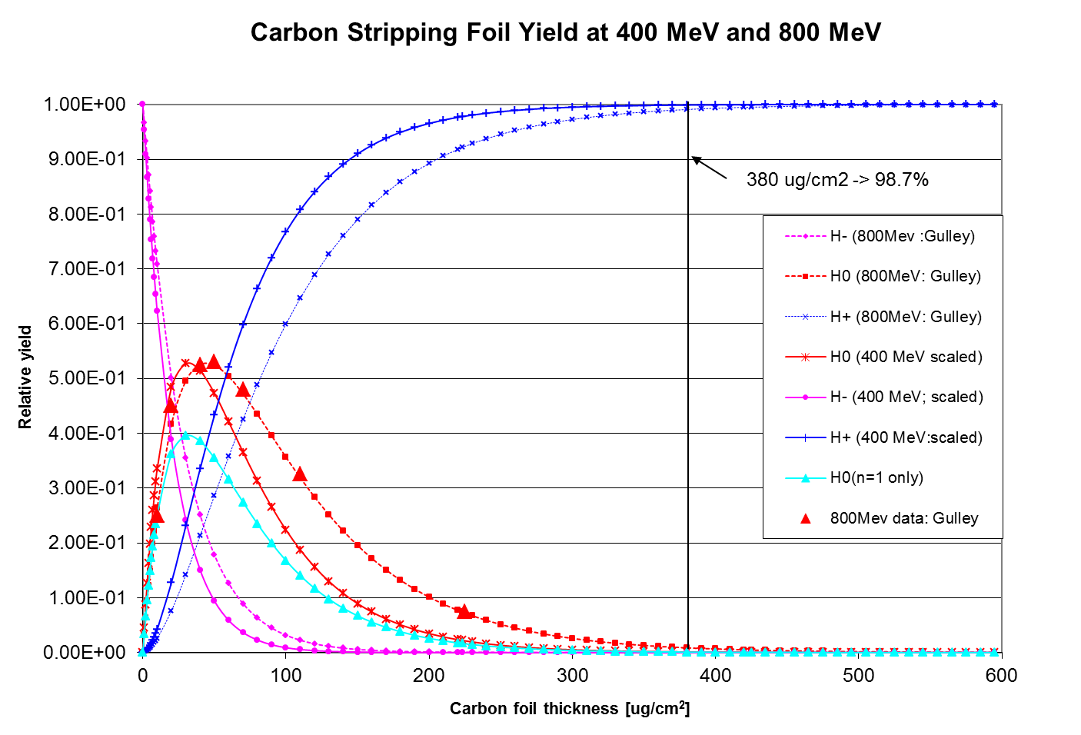
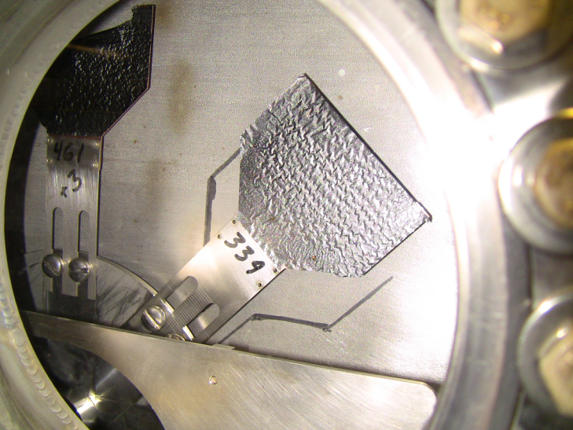
Foil Stripping
For a std. foil thickness 380 μg/cm² (1.15 μm)
400 MeV -> 99.9% efficiency to protons
800 MeV -> 99.1% efficiency to protons
To match 400 MeV efficiency at 800 MeV
foil thickness needs to increase to ~545 μg/cm²
However, thickness a tradeoff between
stripping efficiency and uncontrolled loss
current foil holder
current foil

Slide 9
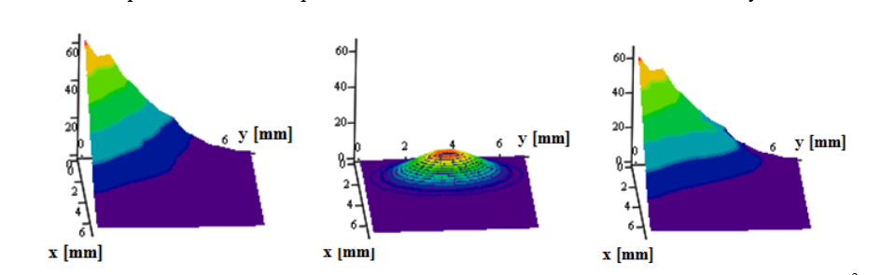
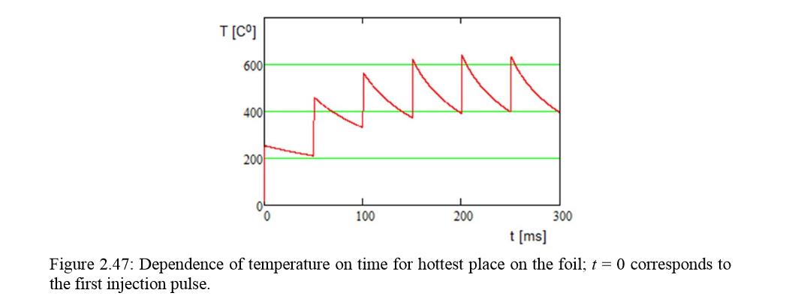
Foil Hits and temperature
V. Lebedev (PIP-II RDR)
secondary
primary
~560 us injection time
~315 turns
Assumed a corner foil
sum
Energy deposition dominated
by secondary hits of circulating
protons
Although foil issues ARE IMPORTANT, the zeroth issue is:
Can we fit 800 MeV injection into a 200 MeV injection Straight Section ?

Slide 10
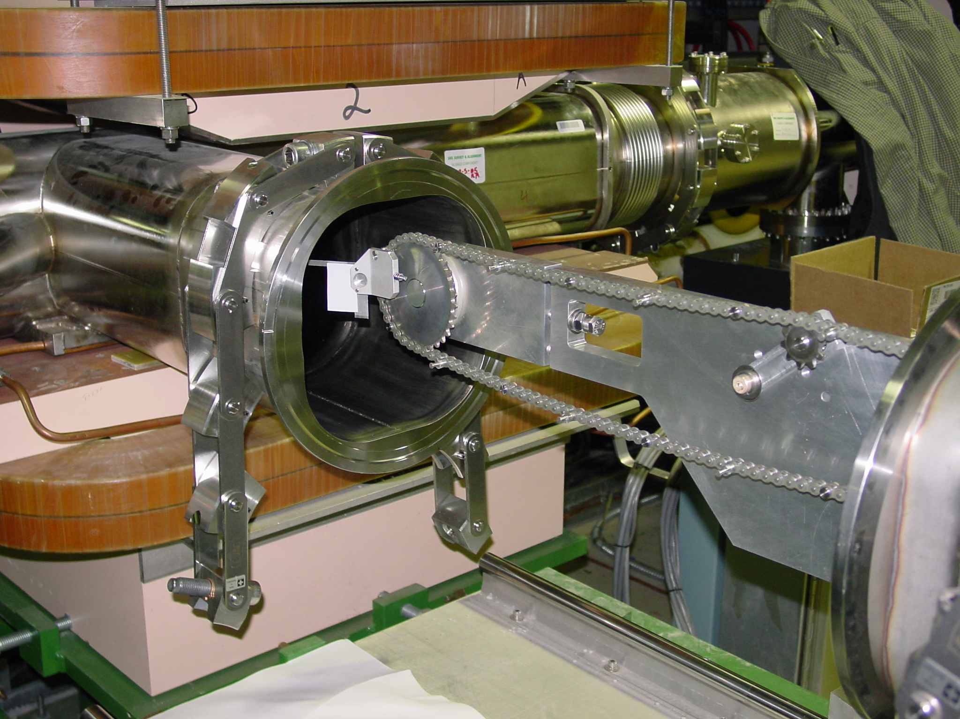
SNS foil holder and foil

Slide 11
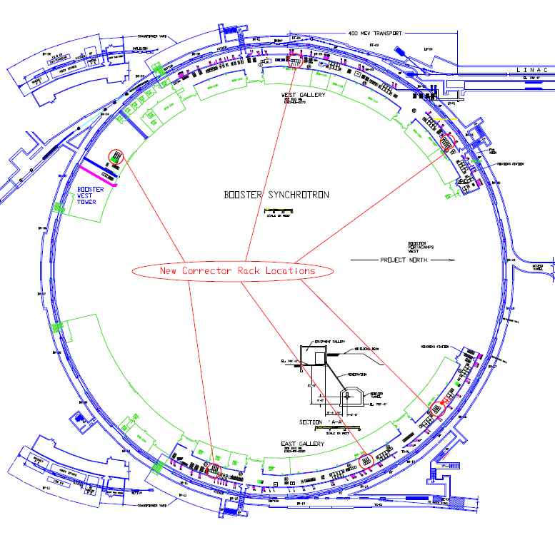
Booster Layout
Long 1: existing 400 MeV inj.
Long 11: PIP-II inj.
End of Booster tower
Inj. line
East GMPS yard

Slide 12
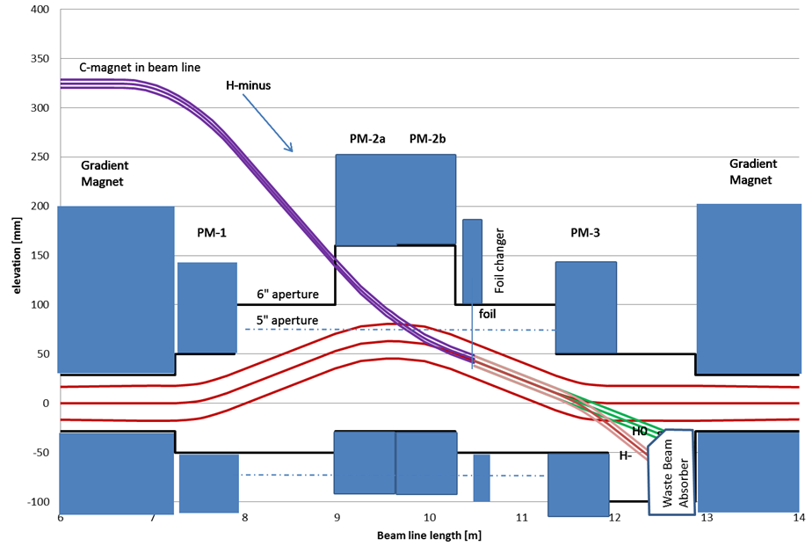
Initial Conceptual Design (as reported in PIP-II RDR)
Essentially a Vertical three bump with the central dipole - 2 magnets
Utilize exiting SS length (5.68m flange to flange)
ORBUMP L_{eff}= 0.5585m B=3.5 kG
Foil after central dipole
Waste beam points to the bottom of aperture
ORBUMP magnets used for painting (requires compensation of central magnet)

Slide 13
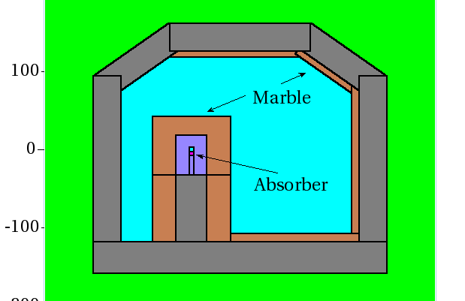
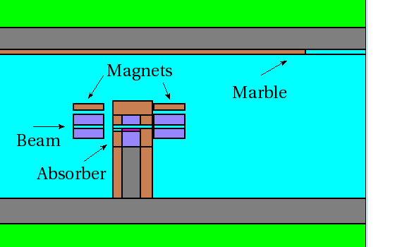
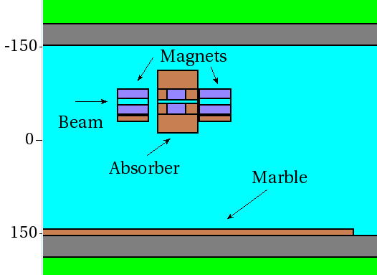
Mars model
MARS model & simulations by Igor Rakhno
Cross section Elevation Plan
Assume 2% H- and 0.2% H0 for total of 400 W waste beam power
Absorber 5x5x30 cm tungsten surrounded by 15 cm steel on concrete
10 cm concrete on far wall, ceiling, and floor
Up/downstream magnets 10 cm marble on top and aisle side
No copper in G MAG model (this will increase residual)

Slide 14
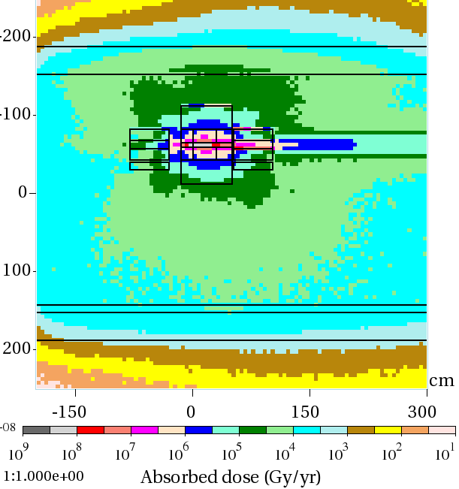
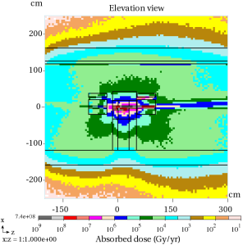
MARS Simulations
MARS model & simulations by Igor Rakhno
“The major drawback is that the re-scattered beam goes directly into the open aperture. It is actually not an absorber but a scraper. I can't imagine that anything can be done to mitigate this.” … Igor Rakhno
Residual activation on GMAG flange
-> 20-30 R/hr !
Absorbed dose ~ 4 MGy/yr
(typical lifetimes of kapton 20-30 MGy)
What to do ? Rethink layout and how to mitigate RA & AD

Slide 15
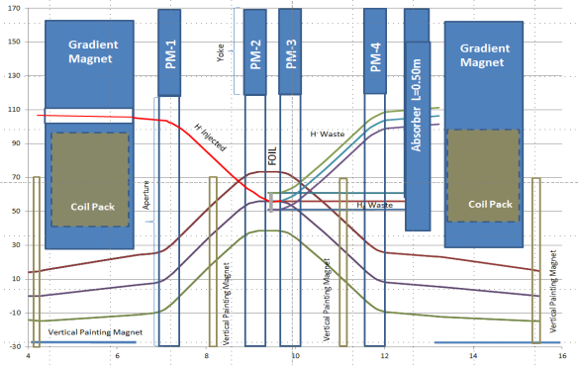
Revised Injection layout (not optimized)
Absorber moved away from aperture
Reduce GMAG length ~ 30% -> increase SS length by 0.86m
4 bump design with separate painting magnets
ORBUMP L_{eff}= 0.422m B=2.7 kG (23.56 mr) fixed inj. field
Painting magnets L_{eff}= 0.195m B~ 500-750 G (2-3 mr)
Requires 2 or 4 new, shorter gradient magnets (special girder either side?)
    If making new D gradient magnet, open aperture?

Slide 16
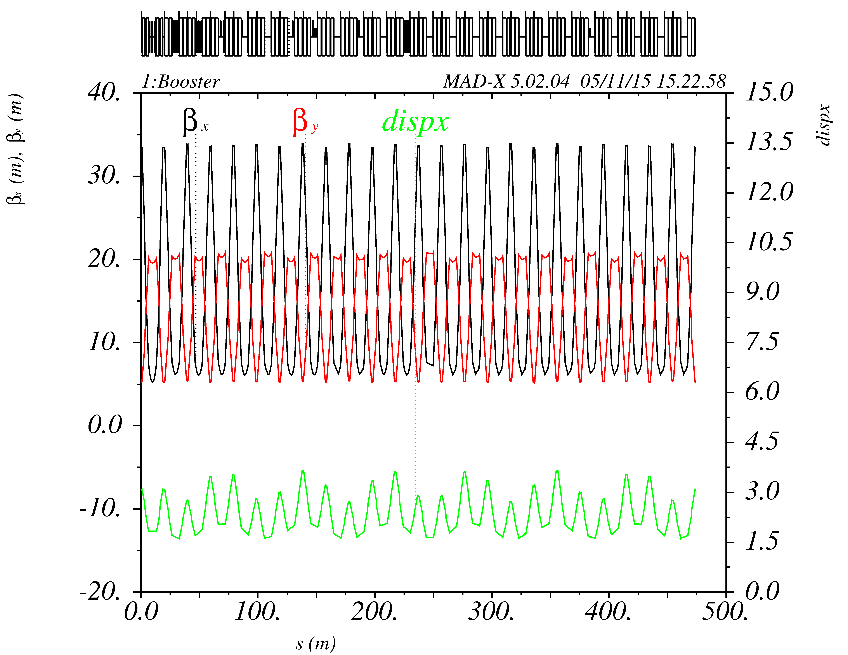
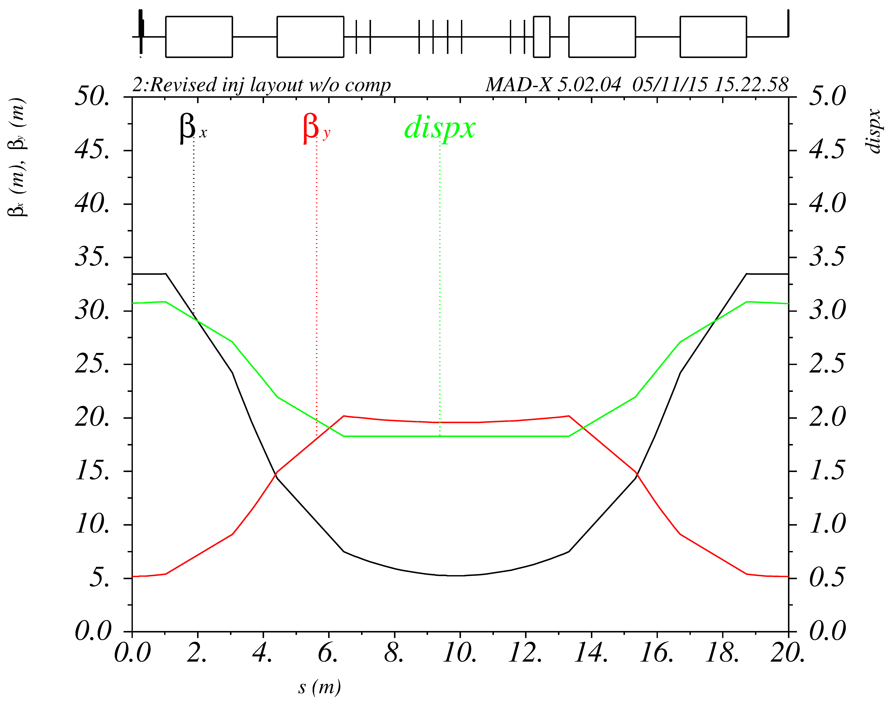
Impact on lattice due to
Reduce defocusing & focusing gradient magnets on either side of straight section by ~30% keeping bend center fixed
  Scale gradient (97% for D and 99% for F) , dipole field keeping bend center fixed
  Allows modest increase of 0.86 meters (enough to add in injection absorber)
  Impact on circumference.
Need to look at new gradient magnet design -ASAP

Slide 17
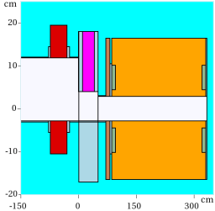
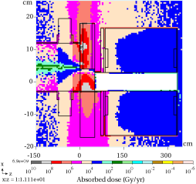
MARS Simulations
MARS model & simulations by Igor Rakhno
Same loss rate as in initial model
Absorber 30 cm thick x 7.5cm wide surrounded by 10 cm steel 10 cm marble upstream of gradient magnet
Complete shielding not included → looking at absorbed dose
Absorbed dose to coils in 0.2 MGy/yr
Residual dose range1-10 R/hr →still high need optimization
Absorber to be optimized & shielding added

Slide 18
Other Considerations
Injection foil issues
  foil changer design
  foil design (thickness, material, size, etc)
  Foil heating not to be an issue an issue at 18 kW
    discussed by V. Lebedev in RDR
  H- missing the foil
  Uncontrolled losses
Transverse painting – discussed by V. Lebedev in RDR
Longitudinal painting – discussed by V. Lebedev in RDR
Electron collection
3D modeling of injection region
Mechanical/vacuum designs

Slide 19
Next Steps
Develop a realistic injection straight section design that
  Addresses the minimization of component activation and absorbed dose
  Has buildable magnets
  Can incorporate all the necessary ancillary equipment
    Foil changer
    Vacuum equipment
    Electron catcher
  Can incorporate beam instrumentation/diagnostics
Start developing magnetic designs
  New gradient magnets →
  ORBUMP magnets
  Painting magnets
Continue the optimization of the injection absorber
Iterate step 2 & 3 with 1
Fold in matching with the transport line & phase space painting
All this requires time, money, manpower and open Task Code

