Slide 1
Digital Damper Systems in Booster
Nathan Eddy
Workshop on Booster Performance and Enhancements
Nov. 24rd 2015

Slide 2
Outline
Digital Transverse Damper
Motivation
System Overview
Tune Measurement
Diagnostics
Digital Longitudinal Damper
Motivation
System Overview
Commissioning
Operation

Slide 3
Transverse Damper - Motivation
Goal to demonstrate a digital bunch by bunch digital feedback system in Booster
FPGA, ADC, Digital Signal Processing, DAC
Wideband system
Flexibility to modify system as needed
Essentially an R&D project so far
Demonstrate transverse system operation
Diagnostic capability – tune, studies, etc
Develop plan for longitudinal system

Slide 4
Transverse Damper System Overview

Slide 5
Current Transverse Damper Installation
Input Signals
Sum/Diff Amps
Digital
Damper
RF Ref
TCLK
Output
Amps

Slide 6
VME Digital Damper Board
Developed in 2006 as R&D Large
Stratix II FPGA handles signal processing & interfaces on multiple clock domains
4 ADC (up to 212MHz) & 4 DAC (up to 636MHz) locked to external RF
Digital I/O – TCLK, MDAT, BSYNC decoders, fanout, diagnostics
Up to 1GB on-board RAM via standard DDR2 SoDimm
VME front-end speaks ACNET via standard Controls front-end

Slide 7
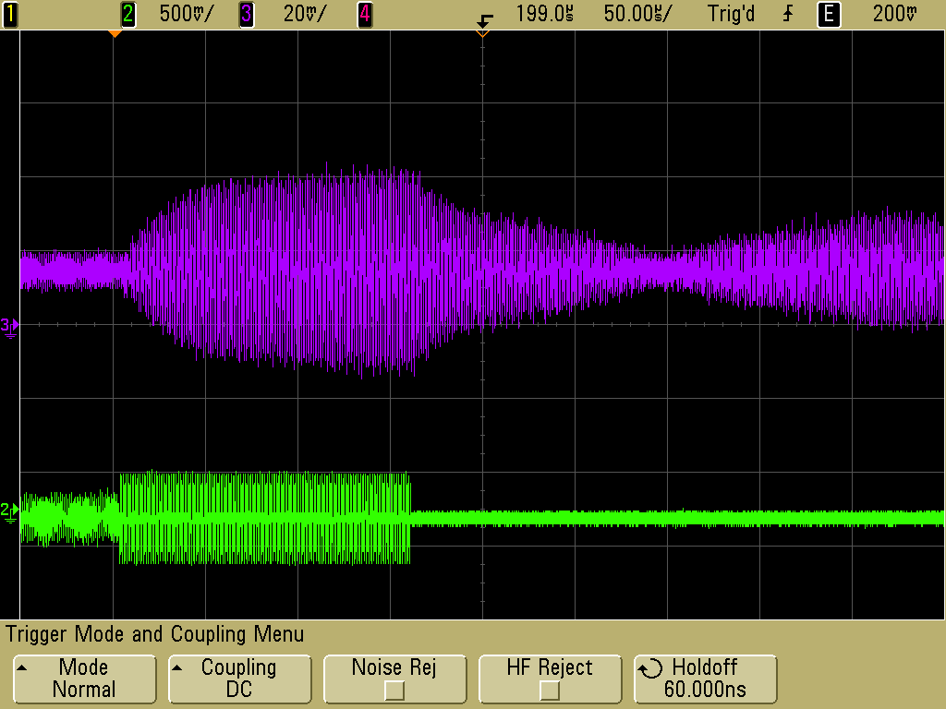
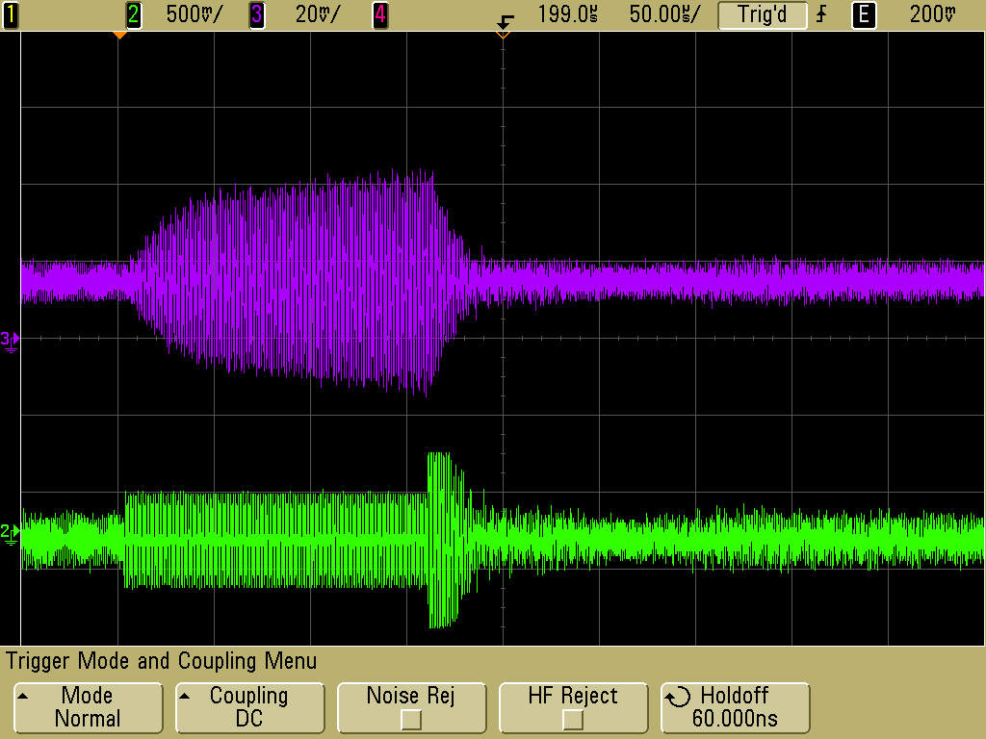
Transverse Damping
Cable delay to sync RF Ref with beam signals
Sample at 4xRF
Adjust ADC clock via PLLs in FPGA
Pseudo I,Q sampling
Programmable Turn Filter
4 bit coefficients
3 Turn Horizontal
5 Turn Vertical

Slide 8
Transfer Function Measurements with VSA

Slide 9
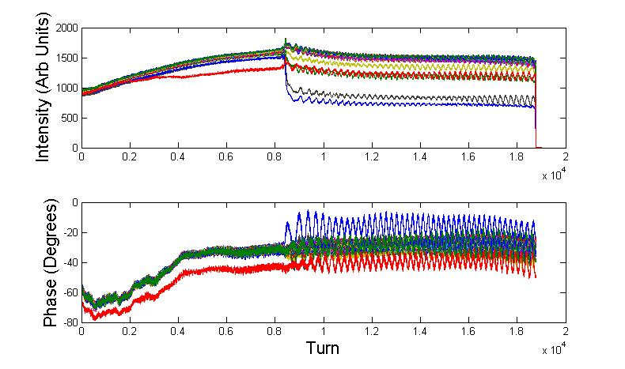
Diagnostic Capability
Record bunch by bunch data for entire Booster cycle
Position, Intensity, Phase
Measure Booster revolution frequency
1Hz resolution @1ms

Slide 10
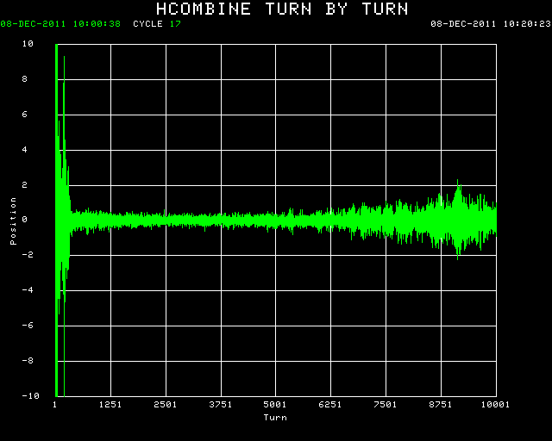
Horizontal Instability Study (2011)
Damper Off
Damper On
Developed when trying to decouple optics after injection
Demonstrated damper operation on real instability
Damper showed slow developing Mode 8 coupled bunch
Results presented at IPAC12

Slide 11
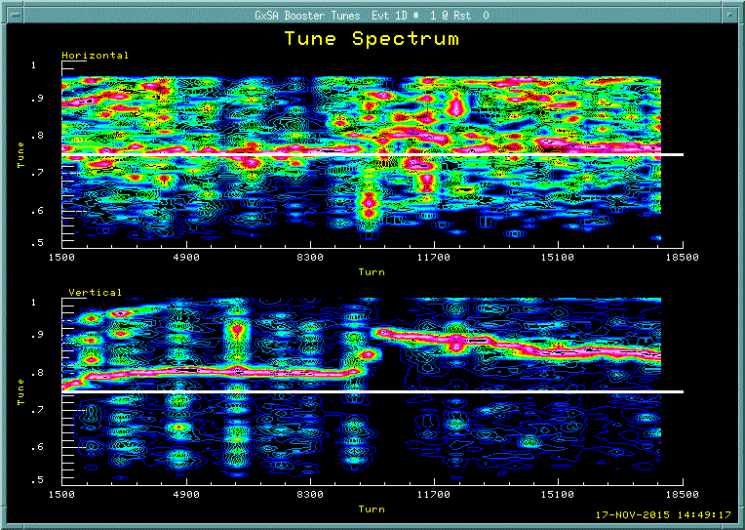
Tune Monitor
Excite Single Bunch & Measure Response
Minimally invasive
Can be run on operational cycles
Fully programmable
Select Bunch
Excitation
Up to 32 Measurements per cycle

Slide 12
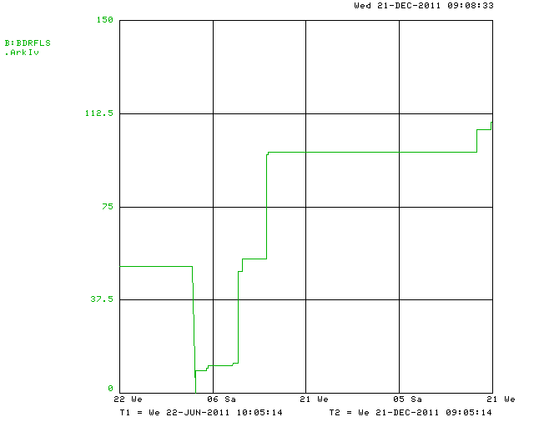
Transverse Damper Issues
Horizontal response is not optimal due to pickup & kicker locations
Difficulty exciting beam horizontally after transition
Chromaticity
Power
RF Clock Lock
Causes PLLs for ADC/DAC to relock
Requires re-phasing

Slide 13
Transverse Damper Status
Transverse Damper currently is not needed for operation
Can we lower Chromaticity?
Do we require more power in the horizontal plane?
Investigate options for moving horizontal pickup & kicker and/or adding additional pickups
Ideal scenario is two pickups ~90 degrees apart
Is our current stripline pickup ideal? Use BPMs?
Developing Replacement based upon 1GS/s ADC
Improve timing/phase stability
Expect to be able to detect head-tail
Can we damp it?

Slide 14
Longitudinal Damper - Motivation
Upgrade the analog damper system
Critical system
Requires dedicated hardware for each mode
Long operational history
Replace difficult to maintain system with digital system
Limited diagnostics
Can take days to fix problems

Slide 15
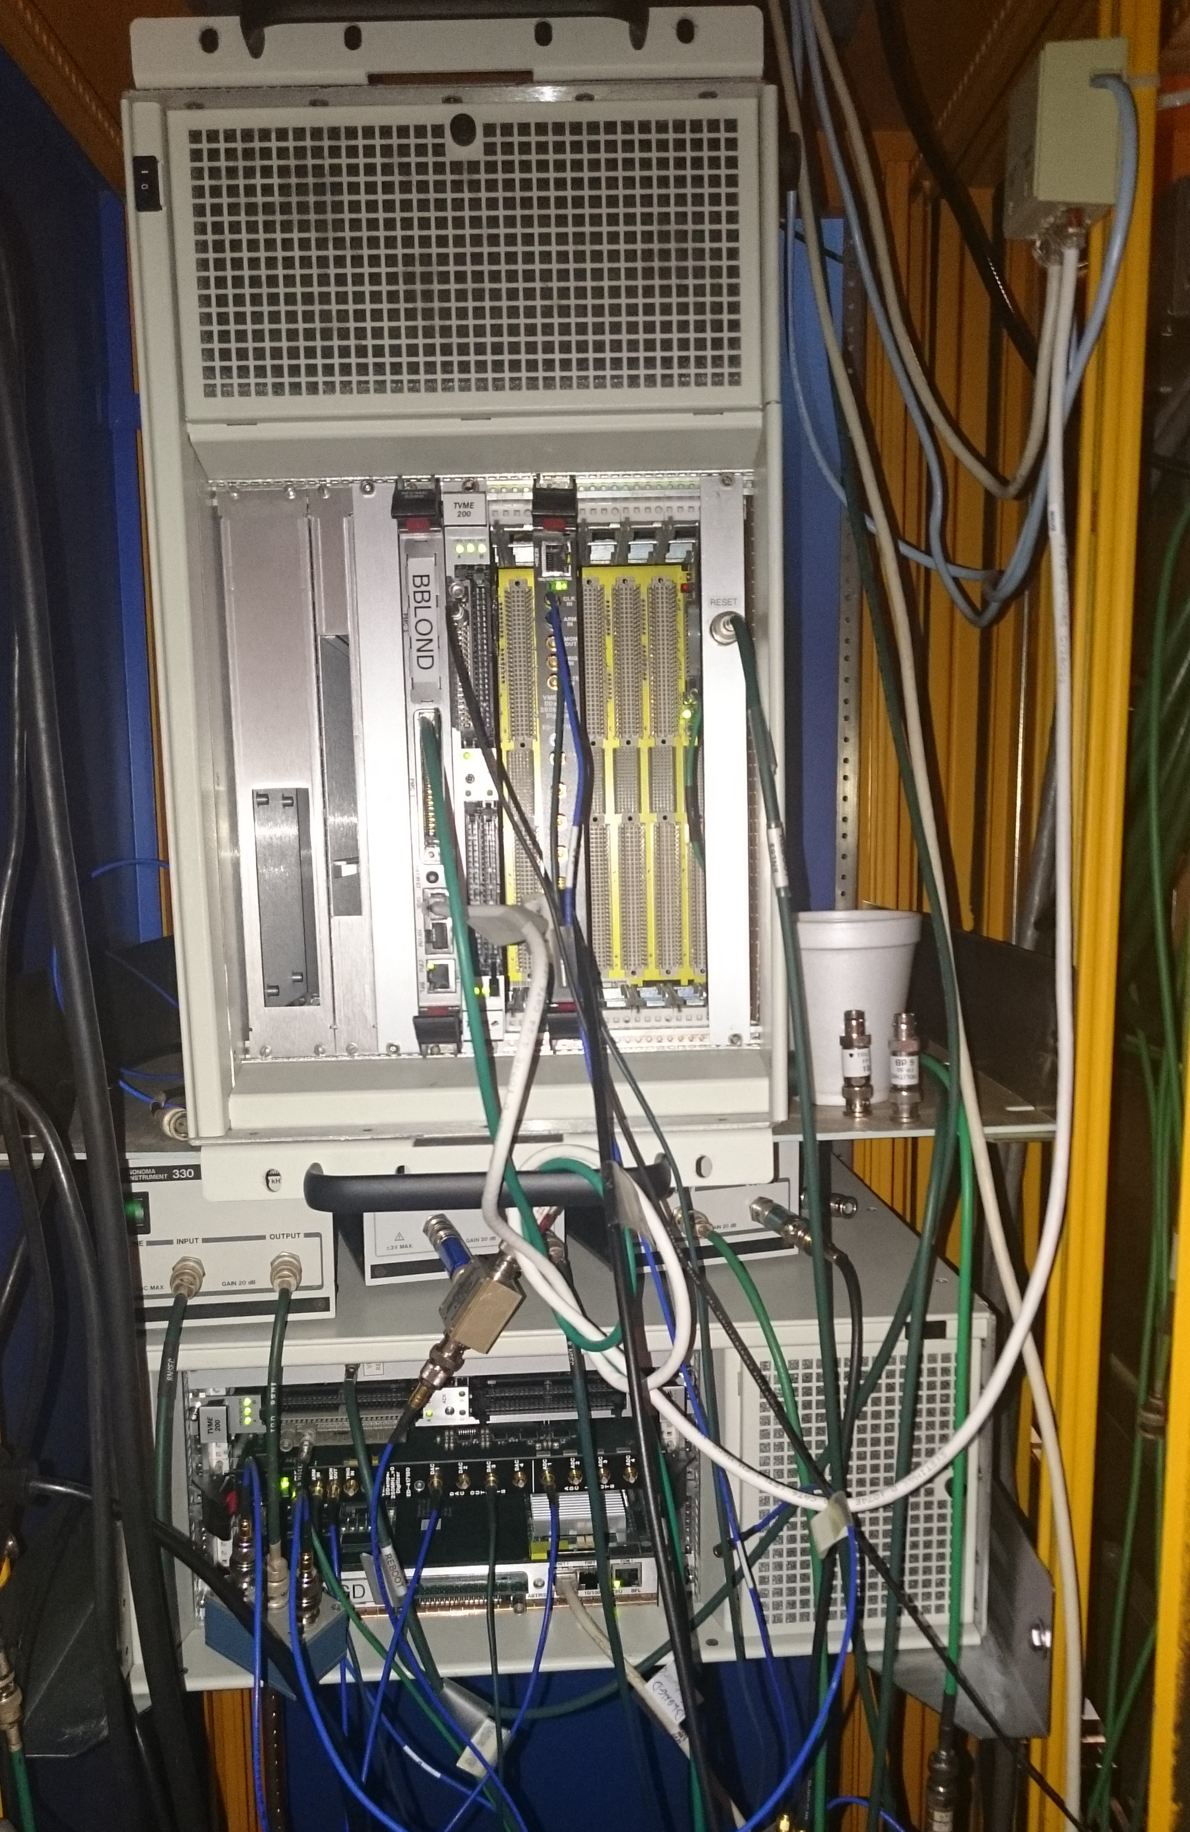
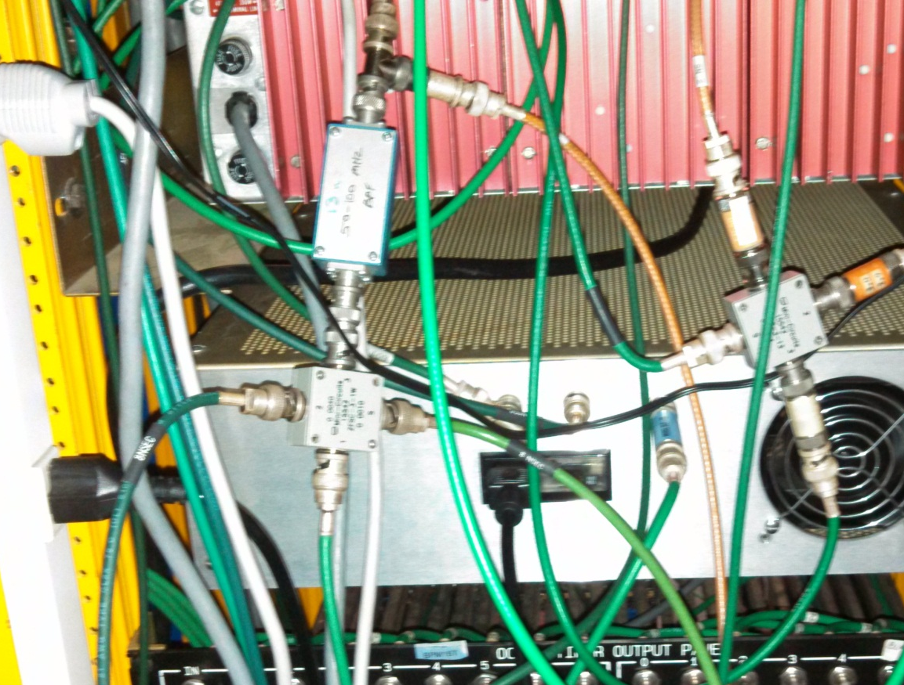
Digital Longitudinal Damper Test Installation
Notch
Filter
BP
Filter
TCLK
Mode N
Digital
Damper
WCM
Phase Pickup
RF Ref
Mode 1
Pickup
First installation thrown together in back of rack
WCM input, RF Reference, TCLK, Up to 4 outputs (RF, Cavity)
Eventually will replace existing analog system with clean simple one board solution

Slide 16
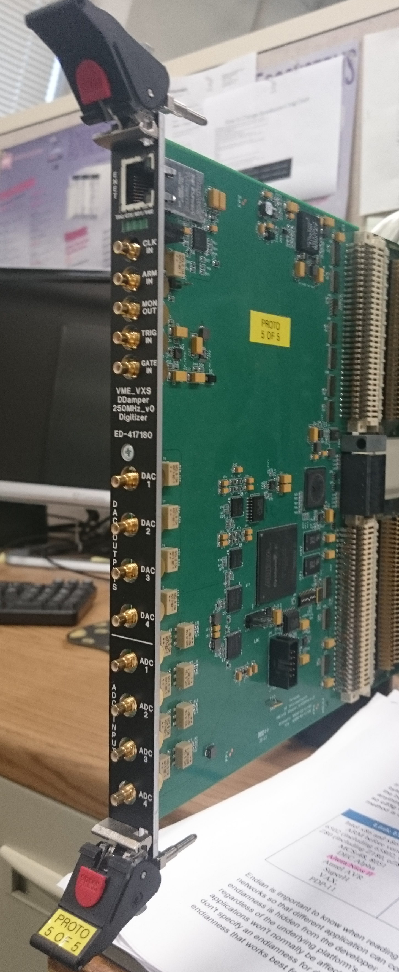
New Digital Feedback Board
Developed for general purpose
4 250 MS/s ADCs
4 500 MS/s DACs
Dedicated PLL based clock distribution chip
Very good clock jitter, limited to 2Mhz Bandwidth
Locks before transition on every Booster cycle
Big effort to make this stable
Looks good so far…

Slide 17
Longitudinal Damper Block Diagram
25KHz
Entire design runs locked to RF
16 fully programmable channels (12 – cavity, 2 RF, 2 Reference)
Same NCO generates sin, cos for I,Q mixing
NCO frequency is centered on rev harmonic of interest
Mɸ correspond to programmable magnitude/phase shift
Will also suppress carrier
For output use Weaver Model – preserves sideband structure

Slide 18
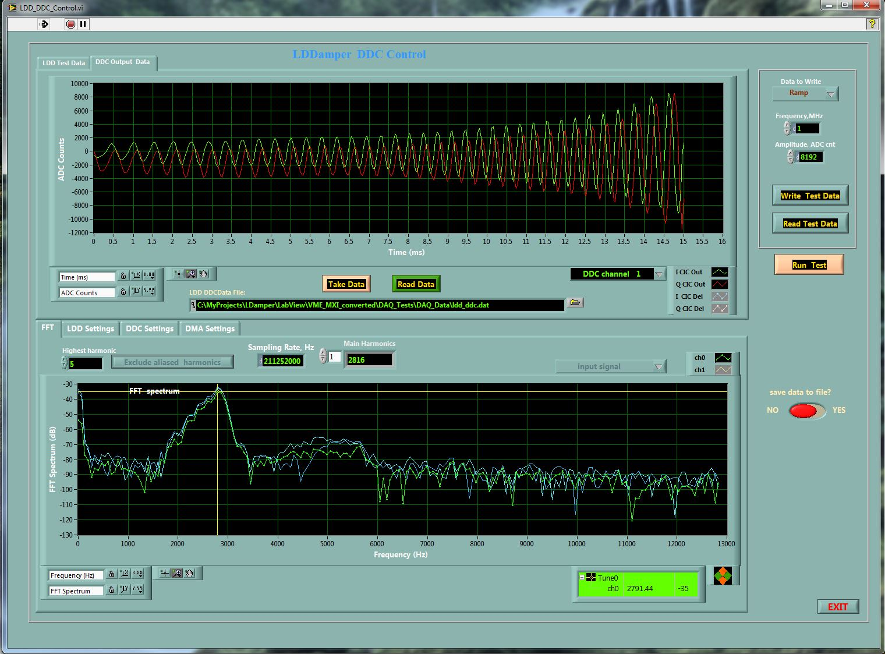
Diagnostics -
Raw Data – up to 16M pts
Downconverted Mode signals

Slide 19
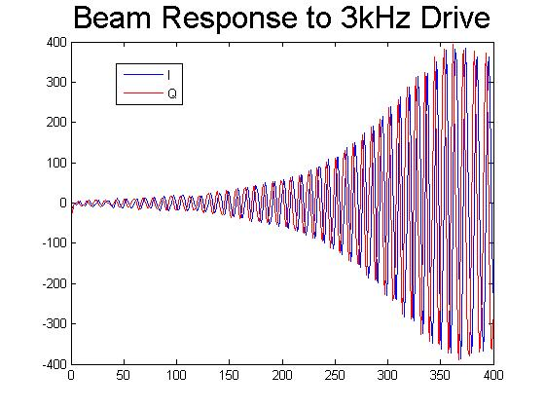
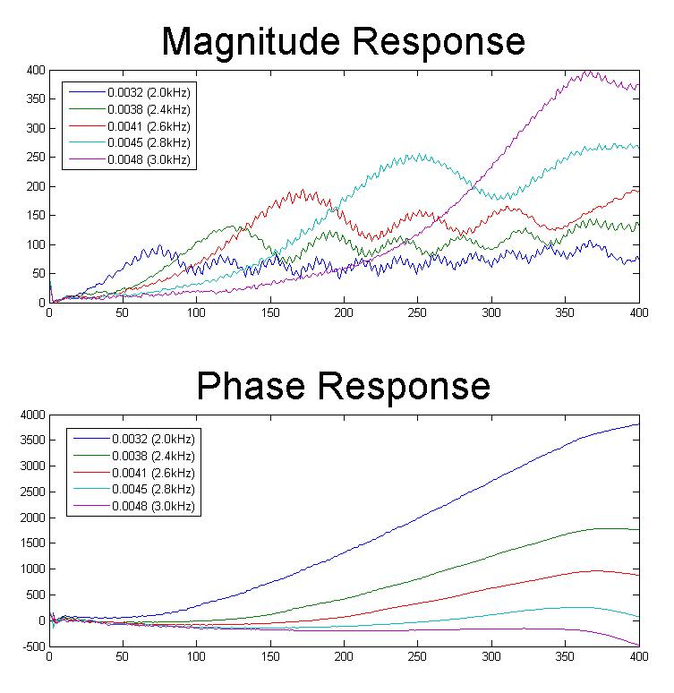
In the Beginning…
Struggled to see expected response
Let’s try to blow things up… Led back to bench
Discovered bench testing setup was using LSB input…
Inverting sign set to produce USB output
Should be able to measure Beam Transfer Function…

Slide 20
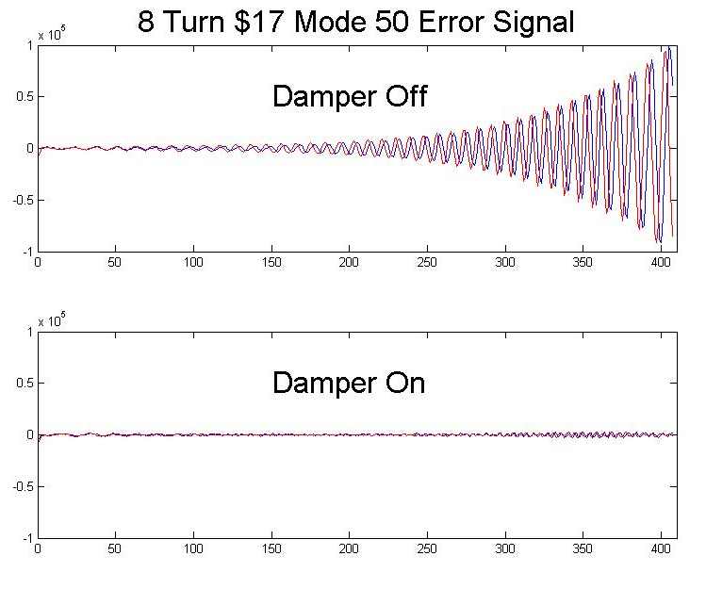
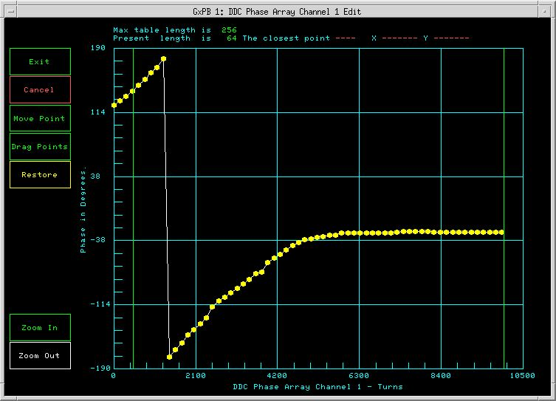
Initial Damping
Need to shift phase to account for fixed system delays
Cables, amplifers, etc.
Initial attempt to set phase on response data not successful…
Traditional Booster “Tuning” employed

Slide 21
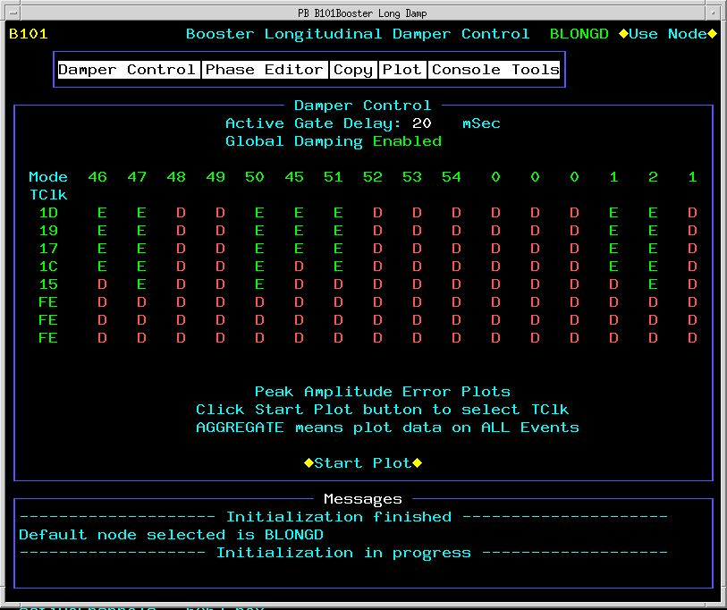
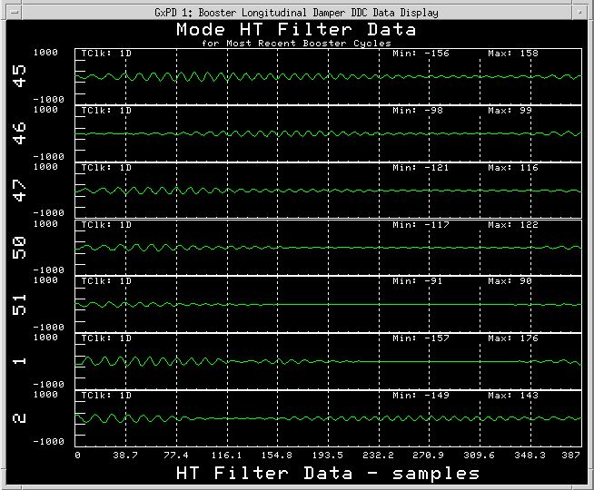
Semi-Operational System
Put into operation in parallel with analog system due to noticeable beam quality improvement
ACNET Application still under development
Implementing features
Diagnostics
Can proceed on Backup/Development node while system is “operational”
Next step turn off the analog system…
Remove old system next shutdown

Slide 22
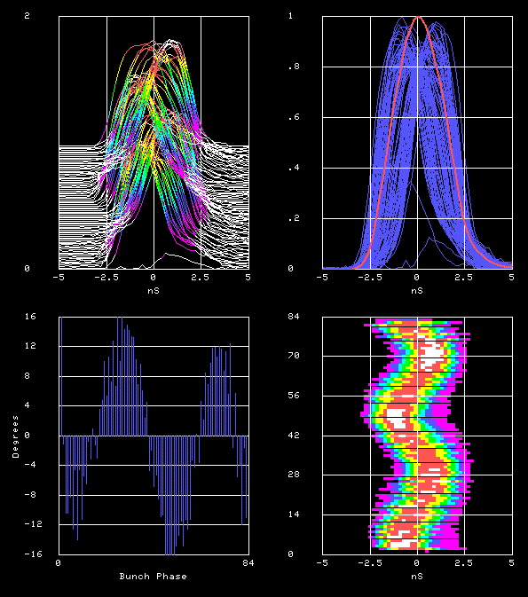
How about Mode 2?
Bunches
16
-16
Bunches
Phase error
Bunch Phase
Beam measurements in the MI-8 line which show amplitude and phase of extracted Booster bunches
With the new digital dampers working – phase errors look excellent and should help reduce loses in downstream machines

Slide 23
Summary
Transverse Digital Damper
Demonstrated ability for digital system to “work” in Booster
Minimally invasive Tune Monitor & Diagnostics very useful
Need system upgrades to improve Horizontal response
Upgraded board under development
Longitudinal Digital Damper
In operation in parallel with old analog system
Has made tuning on old system unnecessary
Improved performance beam quality
Gaining confidence in stability
All the benefits of a digital system
Diagnostics, flexibility, stability
Would like to implement BTF measurement – VSA again?

