Slide 1
Booster Beam Notching
Salah J. Chaurize
Workshop on Booster Performance and Enhancements
23 November 2015

Slide 2
Notching History In the Booster
Notching is controlled removal of selected proton bunches to facilitate a gap in the beam.
This gap allows the Booster extraction kicker magnetic fields to reach full value to allow extraction of the remaining bunches.
Without the gap or “notch” in the beam, the extraction kickers would displace these bunches in a non-controlled fashion causing losses in the extraction region
In the past “notching” was less critical due to lower beam intensities and lower beam duty cycles. Losses were tolerable.

Slide 3
Notching Pre-Shutdown 2012
A 3 bucket gap is created using kickers located at Long 5 and Long 12
Notcher – A High Voltage(55kV) Kicker at Long 5
Noker - Lower Voltage Kicker (20-40 kV) at Long 12
Used to clean out remnant notched beam in buckets
At ~700 MeV due to Cogging operations.
Beam is kicked vertically into Gradient Magnet dipoles at L5 and L12. Some notched beam reaches the collimator region at Long 6 and beam pipe mask at Long 13. This is not optimal
Non-cogged notched cycles occurs at ~400 MeV.
Cogged notch cycles occurs at ~700 MeV.

Slide 4
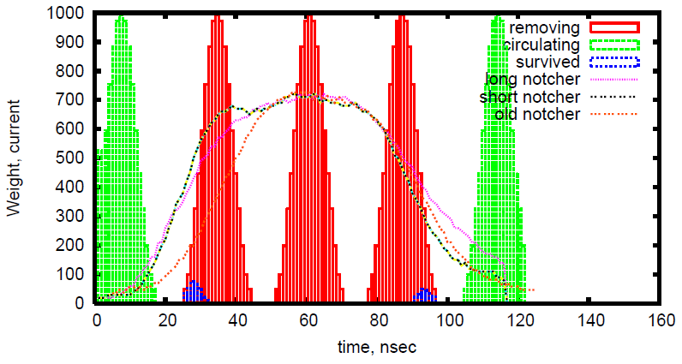
December, 2011 A.Drozhdin
Longitudinal distribution of 3 removing (red), circulating (green) and survival at notching (blue) bunches, and long (1.08m) and short (0.54m) notchers waveform at Long-13, and 1.08-m notcher waveform for Long-05 straight section.
Notes:
4

Slide 5
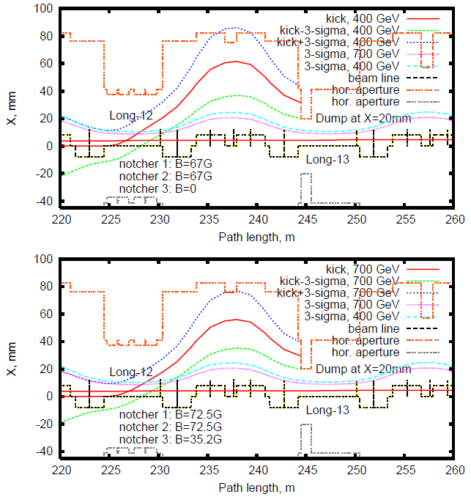
Three horizontal notchers at Booster Long-12
with beam dump at Long-13 straight section.
August, 2011 A.Drozhdin
Horizontal position of 3-σ circulating beam and removed beam at notching for magnetic field of two horizontal notchers of B=67Gauss at 400 MeV (top) and
two notchers of B=72.5Gauss plus one notcher of B=35.2Gauss at 700 MeV (bottom).
Notes:
5

Slide 6
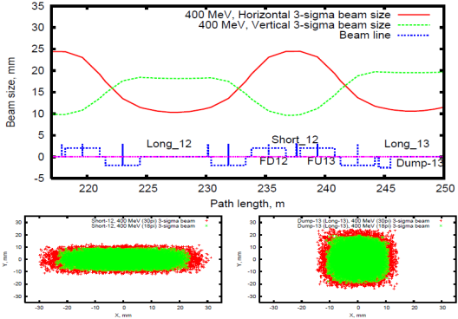
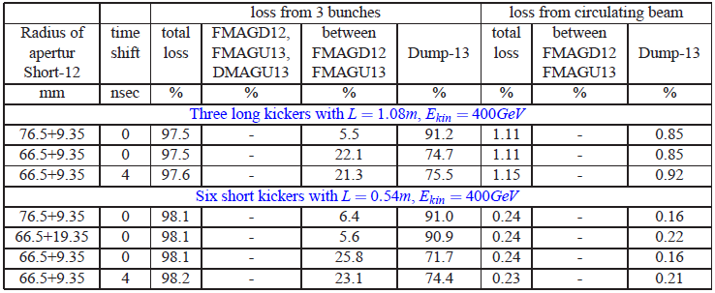
August, 2011 A.Drozhdin
Circulating beam
Three notchers with field of B=62 Gauss. The aperture of Short-12 straight section should be increased to R>86mm to eliminate losses. This can be done by displacement of R66.5mm aperture (without BPM) by dX=20 mm. [46.5-86.5]mm
400MeV
3σ (ε=18π)
Short-12
Dump-13
Y
dX=70mm
X
Red – 30π, green - 18 π
Notes:
6

Slide 8
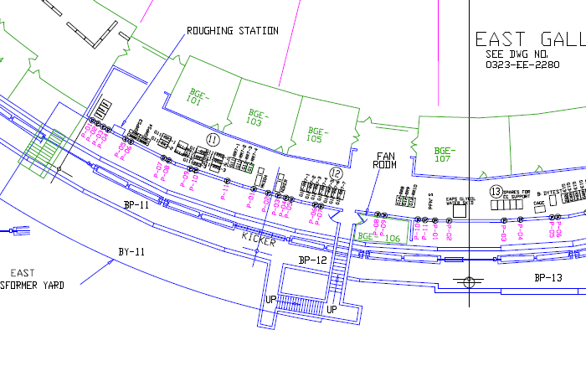
Long-12
Long-13
Kick at L12 to Aisle.
Long 12- Long 13 sections of Booster tunnel.
Notes:
8

Slide 9
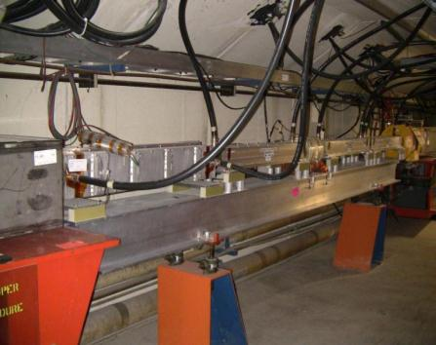
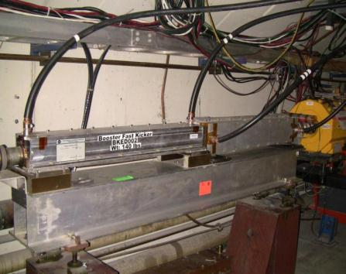
Notching Magnets at Long 5 and Long 12 Pre-Shutdown 2012
old
Horz. Pinger
MK04
Noker
Notcher
Hor. Pinger
Ver. Pinger
Beam direction
Beam direction
L12 Pre-2012 Shutdown
L5 Pre-2012 Shutdown

Slide 10
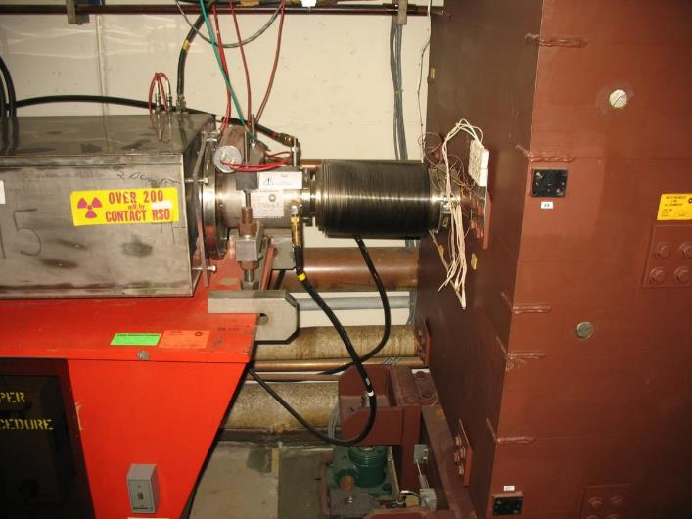
L6a Absorber/Collimator

Slide 11
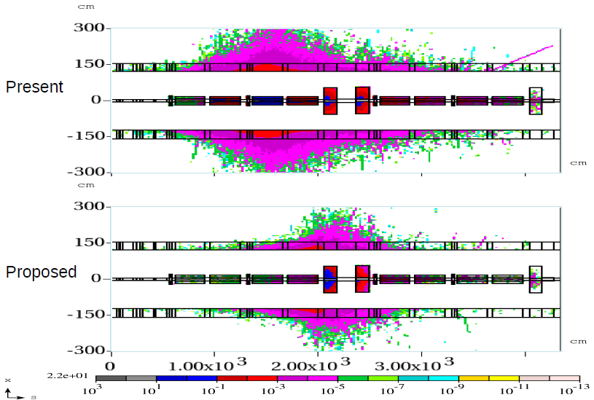
December, 2011 I.Tropin
Vertical
notcher
Horizontal
notcher
Residual dose profiles, vertical cross section (30 days irradiation/1day cooling, mSv/hr).
Notes:
11

Slide 12
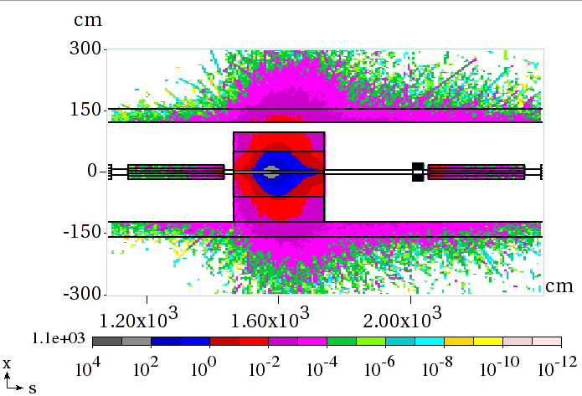
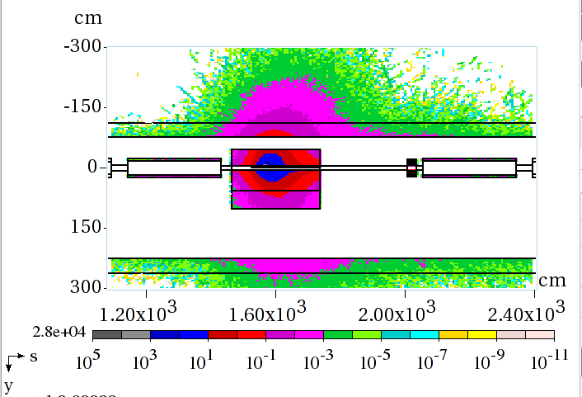
December, 2011 I.Tropin
Long-13: Residual dose on contact (30d/1d) mSv/h
Side view
Top view
Notes:
12

Slide 13
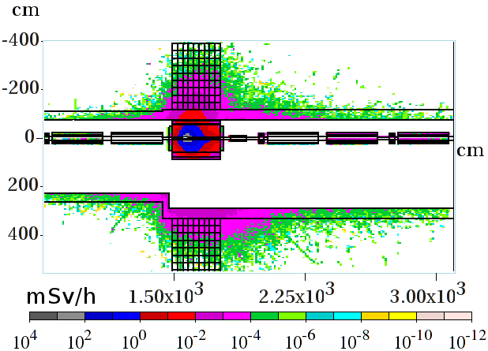
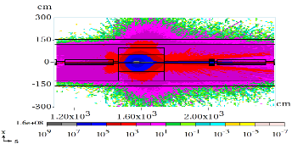
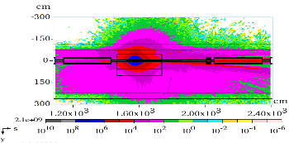
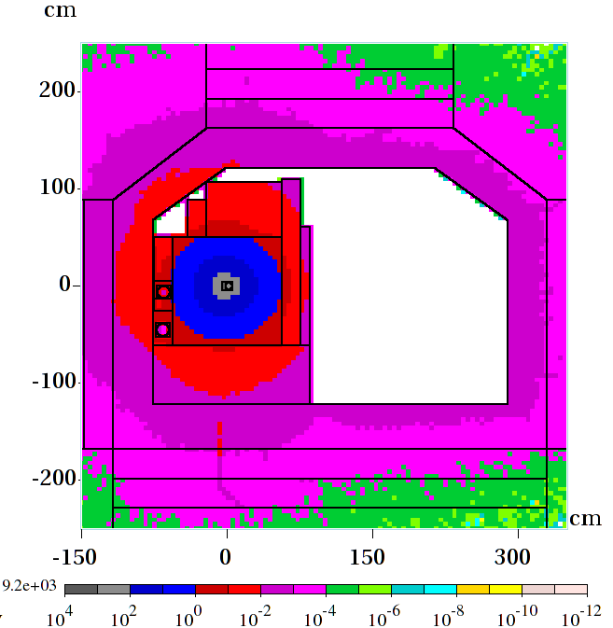
December, 2011 I.Tropin
Long-13: Loss Simulations
Side view
Top view
Notes:
13

Slide 14
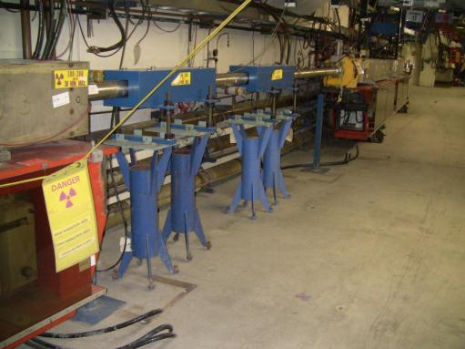
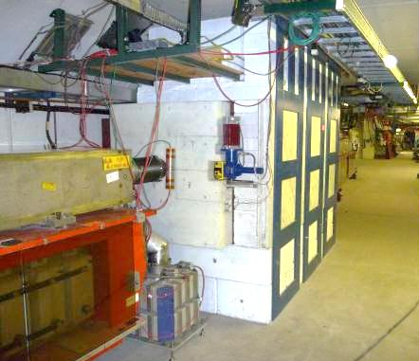
Long 13 Notched beam absorber
Before
After
Beam direction

Slide 15
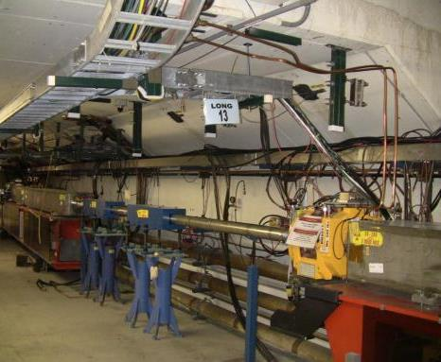
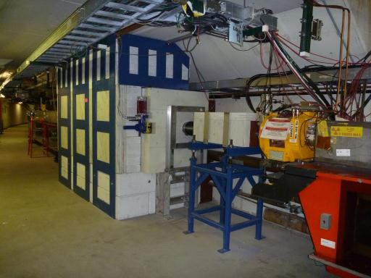
Long 13 Notched beam absorber
Beam direction

Slide 16
Liner section

Slide 17
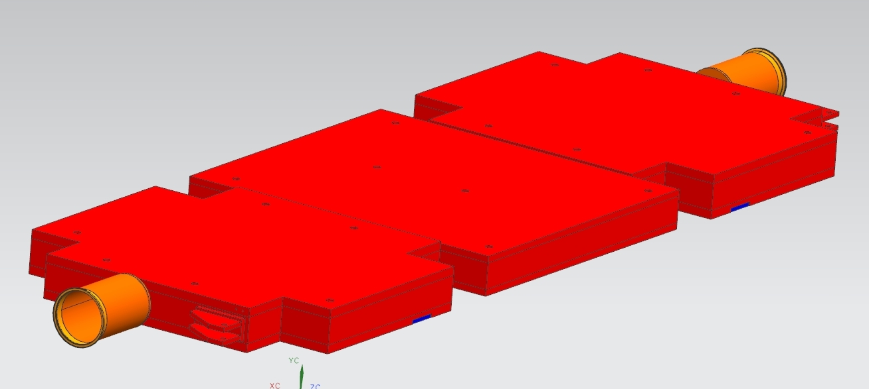
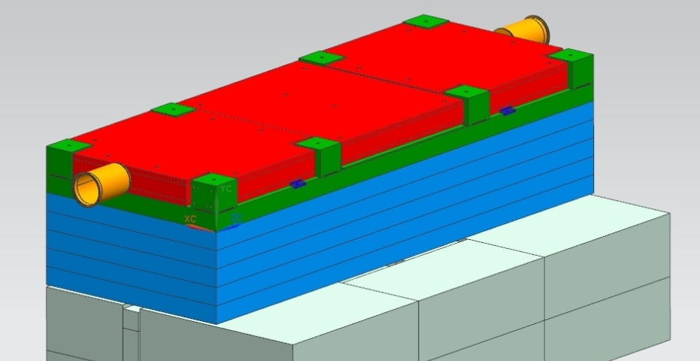
Absorber Moving Liner
Vacuum Liner
Top Plates
Bottom plates
Middle plate
Hard flat
Pivot Bracket

Slide 18
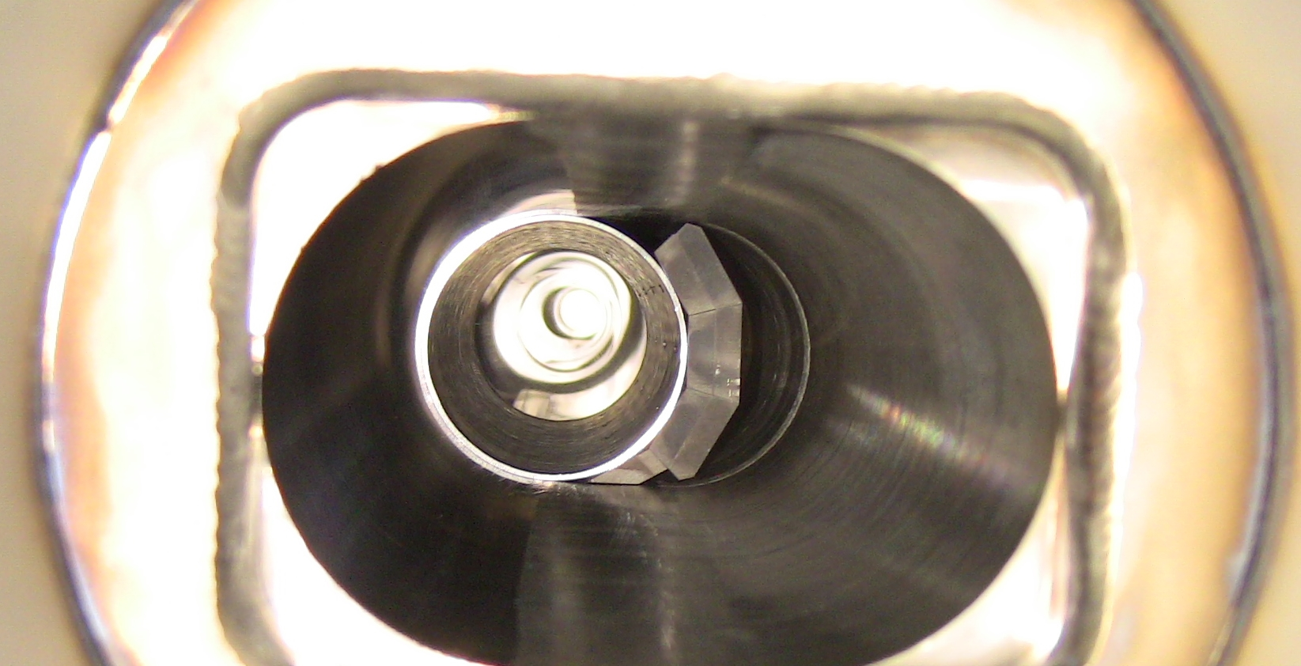
Notched Beam Absorber Liner with 12” insert
Circulating beam
notched beam

Slide 19
Absorber Vacuum Liner
Vacuum Liner neutral position
Vacuum Liner working position.
V. Sidorov

Slide 20
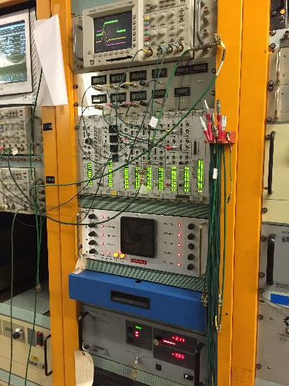
Notching Pulser System using 2 CX2610 pulsed thyratrons

Slide 21
Notch System Diagram

Slide 22
New Pulser system has faster rise/fill time

Slide 23
L12 Straight section
6 half meter long pulsed magnetic kickers

Slide 24
Six notching magnets summed load terminating resistors

Slide 26
Short 12 straight section special BPM and BMA spool
Modified BMA spool 5” full aperture. BPM external to BMA
BMA offset 20mm to radial outside to allow for notched beam aperture

Slide 27
L12 Mini-straight

Slide 28
L13 Upstream notched beam Absorber
Beam Direction

Slide 29
L13 downstream absorber mask

Slide 30
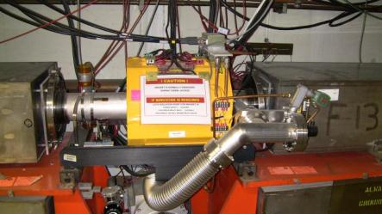
Typical short straight sections downstream of notched absorber S13, S14

Slide 31
Notch Region Top view of magnets
Notching kickers
BLMS12
BLM124
L13 BMA
11-4
12-1
12-2
12-3
12-4
Notch
Absorber
Mask
13-1
MK04 L12 BMA
BLM122 S12 BMA
BLM123
BLM125
BLM126 BLML13
Beam Direction
Diagram continued below
Notch
Absorber
Mask
13-1
13-2
13-3
13-4
BLM126 BLML13
BLMS13 S13 BMA

Slide 32
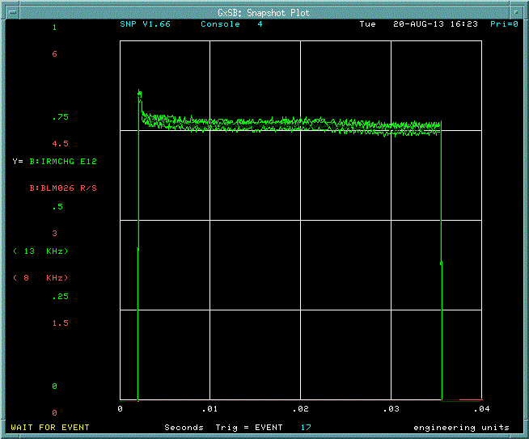
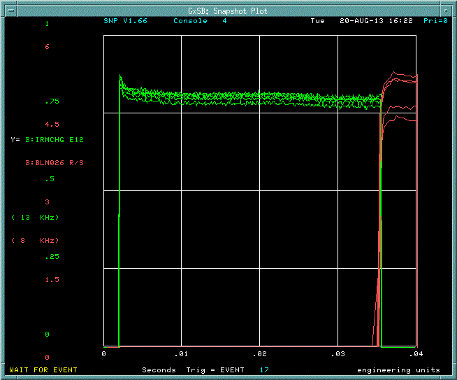
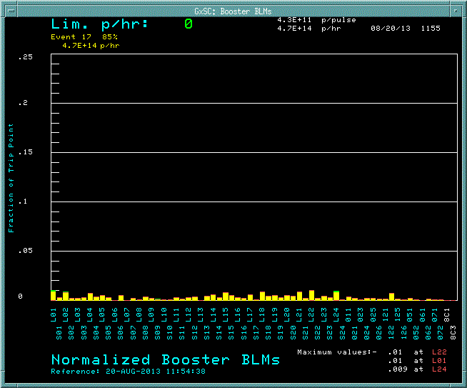
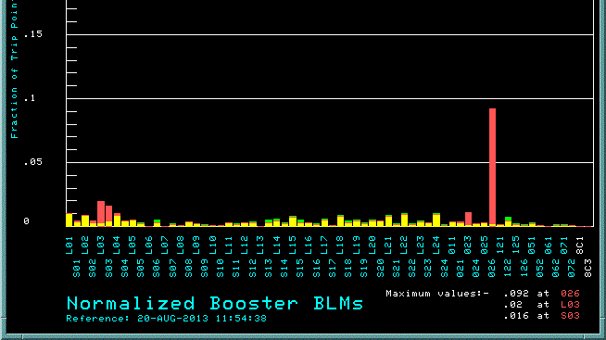
Notching turned On and Off
Extraction loss monitor
Beam Charge
Notching on
Notching off

Slide 33
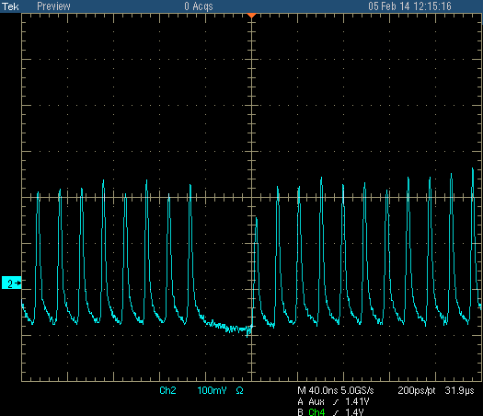
2 bunch notch shown

Slide 34
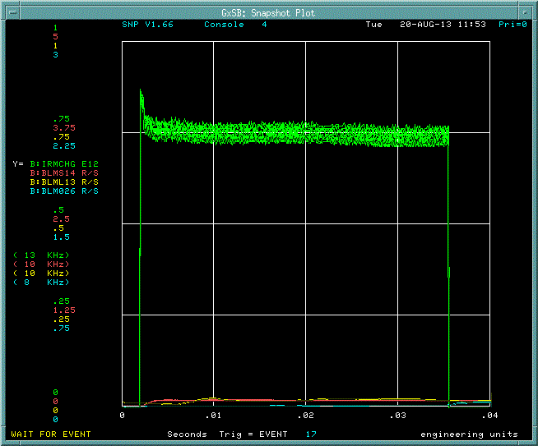
400 MeV Notched beam Absorber in operational position

Slide 35
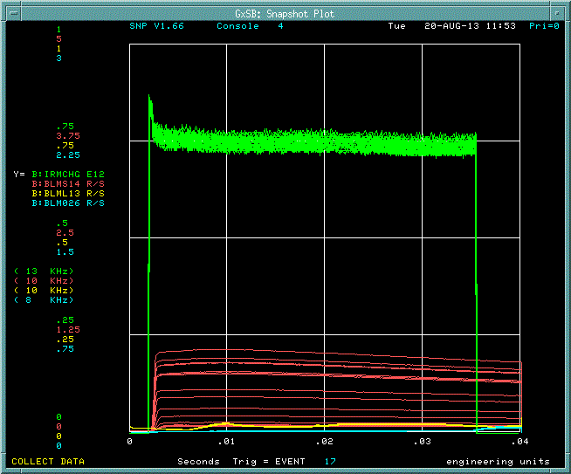
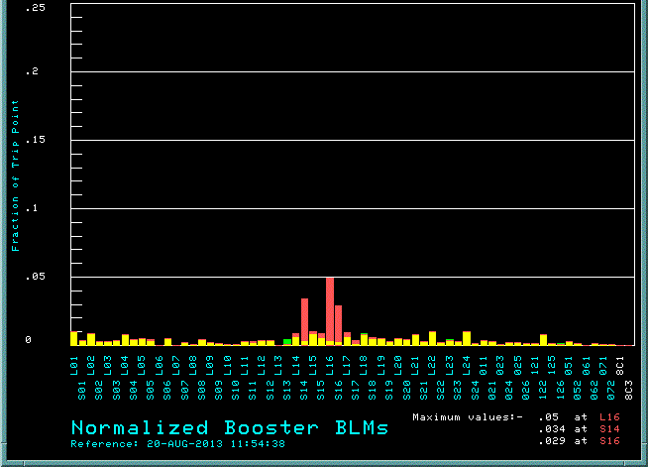
400 MeV Notched beam Absorber Retracted

Slide 36
Notch formation at 400MeV
1st, 2nd , 3rd turn

Slide 37
Long 12 Horz. Raw BPM signal
Inside
Plate
Outside
Plate

Slide 38
Short 12 Horz. Raw BPM signal
Notching Kicker trigger
Inside
Plate
first turn 2.2usec later
Outside
Plate
2 bunches displaced to radial outside

Slide 39
Long 12 Vert. Raw BPM signal
Notching Kicker trigger
Bottom
Plate
first turn 2.2usec later
Top
Plate
Slight beam loss seen on both plates

Slide 40
Fast Loss monitor at Short 12

Slide 41
Fast Loss monitor at Long 13

Slide 42
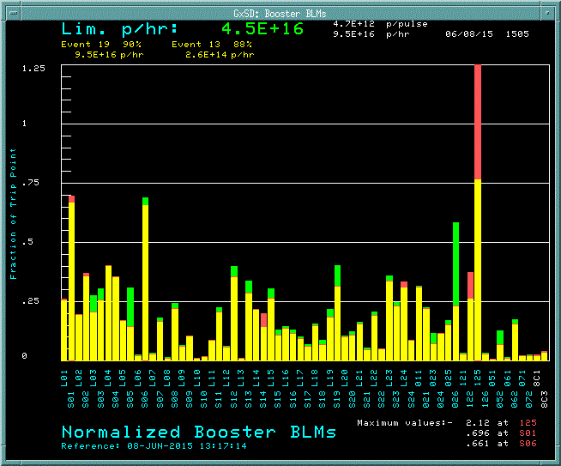
Adjusting the kick strength
Loss monitor at absorber
Reduced multi-turn losses
31kV kick
35kV kick

Slide 43
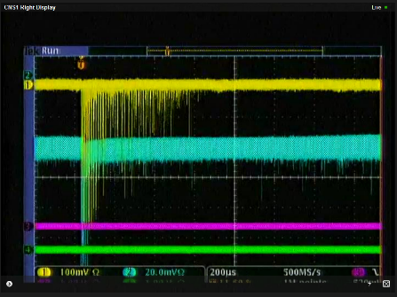
Fast loss Signals downstream of 5-3 and collimator 6b
Reduced multi-turn losses
31kV kick
35kV kick

Slide 44
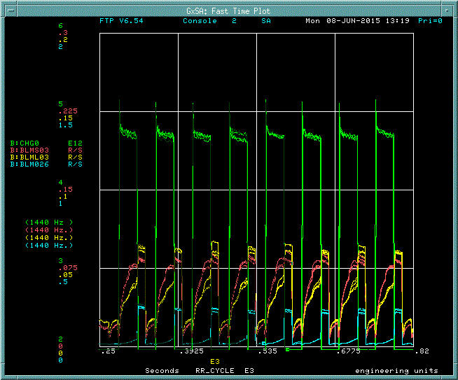
31kV kick
35kV kick

Slide 45
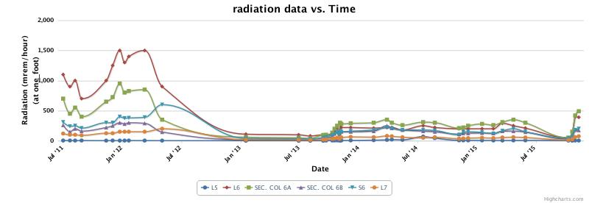
Transition from Notching at L5 (vert.) to L12(horz.)
Vertical notching L5/L13
Horizontal Notching L12/L13
Vertical notching L5/L13
Horizontal Notching L12/L13
Installed and removed partial liner insert

Slide 46
Notch Region Top view of magnets
Notching kickers
BLMS12
BLM124
L13 BMA
11-4
12-1
12-2
12-3
12-4
Notch
Absorber
Mask
13-1
MK04 L12 BMA
BLM122 S12 BMA
BLM123
BLM125
BLM126 BLML13
Beam Direction
Diagram continued below
Notch
Absorber
Mask
13-1
13-2
13-3
13-4
BLM126 BLML13
BLMS13 S13 BMA

Slide 47
Notch Region Top view of magnets
Notching kickers
BLMS12
BLM124
L13 BMA
11-4
12-1
12-2
12-3
12-4
Notch
Absorber
Mask
13-1
MK04 L12 BMA
BLM122 S12 BMA
BLM123
BLM125
BLM126 BLML13
Beam Direction
Diagram continued below
Notch
Absorber
Mask
13-1
13-2
13-3
13-4
BLM126 BLML13
BLMS13 S13 BMA

Slide 48
Current Notching Status
The gap is 2 bunches wide at 8GeV.
We are able to maintain a 2 bunch gap consistently for certain beam cycles and working to improve consistency on extracted beam cycles that require phase locked beam transfers to downstream machines.
How well are we notching now?
Where are losses being deposited?
Does it match simulation expectation?
How can we optimize beam trajectories to the absorber?

Slide 49
Conclusion
Notching is currently working better than before.
This allows us to run greater beam throughput and maintain/ reduce beam loss away from critical components.
We need to further reduce losses in critical areas with another iteration of improvements to the current system.
We gain more tuning capability with improved diagnostics.
We have lowered beam losses be utilizing magnetic cogging to allow for all beam cycles to notch at 400MeV rather than many at 700MeV previously.
We will gain further margin with notching in the Linac
Improved injection orbit management and better particle tracing models will further determine areas of improvement.

