Slide 1
International Services
Getting Started
Griselda Lopez
Neutrino Detector R&D Facilities Workshop
20 January 2016

Slide 2
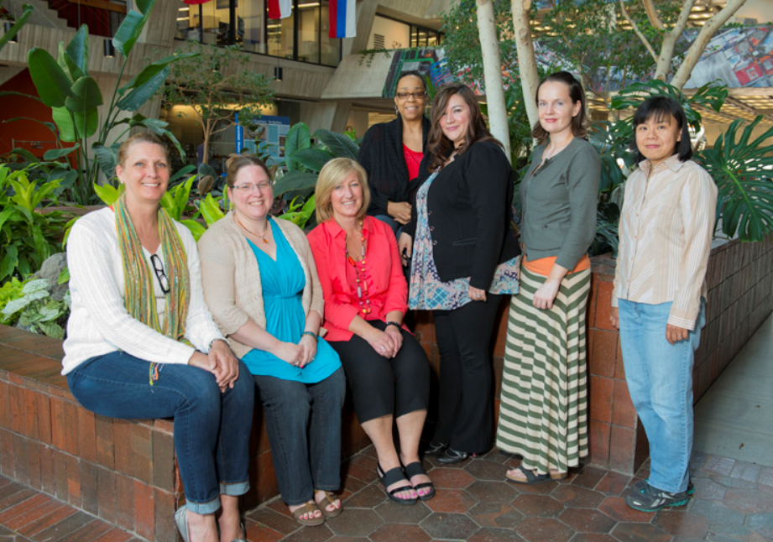
International Services
Staff
  Griselda Lopez, Manager ext. 6304
  Cheng Liu, Administrative Assistant ext. 2856
Users Office (Wilson Hall Mezzanine)
usersoffice@fnal.gov
  Linda Granbur ext. 4376
  Kim Pearce ext. 3111
Visa Office (Wilson Hall 15th floor)
visaoffice@fnal.gov
  Kappy Sherman ext. 3811
  Valery Stanley ext. 3933

Slide 3
Users Office
The Users Office processes requests for Fermilab ID badges and computing privileges. They also provide information about lab policies, procedures, and assist with identifying local resources.
New User
  Service Desk Ticket (https://fermi.service-now.com/new_acct_request.do )
    What you should do prior to arrival
      Complete Safety Training
      Accommodations – Contact Housing Office (ext. 3777 or housing@fnal.gov)
    What you need on your 1st day
      Valid Photo ID (e.g. Drivers License or passport)
      Proof of medical insurance
      Non- US Citizens must bring a valid, unexpired foreign passport, I-94 document, and any other documentation associated with the current visit to the U.S., such as visa, I-20, DS-2019, EAD (Employment Authorization Document), I-797 Approval Notice, or LPR (Green Card), as appropriate.
      Will not issue an ID if on tourist status (if B-2, VT, or VWT is marked on your I-94 document.
      DOE Approval is needed prior to arrival
        Iran, Sudan, Syria, and Russia

Slide 4
Users Office
  Renewing of ID badge and computing privileges
  Service Desk Ticket (https://fermi.service-now.com/renew_acct_request.do) and ensure safety training is up to date.
    What you need to bring to the Users Office
      Valid Photo ID (e.g. Drivers License or passport)
      Proof of medical insurance
      Non- Us Citizens must bring a valid, unexpired foreign passport, I-94 document, and any other documentation associated with the current visit to the U.S., such as visa, I-20, DS-2019, EAD (Employment Authorization Document), I-797 Approval Notice, or LPR (Green Card), as appropriate.
      Will not issue an ID if on tourist status (if B-2, VT, or VWT is marked on your I-94 document.

Slide 5
Visa Office
Visa Office provides U.S. immigration-related services or assistance to non-U.S. citizen employees and Users at Fermilab.
How do you get an invitation letter?
  Directorate issues the formal invitation letter
    Home Institution (no cost obligation to the lab)
    Division/Section/Center/Experiment
    Appropriate visa is defined
      Business Visa (less than 6 months)
      J1 Visa (greater than 3 months)
Open Door
  No longer need an appointment to meet with the Visa Office

Slide 6
What we have done
Since April
  Eliminated the appointment system in the Visa Office
  Changes on the websites
  Visa Office involved in the B1 lab process
  Eliminated most of our paper process
    Host and Hostee notification

Slide 7
What is Next
Location of International Services
  Wilson Hall 1st Floor
Improvements
  New websites
  Badging Committee
  Invitation process
  Improve the overall process for onboarding Users and Visitors
    Use technology to it’s fullest potential (electronic notifications for Host and Hostees)
Additional Training Requirements (February 2016)
  Onsite Users
    Sexual Harassment
    Traffic Safety Awareness
    Workplace Violence and Active Shooter/Active Threat Awareness Training
    Basic Computer Security Training
  Offsite Users
    Basic Computer Security Training

Slide 8
New Services
  Brown Bag seminars
    Getting to Know Your Visa Status
  Did you complete the 2015 survey?
    https://www.surveymonkey.com/r/?sm=kUSGMfUpxwR%2b3IwPejIe7Q%3d%3d

