Slide 1
JLAB Vertical Testing Experience
T. Powers
LCLS II Vertical and Cryomodule Testing Workshop
Oct. 2015

Slide 2
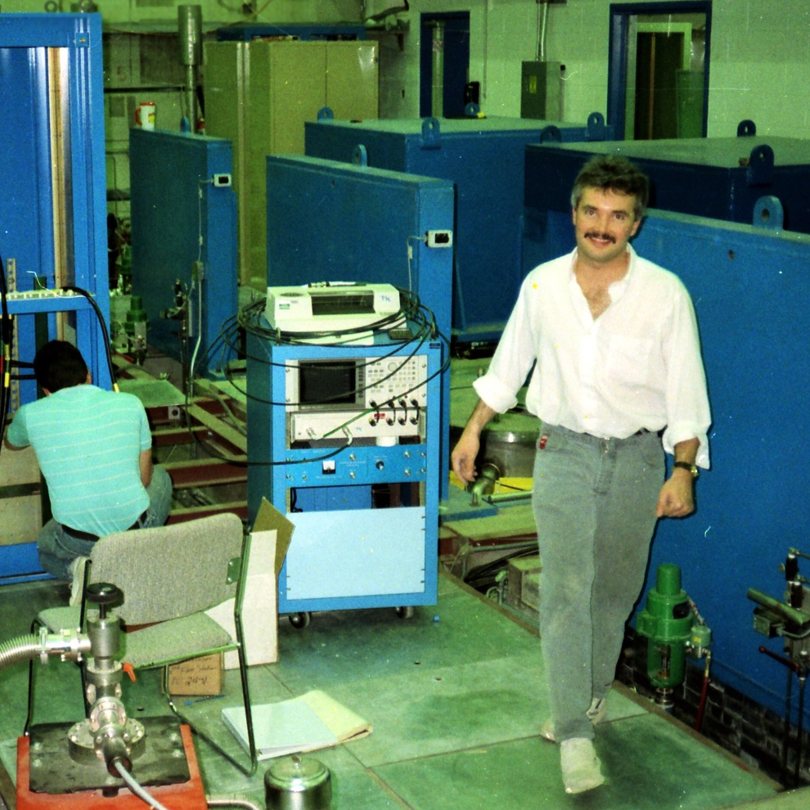
Jefferson Lab Vertical Testing History
Jefferson Lab has been testing cavities since 1988.
Over the years we have performed more than 6,000 tests on at least 650 different cavities.
Production runs have included
  376 cavities for the original CEBAF and FEL production.
  84 cavities for SNS
  80 cavities for the CEBAF C50 rework program
  104 cavities for the C100/R100/F100 production runs.
Extensive R&D testing program.
Typical VTA testing load is 5 to 10 cold RF tests per week.
A young John Mammosser in the VTA

Slide 3
JLAB VTA Test Facility
The Jefferson Lab Vertical test area has 6 shielded test dewars for tests that might produce radiation and 2 unshielded dewars which are used for non-radiation producing tests.
The facility was established in 1990.
The helium distribution system is fed from a cryogenic plant that is shared with the cryomodule test facility (CMTF).
In addition to a 2K pumping system, which is also shared with the CMTF, there is a set of dedicated pumps that is capable of further reducing the temperature to 1.5K (45W @ 1.8K and 6W @ 1.5K).
The cryogenic plant is limited by both the makeup and recovery capacity.
There are plans to upgrade the liquefaction capabilities in the summer of 2016.
RF capabilities range from 300 MHz to 7 GHz
2 production RF systems and 3 R&D RF systems

Slide 4
Current Upgrades
Conversion of 1990 vintage cryogenic controls to PLC based system. In progress to be completed in the spring of 2016.
Conversion of VCO-PLL based systems to digital LLRF based systems.
Conversion from one dedicated system at 1300 MHz and one at 1497 MHz to two systems capable of operating between 1.2 GHz and 1.6 GHz. In progress to be completed in the winter of 2016.
Addition of RF switching network for the two production systems so that either system can be automatically routed to any of the 6 production dewars. This system will be integrated into the personnel protection system.

Slide 5
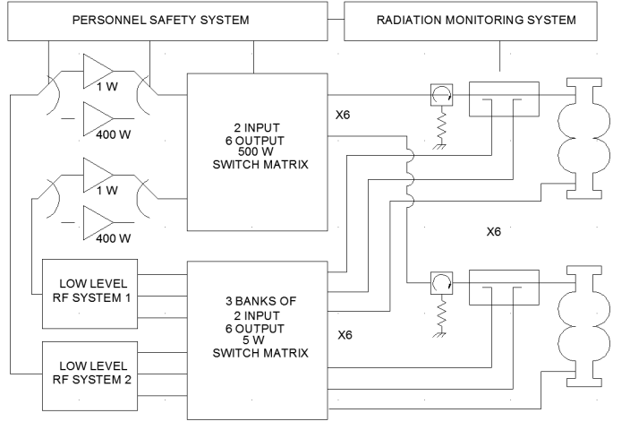
VTA 1.2 GHz to 1.6 GHz System Level Block Diagram

Slide 6
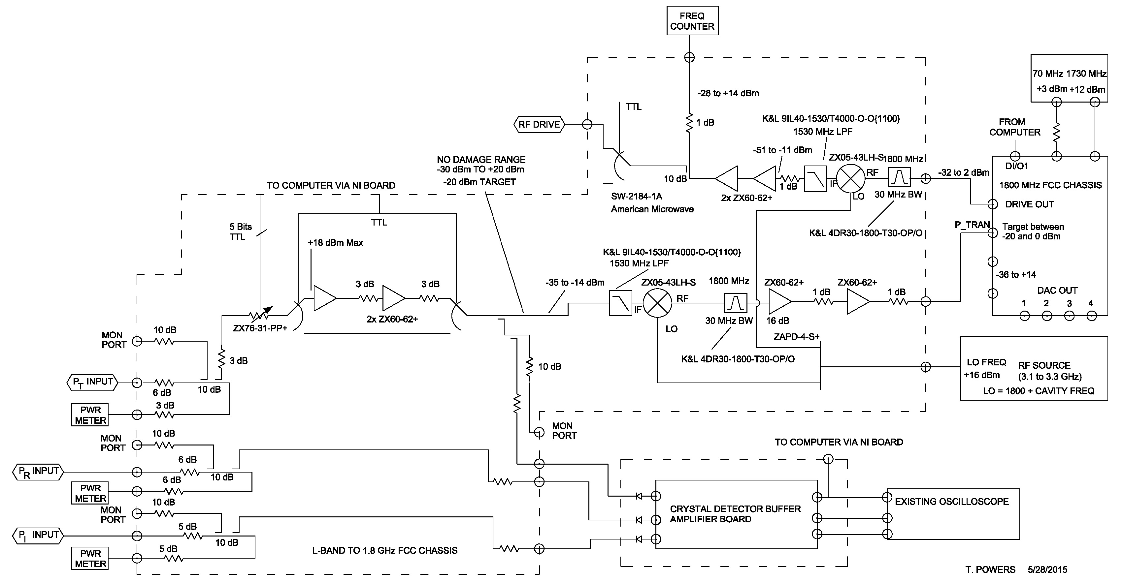
Low Level RF Block Diagram
For Details http://srf2015proc.triumf.ca/prepress/papers/tupb094.pdf

Slide 7
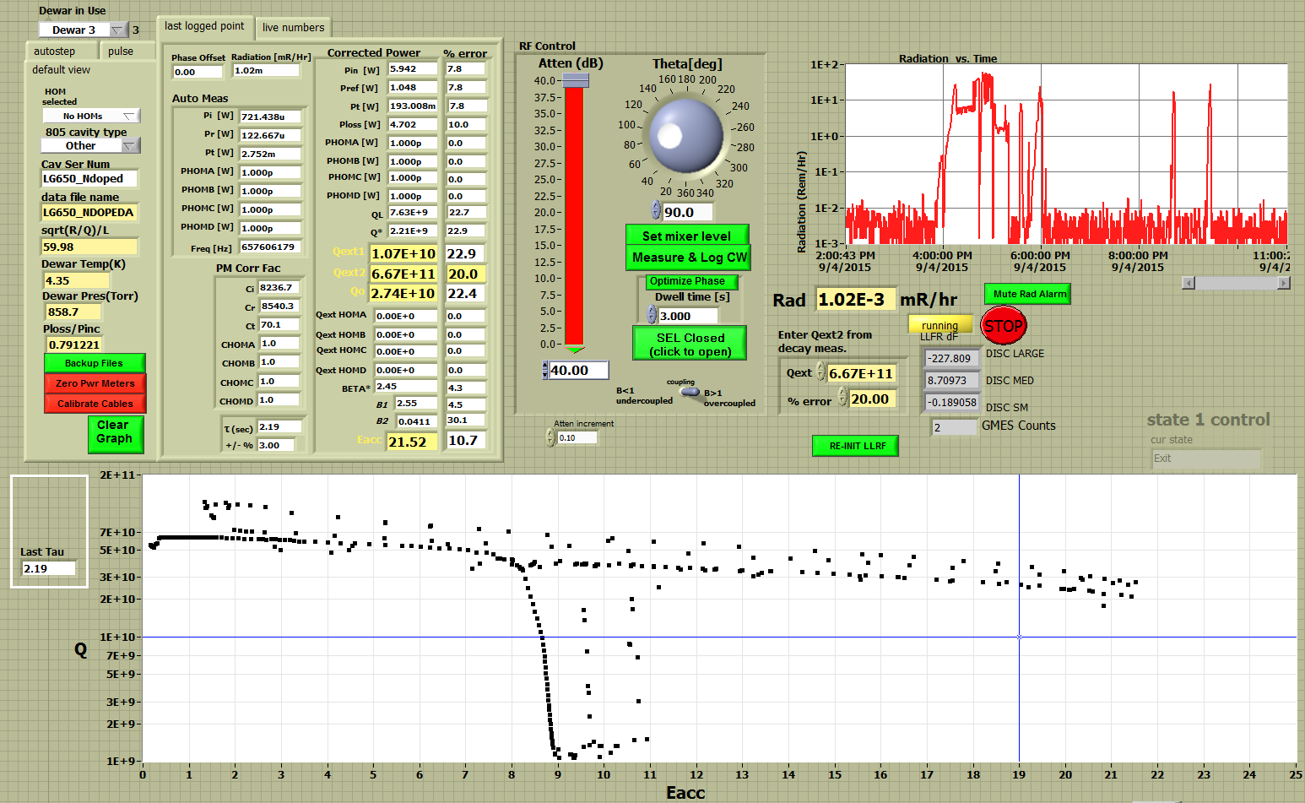
Screen Shot of Labview Test Software
1.6 K
1.8 K
2.0 K

Slide 8
VTA 1300/1500 MHz RF Production System Overview
Two independent systems each capable of 1200 MHz to 1600 MHz operation.
RF switching system allows operators to quickly make connections to selected dewar.
Comparison to last calibration at the end of the calibration process allows the operator to validate that the calibration is valid.
Digital LLRF improves speed to lock to the cavity frequency.
Software has provisions for auto stepping and auto phasing the cavities to quickly get complete repeatable data sets.
All data for each data point is recorded into a text file for future review/processing.
The JLAB software/hardware was used as a basis for the Fermi VTA hardware software when it was implemented in 2006.
Math for error calculations updated as part of conversion to digital LLRF.
Where appropriate new software drivers will be provided to Fermi and assistance will be provided to integrate them into their system to assure continued standardization of calculations.

Slide 9
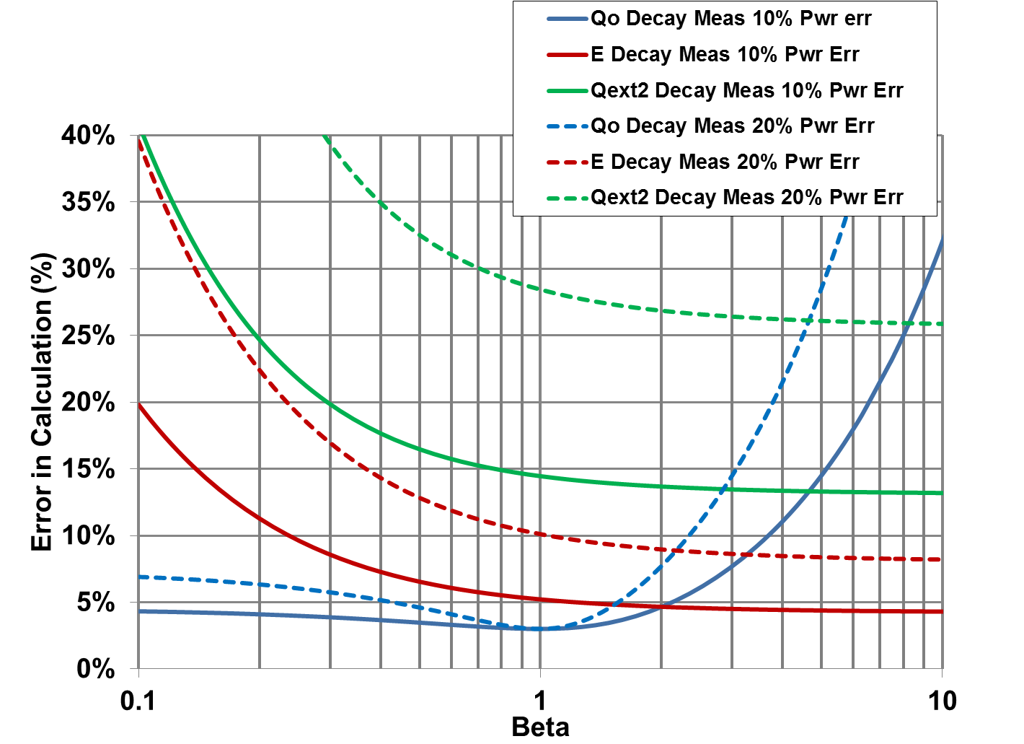
Calculated Decay Errors as a Function of Beta for a 10% and 20% RF Power Measurement Error

Slide 10
Calculated Decay Errors as a Function of Beta for a 10% and 20% RF Power Measurement Error
0.25 < Beta < 3
Range for reasonable
measurements

Slide 11
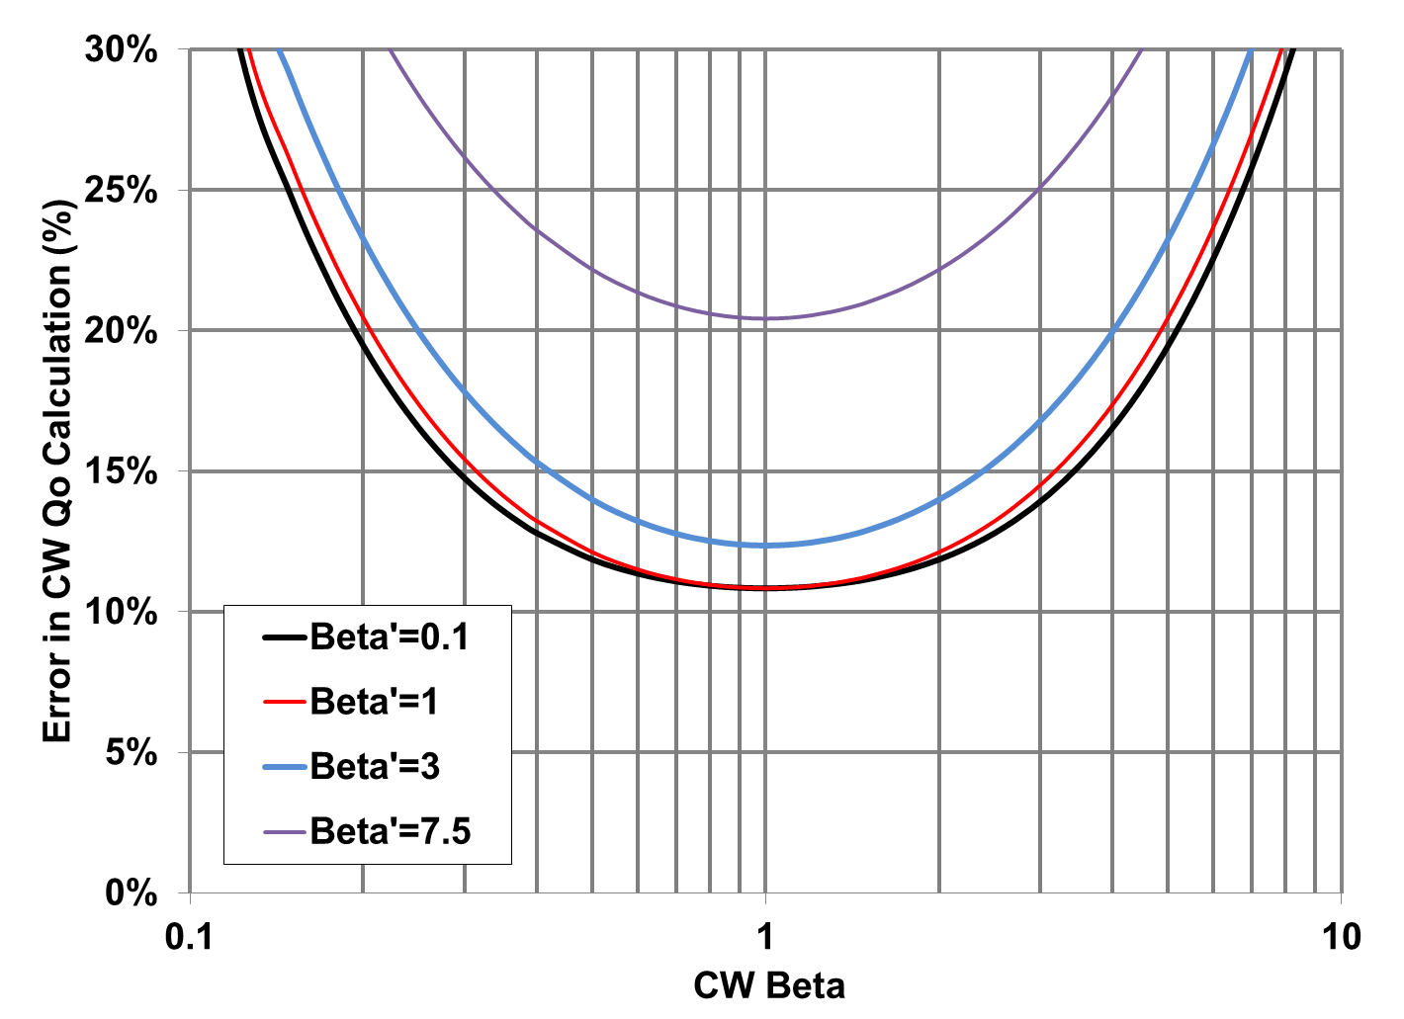
CW Errors in Qo as a function of CW Beta for Various Values of Decay Beta Values
Power measurement calibration error assumed to be 10%
CW power measurement error assumed to be an additional 5%.

Slide 12
CW Errors in Qo as a function of CW Beta for Various Values of Decay Beta Values
Power measurement calibration error assumed to be 10%
CW power measurement error assumed to be an additional 5%.
0.3 < Beta < 3
Range for reasonable
measurements

Slide 13
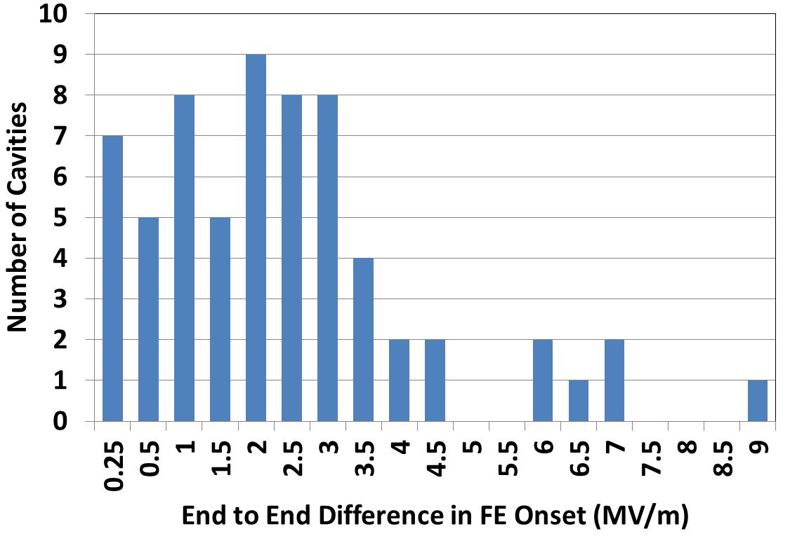
Radiation Instrumentation
Current VTA system is a calibrated system used for personnel protection as well as instrumentation.
VTA sensor located about 2m above the cavity with at least 1” of stainless between the sensor and the cavity.
FE onset. . . Defined as the gradient where there is measurable radiation above background radiation.
Theory states the radiation produced by field emission is directional based on cavity gradient and FE electron source term. This is consistent with studies done in the 1980s and repeated since using better simulation tools.
C100 Commissioning data indicates that field emission onset can easily vary by as much as 3 MV/m depending on end to end sensor location.
C100 Initial Commissioning Results

Slide 14
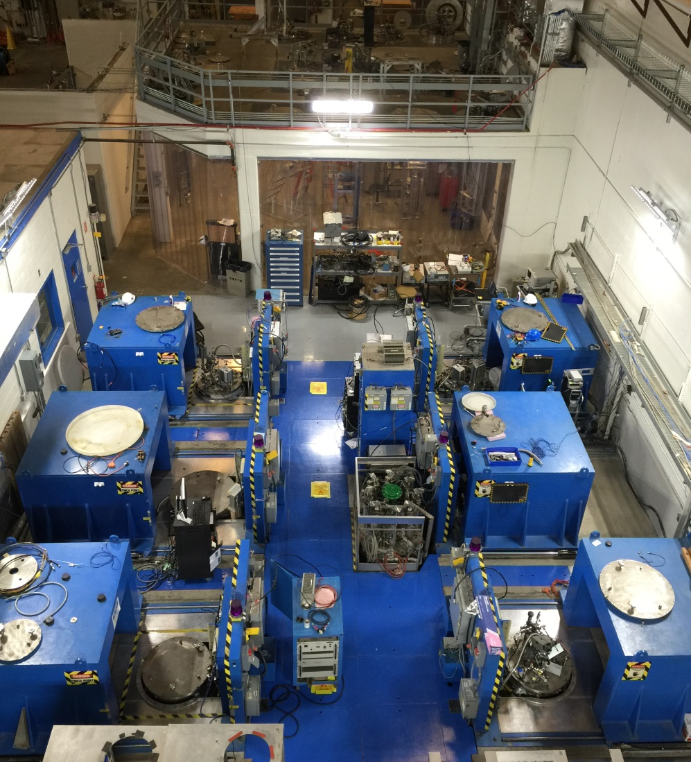

Jefferson Lab Vertical Test Area 2015
Vertical staging area.
Radiation detector
Moveable lead and steel shielding lid.

Slide 15
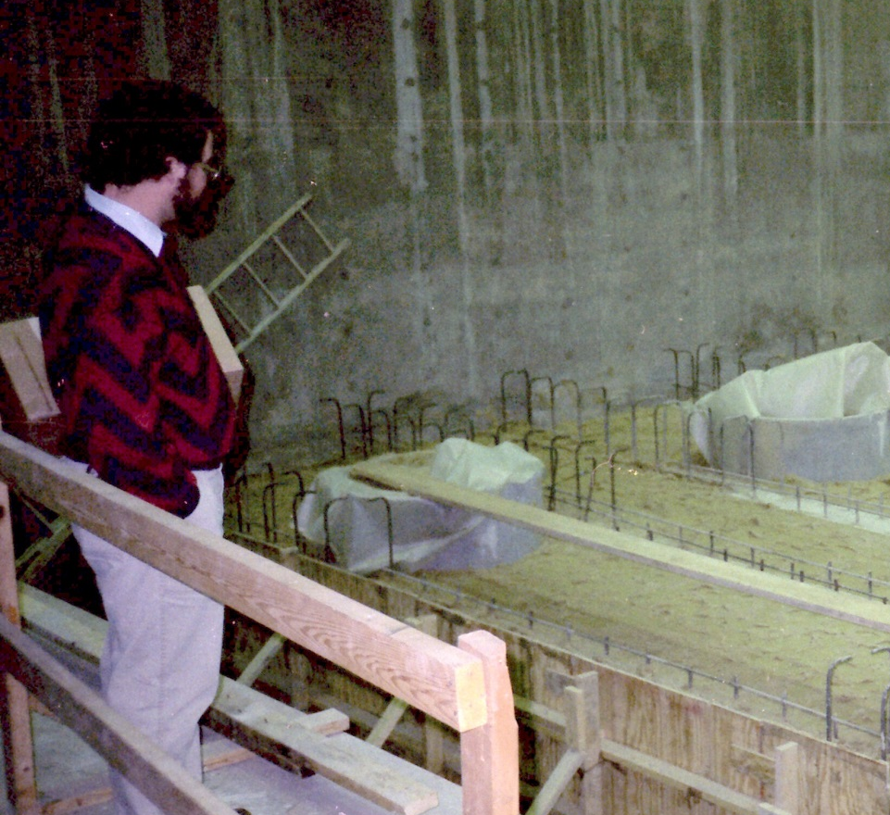
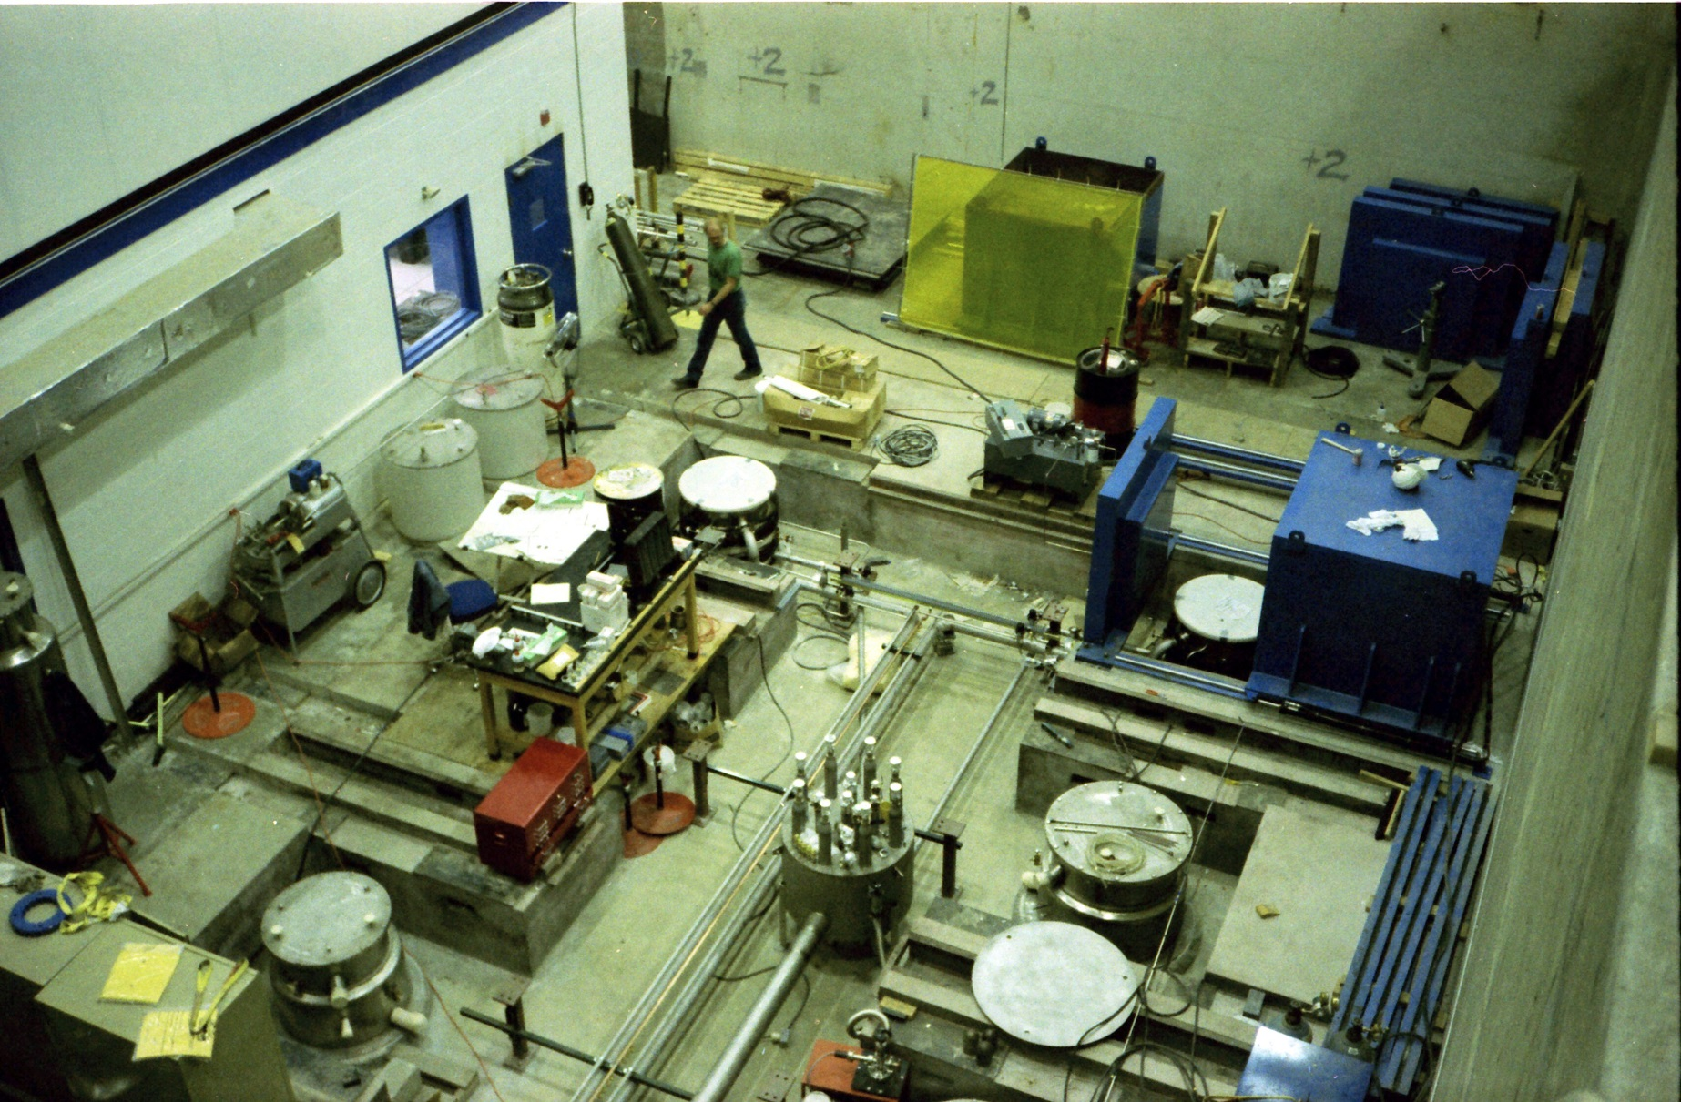
VTA Construction Photos 1988 to 1989
Sand filler with about 2 feet of reinforced concrete would have to be penetrated if we want to put a room temperature sensor at the bottom of the dewar.

Slide 16
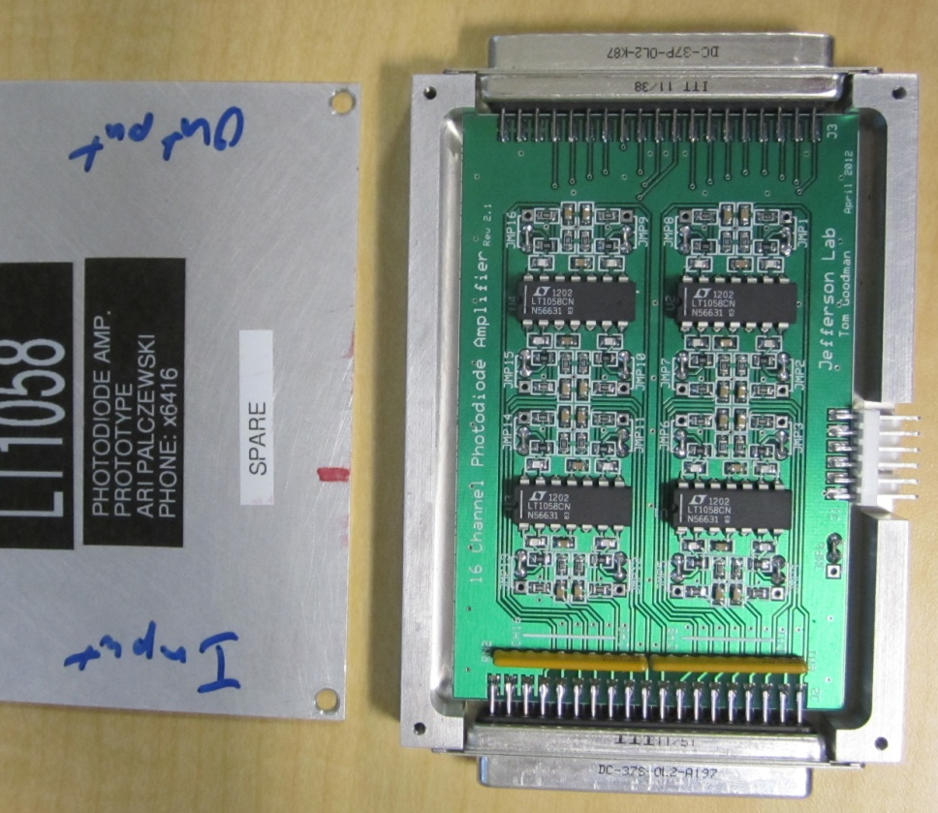
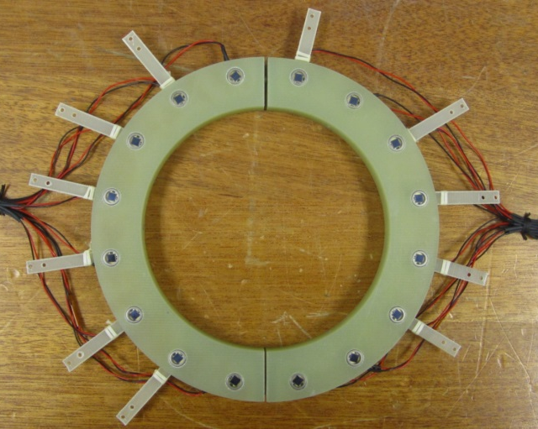
Recommended in Liquid Radiation Sensor
Hamamatsu 1223 photodiode sensor
1 mV noise floor
16 channel per signal conditioning amplifier
Low profile for modular use with all thermometry hardware
22 signal conditioning amplifiers built
Requires 16 bit moderate speed DAQ module
Require 15V +- power supply
Example of a 16-diode detector ring.
Provided by Ari Palczewski

Slide 17
ADMINISTRATIVE LIMITS

Slide 18
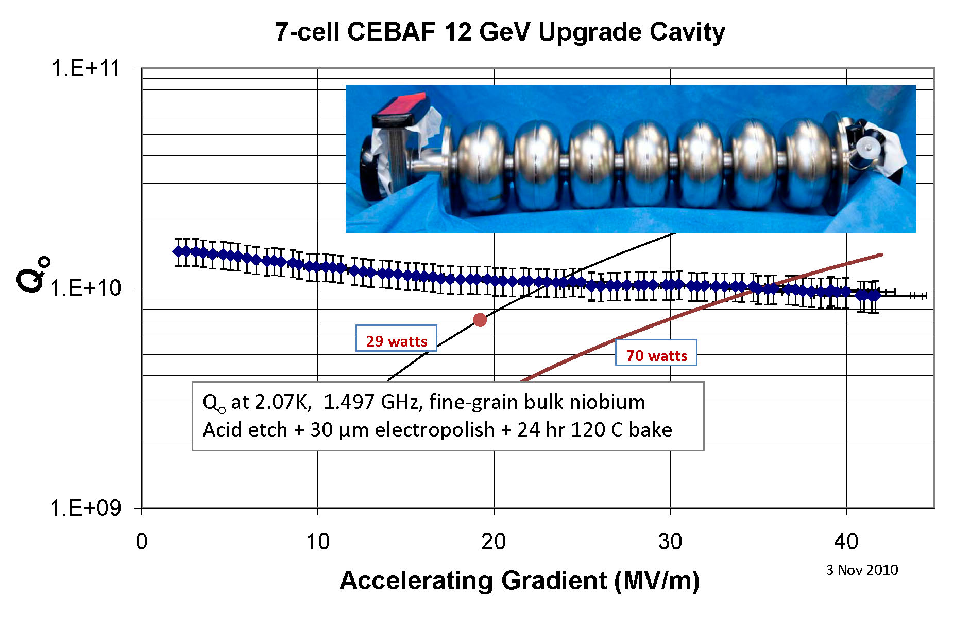
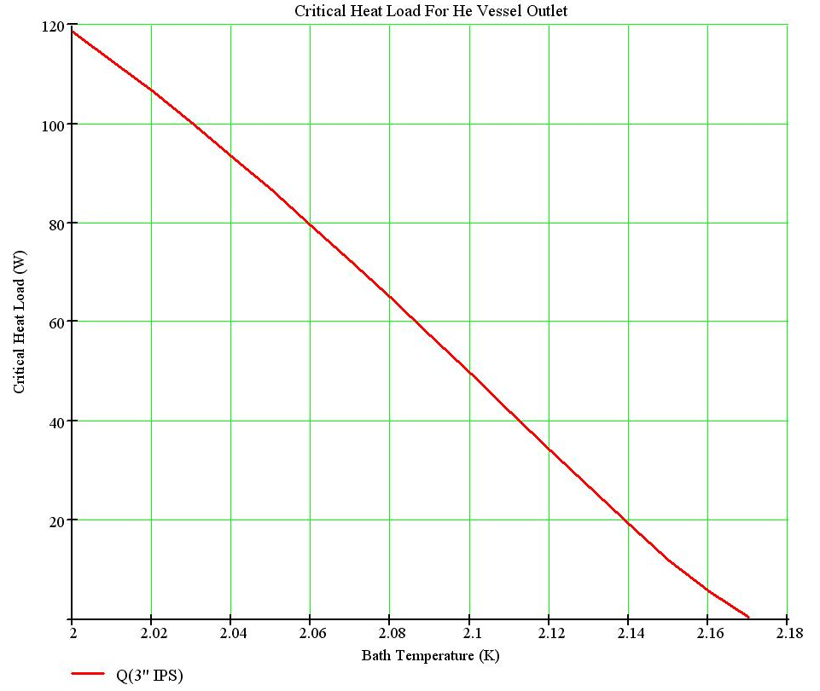
12 GeV Upgrade Cavities
Project specification: 19.2 MV/m average, with 29 W avg. heat
Operational limit in CEBAF, RF power: 25 MV/m
Project conservatism for first two CMs:
  To avoid any potential risk of degradation from “pushing,”
  Limiting vertical cavity acceptance testing to 27 MV/m
  (rather frustrating to us cavity people who look into the future)
Vertical rf test only after HV attached
  Piping size limits heat load to ~70 watts @ 2.07 K
FNAL AP&T Seminar 052411 cer

Slide 19
Reverse-Processing a Cavity AKA Blowing up Field Emitters
Pushing a cavity well into field emission can lead to an event occurring that looks like a quench followed by reduced performance, typically reduced FE onset.
This is not a new phenomena . . . We saw it all through the original CEBAF production but with a spec of 5 MV/m it was normally not a big deal.
We experienced it during the initial C100 testing. Administrative limits were put into place in order to avoid the cost and schedule delays associated with reprocessing cavities because of this type of event.

Slide 20
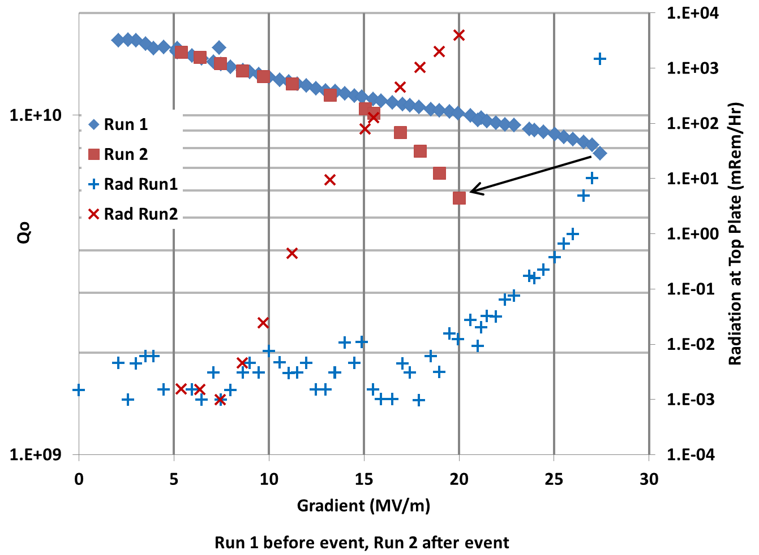
Example of Degradation Due to Blowing Up a FE”
Test C100-RI-004A
1 Dec. 2010
Cavity was stepped up to 27.5 MV/m the next step the gradient degraded.
Field emission onset changed from 19 MV/m to 9 MV/m.
Cavity was HPR and passed the next test with “flat” Qo to 27 MV/m and FE onset at 18 MV/m

Slide 21
C100 VTA Operational Limits
If the radiation reaches 10 R/h (1E+4 mR/h) stop testing immediately (Radiation work permit limit).
Do not exceed a gradient of 27MV/m . (Project imposed after schedule slips due to reprocessing)
If field emission loading (reduction in Qo) occurs at cavity gradients smaller than 15 MV/m, abort test.
If the radiation is greater than 100 mR/h at a cavity gradient less than 27 MV/m, consider RF processing in the other passband modes.
Incident Power <100 W to reduce the risk of cable breakdown in low pressure helium.
Provided by Kirk Davis

Slide 22
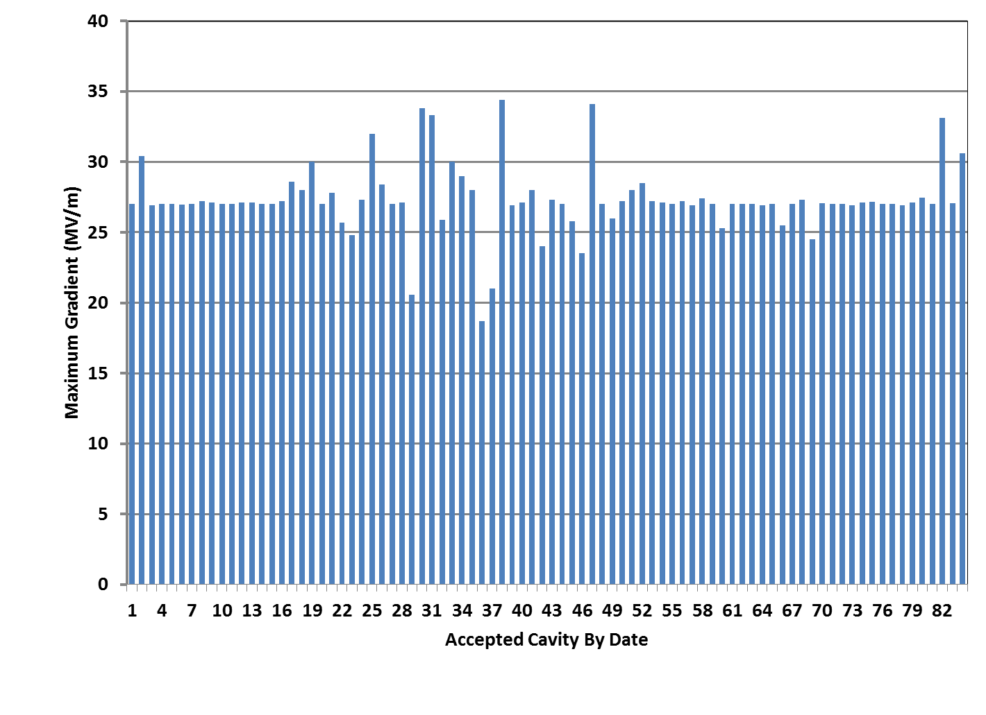
C100 VTA Test Maximum Delivered Gradient
Administrative Limit 27 MV/m
24 Nov. 2010 to 10 Feb. 2012
Project Specification 19.2 MV/m

Slide 23
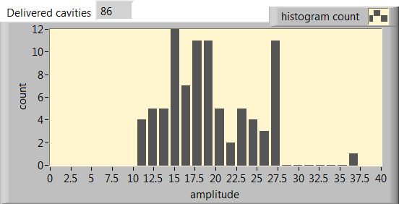
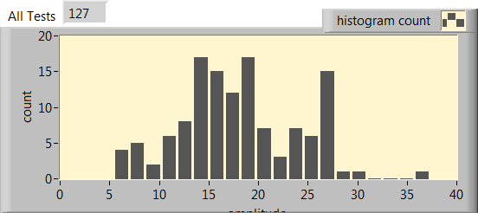
C100 Reprocessing by High Pressure Rinsing
No delivered cavities had field emission onset below 10 MV/m. This is because they were rejected, high pressure rinsed and retested.
Only one cavity out of 82 failed because of a scratch from the HPR wand.
About 10% of the all tests had field emission onset below 10 MV/m
NOTE: The SRF production and testing facility was undergoing major construction during the C100 Production run.

Slide 24
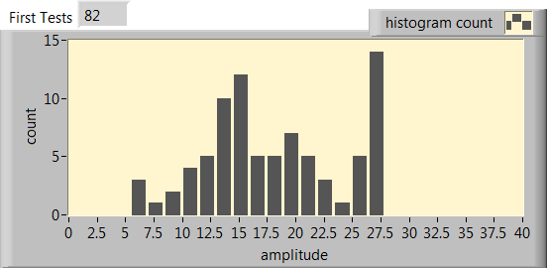
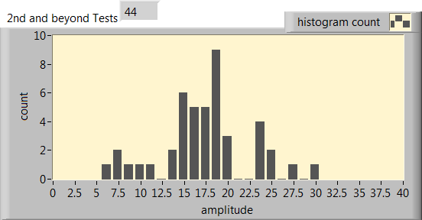
C100 Reprocessing
In general there was a 10% to 15% FE onset below 10 MV/m after high pressure rinse independent of the number of times the cavity was rinsed.
Multiple HPR is a good method for determining if there is a fundamental defect in the cavity.
However, handling after the VTA qualification test has a finite probability to introduce new field emitters.

Slide 25
Recommendations
Set administrative limits on gradient and radiation
Set vertical test abort criteria
Use multiple in dewar sensors for detecting field emission onset, this has the added advantage of allowing both labs to using standard configurations.
The safety radiation detectors should be used as a backup in the event that there is a cold sensor system failure during a given test.
FE onset is one metric but should not drive reprocessing unless it is below some value between 10 to 14 MV/m to be discussed later.
Measure
  Q vs E and data that comes parasitically with it.
  HOM survey (at least take the raw data)
  Pass Band modes
  Only measure at 2K if there is a problem with Qo

Slide 26
Backup Slides

Slide 27
C100 HOM Mode Measurements S21 From FPC to HOM
Data can be taken automatically.
Manual processing needs more than 6 hours.
With Mathematica Polfit, data processing is done in about 1 hour and requires operator interaction.
Provided by Mircea Stirbet

Slide 28
Pass Band Measurements (S21)
Provided by Mircea Stirbet

Slide 29
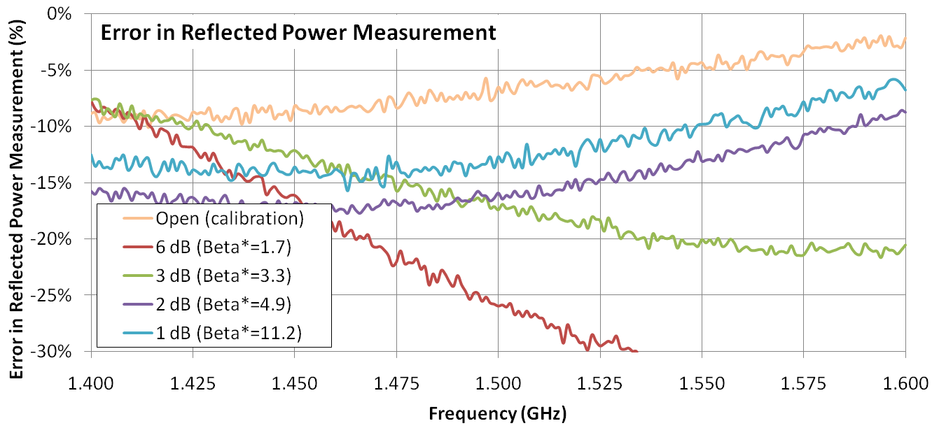
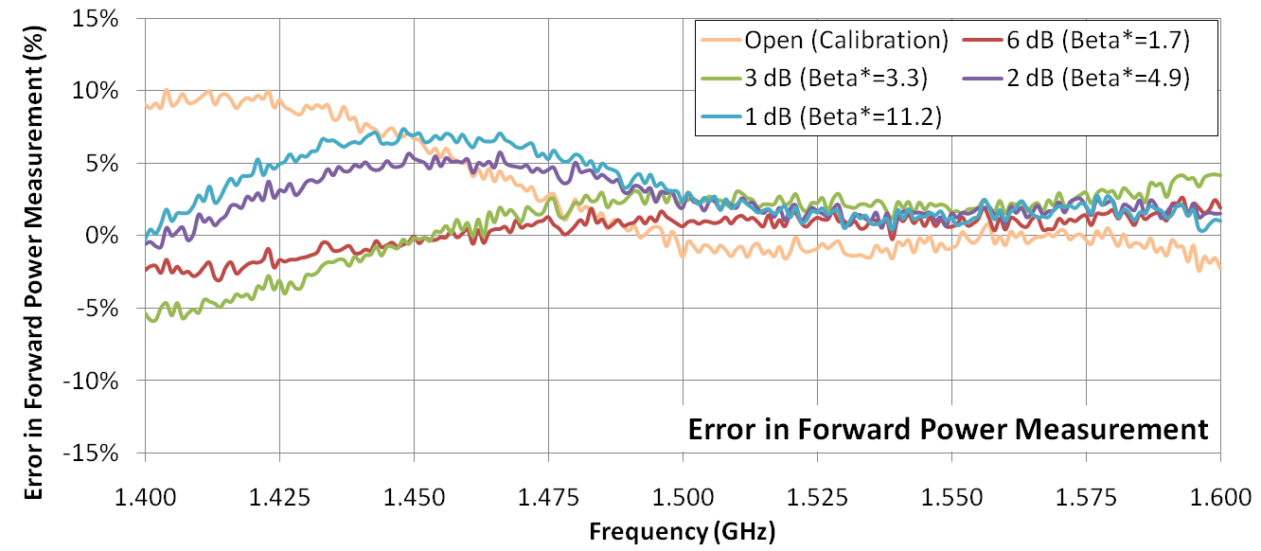
NARDA 20 dB COUPLER
Error in power measurement with different loads on the output of the directional coupler (i.e. different beta*) Narda 3320 Serial 73091

Slide 30
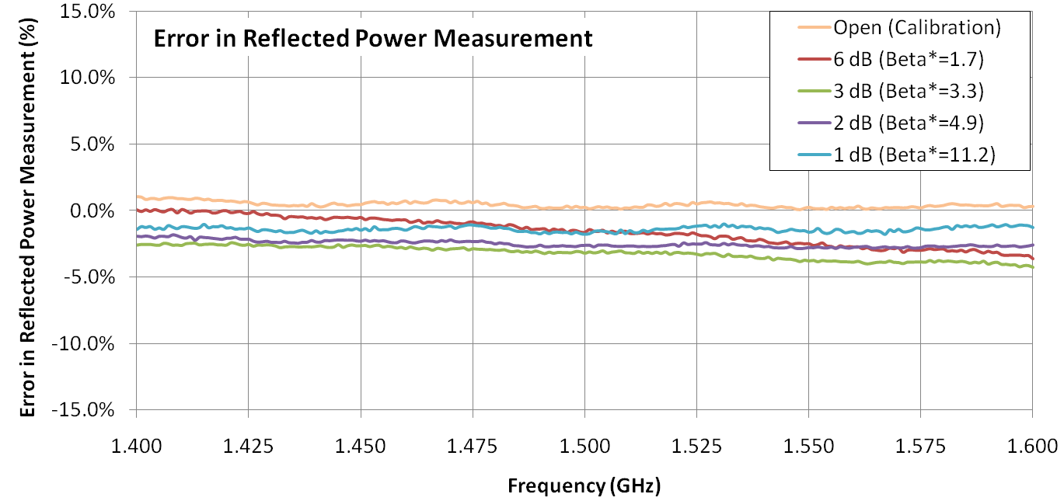
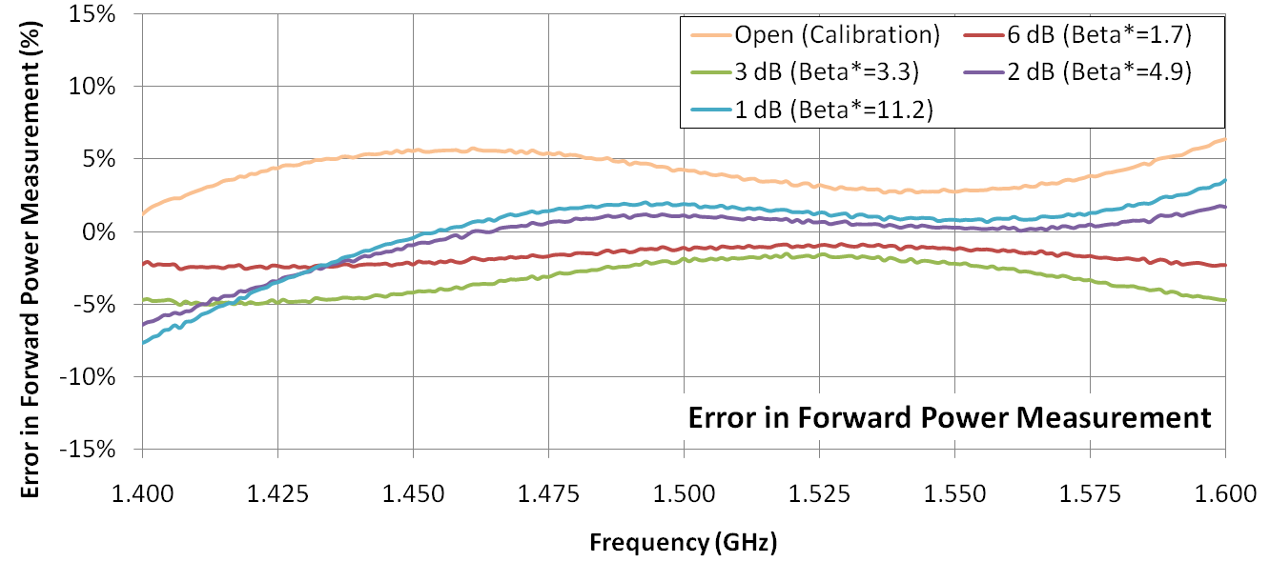
CT MICROWAVE 30 dB COUPLER
Currently used for
1.2 to 1.6 GHz testing.
Error in power measurement with different loads on the output of the directional coupler (i.e. different beta*) CT Microwave 441433, serial 73091

Slide 31
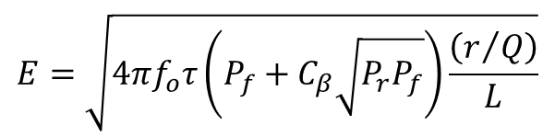
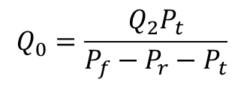
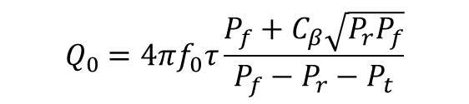
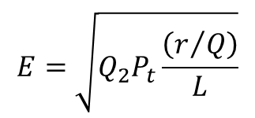
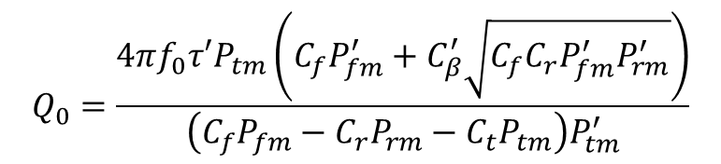
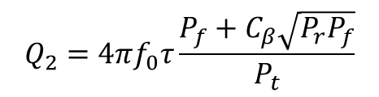
Qo, E, Field Probe Q Calculations and errors
Revisited the error calculations that were originally done in 1991.
The first step was to reduce the math to basic the basic measured parameters.
Decay Measurements CW Measurements
$$E=\sqrt{4πf_{o}τ\left(P_{f}+C_{β}\sqrt{P_{r}P_{f}}\right)\frac{\left(r/Q\right)}{L}}$$
$$E=\sqrt{Q_{2}P_{t}\frac{\left(r/Q\right)}{L}}$$
$$Q_{2}=4πf_{0}τ\frac{P_{f}+C_{β}\sqrt{P_{r}P_{f}}}{P_{t}}$$
$$Q_{0}=\frac{Q_{2}P_{t}}{P_{f}−P_{r}−P_{t}}$$
$$Q_{0}=\frac{4πf_{0}τ′P_{tm}\left(C_{f}P_{fm}^{′}+C_{β}^{′}\sqrt{{C_{f}C_{r}P}_{fm}^{′}P_{rm}^{′}}\right)}{\left(C_{f}P_{fm}−C_{r}P_{rm}−C_{t}P_{tm}\right)P_{tm}^{′}}$$
$$Q_{0}=4πf_{0}τ\frac{P_{f}+C_{β}\sqrt{P_{r}P_{f}}}{P_{f}−P_{r}−P_{t}}$$
C_{β} is +1 for over coupled and -1 for undercoupled case.
P_{f}, P_{r} and P_{t} are the RF power readings at the fundamental power coupler and field probe respectively.
In the last equation the prime marks indicate that the values were those used to determine Q₂ during the decay measurement process; P_{tm}, P_{fm} and P_{rm} are the power meter readings; and C_{f}, C_{r}, and C_{t} are the calibration coefficients for said power meter readings.

Slide 32
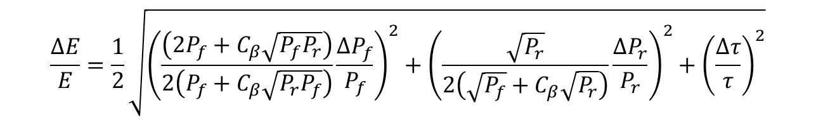
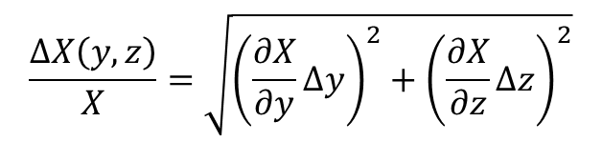
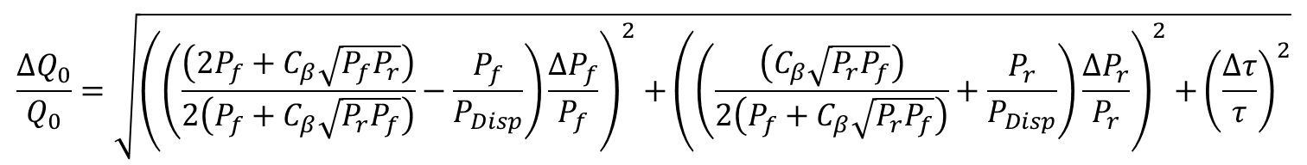
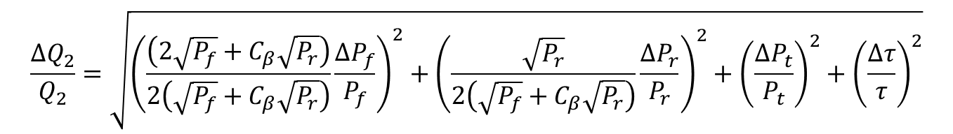
Error calculations
For decay measurements the calculation is straightforward but can be tedious. Using the general form:
$$\frac{∆X\left(y,z\right)}{X}=\sqrt{{\left(\frac{∂X}{∂y}∆y\right)}^{2}+{\left(\frac{∂X}{∂z}∆z\right)}^{2}}$$
And several pages of math. One can show that:
$$\frac{∆E}{E}=\frac{1}{2}\sqrt{{\left(\frac{\left(2P_{f}+C_{β}\sqrt{{P_{f}P}_{r}}\right)}{2\left(P_{f}+C_{β}\sqrt{P_{r}P_{f}}\right)}\frac{∆P_{f}}{P_{f}}\right)}^{2}+{\left(\frac{\sqrt{P_{r}}}{2\left(\sqrt{P_{f}}+C_{β}\sqrt{P_{r}}\right)}\frac{∆P_{r}}{P_{r}}\right)}^{2}+{\left(\frac{∆τ}{τ}\right)}^{2}}$$
$$\frac{∆Q_{2}}{Q_{2}}=\sqrt{{\left(\frac{\left(2\sqrt{P_{f}}+C_{β}\sqrt{P_{r}}\right)}{2\left(\sqrt{P_{f}}+C_{β}\sqrt{P_{r}}\right)}\frac{∆P_{f}}{P_{f}}\right)}^{2}+{\left(\frac{\sqrt{P_{r}}}{2\left(\sqrt{P_{f}}+C_{β}\sqrt{P_{r}}\right)}\frac{{∆P}_{r}}{P_{r}}\right)}^{2}+{\left(\frac{{∆P}_{t}}{P_{t}}\right)}^{2}+{\left(\frac{∆τ}{τ}\right)}^{2}}$$
$$\frac{∆Q_{0}}{Q_{0}}=\sqrt{{\left(\left(\frac{\left({2P}_{f}+C_{β}\sqrt{{P_{f}P}_{r}}\right)}{2\left(P_{f}+C_{β}\sqrt{P_{r}P_{f}}\right)}−\frac{P_{f}}{P_{Disp}}\right)\frac{∆P_{f}}{P_{f}}\right)}^{2}{+\left(\left(\frac{\left(C_{β}\sqrt{{P_{r}P}_{f}}\right)}{2\left(P_{f}+C_{β}\sqrt{P_{r}P_{f}}\right)}+\frac{P_{r}}{P_{Disp}}\right)\frac{∆P_{r}}{P_{r}}\right)}^{2}+{\left(\frac{∆τ}{τ}\right)}^{2}}$$

Slide 33
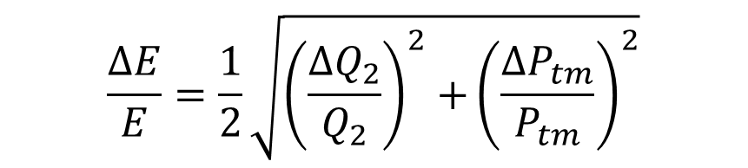
CW Errors
When you do the math you find that the only thing that matters with the CW gradient measurement is the linearity for the transmitted power meter and the error in the field probe-Q when it was determined during a decay measurement.
$$\frac{∆E}{E}=\frac{1}{2}\sqrt{{\left(\frac{{∆Q}_{2}}{Q_{2}}\right)}^{2}{+\left(\frac{∆P_{tm}}{P_{tm}}\right)}^{2}}$$
CW Qo errors are more complicated.
The calibration for the forward and reflected power can change if you repeat the forward power to a detuned cavity calibration and obtain an new value for the in-dewar incident cable losses.
There are errors associated with the directional couplers that are a function of the ratio of forward and reflected power (related to beta) which occurs when Q₀ changes.
There is the error that is carried through with the value of Q₂ that was measured during the decay measurement.

Slide 34
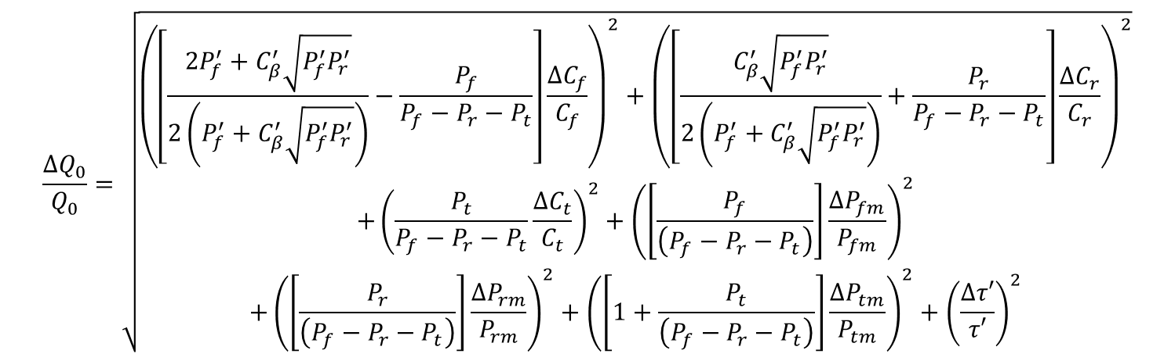
CW Errors in Q₀
$$\frac{∆Q_{0}}{Q_{0}}=\sqrt{\begin{aligned}\begin{aligned}{\left(\left[\frac{2P_{f}^{′}+C_{β}^{′}\sqrt{P_{f}^{′}P_{r}^{′}}}{2\left(P_{f}^{′}+C_{β}^{′}\sqrt{P_{f}^{′}P_{r}^{′}}\right)}−\frac{P_{f}}{P_{f}−P_{r}−P_{t}}\right]\frac{∆C_{f}}{C_{f}}\right)}^{2}+{\left(\left[\frac{C_{β}^{′}\sqrt{P_{f}^{′}P_{r}^{′}}}{2\left(P_{f}^{′}+C_{β}^{′}\sqrt{P_{f}^{′}P_{r}^{′}}\right)}+\frac{P_{r}}{P_{f}−P_{r}−P_{t}}\right]\frac{∆C_{r}}{C_{r}}\right)}^{2} \\ {+\left(\frac{P_{t}}{P_{f}−P_{r}−P_{t}}\frac{∆C_{t}}{C_{t}}\right)}^{2}+{\left(\left[\frac{P_{f}}{\left(P_{f}−P_{r}−P_{t}\right)}\right]\frac{{∆P}_{fm}}{P_{fm}}\right)}^{2}\end{aligned} \\ +{\left(\left[\frac{P_{r}}{\left(P_{f}−P_{r}−P_{t}\right)}\right]\frac{{∆P}_{rm}}{P_{rm}}\right)}^{2}+{\left(\left[1+\frac{P_{t}}{\left(P_{f}−P_{r}−P_{t}\right)}\right]\frac{{∆P}_{tm}}{P_{tm}}\right)}^{2}+{\left(\frac{∆τ′}{τ′}\right)}^{2}\end{aligned}}$$
Here the primed RF power, τ and C_{β} readings are the values when Q₂ was calculated using the decay technique.
ΔC_{x}/C_{x} are the errors in the calibrations for both the CW and decay measurements and
ΔP_{xm}/P_{xm} are the non linarites associated with the power meter measurements.

Slide 35
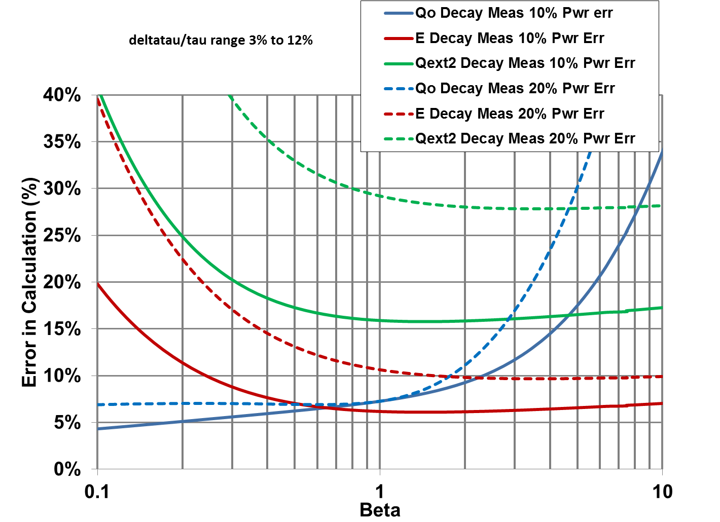
Decay With a Variable Error in Tau
For beta = 0.1 dτ/τ=3% for Beta=10 dτ/τ=12%

