Slide 1
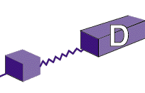
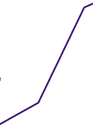
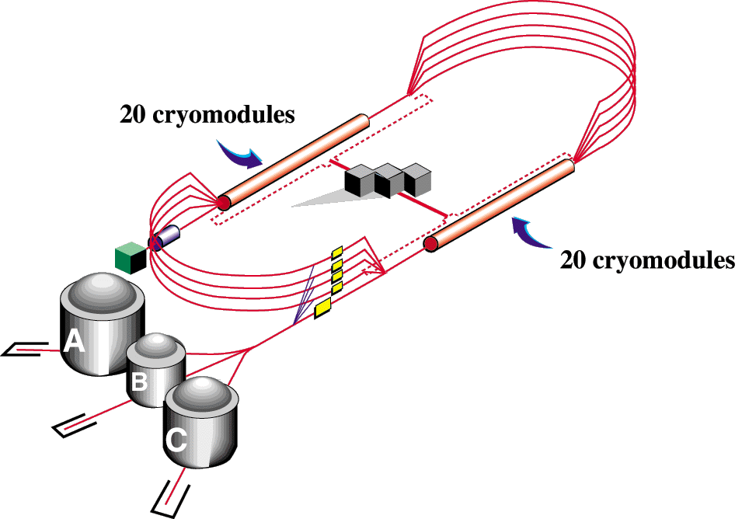
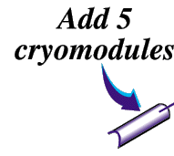

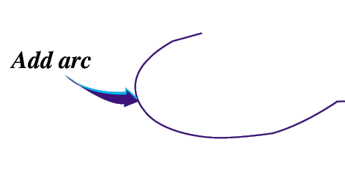

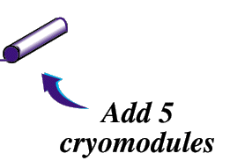
CEBAF 12 GeV Upgrade
12
11
6 GeV CEBAF
Upgrade magnets and power supplies
CHL-2
First two cryomodules - installation summer 2011
Eight more CMs in 2012

Slide 2
Key Project Parameters
New cryomodules : 10
Voltage per cryomodule: ≥ 108 MV avg.
Cavities per cryomodule: 8
Heat budget:
  @ 2.07 K ≤ 300 W / CM
  ≤ 29 W / cavity, avg.
Cavity: 1.497 GHz
0.7 m
“Low loss” cell shape
Higher order mode damping:
  Transverse (R/Q)Qk < 2.4 x 10¹⁰ Ω/m
  Longitudinal (R/Q)Q < 6.5 x 10¹¹ Ω

Slide 3
12 GeV C100 Cavity Process Flow
Inventory Receipt Visual Inspection
Heat Treatment 10 hours at 600C
Electropolish
30 microns at 20C
Ultrasonic Clean
1 hour at 120F
DI+Liquinox
RF Tune
Dimensional Check and Correction
Helium Vessel Welding
Measure RF Properties
Dimensional Receipt Inspection via CMM
RF Receipt Inspection
Ultrasonic Clean
1 hour at 120F
DI+Liquinox
Ultrasonic Clean 1 hour at 120F DI+Liquinox
Lap Vacuum Seal Surfaces
Ultrasonic Clean
1 hour 120F
DI+Liquinox
First HPR
2 hours, 2.4 gpm at 1250 psig
Final HPR
2 hours, 2.4 gpm at 1250 psig
First Assembly
Class 10
Final Assembly
Class 10
Test Stand and Leak Check
RF Test
2K Dewar Dunk
Qualified?
Bake
24 hours at 120C
Final Dimensional CMM
Store in Clean Room for String Assembly
NO
Yes

Slide 4
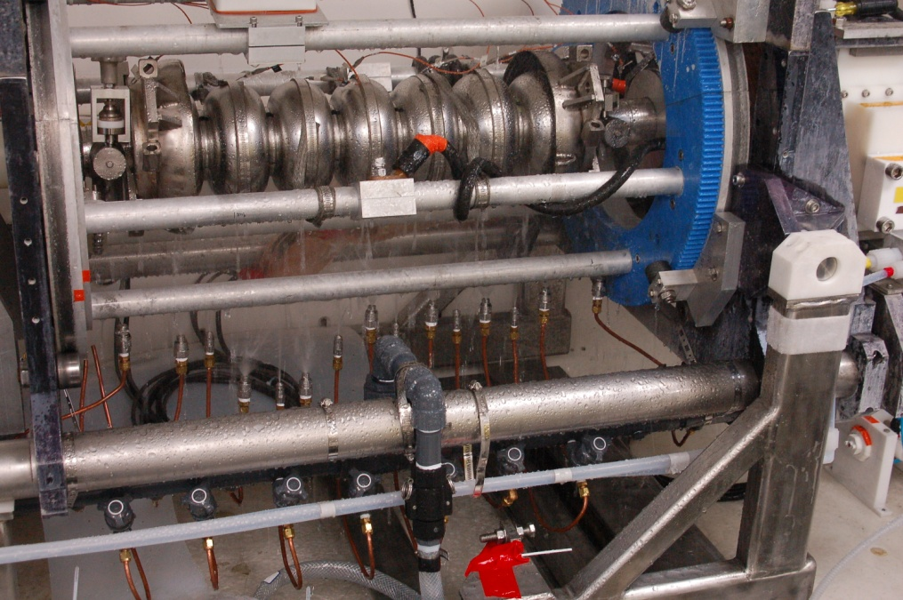
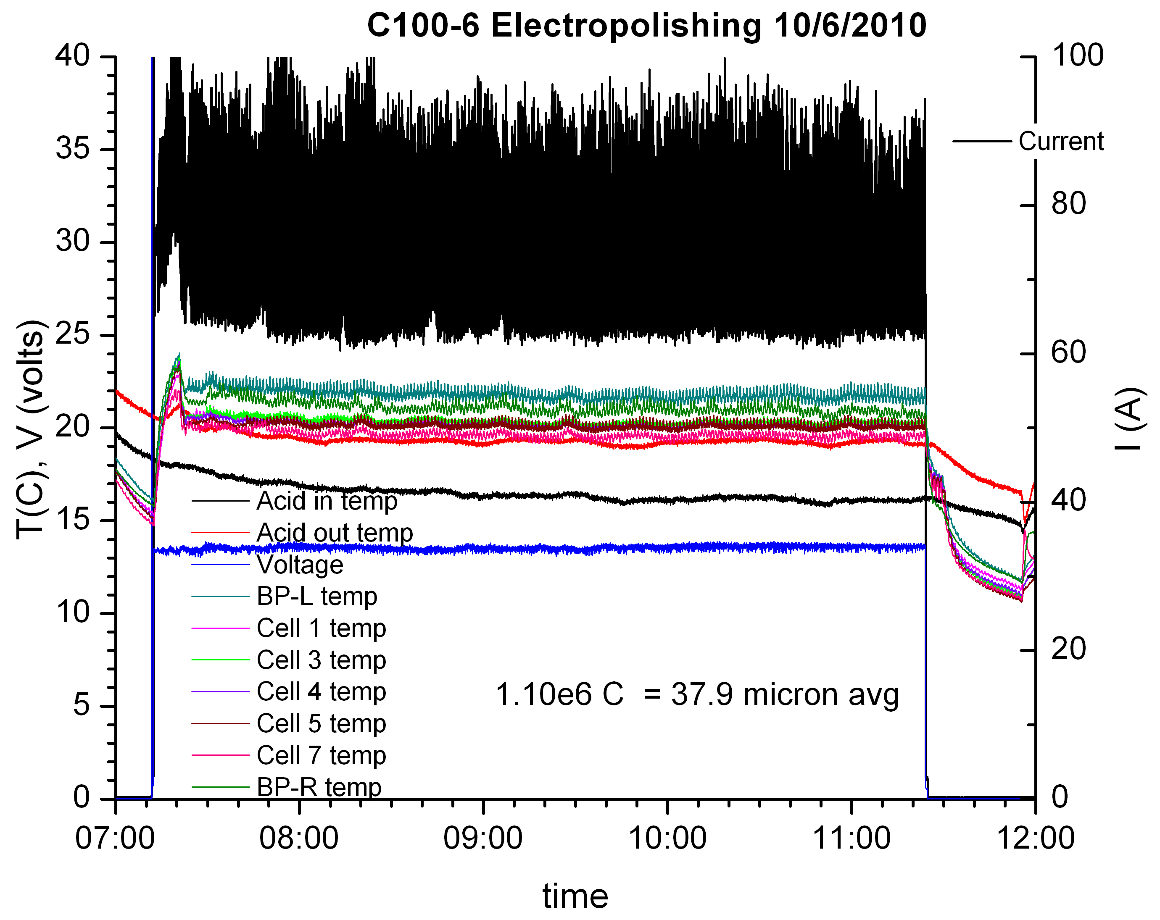
12 GeV Upgrade Cavities
Improved EP process is now standardized and controlled
Exploiting New Electrochemical Understanding of Niobium Electropolishing for Improved Performance of SRF Cavities for CEBAF
C. E. Reece and H. Tian, LINAC10 THP010

Slide 5
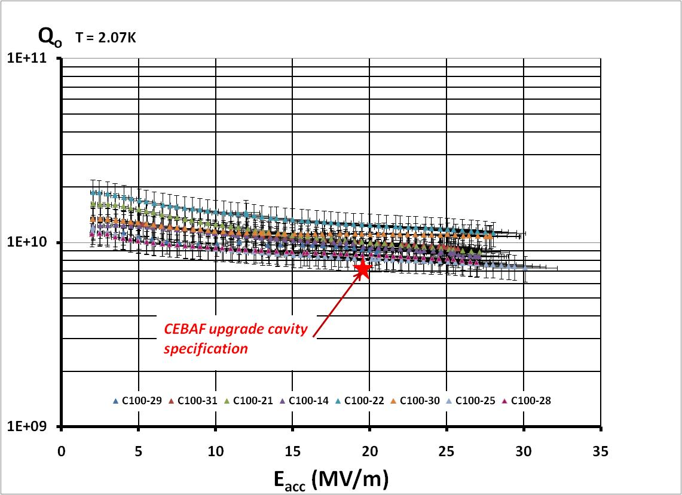
Qualified Cavities for 12 GeV Upgrade Cryomodule C100-3

Slide 6
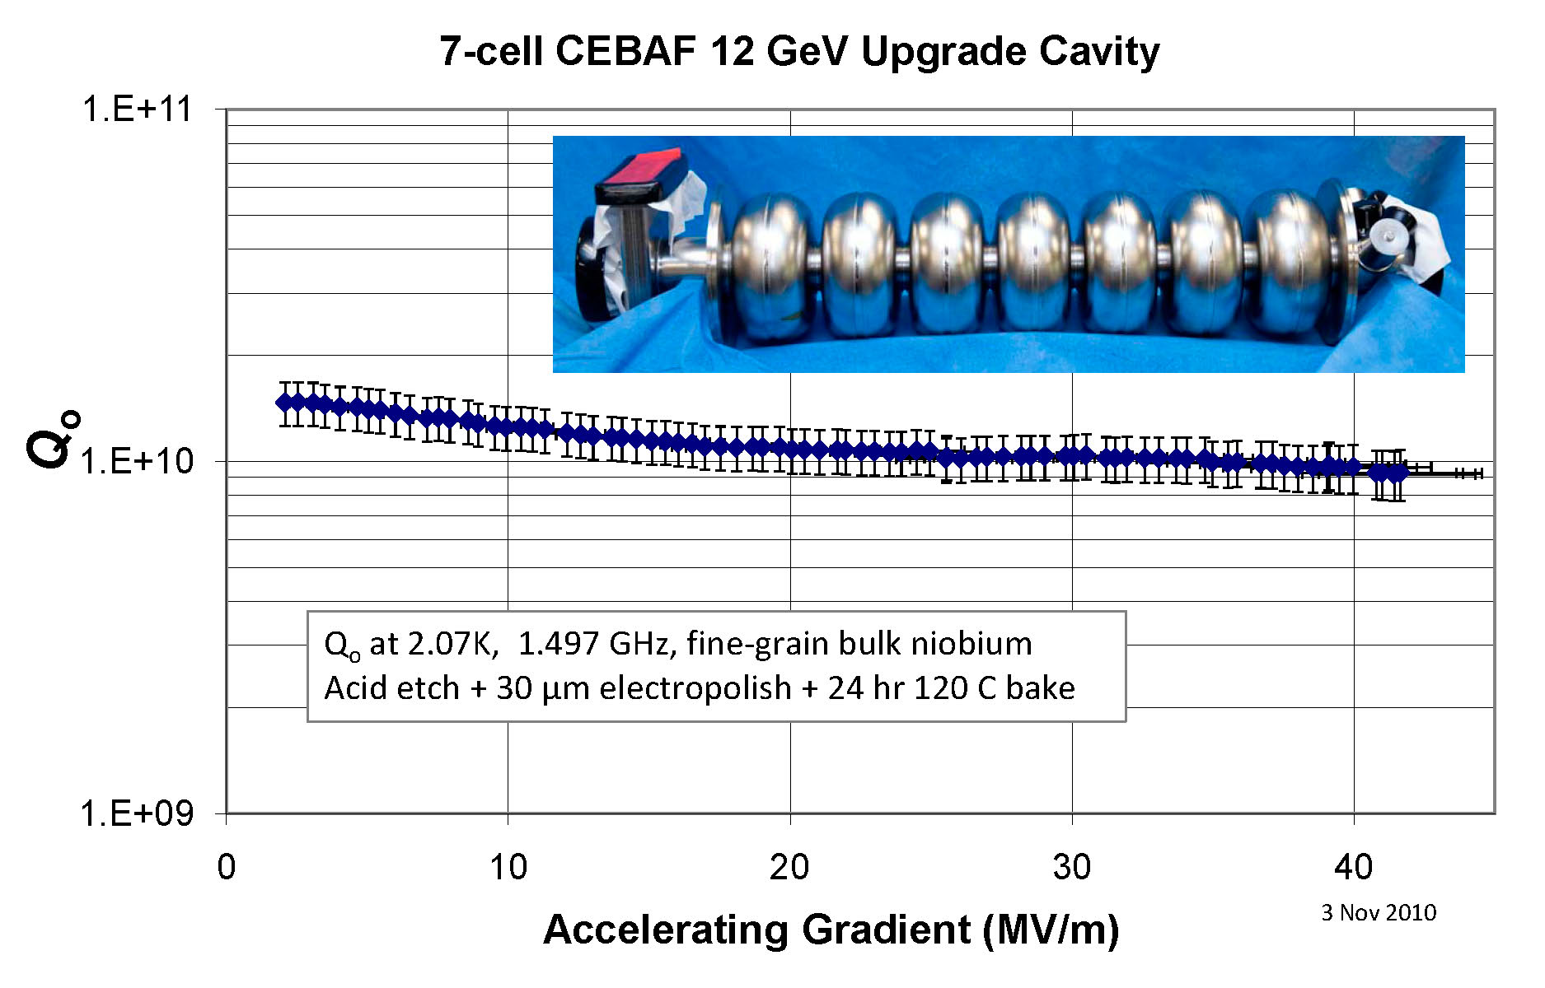
State-of-the-art production SRF cavity
Project Specification
Q is BCS-limited

Slide 7
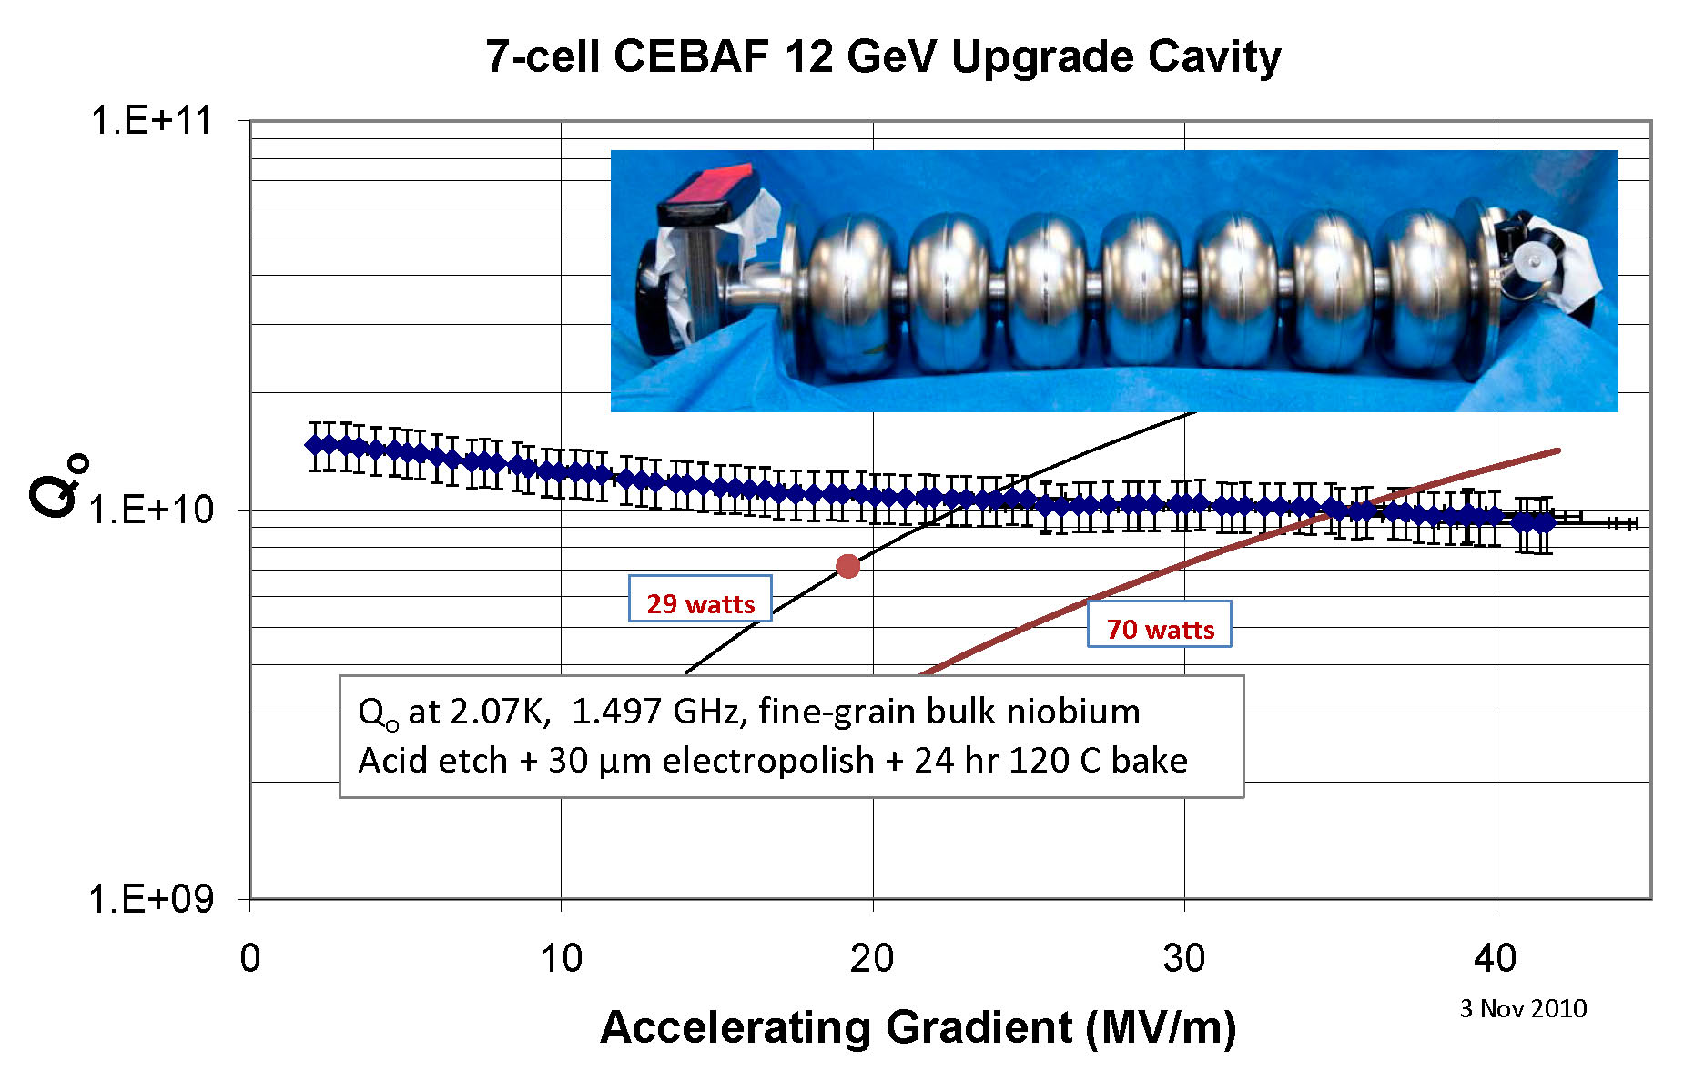
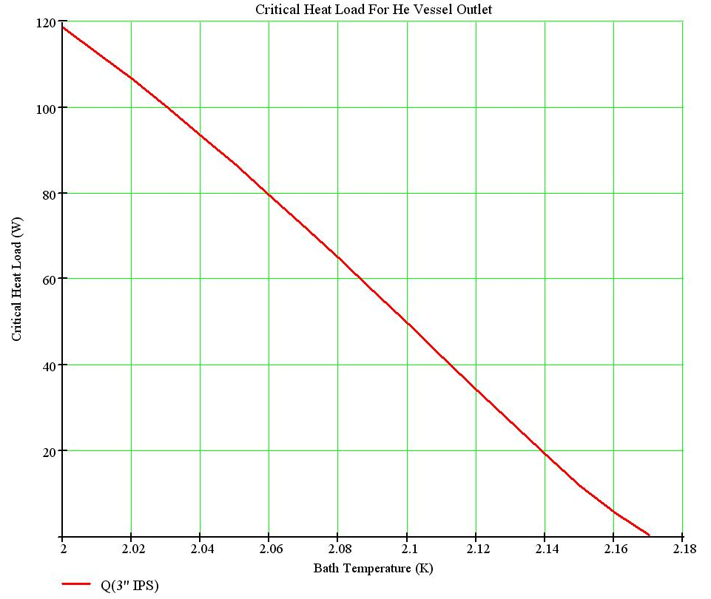
12 GeV Upgrade Cavities
Project specification: 19.2 MV/m average, with 29 W avg. heat
Operational limit in CEBAF, RF power: 25 MV/m
Project conservatism for first two CMs:
  To avoid any potential risk of degradation from “pushing,”
  Limiting vertical cavity acceptance testing to 27 MV/m
  (rather frustrating to us cavity people who look into the future)
Vertical rf test only after HV attached
  Piping size limits heat load to ~70 watts @ 2.07 K
FNAL AP&T Seminar 052411 cer

Slide 8
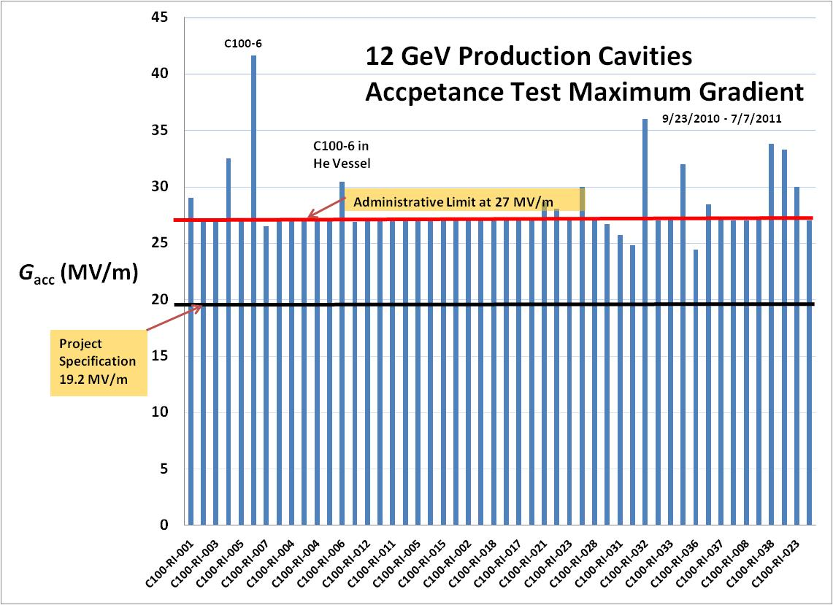
12 GeV project cavities

Slide 9
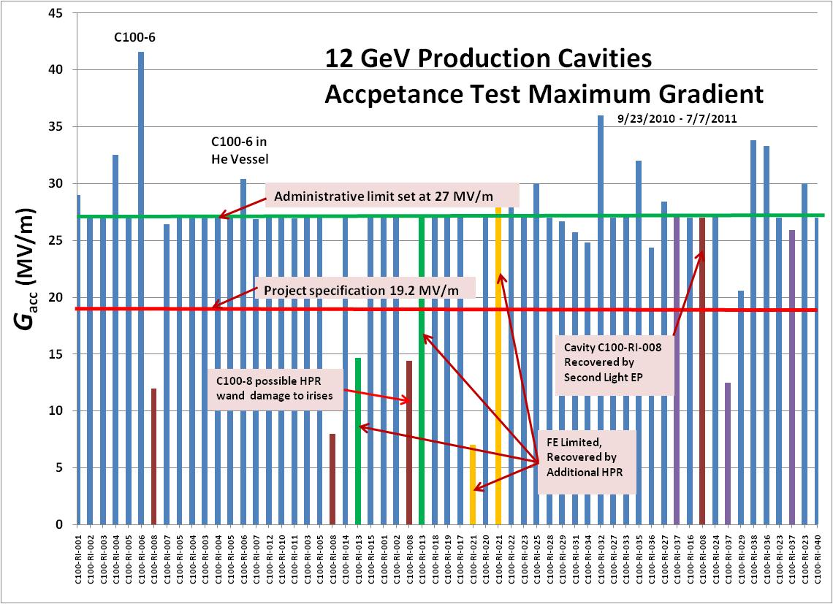
12 GeV Project Cavities

Slide 10
JLab CEBAF Upgrade Cavities - July 2011
C100 cavity – production system is running
  86/86 cavities received
  60/86 cavities EP’d (2/wk)
  40/86 cavities VTA tested
  38/86 cavities qualified in HV (1 damaged)
  32/80 cavities = 4/10 strings completed, ready for #5
  Procedure suite established and tracked
  No SRF performance issues currently open

Slide 11
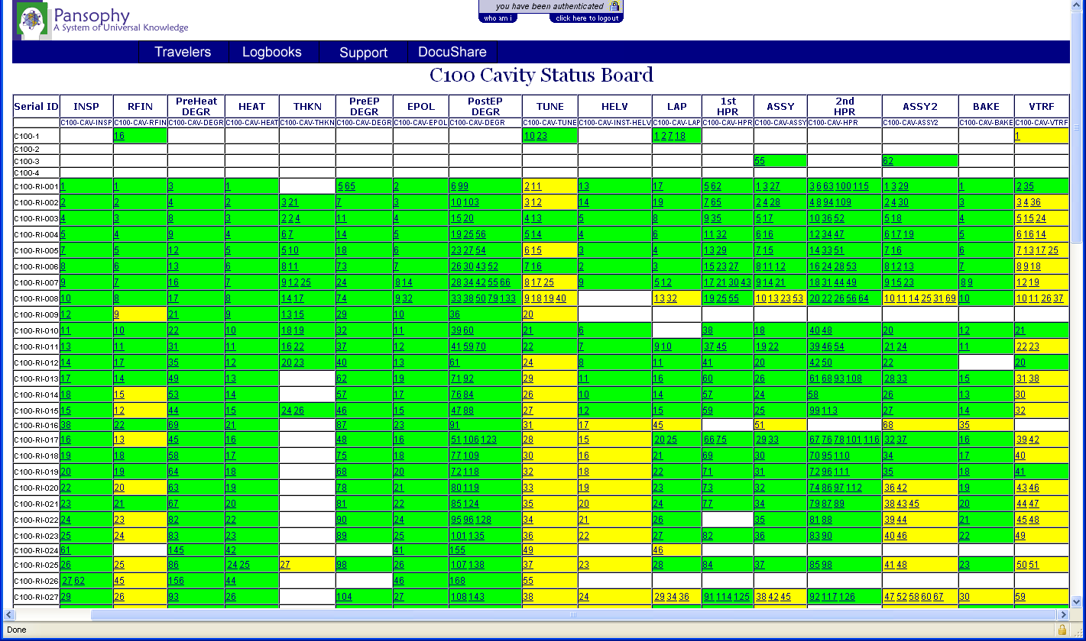
12 GeV Upgrade Cavities
Production cavity tracking screen
FNAL AP&T Seminar 052411 cer

