Slide 1
Cryomodule Acceptance Testing at Jefferson Lab
Michael Drury
Cryomodule / Cavity Test Workshop
29 – 30 October 2015

Slide 2
Outline
Acceptance Testing at Jefferson Lab
  Facilities
  Test Sequence (C100)
  Response to Problematic Performance

Slide 3
Cryomodule Test Facility
The Cryomodule Test Facility (CMTF) at Jefferson Lab has carried out at least 40 successful cryomodule tests.
  These include various CEBAF designs from C20 to C100 as well as SNS cryomodules and several HTB tests for CEBAF and LCLS II.
  Can be quickly reconfigured to test any of the CEBAF designs
  The CMTF currently consists of:
    Dedicated shielded cave with Personnel Safety System (PSS)
      Radiation shielding – 4.5 ft thick concrete walls and 3 ft. concrete roof.
      Magnetic shielding – magnetic fields in the vicinity of the cryomodule of 50 mG or less.
    Close loop 2K helium refrigerator shared with the Vertical Test Area (VTA)
      Primary circuit supply up to 7-8 g/s 2.8 Bar 4K supply for cool-down, steady state ~2-3 g/s
      50 K shield circuit, several g/s (not a limit to operations)
    2 channels of High Power RF, 12 kW each, 2 Klystrons operating in pairs deliver 12 kW per channel at 1497 MHz.
    Control Room
      Currently VXI / VME / GPIB based data acquisition and controls
      Three Windows PC’s running Labview for control and data acquisition
        Faster RF data acquisition and control
        Slower process data acquisition (liquid level, He pressure, temperatures)
        Microphonics, tuner control and characterization

Slide 4
Cryomodule Test Facility
Instrumentation includes:
Six channels RF Power Measurement
Ten Channels Portable GM tubes
Gamma / Neutron Probes (owned by Safety Group)
Several Network Analyzers
Spectrum Analyzers
Variety of Scopes, Waveform Generators, etc…
Temp Diodes, Thermocouples, Vacuum gauges, Pressure Transducers, Cameras, etc…

Slide 5
Upgrades for LCLS II – LLRF
Addition of eight digital Field Control Chassis
  Based on C100 design- modified for CMTF operation and for 1.3 GHz
  Versions of this design already in use for Horizontal Test Bed (HTB) operations at 1.3 / 1.5 GHz
New interlock chassis
New temperature monitoring chassis
New Stepper motor control chassis – cavity tuners
New Stepper motor control chassis - for LCLS II FPC
Upgrades of network hardware serving CMTF (necessary for communications with new hardware)
Communication with the new hardware will be through epics and Channel Access. Labview will still be used for some instrument communication and as a CA user interface.

Slide 6
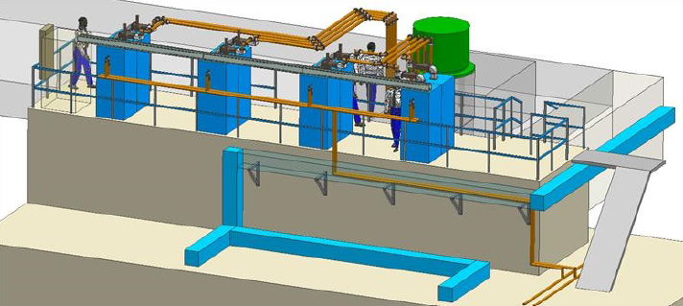
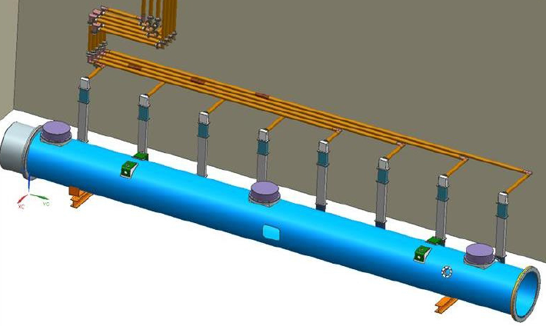
Upgrades for LCLS II-HPRF
Addition of Eight 1.3 GHz, 3.8 kW Solid State Amplifiers (to be received from SLAC)
New 1.3 GHz RF network
Electrical and LCW upgrades to support SSA’s in progress
RF routed to cryomodule through a combination of 3 1/8” coaxial hardline and WR-650 waveguide
  Hardline in process of being procured
  New 1.3 GHz isolators being procured.

Slide 7
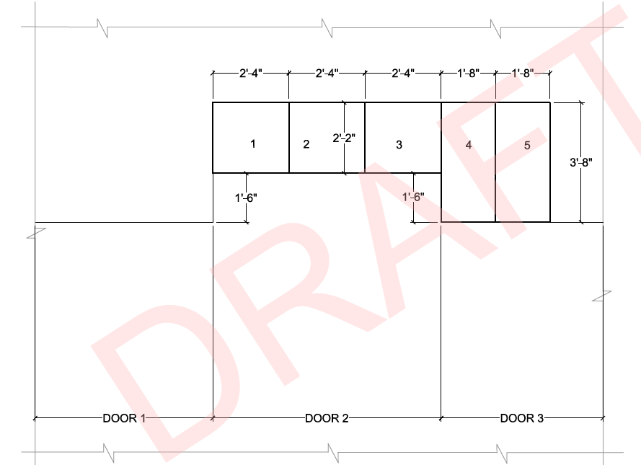
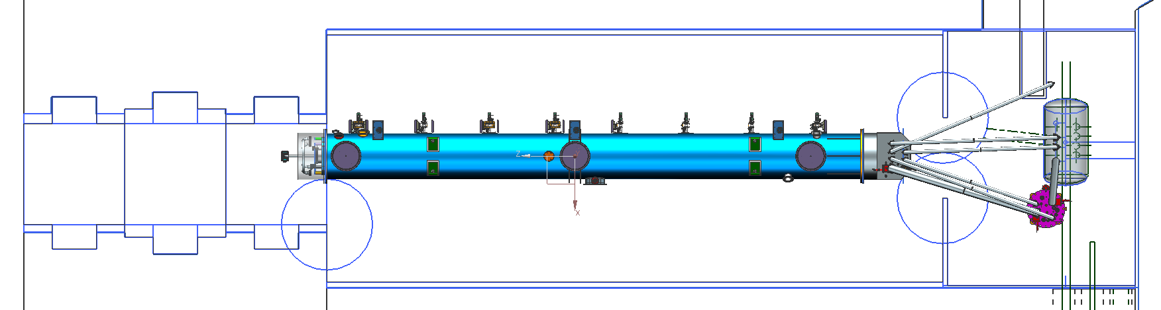
Upgrades for LCLS II-Shielding
Additional shielding blocks to be installed above the roll up doors to compensate for greater length of LCLS II

Slide 8
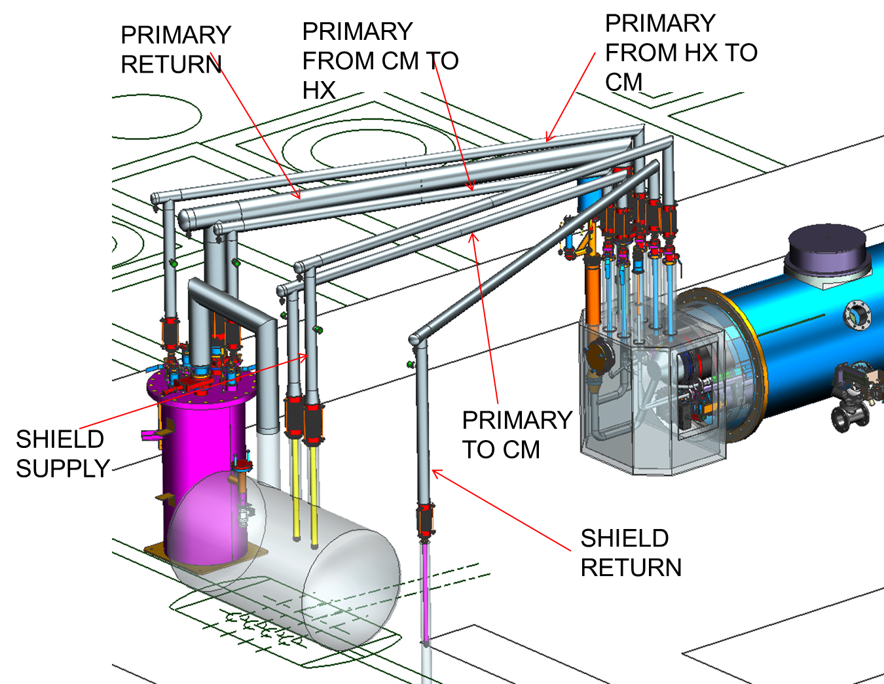
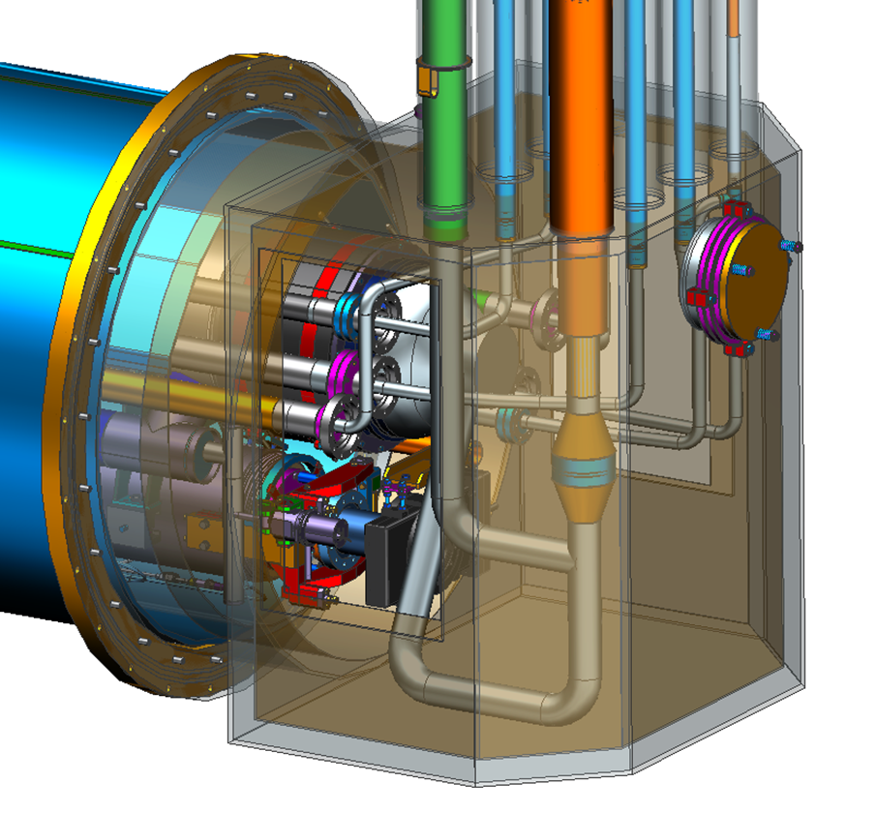
Upgrades for LCLS II – End Cans
End Cans (2 sets to support CM production rate) Design complete, in house fabrication complete for prototype cryomodule testing
  Connects CM to CTF valve box via u-tubes
  Interfaces for valves, LL and diodes to monitor and control helium flow/inventory
  Provides reliefs for primary circuit, shield circuit and insulating vacuum space

Slide 9
Acceptance Testing
Prior to Installation in the tunnel, nearly all Cryomodules undergo a comprehensive set of Acceptance tests in the Cryomodule Test Facility
Acceptance tests are meant to uncover any major problems before delivery to the linac.
  Easier to repair most problems in the Test Lab

Slide 10
Acceptance Testing
Questions to Answer:
Will the Cryomodule survive a cool down?
Does the cryomodule meet specification?
  Static Heat Loads
Do the tuners work?
  Resolution
  Range
  Hysteresis
Do the Cavities meet specification?
  Frequency
  Qext’s
  Maximum Gradient
  Qo
  Field Emission
  Higher Order Modes
Are the Cavities Controllable?
  Microphonics
  Lorentz Detuning
  Mechanical Modes

Slide 11
Testing – Typical Test Cycle (C100)
Install Cryomodule in the Cave
Prep the cryomodule for cool down and testing
Warm Frequencies – all passbands (4 - 5 shifts Install to cool down start)
Cool Down / Pump down (3 – 4 days)
Low Power RF (4 -5 shifts)
  Tuner Characterization
  Cold Tuned Frequencies / Q_{L}’s – All passbands
  Microphonics / Mechanical Modes
High Power RF (12 – 14 shifts)
  HP Checklist
  Emax Determination
  One Hour Runs
  Field Emission
  Qo vs. Eacc
  Lorentz Detuning Measurements
HOM Survey (1 - 2 shifts)
Warm up (3 days to u-tube removal)
On a two shift schedule : 17 – 22 days (production setting, no big surprises)

Slide 12
Testing – Cryomodule Prep (C100)
Install the secondary Waveguides
Clean up the helium circuits
Final leak checking
Connect and checkout all instrumentation
  Continuity checks
  TDR measurements
  Signals checked back to Labview
Connect Cryomodule to the waveguide network
Warm Frequency Measurements (all passbands)

Slide 13
Testing- Cool Down (C100)
Slow Cool Down
  Minimize mechanical stress
  Minimize impact on Vertical Test Area
  2-3 day time span
  After initial set up, process requires minimal monitoring
2K Pump down and Fill
  2- 4 hour process
  Generally handled by Cryo Group Personnel

Slide 14
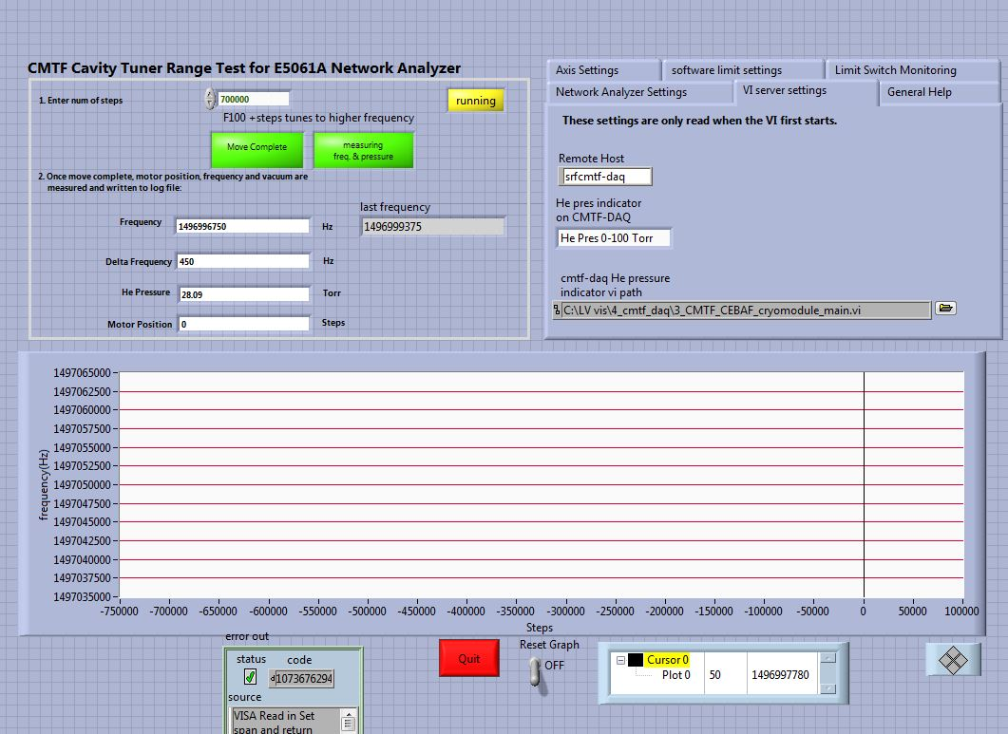
Testing – Tuner Characterization
Tuner Range / Hysteresis
Drive the Cavity with
Network Analyzer or
VCO / SEL and 1W amp
Automated by Labview
Controls motor drive
Talks to Analyzer or Freq Counter
Data Captured by Labview:
Initial Cold Frequencies
Tuner Steps
Frequency
He Pressure

Slide 15
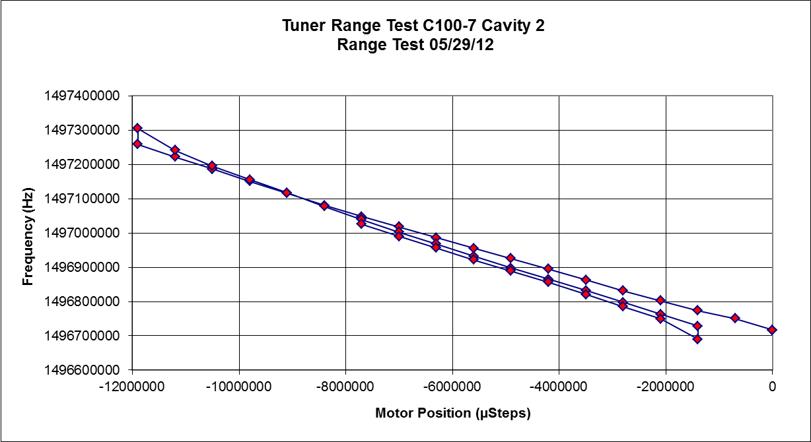
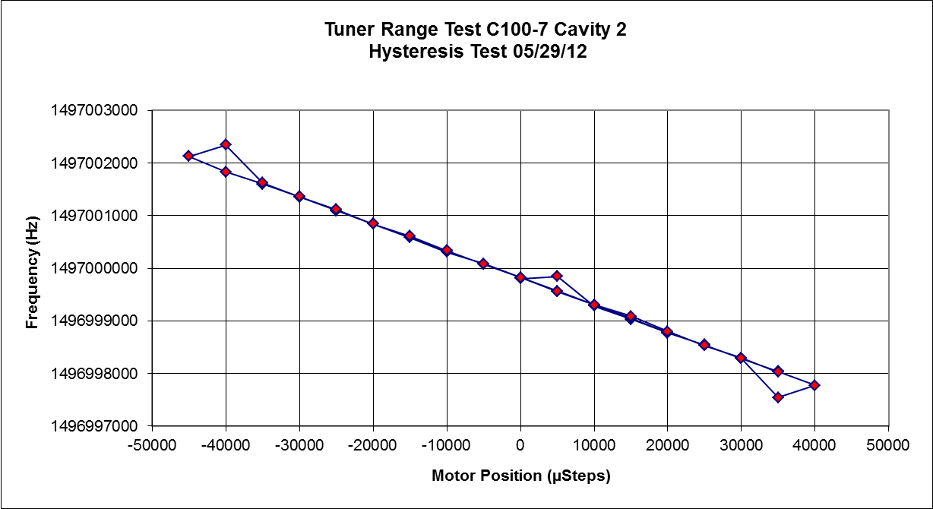
Testing – Tuner Characterization
Tuner Range / Hysteresis
Full tuner range
4 kHz loop for hysteresis measurement
Similar set up used for piezo tuner tests
LabView creates text files
Graphed in Excel

Slide 16
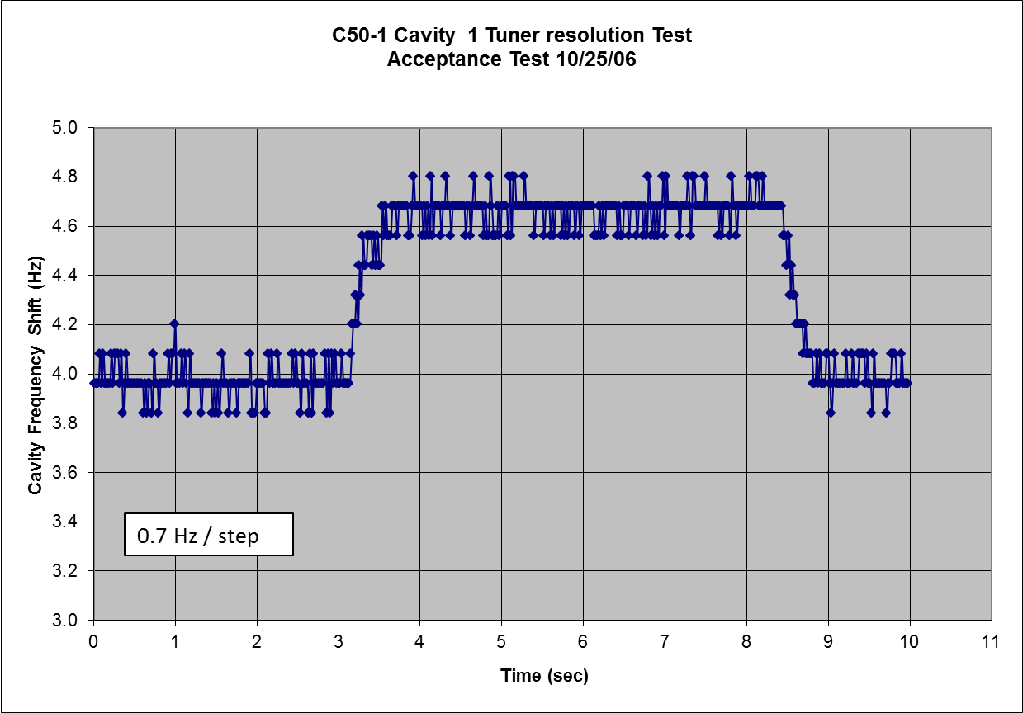
Testing - Tuner Characterization
Tuner Resolution
Drive the Cavity with
VCO / SEL and 1W amp
Storage Scope
Cavity Resonance Monitor (CRM)
Labview
Controls motor drive
Captures data
Similar setup for piezo tuners
Acceptance Criteria
Resolution 2 Hz Max

Slide 17
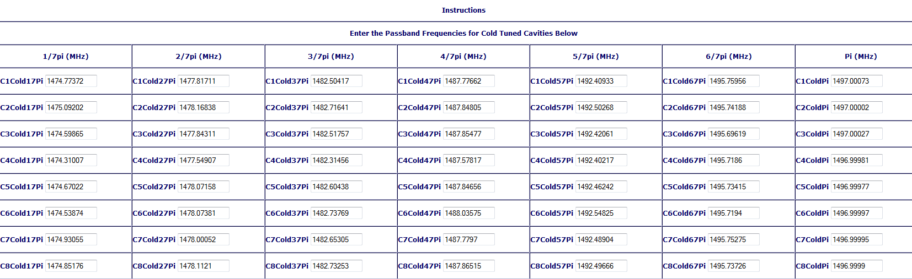
Testing – Frequency Measurements
Network Analyzer and a couple of external amplifiers
Pansophy data capture

Slide 18
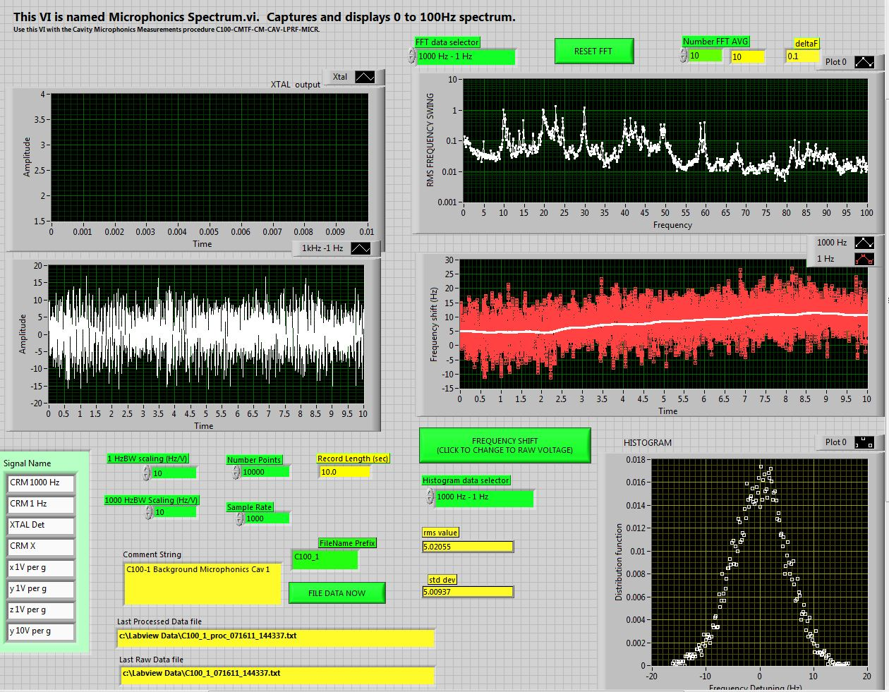
Testing-Microphonics
Drive the Cavity with
VCO / SEL and 1W amp
Storage Scope
Cavity Resonance Monitor (
Labview Captures data
Acceptance Criteria:
25 Hz Peak Detuning
Note: New llrf for LCLS II removes the need for scopes and CRM’s

Slide 19
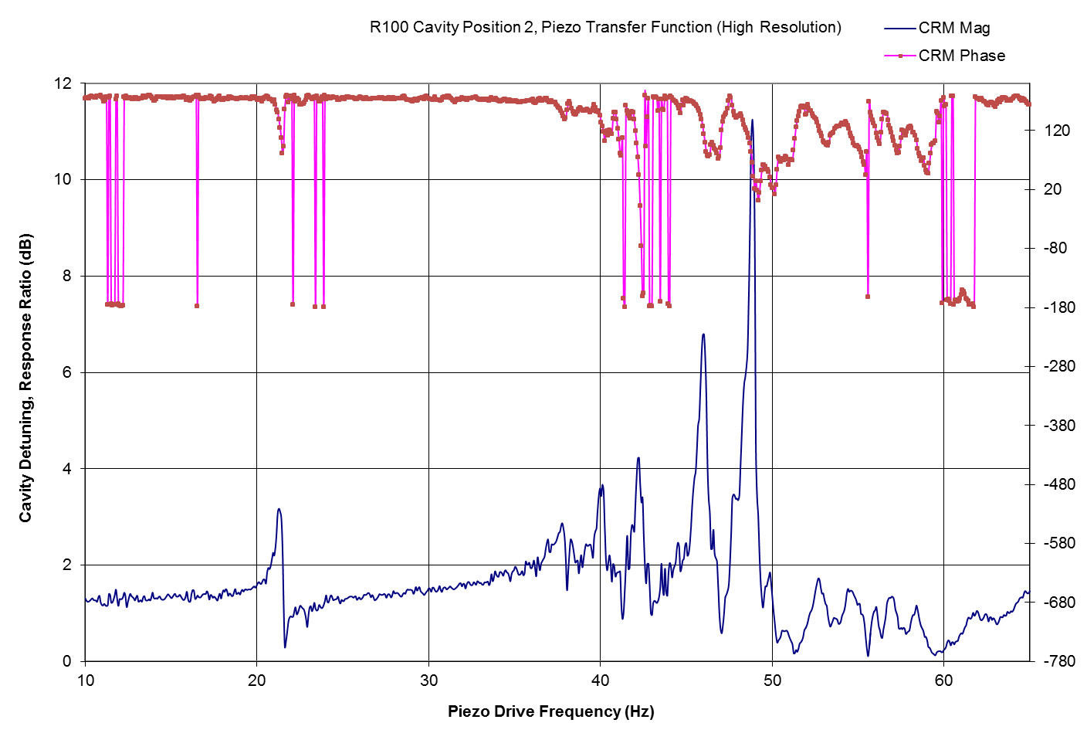
Testing-Piezo Transfer Function
Drive the Cavity with
VCO / SEL and 1W amp
Storage Scope
Cavity Resonance Monitor
Labview Captures data
Similar Setups for
Tuner Resolution
Microphonics
Piezo transfer function
Tests can also be accomplished at High Power

Slide 20
Testing – High Power Checklist
Complete RF Cable Calibrations
Inspect all Waveguide flange connections
Inspect all RF cable connections
Check placement of GM tubes
Machine Protection Interlock Check
Personal Safety System Functional Check

Slide 21
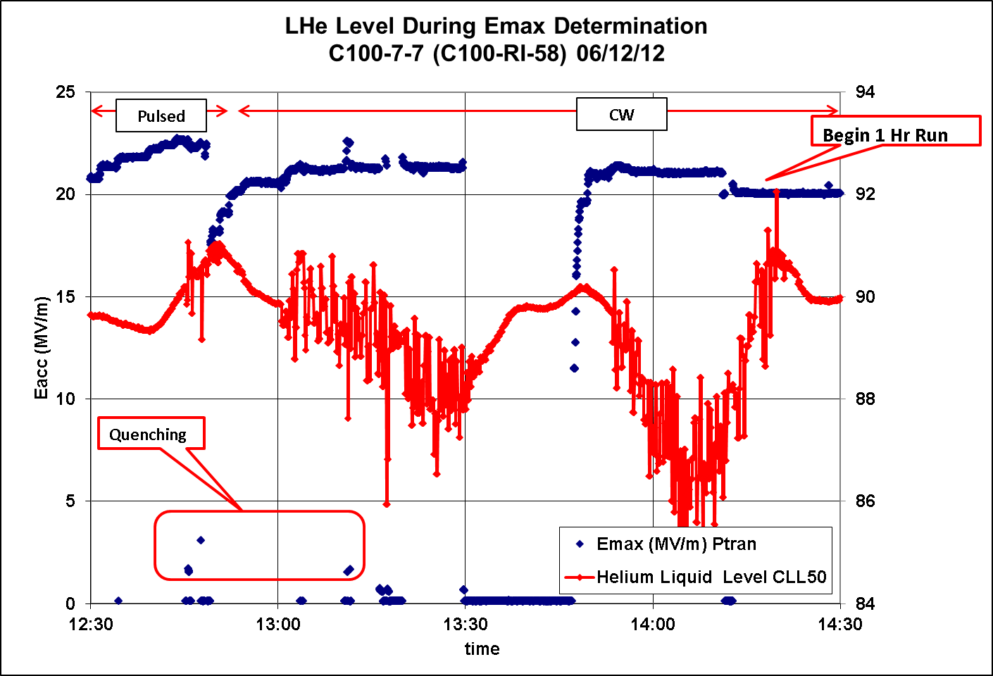
Testing – Emax Determination and One Hour Run
Calibrate the Gradient
  Measure QL, QextFP, Qext HOM’s
Increase Gradient in small steps
  Find the limit using Pulsed RF
  Check the limit – CW RF (Emax - Maximum Achievable Gradient)
  Verify that cavity is not heat load limited
One Hour run to test for stable operation (Emaxop - Maximum Stable Gradient)
  On average, Emaxop < Emax by ~ 1 MV/m
Later on after Heat Loads are Determined, final maximum gradient is set by
  ~ 29 W Dynamic Heat Load per cavity / 232 W for the string
Pulsed mode:
Better for any processing
Faster recognition of quenches
Lower average power during quenches
Acceptance Criteria:
On average gradient must reach 19.2 MV/m per cavity
String must deliver 108 MV

Slide 22
Testing – Emax Determination
Potential Gradient Limitations (C100):
Cavity Quench
High Heat Load (for a single cavity 50 - 60 W)
Admin Limit = 25 MV/m
Vacuum Degradation – Interlocked at 1e-7 torr
Waveguide Arcs
RF Window Temperature
Admin Limit to protect cavity from high field quenches that lead to new field emitters / performance degradation.
Anything above 25 MV/m is outside the installed RF power and control range.
All installed cavities limited by either quench, heat load or admin limit.

Slide 23
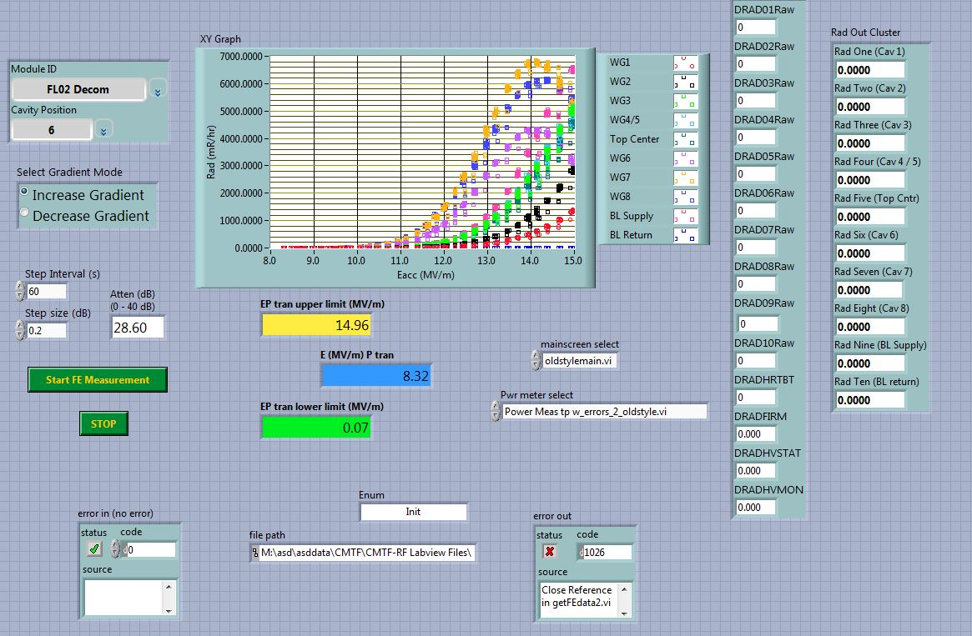
Testing – Field Emission
Generally measured after the Emax measurements
  Some processing of FE may occur during Emax Determination
No acceptance criteria for Field Emission
Automated by Labview
Steps the gradient
Captures GM tube data
Creates text file

Slide 24
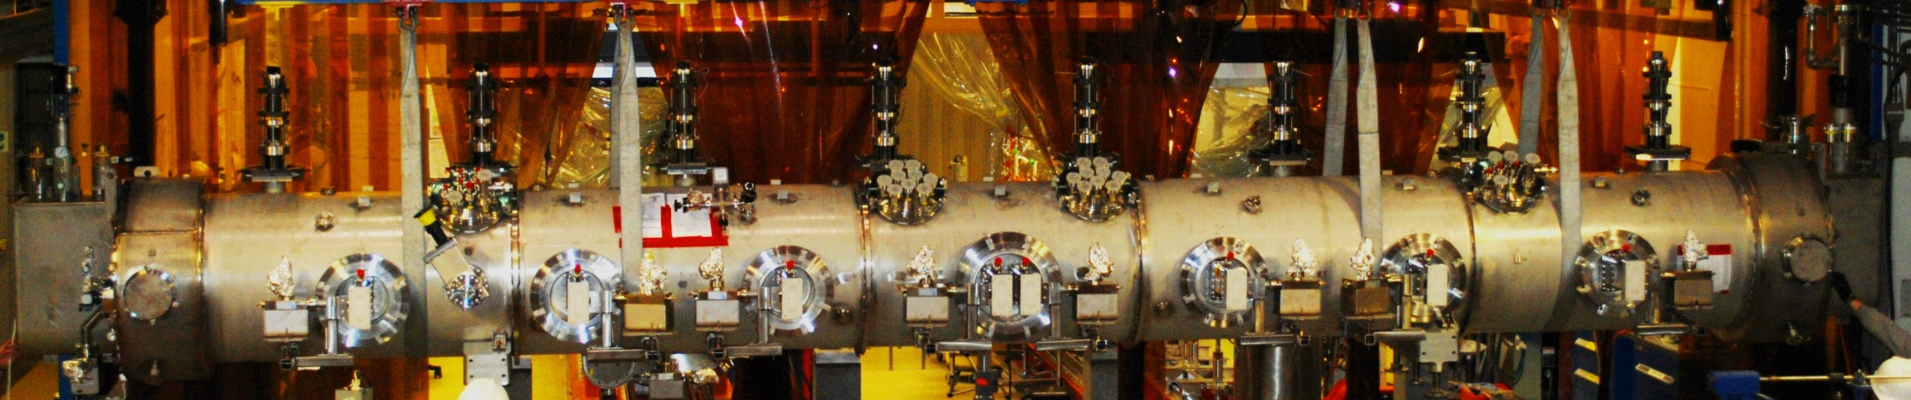
Testing – Field Emission
GM Tube Layout for FE Measurements
Ch5
Ch6
Ch7
Ch8
Ch10
Ch9
Ch1
Ch2
Ch3
Ch4

Slide 25
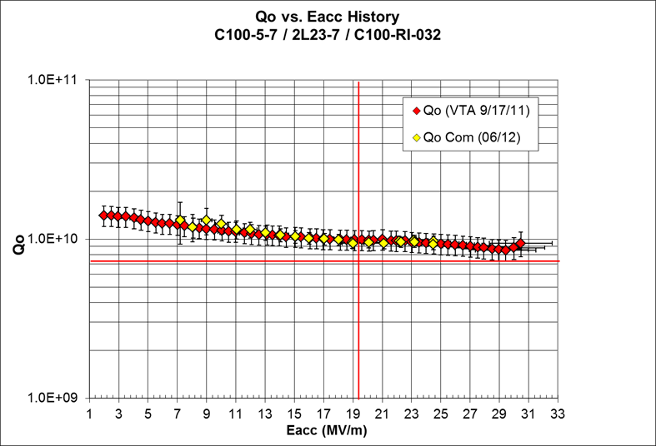
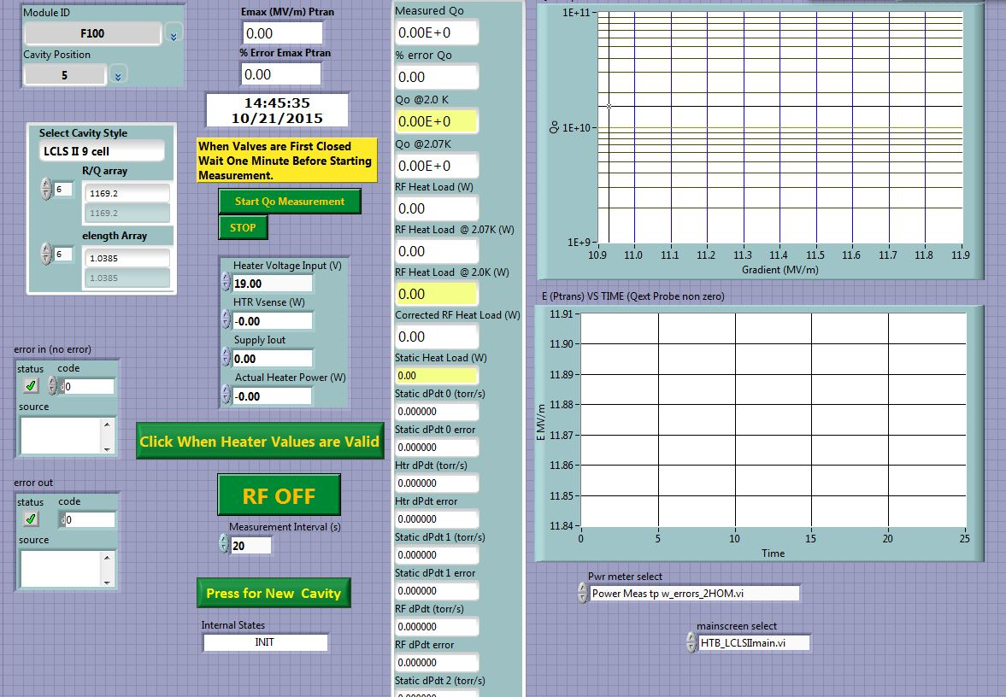
Testing - Qo
Acceptance Criteria:
Qo = 7.2e9 (on Average) at 19.2 MV/m and 2.07 K
Total Dynamic Heat Load per module < 240 W
Calorimetric Method
Automated by Labview:
  Controls RF, Heaters
  Collects Pressure data
Calculates and records Qo’s and heat loads
This measurement cycle also delivers
  Primary circuit static heat load
  Pressure Sensitivity (Hz / torr)
5 minutes per measurement –
3 shifts to complete a cryomodule

Slide 26
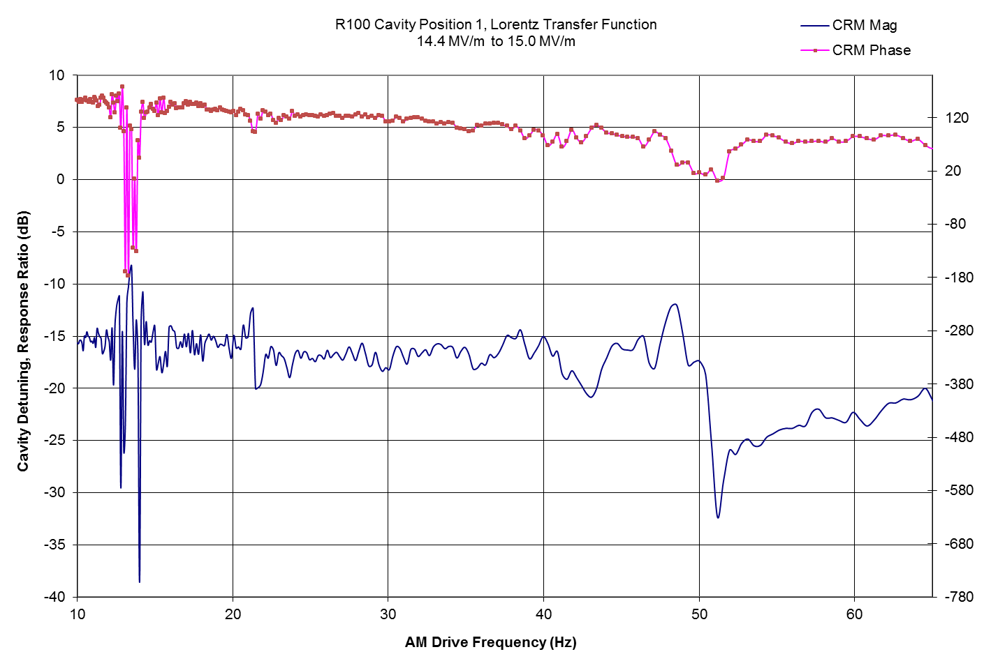
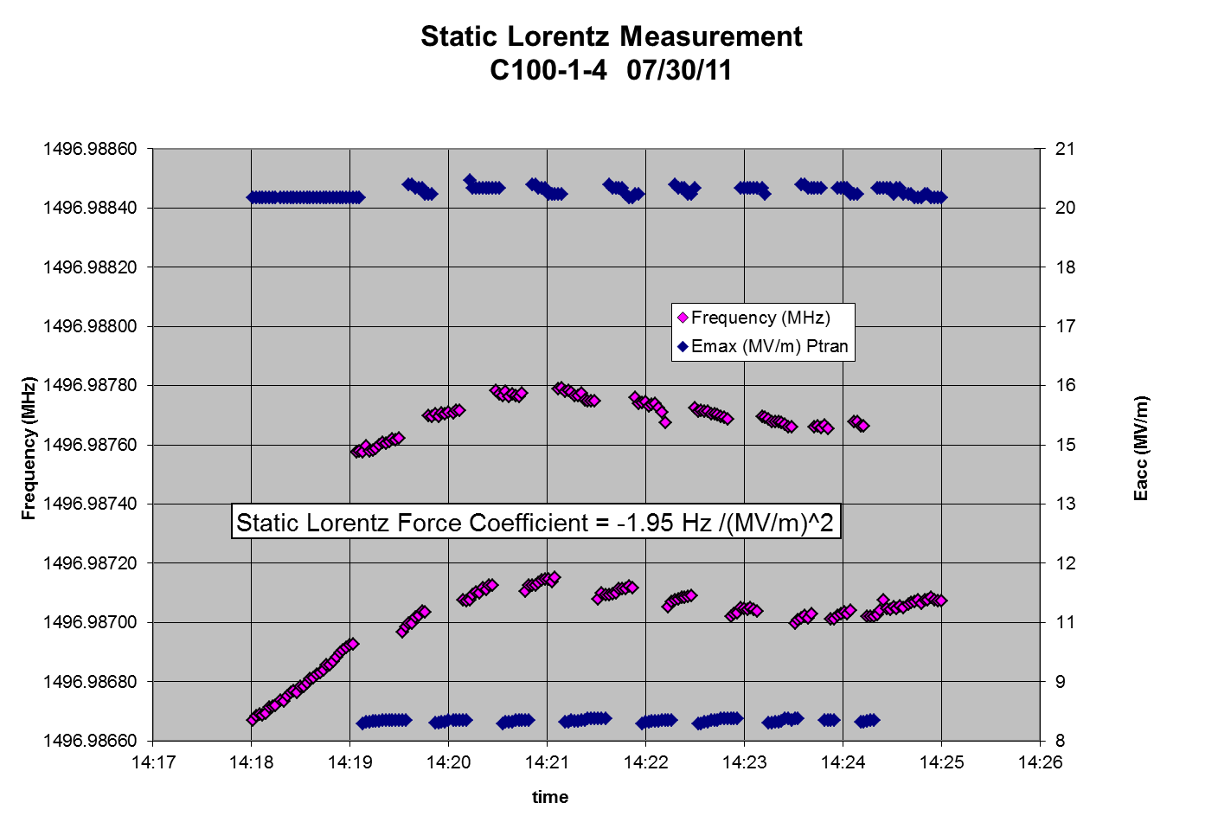
Testing – Lorentz Detuning
Static or Swept sine AM Transfer Function
Similar to microphonics test set up
DSO
Cavity Resonance Monitor

Slide 27
Warm up
Detune Cavities (to original untuned positions)
Close JT valve
Turn on Heaters
Three days to warm up before U-tube removal
One to two more shifts to completely disconnect and remove the cryomodule from the Cave

Slide 28
Responses to Poor Acceptance Performance
Microphonics – early cryomodules
  Higher than expected detuning response
  High Pressure Sensitivity
  High Lorentz Detuning
C100-4 – BL Vacuum Compromised during Assembly
  Poor Cavity Performance
    Most Cavities Fail to meet Gradient and Qo Criteria.
    High FE, Low Onsets

Slide 29
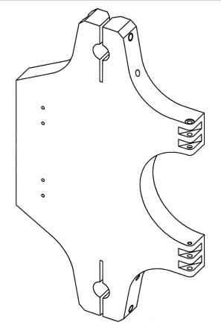
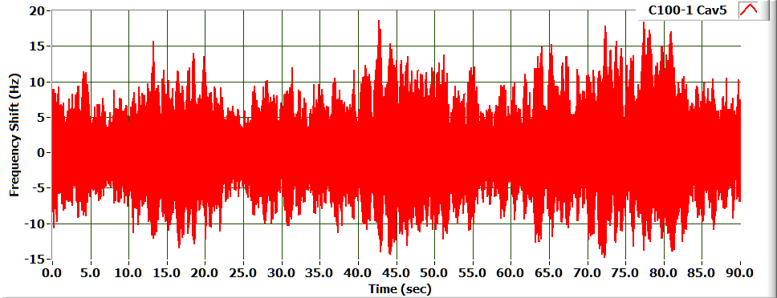
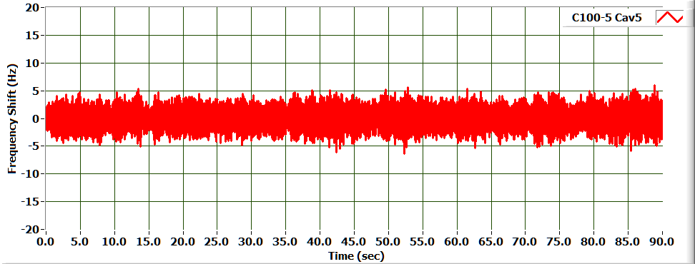
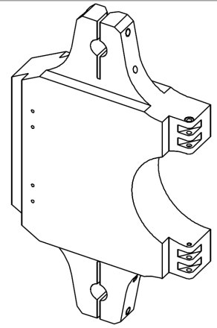
Poor Performance - Microphonics
Microphonic Detuning* | C100-1 | C100-4
RMS (Hz) | 2.985 | 1.524
6σ(Hz) | 17.91 | 9.14
Design allows for 25 Hz Peak Detuning
Actual peak detuning (21 Hz) was higher than expected in first cryomodules
A detailed vibration study initiated
Led to tuner design change
Cavity C100-1-5
A minor change to the tuner pivot plate substantially improved the microphonics for the CEBAF C100 Cryomodules (C100-4 – C100-10).
Also improved pressure sensitivity and Lorentz detuning
Cavity C100-5-5
Notes:
How one determines klystron margin in lightly loaded cavities.
Good shot of the cavities doing their own thing. Not vector sum friendly!
Point out the stiffened tuner in C100-4 and the impact on the better microphponics.
Mechanical modes at 11, 22 and 43 Hz (check with Kirk) are seen on the graphs.

Slide 30
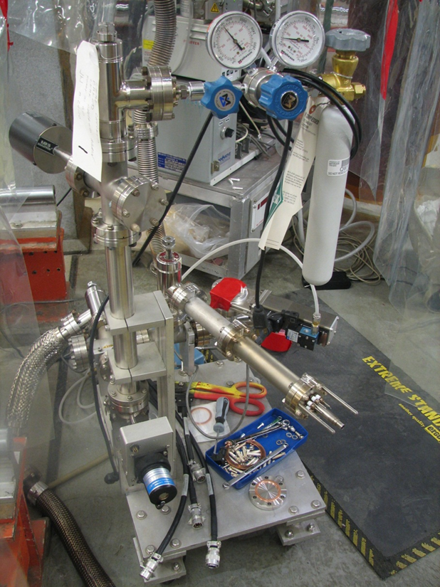
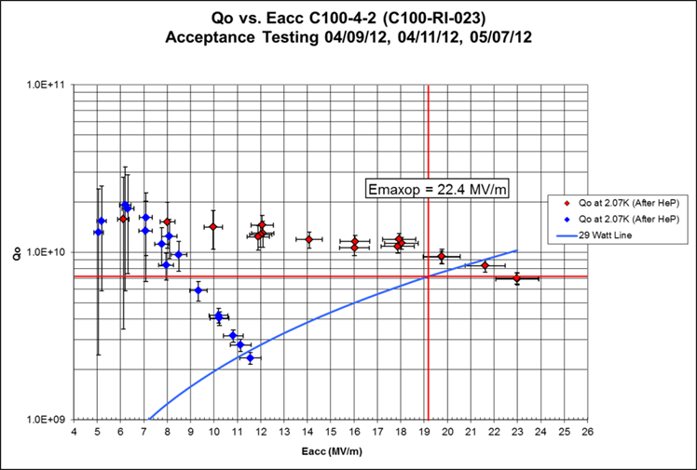
Poor Performance - C100-4
Helium Processing Used to restore cavity performance
Integrated voltage increased from 90 MV to 113 MV
Average FE onset increased from 9.3 MV/m to 13.1 MV/m

Slide 31
Testing – Final Thoughts
C100 Test Cycle described here is a good guide to what is needed for LCLS II.
Major differences for LCLS II:
  Coaxial Couplers
  Magnet package
  Eight Cavity Run capability
After prototype and first few production tests - move to a more compact test plan:
  Tuners
  Microphonics
  Cavity / String Performance

Slide 32
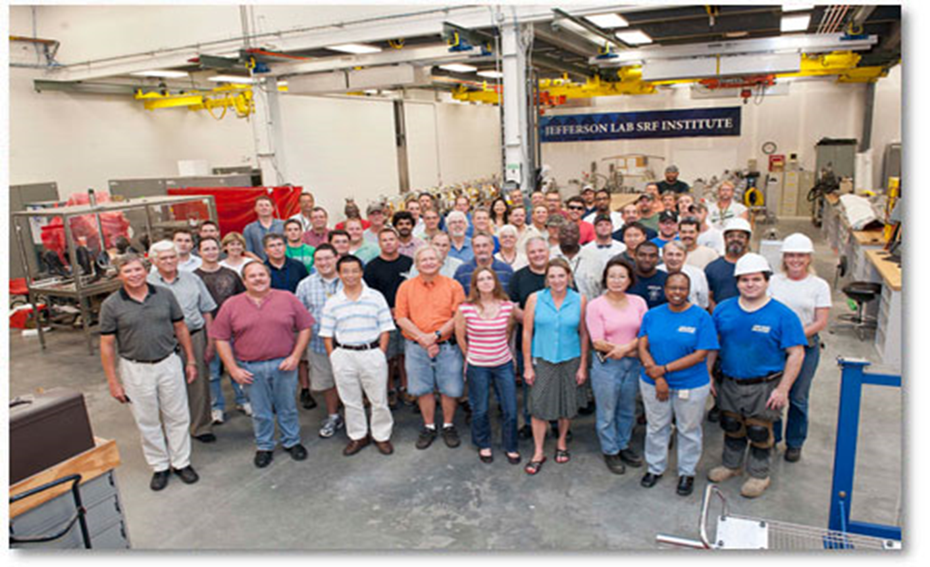
Acknowledgements
Thanks to the conveners for the invitation
Thanks to the folks at SRF for helping me put this together
Thanks to the C100 Team!

Slide 33
Extra stuff

Slide 34
Extra stuff

Slide 35
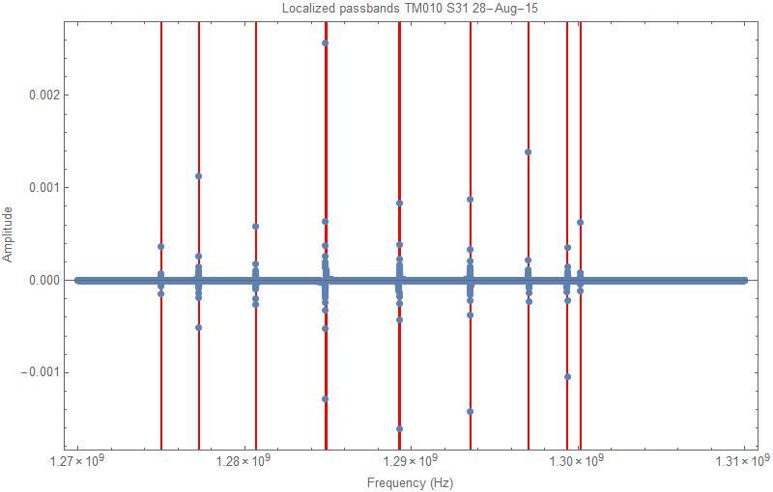
Extra stuff
Pi mode | Frequency (MHz) | Qloaded
π/9 | 1274.98 | 1.28E+07
2π/9 | 1277.23 | 1.43E+07
3π/9 | 1280.666 | 8.14E+06
4π/9 | 1284.844 | 6.52E+06
5π/9 | 1289.276 | 5.06E+06
6π/9 | 1293.536 | 4.76E+06
7π/9 | 1297.036 | 4.21E+06
8π/9 | 1299.362 | 4.15E+06
π | 1300.152 | 5.07E+06

Slide 36
Work Control - Travelers
Acceptance Testing Travelers
Three travelers govern Acceptance Testing
  Cryocycle Traveler
    Covers Cryomodule Prep, Cool down and Warm up
  Low Power RF Traveler
    Covers Tuner work,
    frequency / passband measurements,
    Microphonics
    HOM surveys
  High Power RF Traveler
    Covers High Power Checklist,
    Emax,
    Qo,
    Lorentz detuning measurements

Slide 37
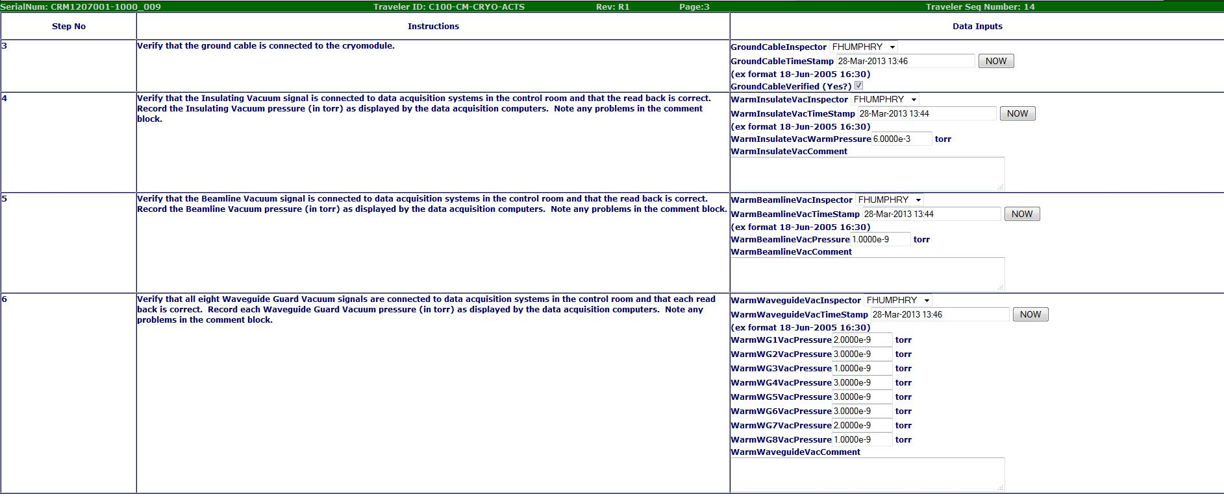
Work Control - Travelers
Cryo Traveler – Module Prep

Slide 38
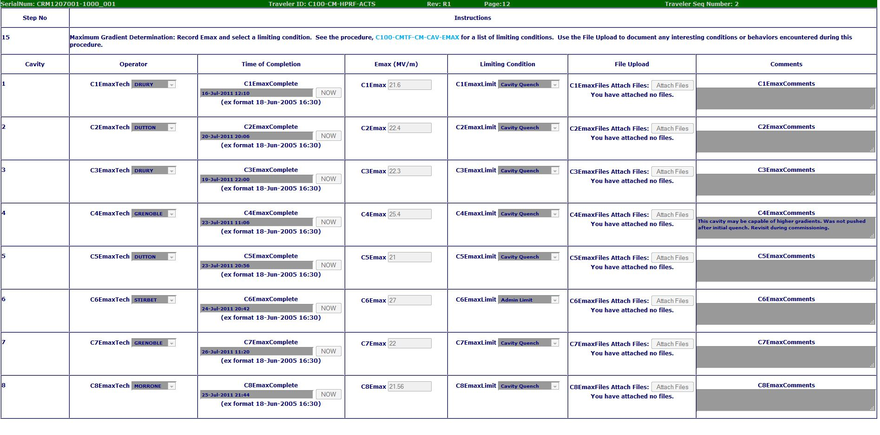
Work Control - Travelers
HPRF Traveler – Emax Data Capture

