Slide 1
Vertical Test Discussion
AG-TP
Cavity and CM Test Workshop
Oct 29th-30th, 2015

Slide 2
Cavity acceptance criteria
What range of Q0 for qualification?
Should we look at Rs_res, Rs_BCS for acceptance?
What minimum gradient for qualification? Do we set an admin limit? at what field?
Qext2 range? HOMs?
Are we sorting cavities for the CM?

Slide 3
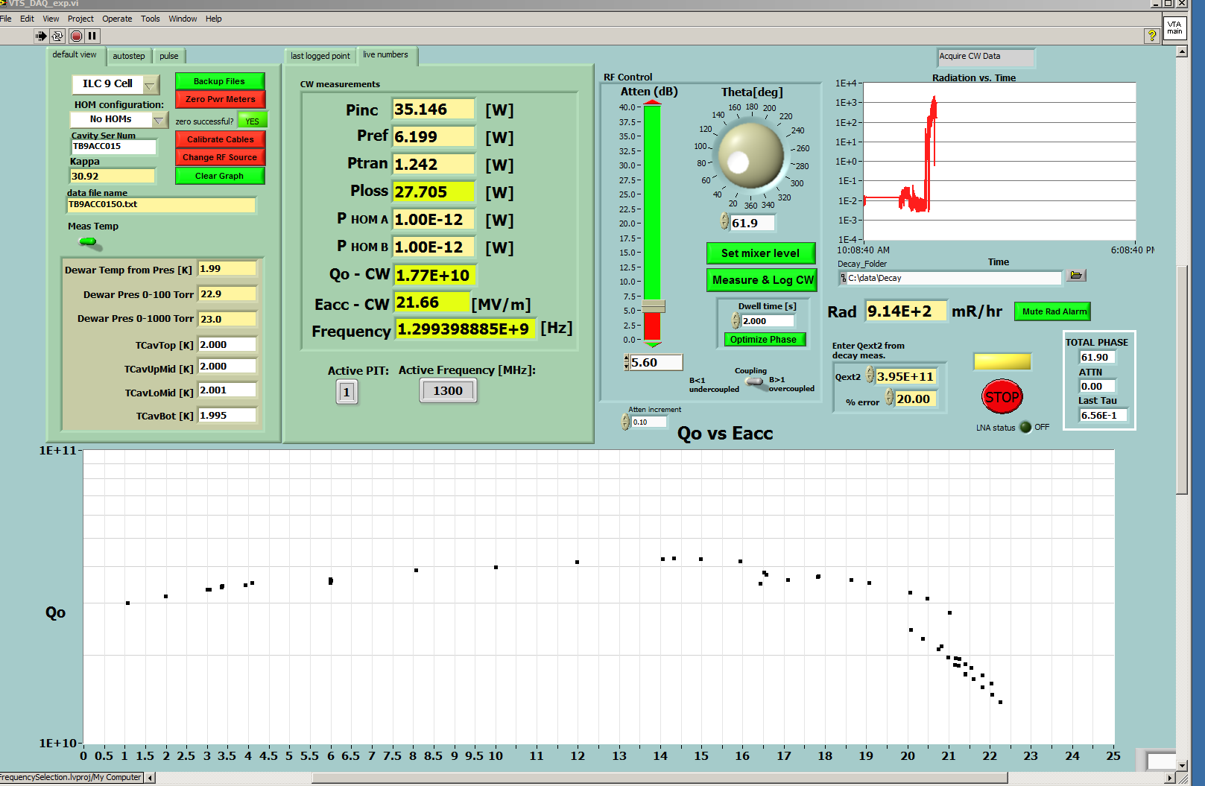
Cavity acceptance criteria
What FE level triggers reprocessing?

Slide 4
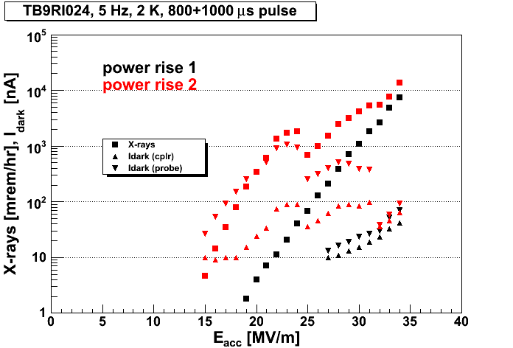
SLAC LCLS-II parameter speficies 700 pA both direction for individual cavity
HTS:
8 mrem/h per nA - 20 mrem/h per nA
VTS: add factor 10 for radiation detector location
0.56 mrem/h per 0.7 nA - 1.4 mrem/h per 0.7nA
Data from A. Hocker

Slide 5
Cavity reprocessing
What if cavity does not meet Q or gradient? More testing to better understand reprocessing pathway?
For reprocessing, repeat HPR how many times? when to re-EP? When to do optical inspection?
If all fails, should we plan to remove vessel? At lab, or send back to vendor?

Slide 6
Question 2 – Test Procedure
Active pumping or not?
Standardizing the instrumentation - decide what, how many, locations
Field emission instrumentation: two locations (top, bottom, discuss)
Fluxgates
Temperature sensors
Cooldown procedure, acceptable mag field levels? should we use PID controller to zero the mag field during the cooldown via coils?
Conditioning procedures, administrative limits?
Q disease test – not needed?
Test at different T? only 2K? 2, 1.8, 1.5K?

