Slide 1
Production Cryomodule Testing
WG-3, Drury & Harms

Slide 2
Observations from CM talks, misc questions
R&D vs. Production mentality
Staffing
Differences from pulsed to cw
Instrumentation
Operate cavities in phase during testing – important?
Unit vs. single cavity measurements after conditioning

Slide 3
Motivation/Purpose/Acceptance Criteria
Acceptance criteria – How are tests ranked? What does Production mean?
When to reject; how long does one troubleshoot before warming up and removing?
Usable Eacc (operating vs. breakdown or administrative limit)
Onset of FE, magnitude at nominal gradient
Dark current
What is the Rework plan?
Magnetic Shielding
Q0
Rs_res,Rs_BCS (are R measurements possible on a CM?)
Coupler condition
QE range
Tuner/piezo range & resolution
Microphonics/LFDC

Slide 4
Test Procedure, etc.
What are the critical Cryogenic operating parameters and acceptable limits? How long a cold soak after cool down is needed?
What are the acceptable vacuum limits in all three circuits – beam tube, coupler, insulating. Are RGA scans needed?
What instrumentation needs to be standardized especially with respect to position relative to the cryomodule and readout (especially for Field Emission)?
Cooldown/Test procedure – how to verify flux expulsion/minimization given different test set ups
What to test – overall performance with all cavities on, and with single cavities For many couplers this will be the first operation at cold. How extensive are single cavity tests?
Ancillary systems – what and how does one measure/verify thermometry, BPM, magnet, etc?
Test Reports format and content
  Standardized test report definition
  Development and guidance for the use of CM testing Travelers

Slide 5
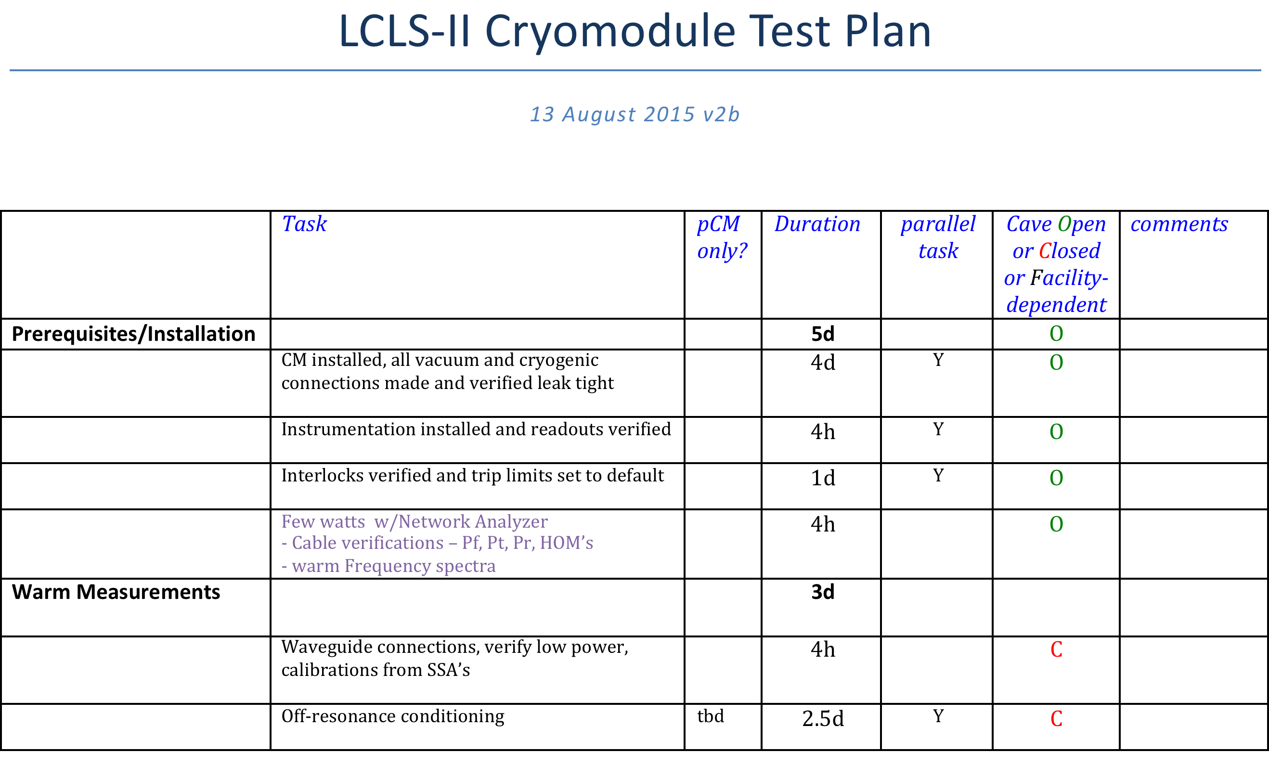
LCLS-II test program - 1

Slide 6
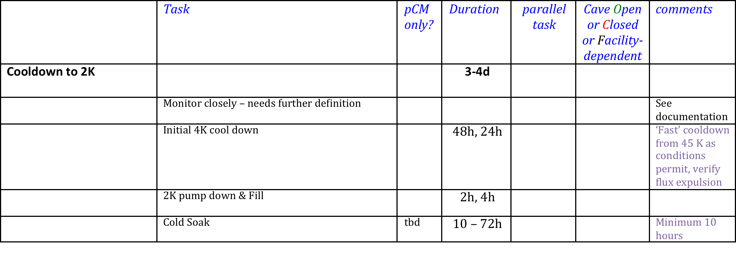
LCLS-II test program - 2

Slide 7
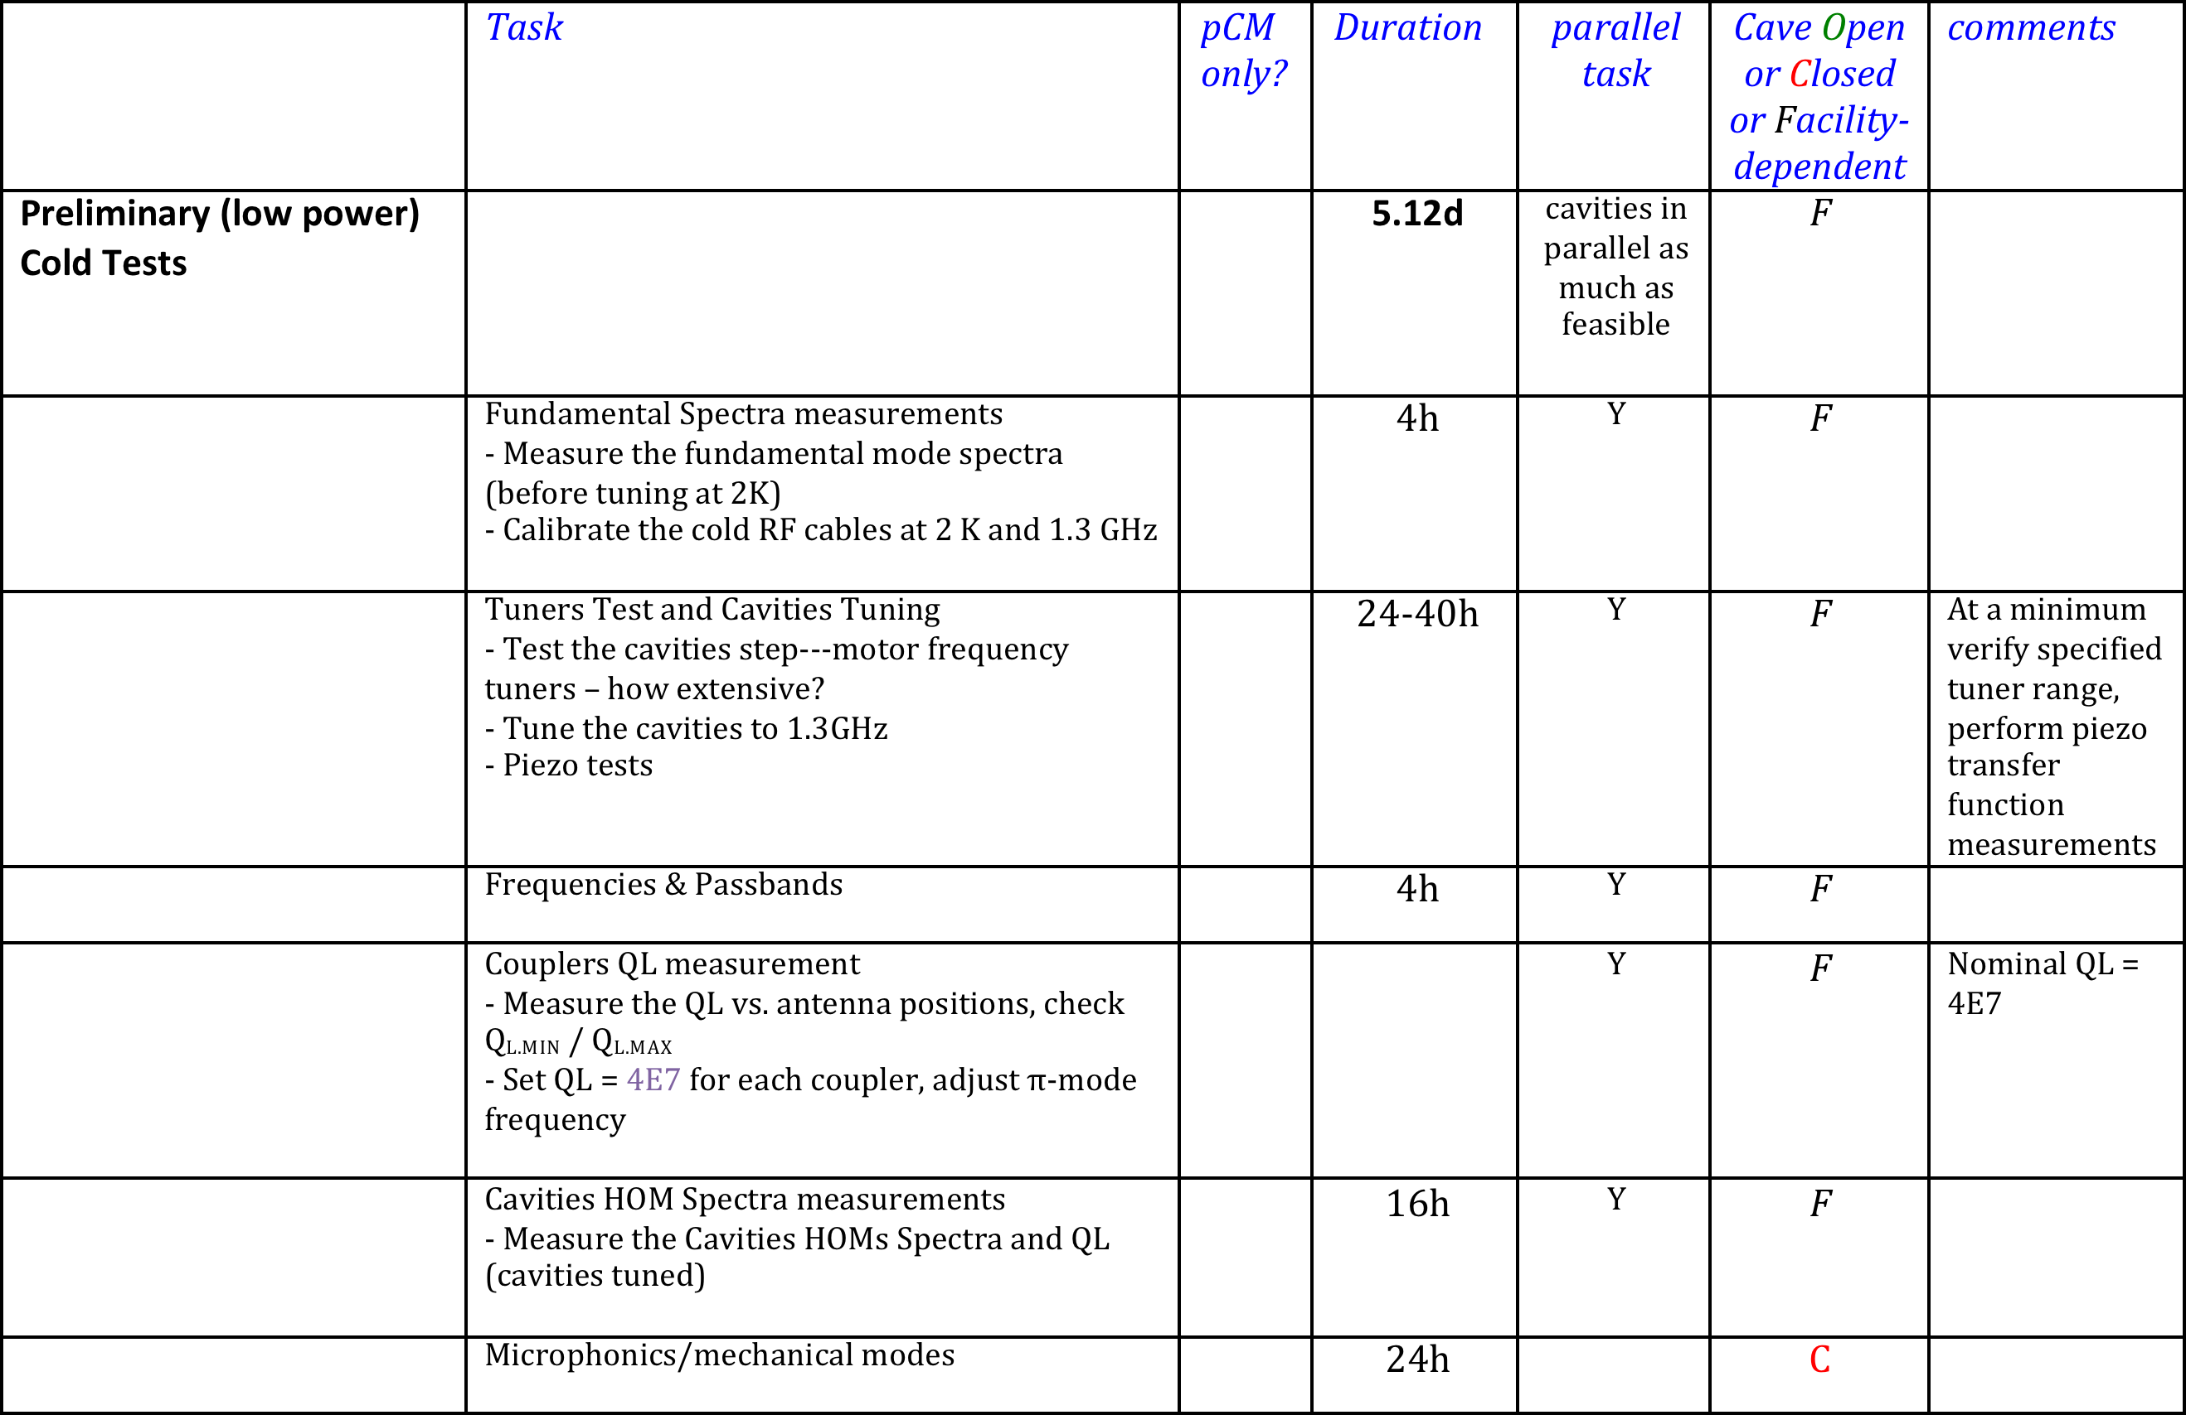
LCLS-II test program - 3

Slide 8
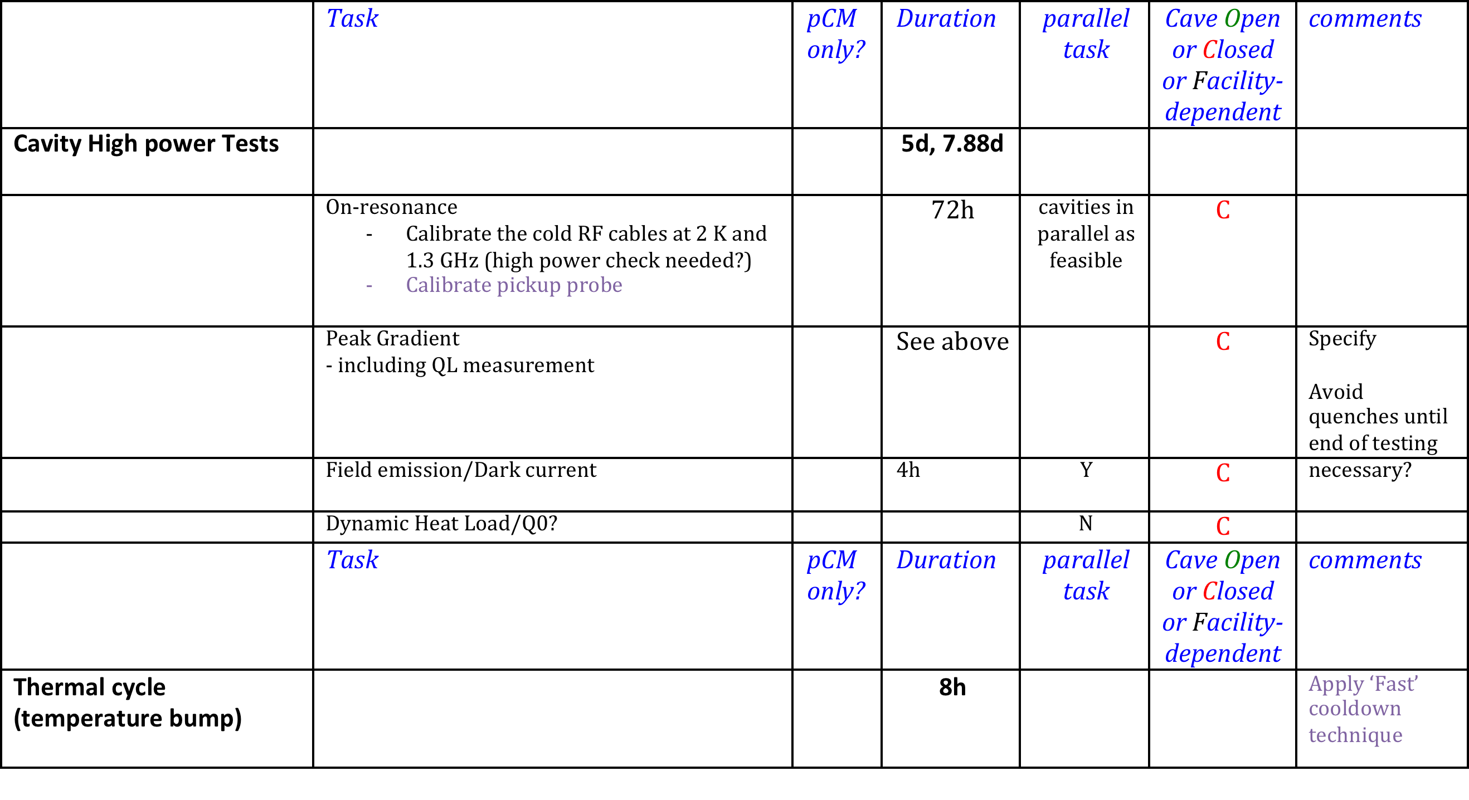
LCLS-II test program - 4

Slide 9
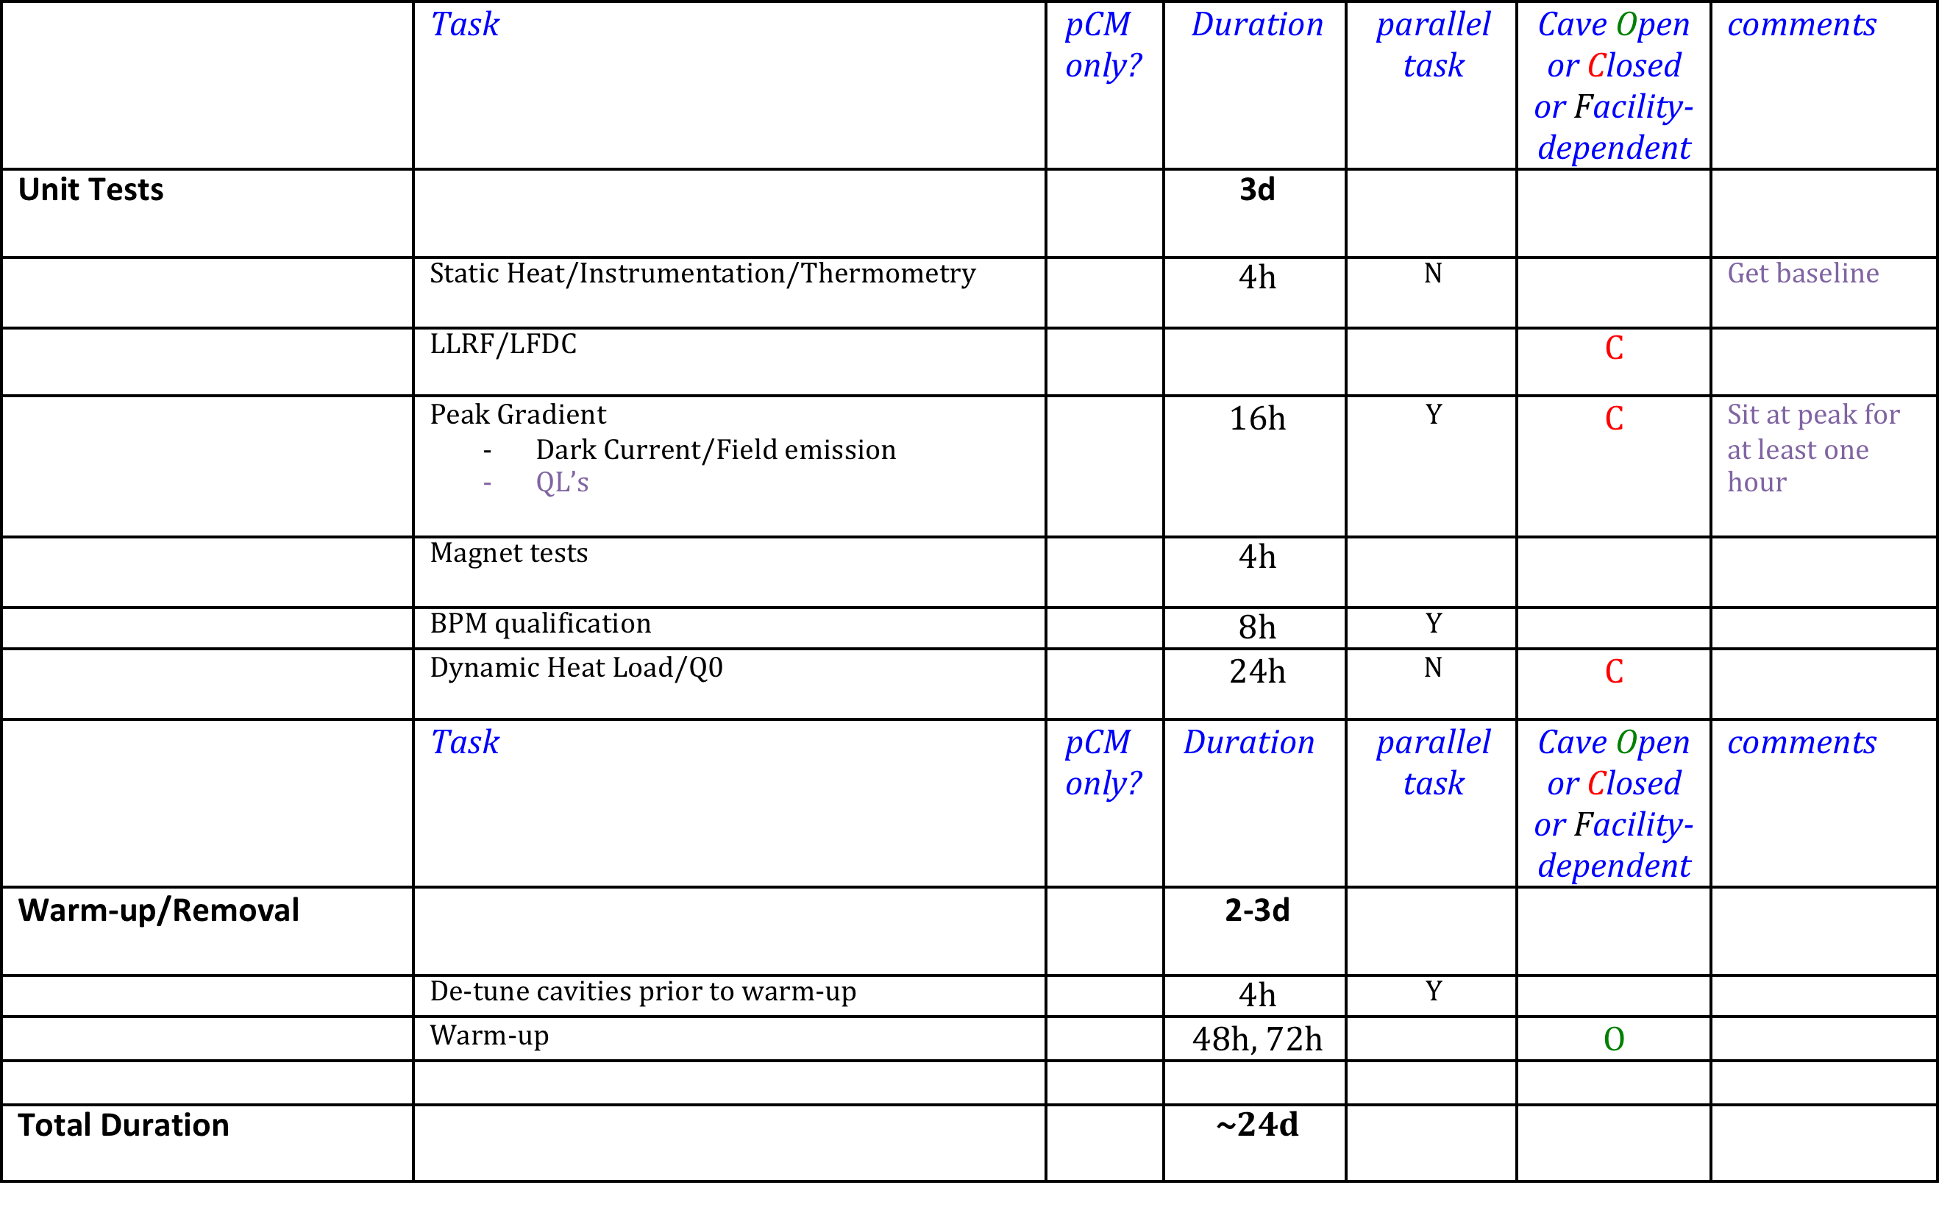
LCLS-II test program - 5

Slide 10
LCLS-II test program - 6
Other factors to consider:
  Magnetic hygiene
  Compensating coils
  How to verify flux expulsion
  Cryo system parameters/stability
  Duration of Cold soak/impact on Q0
  Automation
  Effect of multi-pacting
  Baseline vibration/microphonics

Slide 11
Next steps
prepare detailed procedures for each step, keep generic enough for each lab to adapt to their facility
collate into a traveler-like document
  reflect what the test results given to SLAC for each CM will be

