Slide 1
Design and Fabrication of Spoke Resonators with low sensitivity to perturbations
Leonardo Ristori
Microphonics Workshop
Fermilab 8-9 October 2015

Slide 2
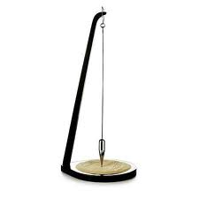
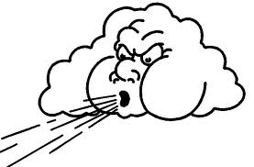
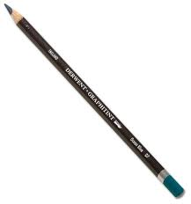
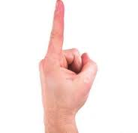
Active and Passive control for SRF cavities
perturbation
perturbation
compensation
compensation
Active only:
Constant compensation even without large perturbations
Passive + Active:
Compensation only during large perturbations
Active controls
Compensating the effects of perturbations
Passive controls (Environment)
Reducing perturbations
Passive controls (Cavity Design)
Reducing sensitivity of cavity to perturbations (LFD, Mechanical Resonances, df/dP)
Focus of this talk

Slide 3
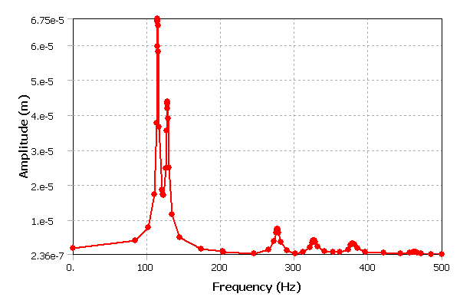
Passive Control: Mechanical Resonances
L. Ristori
Oscillating force f (x,y,z)
rigid modes
(not critical)
hazard zone
lowest RF-coupled mode
(well above 100 Hz)

Slide 4
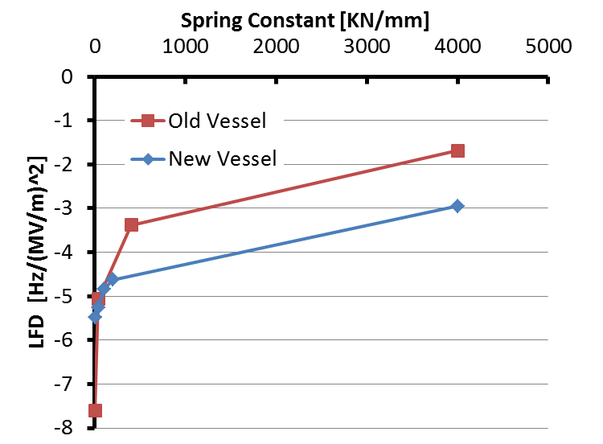
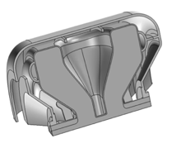
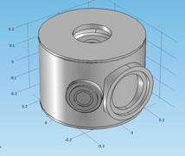
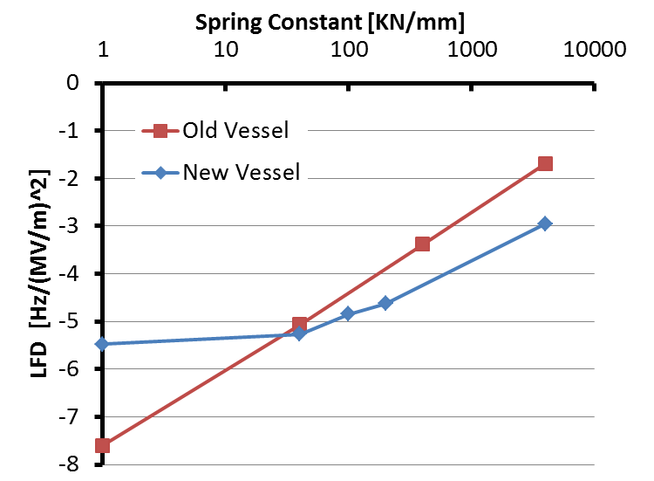
Passive Control: Lorenz-Force Detuning
M. Awida Hassan
The design of Helium Vessel was optimized to keep LFD within specifications.
A spring constant of ~ 30 kN/mm is expected at the interface
Production
Prototype
Log Scale
Spring Constant at Interface [kN/mm] | LFD [Hz/(MV/m)^2]
∞ | -2.74
4000 | -2.95
200 | -4.63
100 | -4.85
40 | -5.27
0 | -5.48
Spring Constant at Interface [kN/mm] | LFD [Hz/(MV/m)^2]
∞ | -1.69
4000 | -1.69
400 | -3.38
40 | -5.07
0 | -7.6

Slide 5
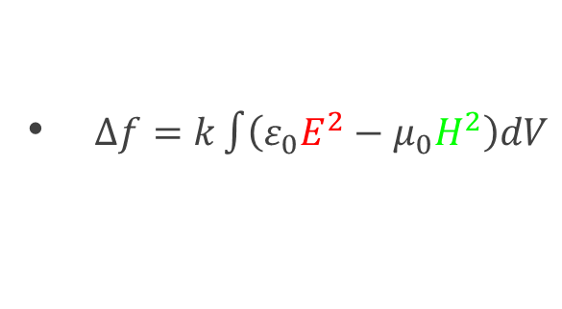
Passive Control: Sensitivity to He bath pressure (df/dP)
Cavity walls deform proportionally to the increment of pressure in the liquid Helium.
Changes in the cavity RF volume produce frequency shifts that can be positive or negative depending on the shape of deformation
Slater’s rule:
df/dP > 0
df/dP < 0
High H
P₀
+ Δ P
+ Δ P
+Δ f
-Δ f
High E
-ΔV
-ΔV

Slide 6
Minimizing He pressure sensitivity
Options for reducing df/dP
Reduce deformations of cavity walls
This approach is widely utilized and easy to implement (increase cavity wall thickness, increase number/size of stiffeners)
Drawback is a general increase in cavity stiffness and in most cases an increase in tuning resistance (dF/df)
Sometimes impractical to achieve df/dP=0
Balance deformations of cavity walls
This method is less intuitive and requires a systematic approach
The specific behavior of the cavity needs to be understood
Opportunity to achieve df/dP=0
Keep tuning resistance under control
High H
High E
Reduce deformations by
Increasing K_{cav}
Δ f = 0?
-ΔV
Balance deformations

Slide 7
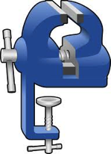
Residual Sensitivity + Linear Sensitivity
The overall df/dP sensitivity is the sum of a residual + linear contribute
The RF design and stiffening system will determine the “residual sensitivity”. It is the sensitivity of the cavity when all interfaces are fixed.
This contribute will always be there, we will have to balance it.
Residual Sensitivity
Example: ILC 9-cell residual df/dP= +15 Hz/torr

Slide 8
Residual Sensitivity + Linear Sensitivity (cont.)
The linear sensitivity is determined by the displacements at the interfaces. As the He pressure changes, how much does the interface move? This sensitivity is directly proportional to the displacements.
It is determined by the resultant force on the interface due to the Helium pressure (P) and mitigated by the stiffness of the cavity (K_{cav}) and tuner+vessel (k_{tun+vess}).
K_{cav}
P
k_{tun+vess}
interface
Linear Sensitivity

Slide 9
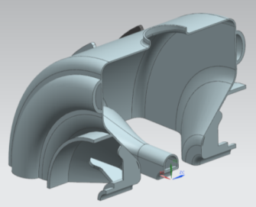
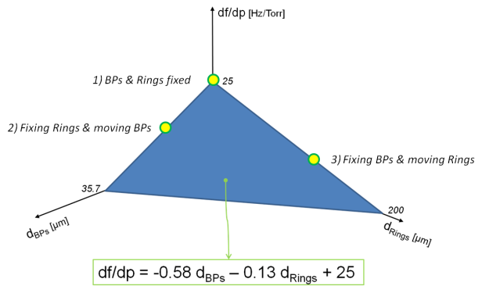
Systematic approach for df/dP estimation
D. Passarelli et al., “Pressure Sensitivity Characterization of superconducting spoke cavities”, IPAC’12, New Orleans, WEPPC056
Methodology (http://accelconf.web.cern.ch/AccelConf/IPAC2012/papers/weppc056.pdf) :
Cavity interfaces determine N degrees of freedom
Utilize superposition principle
With all interfaces locked you estimate the residual df/dP
N coupled RF/mechanical analyses to evaluate the coefficients (a_{i}). After, we can perform mechanical only analysis to predict df/dP.
The helium vessel will have to allow displacements x_{i} such that their linear combination according to the formula above gives df/dP=0
The computation time is reduced considerably, basic codes can be used, more licenses available, more users capable of launching such simulations.
Systematic approach instead of trial-error
Example: In a specific case of SSR1 with two coupling rings, only 3 RF simulations (3 points of the plane) were needed to define the mathematical relation to have an estimation of df/dp based solely on the displacements on Rings (d3, d4) and beam pipes (d1, d2)
d4
d2
d3
d1

Slide 10
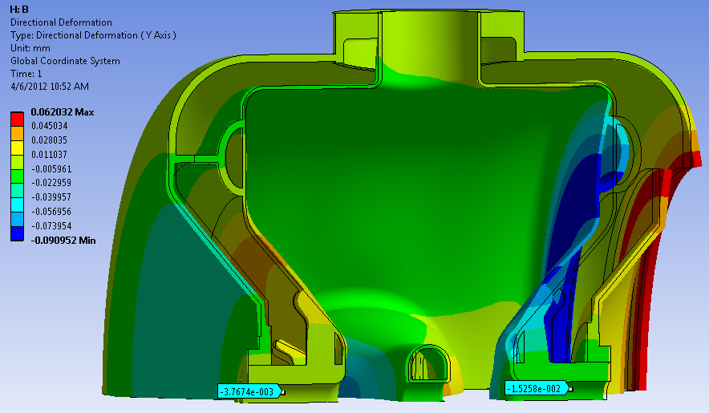
PIP-II SSR1 325 MHz, β=0.2
A self-compensating design was developed allowing low sensitivity
Despite non-negligible deformations (30-90 µm), net shift is very low thanks to Slater’s Theorem
Bare cavity ~ -650 Hz/Torr,
Prediction with He vessel -2 Hz/Torr (no tuner), with infinitely rigid tuner 6 Hz/Torr
Ease of tuning 39 N/kHz (bare), 40 N/kHz (with He vessel)
Methods used to balance deformations:
Diameter of bellows optimized to counteract Helium pressure on cavity end-wall.
Opposite end-wall coupled with vessel
End-wall sensitivity 540 Hz/µm
When shooting for 5 Hz = 1 nm !
Tuning
Side
D. Passarelli

Slide 11
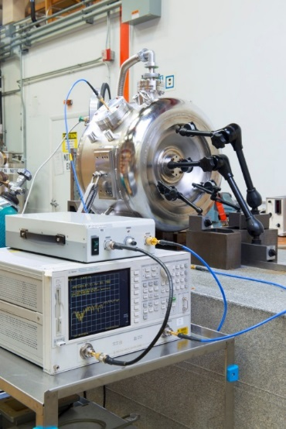
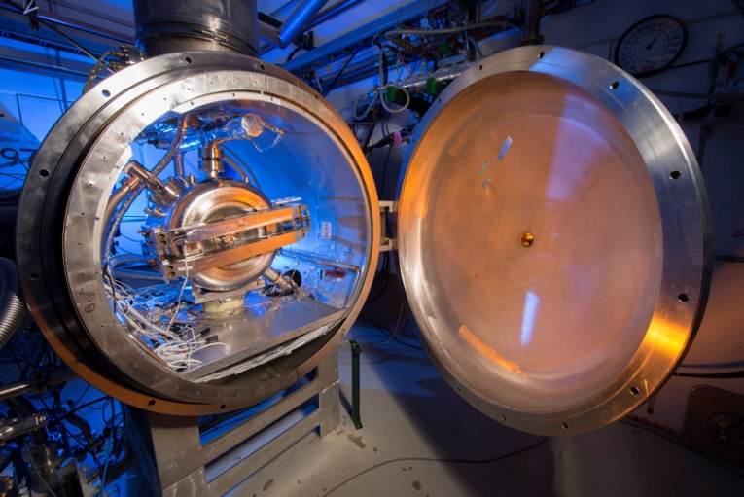
Df/dp of fully dressed cavity (S107)
Measurements at room temperature
Pressure in He space was cycled between 0-1.5 atm using Nitrogen
Frequency measurements taken at different pressure increments
Dial indicators provided valuable information for calibrating our model
Pressure sensitivity tuner not engaged: (df/dp)_{free} = +8 Hz/Torr
Pressure sensitivity tuner engaged: (df/dp)_{eng} = +4 Hz/Torr
Stiffness of the dressed cavity at the actuation flange: k_{cav} = 22 kN/mm
Tuning sensitivity at the actuation flange: df/dL = 550 Hz/mm
Stiffness of the of the tuner (both arms): k_{dtun} = 30 kN/mm
Measurements at cryogenic temperature in the Spoke Cryostat
Pressure sensitivity with the tuner engaged: (df/dp)_{eng} = +4 Hz/Torr
The specification of ≤25Hz/Torr was exceeded with a measured value of +4 Hz/Torr.

Slide 12
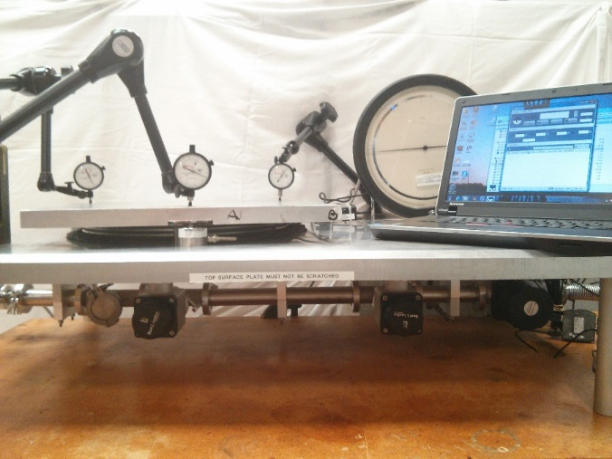
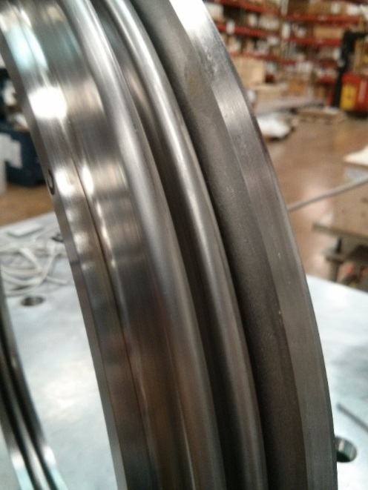
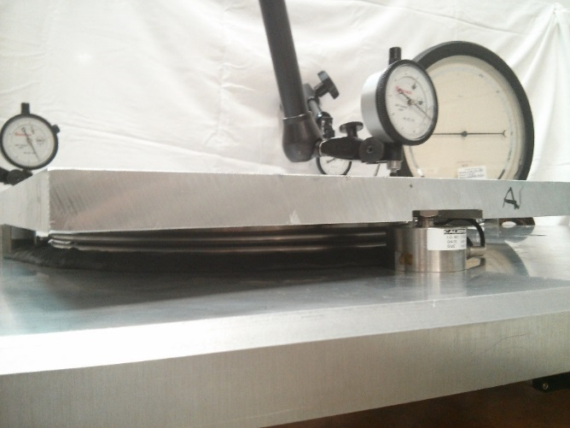
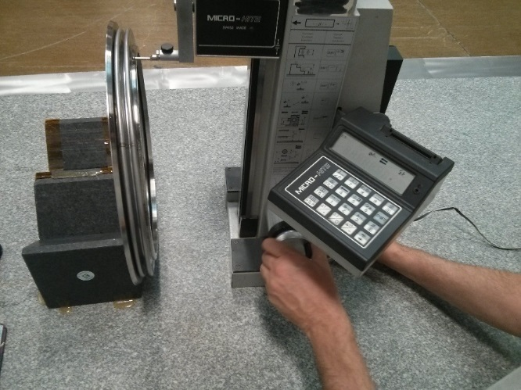
Bellows characterization and pairing
SSR1 designed with large bellows D ~350mm
Just 1 mm error on diameter of bellows causes a pressure change on cavity which accounts for ~ 4 Hz/Torr (hand estimation)
Formed bellows do not have high precision on convolutions
All bellows were characterized to make the best pairing with cavities

Slide 13
Manufacturing variation of df/dP
Room temperature measurements on bare and jacketed SSR1 resonators showing the influence of manufacturing variations on the value of df/dP.
An ~8% variation for bare cavities transforms into a much higher variation (in %) when aiming for very low numbers.
A value of 4 ± 5 Hz/Torr was achieved on a sample of 6 cavities
Hz/Torr | S108 | S109 | S110 | S111 | S112 | S113
Bare cavity | -553.5 | -555.1 | -568.8 | -525.8 | -524.6 | -544.7
With He Vessel | -1.2 | 5.4 | 7.9 | 2.7 | 9.0 | 6.3

Slide 14
Conclusions
Passive controls should be implemented for SRF cavities at the design level by reducing sensitivity to perturbations
Mechanical resonances should be checked early in the process
A systematic approach was developed for investigating df/dP
The first PIP-II spoke resonator achieved 4 Hz/Torr in cold tests
Manufacturing errors need to be considered to achieve very low df/dP

Slide 15
Additional Slides

Slide 16
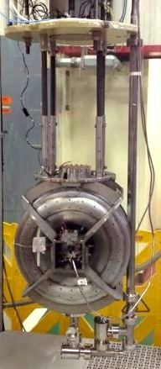
Sensitivity of Bare Cavities in VTS
Slope changes when beam-pipes engage with Ti-cage

Slide 17
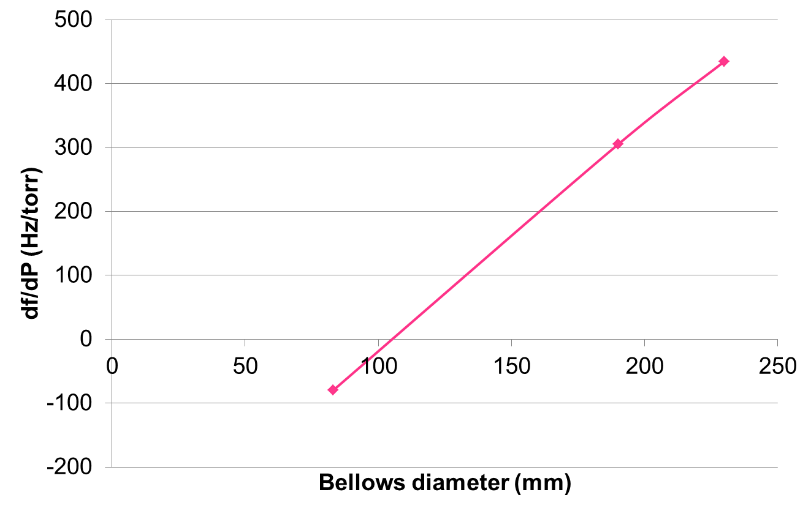
1.3 GHz 9-cell sensitivity, bellows
Let’s investigate its df/dP and the dependence from bellows diameter. Tuner removed for now…
Smallest Bellows possible
D = 83 mm
- 80 Hz/torr
- 215 um
XFEL Bellows
D = 190 mm
Arbitrary minimum:
100 mm
P
305 Hz/torr
660 um
Large Bellows
D = 230 mm
P
435 Hz/torr
980 um
It looks like we can reduce df/dP to enter the “0” range. D_{bellows}≈100 mm.

Slide 18
1.3 GHz 9-cell sensitivity, bellows + tuner
When we add the tuner, the displacements at the interface are reduced → sensitivity is reduced towards the residual value.
You will always be in the range between residual sensitivity and free-state sensitivity. The more stiff the tuner, the closer to the residual value
For the XFEL design this range is 15-305 Hz/torr. The lever-tuner does a great job holding the cavity and producing df/dP ≈ 30-50 Hz/torr.
Requirement: to obtain df/dP=0 in operating conditions, this range must be bridged across the zero value.
Conclusion: with a residual sensitivity of 15 Hz/torr, the free-state sensitivity of the 9-cell must be adjusted to be negative (e.g. -15 Hz/torr).
This looks possible (see previous slide) with a bellows of ≈ 100 mm in diameter.
And we have not increased the cavity’s stiffness
Hz/torr
XFEL
305
30-50
15
fixed
w/tuner
free
Hz/torr
Improved 9-cell?
0
free
15
-15
fixed
w/tuner

