Slide 1
HTS Vibration Experience –
Sources & Mitigation
Jeremiah Holzbauer
Resonance Control Group - Technical Division
October 8th, 2015
Microphonics Workshop

Slide 2
Synopsis
Resonance Control Group has conducted several rounds of testing at HTS and discovered a quite sizable amount of microphonics disturbance
  Notable sidebands at 30, 50 Hz and harmonics
Larry D. and Brian C. attempted to control the cavity but were unable to because the detuning was so large
Early attempts at diagnosis and mitigation revealed some obvious sources, and the environment was improved to the point testing was reasonable
Further studies have proved relatively fruitful (Warren’s Presentation)
The results of this study and the resulting mitigation proposals will be presented here

Slide 3
Testing Setup
Measuring voltage driven across the cavity piezoelectric tuners gives a measurement of the cavity mechanical vibration
Because the cavity it warm, it cannot easily be correlated with absolute frequency detuning, but the spectral information is still quite useful for diagnosis of vibrational sources
A pair of geophones was used in the cave at large to measure surface vibrations
Data was taken for 1 second periods, and the spectral powers were averaged over a number of data sets, usually close to 10
Caveat: 120 Hz line is almost certainly electrical noise

Slide 4
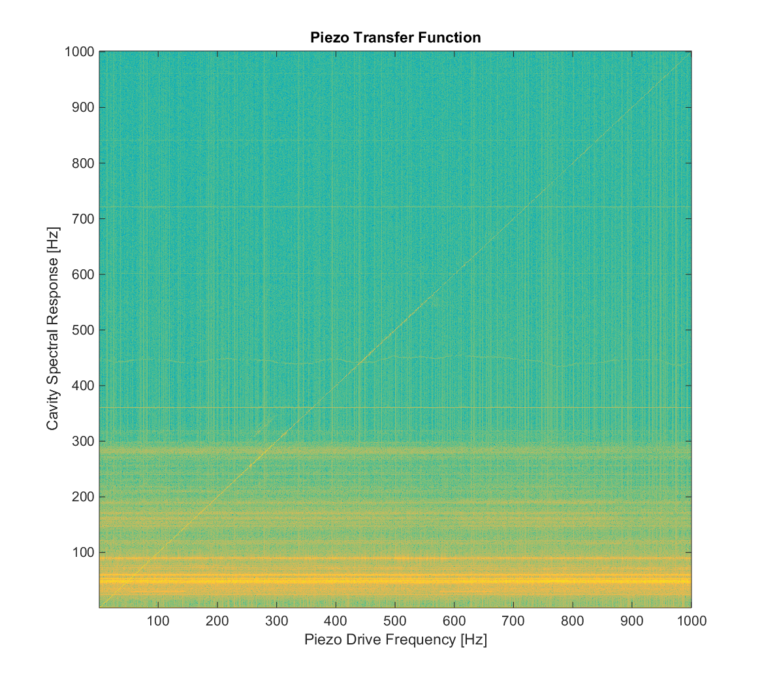
Cold HTS Transfer Function Data

Slide 5
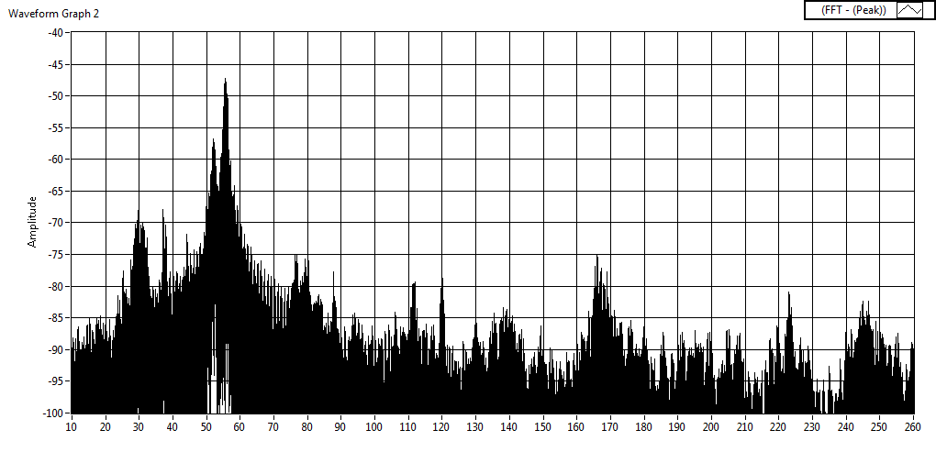
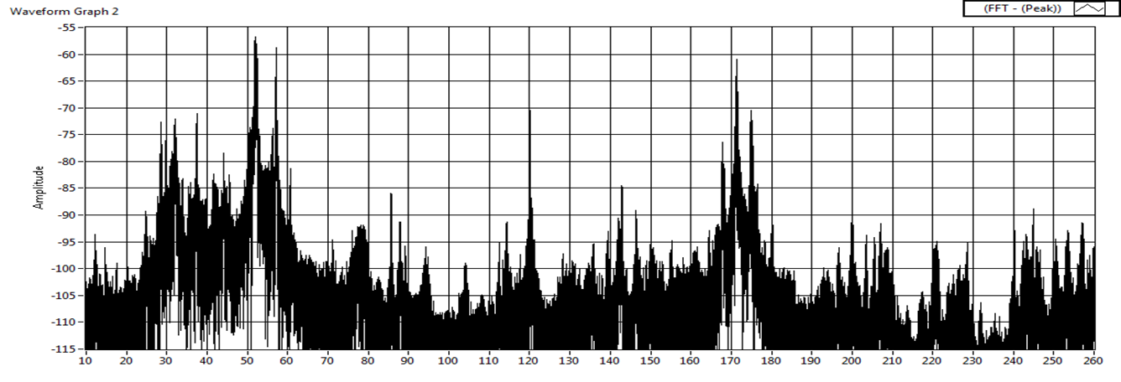
Measurements of cavity vibration (microphonics) using
(1) RF signal from cavity & (2) piezo signal/piezo as a sensor
Cavity as SENSOR
Piezo as a SENSOR
Credit to Yuriy for the Slide

Slide 6
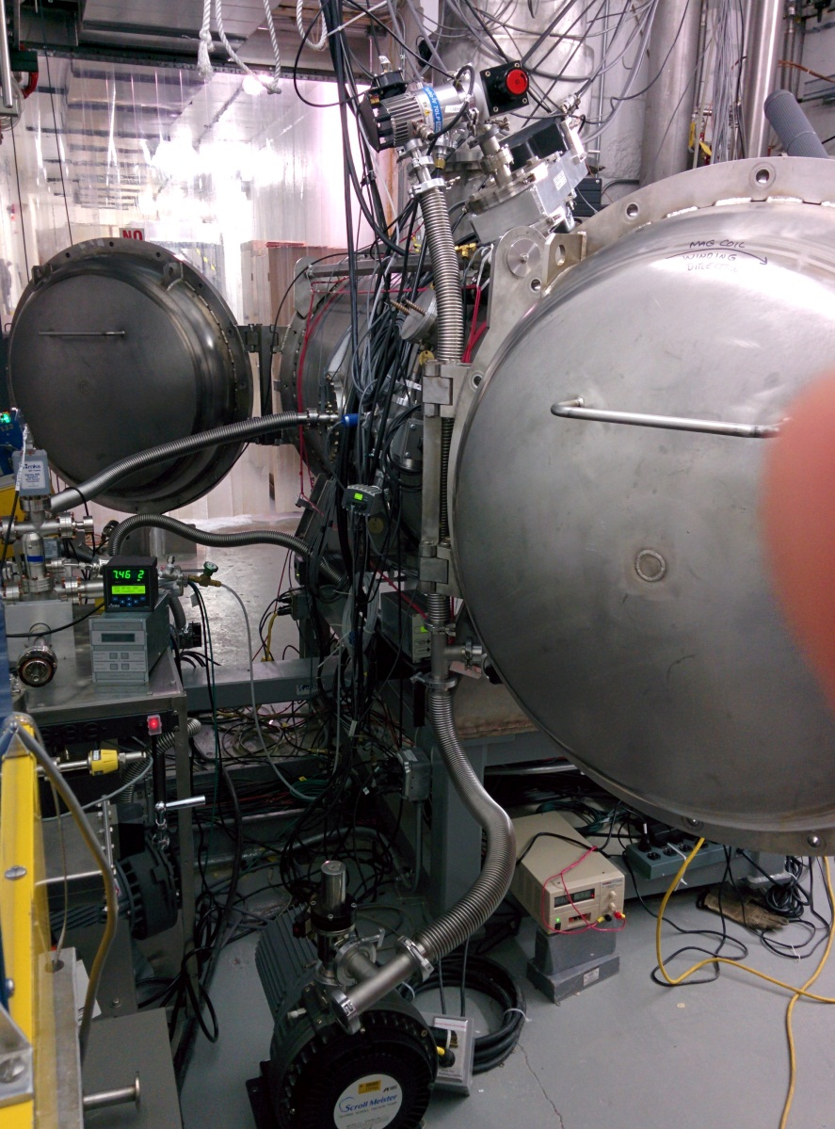
Insulating Pump Stack

Slide 7
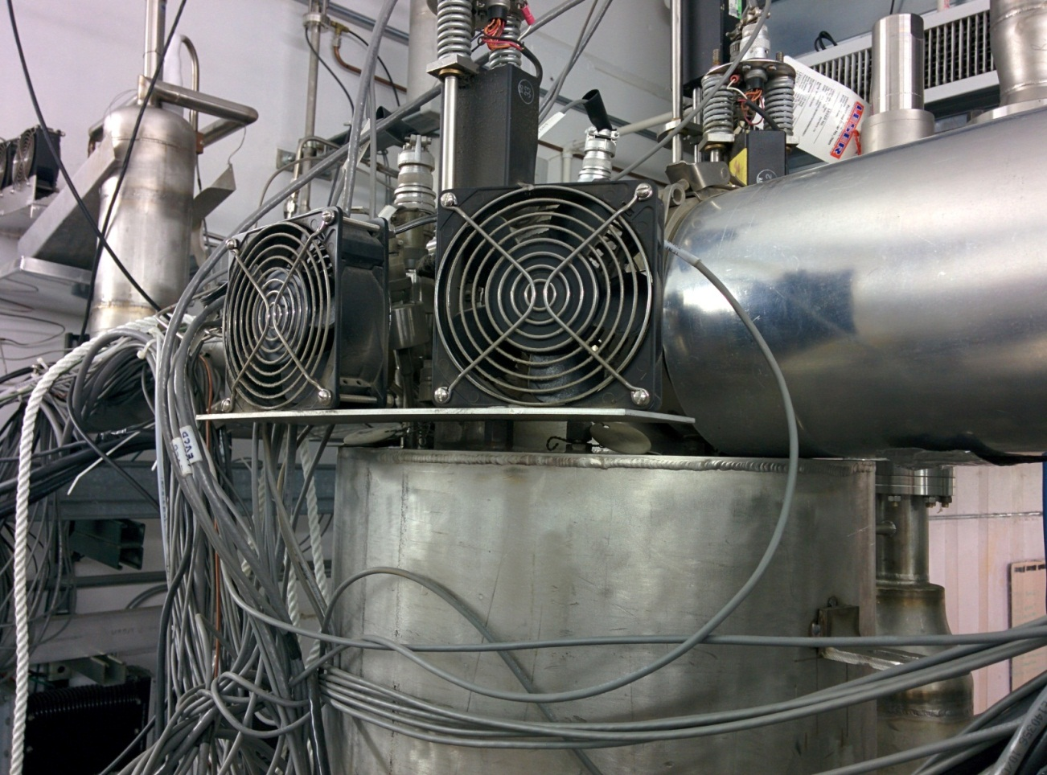
AD Cryo Box Fans
Two box fans on a plate to mitigate valve heat leak, large vibration source
Initially hard mounted, now soft mounted through grommets
Heat leak is too large to have them off for more than a couple hours without significant icing
AD cryo should be able to modify/replace with a non-vibrational heat source

Slide 8
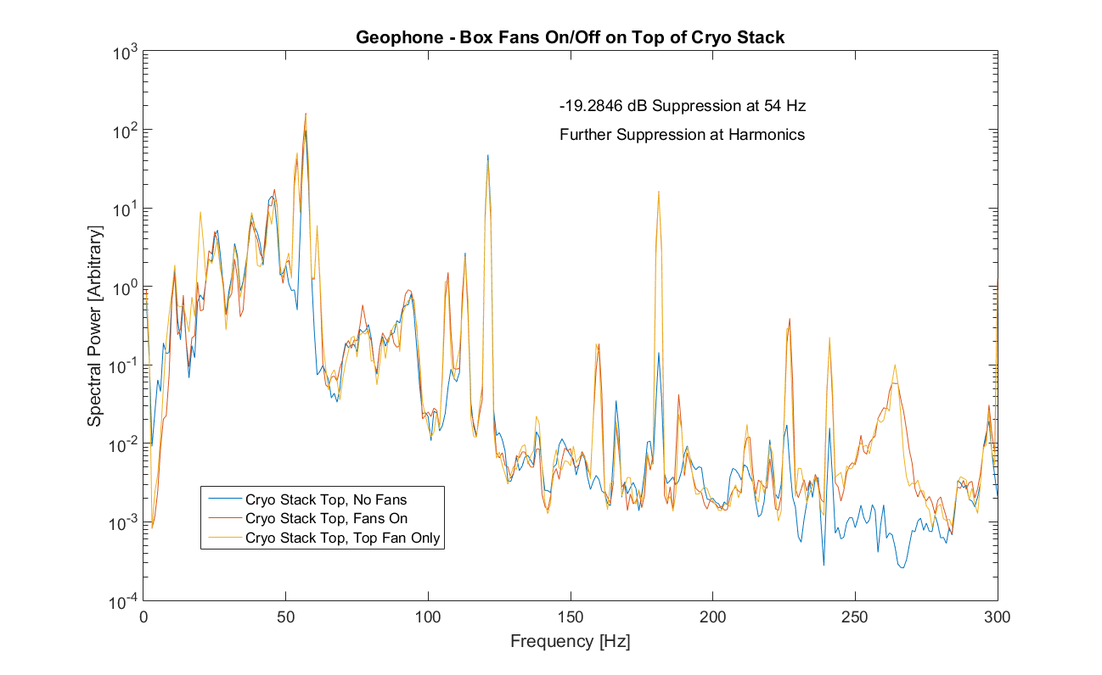
AD Cryo Box Fans – Geophones Next to Source
*Again, be wary of 120 Hz peak/harmonics
Cavity Resonances?

Slide 9
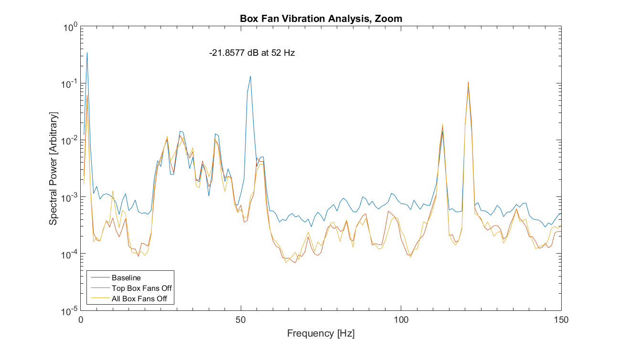
AD Cryo Box Fans – Piezo Data

Slide 10
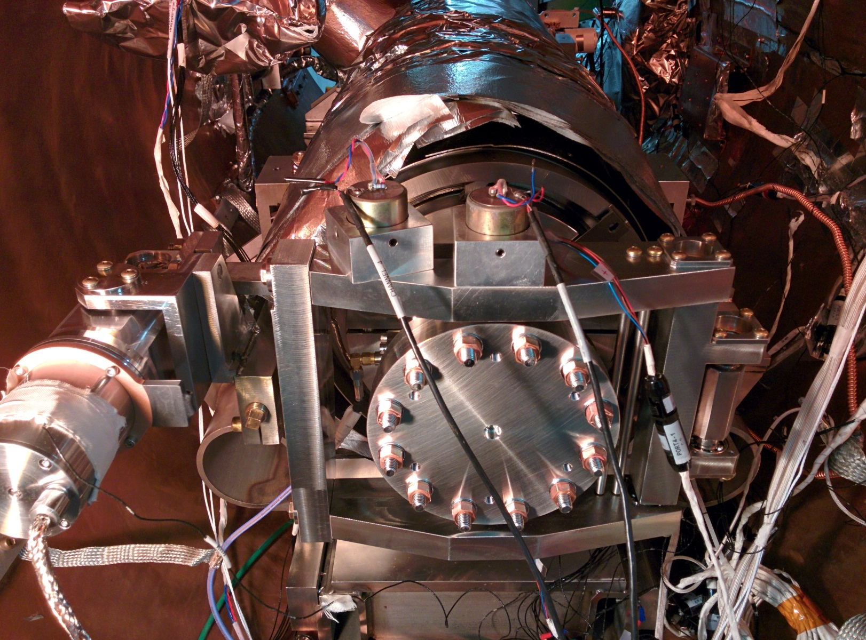
Geophones on Tuner Bracket

Slide 11
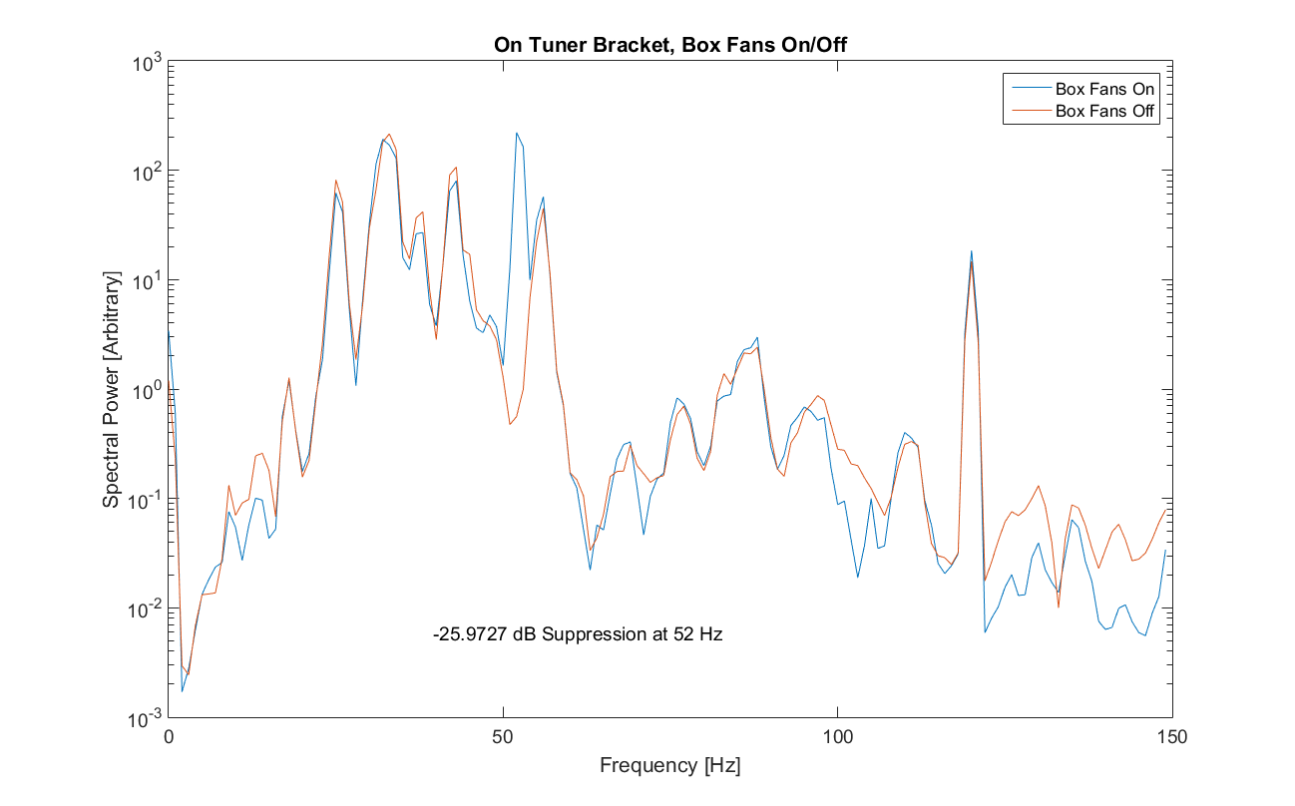
AD Cryo Box Fans – Geophone Data

Slide 12
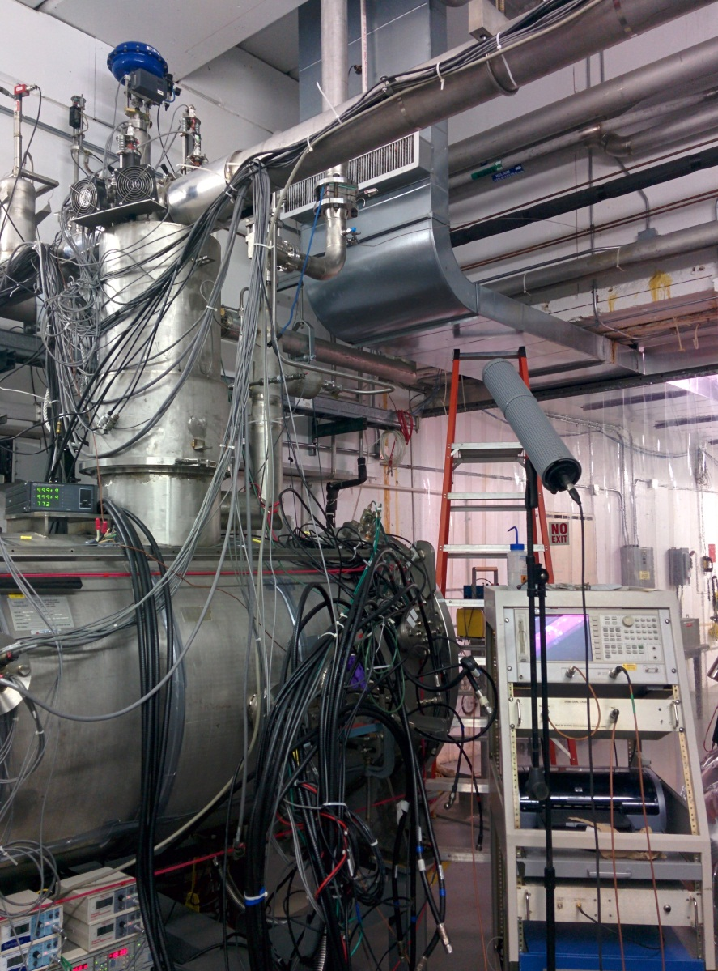
ODH Blowers/HVAC Duct
Ventilation in the HTS cave is run by two systems in parallel
HVAC is (theoretically) controlled by a thermostat outside the cave
ODH ventilation blowers run 24/7 when the cave is unsecured
ODH blowers should be off when cave is secured
Primary vent blows directly onto a cryo relief stack which hard-connects to the HTS stack

Slide 13
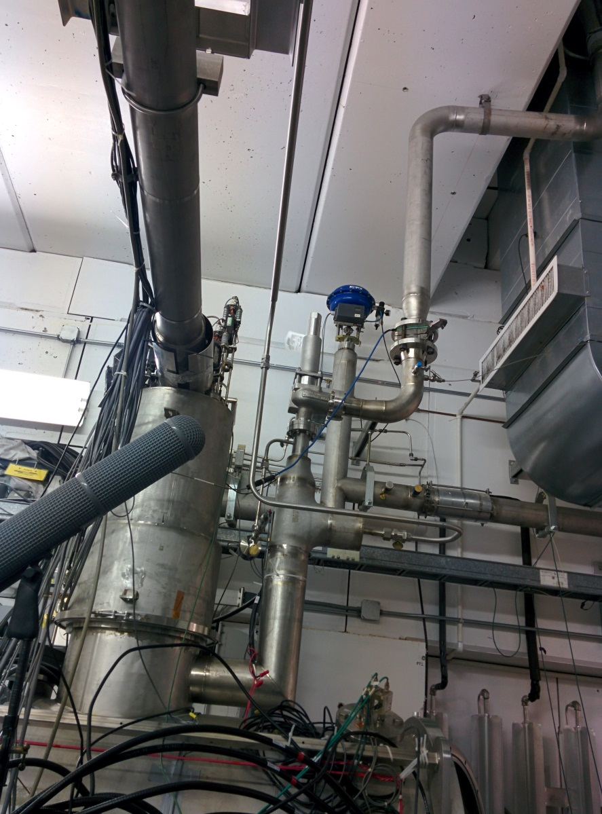
Cryo Relief Stack

Slide 14
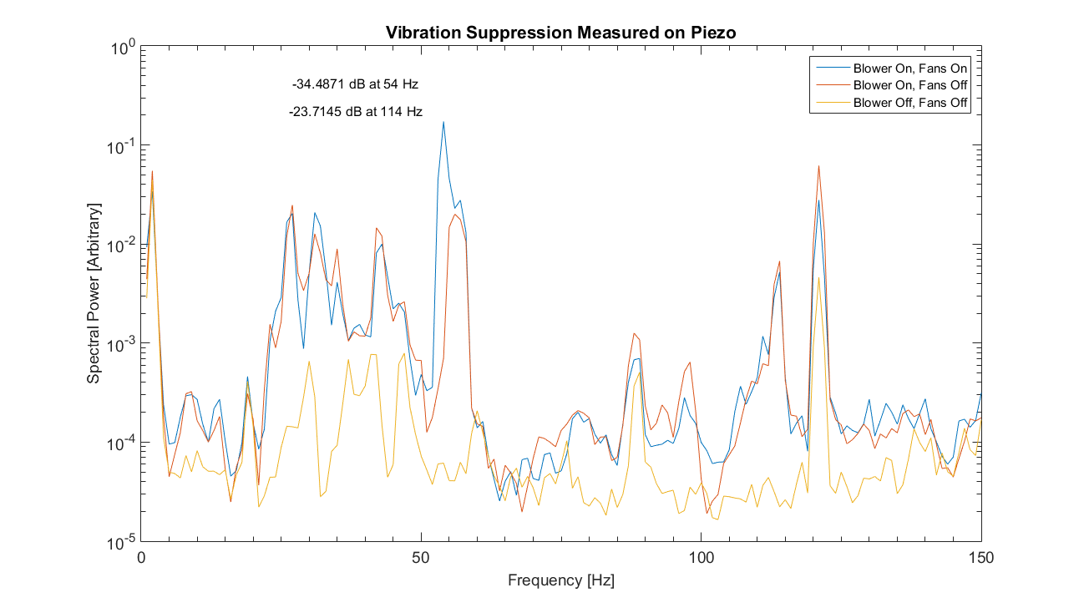
HVAC/ODH Blower is a large noise source

Slide 15
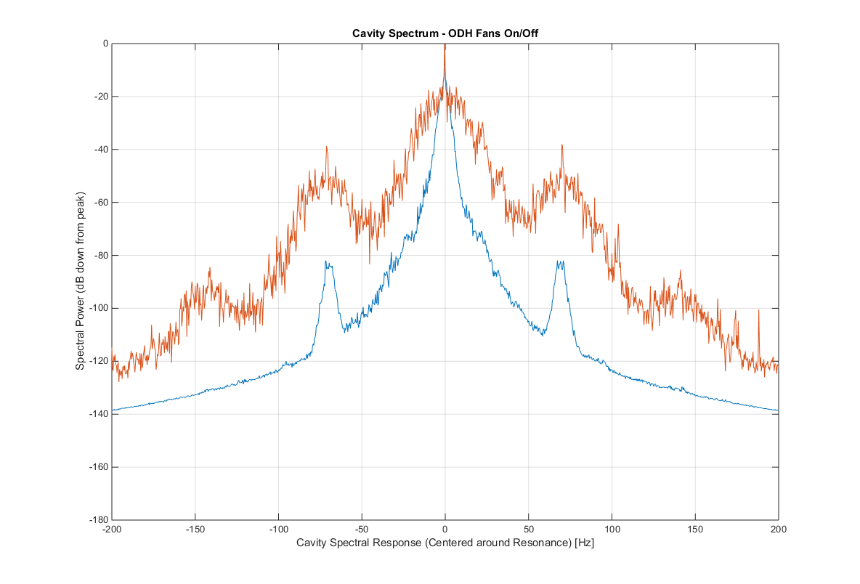
Probe Spectrum Noise ON vs. OFF

Slide 16
Mitigation Conclusions
ODH blower, HVAC, and AD cryo box fans seem to be the dominant sources of noise
All spectral lines between 50 and 55 Hz (the dominant sources) seem to be suppressed or removed by these changes
The ODH should no longer be a problem as it should shut off when the cave is interlocked (the original intention, and now restored)
The HVAC can be turned off for periods of time when needed (summer is harder)
The AD cryo box fans were just turned off, and the Cryo guys keep an eye on the valve icing

Slide 17
Future Work - Conclusions
Passive mitigation is only one aspect of microphonics stability
  Cavity/Tuner Design (excellent work done on df/dP for SSR1)
  Cryogenics/Cryomodule Design (bath pressure environment, mechanical modes)
My motto: “Passive mitigation first, last, and always.”
Good news: Vibration sources/issues are often obvious in retrospect
Bad news: That retrospect part
A centralized effort must be made to think about these issues ahead of time (my opinion)

Slide 18
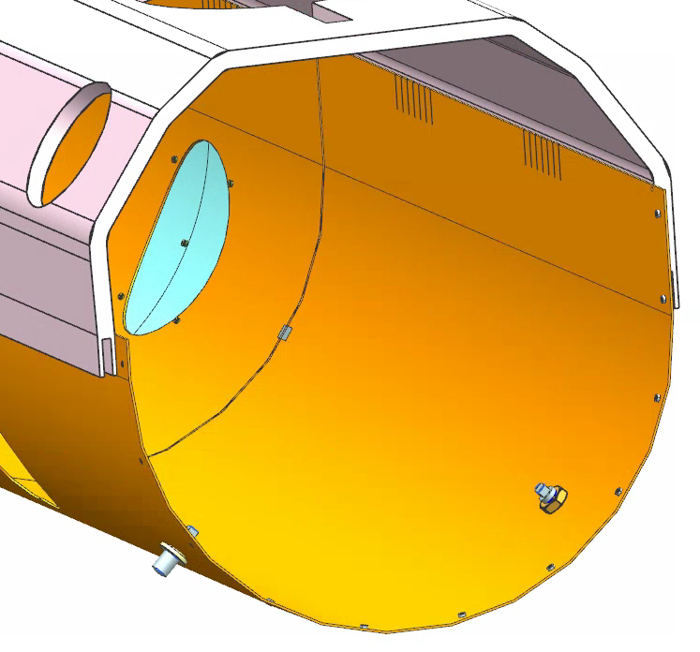
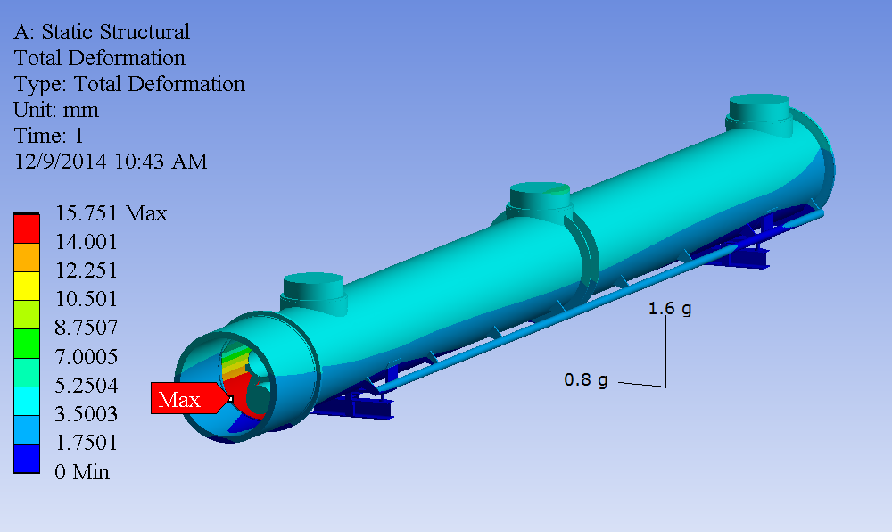
Changes to FEA thermal shield model
Results from previous FEA
Material properties of thermal shield:
EN AW-1050A, Al 99.5%
The extruded tube material: EB AW-6060 AlMgSi0.5
G10 support rods (newly added in 3D model), two on each end of lower shield
To restrict the motion, in case of seismic event the lower shield cannot move further due to the G10 rods getting in contact with the inside of the vacuum vessel
Plan to leave a gap between the inside of the vacuum vessel and the tip of these G10 rods, for thermal leak & shrinkage
Table I. Mass Distribution of Finite Element Model (kg)
Expected to be lower
Table II. Density and Modulus of model parts
Credit to Yun He for the Slide

