Slide 1
Challenges of PIP-II
Warren Schappert
Microphonics Workshop
8 Octobe 2015

Slide 2
SRF Cavity Detuning
SRF cavity cells often formed from thin (2-4mm) sheets of pure niobium to allow them to be cooled below superconducting transition temperature
Thin walls make cavities susceptible to detuning from vibration
Detuned cavities require more RF power to maintain accelerating gradient
Providing sufficient RF reserve power to overcome cavity detuning increases both capital and operational cost of machine
Controlling cavity detuning critical for current generation of machines, (LCLS-II, PIP-II, ERLs, etc.) that employ very narrow bandwidth cavities
For machines with very narrow bandwidth cavities, e.g. ERLs, detuning can be the major cost driver for the entire machine

Slide 3
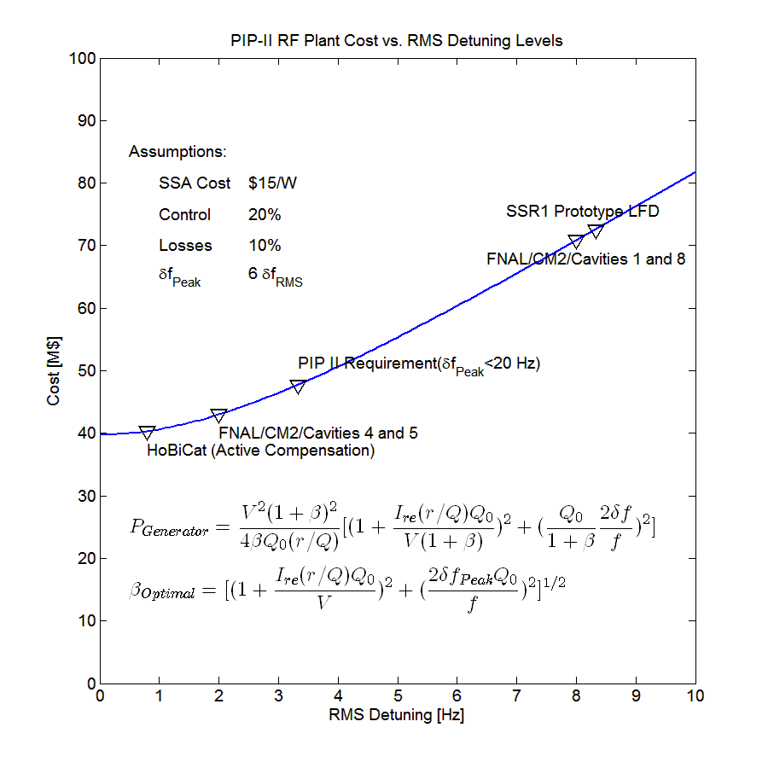
Cost of Cavity Detuning
Detuned cavities require more RF power to maintain constant gradient
PEAK detuning drives the RF costs
Beam will be lost if RF reserve is insufficient to overcome PEAK detuning
Providing sufficient reserve increases both the capital cost of the RF plant and the operating cost of the machine

Slide 4
Controlling Cavity Detuning
Cavities may be detuned by either deterministic sources or non-deterministic sources
Deterministic sources include
Radiation pressure on cavity walls (Lorentz Force)
Non-deterministic sources include
Cavity vibrations driven by external noise sources
Helium pressure fluctuations
Cavity detuning can be controlled using either passive or active measures
Passive measures include
Suppressing external vibration sources
Reducing cavity sensitivity to sources of detuning, e.g. df/dP, LFD,…
Active measures include
Sensing cavity detuning in real-time and using piezo or other actuators to actively cancel detuning
Deterministic sources may be cancelled using feed-forward
Non-deterministic sources require feed-back

Slide 5
Controlling Detuning in the PIP-II Cavities
PIP-II design calls for narrow bandwidth (f_{1/2} ≅30 Hz) cavities operating in pulsed mode
Narrow bandwidth makes cavities susceptible to vibration induced detuning
Pulsed mode LFD can excite vibrations
PEAK detuning of PIP-II cavities must be limited to 20 Hz or less
PIP-II cavities will require active detuning compensation of both LFD and microphonics during routine operation
Will require combination of
best LFD compensation achieved to date
AND best active microphonics compensation achieved to date
AND 24/7 operation over hundreds of cavities for several tens of years
No examples of large machines that require active detuning control during routine operation currently exist
 | N | f | Q₀ | r/Q | E | L _{Effective} | Voltage | Current | Control | Losses | P_{Beam}
 |  | MHz | 10⁹ | Ω | MV/m | m | MV | mA | % | % | kW
HWR | 8 | 162.5 | 5.0 | 275 | 9.7 | 0.21 | 2.01 | 2 | 20 | 10 | 4.02
SSR1 | 16 | 325 | 6.0 | 242 | 10.0 | 0.21 | 2.05 | 2 | 20 | 10 | 4.10
SSR2 | 35 | 325 | 8.0 | 296 | 11.4 | 0.44 | 4.99 | 2 | 20 | 10 | 9.99
LB650 | 33 | 650 | 15.0 | 375 | 15.9 | 0.75 | 11.86 | 2 | 20 | 10 | 23.72
HB650 | 24 | 650 | 20.0 | 609 | 17.8 | 1.12 | 19.92 | 2 | 20 | 10 | 39.84

Slide 6
Controlling Detuning in the PIP-II Cavities
PIP-II design calls for narrow bandwidth (f_{1/2} ≅30 Hz) cavities operating in pulsed mode
Narrow bandwidth makes cavities susceptible to vibration induced detuning
Pulsed mode LFD can excite vibrations
PEAK detuning of PIP-II cavities must be limited to 20 Hz or less
PIP-II cavities will require active detuning compensation of both LFD and microphonics during routine operation
Will require combination of
best LFD compensation achieved to date
AND best active microphonics compensation achieved to date
AND 24/7 operation over hundreds of cavities for several tens of years
No examples of large machines that require active detuning control during routine operation currently exist
 | N | f | Q₀ | r/Q | E | L _{Effective} | Voltage | Current | Control | Losses | P_{Beam}
 |  | MHz | 10⁹ | Ω | MV/m | m | MV | mA | % | % | kW
HWR | 8 | 162.5 | 5.0 | 275 | 9.7 | 0.21 | 2.01 | 2 | 20 | 10 | 4.02
SSR1 | 16 | 325 | 6.0 | 242 | 10.0 | 0.21 | 2.05 | 2 | 20 | 10 | 4.10
SSR2 | 35 | 325 | 8.0 | 296 | 11.4 | 0.44 | 4.99 | 2 | 20 | 10 | 9.99
LB650 | 33 | 650 | 15.0 | 375 | 15.9 | 0.75 | 11.86 | 2 | 20 | 10 | 23.72
HB650 | 24 | 650 | 20.0 | 609 | 17.8 | 1.12 | 19.92 | 2 | 20 | 10 | 39.84

Slide 7
The REAL Challenges of PIP-II (and any other project…)
Technical challenges associated with active control are probably manageable
System identification
Fully characterize each cavity in the system and automatically generate a low-order transfer function
Optimal control
Automatically generate the best possible (LS) controller for each individual cavity based on the measured low-order transfer functions
Implementation is tedious but straightforward
Organizational and cross-disciplinary challenges will likely be far more difficult (IMHO)

Slide 8
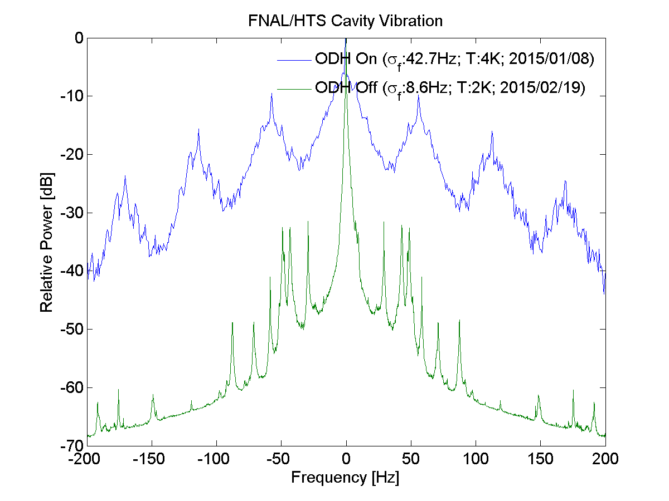
The million dollar muffin fan…
Minimizing cavity detuning requires careful optimization across entire machine
Cavity design, cryomodule design, RF plant, cryogenic system design, civil engineering
Cross-disciplinary challenges may be more daunting than technical challenges
Large potential costs if any aspect ignored
Small design changes may have large impact on cavity detuning
Cost of fixing microphonics afterwards could be very high
Some structure within PIP-II organization will be required to coordinate effort amongst groups and disciplines
Education and communication
Vibration related reviews

Slide 9
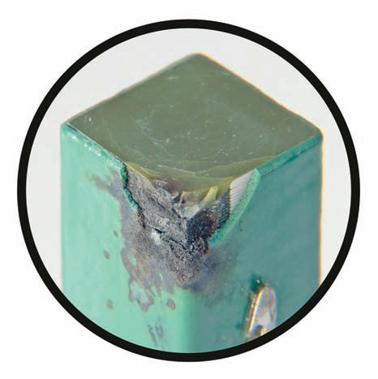
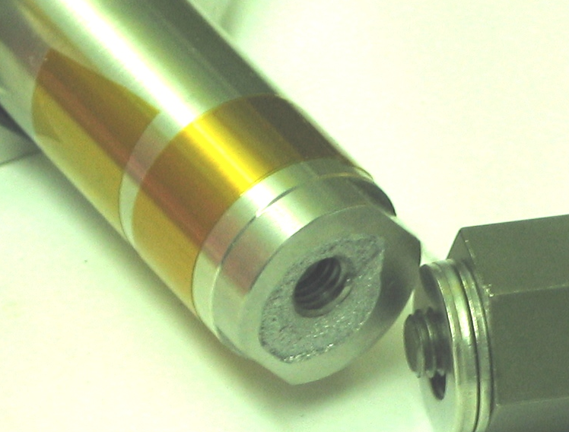
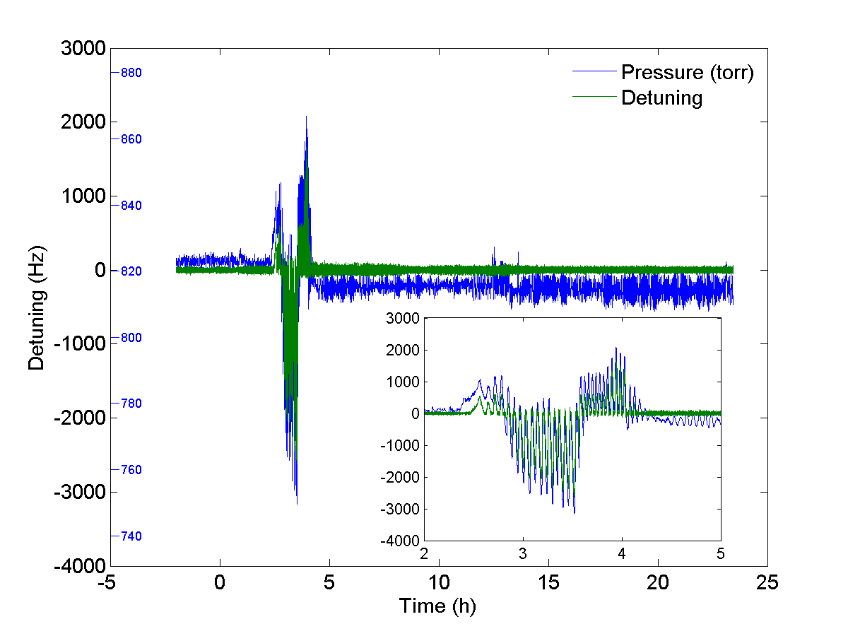
A catalogue of horror stories…
Experience at FNAL with blade tuner for ILC cavities
Everything that can go wrong will go wrong
Extensive component and integration testing required for reliable operation
Experience at other labs
MSU
JLab
SNS
Cornell
HoBiCaT

Slide 10
But those guys never talk to each other…
Project-X Microphonics Study
requested by Sergei Nagaitsev
Ruben Carcagno, Brian Chase, Gustavo Cancelo
Recommendations
Crucial to minimize pressure transients
Crucial to minimize pressure variations
Crucial to minimize cavity vibration
Crucial to minimize cavity sensitivity
Crucial to provide adequate power for all cavities
Can not rely on active compensation alone
All except the last require the co-operation of other stakeholders

Slide 11
You need HOW MUCH test time?....
Every cavity is slightly different
Sometimes more than slightly…
Developing suitable algorithms is extremely time intensive
No substitute for a real cavity
Simulators are only as good as the cavities tested previously
Test time at an absolute premium
Progress on microphonics at FNAL to date has been entirely limited by access to a cold cavity
CCII
It will be back on in July…
STC
It will be back on in September …
Exclusive use for six months or more

Slide 12
I don’t want to hear about the problem…
It will not be enough to present project management with a list of problems associated with microphonics
A set of solutions for those problems must accompany the concerns if they are to be taken seriously
Suitable solutions are not at all apparent to me

Slide 13
The luxury of LFD control…
…
“The problem here is that I understand that Warren and co need a cold cavity to hook up their LLRF board to, and I symphatize because they are motivated researchers, but really it cannot continue to be at the expenses of fundamental measurements. The necessary things must come first. Then the higher priority things. Then the optional. In no way this work feeds into the pCM needs. And there will be years of available HTS time during which these experiments could be performed and still feed into LCLS-2 final accelerator. Also, they could currently use CM2 which is a even better platform for their studies.
Same about HOMs. Other than they do not heat up, what else do we have to study so extensively? And what about the coupler?”

Slide 14
Even I am not interested in attending this workshop …
Hi Slava
…
I do not know why the last minute decision to switch the workshop from Berkley to Fermilab was made but it has made a difficult situation even worse.
A workshop that only involves the LCLS-II LLRF group is a complete waste of time in my opinion. The LLRF group knows that microphonics is an important concern. Progress on the problem is not being impeded by lack of understanding, by lack of communication, or even by lack of ideas. No progress has been made because there has not been adequate access to a cold cavity. Every time we make a presentation at the LCLS-II LLRF web meeting we are asked repeatedly when further HTS test time might be available. Far more progress on active control would be made by allocating Larry Doolittle a week of HTS time than a month of workshop discussions. As things stand, even I am not interested in attending this workshop.
A workshop will only be beneficial if we can draw in members of other groups involved in constructing LCLS-II. We need to convince the LCLS-II management team that even the best active control system we can build may be completely useless if other components of the machine are not constructed with sufficient care. A workshop is one tool we can used to bring us closer to that goal. A workshop at Berkley had some possibility of raising awareness. A workshop at Fermilab does not.
I think we should seriously consider postponing the workshop until it can be organized in a way that will lead to progress.
Warren

Slide 15
Conclusion
Technical challenges associated with active control are probably manageable
Organization challenges are far more difficult
(and far less rewarding)
Suppressing microphonics requires optimization of the entire machine
Active control should be the method of last resort
Achieving that optimization will require a political process
Education and outreach
Proposing solutions
Building consensus
Establishing a suitable process to implement the solution(s)
PIP-II has been generally responsive to these concerns but much more work required

