Slide 1
0L04 Case History
Example of reduced cryomodule heat capacity due to helium pressure RETURN LEVELS

Slide 2
The Problem
R100 cryomodule, situated last in the injector to provide necessary energy gain to facilitate the re-injection match, proved to be a “sensitive” child…
Multiple trips (Microphonic induced Detuning) – especially during normal workday times that abated during evening hours and weekends.
Difficult and lengthy recovery from zone trips once they occurred
The trips all correlated to large transient cavity detuning
Multiple causes for trips, evolving solutions
Focus on helium pressure and transient effects on cryomodule performance

Slide 3
C100 cavity in helium vessel
Riser
Helium in

Slide 4
Clues
Tomasz was recently tasked with correlating mechanical vibration with cavity detune excursions and subsequent trips, plus determining whether PZTs could quiet the cavities – results in later talk. To perform this task he was attempting to set gradients to operational values - ~90 MeV
It was found that when attempting to attain the gradients, the cavities would trip, and liquid level would oscillate as seen by the liquid level sensor probe
Thinking it was due to initial cryomodule electric heat, I raised the heat from 50 to ~250 watts – which was previously tolerated during an earlier run (March 2014)
At ~ 240 watts electric heat, the liquid level began to oscillate – indicating boiling

Slide 5
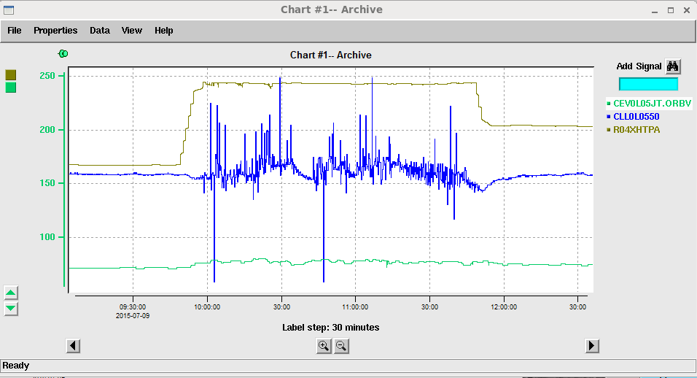
Clues
Total Heat
JT position
Cryomodule liquid level sensor

Slide 6
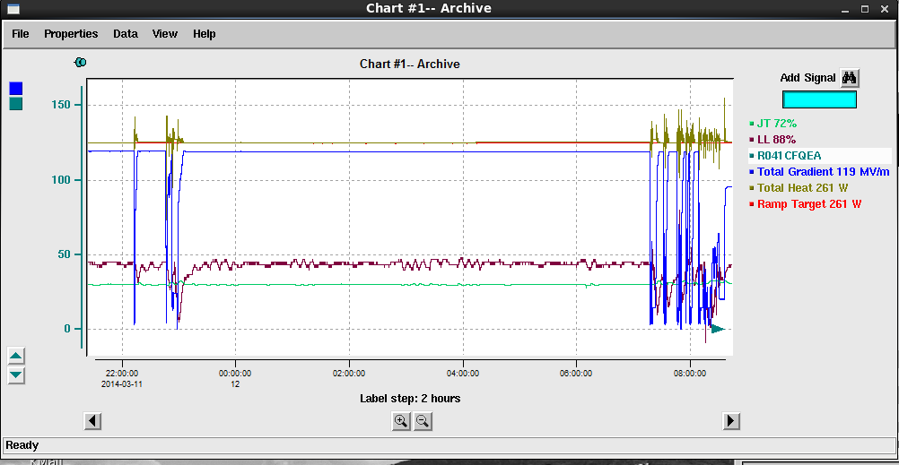
Clues
Prior heat level capacity in cryomodule during March 2014

Slide 7
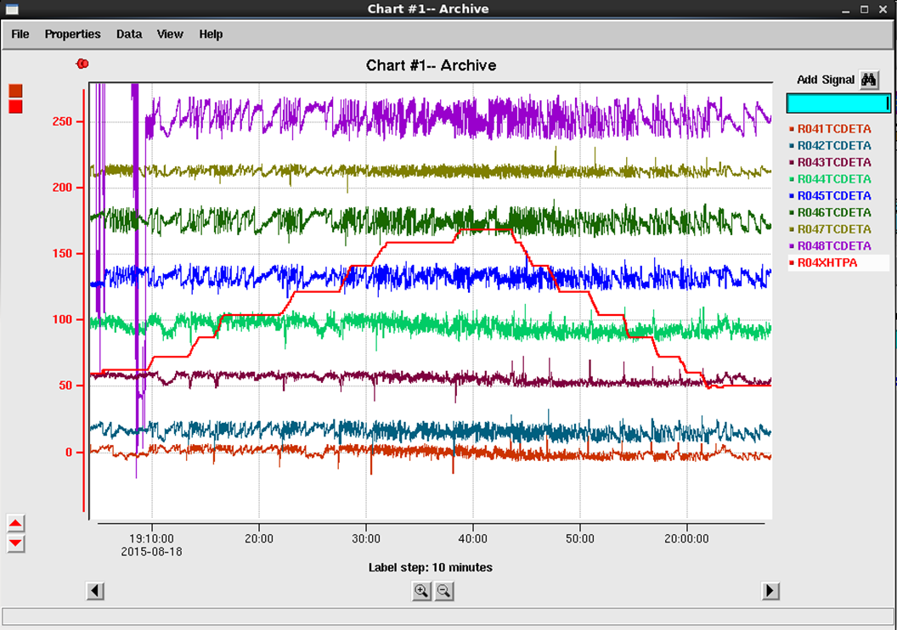
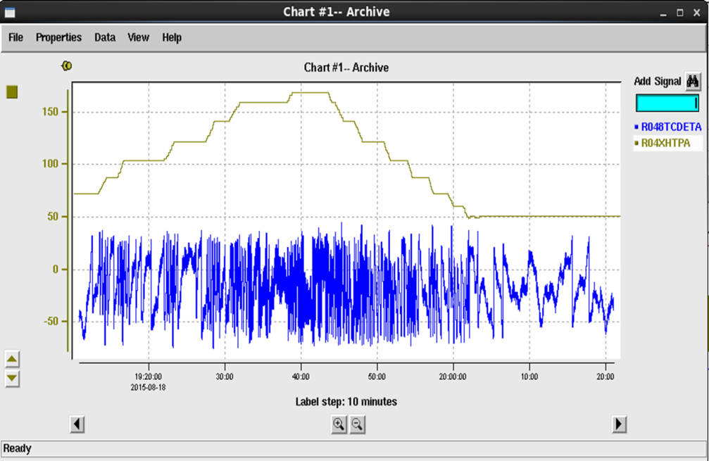
Clues
Also observed - the detune angles in the cavities would show increased oscillation with about 50 watts total heat in the cryomodule, prior to liquid level boiling, and abate when heat was removed
These events spawned an investigation as to why the cryomodule heat capacity was diminished along with cryomodule performance
Total Heat
Detune Angle

Slide 8
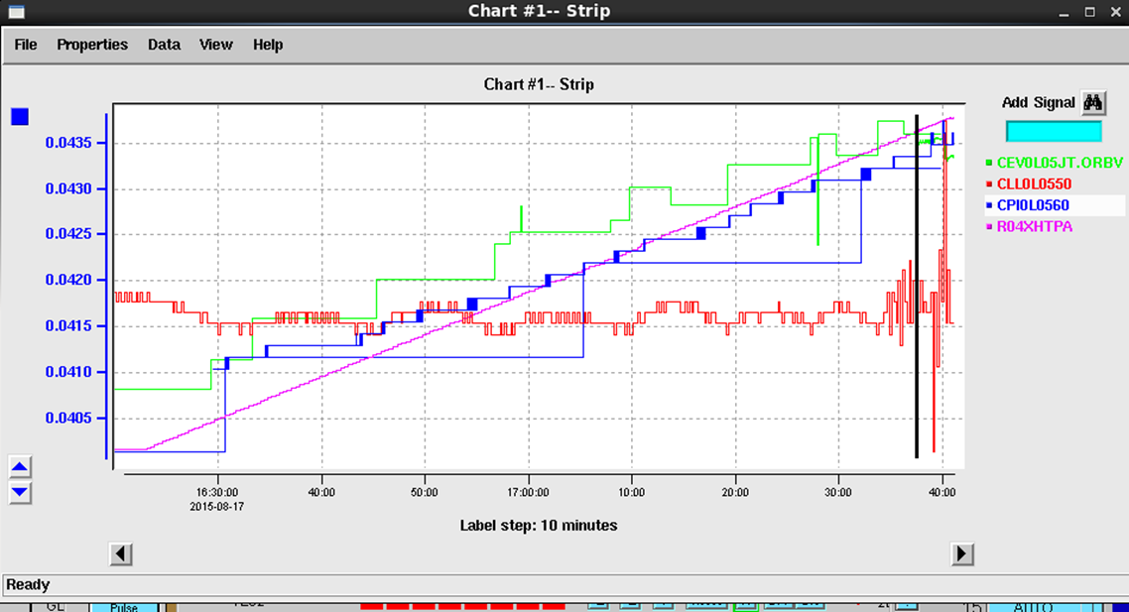
Investigation
I assisted Ed Daly in trying to find the cause for the decreased heat capacity (TN 015-038)
Using liquid level and cryomodule pressure vs electric heat as a metric it was found that the critical heat flux in the riser was being surpassed
At 0.041 atm, heater heat = 142 W At 0.0435 atm, heater heat = 240; LL indicated transition point where critical heat flux in riser is exceeded; 30 W/cavity Expected value should be 50 W/cavity
Helium Pressure
Liquid Level
Total Heat

Slide 9
Investigation
The helium return line pressure as measured at the cryo transfer line “T” during this period was ~0.038 atm, which corresponds to a bout 60 watts CHF limit at the riser. However, due to the pressure rise at the ends of the transfer line in the linacs, the pressure in the cryomodule was estimated to be about 2 to 3 mBar higher. With the addition of heat, the cryomodule pressure rises, and the CHF limit for the riser decreases to around 30 watts

Slide 10
Investigation
Excerpt from TN 015-038:
“Evaluating the Impact of Return Pressure Variation on C100 Cryomodule Performance”
0L04 - Estimation of Pressure and Temperature in Helium Bath
A series of measurements were made on 0L04 using known heater power settings to determine when the transition was occurring by observing the change in liquid level (LL) readback, thereby estimating the local bath pressure [2 – 5]. No RF was applied during any of the measurements. At a measured pressure of 0.041 atm, a heater heat of 142 W was applied uniformly over the eight cavity heaters. The LL readback was stable. The heater heat was ramped until the LL readback began to fluctuate indicating a transition. The measured pressure was 0.0435 atm, and the heater heat was 240 W. Since there are eight cavities in this CM, the critical heat flow per riser is 1/8 of this total power, or 30 W per cavity. Using Figure 3, a value of 30 W corresponds to an inferred bath temperature and pressure of 2.13 K and 0.044 atm.
It should be noted that the bath pressure increases with mass flow rate and corresponding heat loads in the CM. The value of 2.07 K and 0.0375 atm specified corresponds to an expected total heat load of 300 W. The additional pressure drop due to mass flow is at maximum 0.003 atm. Even at 2.1 K in the bath, the critical heat flow is 50 W per cavity or 400 W per CM.
Using the cavity heaters and the LL as an indicator, the local bath pressure can be estimated.

Slide 11
Conclusions
For the C100 cavities, helium return pressure and stability is critical for maintaining maximum cryomodule performance
There is a detectable pressure rise at the ends of the helium transfer lines that require offsets to the measured pressure at the “T” for the cryogenic plant to account for the pressure differential at the cryomodules at the far ends of the lines
Still work to do – Why was detune angle affected at heat levels well below CHF limits, prior to observable liquid boiling?
From the tech note:
It appears that regardless of the source, when heat in the module is increased the tuning becomes increasingly unstable. This is possibly due to bubbles created as the critical heat flow is exceeded in the risers. It is expected that at reduced pressures, this instability would be reduced or eliminated.

Slide 12
Acknowledgements
Thanks to Ed Daly, Tomasz Plawski, Rama Bachimanchi, Curt Hovater and Tom Powers for their assistance

