Slide 1
Microphonics Experience at Cornell - A collection of results -
Matthias Liepe
Cornell University
M. Liepe Microphonics Workshop, FNAL October 8-9 Slide 1

Slide 2
Outline
Microphonics results from
CESR
Cornell ERL Injector Cryomodule
Cornell Main Linac Cavity HTC Testing
HZB, Jlab FEL…
Conclusions
M. Liepe Microphonics Workshop, FNAL October 8-9 Slide 2

Slide 3
CESR
M. Liepe Microphonics Workshop, FNAL October 8-9 Slide 3

Slide 4
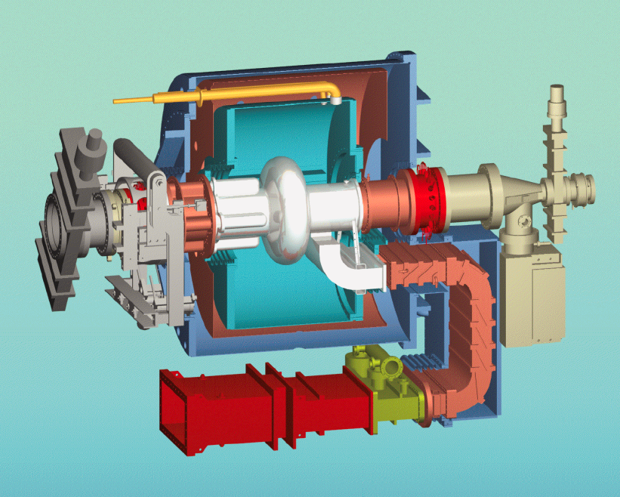
500 MHz CESR SRF
100
σ_{Δf} ≈ 13 to 15 Hz
50
detuning [Hz]
0
-50
-100
0
0.2
0.4
0.6
0.8
1
time [sec]
500 MHz cavities, operated at 4.2 K
Strong microphonics, broad spectrum
M. Liepe Microphonics Workshop, FNAL October 8-9 Slide 4

Slide 5
CESR: Microphonics Spectrum
x 10
5
4
Microphonics spectrum
3.5
3
2.5
2
1.5
fft amplitude [arb. units]
1
0.5
0
0
20
40
60
80
100
120
140
160
180
200
frequency [Hz]
2500
Mechanical resonances
Low frequency mechanical resonances
Resonance frequencies change with time and vary from cavity to cavity
2000
1500
amplitude [arb. units]
1000
500
0
0
10
20
30
40
50
60
70
80
90
100
frequency [Hz]
M. Liepe Microphonics Workshop, FNAL October 8-9 Slide 5

Slide 6
Cornell ERL Injector Cryomodule
M. Liepe Microphonics Workshop, FNAL October 8-9 Slide 6

Slide 7
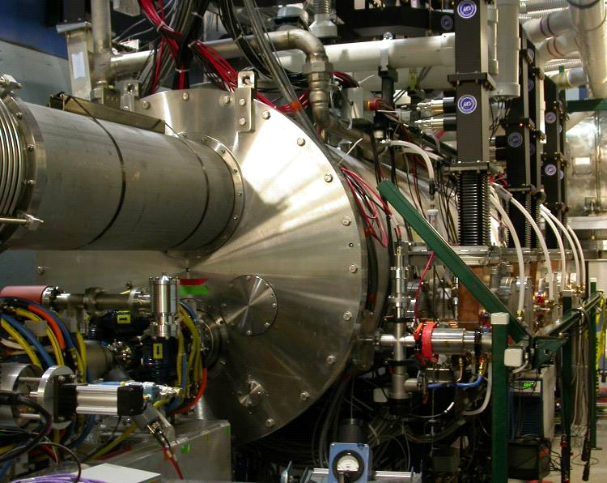
1.3 GHz ERL Injector Cryomodule
Refrigeration
transfer lines
Waveguide
from klystron
Beam exit
Number of 2-cell cavities 5
Acceleration per cavity 1 – 3 MeV
Accelerating gradient 4.3 – 13.0 MV/m
R/Q (linac definition) 222 Ohm
Q_{ext} 4.6×10⁴ – 4.1×10⁵
Total 2K / 5K / 80K loads: 30W / 60W / 700W
Number of HOM loads 6
HOM power per cavity 40 W
Couplers per cavity 2
RF power per cavity 120 kW
Amplitude/phase stability 10⁻⁴ / 0.1° (rms)
ICM length 5 m
M. Liepe Microphonics Workshop, FNAL October 8-9 Slide 7

Slide 8
ERL Injector: Microphonics Bursts
Significant changes over time
Step impulses at ~second rep-rate!?
After improvements
M. Liepe Microphonics Workshop, FNAL October 8-9 Slide 8

Slide 9
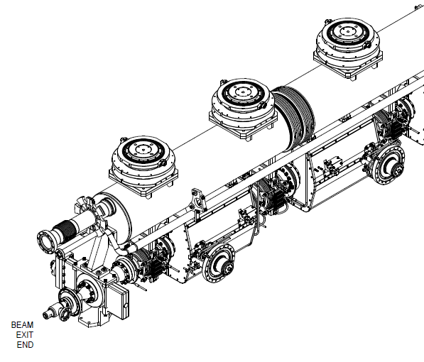
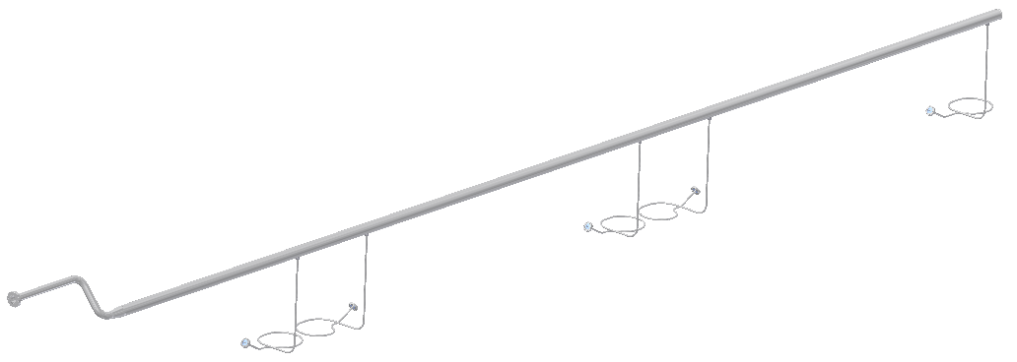
ERL Injector: Source of Microphonics Bursts
Source of “bursts”:
Thermo-acoustic oscillations in
Warm Up – Cool Down plumbing
Closed end (valve) creates dead end with trapped gas
M. Liepe Microphonics Workshop, FNAL October 8-9 Slide 9

Slide 10
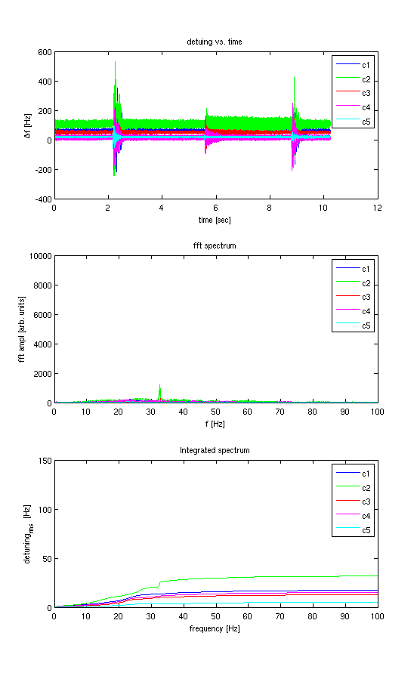
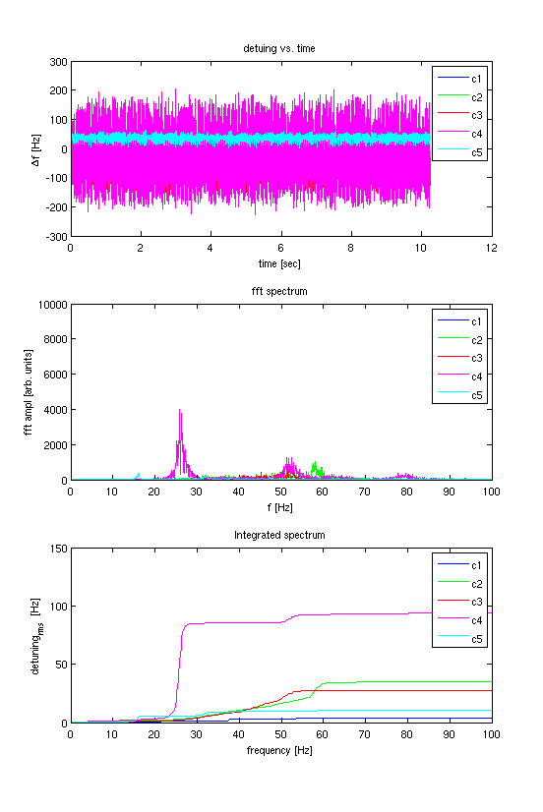
Microphonics Bursts Studies
Warm up – cool down valve closed
Warm up – cool down valve slightly open
M. Liepe Microphonics Workshop, FNAL October 8-9 Slide 10

Slide 11
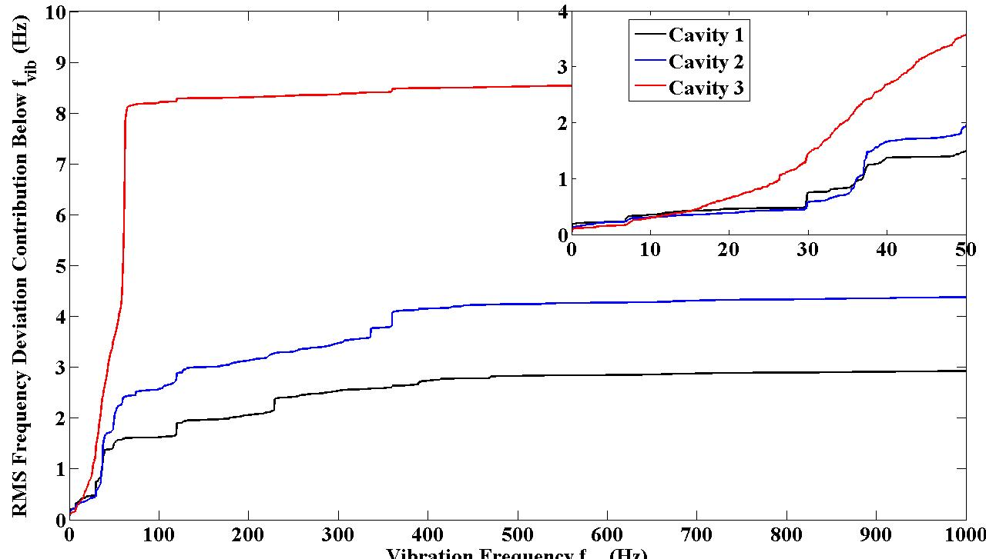
1.3 GHz ERL Injector Cryomodule: Microphonics
Significant differences between cavities
σ_{f} = 3 to 8 Hz
Vibration frequency [Hz]
M. Liepe Microphonics Workshop, FNAL October 8-9 Slide 7

Slide 12
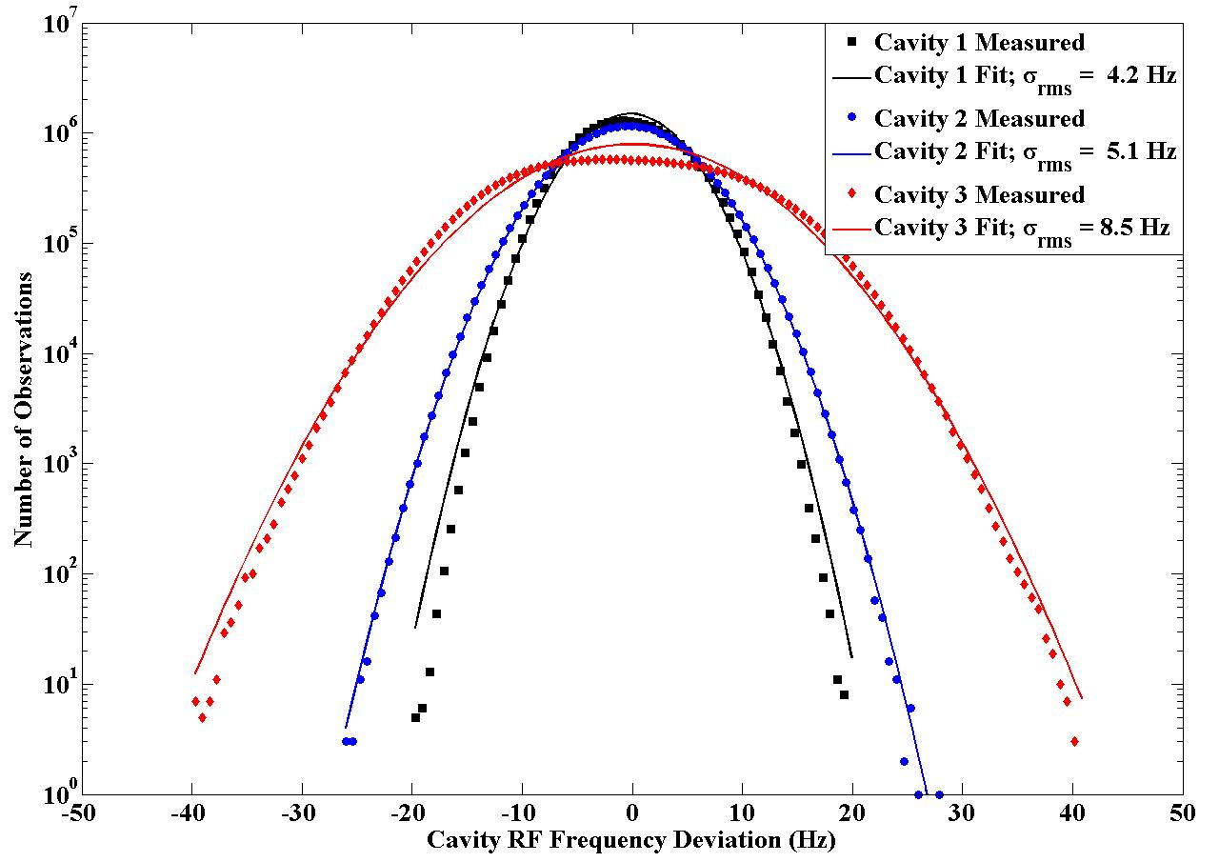
ERL Injector: Microphonics Histogram
Measured during “step-impulse free time”
Graph shows histogram of 30 million samples over a period of 1 hour
Δf_{max} < 5*σ_{f}
M. Liepe Microphonics Workshop, FNAL October 8-9 Slide 12

Slide 13
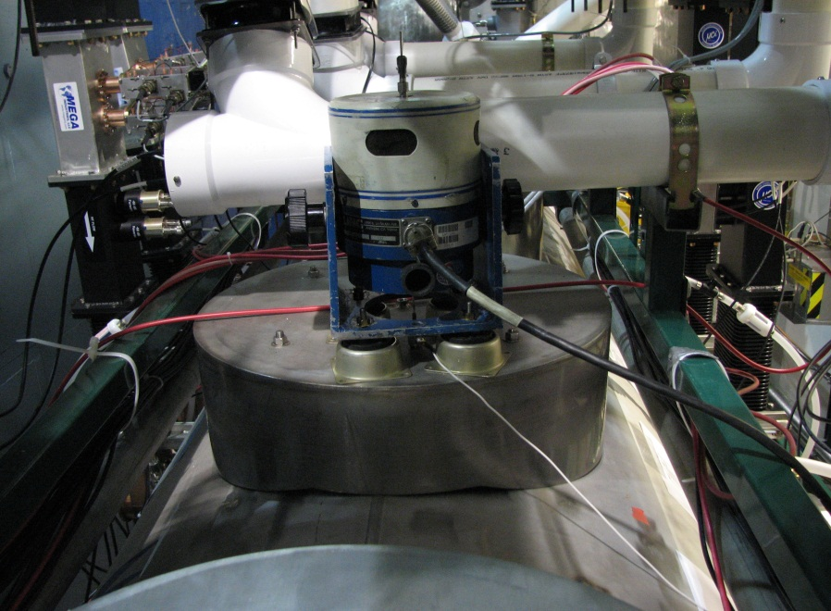
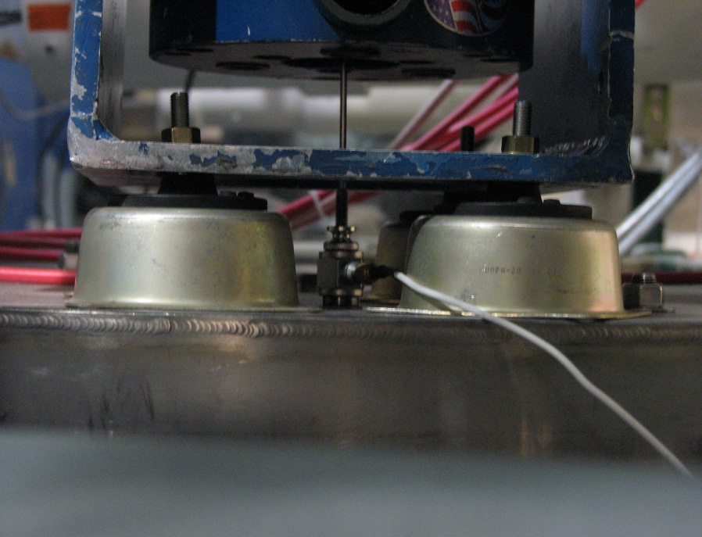
Mechanical Coupling Characterization Measurements with a Modal Shaker
M. Liepe Microphonics Workshop, FNAL October 8-9 Slide 13

Slide 14
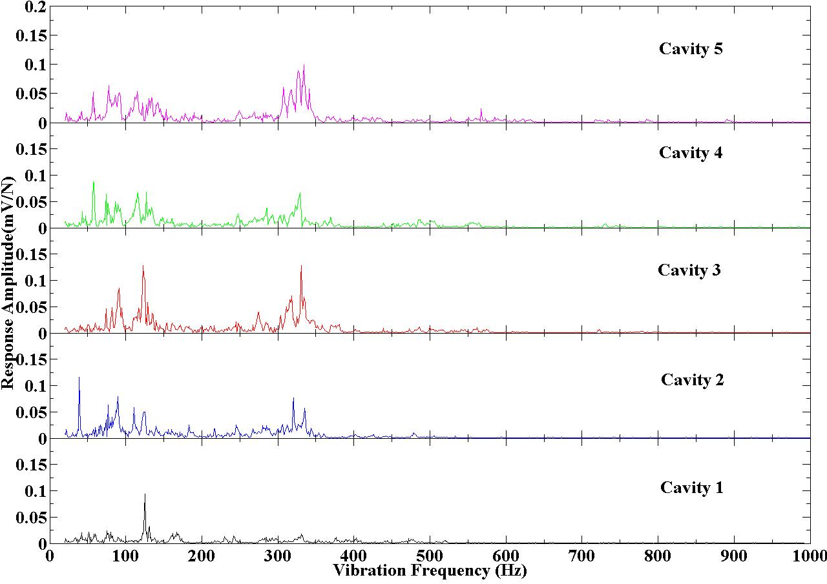
Measurements with a Modal Shaker
Shaker on module support
Shaker on module top (HGRP support)
Response ampl. [arb. units]
Response ampl. [arb. units]
Vibration frequ. [Hz]
Vibration frequency [Hz]
M. Liepe Microphonics Workshop, FNAL October 8-9 Slide 14

Slide 15
Mechanical Coupling Characterization
Excitation Point | Excitation Force | Detectable With Cavity Accelerometer | Detectable On Cavity RF Frequency (>0.1Hz modul.)
Coupler Waveguide | 110 N (25 lbs) | No | No
Coupler | 110 N (25 lbs) | No | No
Cryomodule Saw-Horse Support | 110 N (25 lbs) | Yes | No
Helium Gas Return Pipe Support | 110 N (25 lbs) | Yes | Yes
Beam Line | 10 N (2 lbs) | No | No
Helium Supply/Return | 110 N (25 lbs) | No | No
Ground vibrations and other mechanical vibrations do not strongly couple to the SRF cavities!
Main contribution to cavity microphonics comes from fast fluctuations in the He-pressure and vibrations in the cryogenic system
M. Liepe Microphonics Workshop, FNAL October 8-9 Slide 15

Slide 16
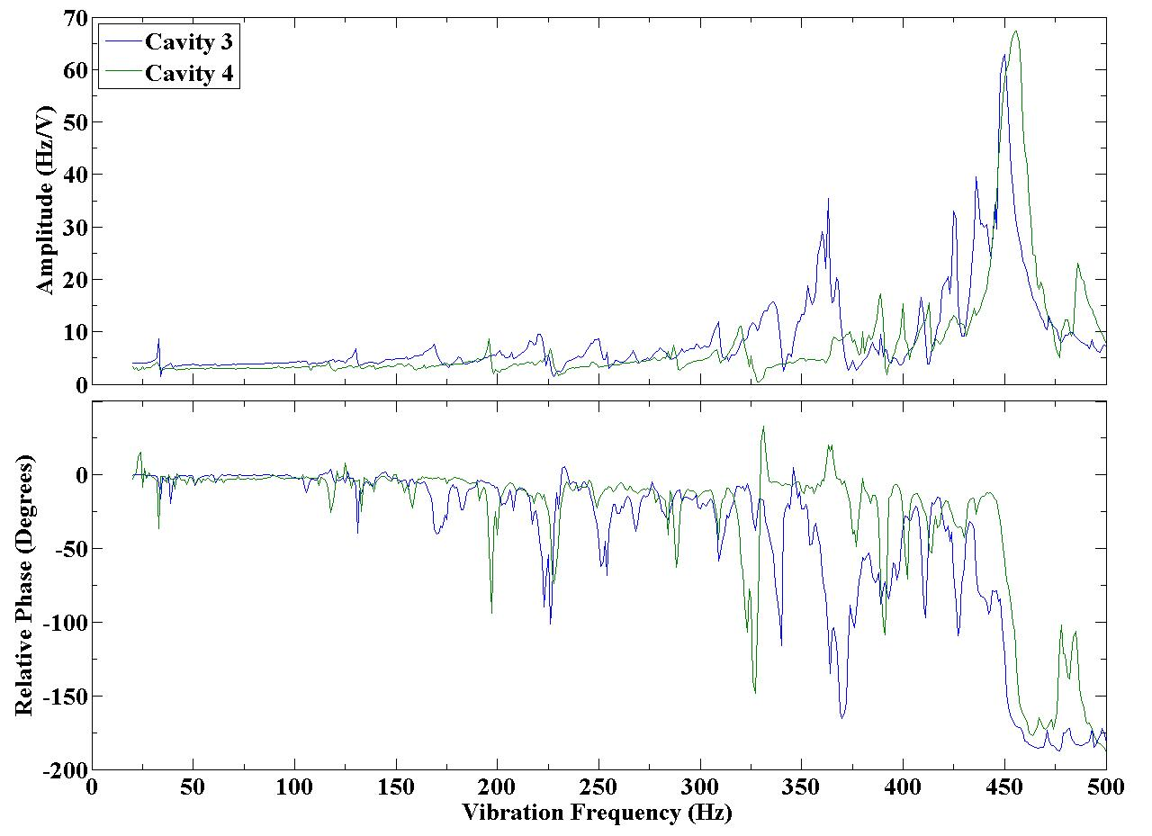
Active Microphonics Control Studies with Fast Piezoelectric Frequency Tuner
Microphonics feedback challenging because of complex transfer function piezo → Δf with mechanical resonances
Linearity and hysteresis issues
Cornell ERL injector cavities
amplitude
phase
Vibration frequ. [Hz]
M. Liepe Microphonics Workshop, FNAL October 8-9 Slide 16

Slide 17
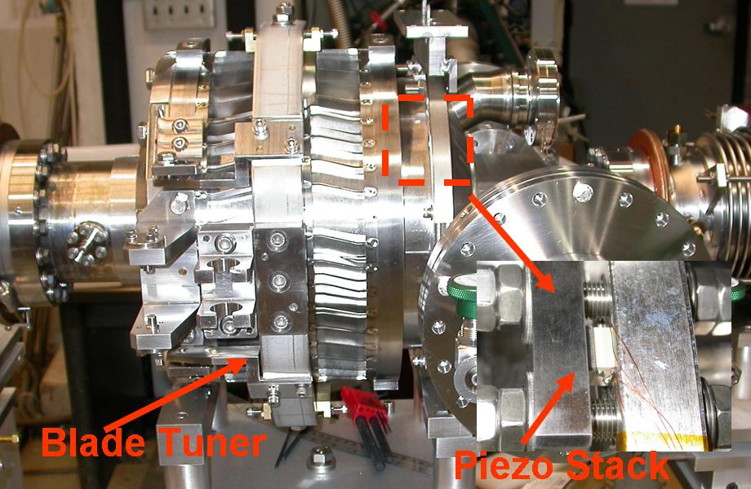
ERL Injector Frequency Tuner
Modification of the INFN blade tuner
Tuning range:
500 kHz stepper
500 Hz piezo
Added piezos for microphonics compensation (R&D)
M. Liepe Microphonics Workshop, FNAL October 8-9 Slide 17

Slide 18
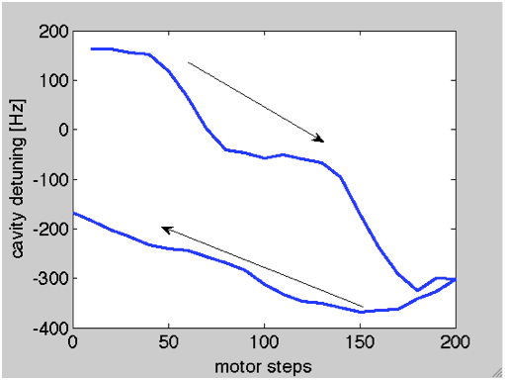
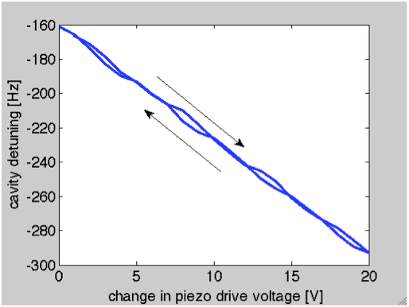
Frequency Tuner Studies
Stepping motor driven tuner: not suitable for fine frequency control!
Piezo driven tuner: suitable for fine frequency control!
M. Liepe Microphonics Workshop, FNAL October 8-9 Slide 18

Slide 19
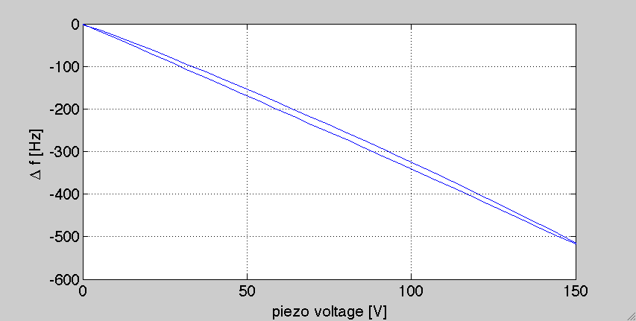
Frequency: Piezo-Tuner Hysteresis
Piezo Hysteresis Curve: DC frequency shift vs. applied voltage to all 4 piezos:
M. Liepe Microphonics Workshop, FNAL October 8-9 Slide 19

Slide 20
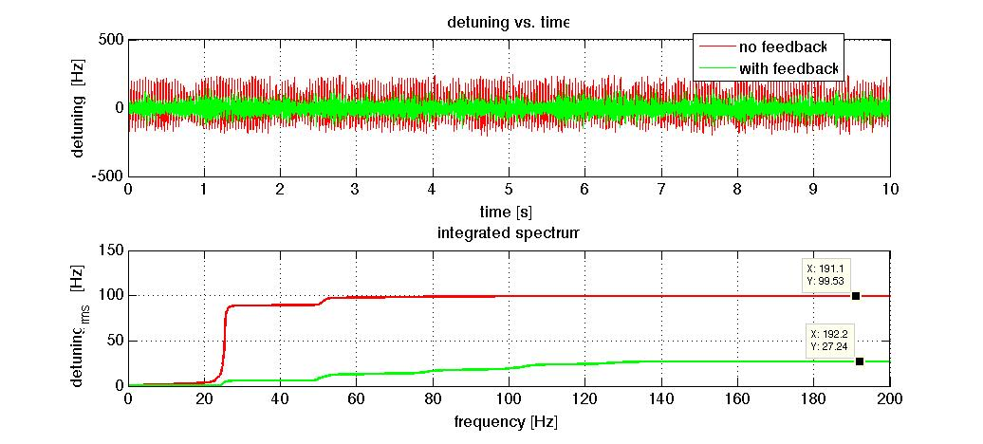
Active Microphonics Compensation
Piezo Feedback on Tuning Angle/Cavity Frequency:
⇒ Reduces rms microphonics by up to 70%!
M. Liepe Microphonics Workshop, FNAL October 8-9 Slide 20

Slide 21
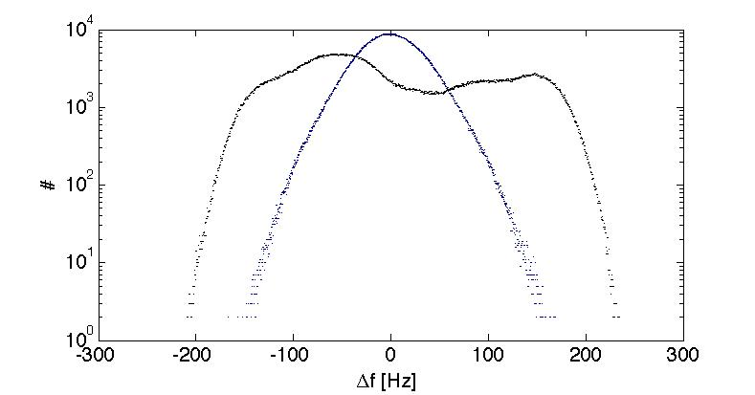
Active Microphonics Compensation
Detuning Histogram: ~30% reduction in peak detuning
Feedback off
Feedback on
M. Liepe Microphonics Workshop, FNAL October 8-9 Slide 21

Slide 22
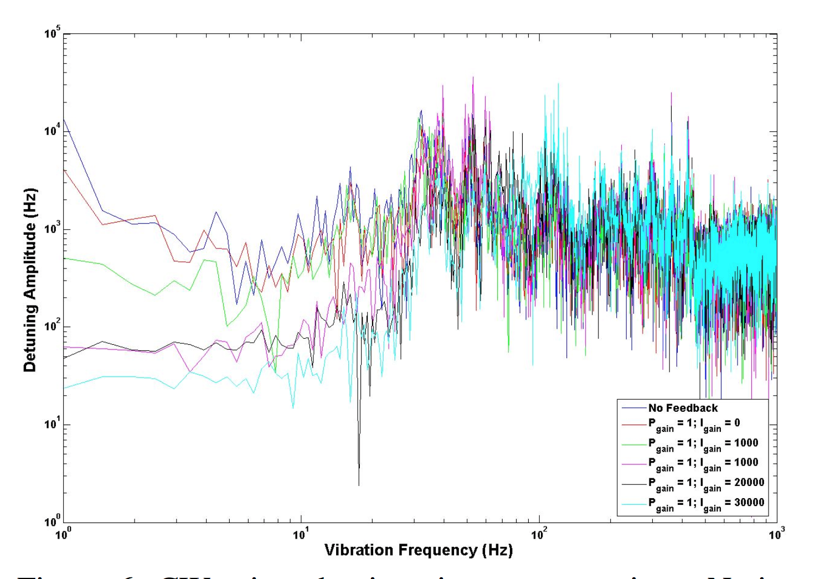
Active Microphonics Compensation
M. Liepe Microphonics Workshop, FNAL October 8-9 Slide 22

Slide 23
Cornell Main Linac Cavity HTC
M. Liepe Microphonics Workshop, FNAL October 8-9 Slide 23

Slide 24
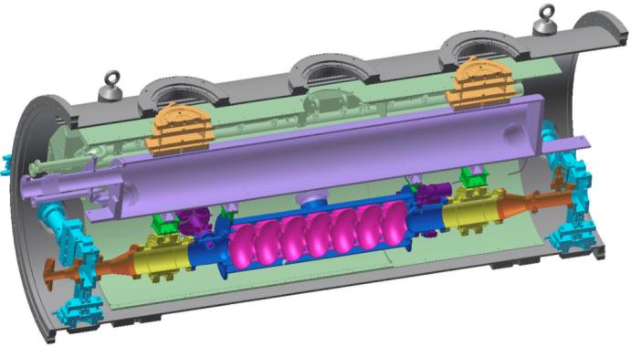
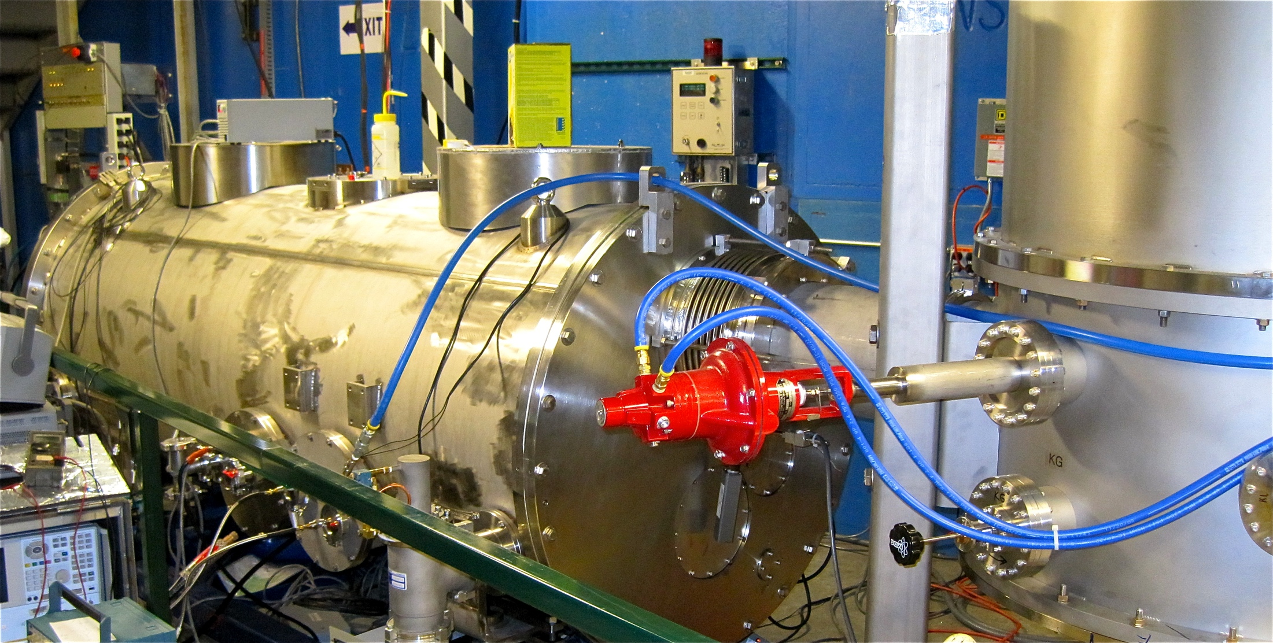
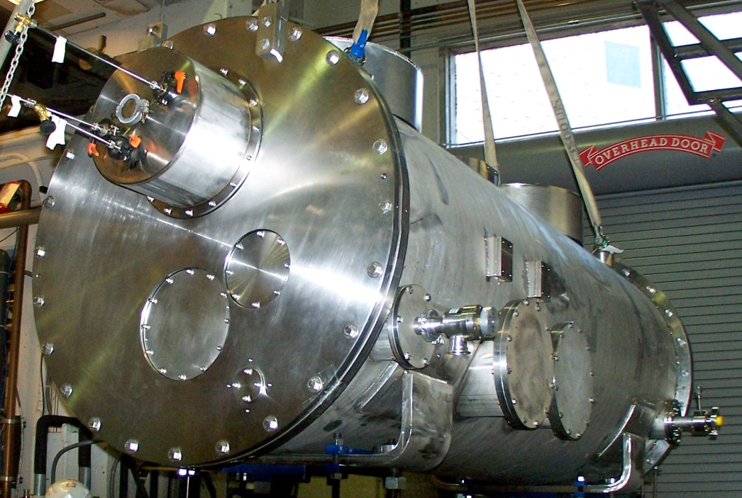
Cornell HTC Test of the Cornell ERL Main Linac Cavity
80K shield
HGRP
Main linac system test in one-cavity test module
1st test: cavity and tuner only
2nd test: add high power RF input
3rd test: add HOM beamline loads
HOM load
cavity
HOM load
Gate valve
Test cryomodule installed at Wilson Lab
M. Liepe Microphonics Workshop, FNAL October 8-9 Slide 24

Slide 25
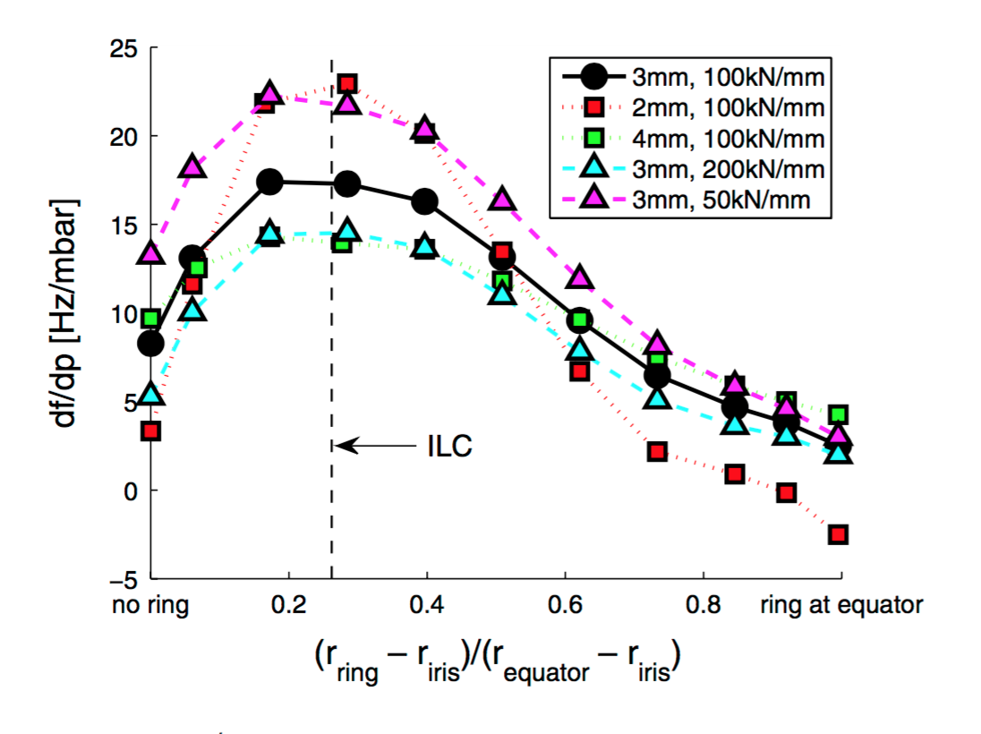
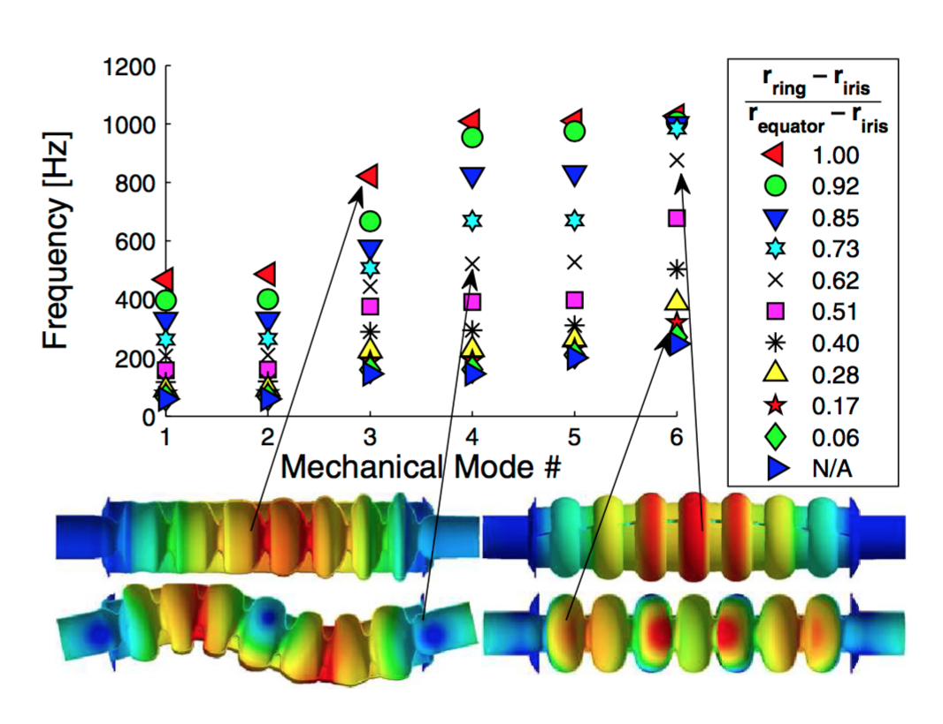
Main Linac Cavity Mechanical Design
Main linac prototype module has
3 cavities without stiffening ring
3 cavities with stiffening ring at ~70% iris-equator distance
M. Liepe Microphonics Workshop, FNAL October 8-9 Slide 25

Slide 26
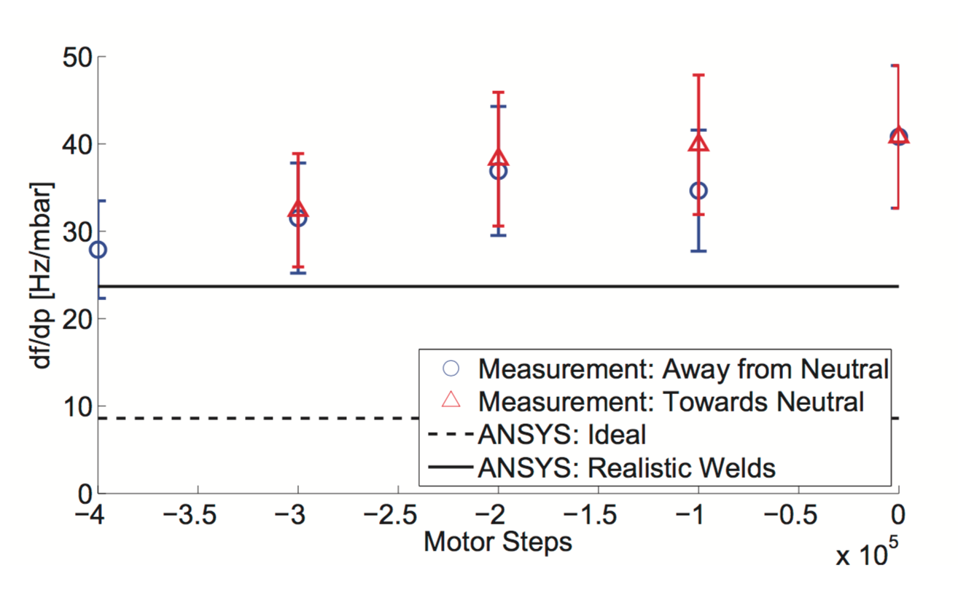
Main Linac Cavity: Measured Detuning Pressure Sensitivity
df/dp as a function of tuner motor steps
M. Liepe Microphonics Workshop, FNAL October 8-9 Slide 26

Slide 27
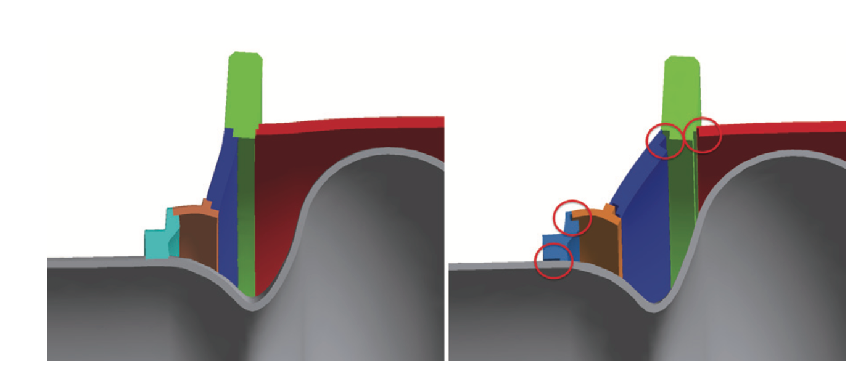
Main Linac Cavity: Detuning Pressure Sensitivity
df/dp as a function of tuner motor steps
Original model for production cavity, deformed by helium pressure
Model in which the welds are modelled more realistically
M. Liepe Microphonics Workshop, FNAL October 8-9 Slide 27

Slide 28
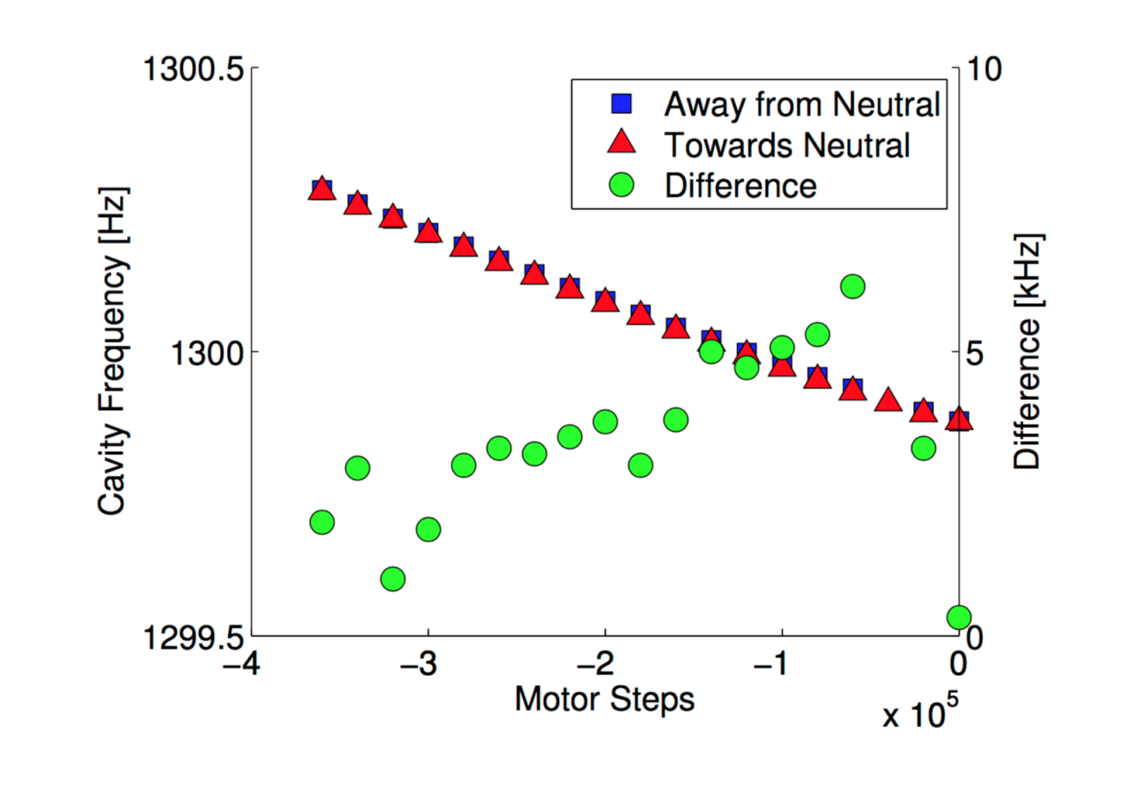
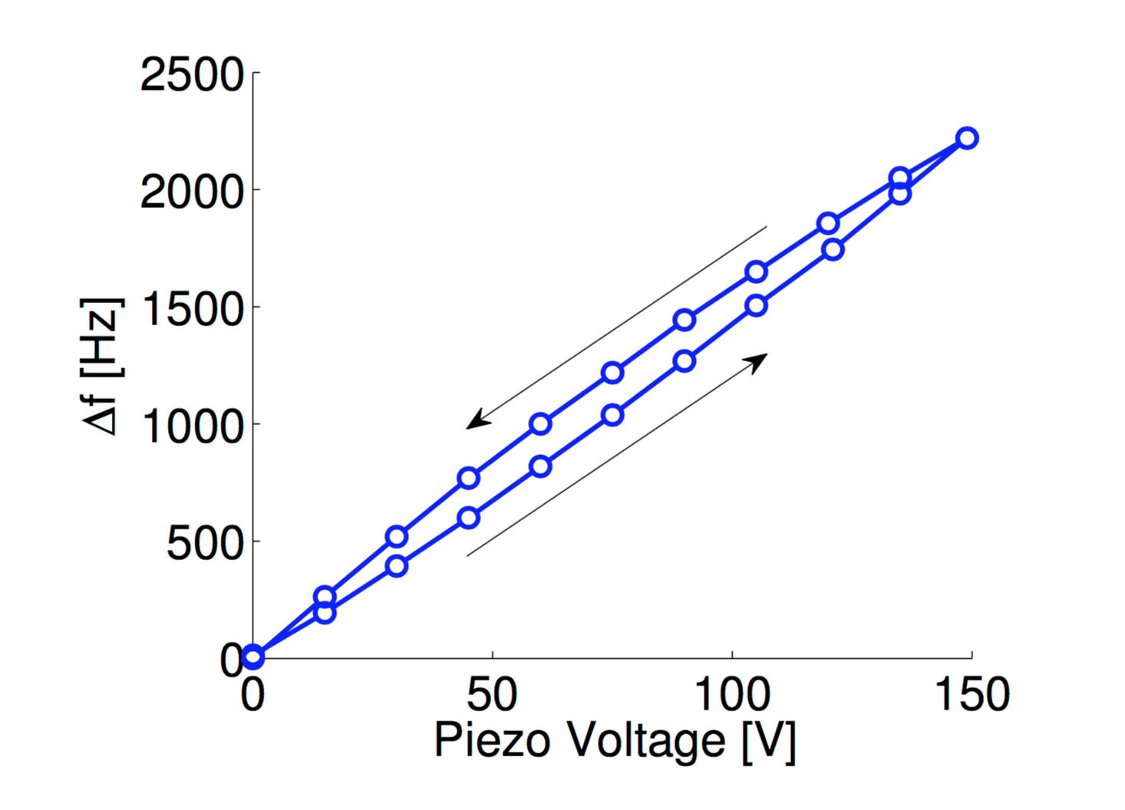
Main Linac Cavity: Tuner Studies
M. Liepe Microphonics Workshop, FNAL October 8-9 Slide 28

Slide 29
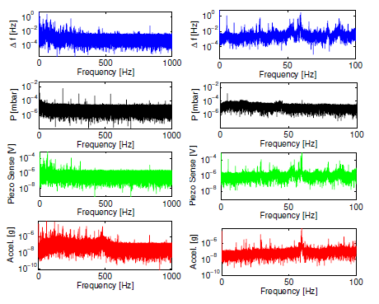
Main Linac Cavity: Vibration and Microphonics Studies
FFT of cavity detuning signal shows 60 Hz
harmonics, but nothing indicative of pumps
M. Liepe Microphonics Workshop, FNAL October 8-9 Slide 29

Slide 30
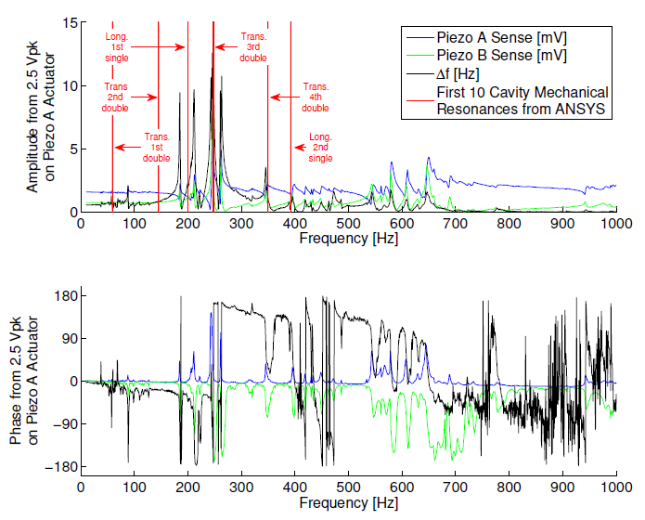
Main Linac Cavity: Mechanical Resonances in HTC-1
Resonances agree fairly with ANSYS predictions for cavity in tank
Several additional resonances in spectrum
M. Liepe Microphonics Workshop, FNAL October 8-9 Slide 30

Slide 31
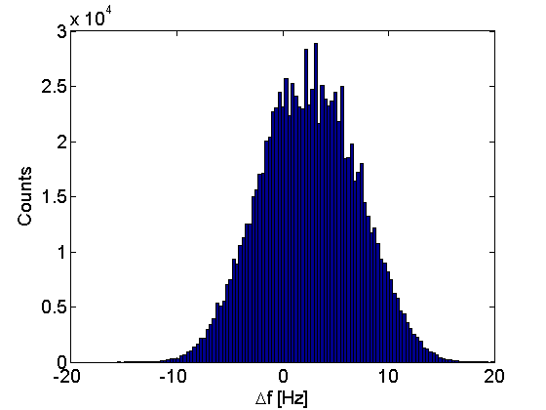
Main Linac Cavity: Microphonics in HTC-1
peak detuning < 20 Hz
RMS detuning ~5 Hz
M. Liepe Microphonics Workshop, FNAL October 8-9 Slide 31

Slide 32
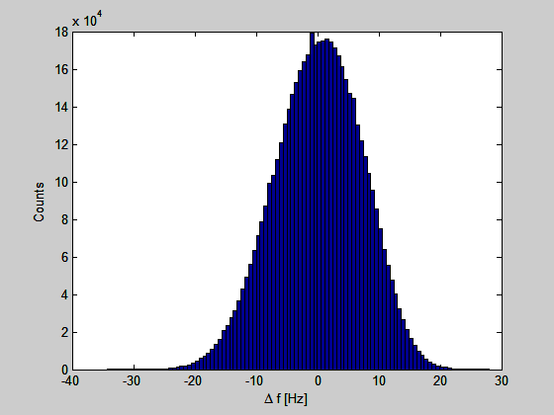
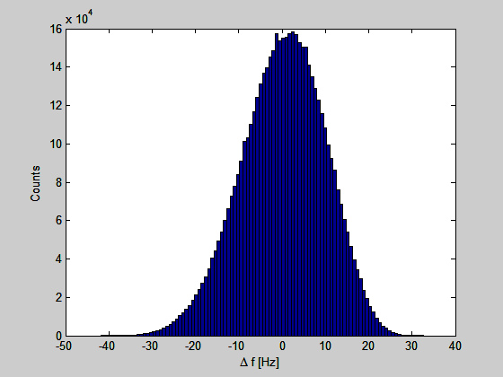
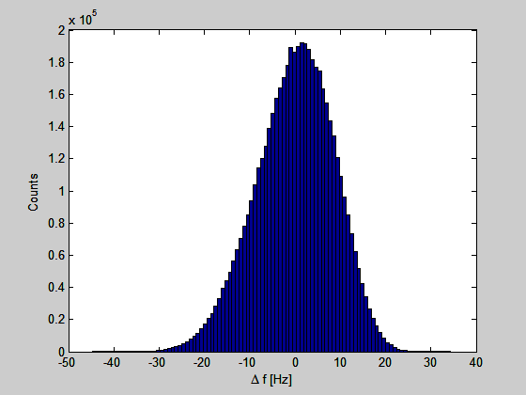
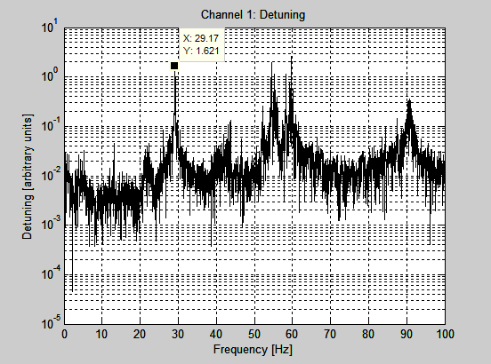
Main Linac Cavity: Microphonics in HTC-3
1.6K
Std: 7.1 HZ
1.8K
Std: 9.6 Hz
2.0K
Std: 8.6 Hz
FFT shows line @
pump frequency
M. Liepe Microphonics Workshop, FNAL October 8-9 Slide 32

Slide 33
HZB, Jlab FEL…
M. Liepe Microphonics Workshop, FNAL October 8-9 Slide 33

Slide 34
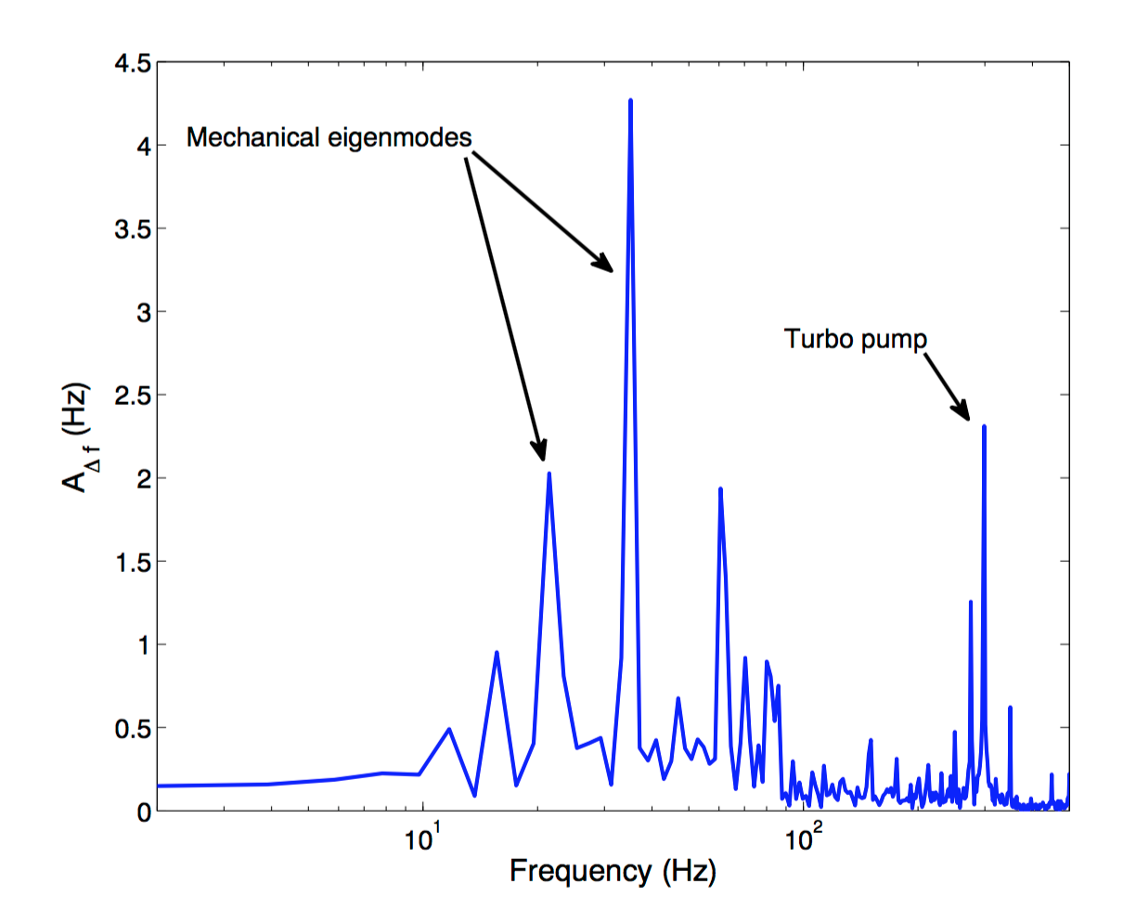
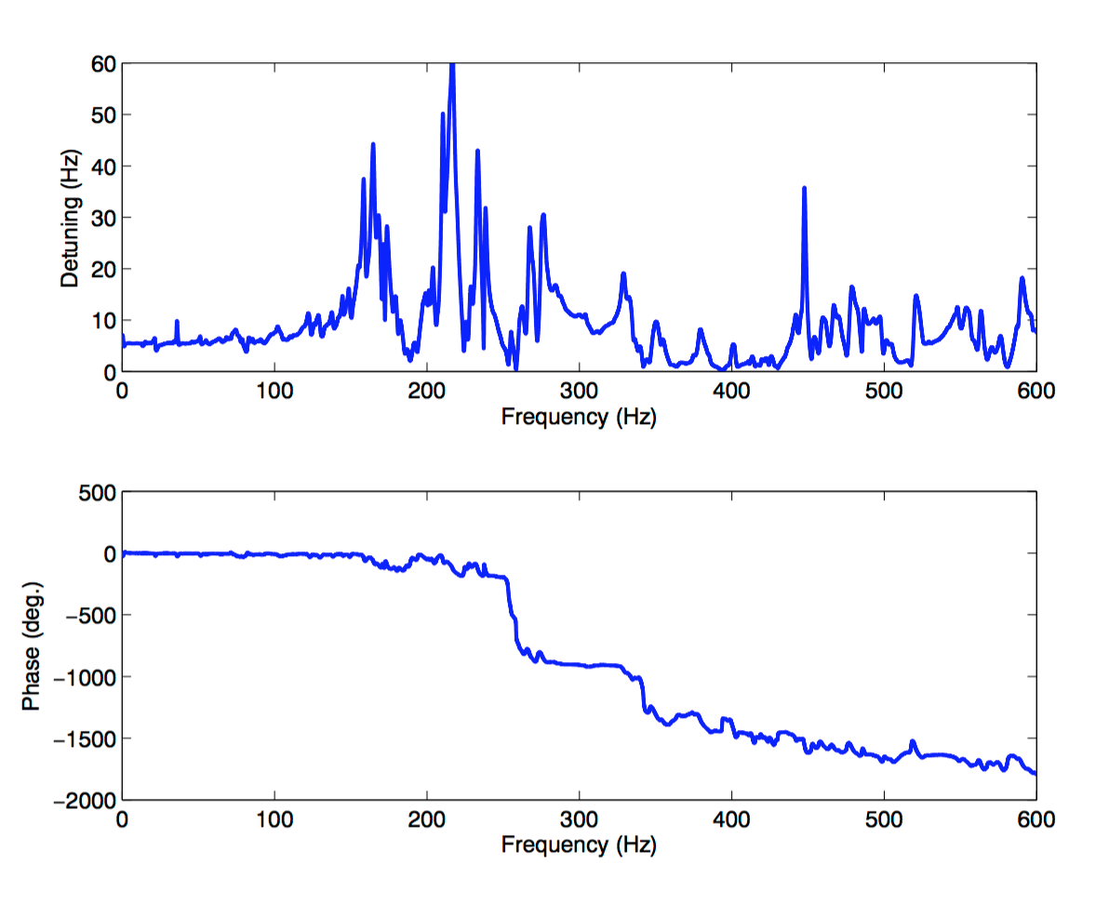
9-cell Test in HZB Hobicat With Cornell LLRF System and Saclay Tuner
Microphonics Spectrum
Piezo to Detuning Transfer Function
Strong mechanical resonances
RMS detuning of 4 Hz with 15 Hz peak detuning
M. Liepe Microphonics Workshop, FNAL October 8-9 Slide 34

Slide 35
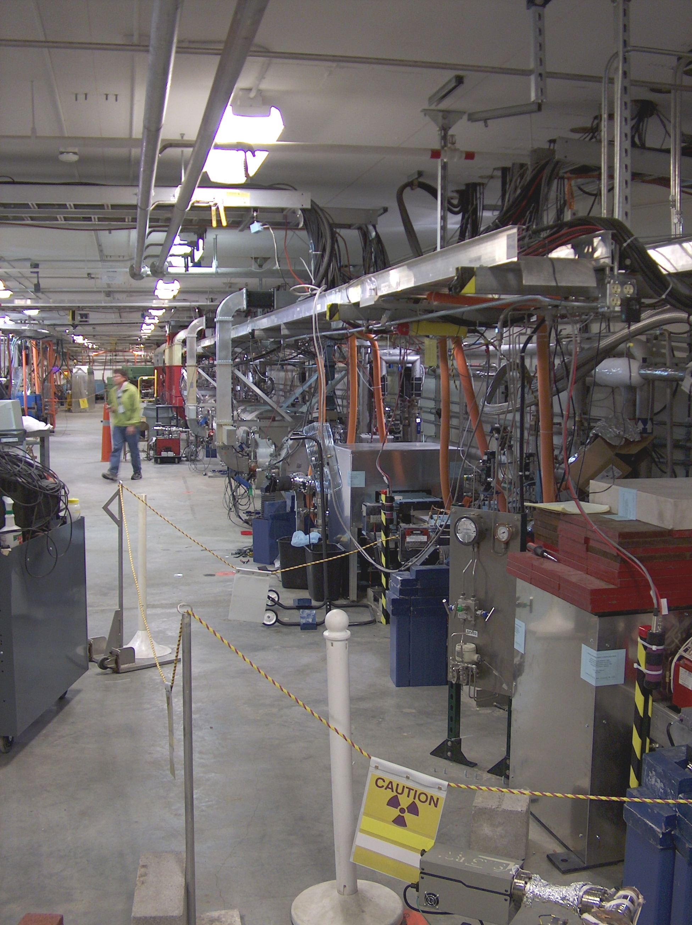
JLAB Upgrade Cryomodule Test With Cornell LLRF System
JLab FEL
5000
4000
3000
# of measurements
2000
1000
0
-6
-4
-2
0
2
4
cavity detuning [Hz]
M. Liepe Microphonics Workshop, FNAL October 8-9 Slide 35

Slide 36
JLAB Upgrade Cryomodule Test With Cornell LLRF System
Automated resonance hunting
cavity on resonance
cavity detuned by 30 kHz (400 bandwidths)
acc. field [MV/m]
4
0
time [minutes]
M. Liepe Microphonics Workshop, FNAL October 8-9 Slide 36

Slide 37
JLAB Upgrade Cryomodule Test With Cornell LLRF System
piezo feedback/feedforward off
piezo feedback/feedforward on
cavity field
[MV/m , kW]
time [seconds]
constant forward (klystron) power (≈ 210 W)
M. Liepe Microphonics Workshop, FNAL October 8-9 Slide 37

Slide 38
JLAB Upgrade Cryomodule Test With Cornell LLRF System
15
Start-up: Field Ramp at Q_{L} = 1.2·10⁸
10
accelerating field [MV/m]
≈ 150 Hz Lorentz-force detuning (compensated by piezo feedforward ), cavity half bandwidth = 6 Hz !
5
0
0
0.2
0.4
0.6
0.8
1
time [sec]
M. Liepe Microphonics Workshop, FNAL October 8-9 Slide 38

Slide 39
JLAB Upgrade Cryomodule Test With Cornell LLRF System
0
Piezo drive signal to compensate
Lorentz-force detuning
-1000
-2000
cavity filling
piezo drive signal
[arb. units]
-3000
-4000
-5000
0
0.2
0.4
0.6
0.8
1
time [sec]
20
Lorentz-force detuning without compensation: 150 Hz
10
detuning [Hz]
0
-10
remaining microphonics
-20
cavity half bandwidth: 6 Hz
-30
0
0.2
0.4
0.6
0.8
1
time [sec]
M. Liepe Microphonics Workshop, FNAL October 8-9 Slide 39

Slide 40
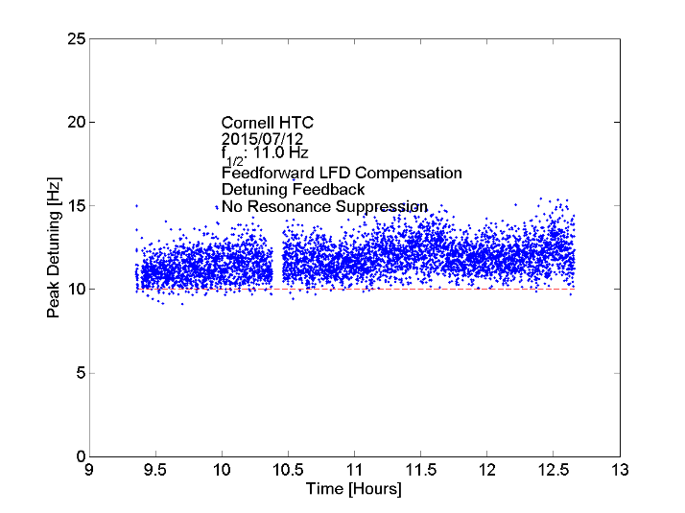
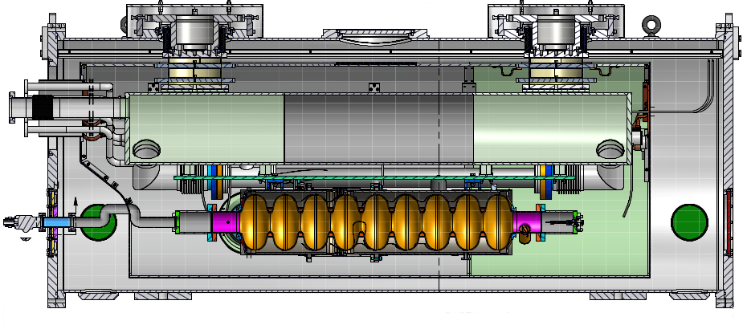
Cornell HTC with LCLS-II Prototype Cavity (measurements by FNAL team)
M. Liepe Microphonics Workshop, FNAL October 8-9 Slide 40

Slide 41
Conclusions
M. Liepe Microphonics Workshop, FNAL October 8-9 Slide 41

Slide 42
Conclusions
Microphonics levels vary significantly from cavity to cavity
Microphonics spectra are often complex with many lines, making active compensation more challenging
Ground vibrations might not be the main driving source, but the He-system might be
Passive compensation/mechanical design for low microphonics can be powerful, but not always possible
Active compensation feasible within limits, but challenging. Success strongly depends on actual microphonics spectrum
Easier to reduce RMS then peak detuning value!
Best Cornell results are ~20 Hz peak detuning for long periods of time (hours)
Much more work needed to understand dominant sources of microphonics, how to reduce them, and to improve active compensation
M. Liepe Microphonics Workshop, FNAL October 8-9 Slide 42

Slide 43
Thank you for your attention!

