Slide 1
Overview of TPC Signal Processing
Xin Qian
BNL

Slide 2
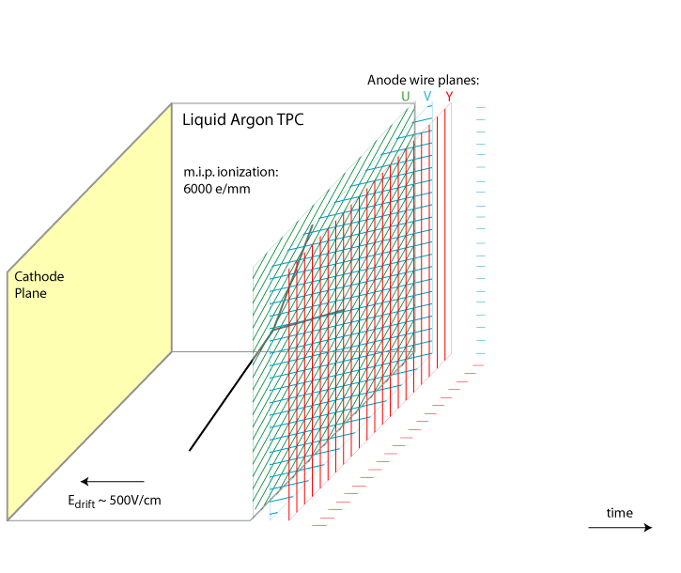
Overview of Signal Processing
Number of ionized electrons
V. Radeka
Field Response
Signal on Wire Plane
Electronics Response
Signal to be digitized by ADC
(Deconvolution)
High-level tracking …
time
TPC signal consists of time and charge information from induction and collection planes
Same amount charge was seen by all the wire planes
The goal of signal processing is to extract both time and charge information reliably

Slide 3
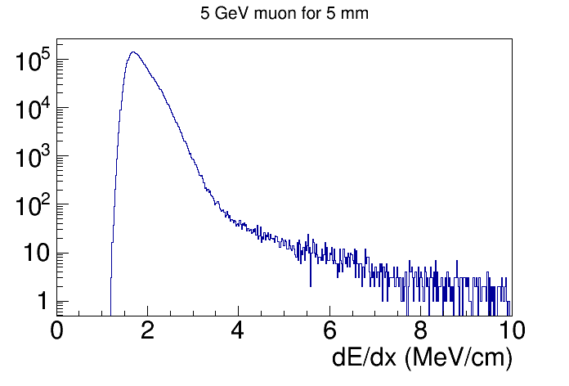
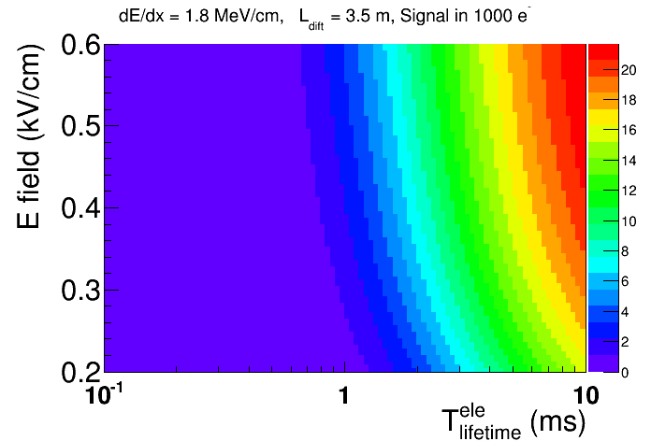
What will affect TPC signal?
E-field:
Electron drift velocity
Recombination factor
Electron lifetime
Drift distance → drift time → signal size
Track angle
Time structure of signal
dE/dx
Recombination etc.
Diffusion
dE/dx fluctuations
MPV: ~ 1.8 MeV/cm

Slide 4
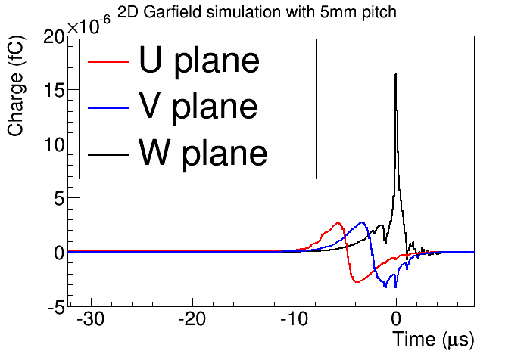
Field and Electronics Response
Leon, SLAC
Charge vs. Time averaged for a single electron
Difference between simulation and data (bigger signal in LongBo arXiv:1504:00398)
Cold electronics:
4 shaping time (0.5, 1.0, 2.0, 3.0 us)
4 gain (4.7, 7.8, 14, 25 mV/fC)

Slide 5
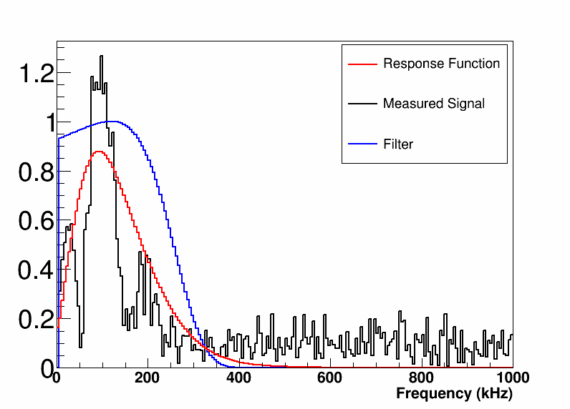
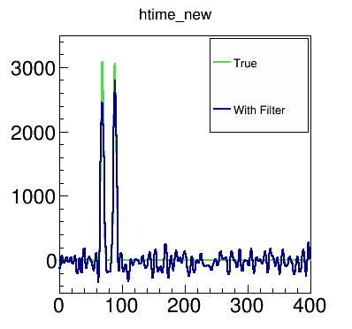
Deconvolution
Frequency Content
Time domain
Fourier transformation
Deconvoluted Signals
Frequency domain
The goal of deconvolution is to help extract charge and time information from TPC signals
Back to time domain
Anti-Fourier transformation
Time Domain
Notes:
Explain
1. What is filter like in the frequency domain?
2.Why filter is necessary (e.g. plot results w and w.o. filter )
3. Why we need a zero at zero frequency?

Slide 6
Deconvolution and Matrix Inversion
Time domain
We can also write the formula in a discrete manner
If there is no filter function in the deconvolution process , the FFT deconvolution is basically equivalent to the matrix inversion problem
Fourier transformation
Frequency domain
Anti-Fourier transformation
Back to time domain

Slide 7
Matrix Inversion and Chi-square
Matrix inversion can be derived through Chi-square
Now, we recovered the solution in the previous slice
The last equation is in matrix format

Slide 8
Adding a Penalty in Chi-square
Let’s use the second derivative to penalty
The second derivative can be written as
, in this case

Slide 9
Continue
The solution is thus
So, we have an additional term of applied to the original solution

Slide 10
A in Matrix vs. Filter in Deconvolution
A in matrix format is multiplied to the original solution → effective a smearing function
Filter in deconvolution is effective a smearing function
Therefore, we can conclude that they are equivalent!
Filter is equivalent to a penalty in the chi-square
Filter is equivalent to a smearing function

Slide 11
TPC Optimization
The measured signal inside TPC contains both signal and (electronic) noise
Assuming deconvolution is correctly performed, we recover the signal completely
Therefore, deconvolution of noise would become uncertainty of charge → smaller the better!
The relevant factors are noise level and response functions
Noise level → electronics, wire length …
Response function → Gap between planes, E-field between planes
This study does not require high-level reconstruction

Slide 12
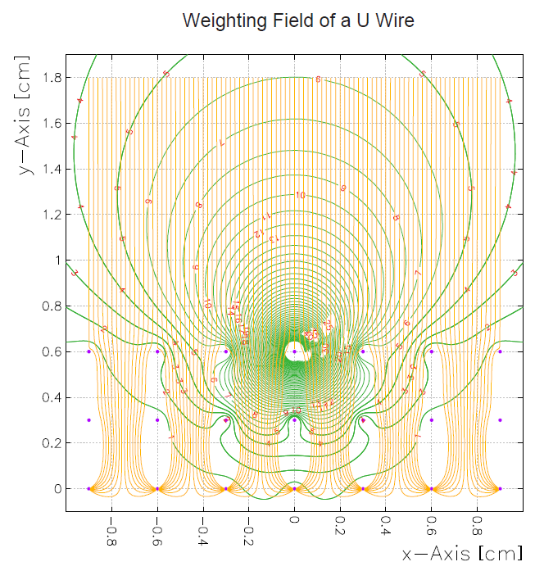
A new Challenge: Induced Charge in Adjacent Wires
V. Radeka Ann. Rev. Nucl. Part. Sci. 38, 217, 1988
v: velocity
E_{w}: weighting field
q_{m}: charge
Bo Yu for MicroBooNE configuration

Slide 13
Double Deconvolution
With induced signals, the signal is still linear sum of direct signal and induced signal
R₁ represents the induced signal from i+1th wire signal to ith wire
S_{i} and S_{i+1} are not directly related
The inversion of matrix R can again be done with deconvolution through 2-D FFT

Slide 14
Simulated by Yichen Li (BNL)
Different curves represent different positions for initial electron
Black → closest to the wire
Green → furthest from the wire
For induction plane, the signal size depends on the position → uncertainty in the charge as we used “average” response function
For collection plane, the signal arrival time depends on the position → uncertainty in the charge

Slide 15
About Wire Pitch
Bigger wire pitch → bigger signal
With same electronics noise, the noise/signal will be smaller → good
Bigger wire pitch → bigger effect due to position-dependent field response → bigger spread of reconstructed signal → bad
Naively, we expect the signal has a form of
a: position-dependent field response,
b: electronics noise
Figure out a&b with detector parameters

Slide 16
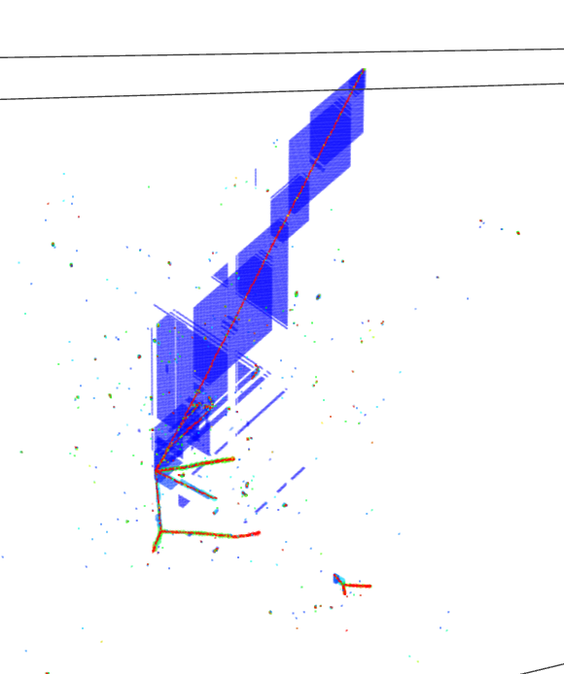
Angle of TPC
In a neutrino event, because of incident neutrino energy, the entire event is more boosted toward forward region
Due to nucleon response, the lepton tends to going more forward in the center-of-mass frame
TPC with wire readout has more trouble to reconstruct “tracks” which are parallel to the wire plane → charges arrive at various wire-plane at same time → ambiguity to figure out the proper correlation
http://www.phy.bnl.gov/wire-cell/ bee/set/4/event/2/

Slide 17
Detector Angle
http://www.phy.bnl.gov/wire-cell/bee/set/7515fe16-d163-4df8-ad87-09f7c809dc7e/event/0/
Same events (rotate 0-19 degrees)
Event 0 → 0 degrees
Event 10 → 10 degrees
Event 19 → 19 degrees

Slide 18
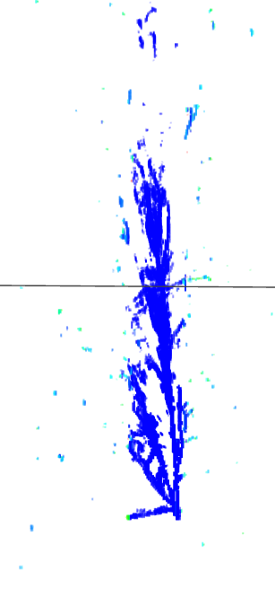
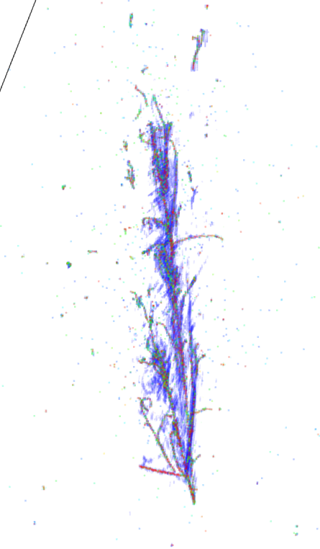
One can click the web-site to look at events in 3D and rotate to get a better understanding.
0 degrees
10 degrees
10 degrees (truth)

Slide 19
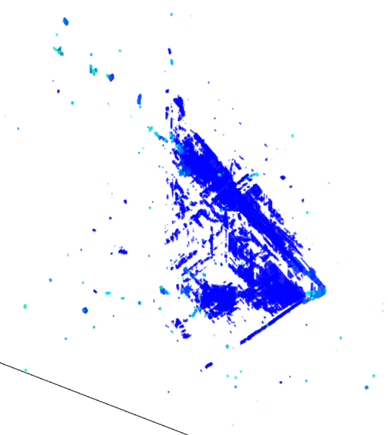
10 degrees
19 degrees
http://www.phy.bnl.gov/wire-cell/bee/set/6/event/8/
MC truth: one electron, one neutral pion, and one positve pion

