Slide 1
PIP-II Overview: Goals, Status, and Strategy
Steve Holmes
PIP-II Collaboration Meeting
9 November 2015

Slide 2
Outline
Update since Last Meeting (June 2014)
PIP-II Status and Strategy
FY16-17 Goals and Budgets
Meeting Goals and Agenda
Our websites:
http://pip2.fnal.gov/
(See Collaboration Information for useful links)
Meeting website:
https://indico.fnal.gov/conferenceDisplay.py?confId=10586

Slide 3
News Since June (2014)
Reference Design Report (RDR)
Released in May in advance of the DOE Review
http://pip2-docdb.fnal.gov/cgi-bin/ShowDocument?docid=1
PIP-II Machine Advisory Committee (P2MAC)
Met in March 2015 (3rd meeting)
Review of Reference Design and associated R&D Program
https://indico.fnal.gov/categoryDisplay.py?categId=366
Notes:
Test
3

Slide 4
News Since June (2014)
DOE Independent Review of PIP-II/June 16-17, 2015
https://indico.fnal.gov/conferenceDisplay.py?confId=9939
Review based on:
RDR
Cost Estimate with offsets for international contributions
Construction period FY2019-FY2023
Proposed cost range: $465-$695M
(cost to DOE after international contributions)
Review committee report:
“The proposed concept is well advanced, beyond what is required at this stage…most likely will satisfy the P5 recommendation”
“The presented cost range appears reasonable. For the most part, the scheduling strategy fits with other major projects at FNAL.”
“After the funding profile for the higher end of the TPC of $695M was established, the Committee judged that the project is ready to proceed to CD-0…”
Notes:
Test
4

Slide 5
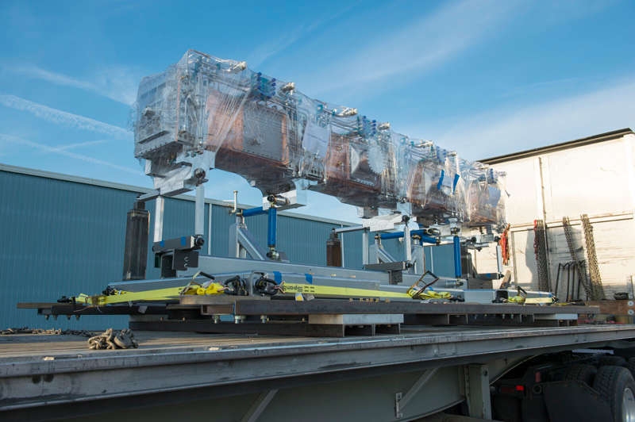
News Since June (2014)
CD-0
Subsequent to the review the upper end of the cost range was lowered to $650M
We provided a funding profile consistent with this number
Mission Need Statement approved by the Office of Science
ESAAB scheduled for November 12
PXIE
LEBT beam characterized
and meets requirements
RFQ has arrived and is
under vacuum at PXIE!
MEBT magnets received
from BARC
Notes:
Test
5

Slide 6
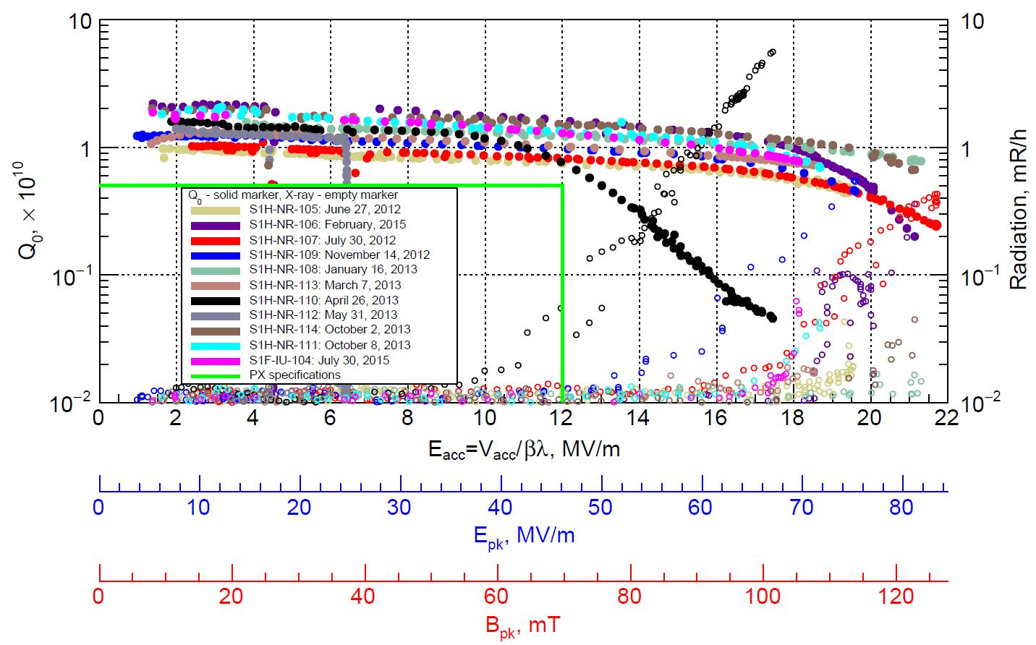
News Since June (2014)
SRF
Two SSR1 cavities
received from IUAC
SSR1 dressed cavity
successfully tested
Lab 2 renovation going
great guns
Preparing for SSR1
string assembly in FY16
Preparing for HWR string assembly in FY16 (ANL)
Significant advances in high-Q₀ and resonance control programs
Indian Collaboration
“Annex I” signed by DOE and DAE
Project Plan for R&D phase signed (DOE and DAE)
7 Indian engineers at Fermilab for 2-year residencies
650 MHz C&CM, LLRF, Cryo, Accel Phys (PXIE)
Notes:
Test
6

Slide 7
News Since June (2014)
Personnel Changes
New Technical Division Head: Sergey Belomestnykh
Replaces Hasan Padamsee (retired)
SRF Program Management Team:
TD PIP-II Coordinator: Allan Rowe
325 MHz cavities and cryomodules: Leonardo Ristori
650 MHz cavities and cryomodules: Tom Nicol
SRF Development Department: Slava Yakovlev
Cavity Performance and Testing: Anna Grasselino
Resonance Control: Yuriy Pischalnikov
Notes:
Test
7

Slide 8
PIP-II Status and Strategy
Reference Design Report describes:
An 800-MeV superconducting linac, constructed of CW-capable components, operated initially in pulsed mode
Modifications to Booster/Recycler/Main Injector to accommodate higher intensities
New Booster injection region to accept 800-MeV beam
Upgrades to Booster damper and collimator systems
LCW system upgrades (reliability)
Recycler RF upgrade for slip-stacking at 0.7 sec cycle time
MI RF power upgrade
MI γ_{t}-jump system
Increase of Booster repetition rate to 20 Hz
Maintain 1 MW down to 60 GeV or,
Provide factor of 2.5 increase in power to 8 GeV program

Slide 9
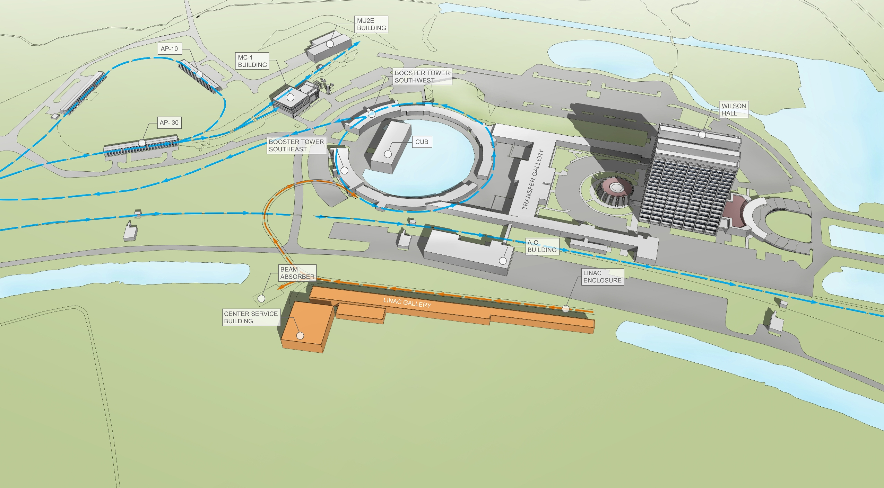
PIP-II Status and Strategy/Site Layout

Slide 10
PIP-II Status and Strategy/Performance Goals
Performance Parameter | PIP | PIP-II
Linac Beam Energy | 400 | 800 | MeV
Linac Beam Current | 25 | 2 | mA
Linac Beam Pulse Length | 0.03 | 0.5 | msec
Linac Pulse Repetition Rate | 15 | 20 | Hz
Linac Beam Power to Booster | 4 | 18 | kW
Linac Beam Power Capability (@>10% Duty Factor) | 4 | ~200 | kW
Mu2e Upgrade Potential (800 MeV) | NA | >100 | kW
Booster Protons per Pulse | 4.3×10¹² | 6.5×10¹²
Booster Pulse Repetition Rate | 15 | 20 | Hz
Booster Beam Power @ 8 GeV | 80 | 160 | kW
Beam Power to 8 GeV Program (max) | 32 | 80 | kW
Main Injector Protons per Pulse | 4.9×10¹³ | 7.6×10¹³
Main Injector Cycle Time @ 60-120 GeV | 1.33* | 0.7-1.2 | sec
LBNF Beam Power @ 60-120 GeV | 0.7* | 1.0-1.2 | MW
LBNF Upgrade Potential @ 60-120 GeV | NA | >2 | MW
*NOvA operations at 120 GeV

Slide 11
PIP-II Status and Strategy/Technology Map
Section | Freq | Energy (MeV) | Cav/mag/CM | Type
RFQ | 162.5 | 0.03-2.1
HWR (β_{opt}=0.11) | 162.5 | 2.1-10.3 | 8/8/1 | HWR, solenoid
SSR1 (β_{opt}=0.22) | 325 | 10.3-35 | 16/8/ 2 | SSR, solenoid
SSR2 (β_{opt}=0.47) | 325 | 35-185 | 35/21/7 | SSR, solenoid
LB 650 (β_{g}=0.61) | 650 | 185-500 | 33/22/11 | 5-cell elliptical, doublet*
HB 650 (β_{g}=0.92) | 650 | 500-800 | 24/8/4 | 5-cell elliptical, doublet*
*Warm doublets external to cryomodules All components CW-capable
Notes:
Multiple corrections to the table and picture

Slide 12
PIP-II Strategy
PIP-II will be executed as a DOE 413.3b project
Strategy
Develop/evolve concepts aligned with community needs
Undertake R&D targeting major technical/cost risk elements
RDR defines concept for meeting community requirements, and provides context for R&D
Coordinate with other Fermilab projects and programs
Status
PIP-II endorsed by P5 as a key element in the U.S. neutrino program
R&D program underway
P2MAC review of RDR and R&D program (March)
Strong collaboration with Indian and U.S. laboratories
Possible collaboration with Europe
Project Office established

Slide 13
Project Strategy/R&D
Goal is to mitigate risk: Technical/cost/schedule
Technical Risks
Front End
Delivery of beam with required characteristics, quality, and reliability
Operate (high Q₀) SC Linac in pulsed mode at low current
Primary issue is resonance control in cavities
Booster/Recycler/Main Injector beam intensity
50% per pulse increase over current operations
Longitudinal emittance from Booster for slip-stacking
Transition crossing
Beam loss/activation
Develop requisite capabilities of international partners and vendors
Cost Risks
Superconducting RF
Cavities, cryomodules, RF sources represent a major portion of construction costs
Goal: Be prepared for a construction start in 2019
R&D deliverables milestones established

Slide 14
Project Strategy/PXIE
Now
2015
2016
2017
2018
30 keV
2.1 MeV
10 MeV
25 MeV
RFQ
MEBT
HWR
SSR1
HEBT
LEBT
40 m, ~25 MeV
PXIE will address the address/measure the following:
LEBT pre-chopping: Demonstrated
Vacuum management in the LEBT/RFQ region: Demonstrated
Validation of chopper performance
Bunch extinction, effective emittance growth
MEBT beam absorber
Reliability and lifetime
MEBT vacuum management
CW operation of HWR
Degradation of cavity performance
Optimal distance to 10 kW absorber
Operation of SSR with beam
CW and pulsed operation
Resonance control and LFD compensation in pulsed operations
Emittance preservation and beam halo formation through the front end
Collaborators
ANL: HWR
LBNL:LEBT, RFQ
SNS: LEBT
BARC: MEBT
IUAC: SSR1

Slide 15
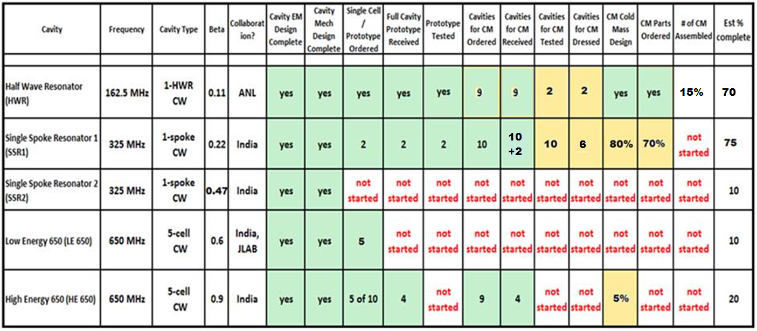
Project Strategy/SRF Development Status (6/1/15)
Legend: green = done, yellow = in process

Slide 16
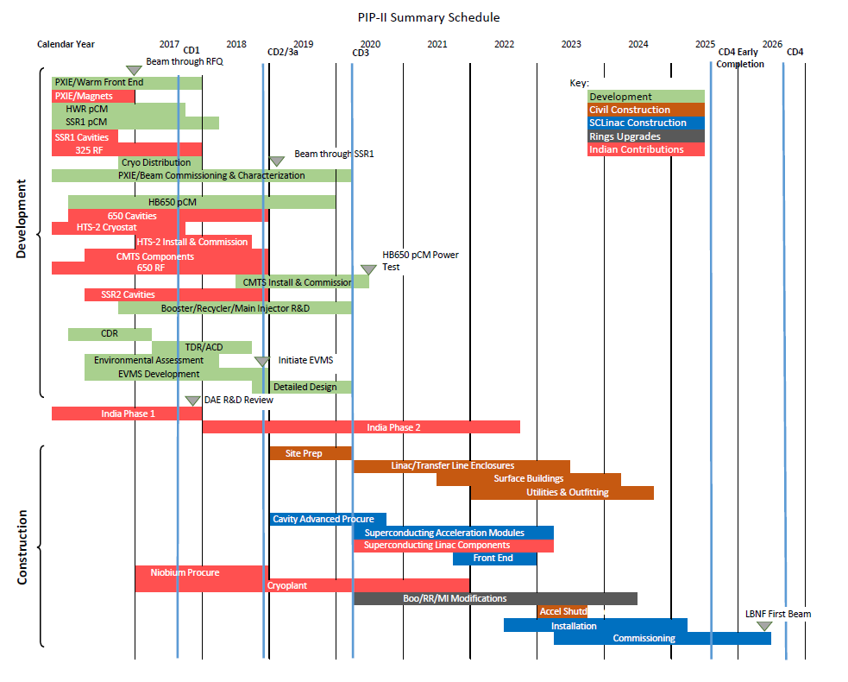
Project Strategy/Preliminary Schedule

Slide 17
FY2016-17 Goals
Fill out project organization and achieve CD-1
CDR, alternatives study, cost range, RLS
Other supporting documentation
Initiate work toward CD-2
Detailed design
Site characterization
NEPA documentation and permitting
EVMS implementation
Advance PXIE
Commission RFQ with beam and characterize in MEBT
Complete MEBT installation
Deliver HWR and SSR1 prototype cryomodules
Complete cryogenic infrastructure
Complete HB650 cryomodule design (w/ India) and initiate procurements
Integrate seven Indian engineers at Fermilab for two year residencies

Slide 18
FY2016-17 Budgets
FY2016 $19.5M
Budget allocations specified at L3 of WBS
Adjustments required to meet budget guidance:
Deliverable | Old Date | New Date
PXIE warm: beam out of MEBT-1 | Q2FY16 | Q4FY16
SSR1: Resonance control testing definitive results | Q4FY16 | Q4FY16
PXIE warm: beam to end of MEBT-2 | Q4FY16 | Q4FY16
PXIE warm: beam to end of final MEBT | Q4FY17 | Q4FY17
PXIE Cold: HWR CM and associated infrastructure (cryo, RF, power, etc.) | Q3FY17 | Q3FY17*
PXIE Cold: SSR1 CM and associated infrastructure (cryo, RF, power, etc.) | Q3FY17 | Q1FY18*
HB650 Dressed Cavities and associated infrastructure (HTS-2, rf) | Q3FY17 | Q4FY18
HM650 CM to CMTS | Q4FY18 | Q1FY20
CD-1 activities: CDR, Site Characterization, civil construction drawings | Q4FY16 | Q3FY17
* Requires augmented funding in FY2016

Slide 19
FY2016-17 Budgets
FY2017 $19.5M
Detailed budget plan does not yet exist
Priority will be on completing elements in prior table scheduled for FY2017 and on getting to CD-1
There will be slippage elsewhere
FY2018
We have been advised that FY2018 will be: $22.0-25.0M

Slide 20
Meeting Goals
Reorientation from Project X to PIP-II has a significant impact on the roles of the various collaborating institutions on PIP-II.
We would like to use this meeting to facilitate the realignment of collaborator roles, in particular during the R&D phase of PIP-II.
Meeting Goals
Review status of the R&D program
Develop plan, including the role of collaborators, in the R&D program
Coverage
PXIE
SRF
LLRF/resonance control
RF sources
Instrumentation
Controls
Cryogenic systems
Booster/Recycler/Main Injector
We have organized three working groups to help achieve these goals

Slide 21
Meeting Goals/Working Groups
Conveners are responsible for organizing their sessions. Each group should:
Review, and modify as necessary, goals and deliverables for the R&D phase
Develop a work plan that defines the sharing of responsibilities among the collaborators for the R&D phase
WG1: PXIE/P. Derwent, A. Shemyakin
Warm components
Integration of HWR and SSR1
Instrumentation
Controls
Experimental program
WG2: Superconducting Linac/S. Mishra, V. Yakovlev, F. Garcia
SSR1, SSR2
LB650, HB650
Test Stands: HTS-2, STC
LLRF/resonance control – joint with WG1
RF sources
Cryogenic systems
WG3: Rings/V. Lebedev, I. Kourbanis
Beam dynamics and modelling
Booster injection
RF systems
Collimation systems
Dampers
Transition crossing

Slide 22
Collaboration Meeting Agenda
Monday, November 9
Plenary Session: Overview 08:30-11:30
Lunch
WG-1: PXIE 12:30-17:00
Floating Point (IARC, 3rd floor east)
WG-2: SCLinac 12:30-18:00
IARC Auditorium
WG-3: Rings 12:30-17:30
IARC 1W (IARC, 1st floor west)
Afternoon break will be outside IARC Auditorium Wednesday, June 4
Tuesday, November 10 8:30-10:00
WG-1
WG-2
WG-3
Adjourn 10:30
https://indico.fnal.gov/conferenceDisplay.py?confId=10586

Slide 23
Our Inspiration…
Hello Steve,
Do you have any idea whether there will be a PIP-II collaboration meeting this summer and, if yes, any guess when?
My daughter is planning her wedding in June and asks when it would be most convenient for me.

Slide 24
Our Inspiration…
I don't think your daughter should be choosing a wedding date based on the PIP-II Collaboration Meeting!
In any event, I think it is unlikely we will have the meeting in June. July or August is more likely.
Cheers,
Steve

Slide 25
Our Inspiration…
Steve,
She is aware of the power of science...

