Slide 1
Passive Mitigation of Microphonics and LFD in LB and HB 650 Cavities
Timergali Khabiboulline
PIP-II Collaboration Meeting
9-10 November 2015

Slide 2
Outline
Passive microphonics control
LFD, reducing cavity frequency shift due to RF pressure
Reducing sensitivity to bath pressure fluctuations, df/dP
Cavity mechanical resonances
Minimizing of acoustics from external forces
Additional RF power for frequency detuning compensation
Active Microphonics control

Slide 3
PIP-II requirements for SRF accelerating cavities
Bandwidth and required power optimized for 2 mA
Section | Freq MHz | Maximal detune (peak Hz) | Minimal Half Bandwidth (Hz) | Max Required Power (kW)
HWR | 162.5 | 20 | 34 | 4.8
SSR1 | 325 | 20 | 45 | 5.3
SSR2 | 325 | 20 | 27 | 17.0
LB650 | 650 | 20 | 29 | 33.0
HB650 | 650 | 20 | 29 | 48.5
Pulsed and CW operations
Low beam loading → narrow cavity bandwidth → microphonics
Lorentz Force Detuning (LFD) is an issue in a pulsed mode, and should be analyzed for each cavity type

Slide 4
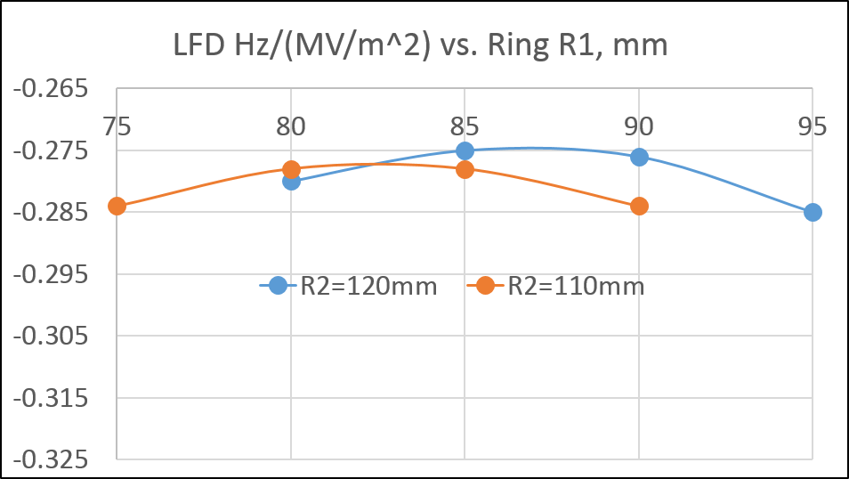
HB650 bare cavity LFD simulations
For 2 rings LFD~-0.275 Hz/(MV/m)²
for 1 ring LFD~-0.38 Hz/(MV/m)².
Because the difference in LFD value for one and two rings options is not essential and the complexity of production of the cavity with two rings is high enough, we decided to use one ring option and redesign the end groups of original Helium vessel.
R1=87.5 mm, R2=120 mm.
R=110 mm.

Slide 5
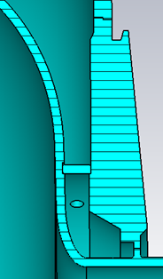
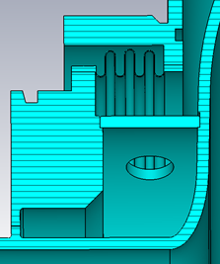
LFD for HB650 dressed cavity
LFD for dressed cavity with R=100 mm stiffening rings

Slide 6
HB650 dressed cavity df/dP optimizations
Stiffness of β=0.92 cavity kN/mm vs. Radius of the Regular stiffening ring

Slide 7
HB650 dressed cavity df/dP optimizations
df/dP for stiffening ring R = 90 mm vs. 100 mm
Bellows radius of OD=125 mm

Slide 8
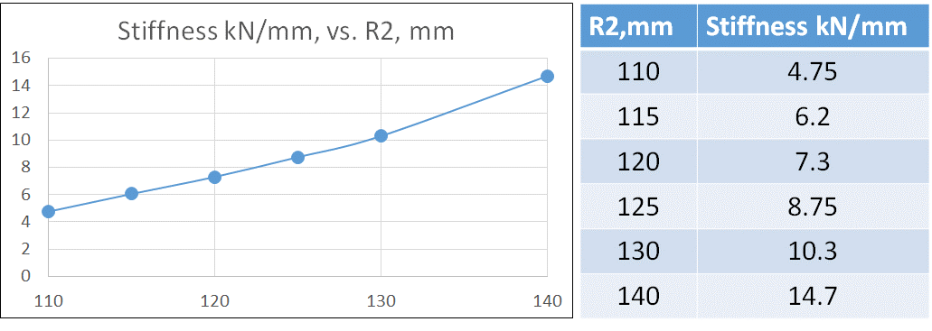
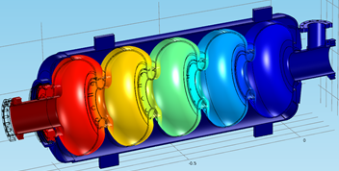
HB650 cavity stiffness
Cavity Stiffness vs stiffening ring diameter
R=100 mm, ΔL ~ 334 μm
Stiffness ~ 3.0 kN/mm

Slide 9
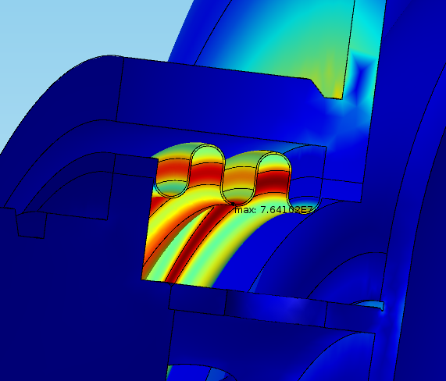
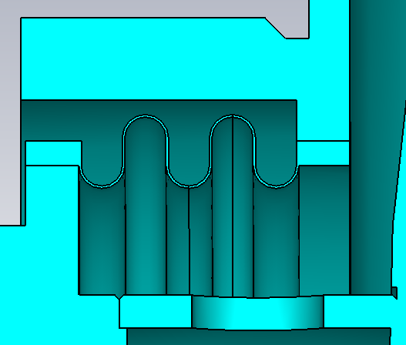
HB650 dressed cavity stress analysis
2 bar pressure + Gravity Load, RT, Tuner = 80 kN/mm
σ ~ 76.4 MPa
σ ~ 90.6 MPa
R
t
R=2.5mm
t=300μm
Maximum allowable Stress is 88.7MPa

Slide 10
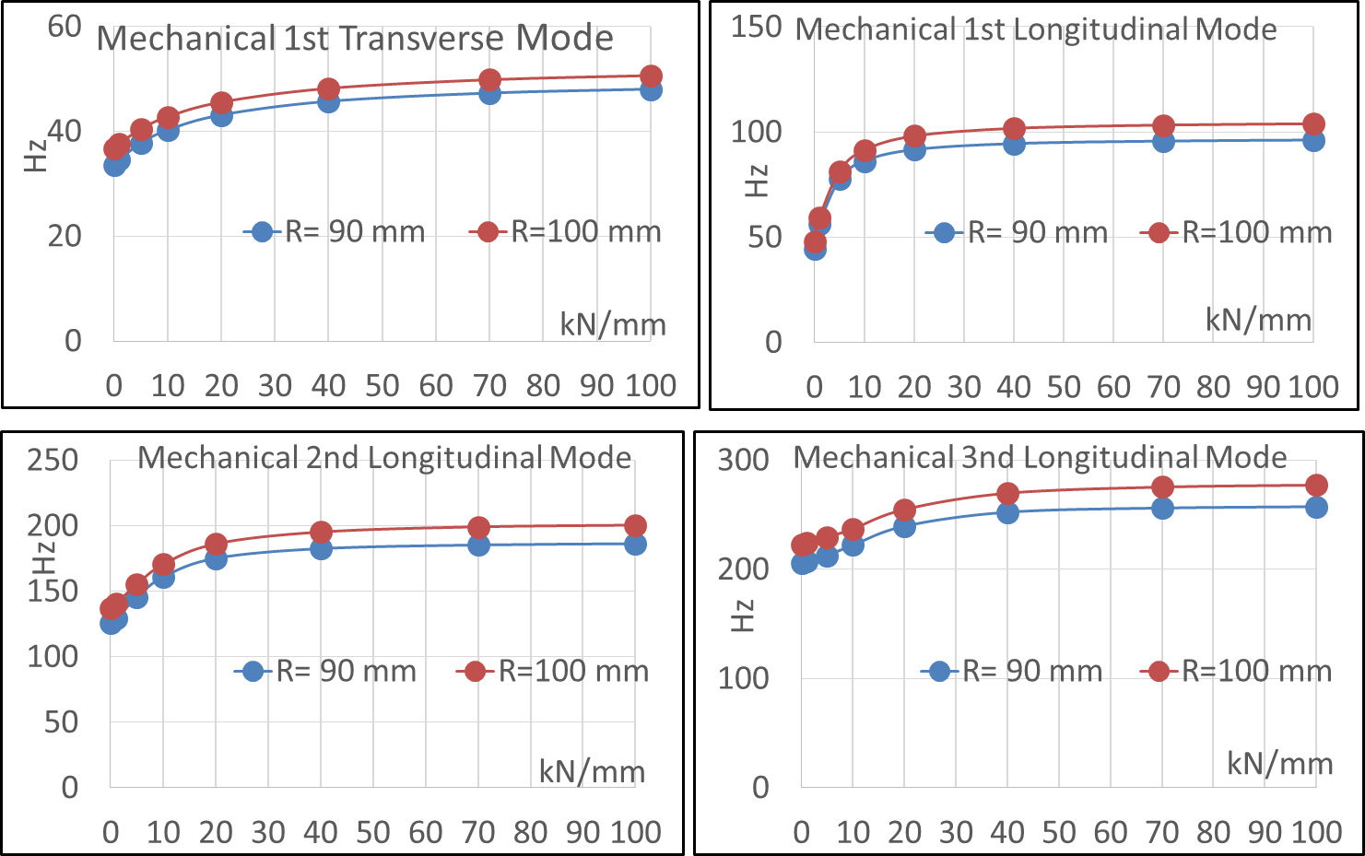
Mechanical resonances of HB650 dressed cavity

Slide 11
Summary
LB650 dressed cavity design is in progress
HB650 dressed cavity optimization done
Stiffening ring position R=100 mm and bellow radius R=125 mm accepted
LFD Coefficients for tuner stiffness 80 kN/mm -0.69 Hz/(MV/m)^2
dF/dP for tuner stiffness 20 - 80 kN/mm is less than 12 Hz/mbar.
Cavity stiffness is ~ 3.0 kN/mm and tuning sensitivity is ~ 160 kHz/mm.
Modal analysis has been done. Lowest longitudinal mode ~ 100 Hz with 20-80 kHz/mm tuner stiffness.
Stresses analysis has been done for internal pressure of 2 bar + gravity load at RT
Stresses in cavity are acceptable
Stresses in bellow are allowable for 5 mm pitch

