Slide 1
PXIE Cryogenics
Mike White
PIP-II Collaboration Meeting
Nov. 9, 2015

Slide 2
Overview
Show major cryogenic components
Discuss space constraints
Specification Outline
Installation Outline
Commissioning Outline

Slide 3
PXIE Cave Area Cryo Components
SSR Cryomodule (Future)
PXIE Transfer Line (Future)
HWR Cryomodule (Future)
Mycom Compressor Header (Future)
Cavity Relief Vents (Future)
Kinney Pump Header (Existing)
Distribution Box (Existing)
CMTS Transfer Line
(Existing)

Slide 4
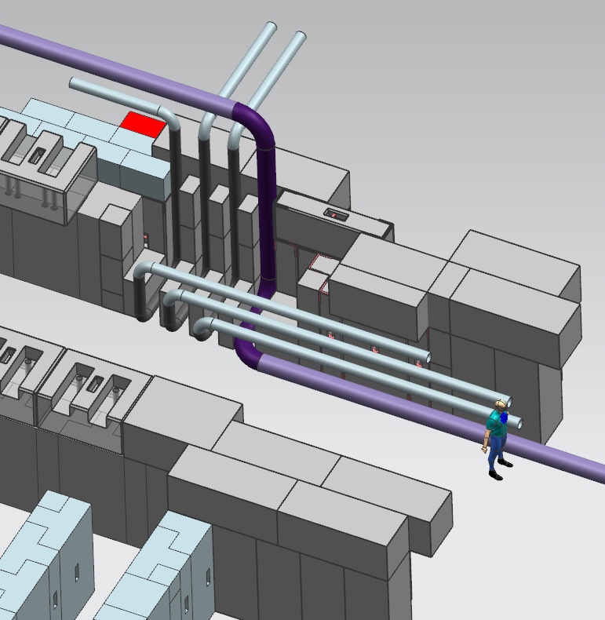
Penetration into PXIE Cave
East supplemental shielding installed early
Darker section of piping indicates prefabricated section craned into slot
BEAM
Covering blocks (not shown) can be craned in over piping
Field weld locations are accessible

Slide 5
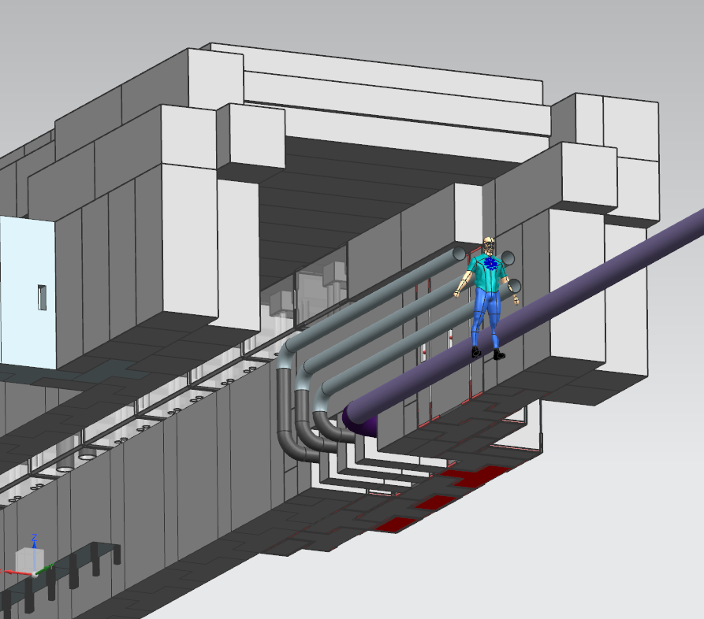
Penetration into PXIE Cave
Cryo distribution
BEAM
Relief lines (2) and He Suction

Slide 6
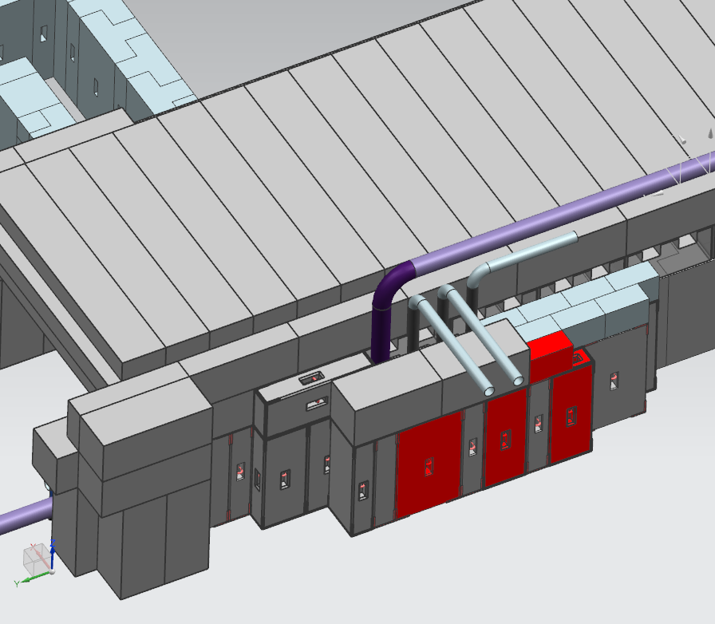
Penetration into PXIE Cave
Does not affect design of roof layers
BEAM
Significant bump-out to East of existing cave

Slide 7
Space along East Wall
990 mm
758 mm

Slide 8
Space along Ceiling
Limited clearance for pulling U-tubes
Limited space for SSR 2K Relief System
Assume cryo takes up all this space
3200 mm (10’6”)
Edge of wall past HWR and SSR

Slide 9
HWR Ports

Slide 10
HWR Connections to Distribution System
BEAM
Bayonet Can
Pipe
U-tube
Conceptual Cartoon

Slide 11
SSR Connections to Distribution System
2K Relief
All SSR Bayonets
Conceptual Cartoon

Slide 12
Valves and Instrumenation
Due to tight space constraints inside cave, as much as possible keep control valves, relief valves, expansion joints, and instrumentation in cans at these three locations

Slide 13
Lines Available in PXIE Transfer Line Stub
There are no control valves for PXIE in the distribution box (all lines have direct path to refrigerator)
Number of valves required for PXIE is highly correlated with independence required from CMTS operations

Slide 14
Conclusions on Space Constraints
Installation order of components is important
Walking along east wall of cave not practical
Tight spaces for welding
U-tube installation/removal may require removing roof
U-tube may need to be lifted by crane after pulling to store elsewhere
People likely have to stand on HWR lid
HWR u-tubes heavy enough that several people required
Keep as many components as possible out of cave due to space limitation
Counterpoint: It is also difficult to access points at elevation, since room for lifts in and around cave is almost nonexistent

Slide 15
Specification Steps Outlined
Review current cryomodule FRS
Write overall TRS for distribution system
Define allowable interdependence between PXIE and CMTS operations
Define heat load measurement accuracy
Cooldown constraints (fast, slow, either)
Resolve any other missing or ambiguous specifications
Create key process documents
PID
Valve & Instrument list
Define pipe sizes
Write TRS for vendor to supply major distribution system components
Define allowable envelope
Define interface locations
Define support locations
Schedule requirements
Other standard specifications

Slide 16
Installation Steps Outlined
Vendor supplied distribution system components
Select vendor
Ship FNAL-supplied components to vendor
Design review
Fabrication
Testing
FNAL Mechanical (independent of vendor or cryomodule)
Run cavity relief vent header into cave
Run Mycom suction header into cave
Install supports for transfer line & headers
Prefab of U-tubes
Install connection to Kinney vacuum pump?
FNAL Mechanical (dependent on vendor and/or cryomodule)
Join transfer line sections
Final welding of U-tubes
Install cryomodule cavity reliefs & connect to relief vent header
Connect all relief and vent ports to Mycom header
Run pneumatic tubing for control valves

Slide 17
Installation Steps Outlined
FNAL Electrical & Controls (independent of vendor or cryomodule)
Prepare instrumentation and controls cabinets
Install cabinets at CMTF
Create ACNET variables & Synoptic pages
Create control loops
Input temperature sensor calibration data
FNAL Electrical & Controls (dependent on vendor and/or cryomodule)
Run & terminate cables from cabinets to instrumentation & control valves

Slide 18
Commissioning Steps Outlined
Engineering documents (distribution system and cryomodule)
Piping notes
Vacuum Vessel notes
Pressure Vessel notes (cryomodule only)
ODH notes
Cryogenic System Review notes
Testing
Helium leak checks
Pressure tests
Electrical check-out
Operations
U-tube installation/removal procedures
Cooldown/Warmup guidelines

