Slide 1
MEBT status and plans
A. Shemyakin
PIP-II Collaboration Meeting
9-10 November 2015

Slide 2
Outline
Configuration and functions
Components
Commissioning plans
MEBT at PXIE vs PIP-II

Slide 3
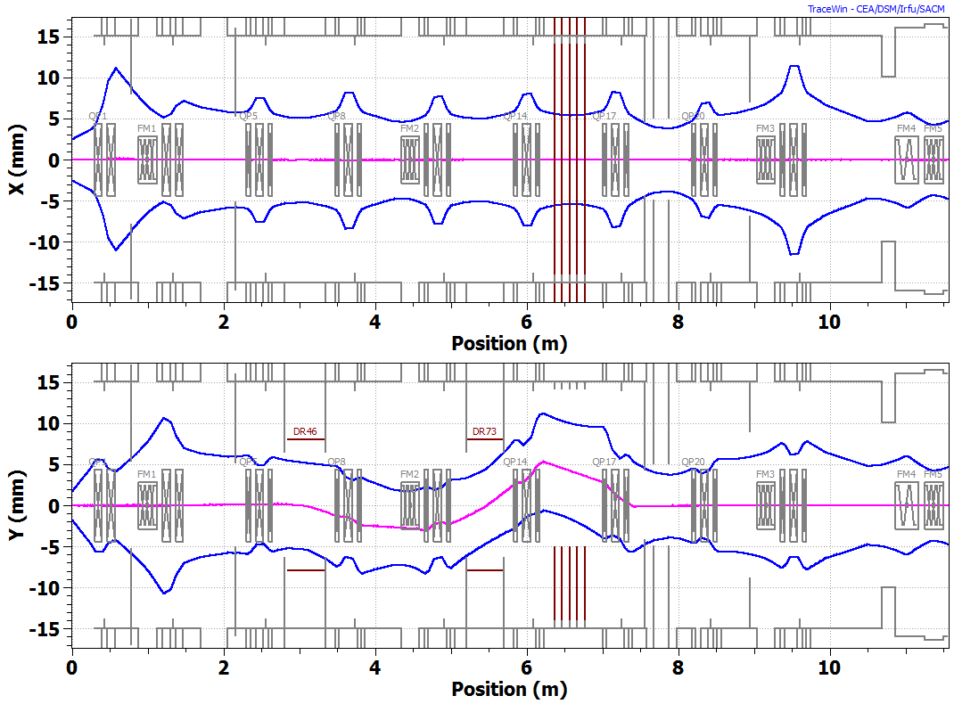
MEBT configuration
3σ envelopes of passing bunches. 2.1 MeV, 5 mA. TraceWin.
A. Saini.
Two doublets and 7 triplets; three bunching cavities
  No significant changes in the optical design since 2011
Chopping system: two kickers and absorber
Smaller beam size after absorber for differential pumping

Slide 4
MEBT functions
1175mm
#0
#1
#2
#3
#4
#5
#6
#7
#8
Slow valve,toroid
Ring pickup
ScrapersRF
Emittance monitor, scraper, wire scanner
Kicker
RF, wire scanner, Laser Wire
Kicker
Absorber
Different. pumping,
scrapers, wire scanner
Scrapers, RF, slow valve, extinction monitor
Fast valve, DCCT, toroid, laser wire, wire scanner
Slow valve
Optical matching from RFQ and to HWR
Chopping
  Any bunch from initial CW train can be removed
Scraping
Transition from HV to particle-free, UHV part upstream of HWR
Measuring beam parameters, MPS

Slide 5
MEBT components
Magnets
Bunching cavities
Scraping system
Chopping system
Vacuum components
Instrumentation- see Vic Scarpine’s talk

Slide 6
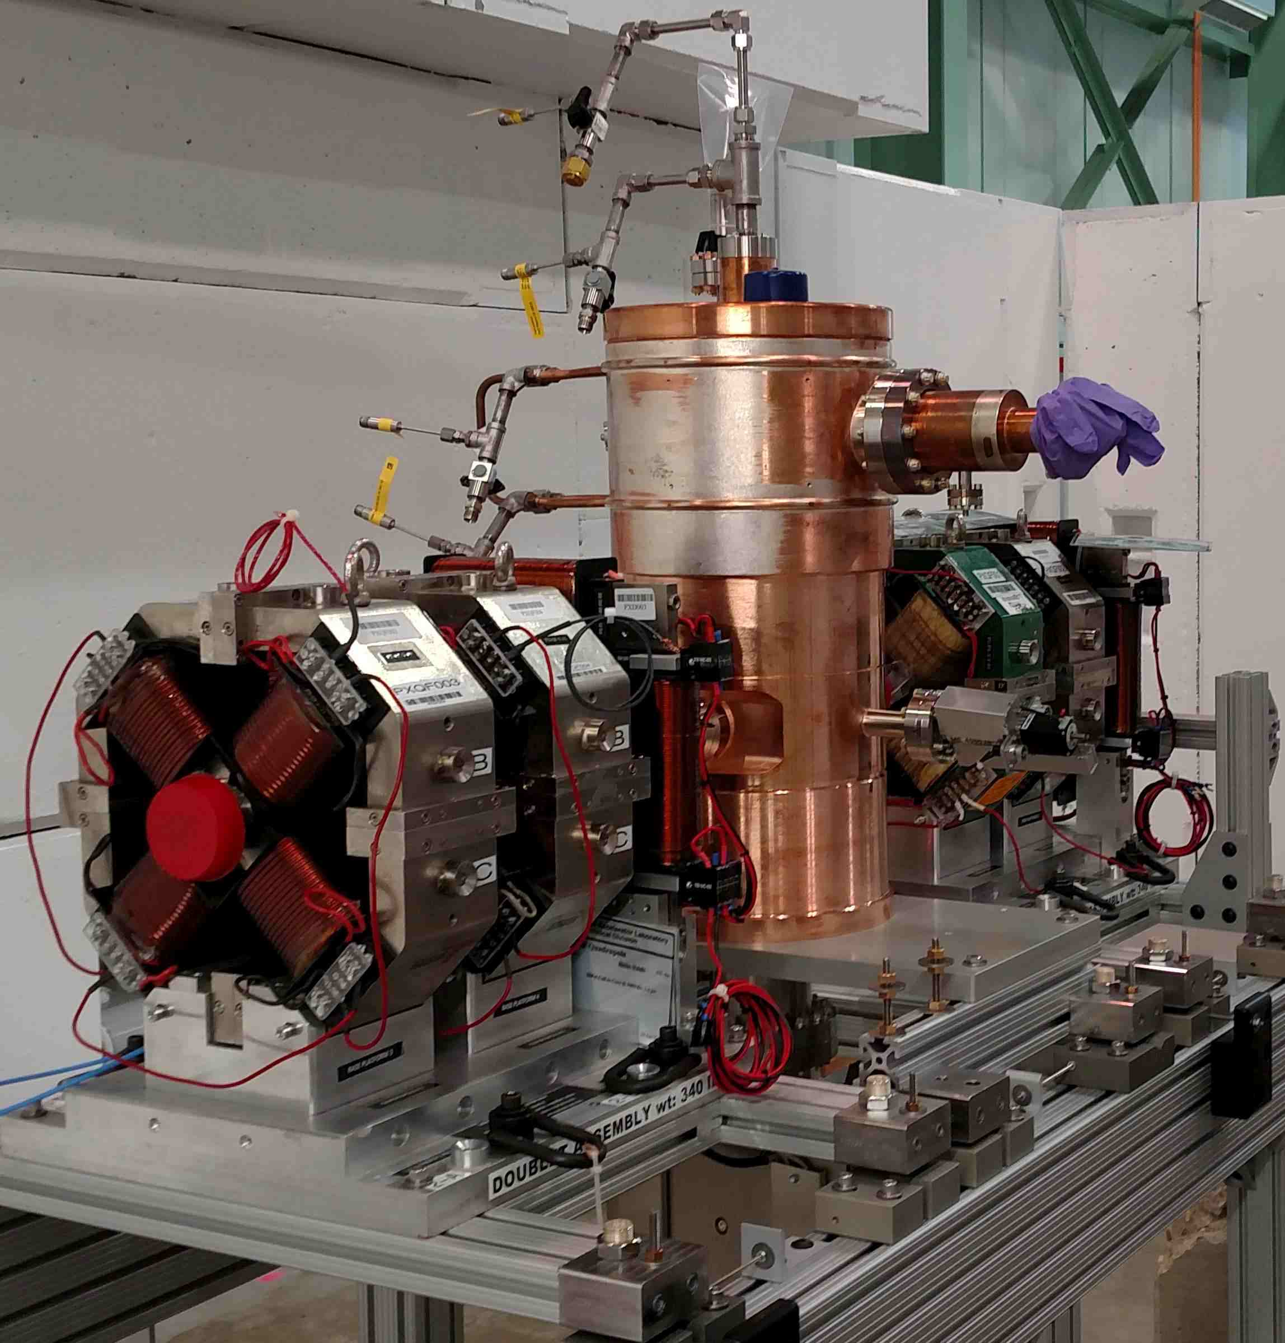
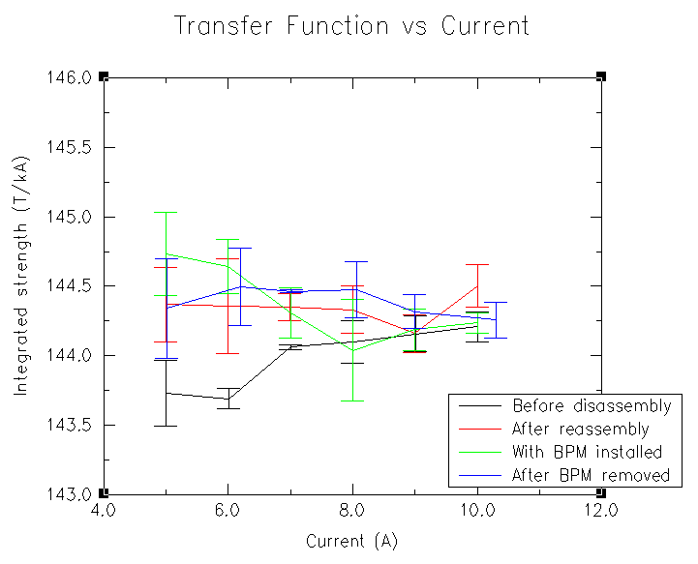
Magnets
25 quadrupoles, 9 dipole correctors (X&Y) + spares
  Produced by BARC, India and delivered in batches
  First two doublets with dipole correctors are installed on girder
    Considered prototypes, but quality within specs
  Four triplets are coming in June 2016
  The rest in FY17
Power supplies are inherited from ECool
Relative quadrupole strength measured at Fermilab. M. Tartaglia
Two doublets and bunching cavity installed on a girder in the PXIE cave

Slide 7
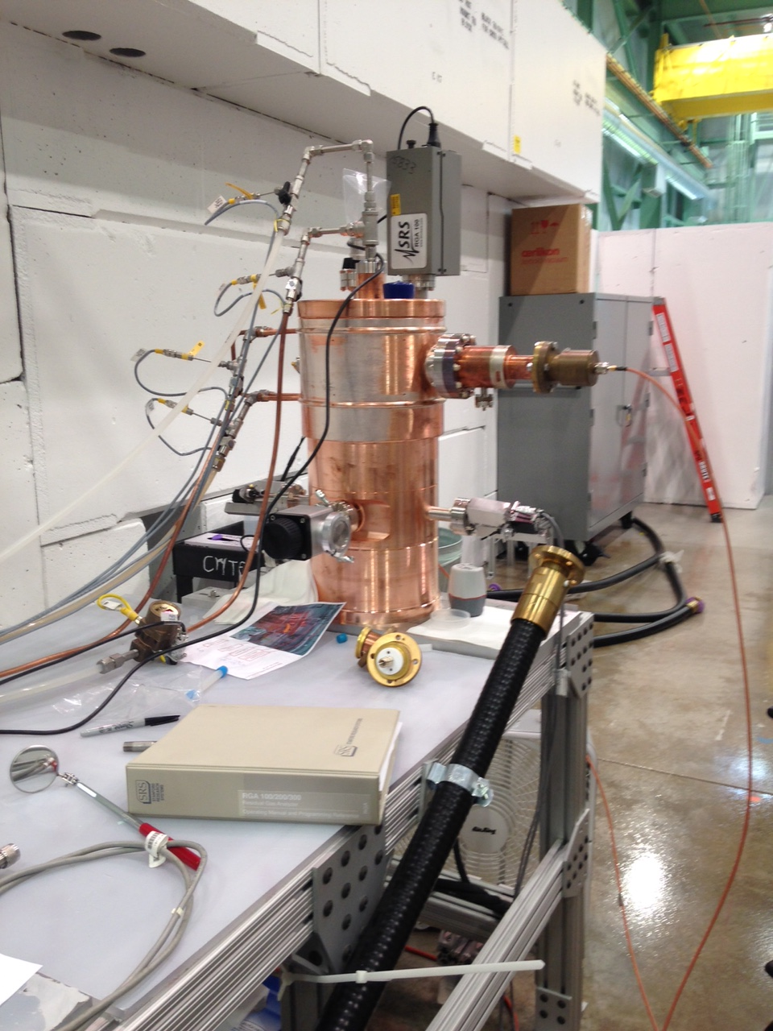
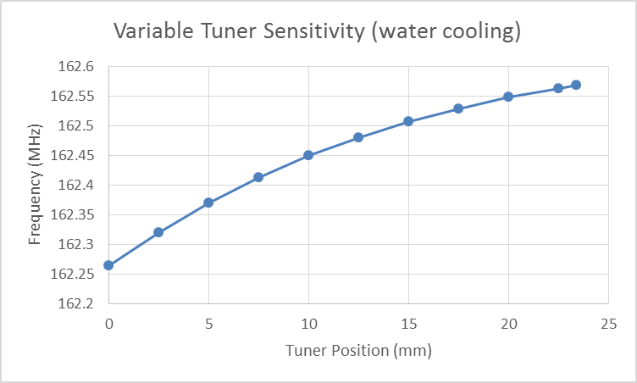
Bunching cavities
Designed by Fermilab, procured at HiTech
A prototype was fully tested
  A vacuum leak was cured with epoxy
  Properties are within specs
Three production cavities have been ordered
  Delivery is expected in May 2016
Prototype bunching cavity under testing in the PXIE cave (D.Sun, J.Steimel, D.Peterson)

Slide 8
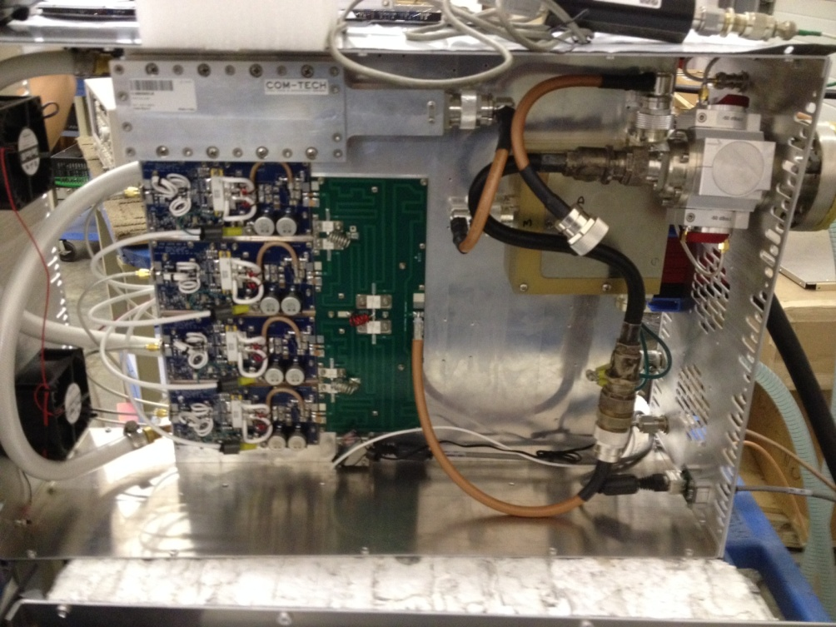
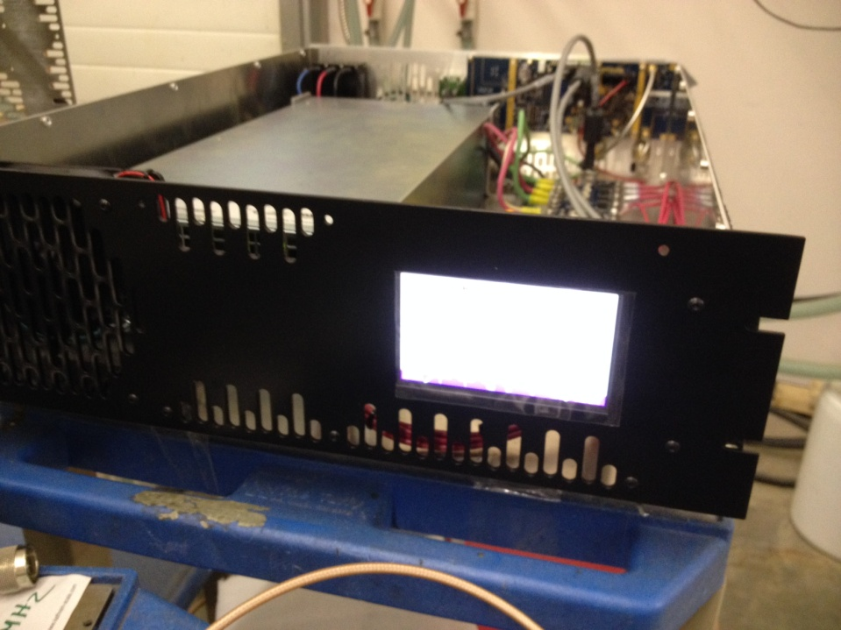
Bunching cavity amplifiers
Five units had been ordered and delivered
  Comark 3 kW CW 162.5 MHz TAVD-600L
    need ~1 kW for bunchers, 3 kW for the first HWR cavity
All five returned to Comark for repair; two returned to FNAL
  one of them failed again on flow meter fault
  second can run CW at 3 kW with a 50 ohm load
    does not operat correctly into a non 50 ohm load.
    Same for all modified units, requiring a software revision. Status pending.
  Waiting for response from Comark on how to proceed
R. Pasquinelli, D. Peterson

Slide 9
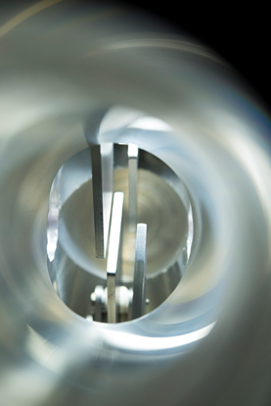
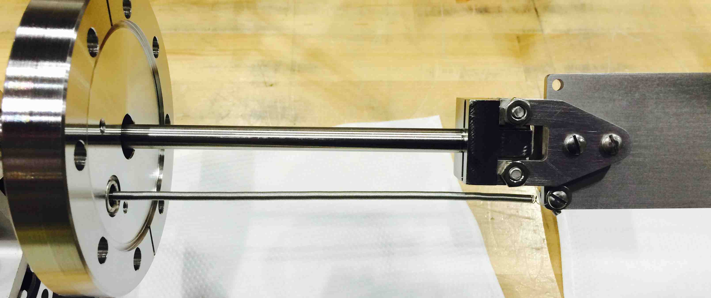
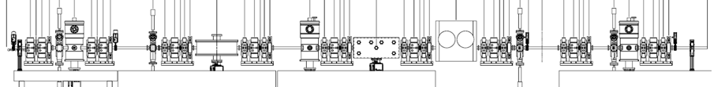
MEBT scraping system
4 scraper sets, 4 blades in each set. Will be used for
  Diagnostic
    Beam size and profile measurements; beam halo
  Part of active protection system
    Increased scraper current generates alarm signal for MPS
  Scraping (the main function)
    Scrape the beam halo or intercept the beam in case of incidents
One set was successfully tested at LEBT
  100W/set rating
Single blade.
C. Baffes, K. Kendziora
Scraper location in MEBT

Slide 10
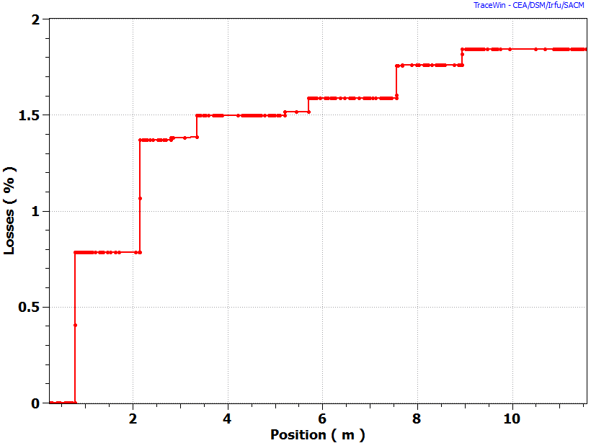
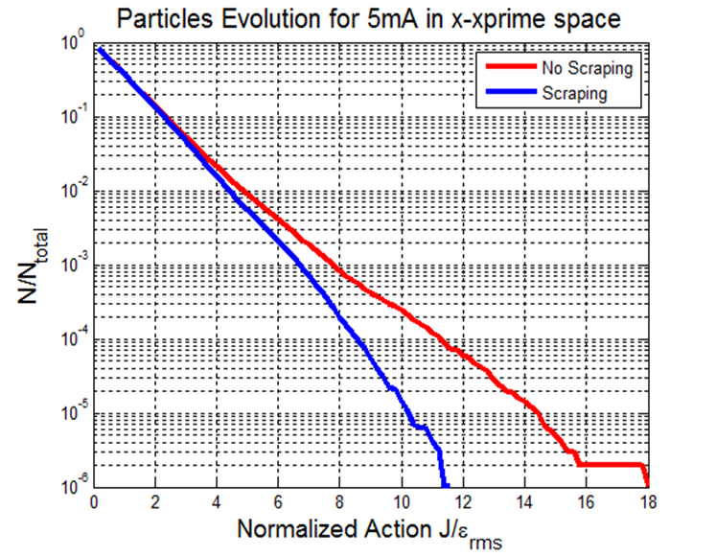
Nominal scraping scenario
  Scraper positions are adjusted to be close to 90⁰ of transverse phase advance
  Protect SRF from trajectory or envelope errors
Scraper 2
Scrapers 3 & 4
Scraper 1
Beam losses for passing bunches. Nominal beam (5 mA, ε_{tr/z}=0.21/0.28 µm). A. Saini.

Slide 11
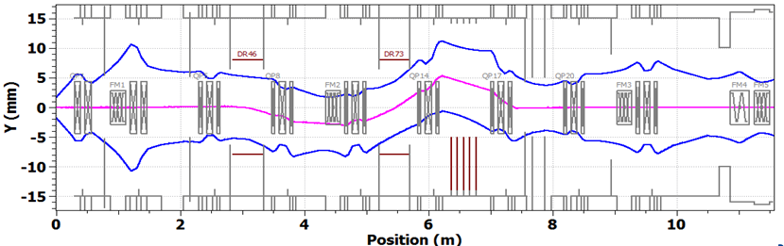
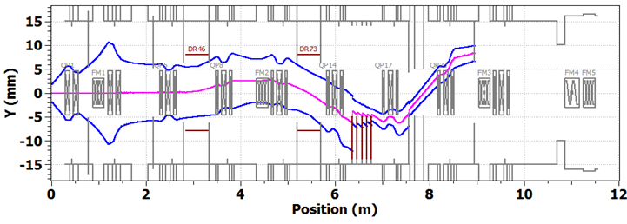
Chopping system
Two travelling-wave kickers working in synch and absorber
  Two kicker versions, 50 Ohm and 200 Ohm
Passing bunch.
-250V, +250V on upper plates.
Removed bunch. +250V, -250V on upper plates. Case with 0.05% of beam leaking to scrapers is shown.
3σ envelopes. 2.1 MeV, 5 mA. A. Saini.

Slide 12
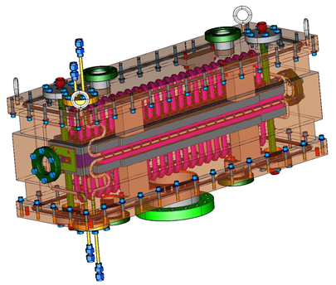
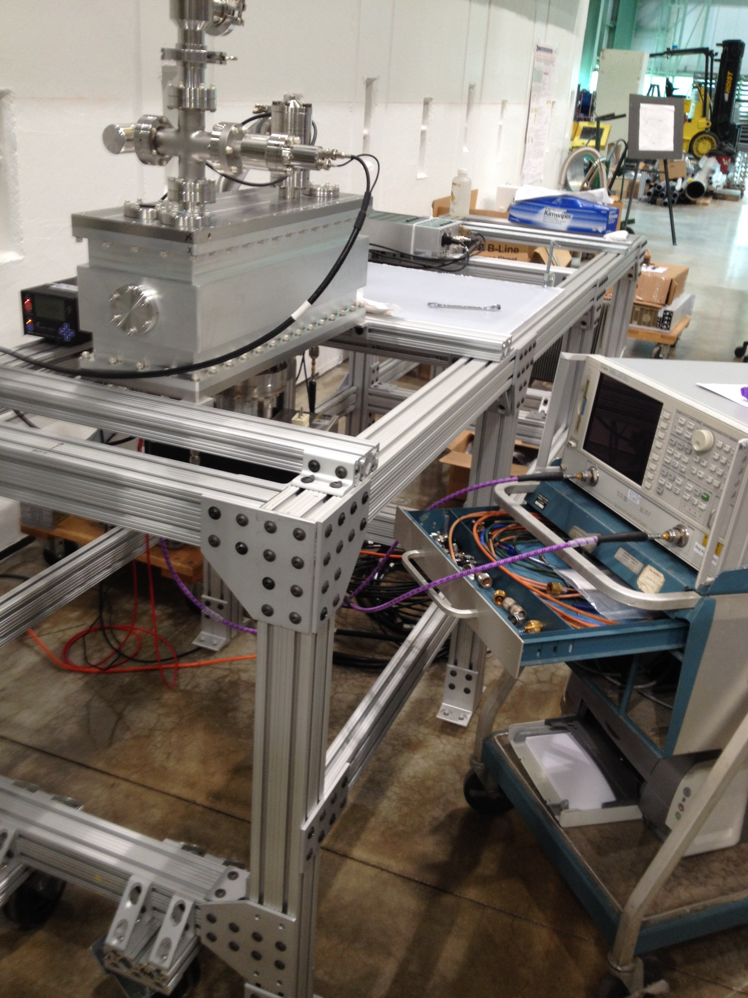
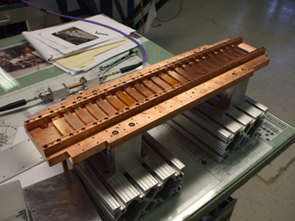
50 Ohm kicker
Features
  Bipolar signal; commercially available amplifier
  bunches to be removed or passed are kicked in opposite directions
  Plates connected in vacuum with 50 Ohm cables
Status
  One plate is successfully tested in vacuum
    Full-power and RF measurements
  Final prototype is fully assembled
    Will be power-tested in coming months
3D model. A.Chen, M. Jones
Half of the kicker (one plate) assembled. D.Sun
Kicker under testing. D.Sun, D. Peterson

Slide 13
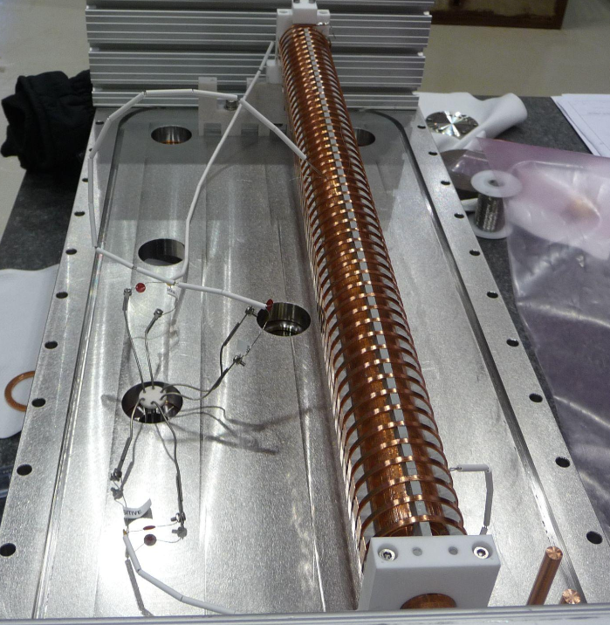
200 Ohm kicker
Higher impedance allows considering a fast switch as a driver
  Potentially simpler and cheaper solution; DC-coupled
TW structure is a helix
One vacuum-compatible helix was tested
  Power testing in vacuum is successful
  The phase velocity was found off by 5%; redesigned
Parts for a complete kicker have been ordered
  Will be fully tested before June 2016
Kicker prepared for power testing in vacuum.
A.Chen, G.Saewert

Slide 14
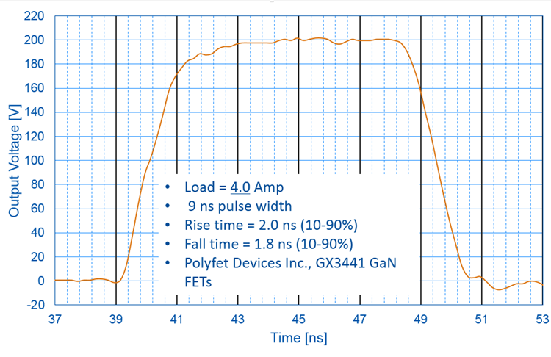
200 Ohm Helix Driver (G. Saewert)
Initial scheme: bipolar cascode switch; 5 FETs each side
  500V with one side was demonstrated; 2.3/ 9 ns times
  Bipolar: too high capacitance; dead time during transition
  Found that driver jitter is low => can drive FETs individually
Present stage: unipolar switch
  Two FETs driven individually
  matched to <0.2ns
  200V pulse with good rise/fall time
New development
  New GaN FETs, 650V rating
  Switch with 3 FETs is being assembled; goal is ≥500V
  Cooling scheme for CW (~35 MHz) is being designed

Slide 15
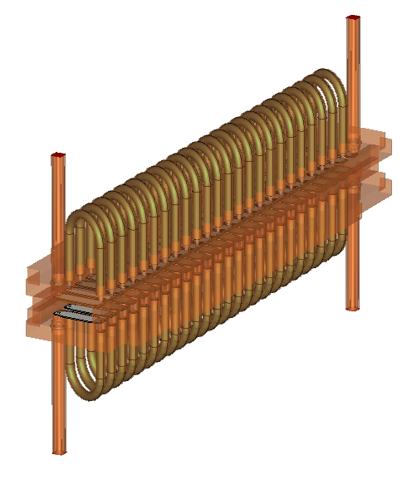
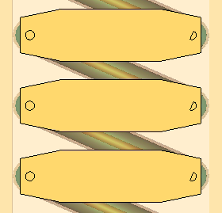
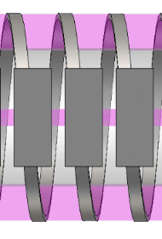
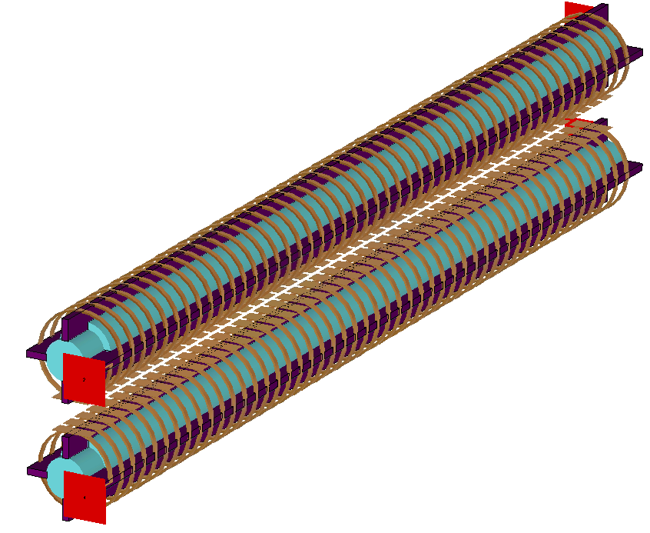
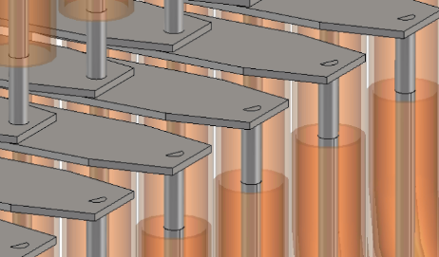
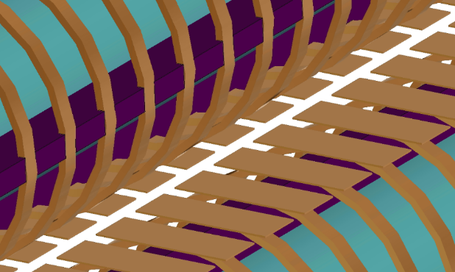
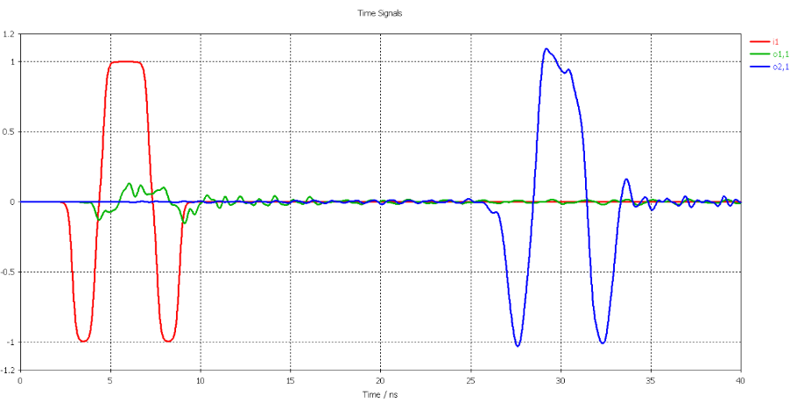
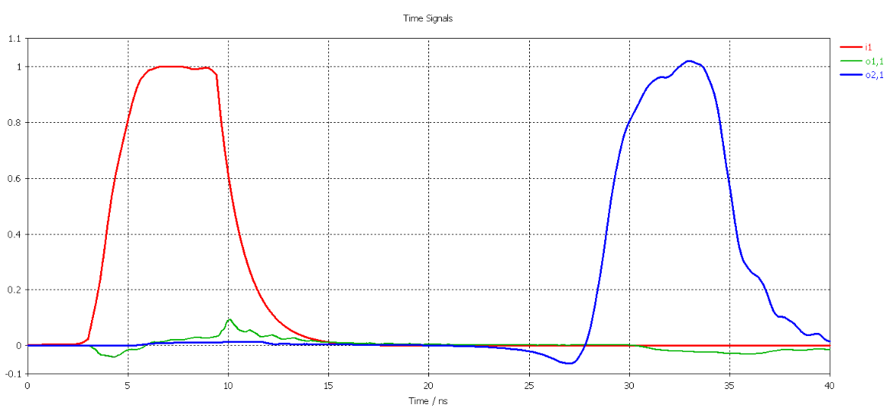
Kickers simulations (M. Hassan)
Both kickers were simulated with time domain solver of CST
  With all mechanical details and realistic pulse shapes
Angles differ from the model of parallel plates by <10%
2.84 mm
5.3 mm
20 mm
10.46 mm
Simulated geometries and propagated signals for two kickers
50 Ohm
200 Ohm

Slide 16
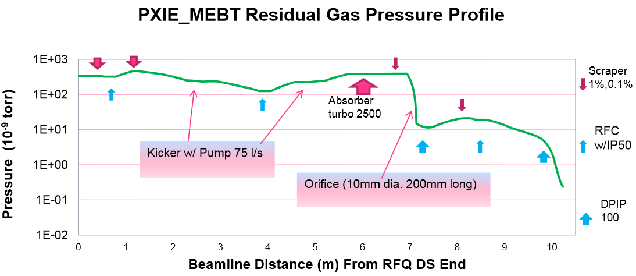
Vacuum components
MEBT vacuum concept did not change since 2012
  HV in most of MEBT and UHV, particle-free in last ~3m
  All vacuum equipment was identified and most purchased
  Design of the differential pumping section will start in FY16
  During PXIE operation, need to determine for PIP-II
    Length of particle-free region
    Fast acting valve system area (see C. Baffes’ talk)
A. Chen

Slide 17
MEBT commissioning plans
MEBT length will grow in 3 steps, determined by magnet delivery schedule
  MEBT-1 – 2 doublets, 1 bunching cavity (FY16)
    Main goal: commission the RFQ beam – see J. Steimel’s report
    Test absorber prototype with H- beam
  MEBT-2 - + 4 triplets, 1 bunching cavity
    Install in Jul-Sep 2016, run in Oct-Dec 2016
  MEBT-3 - + 3 triplets, 1 bunching cavity
    Install in Jan-Feb 2017, run Mar-Apr 2017
The final MEBT (install in 2017)
  Particle-free vacuum chamber in front of HWR
  Final chopping system

Slide 18
MEBT-2
2-3 versions differing by placement of diagnostics
The main goal is to test kickers
  Both prototypes are installed
  Test: kickers survival and resulting angle
  50 Ohm: two 81.25 MHz CW drivers
  200 Ohm: two 500V switch prototypes
  If lucky and time permits, may try to run them in synch aiming to observe separation of every other bunch
Also: optics; tests of laser wire and extinction monitor (RWM)
WS and laser wire
Toroid
BPM
50 Ohm kicker
200 Ohm kicker
AS
Dump
FFC
ToF

Slide 19
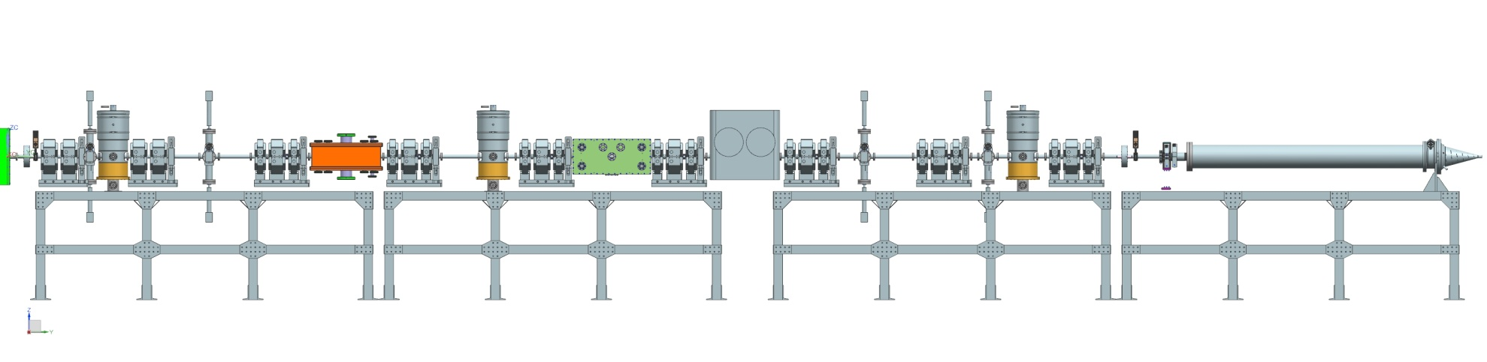
MEBT-3
All magnets, cavities, and scrapers are in final locations
The last ~2m are “cleanable” but assembled not particle-free
The kickers are 50 Ohm and 200 Ohm prototypes
5kW absorber prototype instead of full absorber
Likely several versions similar to MEBT-1,2
Main goals
  Prepare beam for injection into HWR
  Optics; UHV sections and differential pumping
  Continue previous measurements
Absorber
Differential pumping section

Slide 20
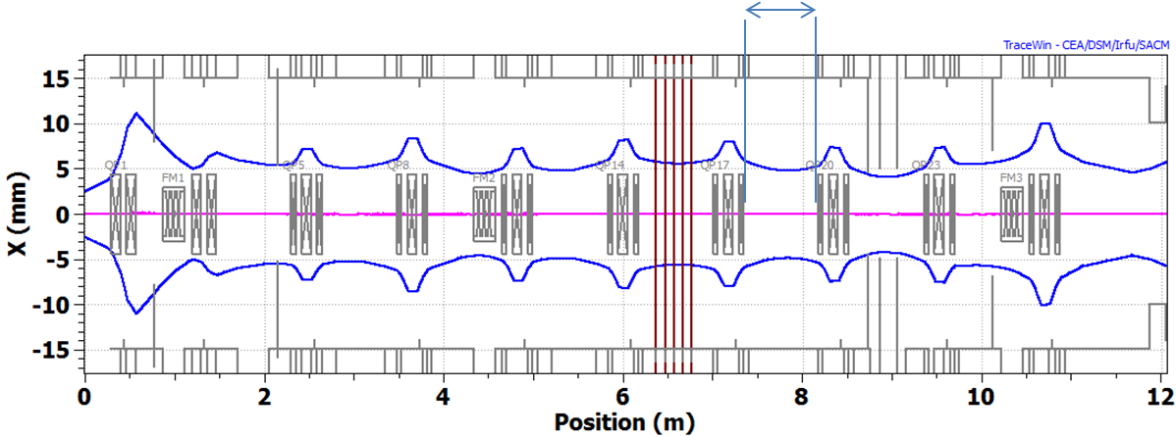
PXIE MEBT vs PIP-II MEBT
While all PXIE MEBT components are designed to PIP-II specs, there may be differences
  The ion source needs to be accessible during linac operation
    Need a radiation wall (similar to SNS) in MEBT; might fit into one more section
  PXIE experience may indicate a need for a longer particle-free region in MEBT
  More detailed analysis of risks may require a longer distance from the MEBT chopper absorber to SRF to provide protection by the fast acting valve
Possible wall location
A.Saini
  Longer MEBT would require additional triplets and may need an additional bunching cavity

