Slide 1
Beam Stability in Recycler and Main Injector
Phil Adamson
PIP-II Collaboration Meeting
9th November 2015

Slide 2
Introduction
Longitudinal stability
  Not addressed in this talk. Don’t expect problems
Transverse stability
  Coupled bunch instability
    Mostly driven by resistive wall
  Issues during slip-stacking
    Overlapping beams
  Recycler fast horizontal instability

Slide 3
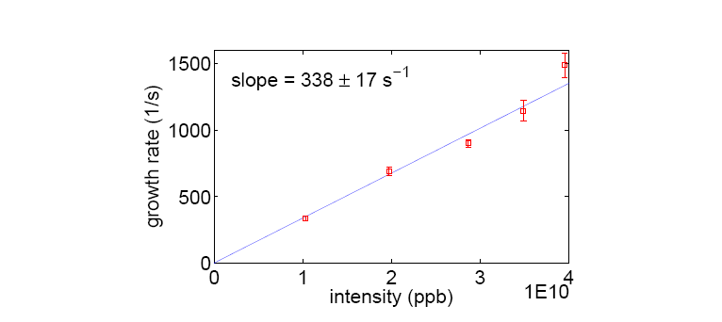
MI coupled bunch growth rate
Measurement of growth rate of transverse coupled bunch instabilities
  PA, X. Huang, 2006
Measurements reasonably consistent with expectation for impedance
Recent measurements of recycler impedance are similar to Main Injector
  R. Ainsworth

Slide 4
Available transverse damper gain
Measurement from 2006 (PA, R. Zwaska)
  MI Dampers have adequate gain/power up to more than 20e10 protons per bunch
  No issue for PIP-II
Have not done identical measurement for recycler, but impedance is similar
  Also have routinely run recycler with one missing damper amplifier

Slide 5
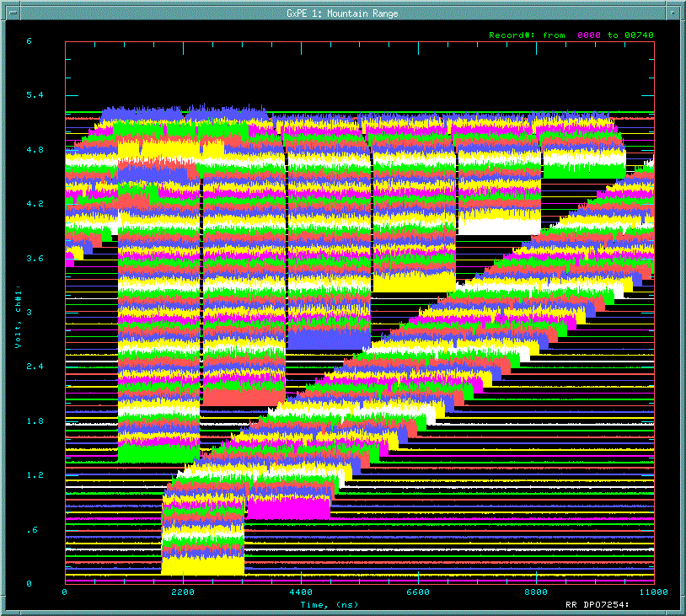
Challenges for 4+6 and 6+6
Transverse damping challenging for region where beams overlap
  Small for 2+6, larger for 4+6 and 6+6
  Need to run with larger chromaticity to gain stability
    Also see R. Ainsworth simulations
  Currently an open question
    Larger frequency separation for 20Hz is not helpful
4+6
6+6

Slide 6
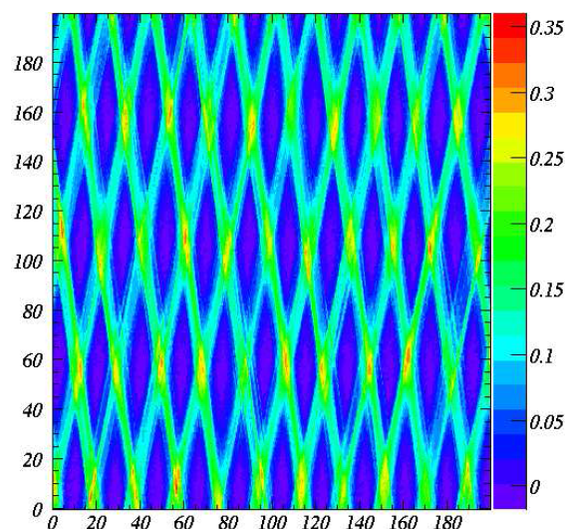
Damp overlapping beams?
Currently investigating transverse damping in region where two beams overlap
  Have to provide the same kick to both beams, obviously
  “Interesting” to extract useful data from BPMs
    Easier in vertical
    (no dispersion)
  Work in progress – ask me next year!

Slide 7
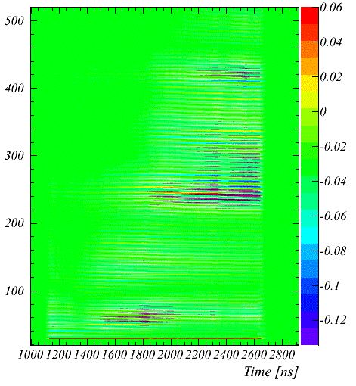
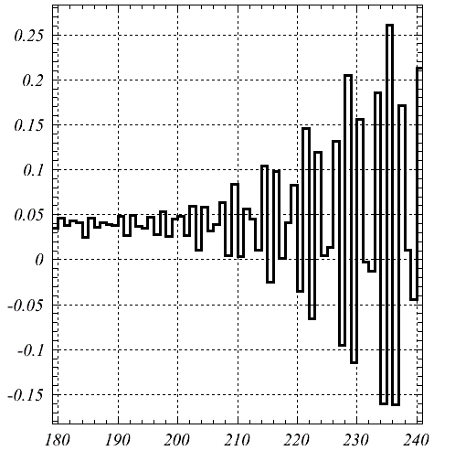
Recycler Horizontal Fast Instability: a surprise
Color scale shows horizontal motion
When we started to run the six-batch boxcar cycle at high intensity
Fast instability at injection for high linear charge density
  Only in horizontal plane
  Single batch effect – not made worse by more beam in machine
    In fact, the opposite
    Before 2014 shutdown, first batch intensity ~80% of others
  After shutdown, can run full intensity without instability
  Hints that threshold increased with vacuum scrubbing
Growth rate 10-15 turns
Machine turns
½ synchrotron period
One batch, at injection

Slide 8
Recycler Horizontal Fast Instability: a surprise
Color scale shows horizontal motion
Doesn’t occur in Main Injector at same intensity
  (even with shorter bunches)
Differences between RR and MI
  RR beam tube a little smaller
  Combined function magnets?
  Studies and simulations in progress
    E-cloud is a popular explanation given the fast growth rate, but we can’t yet explain all the details
    Trapping in gradient magnets?
  Similar instability seen at extraction in CERN PS?
    R. Steerenberg et al., PAC07
  Does not occur for 700kW operations
    Potential issue at PIPII intensity
Growth rate 10-15 turns
Machine turns
½ synchrotron period
One batch, at injection

Slide 9
Conclusions
No transverse stability issues for Main Injector in PIP-II era
  Unless electron cloud shows up. Ongoing work to determine effects of beam pipe coating and beam scrubbing.
    See Ioanis’s talk
Some work to do in Recycler
  Dampers are fine when beam isn’t overlapped
  Work ongoing to determine how dampers can operate in the overlapping region
  Ongoing work to study fast horizontal instability
    Active working group
    If it’s e-cloud, pipe coating will help
    Low frequency (<1MHz) high-power (damp 10 turns growth rate) damper is buildable, if necessary

