Slide 1
Booster modification for 20 Hz operation
Kiyomi Seiya
PIP-II Collaboration Meeting
9-10 November 2011

Slide 2
Outline
Resonance circuit modifications
Injection energy stabilization
Cogging

Slide 3
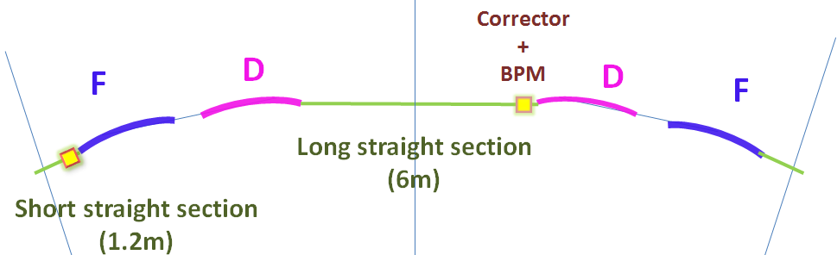
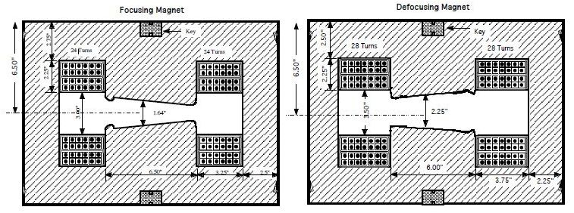
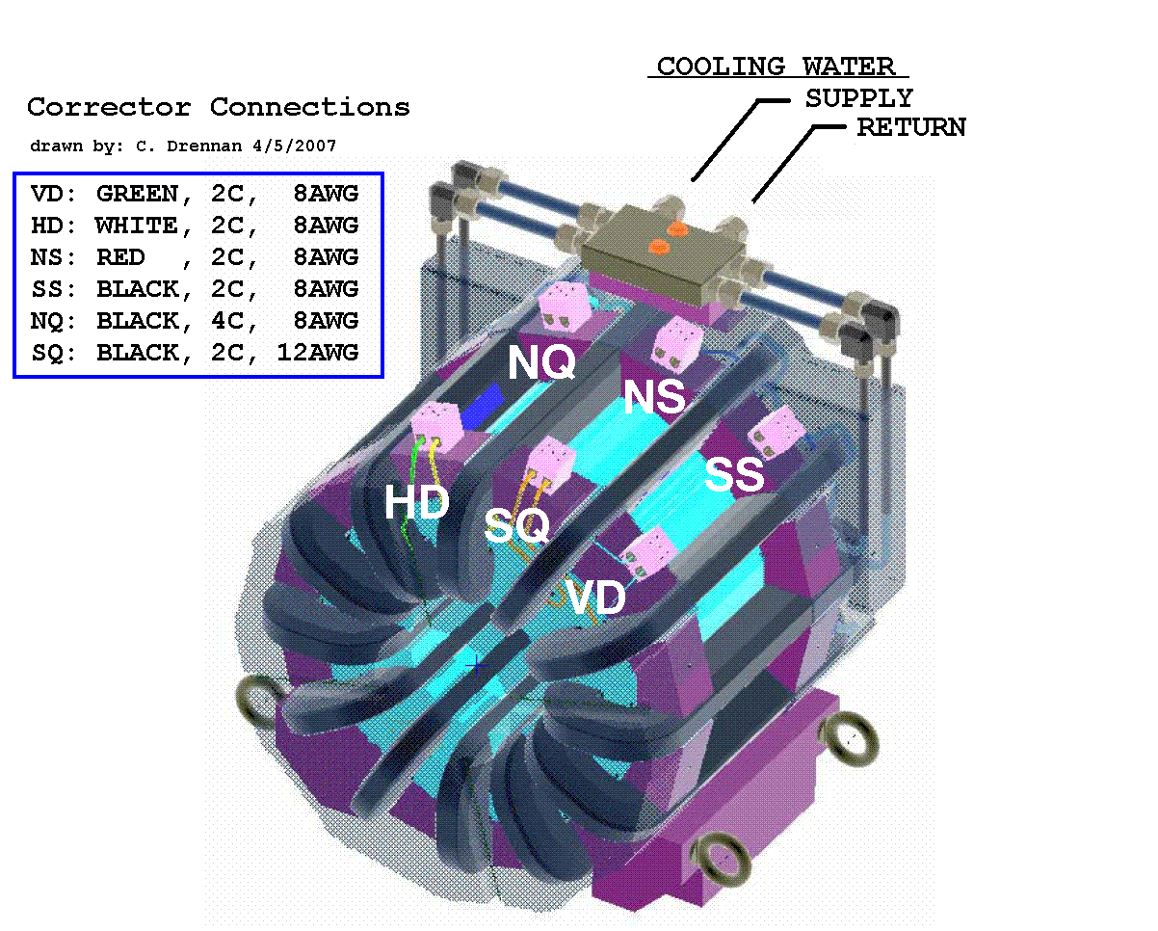
Booster FDOODF lattice
F Magnet
D Magnet
Combined function magnets: F, D
FDOODF x 24 periods
Corrector packages at short and long
Corrector package (12 poles) includes
H & V dipoles, quad, skew quad, sextupole, skew sextupole
and H & V BPMs.
Corrector Package

Slide 4
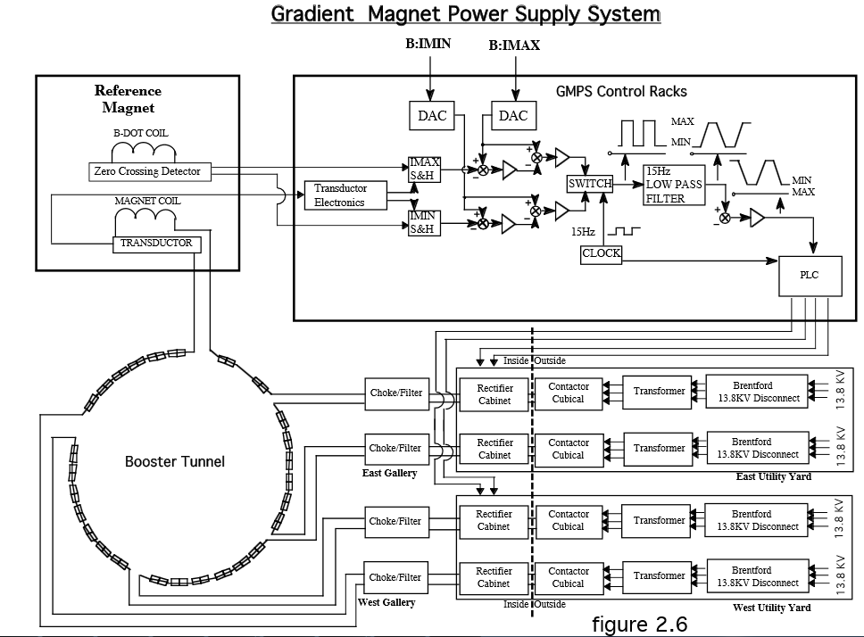
GMPS(Gradient Magnet Power Supply System)
PS1
PS2
PS3
PS4

Slide 5
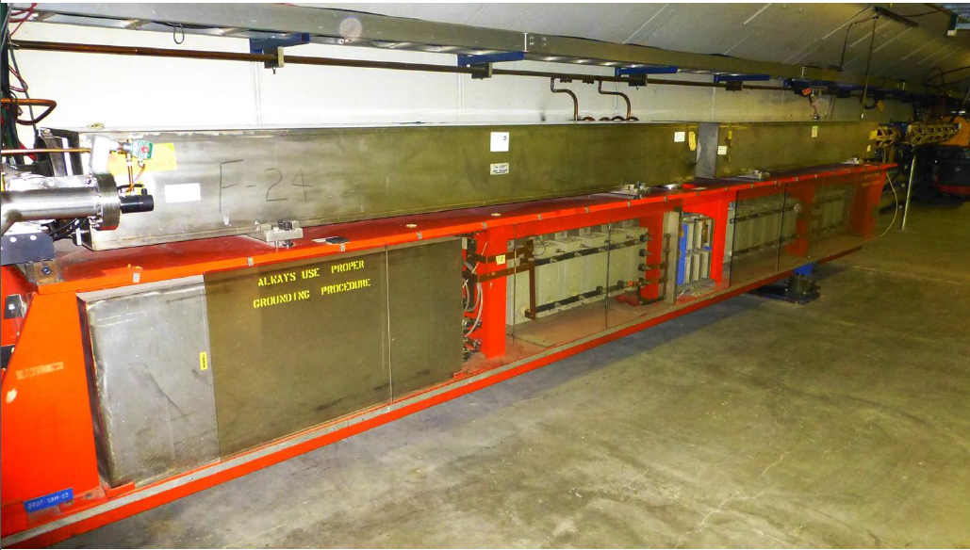
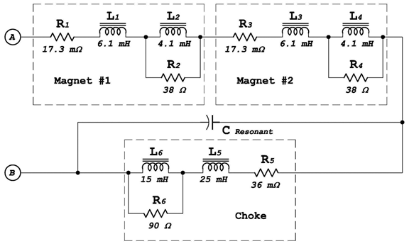
F Magnet and D Magnet on a Girder
D-Magnet
F-Magnet
Resonant Capacitor
Coil
Magnet pole
Choke
F-Magnet
D-Magnet
Resonant Capacitor
Current on Magnets
@ Injection → @ Extraction
103A 966 A
Choke
11/9/2015

Slide 6
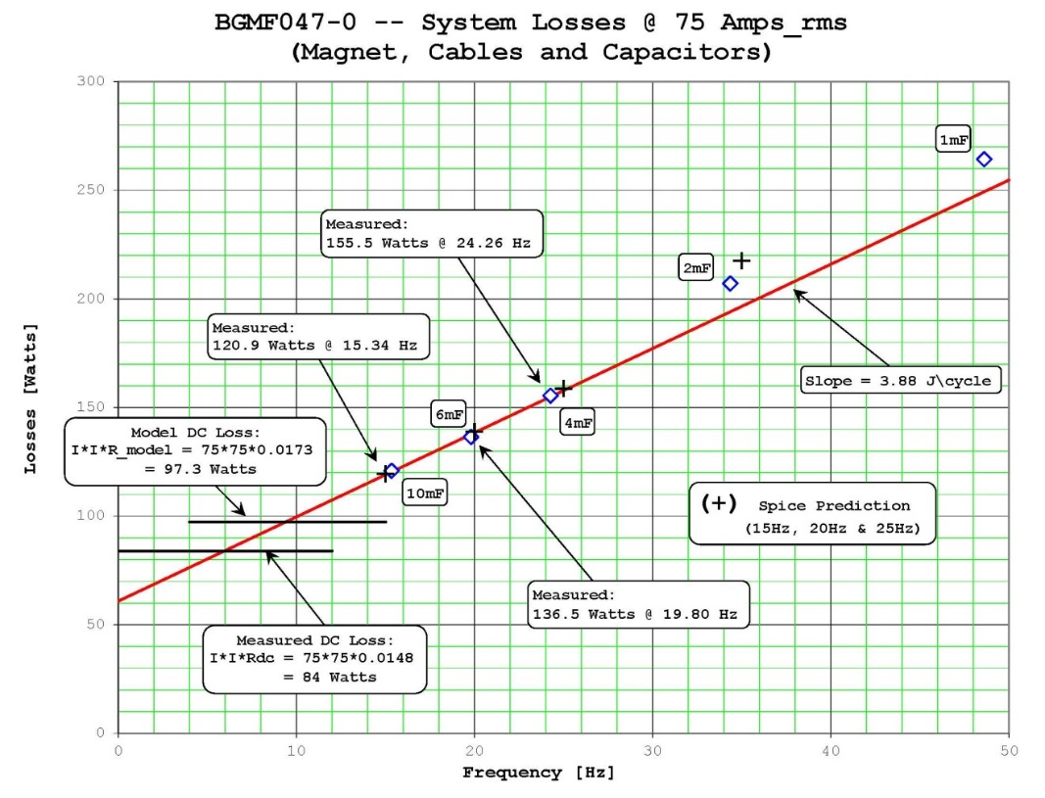
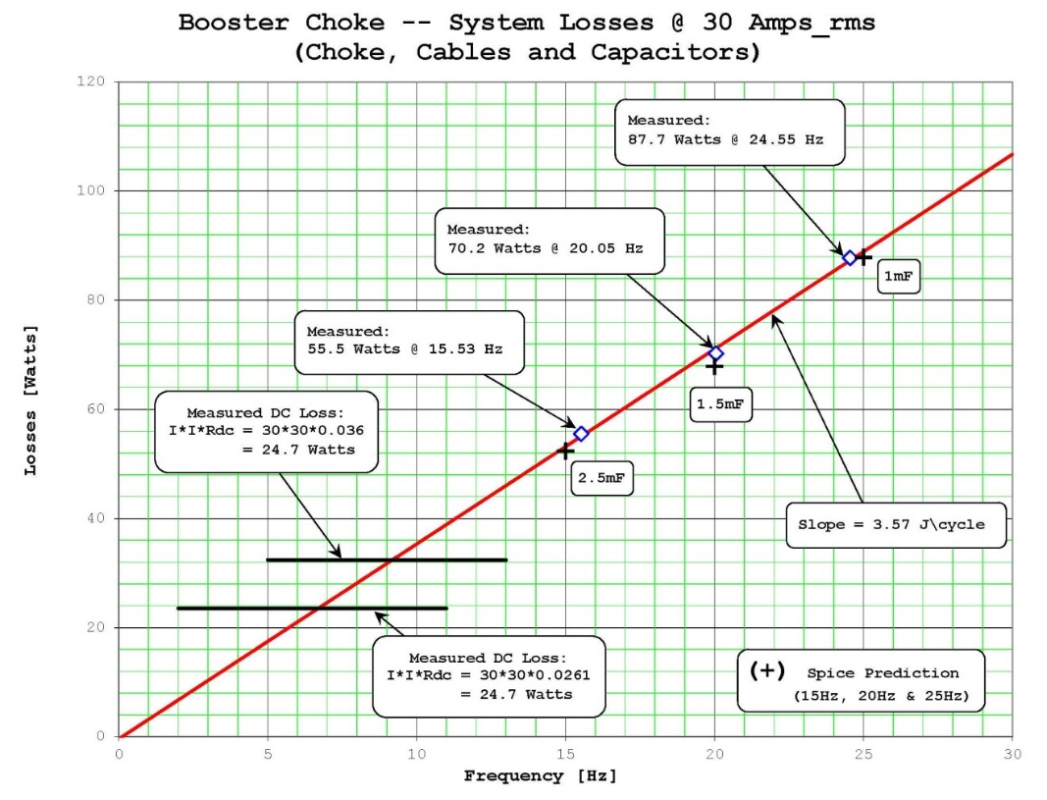
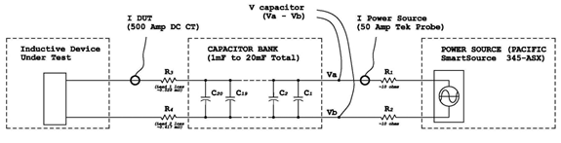
Loss measurements at 20 Hz
Losses @ 75 A (rms)
with Magnet, Cable and Capacitors
Losses @ 30 A (rms)
with Choke, Cable and Capacitors
Losses [W]
Losses [W]
0
10
20
30
40
50
0
5
10
15
20
25
30
Frequency [Hz]
V
Frequency [Hz]
I

Slide 7
Requirement for 20 Hz operation on GMPS
Require about 3.9% more power.
Capacitor voltage will increase by about 32%
Resonant capacitor at each “Girder” must decrease from ~8.33 mF to 4.69 mF.
RMS current per µF will also increase as well.
Require same measurements at high current ~500A(rms)

Slide 8
Injection field error on present operation
I_err ~ 0.04A
Current on Main dipole magnet
Orbit difference
T_err_max ~ 40 μsec
dR ~ 1.2mm

Slide 9
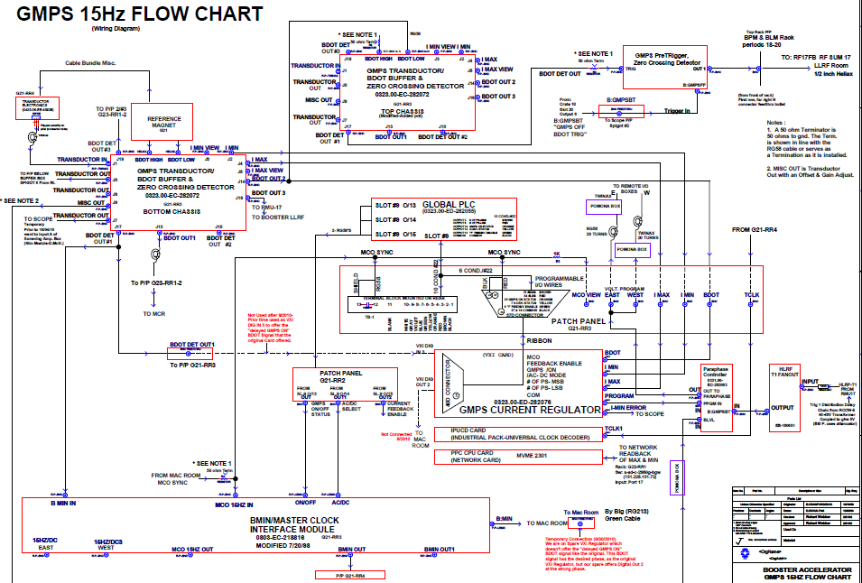
GMPS regulation
Reference
Magnet
Transductor
GO TO
4 PSs
VXI card
DAC OUT
NIM

Slide 10
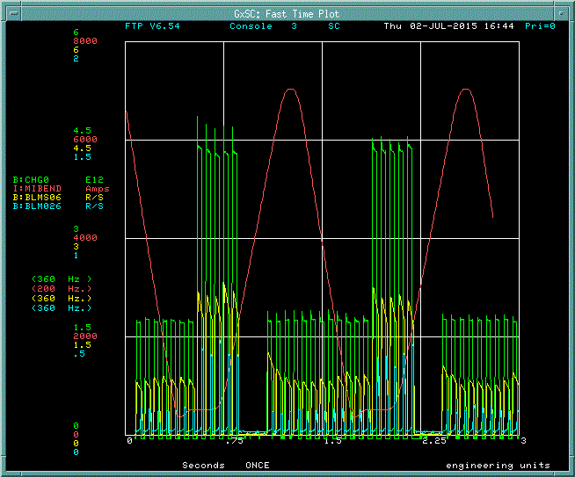
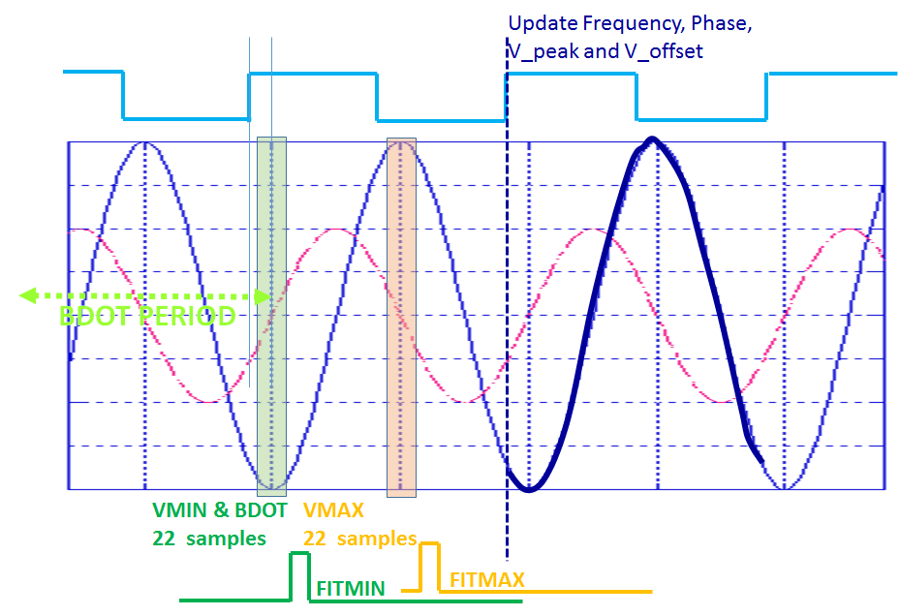
GMPS feedback
VXI card: I_MIN, I_MAX and period
NIM module: Set gain according to the operation time line
(Booster and MI are using same substation)
MI field
Booster Int.
B
Booster Loss
Vout = G * coeff * (Vave + Vpeak * cos(output_phase))

Slide 11
Plan for GMPS regulation
I_err < +/- 0.02 [A], T_err < 20 μsec
Both feedback on a new VXI board
15Hz operation
PIP-II 20Hz operation
~ 600 μsec
~ 40 μsec

Slide 12
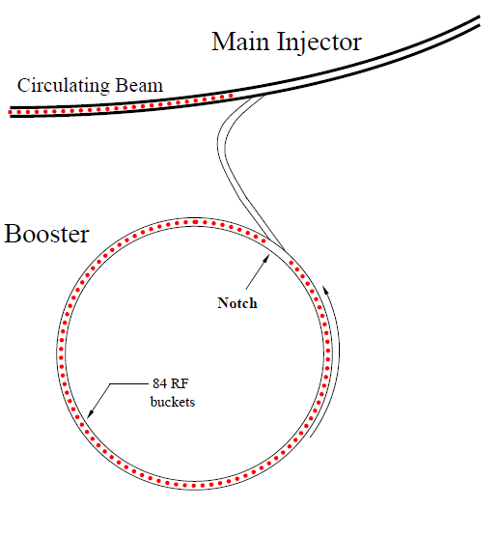
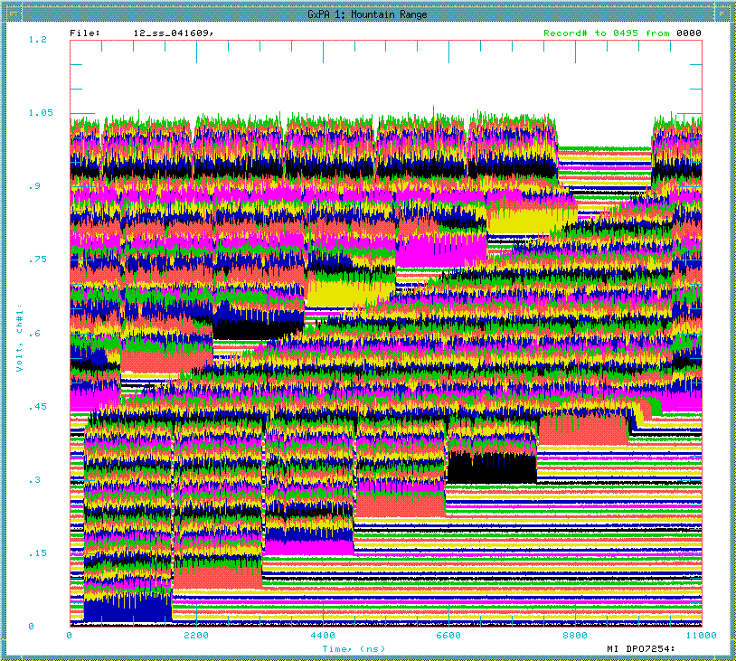
Notch and Cogging
Time
h=588
Main Injector / Recycler
Gap
for the extraction kicker
h=84
2nd Booster batch
81 bunches + 3 empty buckets
1st Booster batch
MI/RR revolution
Notch(extraction kicker gap) – Booster extraction kicker – MI/RR injection kicker

Slide 13
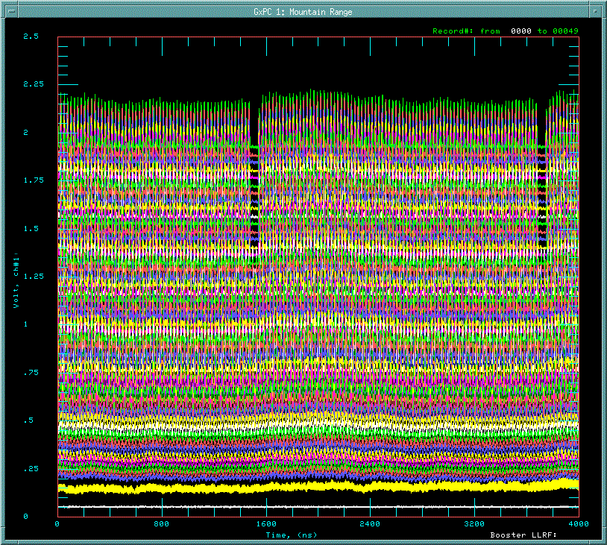
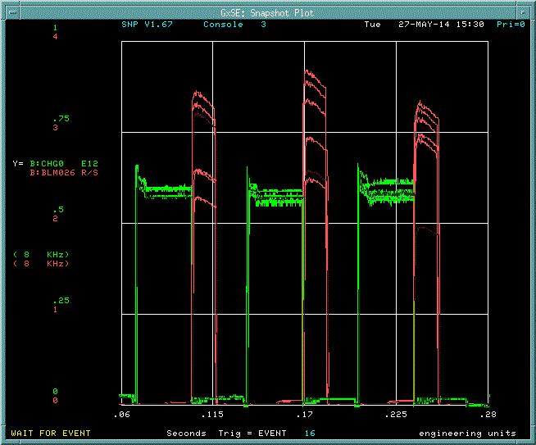
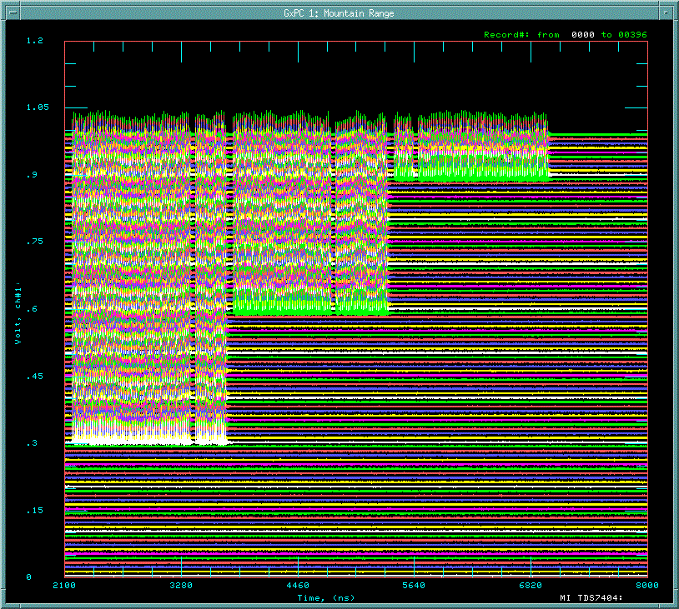
Beam at injection and extraction without Cogging
1 Booster revolution
at injection
Notch
→ 81 bunches + 3 empty buckets
Time
Adiabatic capture with 37MHz RF
→ 84 bunches
Injection from LINAC @ 400MeV
at extraction
at MI/RR injection
Intensity
Lost 3 bunches
every Booster
extraction.
2nd
1st Booster batch
Beam loss at extraction
Notch

Slide 14
Total bucket count during Booster cycle
Booster:
15 Hz resonant circuit
RF frequency: 37.7 – 52.8MHz
Total rf bucket count = const.
Total rf bucket count = const. -- Notch is at same position at extraction

Slide 15
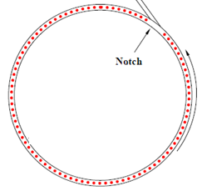


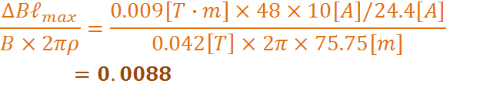
Cogging using 48 new dipole corrector magnets
Fixed with RPOS feedback
Changed by dipole corrector
Dipole corrector: 0.009[T-m] @ 24.4[A]
(Assuming 10[A] change )
B field error ~1% can be compensated.
Keeps beam on central orbit and save aperture.
Creates notch anytime after injection( even LINAC notch)
→ reduce beam power loss by 40%.

Slide 16
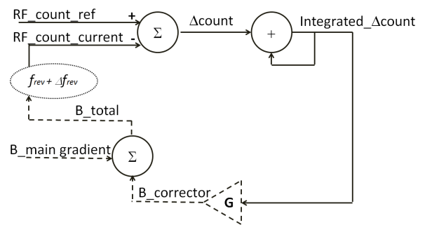
Block diagram of Cogging feedback
Bdot
BRF
11 μsec (MI/RR RF x 588)
Integrated diff. bucket count has to be ‘0’ at the end of cycle.

Slide 17
Field error and integration of difference of rf counts
Booster: 15Hz resonant circuit synchrotron synchronized to the 60Hz power line.
B_main dipole field
Simulation
Measurement
Number of MI/RR revolution

Slide 18
Simulation for the feedback and measurements
Integrated error w/o feedback (simulation)
With feedback (simulation)
With feedback (MEASUREMENTS)

Slide 19
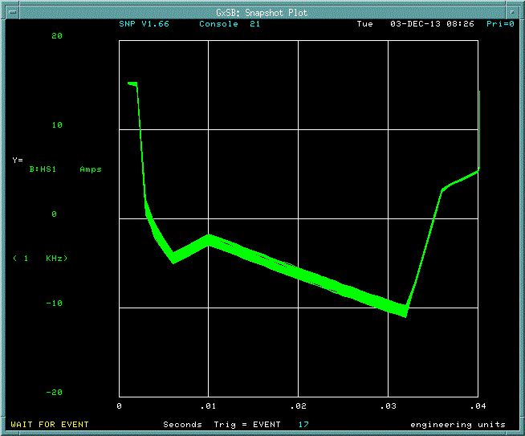
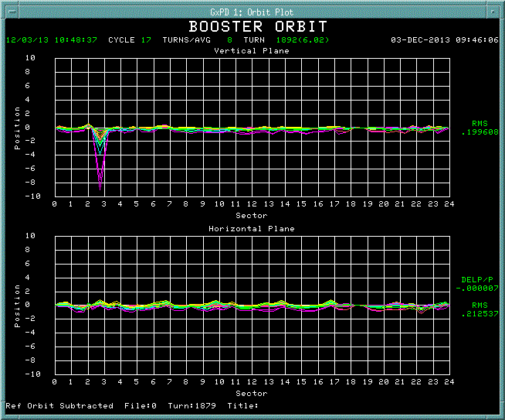
Orbit changes during Cogging operation
Corrector current
Orbit difference
2A
+/- 10 mm
Corrector current : +/- 1A
Orbit change < 1mm

Slide 20
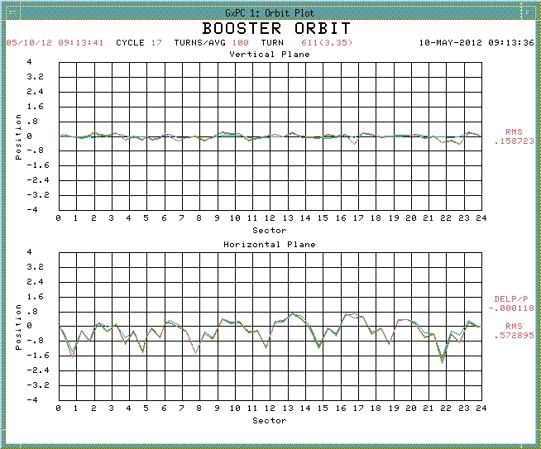
Cogging at 20Hz
Integrated error with feedback (simulation)
Required corrector current
for Cogging at 20 Hz operation: < 4A
Measured orbit change
with 4A offset < +/- 1mm
+/- 4mm

Slide 21
Summary
Resonance circuit modifications
→ Estimated losses, power and required capacitors
→ Need measurements at high current
Injection energy stabilization
→ Developing new GMPS regulator for present 15 Hz operation
→ It should work for 20Hz
Cogging
→ Current system should work for 20Hz

