Slide 1
Booster RF Cavity Replacement
Thomas Kroc
PIP-II Collaboration Meeting
9-10 November 2015

Slide 2
Why?
While the existing cavities have been refurbished, they are still 40 years old.
PIP II operations will leave no extra operating margin.
Uncertain operational impact of needing to run all cavities at maximum performance 24/7.

Slide 3
PIP & PIP-II high level performance goals
Beam Performance Parameter | PIP | PIP-II
Injection Energy | 400 | 800 | MeV
Linac Particle Type | H⁻ | H⁻
Linac Beam Current | 27 | 2 | mA
Linac Beam Pulse Length | 0.03 | 0.5 | msec
Beam Capture | Adiabatic Paraphase | Bucket to Bucket
Booster Pulse Repetition Rate | 15 | 20 | Hz
Booster Protons per Pulse | 4.2×10¹² | 6.4×10¹²
Booster Beam Power @ 8 GeV | 80 | 160 | kW
Beam Emittance (6s, normalized; ex=ey) | <18 | <18 | π mm-mrad
Delivered Momentum Spread (97% full height) | 12.2 Momentum Spread (97% full | 12.2 Momentum Spread (97% full | MeV Momentum Spread (97% full
Delivered Longitudinal Emittance (97%) | .08 | .08 | eV-sec

Slide 4
PIP & PIP-II RF Parameters
Cavity Performance Parameter | PIP | PIP-II
Frequency Sweep | 37 to 53 | 44.7 to 53 | MHz
Cavity Tuning (Bias Supply Max Current) | 3000 | 3000 | amps
Modulator Voltage (Max: Anode – drop) | 30 | 30 | kV
Higher Order Mode | < 1000 | <1000 | Ohms
Aperture | ~ 3 | ~3 | inch
*Total Voltage | 1000 | 1100 | kV
Overhead Voltage | 100 | 100 | kV
Duty Cycle | 50 | 50 | %
Cavity Q | 300 to 1250
Shunt Impedance | 17 to 61.25 |  | k Ohms
LCW Cooling Temp (actual) | 95 (88 – 94) | 95 (88 - 94) | F
LCW Flow | 100 | 100 | PSI
Forced Air Cooling | Yes | Yes
* Sum of gap voltages at peak power, overhead allows for running with reduced # of cavities.

Slide 5
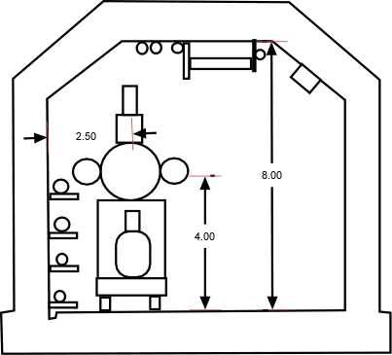
Tunnel Constraints
Must fit in existing tunnel, limitation of options for new Pas.

Slide 6
Cavity Voltage
830 kV – 950 kV, present operating range depending upon beam requirements and cavity repair status.
< 850 kV, losses increase for 4.2E12/pulse.
requires a minimum of 17cavities at the nominal voltage 50 kV or 25 kV/gap.
1.2 MV ( 1.1 MV total + 0.1 MV overhead )
Plan to run similar to MI, all cavities on, voltage fixed/regulated as needed.
# of cavities | 1200 kV
20 | 60
21 | 57
22 | 55

Slide 7
Cavity Tuning and Drive System
Will use existing hardware which was all recently upgraded for PIP
New solid state driver system
Upgraded bias supplies
New anodes – higher power
Additional cooling (air & LCW) systems for RF systems
Upgrades on low level controls
This task of the PIP project is replacement of cavities only

Slide 8
Other cavity performance factors
Beam Loading and Power Requirements
Each cavity must meet the specified voltage while accelerating up to 1000ma of beam (at a synchronous phase of ~40 degrees (synchrotron definition, 90 degrees at crest)) with 2-3 of the 84 buckets empty.
The loaded cavity shall be designed to operate with up to 150 kW RF power from a CPI (EIMAC) Y-567B tetrode power tube. Although rated to operate at higher power up to 200 kW, for lifetime considerations operating at a lower power is preferable.
Cavity Impedance and Spurious Modes
The cavity shall be designed for R/Q = 50 ohms and the impedance of all higher order and spurious modes shall be ≤ 1000 ohms.
Multipacting
The cavity must be able to turn on and run at any voltage between 25% and 100% of the specified operating voltage over the full frequency range without operationally significant multipacting at the nominal operating vacuum pressure.

Slide 9
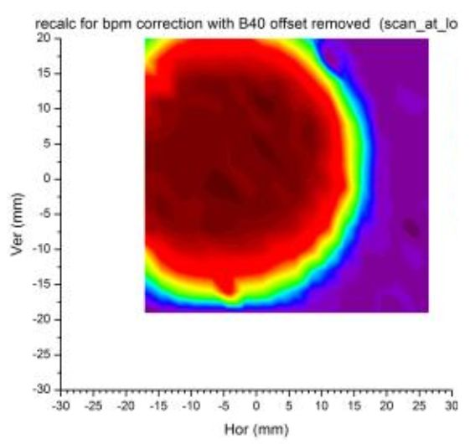
Aperture - Magnets and RF
Aperture Scan data
at Long 14
0.75” radius circle
2.25" RF

Slide 10
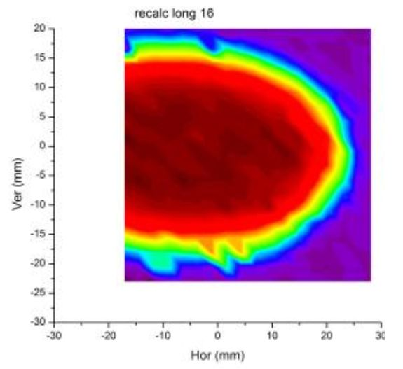
Aperture - Magnets and RF
Aperture Scan data
at Long 16
Fit to ellipse
a=1.24”, b=0.6”
e=0.85

Slide 11
Aperture - Ellipse using maximum parameters
Maximum Ellipse
(semi-arbitrary offset)

Slide 12
Aperture - Conclusion
 | a (inch) | b (inch) | area (in²)
average | 0.9113 | 0.6519 | 1.87
max | 1.24 | 0.75 | 2.92
Ratio (max/ave) | 1.36 | 1.15 | 1.57
New aperture radius | 1.53 | 1.29 | 6.22
Radius = 1.4
3” beam pipe will provide 0.1” to 0.2” margin

Slide 13
Aperture – Second Look
Vertical aperture limited by magnets
Horizontal aperture limited by cavities
57.17mm
57.17mm

Slide 14
PIP-III Beam Parameters
Table 3 | Booster (PIP) | PIP II | New RCS (PIP III)
Pulse Intensity | 4.3E12 | 6.5E12 | 30E12
Peak RF Beam Current | .86 amps | 1.3 amps | 6 amps
Cycle Rep Rate | 15 | 20 | 20
Injection energy | .4 GeV | .8 GeV | 2 GeV*
Extraction energy | 8 GeV | 8 GeV | 8 GeV
Revolution time | 2.22 to 1.59 us | 1.88 to 1.59 us | 1.66 to 1.59 us
*Representative value (still under discussion)

Slide 15
PIP-III Cavity Parameters
Table 4 | Booster (PIP) | PIP II | New RCS (PIP III)*
Frequency Sweep | 37 to 53 MHz | 44 to 53 MHz | 50 to 53 MHz
Peak DP/DT MeV/.1ms | 376 | 470 | 387
Peak eV/turn | 606 | 755 | 620
Harmonic # | 84 | 84 | 84
* No design available – basic assumptions about beam current and injection energy

Slide 16
Review
Consensus
New cavities – yes
Larger bore necessary for PIP-III suggested but impact on design not understood
Continue simulation efforts for II & ⊥ bias cavities
Prototypes for II & ⊥ bias cavities
Questions
Wait for results of ⊥ bias ?
Cost trade-off between copper and garnet
Additionally
Instrumentation, feedback, and control needs to be upgraded for reliable operation at projected beam powers

Slide 17
Conclusion
No upstairs systems are involved
All necessary upgrades will have been completed as part of PIP
Physical constraints remain the same – no tunnel modifications anticipated
Beam parameters for PIP-II are set
Cavity specs are complete and can be applied to either:
Parallel bias cavity or
Perpendicular bias cavity
Major cavity specs are compatible with PIP-III/RCS
Detailed specs will determine whether cavities can be used
Work ramping up in FY16 with plans to test prototype in FY17

