Slide 1
PXIE Plan: 2016, 2017, 2018
Paul Derwent
PIP-II Collaboration Meeting: Working Group 1
9-10 November 2015

Slide 2
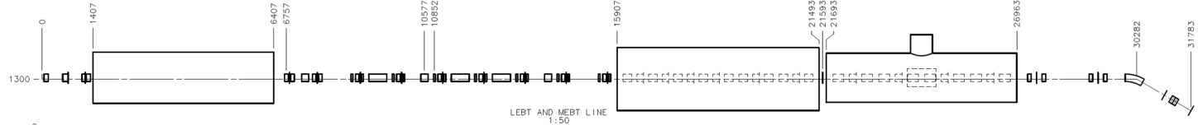
PXIE (PIP-II Injector Experiment)
Now
2016
2017
2018
2018
30 keV
2.1 MeV
10 MeV
25 MeV
RFQ
MEBT
HWR
SSR1
HEBT
LEBT
40 m, ~25 MeV
PXIE will address the address/measure the following:
  LEBT pre-chopping : Demonstrated
  Vacuum management in the LEBT/RFQ region : Demonstrated
  Validation of chopper performance
    Bunch extinction, effective emittance growth
  MEBT beam absorber
    Reliability and lifetime
  MEBT vacuum management
  CW Operation of HWR
    Degradation of cavity performance
    Optimal distance to 10 kW absorber
  Operation of SSR1 with beam
    CW and pulsed operation
    resonance control and LFD compensation in pulsed operations
  Emittance preservation and beam halo formation through the front end
Collaborators
ANL: HWR
LBNL:LEBT, RFQ
SNS: LEBT
IIFC: MEBT, RF, SSR1

Slide 3
Beam requirements at the end of PXIE:FRS
* RMS, normalized
PIP-II requirements are not the same!
  CW vs pulsed: 20 Hz, 55 msec
  MEBT end: 0.23 μm
  2 mA

Slide 4
PXIE plan
FY16: well defined
  Commission RFQ (RF and beam)
  Install most of the MEBT magnets
  Install and test kicker prototypes
  Initial Machine Protection System
FY17:
  Receive HWR
  Cryogenic Distribution
  Install final MEBT& HWR
FY18
  RF commissioning of HWR
  10 MeV beam ? Temporary HEBT?
  Installation of SSR1
FY19
  Final beam parameters

Slide 5
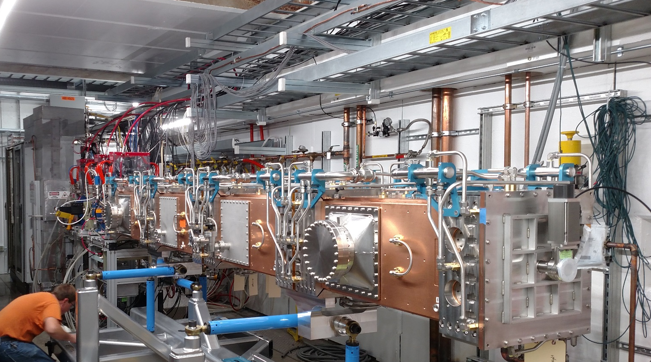
RFQ
Designed and fabricated by LBNL
  Delivered beginning
  of September
  Installation in progress
Two 75 kW 162.5 MHz
solid-state amplifiers
Water and Resonance Control systems
LLRF
Matt Hoff
J. Steimel to discuss

Slide 6
MEBT stages
The MEBT is proposed to be installed in several steps, determined mainly by arrival of magnets from BARC
  MEBT –x, x=1, 2, 3 in this report corresponds to intermediate configurations with different number of magnets
  Each configuration may have several variations of different diagnostics placement, which are referred as MEBT x-y
1175mm
#0
#1
#2
#3
#4
#5
#6
#7
#8
Slow valve,toroid
Ring pickup
ScrapersRF
Emittance monitor, scraper, wire scanner
Kicker
RF, wire scanner, Laser Wire
Kicker
Absorber
Different. pumping,
scrapers, wire scanner
Scrapers, RF, slow valve, extinction monitor
Fast valve, DCCT, toroid, laser wire, wire scanner
Slow valve
A. Shemyakin
V. Scarpine
MEBT-2: +4 triplets, 1 buncher
MEBT-3: +3 triplets, 1 buncher
MEBT-1: 2 doublets, 1 buncher

Slide 7
PXIE in FY16
RFQ beam in pulse mode in Jan 2016
  RFQ is RF- commissioned
  MEBT 1-1 is ready to roll in
Shutdown July 2016 for installation of MEBT-2
Need:
  4 triplets from BARC
    (delivery June 2016)
    one re-measured in TD
  2nd bunching cavity
  Kickers and additional diagnostics are ready
Assembly of MEBT-2 high priority:
  hold to shutdown in summer 2016
  define the minimal measurements needed

Slide 8
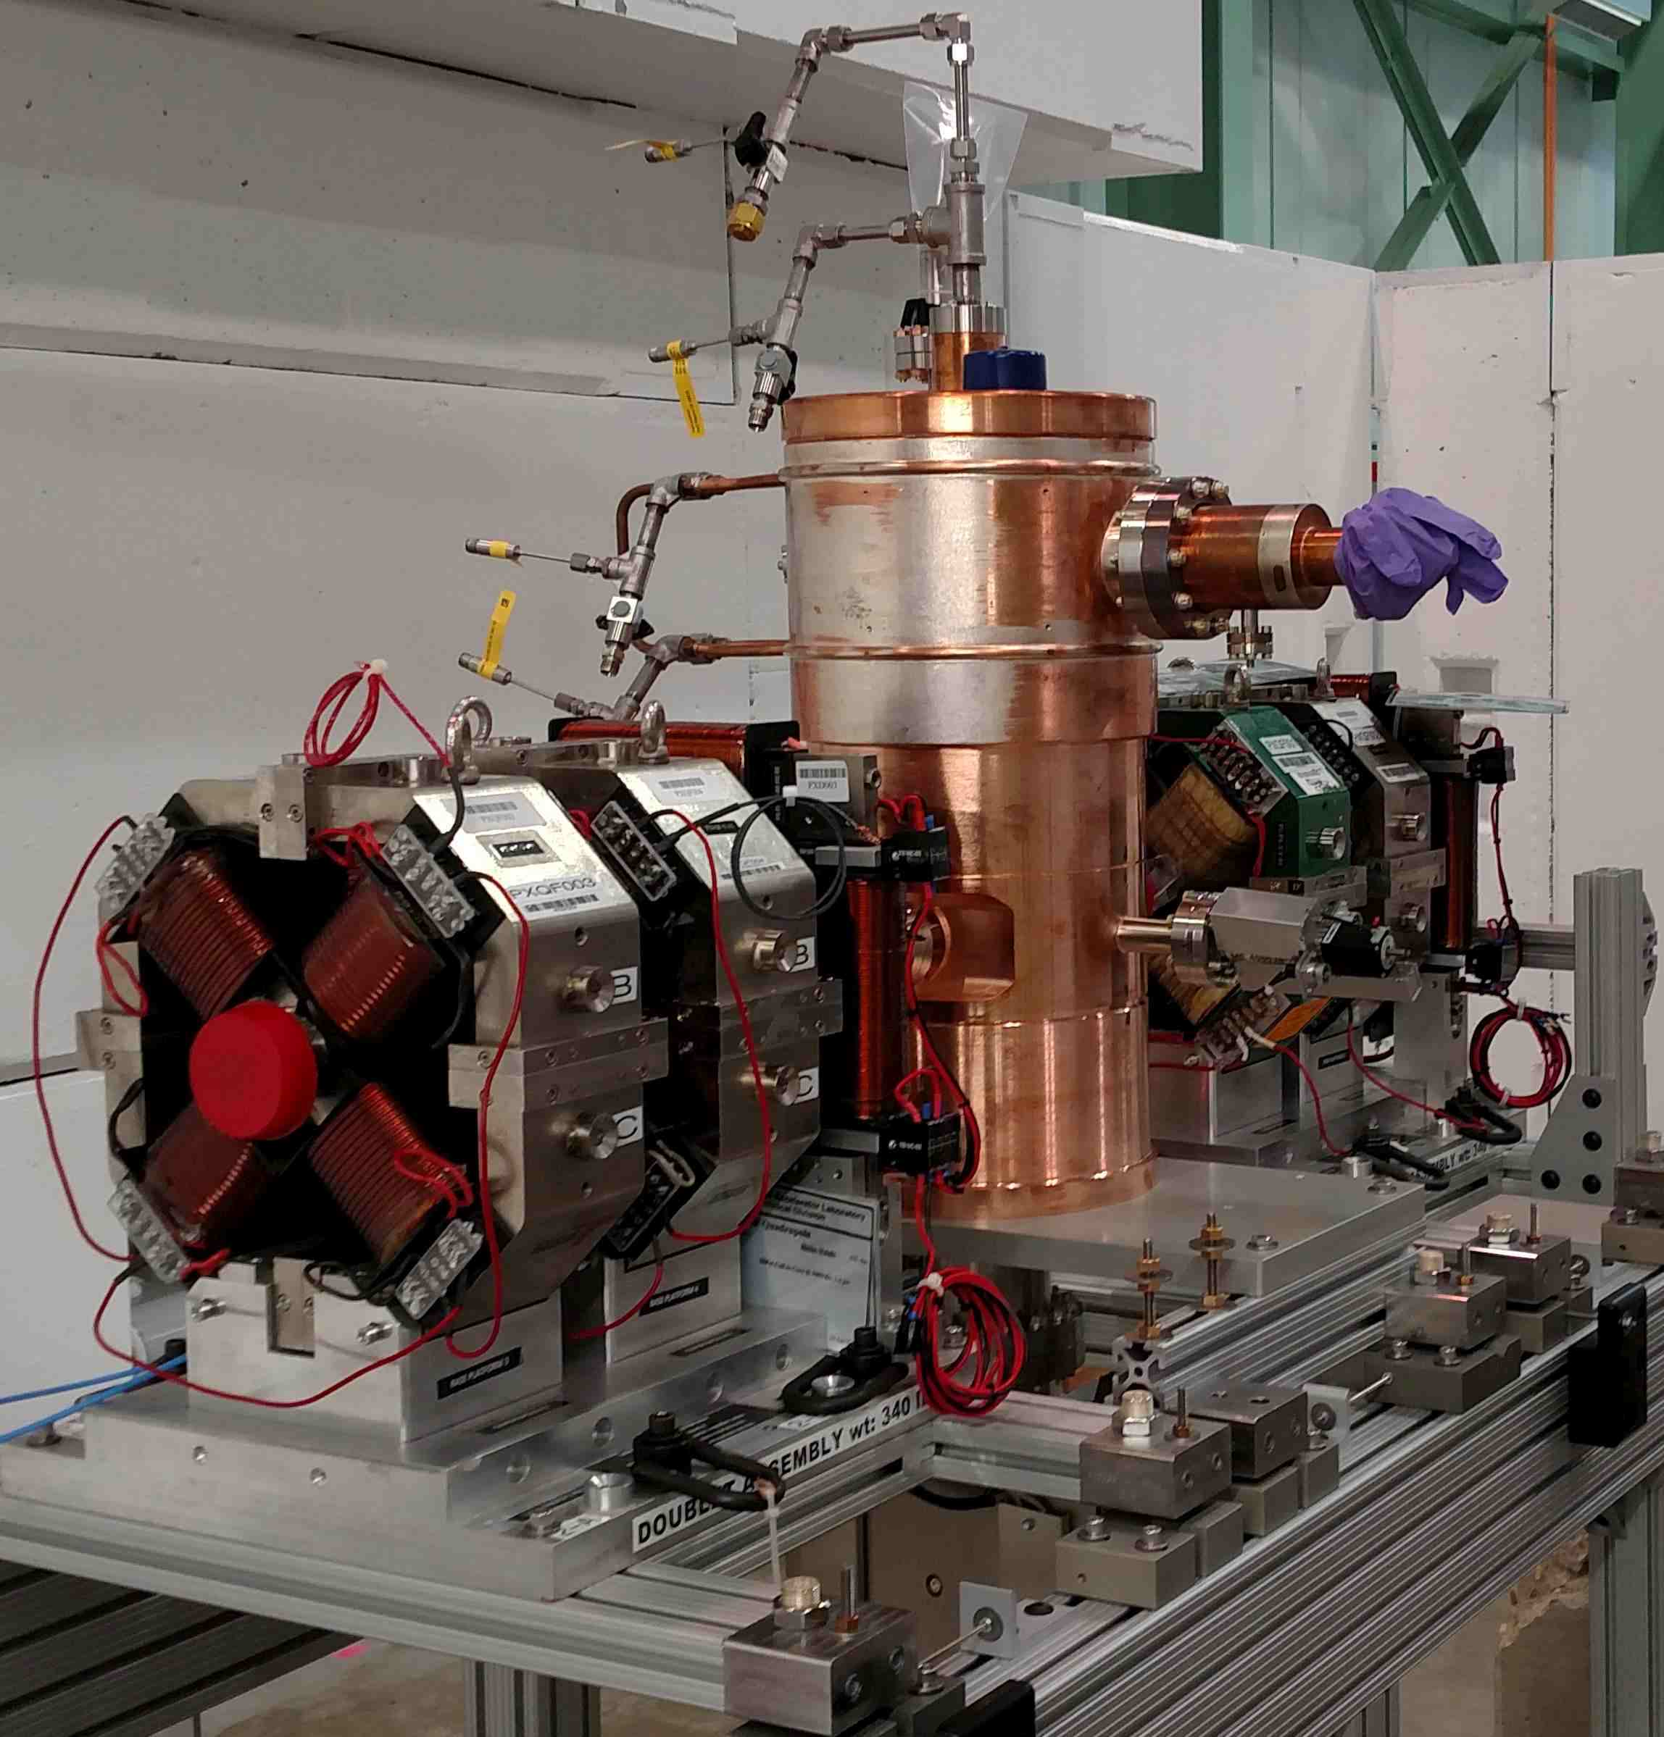
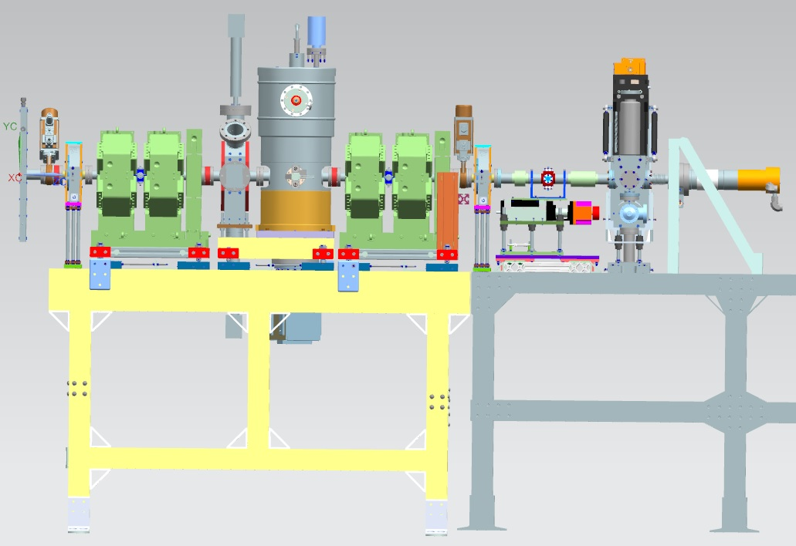
MEBT 1 FY16
Goals (beam – related)
  Measure RFQ transmission and H- energy
  Measure of transverse and longitudinal properties of a pulsed beam
  Commission MPS
  Characterize bunching cavity
toroid
FFC
toroid
LEBT FC
ToF
In parallel, a lot of instrumentation, LLRF and other efforts
All beam line elements are fabricated
doublet
doublet
valve
ring pickup
scrapers
900 mm
Picture by S. Oplt
Need RFQ and bunching cavity phase-locked

Slide 9
MEBT 2 FY16
2016- installation of MEBT 2-1 and LEBT bend
  First two MEBT sections stay unchanged
    Keep emittance scanner in the same position to understand possible changes due to the LEBT bend
  Add:
    4 triplets with BPMs, 1 bunching cavity, 2 kicker prototypes, +BPM
    Assembly with Wire scanner and Laser wire with electron collection
  Design just started
WS and laser wire
Toroid
BPM
Scrapers + WS
Kicker 50 Ohm
Kicker 200 Ohm
AS
Dump
1175mm
ToF
FFC

Slide 10
PXIE in FY17
MEBT measurements continue until shutdown for HWR
  Continuing with MEBT2, chopper system
Goal: HWR Delivery in Q3FY17, installation
  priority for PIP-II management
Need to be ready
  Cryo distribution
  162.5 MHz RF power sources
    12-14 month lead time?
P. Ostroumov
C. Baffes
M. White

Slide 11
What if scenario for the HEBT
HWR ready, SSR1 not ready
10 MeV HEBT?
  do we install a short HEBT? Decision point ~ May 2016
    Pros:
      Understanding of beam from HWR crucial: first SRF CM
      Quantify beam through 1 CM vs 2 CM
      Beam and RF commissioning experience then directly applicable to SSR1
    Cons:
      Resource allocation for design/installation of short HEBT
      Slows down readiness for 25 MeV HEBT
Full 50 kW CW HEBT
  Big question here is 50 kW beam absorber
    design, fabrication, installation, ALARA
  PIP-II does not run CW beam through HWR or SSR1
    20 Hz, 55 msec pulse, 2 mA peak
HWR: Q3 FY17
SSR1: Q3 FY18

Slide 12
FY18 Goals
Getting fuzzier: many dependencies
HWR RF commissioning
  dependent on 162.5 MHz RF amp, LLRF, Interlocks
  10 MeV HEBT?
SSR1 & HEBT installation
  25 MeV HEBT
    size of dump?
    goals for beam operation?
      CW vs pulsed

Slide 13
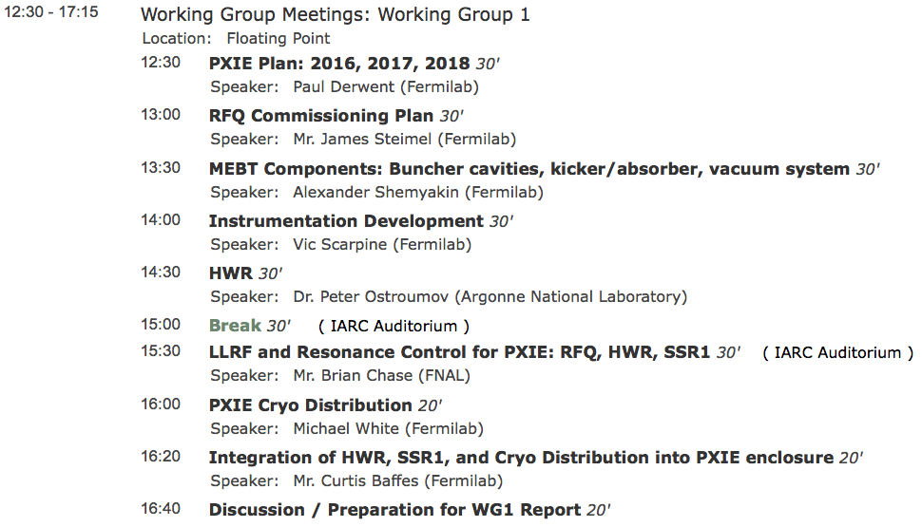
Working group 1: PXIE
We would like to focus on the plan for the next three years:
  What are the goals and deliverables of the R&D phase of PXIE during this time frame?
  What are the identified responsibilities among collaborators and where are opportunities for additional collaboration?
Joint with WG2

Slide 14
Summary
FY16 plan understood
FY17 plan pictured, lots of dependencies to make it happen
  have some decision points in FY16
FY18 fuzzier
Goals and Deliverables:
  are we on track?
  do they need adjustment?
    HEBT requirements
    operational order
      beam through 1 or 2 CMs?

Slide 15
MEBT-2 goals (FY17): Before installation of HWR
Characterize transverse and longitudinal optics of the longer beam line, start experiments with laser wire and WCM
Main goal: test and characterize kickers
  First, separately, looking at the trajectory with BPMs
    50 Ohm powered by two 81.25 MHz CW amplifiers
    200 Ohm: two prototype 500V switches
  Then, synch them and try to remove every other bunch
WS and laser wire
Toroid
BPM
Scrapers + WS
AS
Dump
1175mm
ToF
FFC

