Slide 1
MI/RR Upgrades
Ioanis Kourbanis
PIP-II Collaboration Meeting
9-10 November 2015

Slide 2
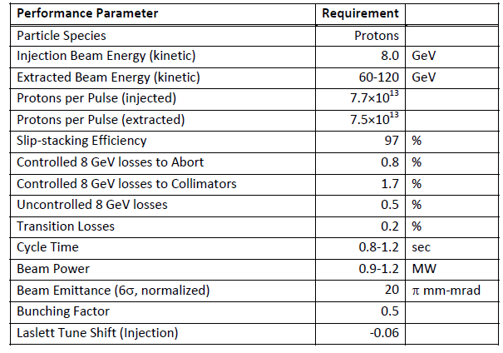
MI/RR Performance Requirements
Slip stack and accelerate 50% more intensity.
Run MI at lower energies.

Slide 3
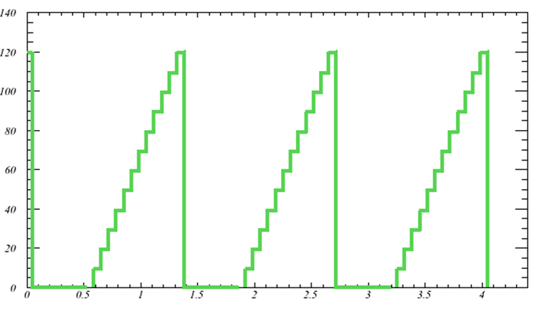
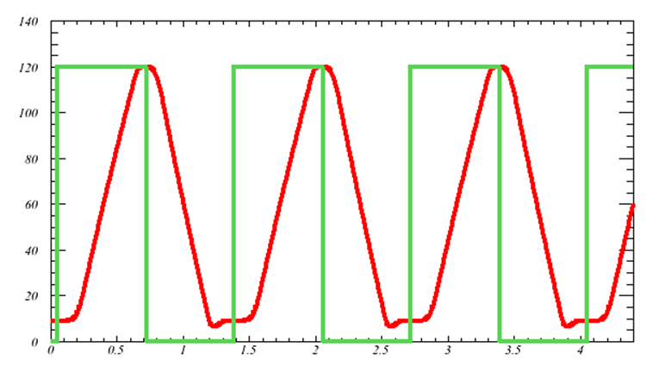
Current MI high power operation
Transformed the Recycler into a proton injector ring for injecting and slip stacking the protons from Booster.
Eliminated the long dwell MI time.
Doubled the MI beam power without increasing the beam intensity from Booster.
Recycler
MI

Slide 4
MI/RR Accelerator Issues
Can we slip stack and accelerate 50% more intensity.
  Power loss from slip stacking (8 GeV)
  RF Power (Acceleration)
Running Recycler 53 MHz Cavities CW (Running at 60 GeV)
Transition crossing
Electron cloud
Beam loss control/mitigation

Slide 5
Slip Stacking in the Recycler
We need to maintain the same power loss from slip stacking with 50% more intensity per bunch (120 GeV operation).
  Increase slip stacking efficiency from 95% to 97%.
  Limits on longitudinal emittance and bunch height from Booster beam.
For MI operation at lower energies than 120 GeV the power loss will increase up to 50%.
  Have no un-controlled losses.
  Collimators should be able to handle the extra loss.

Slide 6
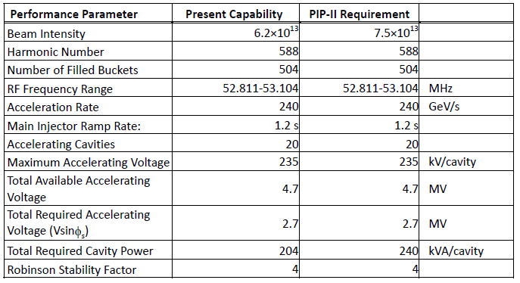
Present and Required MI RF Capabilities
Present RF System does not the power to accelerate the PIP-II Beam intensities

Slide 7
MI RF Options for higher power (J. Reid’s talk)
Operate the current RF cavities with two power tubes instead of one in a push-pull configurations.
  Need to double the number of modulators and solid state drivers.
Use a new more powerful power tube (EIMAC 4CW250,000B).
  New mounting configuration (much longer tube).
  New modulators and upgraded PA cooling.
Establish an R&D plan to test and evaluate both options.

Slide 8
New RR RF Cavities (J. Dey’s talk)
The present Recycler 53 MHz cavities used for slip stacking have a high power dissipation (90 KW, 60% DF) because of the low R/Q (13 Ohms).
Running MI at energies as low as 60 GeV will require the slip stacking cavities to run CW.
Running Booster at 20 Hz will require higher RF voltage (140 KV instead of 80 KV).
  We only have space for 3 cavities
We will need a different cavity design with higher R/Q and active beam loading compensation.
Plan to use the same cavity design for a new MI 53 MHz cavity.

Slide 9
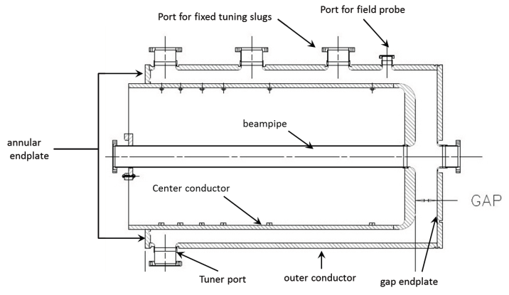
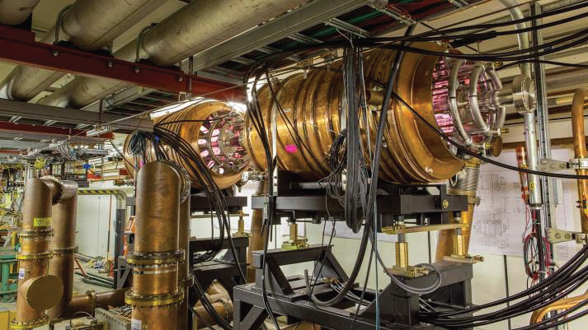
Recycler 53 MHz cavities

Slide 10
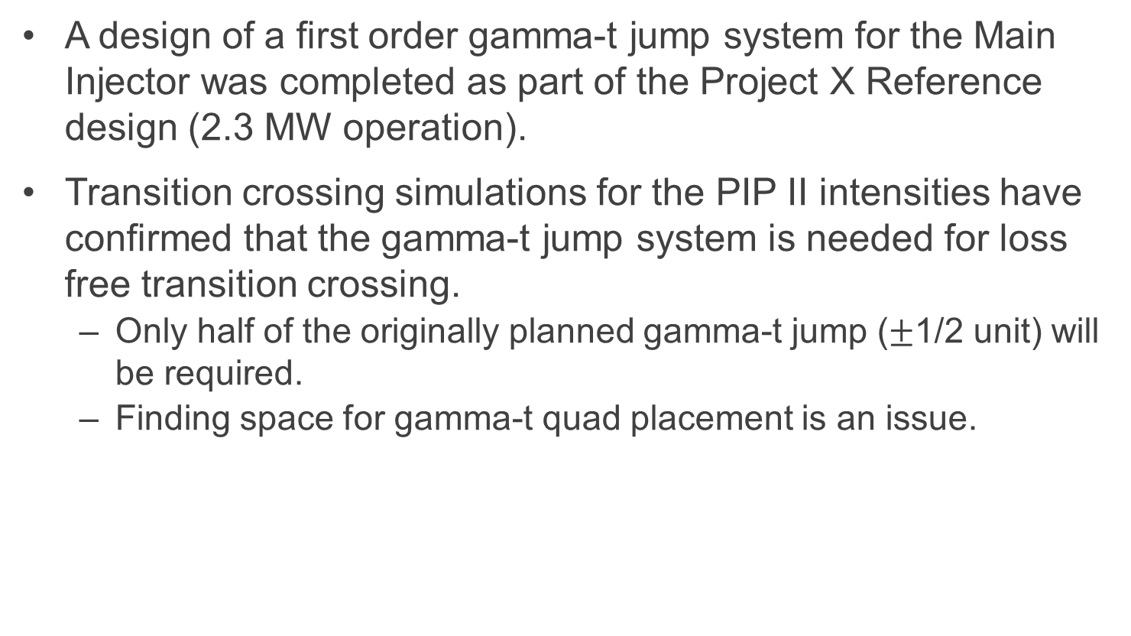
Transition crossing
A design of a first order gamma-t jump system for the Main Injector was completed as part of the Project X Reference design (2.3 MW operation).
Transition crossing simulations for the PIP II intensities have confirmed that the gamma-t jump system is needed for loss free transition crossing.
  Only half of the originally planned gamma-t jump ($±$1/2 unit) will be required.
  Finding space for gamma-t quad placement is an issue.

Slide 11
MI Gamma-t system
A first order jump system with small dispersion increase (taking advantage of the dispersion free region)
Design goal:
  Δγ_{T} = ± 1 within 0.5 ms
  dγ /dt = 4000 1/s
  16 times faster than the normal ramp (240 GeV/s)
Components:
  8 sets of quad triplets
  8 sets of power supplies
  Inconel beam pipe

Slide 12
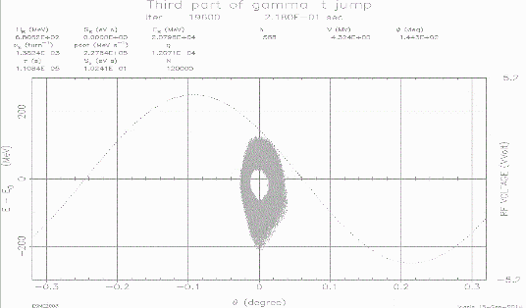
MI transition simulations
Phase space distributions after transition
No Jump
Half Jump
Full Jump

Slide 13
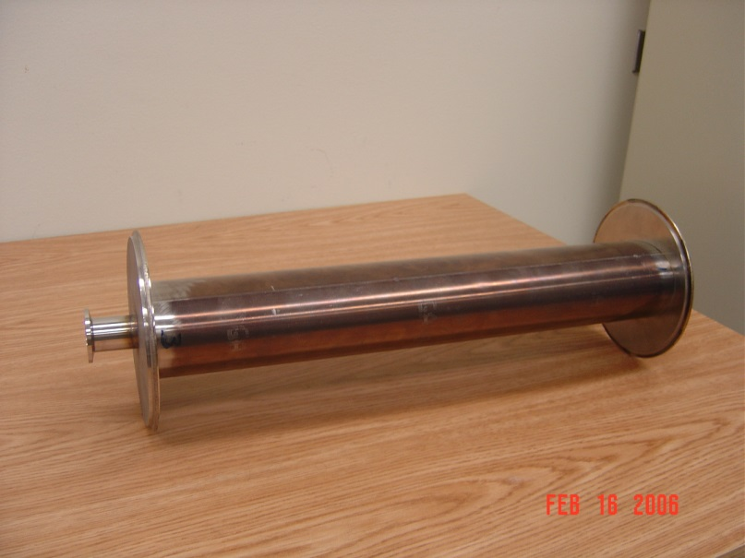
R&D Plan for gamma-t jump
Finalize the design, build and test a gamma-t quadrupole magnet including the Inconel beam pipe.
Estimate about a year for this effort.
Inconel Beam Pipe

Slide 14
Electron Cloud
Recent measurements in MI indicate that beam scrubbing is quite effective in reducing the SEY of the beam pipe so no electron cloud problems are anticipated.
  Beam scrubbing has also been observed in Recycler during slip stacking commissioning.
Electron cloud simulations indicate that a SEY smaller than 1.4 will be sufficient for suppressing the e-cloud in both MI and Recycler.
We have the capability to coat both the MI and the Recycler beam pipe.
  The MI beam coating has to be done in situ.
  The Recycler beam pipe can be replaced.

Slide 15
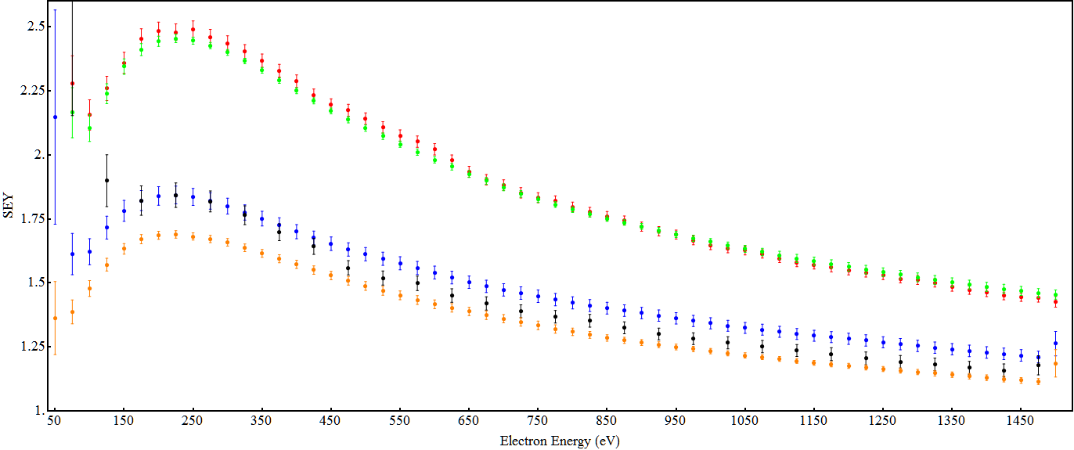
MI SEY (316L SS) for different intensities
Initial
3E10 p/b
5E10 p.b
5E10 p/b
6E10 p/b

Slide 16
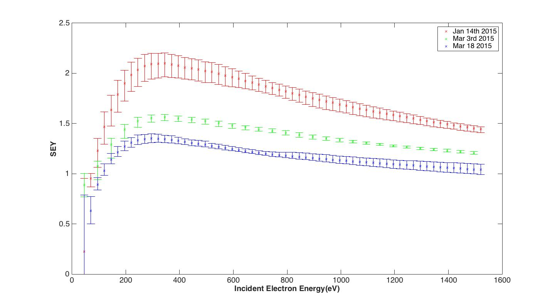
MI SEY (TiN coating)
Initial
6E10 p/b
8E10 p/b

Slide 17
Electron cloud density vs SEY in MI

Slide 18
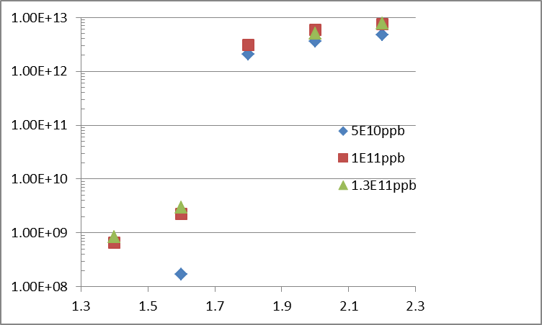

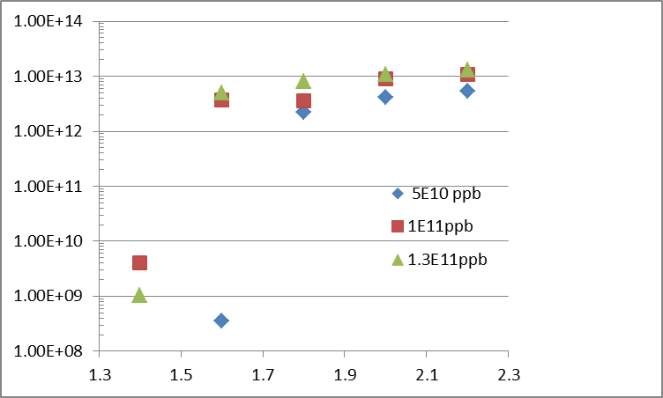
Max e-cloud intensity vs SEY in Recycler
Preliminary
Field Region
Field free region
E-cloud density [m^-3]
SEY
SEY

Slide 19
Loss control
Need to understand and control the space charge losses with the higher intensity beam in MI and Recycler.
  In MI the collimators intercept most of these losses.
  We have a plan to install Recycler collimators next year.
Realistic simulations(real apertures, magnet multipoles, space charge..) using SYNERGIA are under way (Rob Ainsworth’s talk).
  Comparing slip stacking in PIP II to current operations.

Slide 20
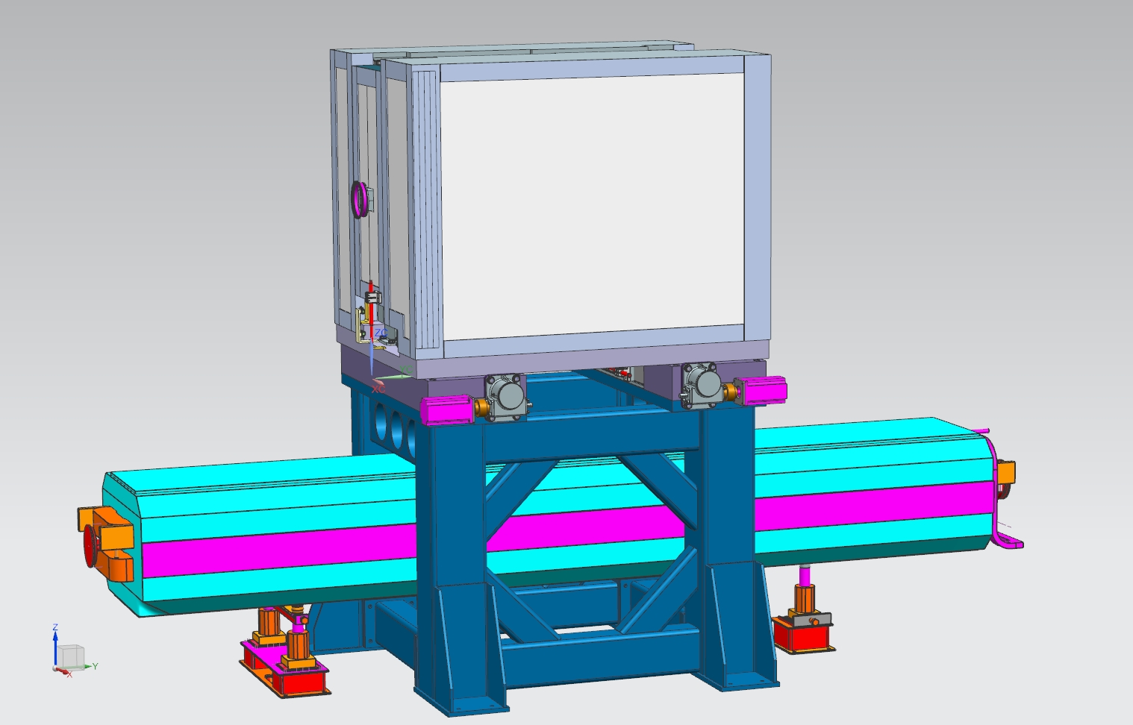
Plan for Recycler loss control
We are going to continue the SYNERGIA multi-particle simulations of slip stacking in the Recycler.
Plan to design and install Recycler collimators in the next couple of years.
  Need to make sure that the collimators can handle the extra loss from the PIP-II.
Recycler secondary collimator design

Slide 21
Conclusions
We have identified the required MI/RR modifications/upgrades required for running at the PIP-II Intensities.
Slip stacking loss requirements drive stringent specifications for the beam out of Booster.
Loss control in the Recycler will be an issue that we need to address even during the current NOvA running.
We have developed R&D plans for the major MI/RR upgrades required for PIP II.

Slide 22
EXTRA SLIDES

Slide 23
Injected beam requirements for 97% efficiency.
8.0 MeV
4.2 nsec
Particles on initial matching contours in an 140KV bucket after 300 msec of slip stacking with 1,680 Hz separation.

Slide 24
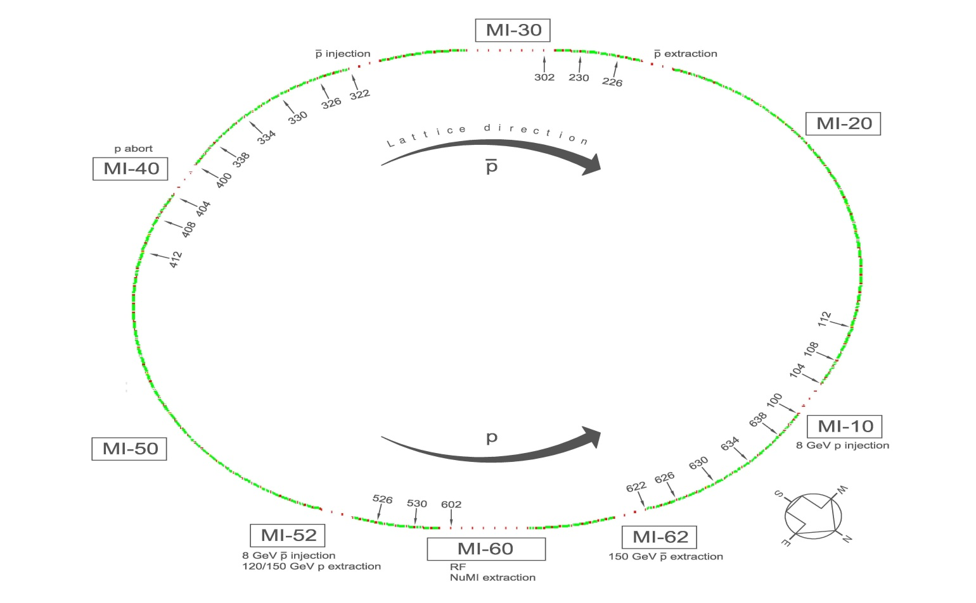
Location of gamma-t quads in MI

