Slide 1
PXIE RFQ Commissioning Plans
James Steimel
PIP-II Collaboration Meeting
9-10 November 2015

Slide 2
LBNL Collaboration Engineers
RFQ designed and constructed at Berkeley Laboratories.
Successful collaboration between FNAL and LBNL engineering and scientific staff.
Picture shows LBNL RFQ engineering staff (and FNAL liaison) in front of assembled RFQ modules before final tuning.

Slide 3
RFQ Delivered
RFQ arrived at FNAL on Sept 15, 2015.
Picture on right shows RFQ in its PXIE beam line position.
Delivery was smooth and LBNL tuning was successfully verified.
RFQ was leak tested and successfully pumped down to specified vacuum pressure.

Slide 4
RFQ System Block Diagram
RFQ driven by two, indepen-dent RF power amplifiers.
Interlock system protects RFQ from overheating and sparking.
Resonant frequency control done only with water temperature control.
High level model of RFQ system components and interactions.

Slide 5
Infrastructure Status and Plans
Vacuum equipment and most of water manifold components installed.
Hardware for resonance control is on-hand and mostly installed. Work continues on control algorithms and interfaces.
Installation of instrumentation wiring and infrastructure will be next.

Slide 6
Power Amplifier Commissioning
Power amplifiers and circulator combo tested to 60kW CW power into matched load over 24hr period.
Circulators are temperature sensitive and need to be cooled to 83°F for ideal isolation.
Isolation of circulator not good enough to operate full CW power into short. It should be good enough to protect power amplifier during fill time, sparks and trips.

Slide 7
Power Amplifier Status
RFQ amplifiers have catastrophic failure mode when running CW.
Vendor is investigating and repairing under warranty.
Contracted spares supply is currently depleted but negotiations underway for a larger supply.
Failure has not occurred when amplifiers run at 10% duty or less.

Slide 8
RFQ Commissioning Phases
May condition RFQ in pulsed mode only if amplifiers not repaired in time.
Ensure low spark rate at rated field
Verify cooling system effectiveness
Measure peak field
Measure thermal properties
Conditioning
Beam steering/focusing for minimum loss
Verify beam energy
Longitudinal beam profile
Transverse beam profile
Low Duty Beam Tests
Verify low loss, CW beam acceleration
High Current Beam Tests

Slide 9
Conditioning Prerequisites
Specified water flowing to all RFQ cooling channels. Water temperature stable to within 2°C during conditioning activity.
Input couplers installed, tuned and high voltage bias tested.
Local interlocks tested.
RF system capable of pulsed and CW operation.
Power amplifiers tested successfully in CW and pulsed operation (recent CW failure).
LLRF system capable of pulsed operation for up to 1ms at 15Hz before transitioning to CW.
LLRF system can lock to RFQ resonant frequency.

Slide 10
Input Couplers
New design – capacitively coupled to RFQ cavity.
Center conductor and loop can be biased to 5kV to reduce multipacting.
Center conductor and loop are forced air cooled.
Couplers will be conditioned with RFQ due to late delivery.

Slide 11
Coupler Issues
Input couplers are a year behind schedule.
Current vendor is having problems with brazing vacuum window and antenna.
No firm estimate on delivery of vacuum window section.

Slide 12
Conditioning Process
Start with 50µs pulse at 1Hz; increase peak power to 80kW
Increase pulse width to 1ms; increase rate to 15Hz
Measure field with x-ray monitor
Increase peak power to 95kW or power required to reach 66kV – 10% over design field (whichever is greater).
Plot above shows first test of x-ray detector on PXIE MEBT buncher cavity. Buncher cavity also runs around 60kV. Preliminary results show accuracy to within 10% (before calibration).
Set power just above multipacting transition and run CW. Increase power to 10% over design field.

Slide 13
RFQ Resonance Control
Resonant frequency of RFQ can only be controlled with water temperature.
Available power of amplifiers limits resonant frequency error to 3kHz in RFQ, leading to 0.1°C stability in water system.
Frequency has large, fast dynamic shift with power interruption.
FNAL is in collaboration with Colorado State University to design and commission a water, resonant control system that will keep RFQ in tune and reduce recovery time from RF power glitches.
Resonant control team will have a dedicated week during RFQ conditioning to measure RFQ thermal response and time constants.

Slide 14
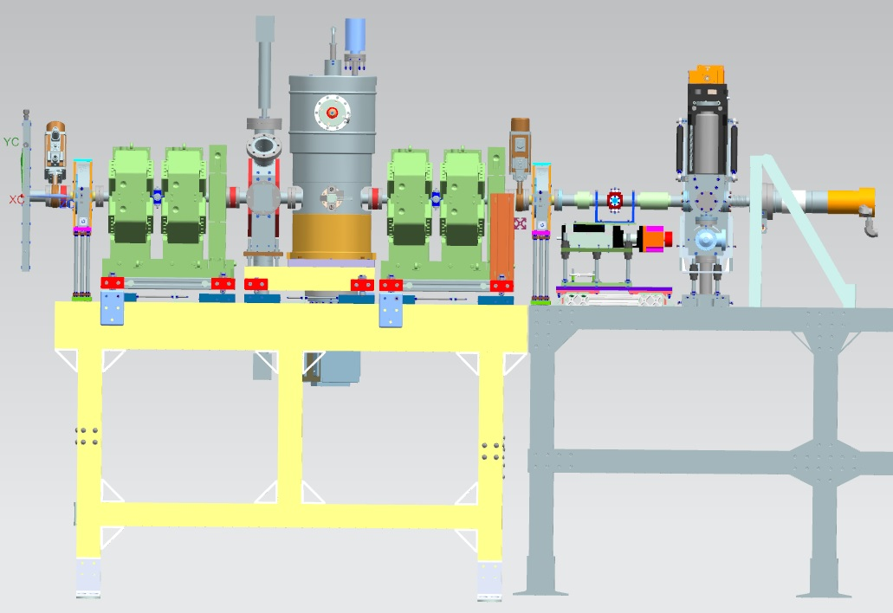
MEBT 1-1
MEBT version 1-1 will be the first RFQ beam diagnostic line.
Doublets are designed and constructed by BARC through India collaboration.
RFQ first beam commissioning will also include first beam commissioning of prototype MEBT buncher cavity.
Total beam impact on Faraday Cup dump must be limited to under 300W.
toroid
FFC
toroid
LEBT FC
ToF
doublet
doublet
valve
ring pickup
scrapers
900 mm
Picture by S. Oplt

Slide 15
Low Duty Pulsed Beam Prerequisites
MEBT 1-1 installed at the end of RFQ.
RF system can maintain RFQ and buncher cavity resonant frequencies at 162.5 MHz in pulsed RF mode.
Preliminary Machine Protection System (MPS) tested.

Slide 16
MEBT 1-1 Machine Protection System
MPS system must be operational for commissioning MEBT 1-1.
Potential for beam damage will be significant.
MPS will disable LEBT beam if RFQ amplifiers are off.
It will utilize a ring pickup and scraper to monitor beam duty factor and disable beam if pulse lengths get too high.
It will produce more stringent duty factor monitoring when Fast Faraday Cup (FFC) is in beam.
Preliminary commissioning started with LEBT testing.
toroid
FFC
toroid
LEBT FC
valve
ring pickup
scrapers
900 mm
Picture by S. Oplt

Slide 17
Low Duty Pulsed Beam Commissioning Process
Steer and focus beam from LEBT into RFQ for maximum transmission using comparison of LEBT toroid and MEBT 1st toroid.
Capture transverse beam profile using scrapers and Faraday Cup.
Steer and focus beam for best transmission through bunching cavity using MEBT doublets and 2nd toroid.
Verify transverse emittance using quadrupoles, scrapers, and Faraday Cup.
Perform buncher cavity phase scan using movable BPM (ToF) and/or FFC. Set phase to get 2.1 MeV output energy.
Verify longitudinal profile using FFC.

Slide 18
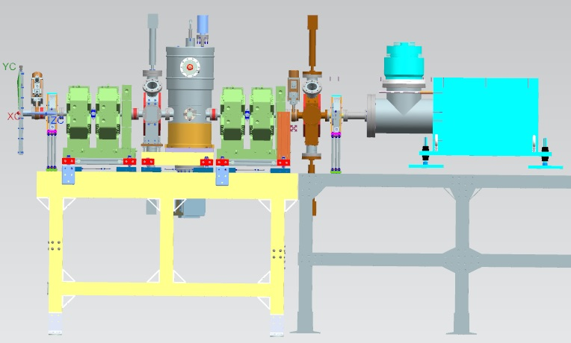
MEBT 1-2
Second version of RFQ diagnostic line includes beam dump capable of 10kW of beam power.
Dump borrowed from ORNL – SNS DTL commissioning dump.
RFQ resonant control system must be fully operational for CW beam transport through MEBT.
MPS will be upgraded to incorporate beam loss measurements in RFQ and MEBT scrapers.
SNS dump
Picture by S. Oplt

Slide 19
Plans forward
Input couplers are now the critical path item. We will organize back-up plans if vendor cannot reliably braze final antenna. This may start after this meeting.
RF amplifiers can be made to run reliably at low duty pulsed, even if it’s not ready for CW operation.
If input coupler components arrive before amplifier repairs are complete, RFQ will be conditioned in pulsed mode only and transition to MEBT 1-1 configuration for pulsed beam tests.

