Slide 1
International Program
Shekhar Mishra
PIP-II Collaboration Meeting
9-10 November 2015

Slide 2
Outline
Introduction
Indian Institutions and Fermilab Collaboration on R&D
  Areas of R&D Collaboration
  Technical Progress
  R&D Phase Summary
DAE-DOE Discovery Science Agreement Project Annex I
  Indian Strategy on PIP-II
  Project Annex I: Areas of Collaboration
  Project Annex I: PIP-II Construction deliverables
Summary

Slide 3
Introduction
Fermilab has proposed construction of PIP-II a High Intensity Superconducting Proton Accelerator
  Provide ~1.2 MW of proton beam at 120 GeV for the Deep Underground Neutrino Experiment (DUNE)
Indian DAE laboratories have proposed construction of
  Indian Spallation Neutron Source at RRCAT, Indore (Pulsed)
  Physics and Advanced Technologies for High Intensity Proton Accelerator (PATHIPA).
Indian Institutions Fermilab Collaboration (2007- Present) (8 Institutions level MOUs for R&D)
  Initial collaboration confined to SRF R&D
  Subsequently expanded to include R&D on
    HLRF and LLRF, Cryogenics, Instrumentation, Magnets
  “Joint R&D Document” in the Project Mode

Slide 4
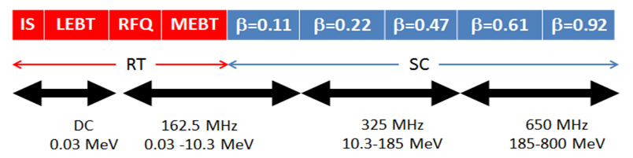
Areas of R&D International Collaboration
USA
IIFC
High Power Tested Dressed SRF Cavity
Non SRF components (BARC)
β = 0.22: IUAC & VECC
β = 0.47: BARC & IUAC
β = 0.61: VECC (Europe?)
β = 0.92: RRCAT
325 MHz RF Power: BARC
650 MHz RF Power: RRCAT
Cryogenic Plant and Distribution
RF
  LLRF
  Protection System
Instrumentation: BPM, BLM
Controls
MEBT Magnet

Slide 5
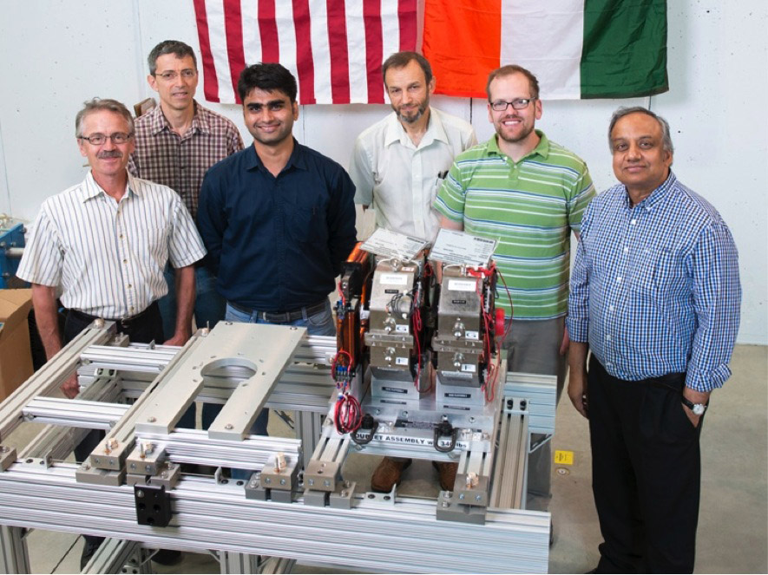
MEBT and SRF Linac Magnets: BARC and FNAL
BARC is working with Fermilab in the development of
  MEBT Dipoles and Quadrupoles
  SSR2 Solenoid Magnets
  650 MHz Section Warm Dipoles and Quadrupoles

Slide 6
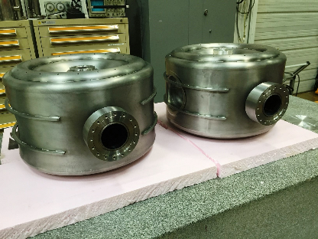
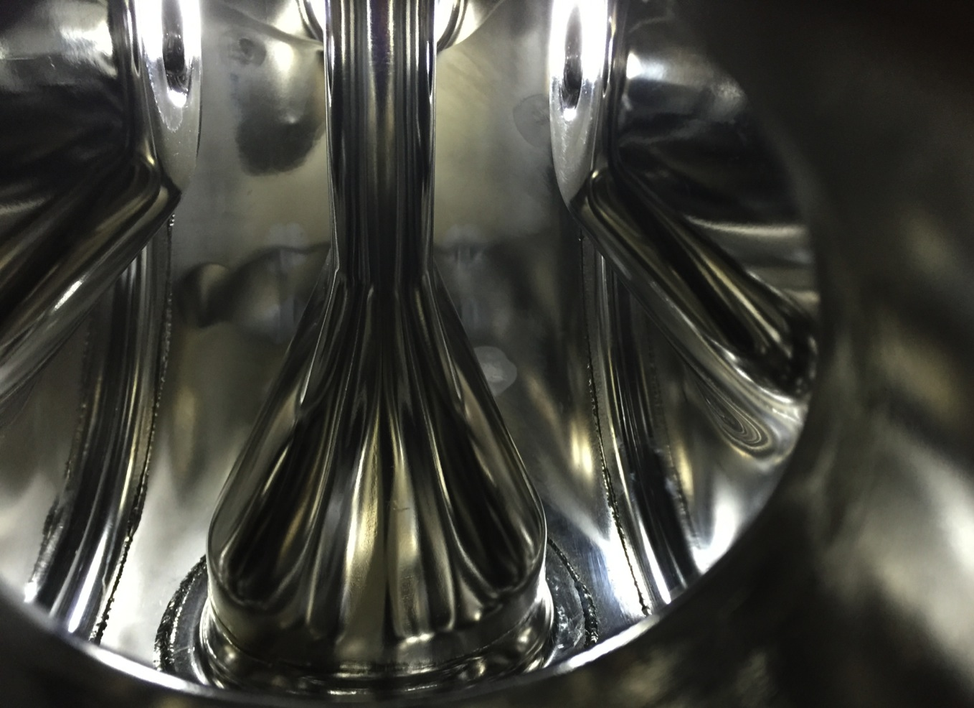
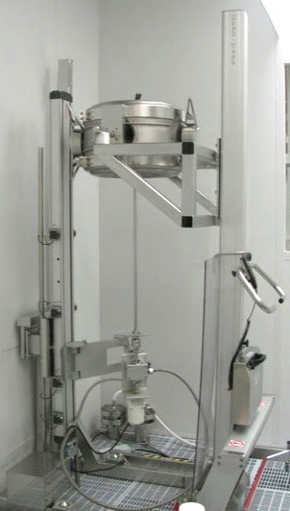
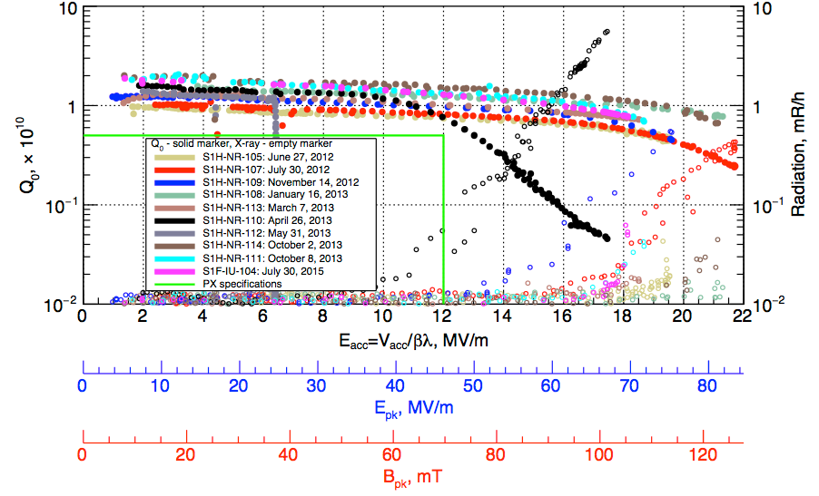
IIFC: β = 0.22 R&D: IUAC and FNAL
BARC will fabricated He Jacket, Tuner and ship it to Fermilab.
  These two cavities will be dressed at Fermilab for installation in the 1st cryomodule to be tested at PXIE in 2018.

Slide 7
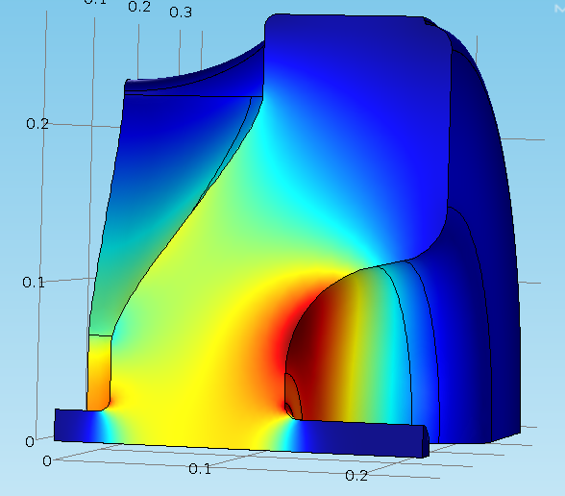
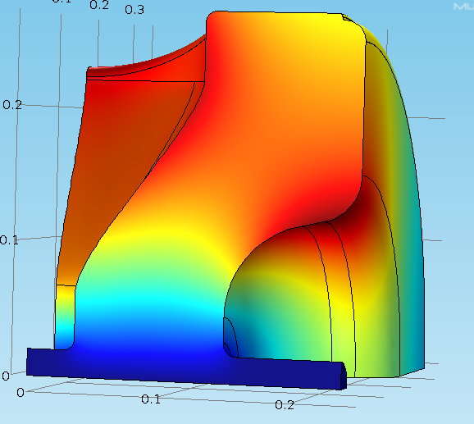
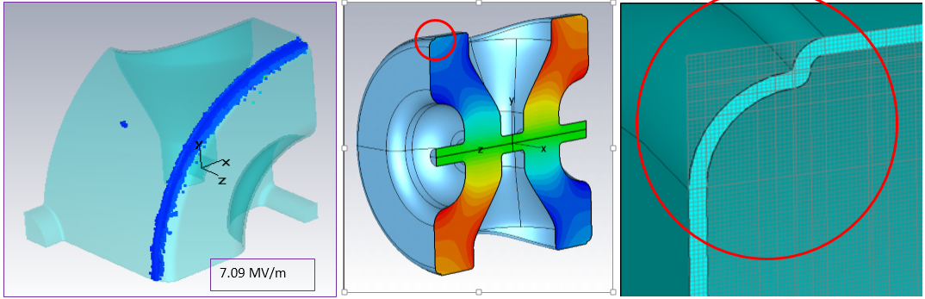
IIFC: β = 0.47: BARC, IUAC and FNAL
Fermilab has worked on SSR2 RF Design.
BARC has initiated to expand on this SSR2 design and will fabricate 1st prototype.
  Nb to be provided by Fermilab
BARC Investigating details of cavity design, fabrication, including e-beam facility
E
M

Slide 8
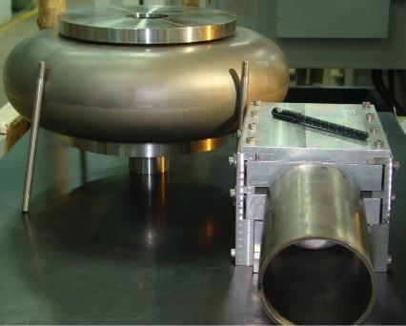
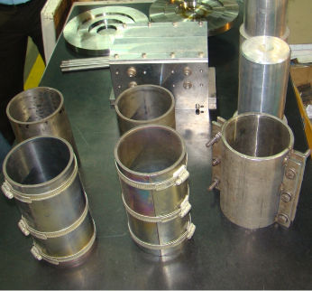
IIFC: Development of β = 0.61, 1-cell Nb cavity
VECC has developed a complete design of a β = 0.61 cavity
1-cell cavity has been fabricated in collaboration with IUAC. ( Aug 2015)
Processing and testing at Fermilab (Jan 2016)
Niobium Half cells , beam pipes and necessary fixtures are ready for e-beam welding

Slide 9
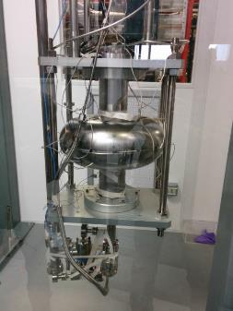
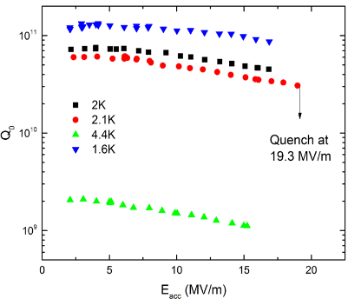
IIFC: Development of β = 0.92, 1-cell Nb cavity
Fermilab/RRCAT/IUAC have Fabricated one Nb HB650 650 MHz single-cell cavity (July 2013) this is β = 0.9 design.
  Processed & tested at Fermilab
  The cavity achieved E_{acc} 19.3 MV/m with Q > 4E10 at 2K.
Cavity VTS mounting
Q0 vs Eacc plot of Cavity
Fermilab has finalized the design of β = 0.92 5-cell cavity with End-Group, RRCAT/Fermilab will fabricated 3/3 cavities.

Slide 10
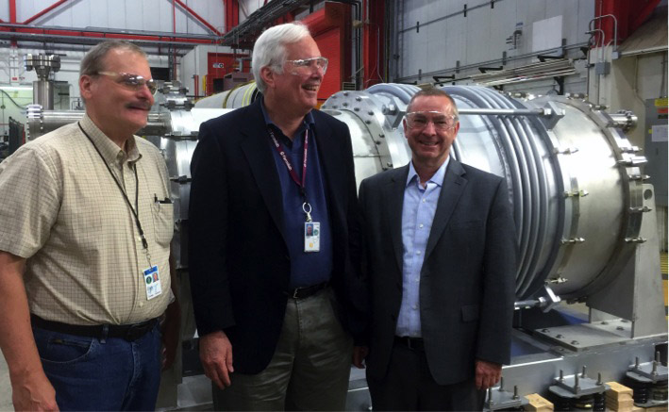
IIFC: 650 MHz Cryomodule Test Stand
BARC will start the design of the 650 MHz CM test stand in FY2015.
650 CM will be closed system with a cryo-distribution in the middle.
  It is expected to be a relatively easier design. As compared to 1.3 GHz CM design and construction.
Goal: 2018
Establishing procedure for large scale cryo fabrication

Slide 11
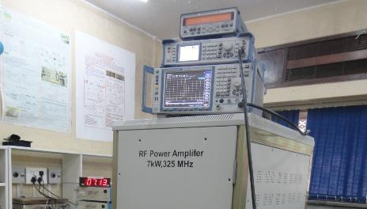
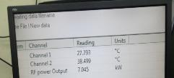
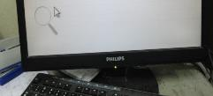
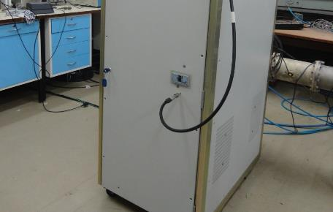
DAE: 325 MHz Solid State RF Power Development
Display of Calorimetric measurement of RF Power
RF Power Waveform at 7 kW on spectrum analyzer
Sensor data of Calorimetric measurement of RF Power
Overall conversion efficiency: 66.3%
Functional Requirement Specification being finalized by Fermilab and BARC

Slide 12
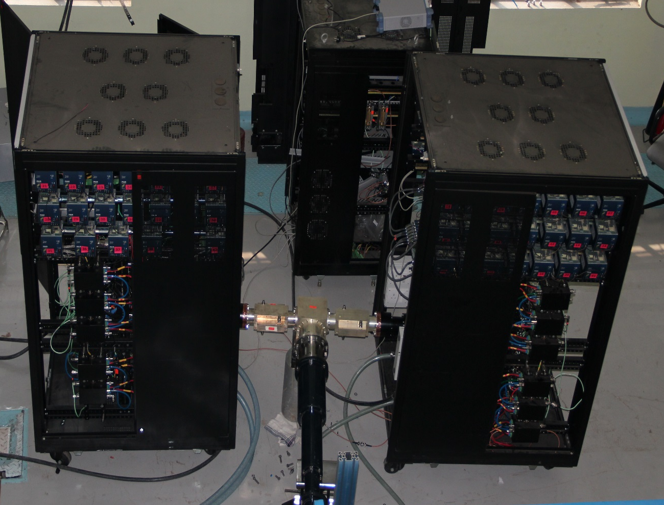
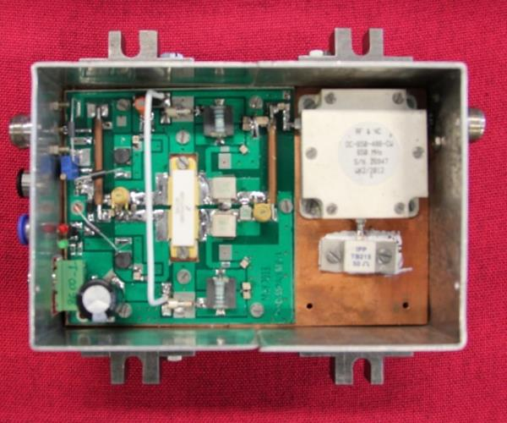
DAE: 650 MHz Solid State RF Power Development
Design of 40 kW, 650 MHz solid state RF power amplifier is completed based on Functional Requirement Specifications provided by Fermilab.
  40kW power will be obtained by summing output of two 20 kW units. Each 20 kW unit will be housed in a single euro rack with 48 amplifier modules, each one using LDMOS giving output RF power of 500 W.
The 40/70 kW power units for PIP-II will be built using similar Solid State RF technology.

Slide 13
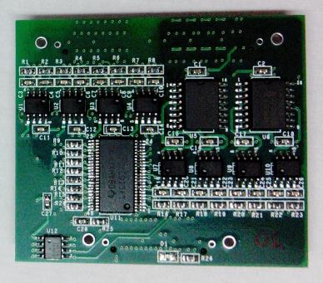
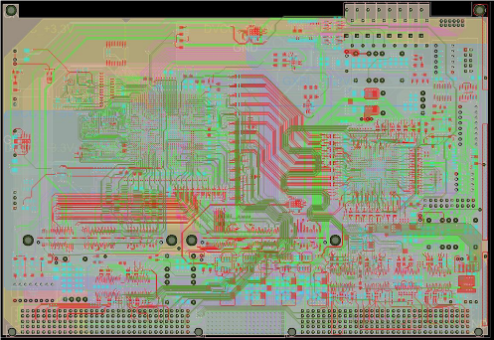
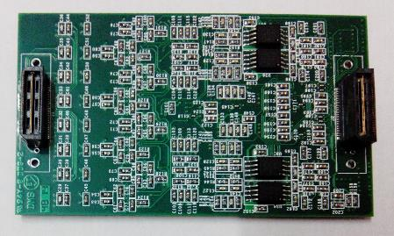
IIFC: RF Protection System: BARC & Fermilab
An upgraded RF Protection system is jointly being developed by BARC and Fermilab.
  It will be tested at PXIE.
Similar development for LLRF has started

Slide 14
IIFC: DAE Scientists and Engineers at Fermilab
Fermilab has been hosting short term DAE visitors since 2007. Their visits have been critical in initiating the SRF Linac R&D in India.
  SRF Infrastructure Development at RRCAT
  SRF Cavity and Cryomodule R&D at RRCAT, IUAC, VECC and BARC
  RF Power Controls development at RRCAT and BARC
  Cryogenic
  Magnets
After signing of the Project Annex I: IIFC is focusing on construction deliverables.
  Project Annex I has provision to support long term DAE visitors to Fermilab.
First | Last | Area
SVLS | Sista | PXIE and PIP-II AP
Vikas Kumar | Jain | 650 Cavity & CM
Shailesh | Khole | LLRF and RF
Anindya | Chakravarty | PIP-II Cryogenics
Tejas | Rane | PIP-II Cryogenics
Navneet Kumar | Sharma | 650 Cavity & CM
Dheeraj | Sharma | LLRF and RF
First | Last | Area
J.K | Mishra | RF
Kumud | Singh | SSR2
Abhishek | Rai | SSR1
Sundaram Kumar | Sonti | SSR1
Prashant | Khare | 650 CM
Short Term

Slide 15
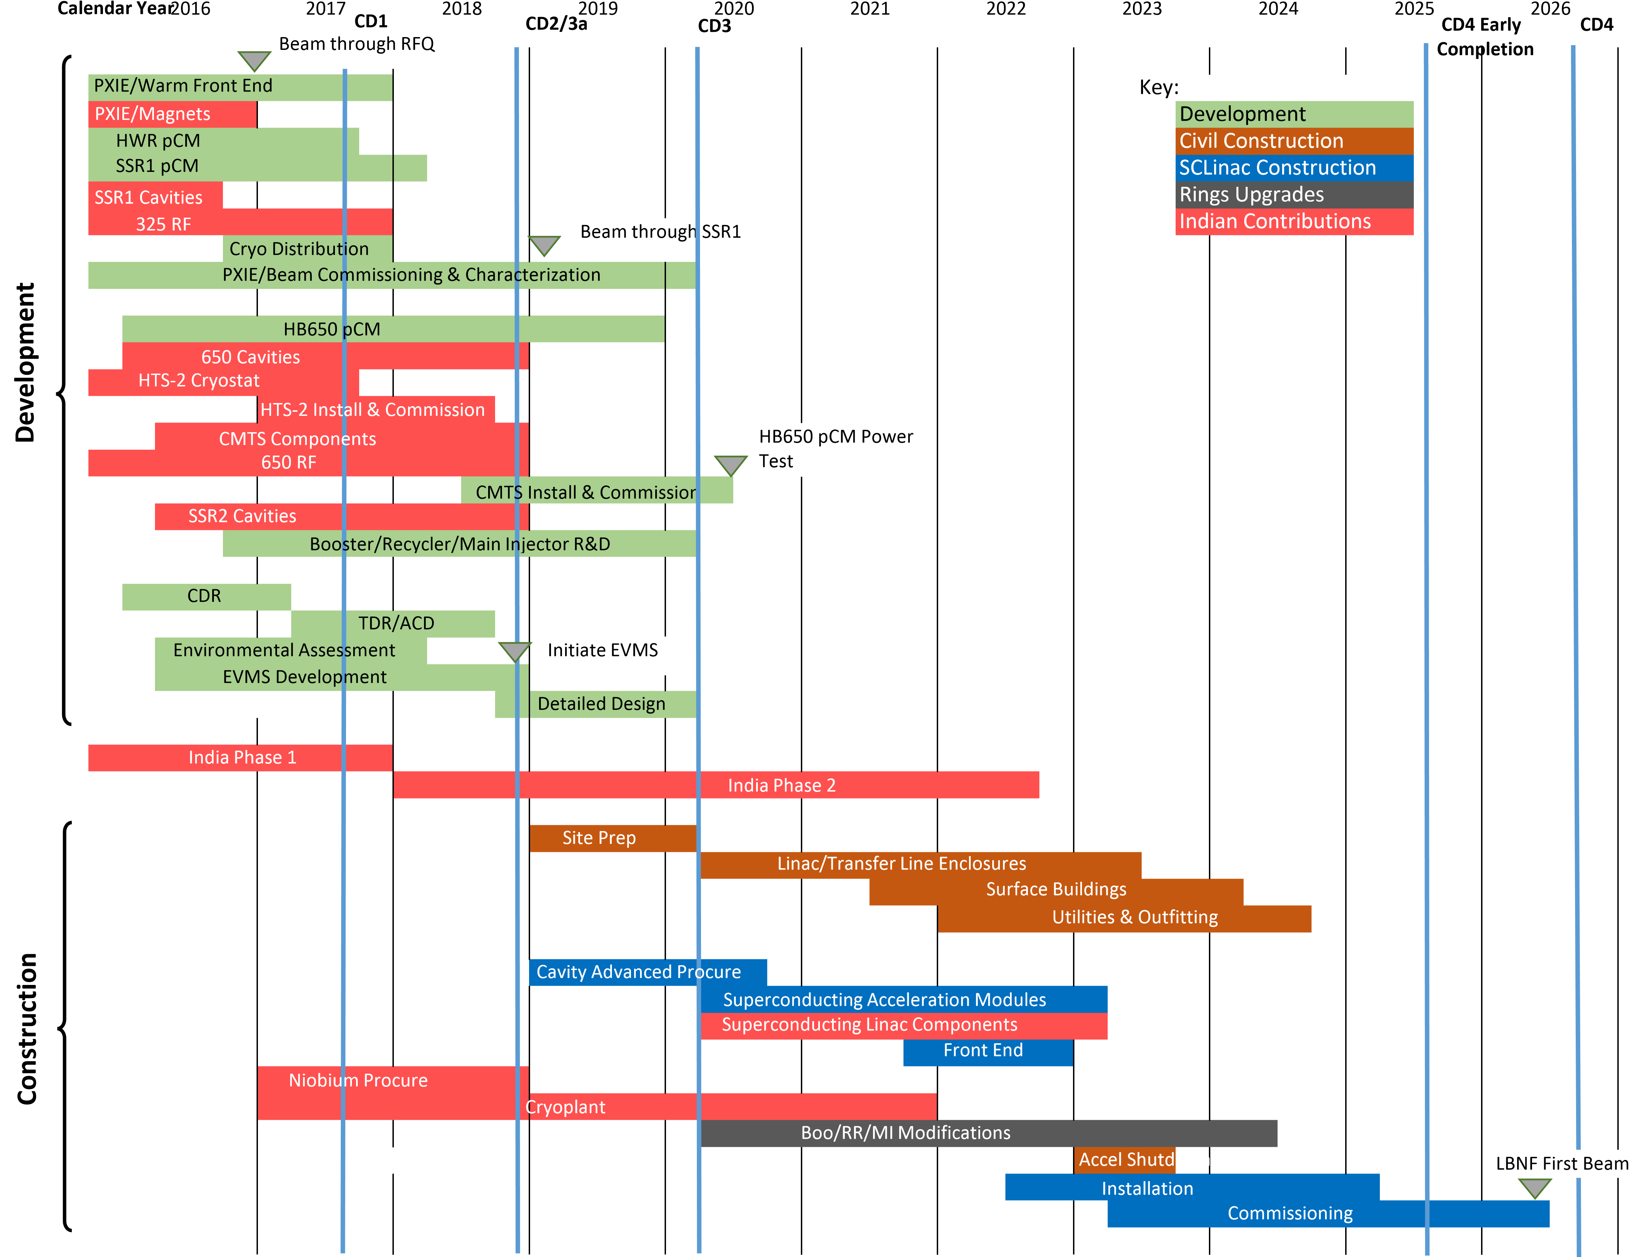
PIP-II Preliminary Schedule

Slide 16
IIFC R&D: 2nd Phase Integration
Integration Test of IIFC:
Horizontal Test Stand
SSR1 Cryomodule at PXIE
HB650 at CMTS
The Collaborating DAE laboratories have installed and continues to install significant infrastructure to
  Support the joint RD&D and PIP-II Construction
  Engage Indian Industries ←

Slide 17
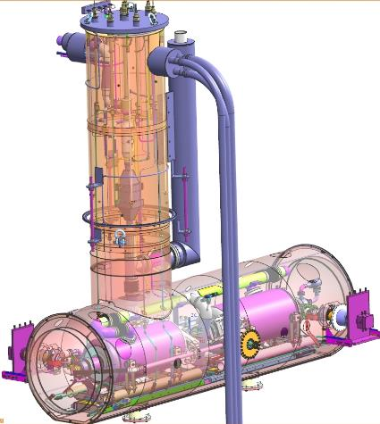
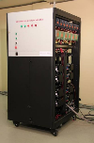
IIFC: 650 MHz Dressed Cavity Horizontal Test Stand
Q3/4-CY16
Two 40 kWatt Units
(RRCAT)
FNAL
FNAL
FNAL
RRCAT
Cryostat at Fermilab Jan 2017
Cryogenics for HTS July 2016
Two 40kWatt RF July 2016
LLRF/RF Protection July 2016
Control System July 2016
Integration with cryostat Oct 2016
Test of 1st Dressed Cavity 2017
IIFC RF Protection
(FNAL/BARC)
LLRF
(FNAL/BARC)
Integration and Controls (FNAL)

Slide 18
IIFC: System Test of SSR1 CM and RF Power with Beam
Cryogenics
(FNAL)
Instrumentation
(FNAL)
Axillary Systems
(FNAL)
10 MeV Beam PXIE
FNAL
FNAL
Magnet
FNAL
FNAL
Magnet
FNAL
FNAL
Magnet
FNAL
IIFC/ FNAL
Magnet
IIFC/FNAL
FNAL
FNAL
FNAL
FNAL
FNAL
FNAL
FNAL
FNAL
7 kWatt
(BARC)
7 kWatt
(BARC)
7 kWatt
(BARC)
7 kWatt
(BARC)
7 kWatt
(BARC)
7 kWatt
(BARC)
7 kWatt
(BARC)
7 kWatt
(BARC)
IIFC RF Protection
(FNAL/BARC)
SSR1 CM May 2017
Solid State RF Jan 2018
LLRF/RF Protection Jan 2018
Control System Jan 2018
Cryogenic for SSR1 Jan 2018
Integration with CM July 2018
(completion dates shown)
Q3-CY2018
With Beam
IIFC LLRF
(FNAL/BARC)
Integration and Controls (FNAL)

Slide 19
IIFC: Integrated Test of HB650 Cryomodule and RF Power
Cryogenic Distribution Box IIFC
Cryogenics
(FNAL)
Instrumentation
(FNAL)
Axillary Systems
(FNAL)
FNAL
FNAL
FNAL
IIFC
IIFC
IIFC
FNAL
FNAL
FNAL
FNAL
FNAL
FNAL
40 kWatt
(RRCAT)
40 kWatt
(RRCAT)
40 kWatt
(RRCAT)
40 kWatt
(RRCAT)
40 kWatt
(RRCAT)
40 kWatt
(RRCAT)
Solid State RF April 2018
LLRF/RF Protection April 2018
Control System April 2018 Cryogenic for April 2018
Integration without CM July 2018
HB650 CM Sept 2018
Q4-CY2018
CM Cold
With RF
IIFC LLRF
(FNAL/BARC)
IIFC RF Protection (FNAL/BARC)
Integration and Controls (FNAL)

Slide 20
IIFC: R&D Phase Summary
Goal:
  Jointly Retire all the critical R&D by end of CY2018.
  Develop infrastructure and industries for the construction
Development and test of SSR1 Cryomodule with beam at PXIE
  Deliverables from India
    2 SSR1 Cavities, CM Design
    8, 325 MHz 7 kWatt Solid State RF Amplifiers System
Development and Test of one HB650 MHz Cryomodule
  Deliverables from India
    3 HB650 Dressed Cavities
    Horizontal Test Stand
    8, 650 MHz 40 kWatt Solid State RF Amplifiers System
Development LB650 Dressed Cavities.
Development of SSR2 Cavities.

Slide 21
Indian Strategy on PIP-II
Based on the initial success of the IIFC, the DAE and DOE decided to extend this collaboration to the agencies level.
Project Annex I, signed in Jan 2015, provides framework for Indian DAE Institutions and Fermilab to participation in R&D leading to the PIP-II construction phase.
Joint DAE-DOE review mid-point in the R&D phase (Mid 2017) will provide go ahead to initiate construction deliverables.
  Indian Institutions to establish infrastructure and industry in the R&D Phase
DAE-DOE will start to sign the “Joint Construction Phase Deliverable” document that was finalized in Sept 2013.

Slide 22
Project Annex I: Areas for Cooperation
Jointly managed by Fermilab and DAE laboratories.
Detailed list of R&D and initial Construction deliverables exists

Slide 23
DAE-DOE: Contributions from the Parties
3a: CY16-18
  Nb
  Initiate Cryogenic Plat design and procurement
3b: CY19
  We will initiate this after CD-2 of PIP-II
4. In June of 2013 DAE and DOE finalized an initial list of deliverables for the CW linac. This was for DAE to initiate the final approval process for Project Annex
  ~50% of SRF cavity, ~100% of RF Power Amplifier and associate electronics hardware that can be fabricated in Indian Industries.

Slide 24
PIP-II Construction Deliverables: India
Dressed High Power Tested Cavities (50%)
  SSR2
  LB650
  HB650
SSR2 Solenoid Magnets (100%)
650 Warm Magnets (100%)
Solid State RF Amplifiers at 325 and 650 MHz at various power (100%)
Cryogenic Plant (one)
LLRF and RF Protection System
BPM and BLM
Control

Slide 25
Summary
International Collaboration is vital for the timely execution of the PIP-II.
  PIP-II is absolutely needed for the 1.2 MW running of DUNE.
With India, Fermilab is working on R&D topics that spans the whole SRF accelerator.
  These R&D should conclude by the end of CY18.
    Which would retire all the critical PIP-II R&D.
Although the construction deliverables are defined in the Joint Project Annex I Document
  In CY17-18, Fermilab, DOE and DAE will decided on the final construction deliverable table for PIP-II.
Fermilab and DOE are also working to develop collaborative programs with UK, France and Italy

