Slide 1
Low-β and High-β 650 MHz Cavity Cryomodules
Tom Nicol - Fermilab
PIP-II Collaboration Meeting
9-10 November 2015

Slide 2
Linac map

Slide 3
General cryomodule parameters

Slide 4
Low-β cryomodule general requirements
General
 | Physical beam aperture, mm | 83
 | Overall length (flange-to-flange), m | 3.9
 | Overall width, m | ≤1.6
 | Beamline height from the floor, m | 1.3
 | Cryomodule height (from floor), m | ≤2.00
 | Ceiling height in the tunnel, m | 3.20
 | Max allowed heat load to 70 K, W | 100
 | Max allowed heat load to 5 K, W | 15
 | Max allowed heat load to 2 K, W | 100
 | Maximum number of lifetime thermal cycles | 50
 | Intermediate thermal shield temperature, K | 45-80
 | Thermal intercept temperatures, K | 5 and 45-80
 | Cryo-system pressure stability at 2 K (RMS), mbar | ~0.1
 | Environmental contribution to internal field | <0.1 mG
 | Transverse cavity alignment error, mm RMS | <0.5
 | Angular cavity alignment error, mrad RMS | ≤5
Cavities
 | Number, total per cryomodule | 3
 | Frequency, MHz | 650
 | β geometric | 0.61
 | Operating temperature, K | 2
 | Operating mode | CW and pulsed (0-100%)
 | Operating energy gain, MV/m | 17.7
 | Coupler power rating (TW, full reflection), kW | 120
Table from FRS
(subject to change)

Slide 5
High-β cryomodule general requirements
General
 | Physical beam aperture, mm | 118
 | Overall length (flange-to-flange), m | 9.5
 | Overall width, m | ≤1.6
 | Beamline height from the floor, m | 1.3
 | Cryomodule height (from floor), m | ≤2.00
 | Ceiling height in the tunnel, m | 3.20
 | Max allowed heat load to 70 K, W | 300
 | Max allowed heat load to 5 K, W | 25
 | Max allowed heat load to 2 K, W | 220
 | Maximum number of lifetime thermal cycles | 50
 | Intermediate thermal shield temperature, K | 45-80
 | Thermal intercept temperatures, K | 5 and 45-80
 | Cryo system pressure stability at 2 K (RMS), mbar | ≤0.1
 | Environmental contribution to internal field | 10 mG
 | Transverse cavity alignment error, mm RMS | <0.5
 | Angular cavity alignment error, mrad RMS | ≤1
Cavities
 | Number, total per cryomodule | 6
 | Frequency, MHz | 650
 | β geometric | 0.92
 | Operating temperature, K | 2
 | Operating mode | Pulsed and CW
 | Operating energy gain, MV/m | 17.7
 | Maximum cavity heat load to 2 K, W (each) | 30
Table from FRS
(subject to change)

Slide 6
Pressure system requirements
System | Warm MAWP (bar) | Cold MAWP (bar)
2 K, low pressure | 2 | 4
2 K, positive pressure piping | 20 | 20
5 K piping | 20 | 20
45-80 K piping | 20 | 20
Insulating vacuum | 1 atm external, vacuum inside | Na
Cavity vacuum | 2 bar external, vacuum inside | 4 bar external, vacuum inside
Beam pipe outside cavities, includes warm to cold transitions | 1 atm external, vacuum inside | 1 atm external, vacuum inside
Table from FRS
(subject to change)

Slide 7
Cryomodule heat loads in CW

Slide 8
Maximum allowed heat load per cryomodule

Slide 9
SSR1 cryomodule (SSR2 will probably be similar)
First LB 650 cryomodule must connect to this end of the last SSR2

Slide 10
Configuration options
XFEL, ILC, LCLS-II style
Cavity string supported from gas helium return
Atlas, FRIB, etc.
Cavity string support from top plate of rectangular vessel
SNS, ESS, etc.
Cavity string supported using tension elements, with and without space frame
SPL
Cavities supported by the input coupler
Superconducting magnet inspired supports, e.g. SSC or LHC

Slide 11
Configurations – XFEL, ILC, LCLS-II

Slide 12
Configurations – XFEL, ILC, LCLS-II

Slide 13
Configurations – Atlas, FRIB, etc.

Slide 14
Configurations – Atlas, FRIB, etc.

Slide 15
Configurations – SNS, ESS, etc.

Slide 16
Configurations – SNS, ESS, etc.

Slide 17
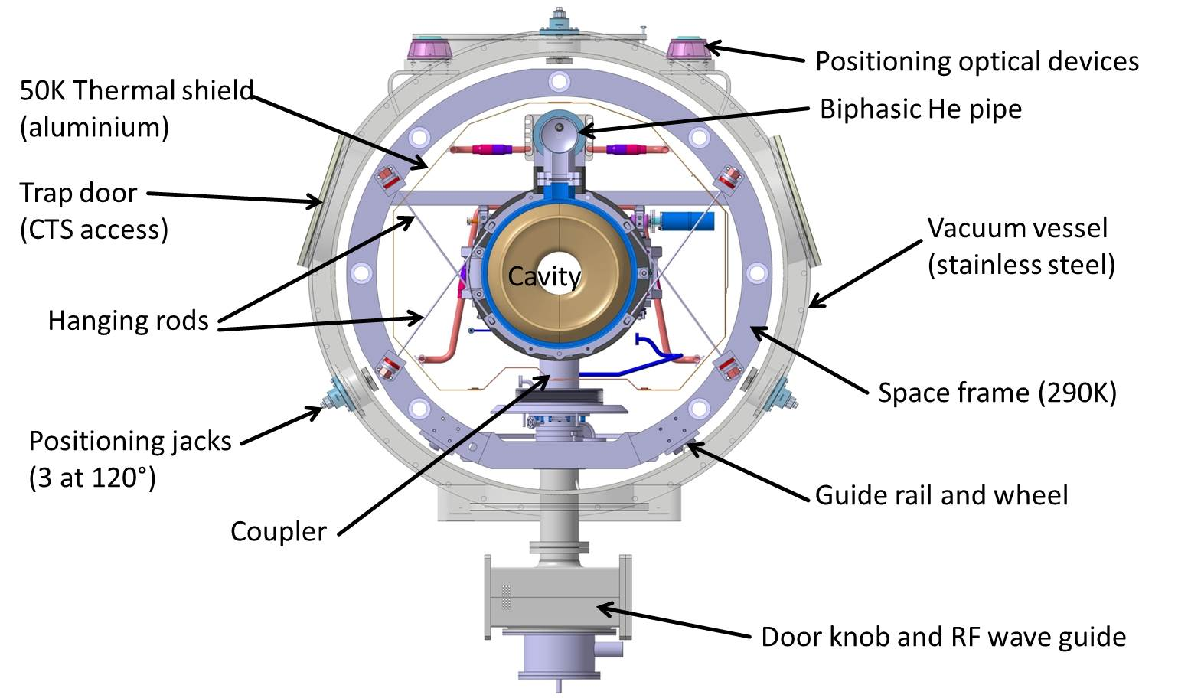
Configurations – SNS, ESS, etc.

Slide 18
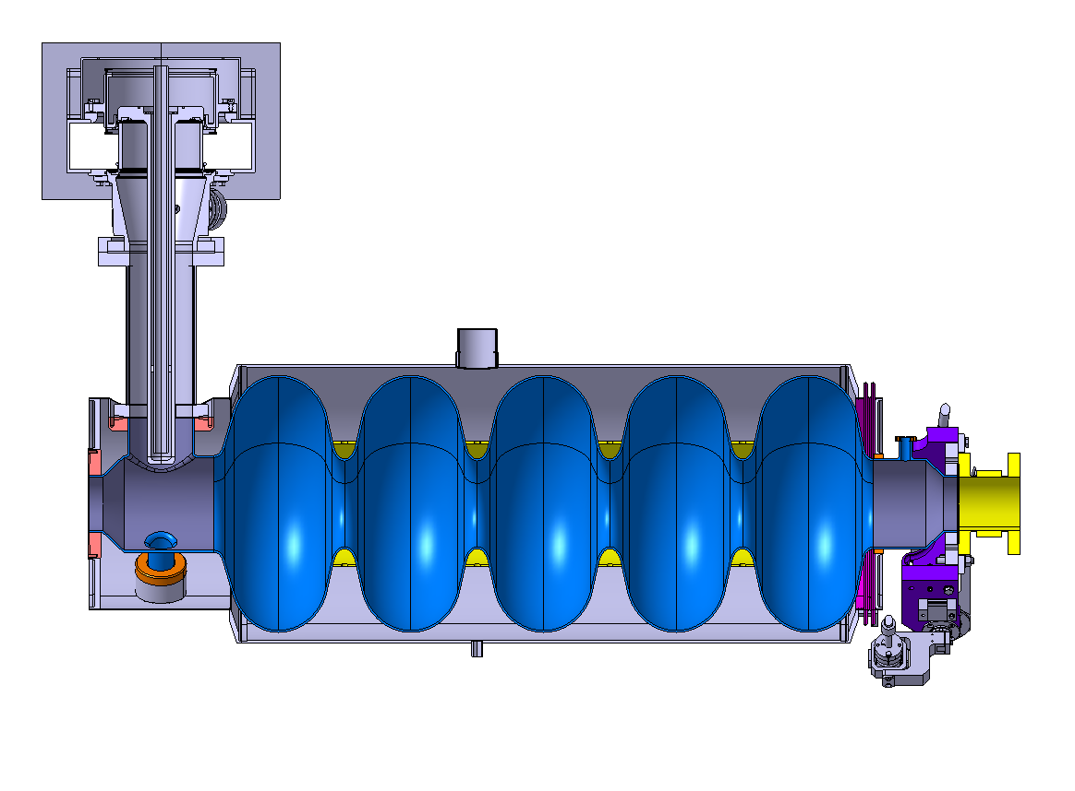
Configurations – SPL

Slide 19
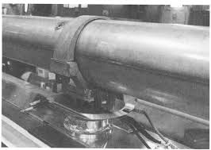
Configurations – Superconducting magnet inspired

Slide 20
Configurations – Superconducting magnet inspired

Slide 21
Configurations – Superconducting magnet inspired

Slide 22
Configurations – Superconducting magnet inspired

Slide 23
Configurations – SSR1 cryomodule

Slide 24
Configurations – Spoke test cryostat

Slide 25
Configurations
Concept 1
Vacuum vessel closed at both ends
Room temperature strongback – cavities supported from bottom
Strongback is inside the vacuum vessel, outside the thermal shield
Support post(s) for each cavity
Concept 2
Vacuum vessel closed at both ends
Cavity support similar to XFEL – cavities hanging from return pipe
Support posts attached to return pipe not cavities

Slide 26
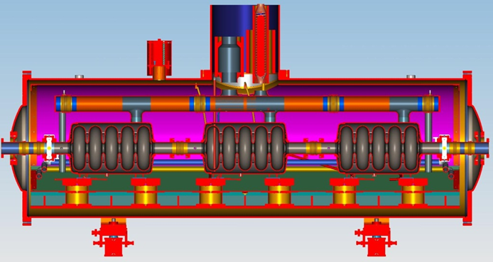
Low-β cryomodule configuration
11 total cryomodules
3 cavities each (650 MHz, 5-cell)
33 total cavities
No magnets internal to the cryomodule
Approximate length = 3.9 m

Slide 27
High-β cryomodule configuration
4 total cryomodules
6 cavities each (650 MHz, 5-cell)
24 total cavities
No magnets internal to the cryomodule
Approximate length = 9.5 m

Slide 28
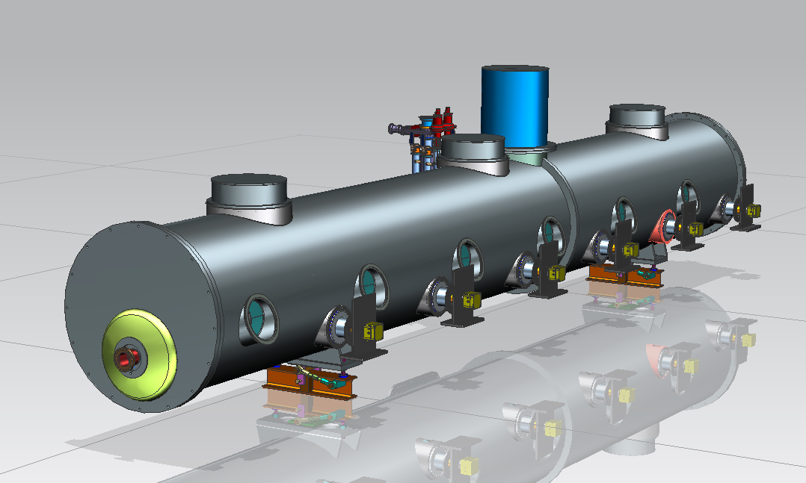
Low and High-β cryomodule general configuration
Heat exchanger
Bayonets connections,
cryogenic valves, etc.
Power couplers
Ports to access tuner
motors
Beam pipe

Slide 29
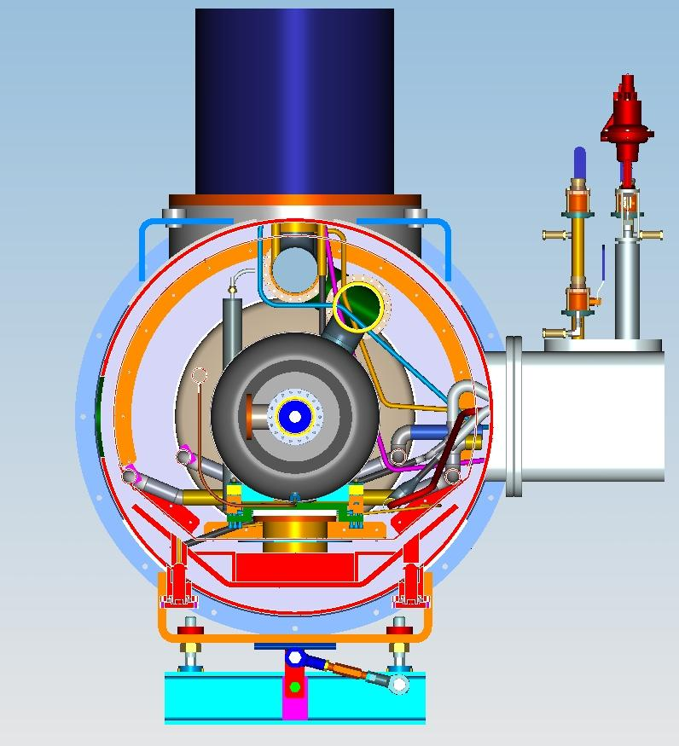
Concept 1
Heat exchanger enclosure
Thermal shield
Vacuum vessel extension for bayonets, cryo valves, etc.
Support post
Strongback

Slide 30
Concept 1
Illustration only – not representative of actual cavity string
He reservoir
with level sensor
650 Cavity with 2-phase pipe
Warm up cool
down pipe
Strong back with
supports
4K circuit for intercepts
Thermal shield

Slide 31
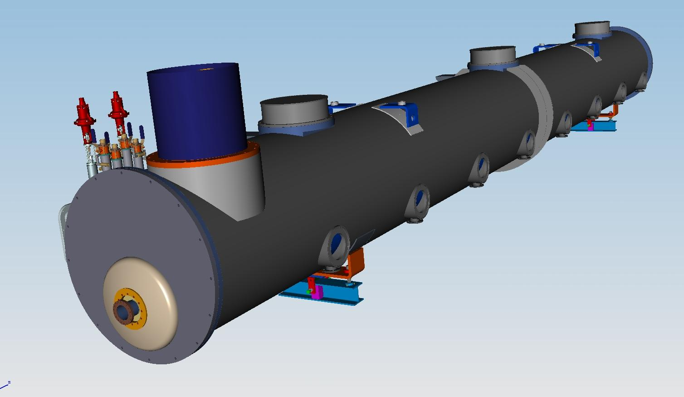
Concept 2
Cold mass supports:
Fix
Sliding
Heat exchanger
Coupler ports
Beam pipe
Illustration only – not representative of actual cavity string

Slide 32
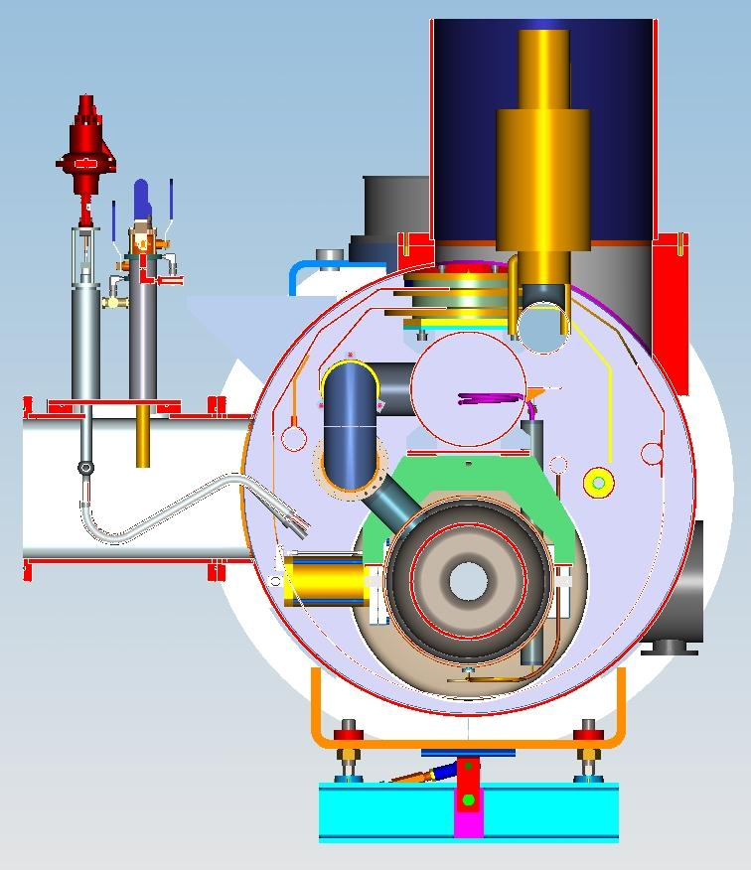
Concept 2
Heat exchanger
300 mm pipe
Thermal shield
He 2-phase pipe
650 MHz cavity
Bayonets, cryo valves, etc.
Vacuum vessel
Coupler port

Slide 33
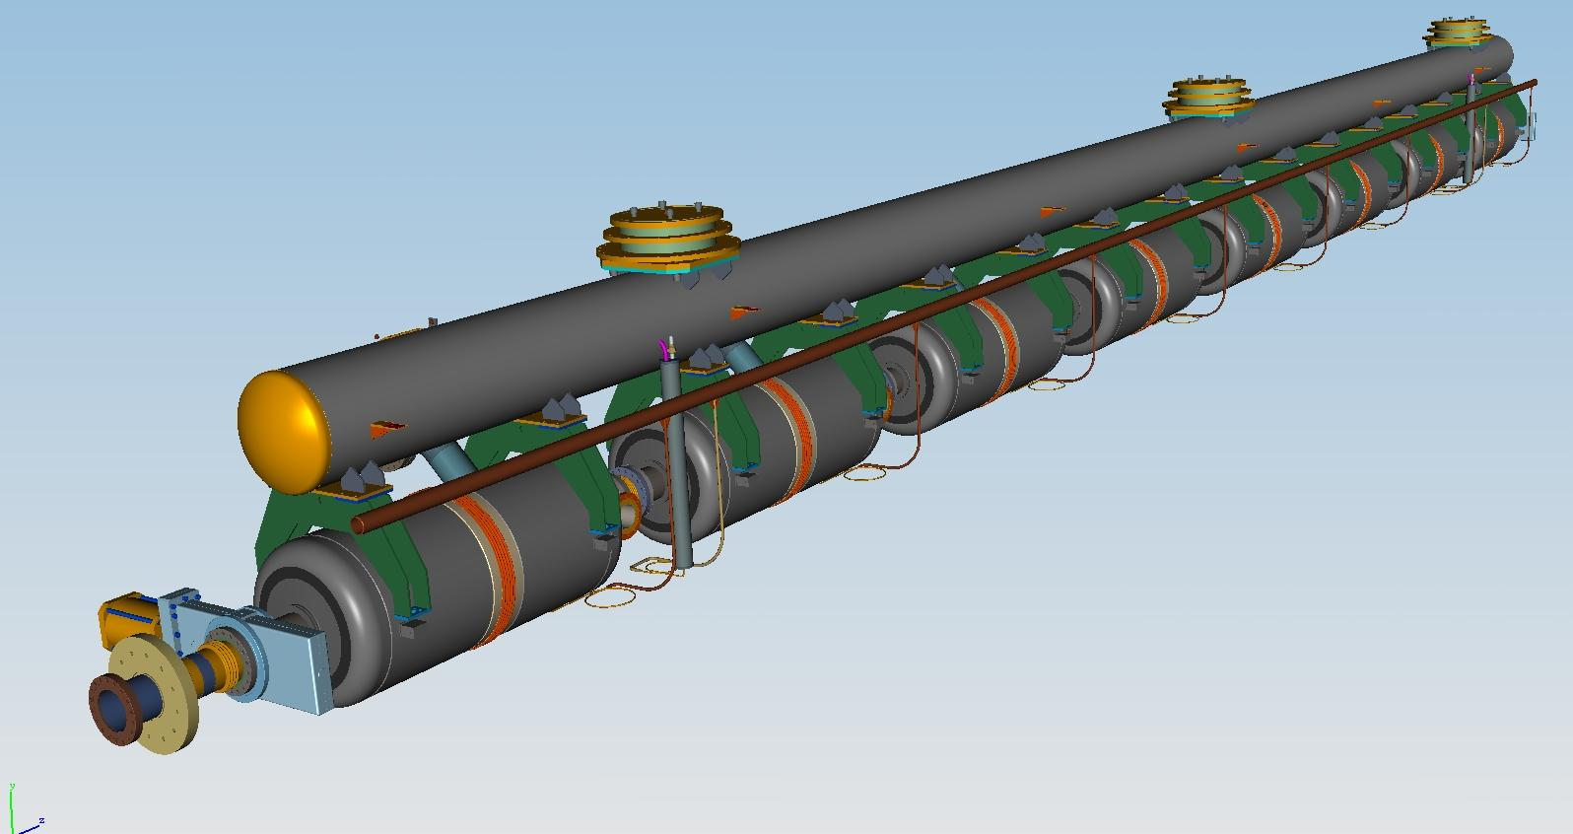
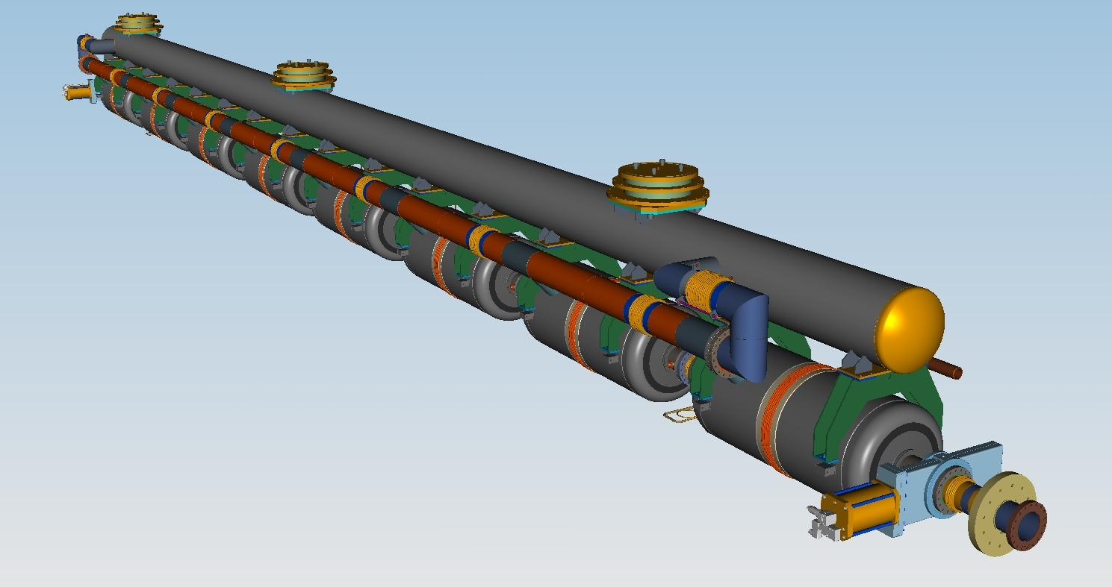
Concept 2
He reservoir with level sensor
Warm up cool down pipe
Illustration only – not representative of actual cavity string

Slide 34
Cryomodule design concepts - Pros and cons
Concept 1 (room temperature strongback)
Many design features common with the current SSR1 cryomodule design
Coupler port locations are fixed with respect to the vacuum vessel
Support system not subject to thermal distortions during cooldown
To date, unproven
Concept 2 (XFEL-like design)
Design concepts are direct descendants of the XFEL design
Could possibly use tooling common to XFEL-like cryomodules
Coupler positions change during cooldown
Support pipe can distort during cooldown

Slide 35
High-β cryomodule
Heat exchanger
Check valve
Gate valve
Tuner access ports

Slide 36
High-β cryomodule
2-phase manifold
Support posts
Strongback

Slide 37
High-β cryomodule

Slide 38
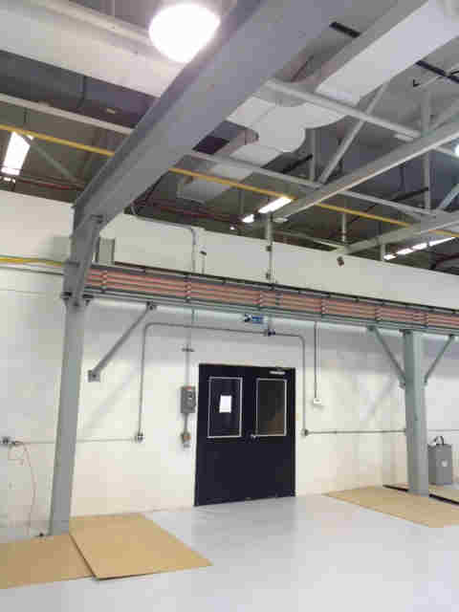
Lab 2 renovation

Slide 39
Summary and status
Four 5-cell β=0.9 cavities manufactured by AES are in-house, five more expected from PAVAC.
Low-β cavity design being developed at VECC.
High-β cavity design will be provided to RRCAT for manufacture.
Common tuner design being developed by engineers from RRCAT.
Input coupler for all 650 MHz cavities will be developed at Fermilab.
Low-β cryomodule design will be developed at VECC, hopefully with features common to high-β design.
High-β cryomodule design will be a joint effort between Fermilab and RRCAT.
Significant progress is being made on the high-β cryomodule design. The most urgent need is for assembly tooling that could be common for both SSR1 and 650 MHz cryomodules.
Current plan is to put four US-made β=0.9 cavities and two India-made β=0.92 cavities in the prototype high-β cryomodule.
Significant progress is being made in Lab 2 for cryomodule assembly.

