Slide 1
WG 2: Superconducting Linac Summary
S. Mishra, V. Yakovlev, F. G. Garcia
PIP-II Collaboration Meeting
9-10 November 2015

Slide 2
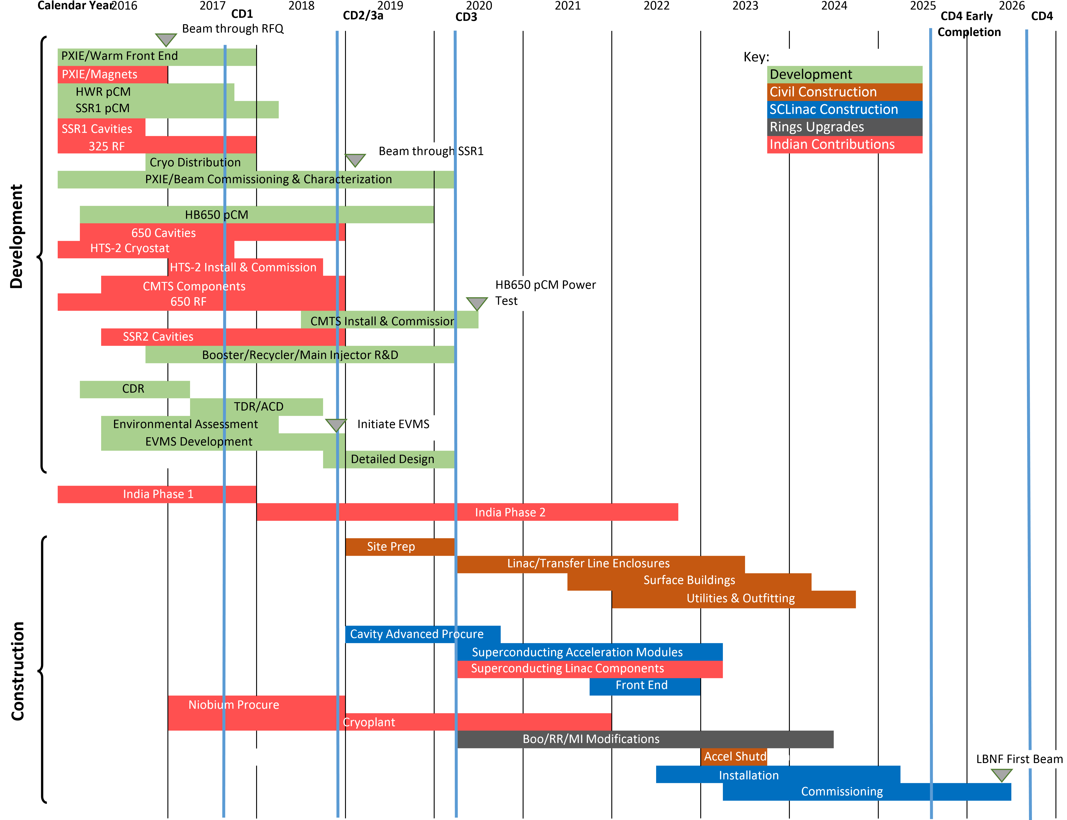
PIP-II Preliminary Schedule

Slide 3
FY2016-17 Budgets
FY2016 $19.5M
Budget allocations specified at L3 of WBS
Adjustments required to meet budget guidance:
Deliverable | Old Date | New Date
PXIE warm: beam out of MEBT-1 | Q2FY16 | Q4FY16
SSR1: Resonance control testing definitive results | Q4FY16 | Q4FY16
PXIE warm: beam to end of MEBT-2 | Q4FY16 | Q4FY16
PXIE warm: beam to end of final MEBT | Q4FY17 | Q4FY17
PXIE Cold: HWR CM and associated infrastructure (cryo, RF, power, etc.) | Q3FY17 | Q3FY17*
PXIE Cold: SSR1 CM and associated infrastructure (cryo, RF, power, etc.) | Q3FY17 | Q1FY18*
HB650 Dressed Cavities and associated infrastructure (HTS-2, rf) | Q3FY17 | Q4FY18
HM650 CM to CMTS | Q4FY18 | Q1FY20
CD-1 activities: CDR, Site Characterization, civil construction drawings | Q4FY16 | Q3FY17
* Requires augmented funding in FY2016

Slide 4
FY2016-17 Budgets
FY2017 $19.5M
Detailed budget plan does not yet exist
Priority will be on completing elements in prior table scheduled for FY2017 and on getting to CD-1
There will be slippage elsewhere
FY2018
We have been advised that FY2018 will be: $22.0-25.0M
WG2: Fermilab and Indian colleagues should work immediately to make a plan with this budget.
Still focused on retiring most critical PIP-II R&D
Goal: 15 Dec 2015

Slide 5
Management/Organization
Wherever appropriate re-organize the group and assignment of sub-sub--managers who will be responsible for carrying-out specific tasks
This is underway
There must not be a TD effort and AD effort, there should be a PIP-II effort
Document and clearly communicate to the collaboration “who is who”
This is underway
Clearly communicate to the collaboration what the deliverables are for each group and responsibility of each sub Project Managers.
Build-up Fermilab team with collaborators
Collaborators are members of your department
Finalize the Microsoft Project Plan for the R&D phase by 30 Nov 2015
Develop a RLS schedule, which is expected post CD-0
Improve Communication with Indian colleagues
This is now getting in place but there are significant hurdles
Joint understanding of the Indian DAE system

Slide 6
Moving Forward
Incredible amount of work has been done so far over the course of several years
With CD-0 expected this week the project will get serious traction
Time and $$ will start being tracked.
Time to develop a schedule that can realistic reflect the work that needs to be accomplished
prioritize tasks that will be required to work towards CD-1, CD2/3a and CD3
Focus on Mid review by DAE-DOE in summer of 2017.
DOE and DAE should finalize the charge of that review

Slide 7
R&D: Early evaluation of cost impact
The focus of the Project must be on retiring critical R&D before CD-3.
It has been outlined in PIP-II scheduled submitted to DAE
But we cannot forget a few promising R&D
High Q
Active Resonance Control
Evaluate construction and operation cost impact of these R&D (Spring 2016) with for example the following goals
Increase the base line Q from 2e10 to 4e10
Effect on cryomodules design
Cryogenic plant design
Increase the baseline gradient by 25%.
What implications it has on other subsystems
RF Power
Focus effort on cost reduction
Optimization and tradeoffs
Example: Tuner strength (LDF and Microphonics)
Example: Laser welding vs tigg welding of He Vessel to cavity
Example: Automated tuning vs semi automated tuning machine
Example: Fully configured Solid State RF vs in parts.

Slide 8
Specifics: SSR1
Decide that we are going to put two Indian cavities in the string.
Engage in the He vessel fabrication
Finalize the tuner design
Coupler
Make a String Assembly schedule that matches better with the projected budget schedule for FY17 and 18

Slide 9
Specific: SSR2
Jointly finalize the cavity RF design
Fermilab transmitting what we know and experience from SSR1
BARC to lead the mechanical design and fabrication of Dressed cavity and cryomodule
Fermilab needs to be fully integrated in this

Slide 10
Specifics: HB650/LB650
Finalize the HB650 Dressed Cavity design
Tuner (Finalize Specification)
Coupler (Finalize Specification)
Work with VECC on the new specification for LB650
Selected Option 1 for the cryomodules design and proceed
Get the engineering team from India (RRCAT, VECC and BARC) involved
Keep in mind the R&D on cavity Q
Forget that β = 0.9 cavity exists in this design effort

Slide 11
Specific: HTS-2
HTS-2 is on a critical path for the PIP-II R&D
Work with DAE on a realistic plan of cryostat construction and commissioning
Make a detailed plan of sub-component integration
Group discussion of sub-project manager on regular basis

Slide 12
Specific: PIP-II Cryogenic Plant
IIFC is expected to jointly develop and place an order of the PIP-II cryogenic plant.
Size the cryogenic plant for Q = 2e10.
In Project Annex I it is expected to be Fermilab driven and DAE supported project
Fermilab needs to understand DAE mechanism
We have to be there on regular basis to work
To understand the DAE management that would aid in making our plan
Make a procurement plan that will work
This is on critical path of the DAE-DOE mid 2017 review.

Slide 13
Specifics: RF, LLRF, RF Protection and Controls
Integrated effort in these areas
Fermilab, RRCAT and BARC
1st testing of this integration HTS-2 at Fermilab.
2nd SSR1
3rd 650 CMTS
A lot of achievable work:
Systematic Organization
Clear Communication
Clear Documentation
Let us get to work: Thanks

