Slide 1
Mu2e Project Overview
Steve Werkema – Mu2e Accelerator Systems L2 Manager
Mu2e Accelerator Radiation Safety Improvements Design Review
20 October 2015

Slide 2
Outline
The Mu2e Experiment
The Muon Campus
The Mu2e Project Accelerator Systems
Construction Progress
Schedule Overview

Slide 3
The Mu2e Experiment

Slide 4
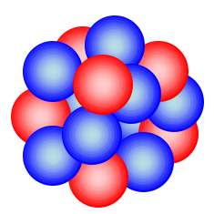


Charged Lepton Flavor Violation
Al
The Mu2e experiment will attempt to detect Charged Lepton Flavor Violation (CLFV)
CLFV is a process involving charged leptons (e±, μ ±, τ ±) that violates the conservation of the number of leptons of each flavor
e⁻
105 MeV
μ ⁻
μ ⁻ N → e⁻ N
L_{μ}: 1 0 ΔL_{μ} = -1
L_{e}: 0 1 ΔL_{e} = 1
Both L_{μ} and L_{e} are not conserved in this process
Ordinary muon decay is not CLFV
L_{μ}: 1 0 0 1
L_{e}: 0 1 -1 0
If this is observed, it is evidence physics beyond the Standard Model
Notes:
Muon stopping target is Aluminum.
Mu2e is looking for a neutrinoless final state.

Slide 5
What Mu2e Measures
The Mu2e experiment will measure the ratio of the number muon captures in aluminum that produce a conversion electron to the number of those that are captured in the ordinary way. This ratio is designated “R_{μe}”
Rate of CLFV μ → e conversion
μ capture rate
Mu2e goal for 10¹⁸ stopped muons:
Single event sensitivity = 2.87×10⁻¹⁷ (i.e. one observed event yields R_{μe} = 2.87×10⁻¹⁷)
90% CL R_{μe} Limit < 6.0×10⁻¹⁷

Slide 6
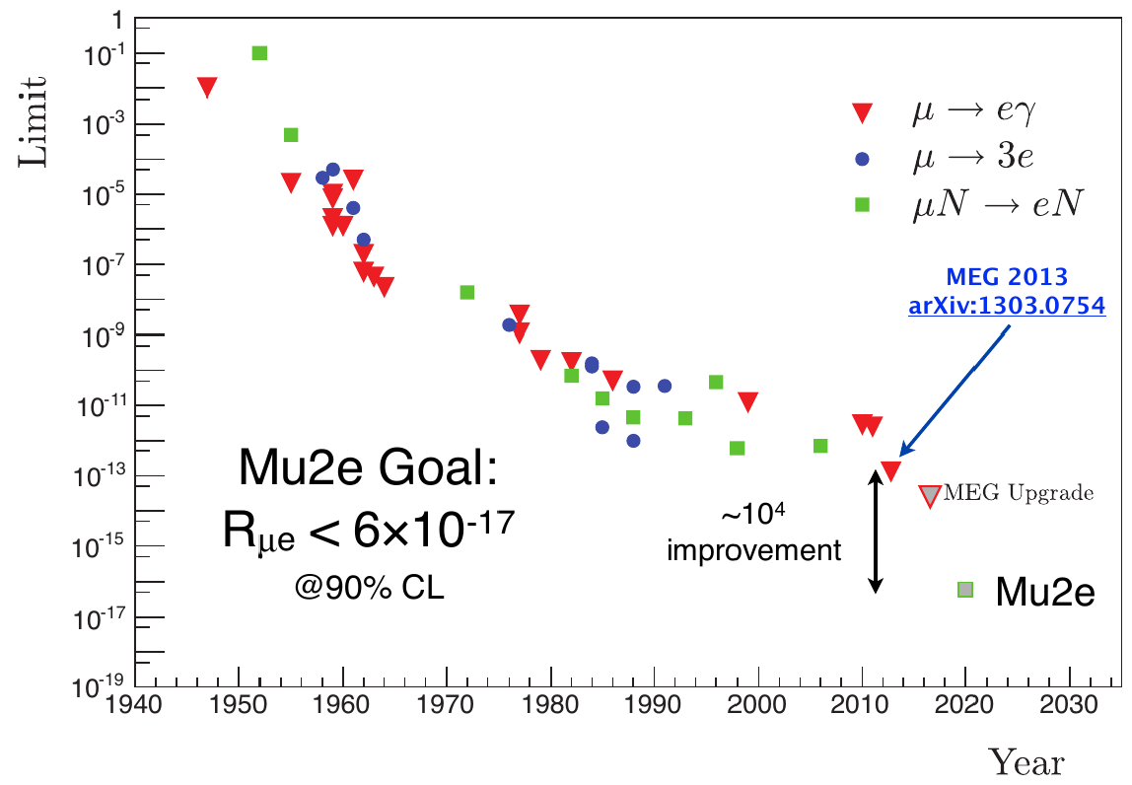
Results of Previous CLFV Searches
90% CL Limit

Slide 7
Mu2e Apparatus
The Mu2e apparatus consists of three superconducting solenoids joined together to make a continuous whole
Production Solenoid
Contains proton target
Magnetic mirror – reflects secondaries back toward transport solenoid
Transport Solenoid
Collimation
Momentum and charge selection
Transport to stopping target
Detector Solenoid
Contains stopping target
Tracker (straws)
Calorimeter (BaF₂ crystals)
Proton Beam
Calorimeter
105 MeV e ⁻
Tracker
2.5 T
1 T
4.5 T
1 T
2 T
~ 0.0019 stopped μ⁻/POT
10¹⁰ Hz of stopped muons
Al Stopping Target
Notes:
Particle trajectories drawn by Ron Ray.

Slide 8
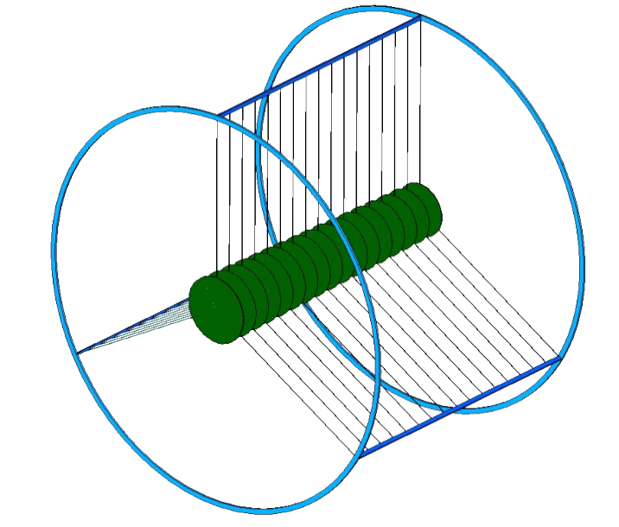
Stopping Muons
Aluminum
Nucleus
μ ⁻
Captured μ ⁻
M_{μ} = 105 MeV/c²
Mu2e muon stopping target
17 Al 200 μm foil disks
Disk radii decrease from 83 mm to 65 mm in downstream direction
A muon that is stopped in the Mu2e target is captured into an atomic orbital state of an aluminum nucleus
The muon quickly (≲ psec) transitions* to the 1S state where its wave-function overlaps the nucleus
* A target monitor counts nuclear transition photons
Notes:
The muon stopping target is designed to simultaneously optimize the muon stopping rate will minimizing the amount of material through which a conversion electron must pass.

Slide 9
The Muon Campus

Slide 10
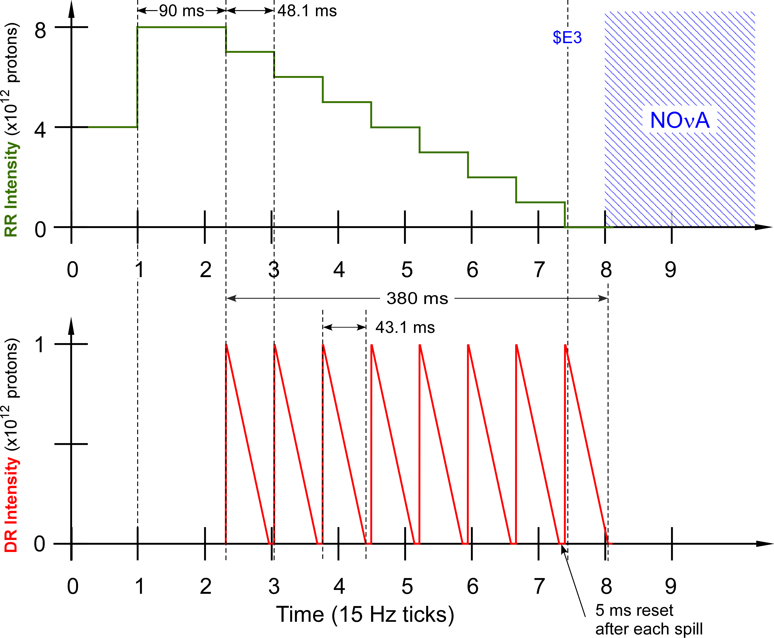
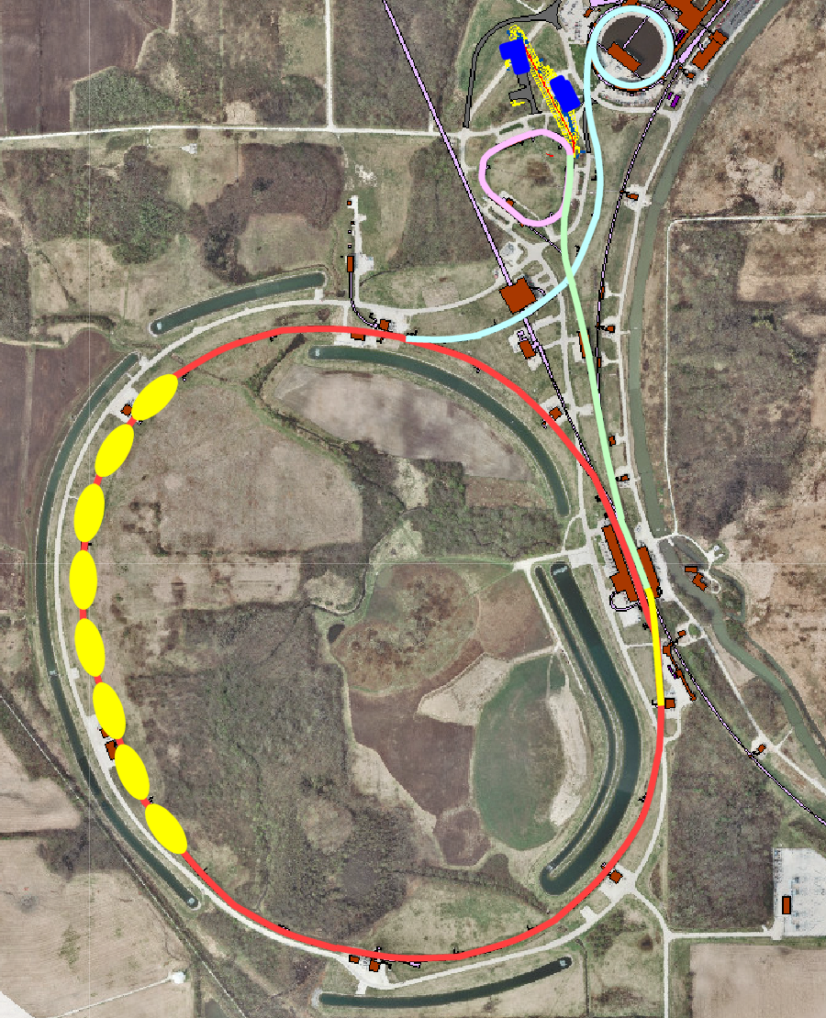
Acquisition of Beam for Mu2e
Muon Campus
Muon Campus Beamlines
Recycler Ring
Accelerator timeline for Mu2e proton beam delivery
Spill duration: 43.1 msec
Interval between spills 48.1 msec
Duty Factor: 27.1%
(Total Spill Time/Length of Cycle)
Peak Delivery Ring proton intensity: 1.0 ×10¹²
Notes:
The muons for the Mu2e experiment come from the interaction of a primary proton beam with a tungsten target in the Mu2e experimental hall. The protons that meet the requirements of the experiment are derived thusly:
Two Booster proton batches (4 Tp/batch) of 8 GeV KE are transported to the Recycler Ring via the MI-8 Line. Booster batches are injected into the Recycler at a rate of 15 Hz. Thus, the basic unit of time in the Accelerator Timeline is one 15 Hz cycle = 67 msec ≡1 tick
- The protons are rebunched in the Recycler with a 2.5 MHz RF system into 8 narrow 1 Tp bunches that occupy 2/7th of the Recycler circumference.
- These bunches are extracted, one-at-a-time, from the Recycler and transported to the Delivery Ring.
- The single bunch circulating in the Delivery Ring is resonantly extracted over approximately 54 msec to the Mu2e proton target forming a train of bunches spaced in time by 1.695 micro-sec (Delivery Ring T_{rev}).
- These proton bunches are transported to the proton target via the M4 Beamline.
- During transport from the Delivery Ring to the target the beam pulse passes through an extinction section containing a fast ac dipole magnet that removes the unwanted beam between pulses.
- This process is repeated twice for every 1.333 sec MI ramp cycle in the part of the cycle during which NOvA beam is being accelerated in the Main Injector.

Slide 11
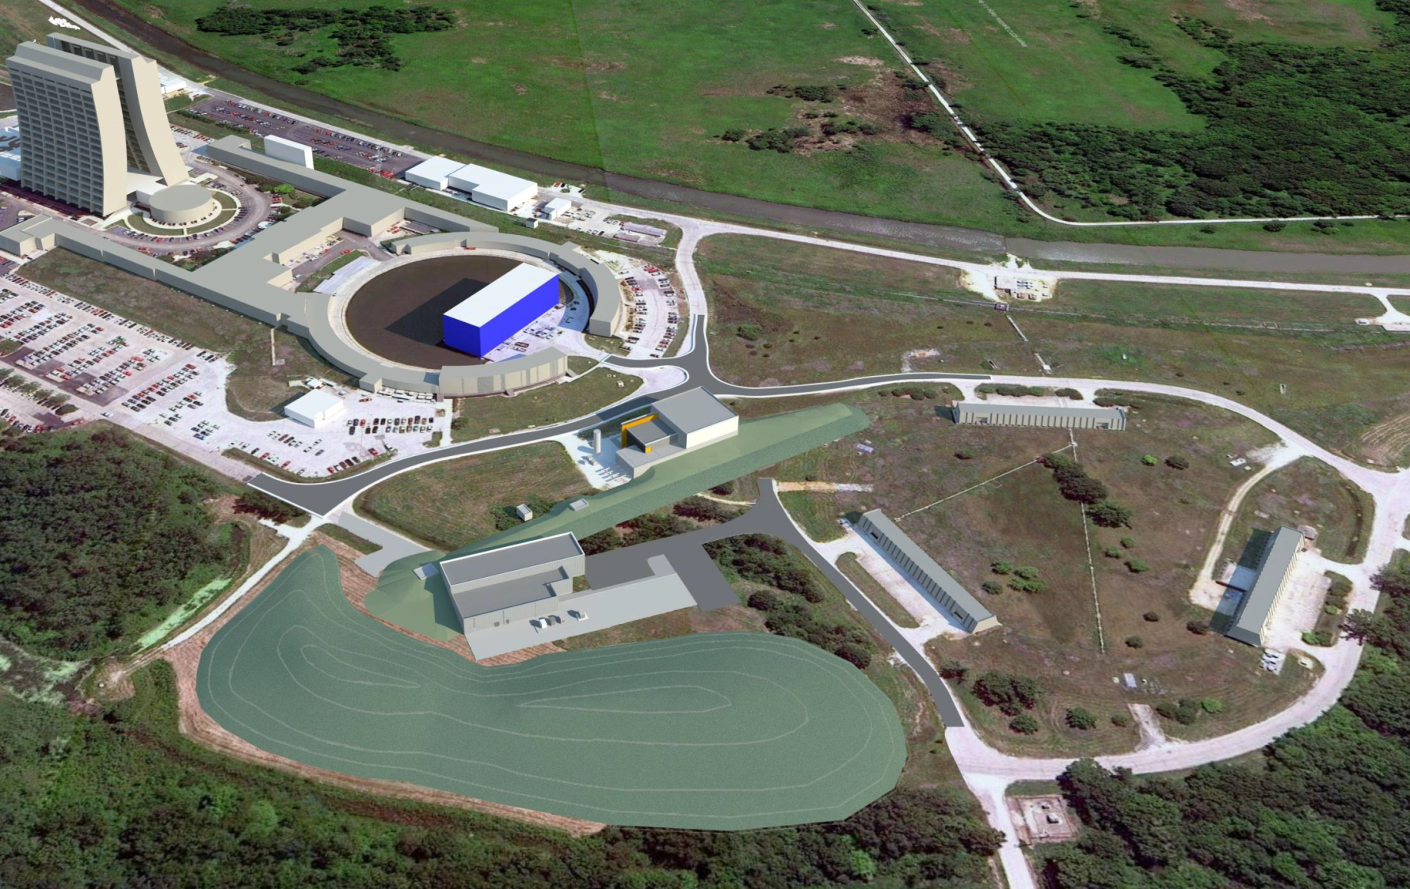
The Muon Campus
+ ^{a new Recycler RF system}
+ ^{Recycler to P1 transfer}
+ ^{Beamline upgrades}
+ ^{Cryo support}
g-2 (MC-1)
M4 Beamline
Picked over remnants of the Antiproton Source 😐
Mu2e
The Muon Campus Program consists of a total of 9 projects
Notes:
Note: the Mu2e and g-2 experiments will not be able to run at the same time.

Slide 12
DOE Projects, AIPs, GPPs
Building the Muon Campus requires the following projects:
DOE Projects
  Muon g-2
  Mu2e
AIPs (Accelerator Improvement Projects)
  Recycler RF
  Beam Transport
  MC Cryo Plant
  Delivery Ring
GPPs (General Plant Projects)
  MC-1 Building
  Beamline Enclosure
  MC Infrastructure Upgrade
Notes:
DOE Projects = Projects for which DOE Order 413.3b applies

Slide 13
Muon Campus Upgrades Required for the Mu2e Experiment but not on the Mu2e Project
Accelerator Upgrade | Project
MI-8 beamline to Recycler Ring Injection | NOvA Project
Recycler Ring 2.5 MHz RF system | Recycler RF AIP
Delivery Ring 2.4 MHz RF Cavities and HL Amps & Cooling | Recycler RF AIP
Single bunch extraction from Recycler Ring | Beam Transport AIP
Beamline aperture upgrades | Beam Transport AIP
AP1, AP2, AP3 to M1, M2, M3 conversion & upgrade | Beam Transport AIP
Beam transport instrumentation & infrastructure | Beam Transport AIP
Beam transport controls | Delivery Ring AIP
Delivery Ring Injection | Delivery Ring AIP
Delivery Ring Abort | Delivery Ring AIP
Delivery Ring infrastructure | Delivery Ring AIP
Delivery Ring Controls and Instrumentation | Delivery Ring AIP
D30 straight section reconfiguration | g-2 Project
Delivery Ring Extraction (except ESS) | g-2 Project
Extraction line (M4) to M5 split | g-2 Project
M4 beamline enclosure | MC Beamline Enclosure GPP

Slide 14
The Mu2e Project Accelerator Systems

Slide 15
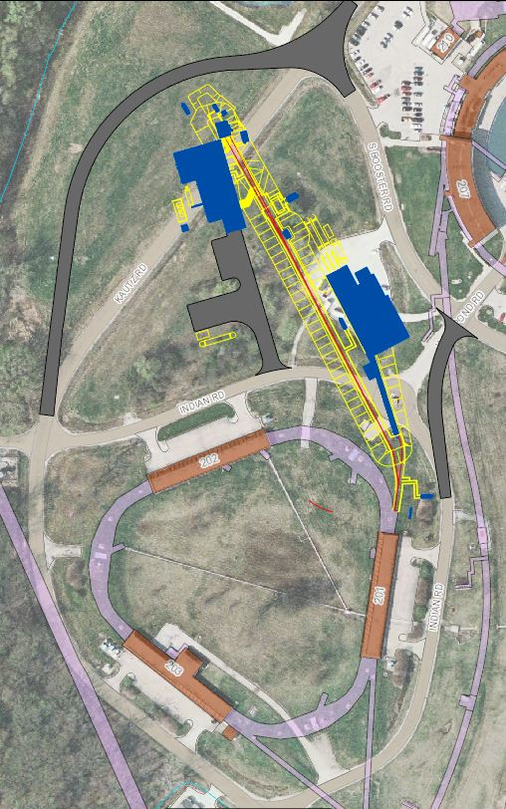
Mu2e Accelerator Systems Scope Overview
×
475.02.08.03 Extinction Monitor
475.02.09 Target Station
Mu2e
Bldg
475.02.07 External (M4) Beamline
MC-1
Bldg
475.02.08.02 Extinction
475.02.03 Instrumentation & Controls
475.02.04 Radiation Safety
Everywhere
Delivery Ring
475.02.05 Resonant Extraction
475.02.06 Delivery Ring RF
Notes:
Note: Kautz Road will not be routed around the Mu2e building – hence the big red X.

Slide 16
Mu2e Proton Beam Requirements
Parameter | Design Value | Requirement | Unit
Total protons on target | 3.6×10²⁰ | 3.6×10²⁰ | protons
Time between beam pulses | 1695 | > 864 | nsec
Maximum variation in pulse separation | < 1 | 10 | nsec
Spill duration | 54 | > 20 | msec
Beamline Transmission Window | 230 | 250 | nsec
Transmission Window Jitter (rms) | 5 | <10 | nsec
Out-of-time extinction factor | 10⁻¹⁰ | ≤ 10⁻¹⁰
Average proton intensity per pulse | 3.1×10⁷ | < 5.0×10⁷ | protons/ pulse
Maximum Pulse to Pulse intensity variation | 50 | 50 | %
Target rms spot size | 1 | 0.5 – 1.5 | mm
Target rms beam divergence | 0.5 | < 4.0 | mrad
3-4 year run
Time Structure
Intensity
Beam
Size
Notes:
The time structure requirements are generally for the reduction of prompt backgrounds in the Mu2e detector.
The intensity requirements optimize Mu2e detector performance.
The beam size requirements optimize muon yield and preclude excessive energy density in the proton target.

Slide 17
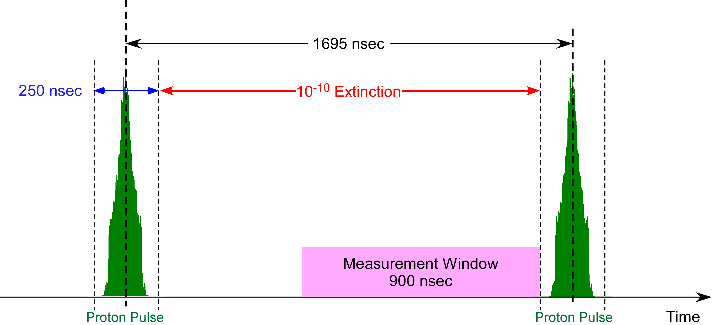
Proton Beam & Extinction Requirements
Two successive proton pulses on the Mu2e target (out of ~30,000 per spill)
Each pulse contains ~40×10⁶ protons
Extinction = No. of out-of-time protons / No. of in-time protons
(Requirement: <50 Mp/pulse)
Notes:
Holdoff time is the time required for primary proton induced background particles to decay or be lost by interaction with muon beamline materials. Holdoff time is determined by physics and may not be what is shown here.
Therefore, the measurement window is decreased as the proton pulse width is increased. The measurement window ends at the leading edge of the next proton pulse.

Slide 18
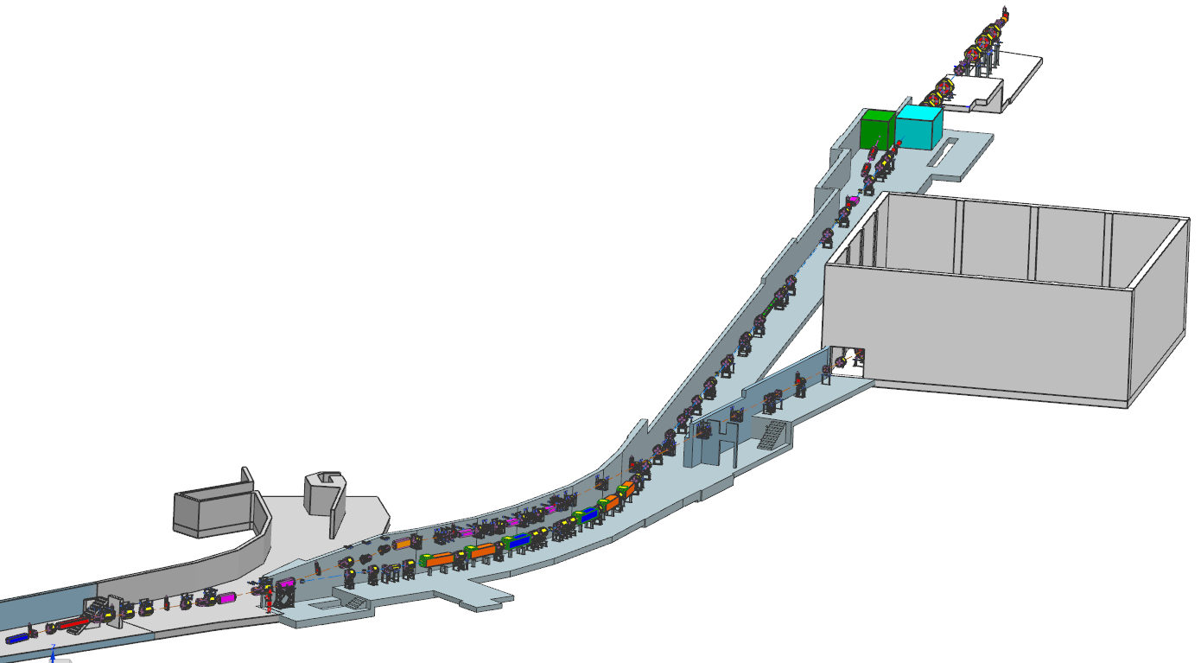
External (M4) Beamline Layout
Mu2e
g-2 project responsible for M4/M5 combined beamline section
Mu2e Project responsible for beamline downstream of V907
Diagnostic Absorber
Final Focus
Temp Shielding
Extinction Dipole Modules
MC-1
g-2
V907
Delivery Ring
M5 Beamline
M4/M5 Combined Beamline

Slide 19
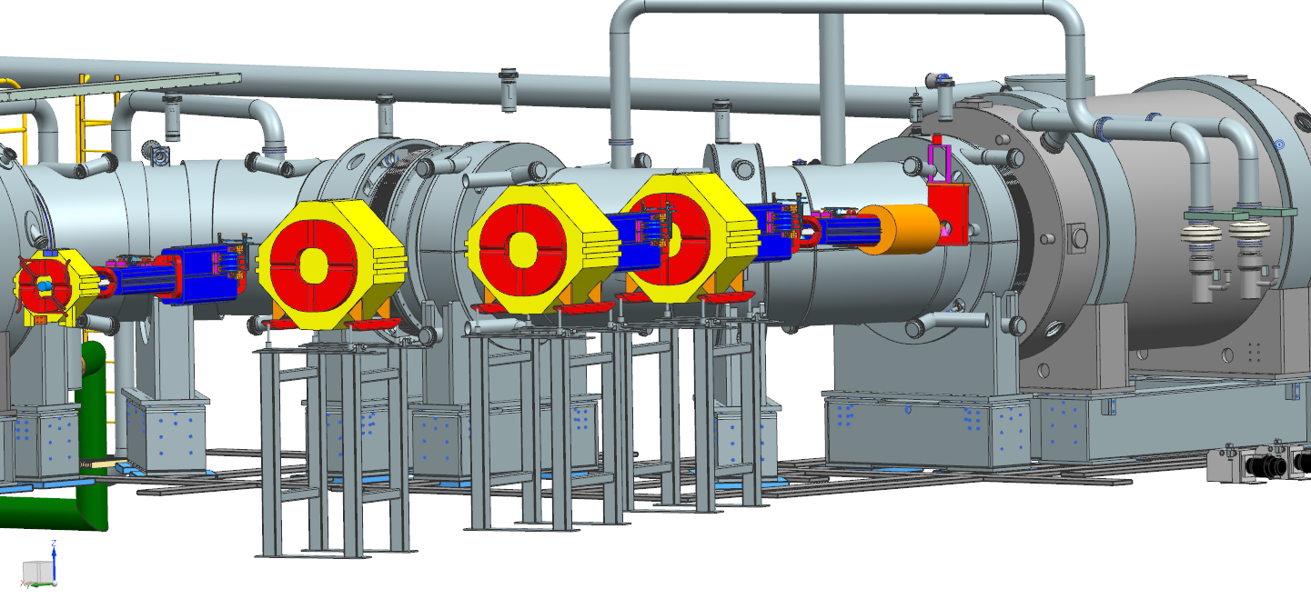
M4 Beamline / Production Solenoid Interface
Transport Solenoid
Production Solenoid
HRS Protection Collimator
beampipe has not yet been included

Slide 20
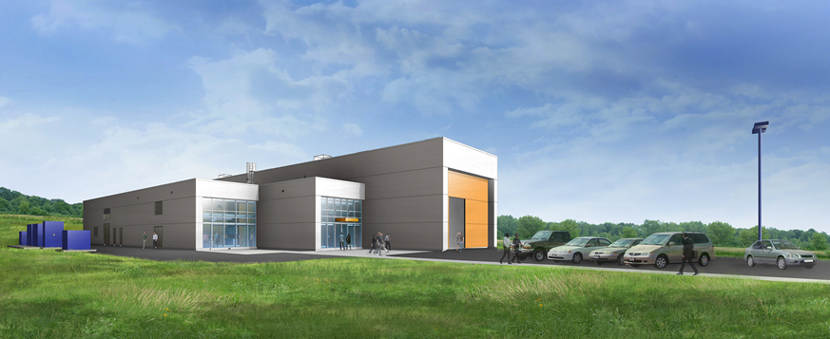
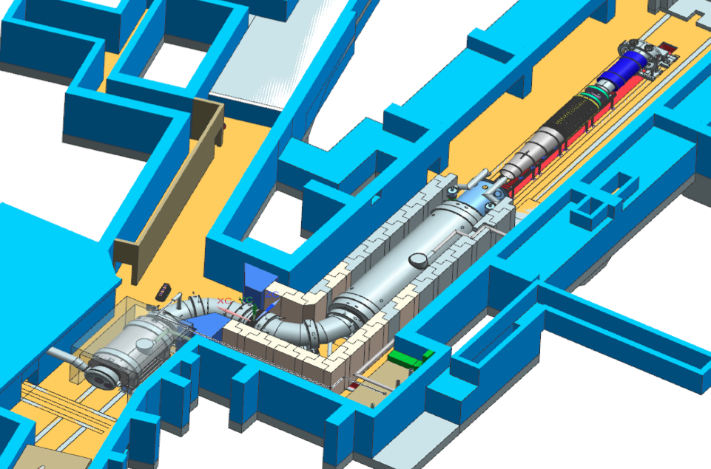
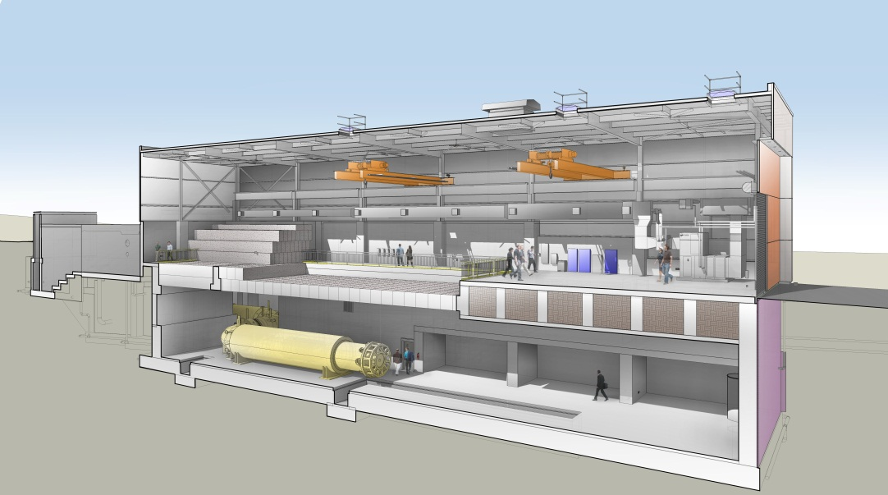
The Mu2e Building
Proton Target
lives here
M4 Beamline

Slide 21
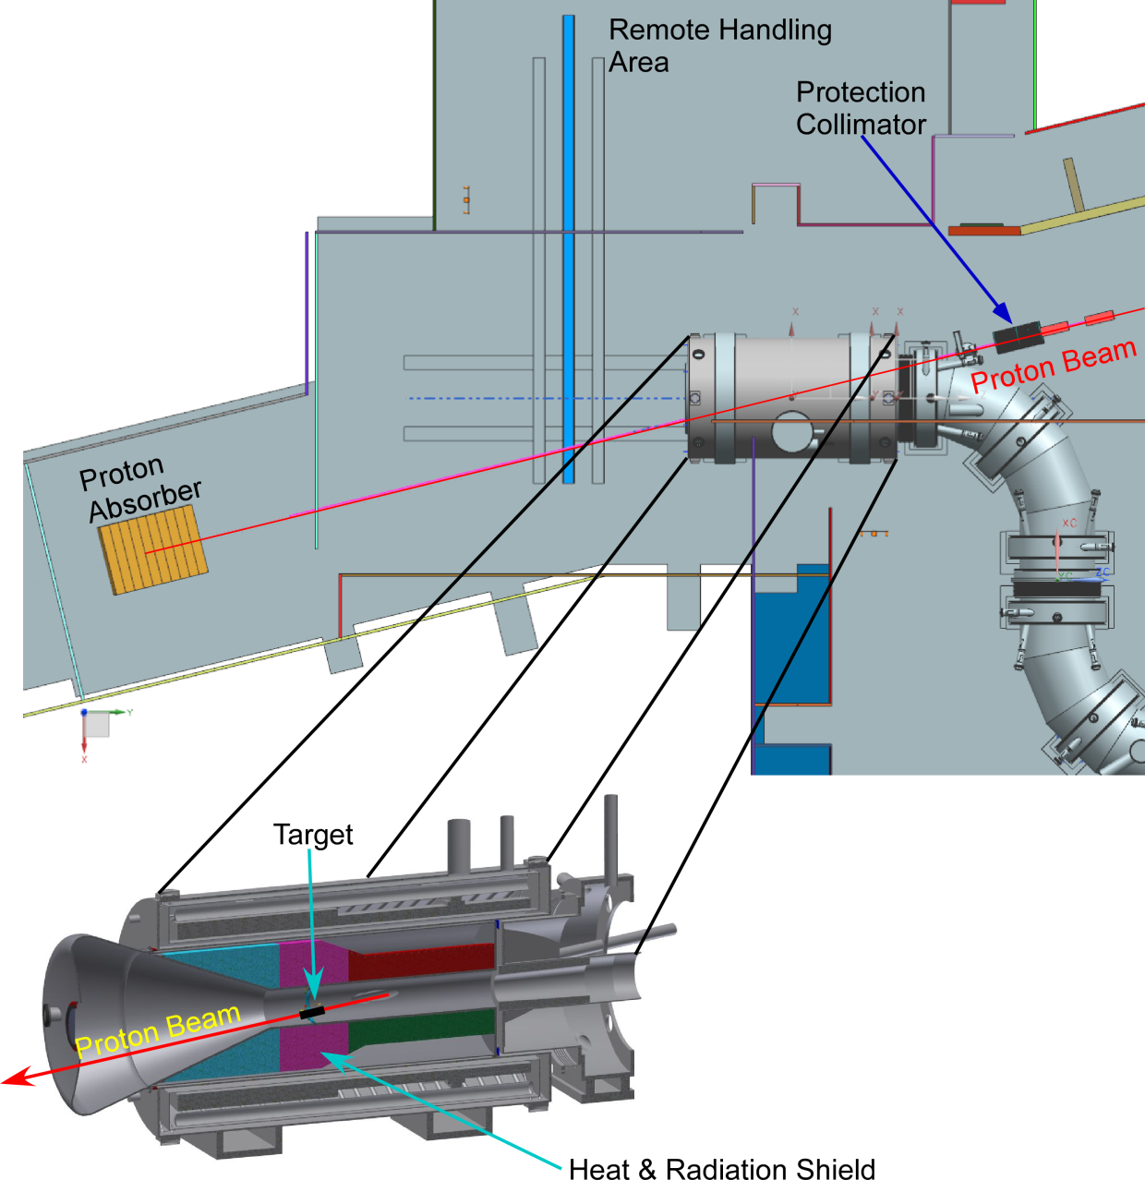
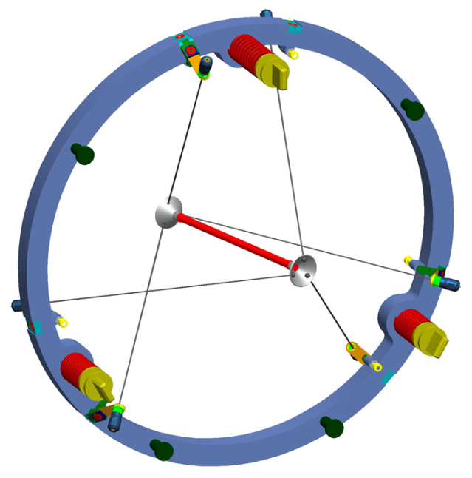
Mu2e Proton Target Station
Target – located inside the Production Solenoid (PS)
Heat & Radiation Shield (HRS)
Proton Absorber
Protection Collimator
PS

Slide 22
Construction Progress

Slide 23
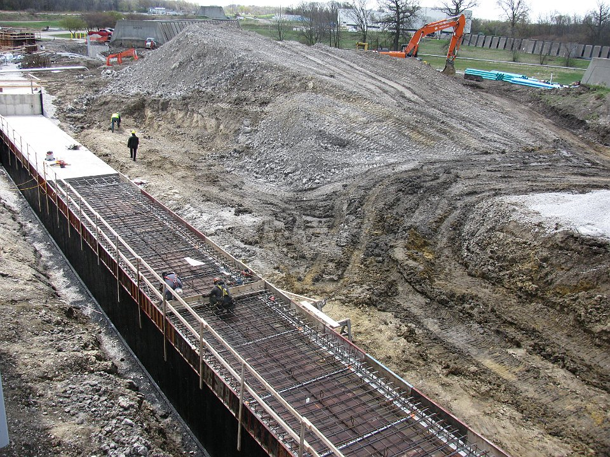
M4 Enclosure Construction
AP30

Slide 24
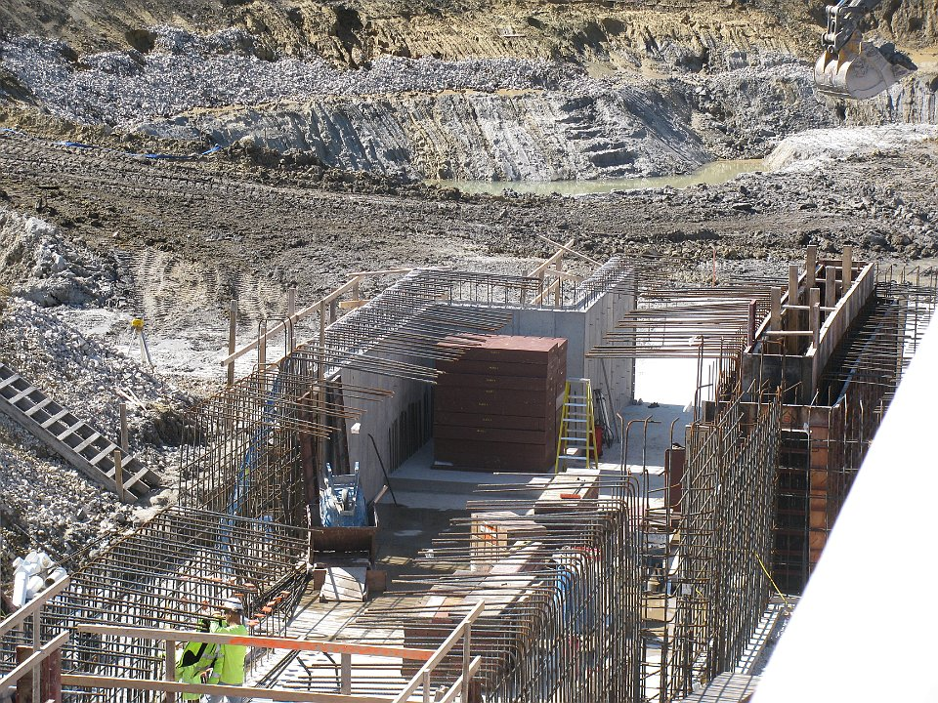
M4 Beamline Enclosure construction – Diagnostic Absorber
Diagnostic Absorber Steel Core

Slide 25
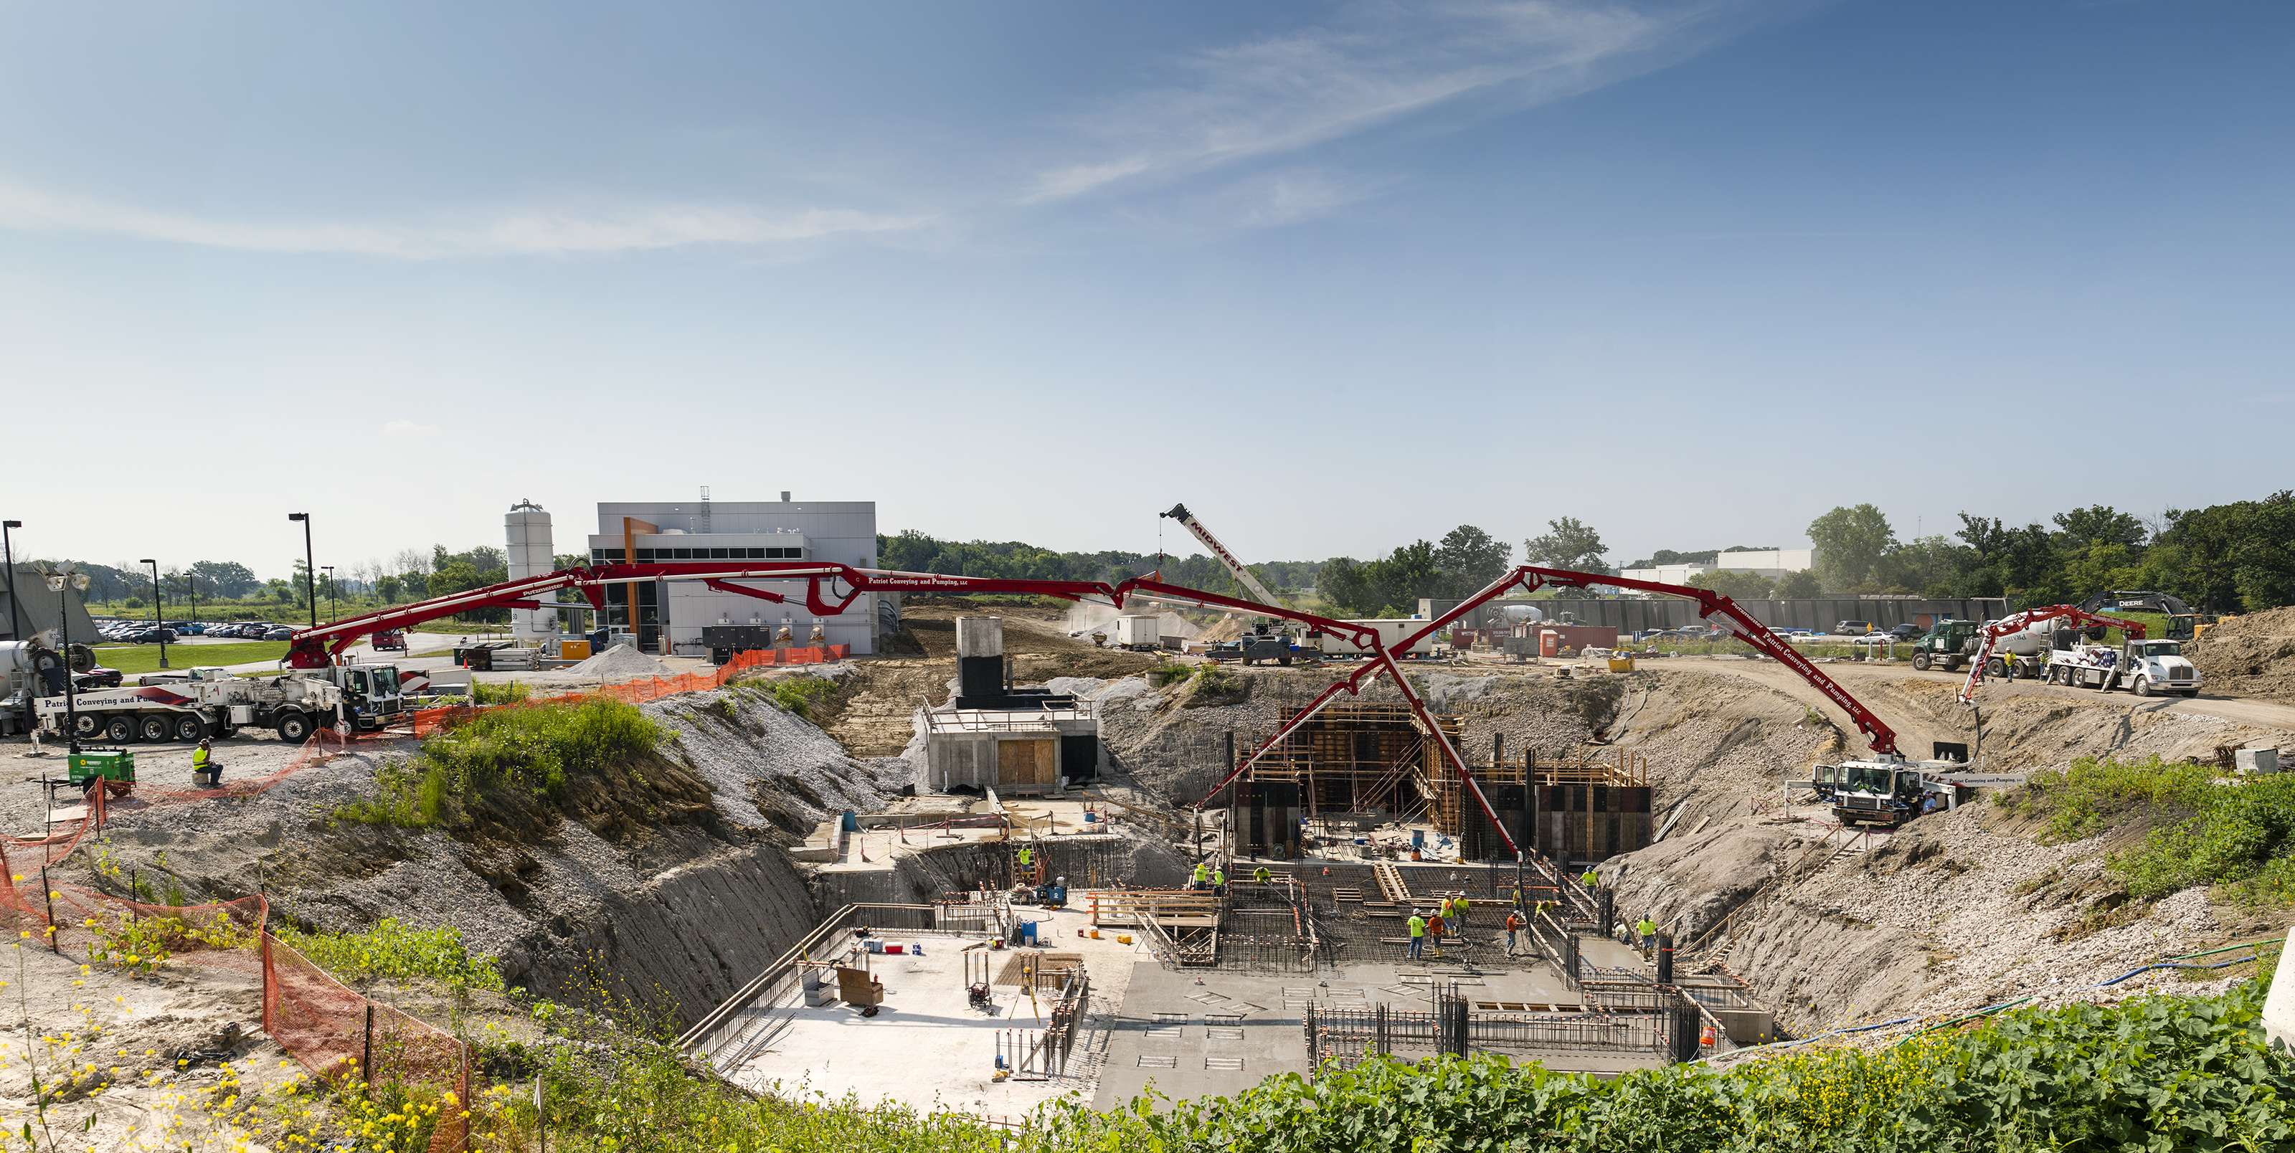
M4 Beam Enclosure
MC-1
Pouring Mu2e building floor slab
Looking east toward g-2 Building

Slide 26
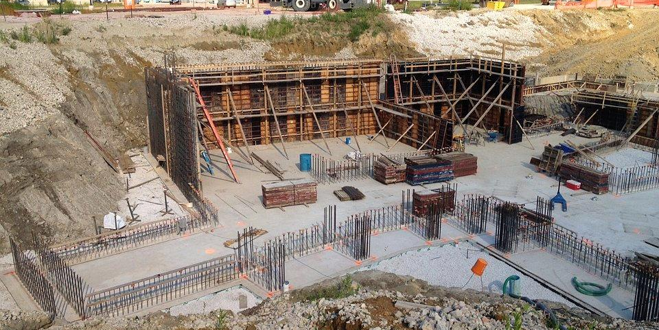
Target Dump floor
Framing the walls in the proton target station area of the Mu2e building

Slide 27
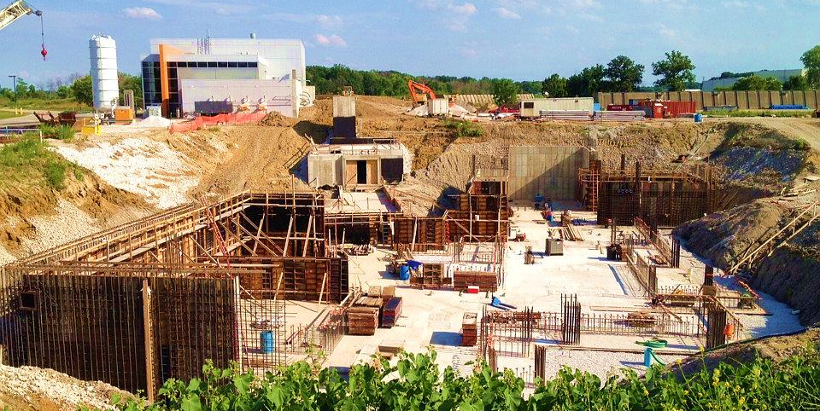
M-4 Enclosure
AP30
AP10
MC-1
Concrete floor complete
Framing and pouring the walls

Slide 28
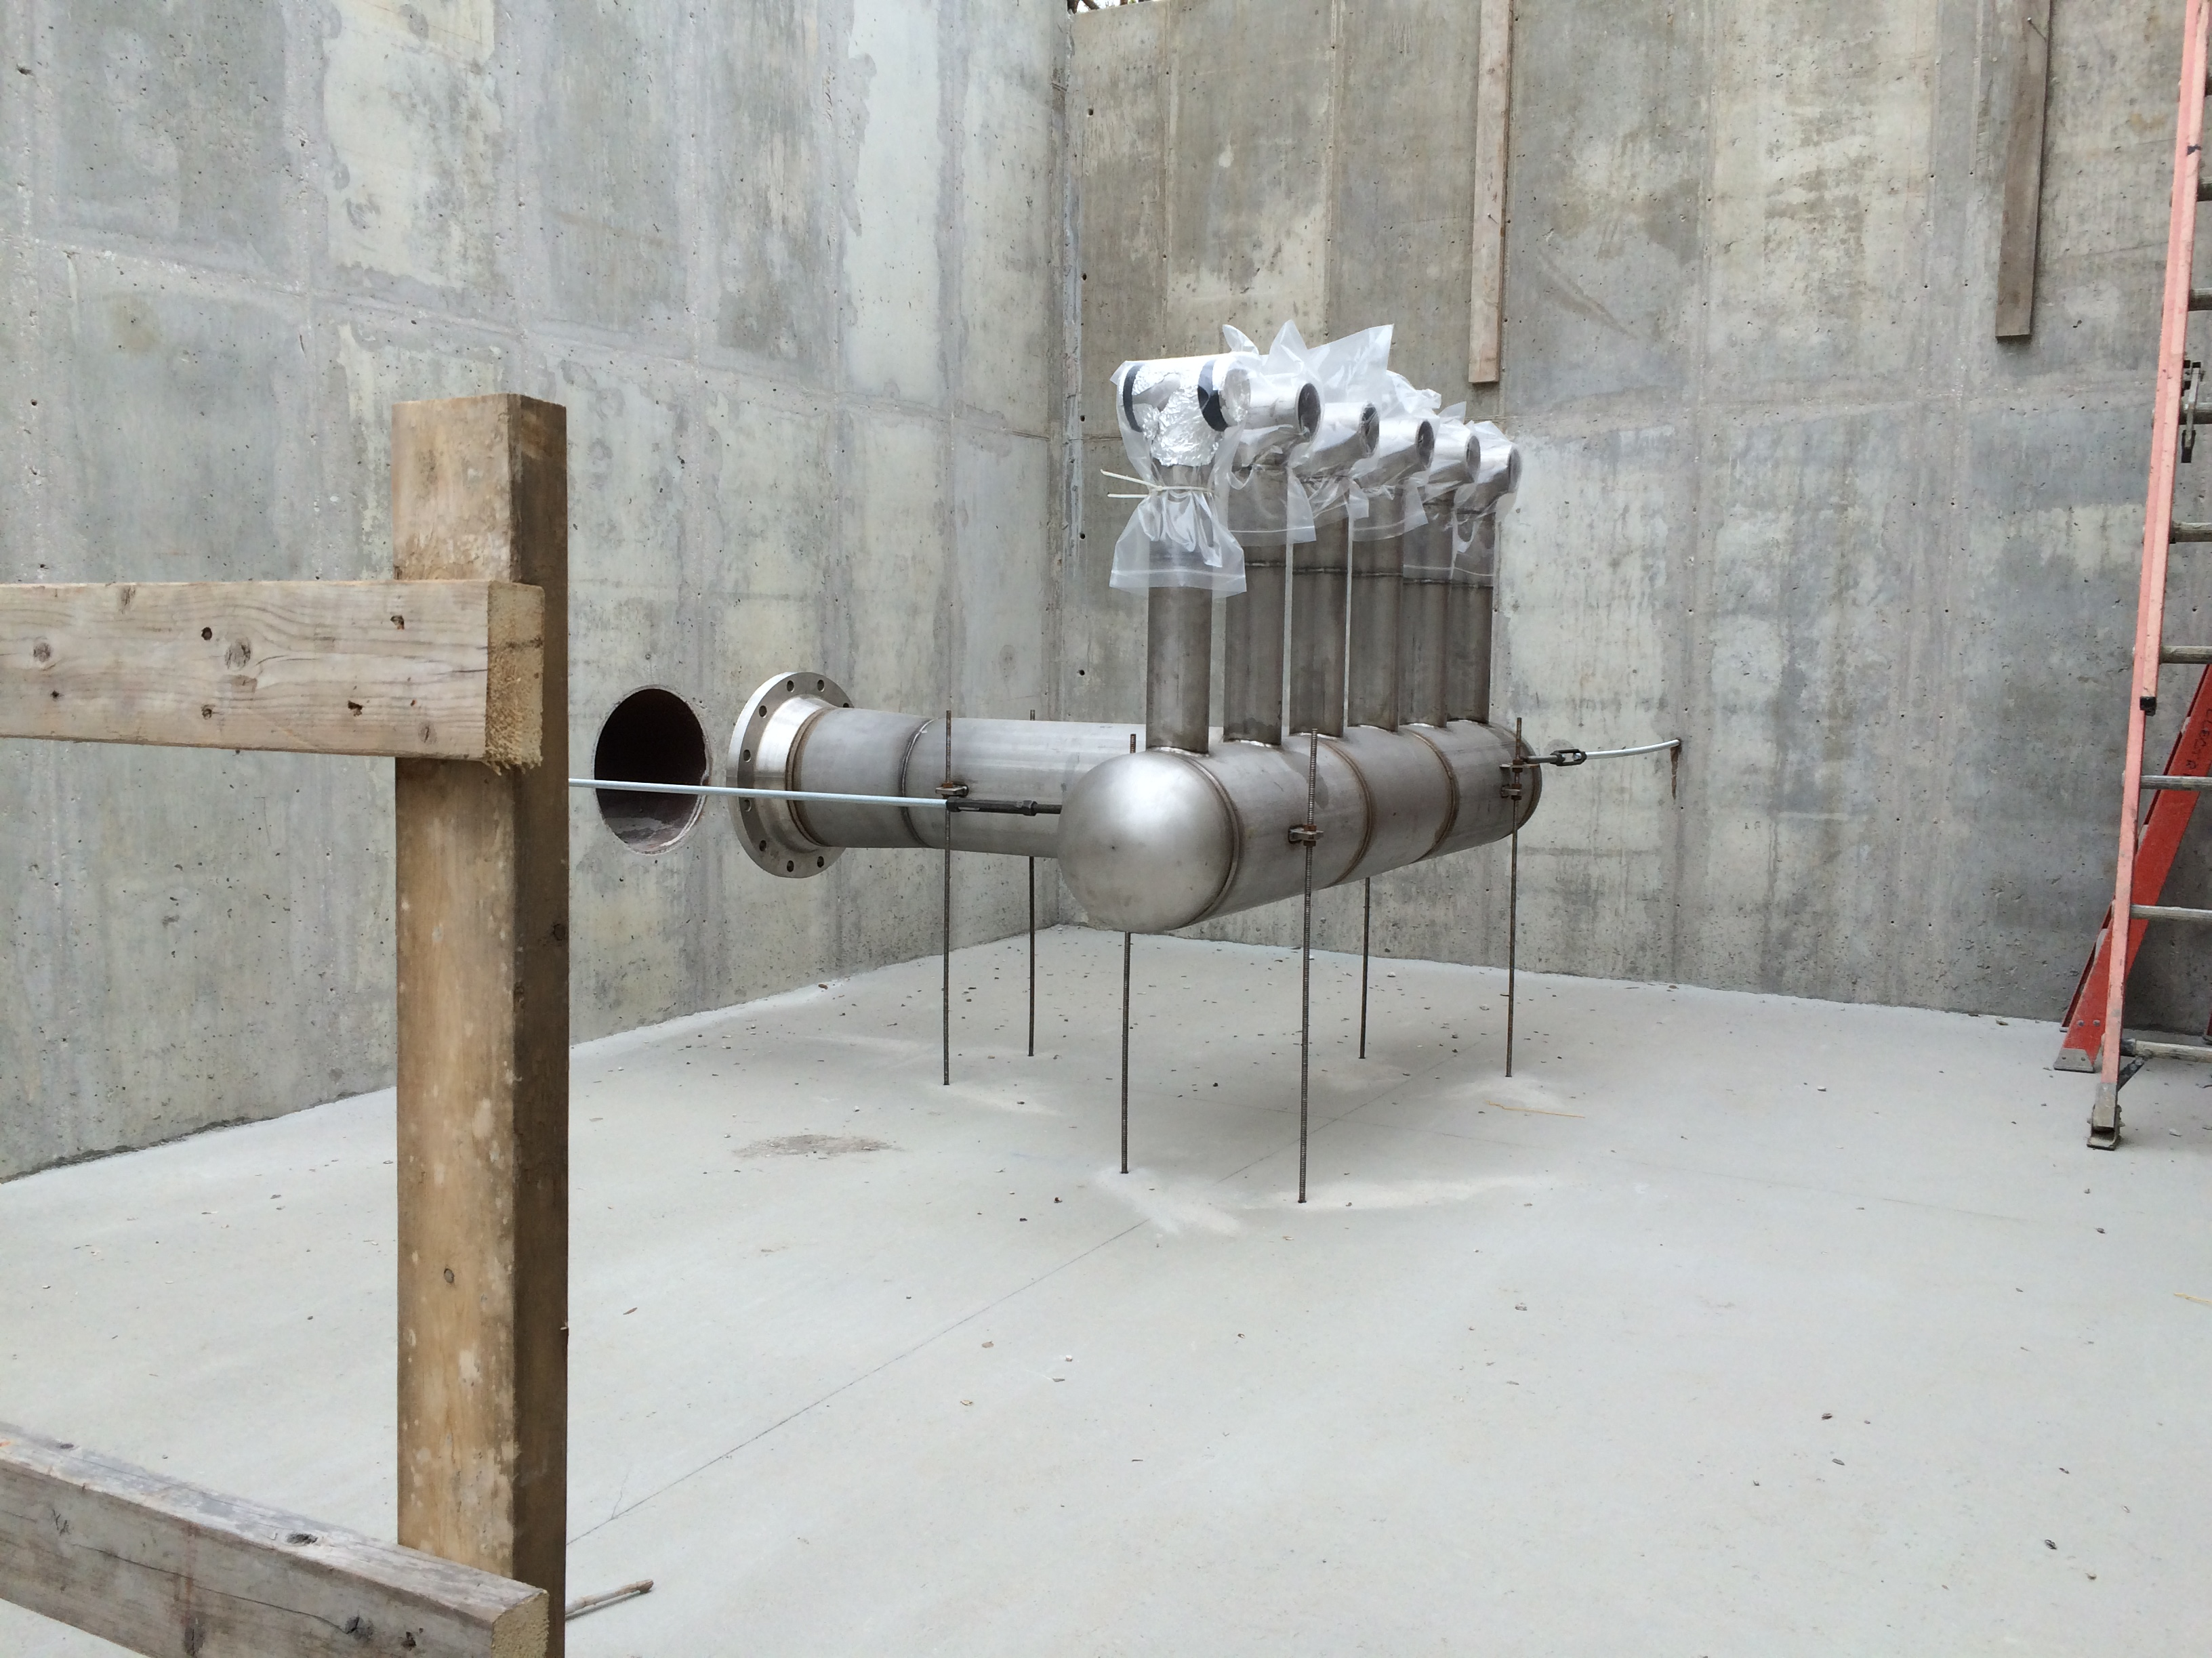
Target Proton Beam Absorber Air Manifold

Slide 29
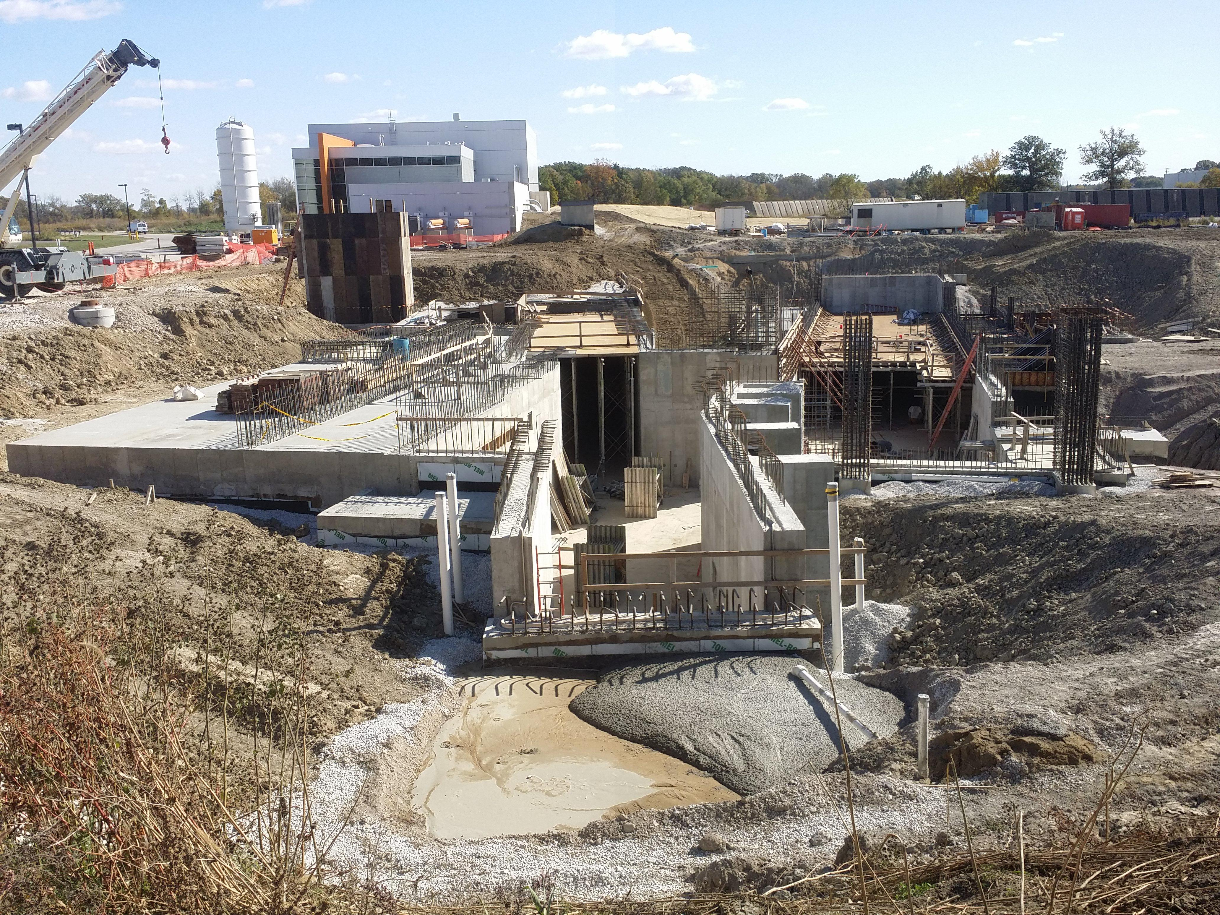
Saturday, 17 October 2015
MC-1
M-4 Enclosure
AP30

Slide 30
Why Start Building Construction before Design is Complete?
Generally, this is a very bad thing to do
  Removes the flexibility to accommodate unforeseen design issues that might be alleviated by building changes
  Once an A&E firm is retained, building design changes are expensive. Once a construction contract is awarded changes become even more costly
  The building becomes a design constraint as soon as concrete is poured
The Muon Campus and Mu2e projects did this because:
  Allows early start on projects necessary for g-2 – early g-2 running simplifies accelerator commissioning for Mu2e
  Construction costs were relatively low and projected to trend up when this decision was made
Notes:
This slide is for those who might think it is very odd that they are being shown construction photographs at a design review.

Slide 31
Schedule

Slide 32
Mu2e Accelerator Schedule
CD-2/3b
CD-3c
Mu2e Complete
M4 Enclosure
BO
Beam to Diagnostic Absorber
Resonant Extraction Design
Fabrication & Installation of Res. Extr. Magnets, Power Supplies, & Electronics
Fabricate ESS
Install ESS
Commission Res. Extr.
External (M4) Beamline Design
Extinction & M4DA Section Installation
Hbend Section Installation
Final Focus Section Installation
Target Station Design
Target Fabrication
Target Remote Handling Fabrication & Installation
HRS Procurement & Fabrication
HRS Installation
Extinction Design
AC Dipole, Pwr Supply & Collimator Procurement, Fabrication & Install
Extinction Monitor Procurement, Assembly & Install
Instrumentation & Controls Design
Instrumentation & Controls Implementation
Radiation Safety Design
Radiation Safety Procurements, Fabrication & Installation
Delivery Ring RF Design
Delivery Ring RF Procurements, Fabrication & Installation
Beam Operations:
g-2 Beam Operations
M4 Commissioning with single turn Beam
Q3 | Q4 | Q1 | Q2 | Q3 | Q4 | Q1 | Q2 | Q3 | Q4 | Q1 | Q2 | Q3 | Q4 | Q1 | Q2 | Q3 | Q4 | Q1 | Q2 | Q3 | Q4 | Q1 | Q2 | Q3 | Q4 | Q1 | Q2 | Q3 | Q4 | Q1 | Q2 | Q3 | Q4
FY14 FY15 FY16 FY17 FY18 FY19 FY20 FY21
Notes:
Notes:
No Muon Campus beam between Spring 2014 and Spring 2017
M4DA = M4 Diagnostic Absorber
The ESS replaces a Delivery Ring extraction kicker module. Therefore, ESS installation precludes further single turn extracted beam to the M4 beamline.
HRS installation takes 10 days (box on schedule is over-sized)
Target installation is off-project and estimated to occur later than Dec. 2021.
Beam commissioning activities are not on the Mu2e project

Slide 33
Significant Milestones
Milestone | Date
Diagnostic Absorber Installation Complete | March 2015
M4 Beamline Enclosure Beneficial Occupancy | Nov 2015
DOE CD-3c Approval | June 2016
Start of Muon g-2 Run | May 2017
Ready to run beam to diagnostic absorber | June 2020
M4 Beamline commissioned to Diagnostic Absorber | Sept 2020
Start electro-static septum installation | Oct 2020
DOE CD-4 Approval | May 2021

Slide 34
Muon Campus Program Cost
Project | Total Project Cost ($M) | Accelerator Costs ($M)
Muon g-2 Project | 46.4 | 22.2
Mu2e Project | 271.0 | 50.2
Recycler RF AIP | 9.7 | 9.7
Beam Transport AIP | 6.2 | 6.2
Delivery Ring AIP | 9.3 | 9.3
Cryo AIP | 9.7 | 9.7
MC-1 Building GPP | 9.0
Beam Enclosure GPP | 9.7
MC Infrastructure GPP | 1.0 | 1.0
Total | 372.0 | 108.3
All costs are base cost + estimate uncertainty (contingency)
Notes:
This cost estimate was compiled in November 2014
The external beamline is approximately 20% of the accelerator cost

Slide 35
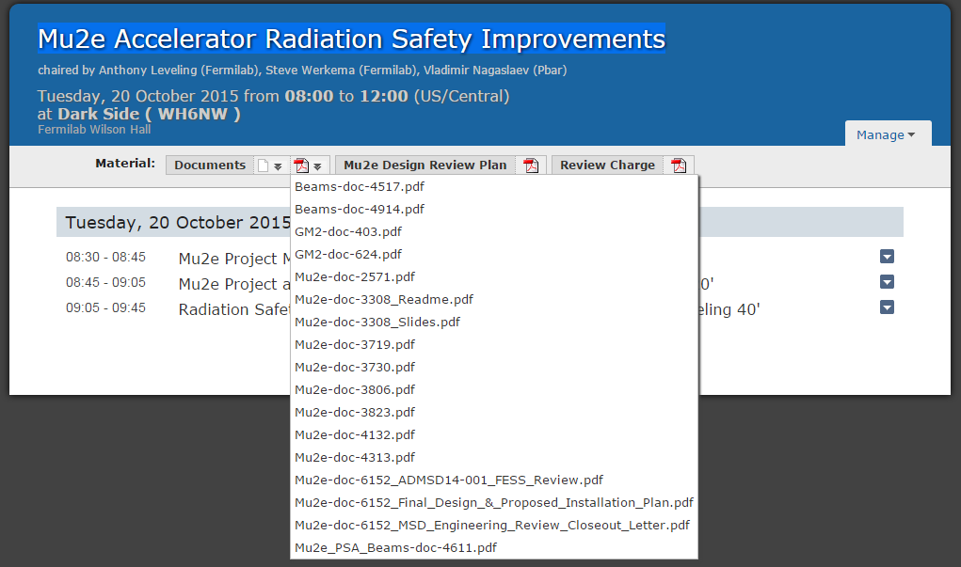
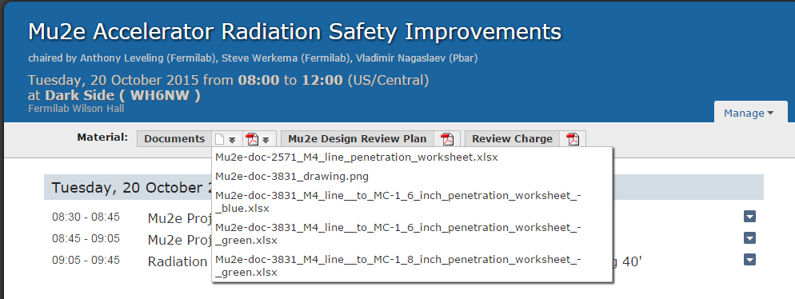
Access to documents
Two drop-down lists under “Documents”
All documents referenced in Tony Leveling’s talk should be available on the review Indico site

Slide 36
Conclusion
Thank you for your helping us by participating in this review
The Mu2e project is in the final stages of completing its final design
  We expect to begin our CD-3c reviews in ~March of next year
We would very much appreciate your advice on how we should best focus our attention in preparation for these reviews

Slide 37
Backup Slides

Slide 38
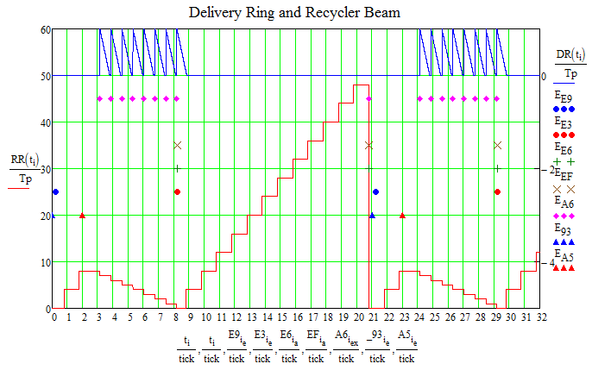
Mu2e / NOvA Accelerator Timeline Model
DR Beam ⇒
RR Beam ⇒
Notes:
Horizontal axis is time in units of Booster 15 Hz ticks. 1 tick = 1/15 Hz = 67 msec

Slide 39
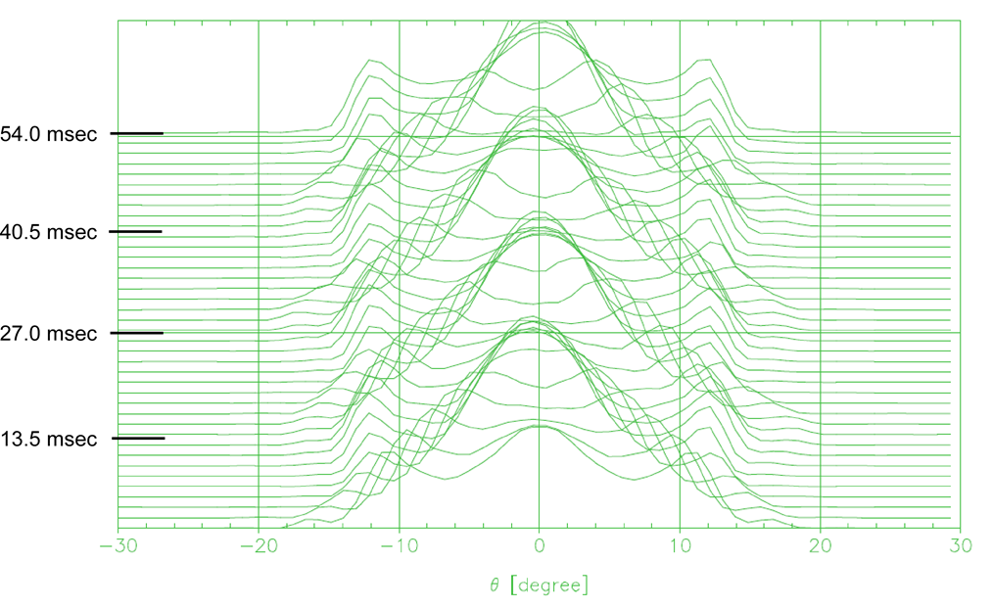
Delivery Ring Bunch Shape Variation in Time
The re-bunched beam from the Recycler is poorly matched to the 2.4 MHz RF bucket in the Delivery Ring. Thus, the beam tumbles in the bucket. The bunch shape changes at twice the synchrotron frequency (T_{synch} = 25.6 msec).
-94 ns
-47ns
47ns
94 ns
Waterfall display of the variation of the proton bunch time profile as the bunch rotates in the 2.4 MHz RF bucket. A trace is plotted every 1.35 msec over the course of the spill. The vertical axis is time relative to the start of the spill. The horizontal axis is Delivery Ring phase (1° = 4.708 nsec).

