Slide 1
Final design review for Accelerator Radiation Safety Improvements
Level 3
Overview presentation for review panel
A. Leveling
10/20/15

Slide 2
Outline
Purpose of the Final Design Review (FDR)
Charge questions
Notes on Preliminary Shielding Assessments (PSAs)
Muon Campus modes
Input for charge questions
  PSAs
    Changes since PSAs were approved
  Total Loss Monitor System
  Radiation Safety and Electrical Safety Interlocks
  ODH monitoring
  Friskers, Wallflowers, and Air Monitors
  In tunnel shielding
  MARS simulations

Slide 3
  Purpose of FDR (from Mu2e doc.db 5061-v2)
FDRs take place prior to the CD-3c review by DOE
“Final Design Reviews will be held when designs and drawings are 80-90% complete. The design is mature enough to be reviewed but it is still possible to make adjustments based on feedback. A Final Design Review provides assurance that the completed design will meet all functional and performance specifications as well as interface agreements.”
Review committees are required to include experts from outside of Mu2e

Slide 4
Charge questions
Is the scope of the Radiation Safety Improvements subproject adequate to meet the requirements of the Fermilab Radiological Controls Manual (FRCM)?
Is the design, fabrication, and implementation of the TLM systems for the AP1 to Delivery Ring, Delivery Ring, and M4 beam line technically sound and mature enough to be considered a final design? Are there any remaining issues that require attention prior to the fabrication and installation of TLM systems?
Is the design of the Electrical and Radiation Safety Systems for the Delivery Ring, M4 beam line, Production Solenoid Room, Transport Solenoid Room, and Detector Solenoid Room technically sound and mature enough to be considered a final design? Are there any remaining issues that require attention prior to the fabrication and installation of these systems?
Is the design of the ODH systems for the Production Solenoid, Transport Solenoid, and Detector Solenoid rooms technically sound and mature enough to be considered a final design?
Is the plan to deploy Friskers, Wallflowers, and Air Monitors technically sound and mature enough to be considered a final design?
Has the design of in-tunnel shielding systems been adequately reviewed? Can these designs be considered final designs?
MARS simulations have recently been completed for the Production Solenoid room shielding berm. Supplemental concrete and steel shielding masses have been included as a result of the latest simulations. Is the final simulation result compliant with the requirements of the FRCM? Was the final simulation completed using acceptable modeling techniques?
These charge questions were derived from the Mu2e Design Review Plan, which is posted on the review Indico site.

Slide 5
Regarding the Preliminary Shielding Assessments . . .
The Muon Campus PSA (Beams-doc-4513-v7) includes items that are not a part of the Mu2e project, and thus not within the scope of this review. For example:
  Delivery Ring Cleanup Abort: Delivery Ring AIP
  Diagnostic Absorber in M4 line: Beam line tunnel GPP
  M5 shield wall: Muon g-2 Project
  M4 Beam Line Penetrations to MC-1: Beam line tunnel GPP
These elements have been reviewed elsewhere, specifically in the muon campus PSA

Slide 6
Regarding the Preliminary Shielding Assessments . . .
Some significant changes have been made to the Mu2e target station after construction start
Technically, review of the changes could be put off until the Final Shielding Assessment process
These changes are the subject of recent MARS simulation updates and are the subject of charge question 7
  Mu2e Target Station Shielding
  Mu2e Target Station Surface water activation
  Mu2e Target Station Air Activation
  North wall shield

Slide 7
Muon campus modes

Slide 8
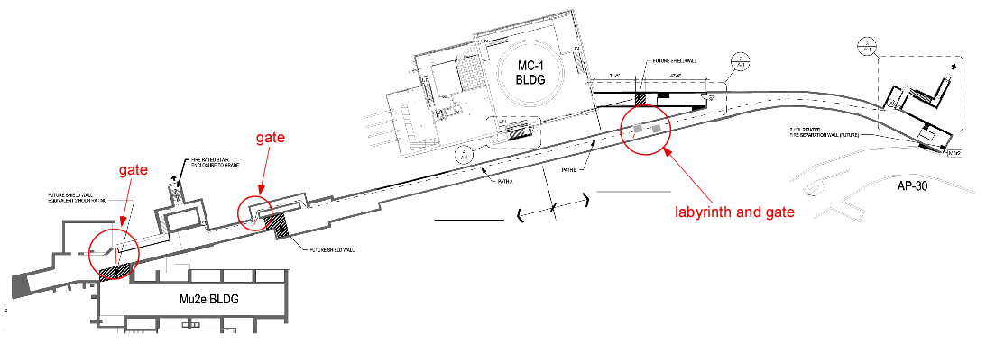
Muon Campus schematic - partial
Main
Beam
absorber
Extraction enclosure
Remote
handling room
M5 beam line
Drop hatch
bypass
M4 beam line
Diagnostic
Absorber
and shield wall
7’ step in floor
PS room
10/20/15

Slide 9
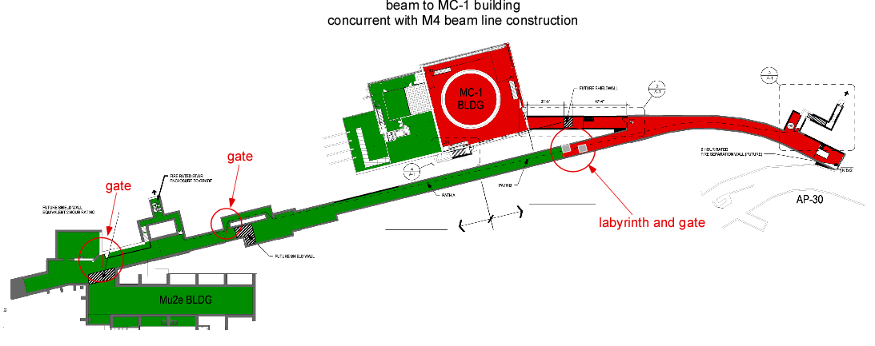
Beam to MC-1 with temporary labyrinth
Muon g-2 experiment run starts with M4 upstream labyrinth in position and interlocked gate forming the boundary of the extraction enclosure
M4 beam line is built in the section between the upstream labyrinth and the diagnostic absorber
Legend
No access
Access
Uncertain
Extraction enclosure

Slide 10
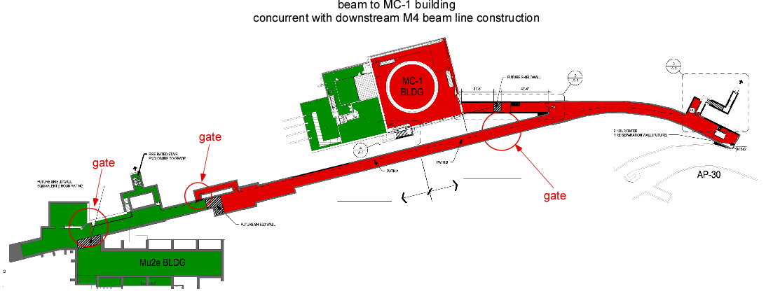
Beam to MC-1 building after labyrinth removal
Activate both M4 beam line ESS and RSS
Move M4 upstream labyrinth concrete to diagnostic absorber
With upstream M4 line RSS and ESS made up, continue to run muon g-2
Legend
No access
Access
Uncertain

Slide 11
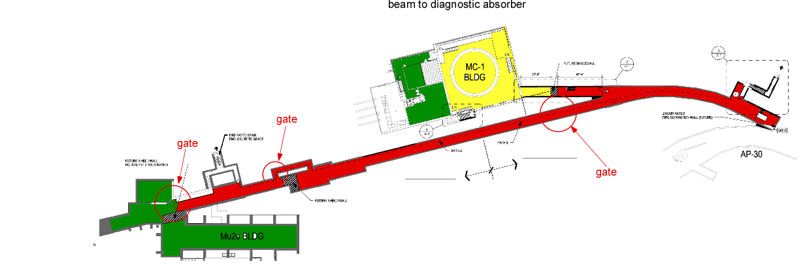
Beam to Diagnostic Absorber
With downstream M4 line ESS and RSS made up, occasionally take beam to diagnostic absorber during muon g-2 down periods.
Solenoid Room work continues without interruption
Legend
No access
Access
Uncertain

Slide 12
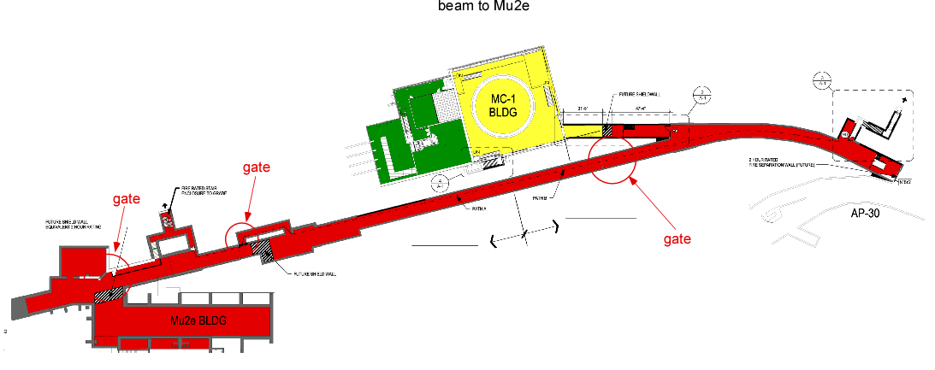
Beam to Mu2e
Legend
No access
Access
Uncertain

Slide 13
Input for Charge question 1
Preliminary Shielding Assessments are required by FRCM prior to going out for bids for construction on new accelerator/beam line projects
Two construction phases
  Muon campus - PSA is at Beams doc.db 4513-v7
    Reviewed and approved by Accelerator RSO & staff
      Documented at Mu2e doc.db 4313-v1
  Mu2e Experimental Area - PSA is at Beams doc.db 4611-v2
    Reviewed and approved by Accelerator RSO & staff
      Documented at Mu2e doc.db 4313-v1
In early shielding assessment work, it became clear that interlocked radiation detectors would be necessary for the muon campus
  Directorate approval required to use interlocked detectors in lieu of passive shielding
    Approval was obtained - Mu2e Document 3823-v1

Slide 14
Input for Charge question 1
Some additional evaluations not included in the PSAs
  MC1 to M4 beam line penetration calculations
    Mu2e doc 3831-v1
  Radiation Shielding Evaluation of the M4 Beam Line Drop Hatch
    Mu2e doc 3806-v1
  Dose attenuation calculation for M4 beam line cable penetrations to Mu2e Detector Hall
    Mu2e doc 2571-v2
Recent MARS simulations (discussed below) provide revised/expanded coverage of some PSA topics

Slide 15
Input for Charge question 2
TLMs
  Level 3 scope includes:
    AP1 to Delivery Ring
    Delivery Ring
    M4 beam line
  Final approval of TLM systems was granted by ESH&Q Section June 5, 2015 (Mu2e doc.db 4132-v2)
  A full implementation of 8 permanent systems has been installed in the Booster
  Data collection for normal operations and for over 200 accident scenarios has been collected at the Booster (Beams doc.db 4914-v1)
  A Booster shielding assessment remains to be completed
  We have realized the full design, construction, and implementation of TLM systems in an off-project venue
  The implementation of TLM systems is described in the muon campus PSA

Slide 16
Input for Charge question 3
Interlock systems
  FDR scope includes:
    M4 beam line
    Mu2e Production Solenoid Room (aka target hall)
    Mu2e Transport Solenoid Room
    Mu2e Detector Solenoid Room
    Extinction Room
    Detector Hall
Work remaining to complete interlock systems final design:
  Interlock plan is based upon earlier conception drawings
  We will meet with the integration team leader to review various safety system boundaries using current construction drawings
  A new subdivision of the M4 beam line will be created to permit Muon g-2 operation while accessing the remote handling room
    Requires additional ESS RMMS module
  Team center drawings will be updated to indicate these changes
  Change request for this additional scope will be initiated

Slide 17
Input for Charge question 3
Some post CD-3c AD Operations/AD ES&H decisions may remain:
  Will the PS Room be controlled
    with interlock key access, or
    by RSO lock and key access ala pbar target vault, beam enclosure drop hatches, NuMI target vault, NO1 target train, etc.?
    Search and secure of the PS room by operations will be impractical after beam operation begins
  Search and secure procedures for all areas
    to be developed after the final equipment and shield configurations are established
The resolution of these issues is not required to complete the final design

Slide 18
Input for Charge question 4
  ODH monitoring systems
    The ODH systems cost estimate is based upon ODH monitoring systems for similar room sizes
    There is no technical design analysis for ODH systems at this time
    Recently, we learned Particle Physics Division has been working independently on ODH monitoring systems for the Transport Solenoid and Detector Solenoid areas
    The delineation of responsibility for ODH monitoring systems across the 3 rooms remains to be clearly defined
    The role of ODH monitoring systems requires integration with ODH fan and control systems
    A dialog between AD and PPD ODH monitoring system experts has started

Slide 19
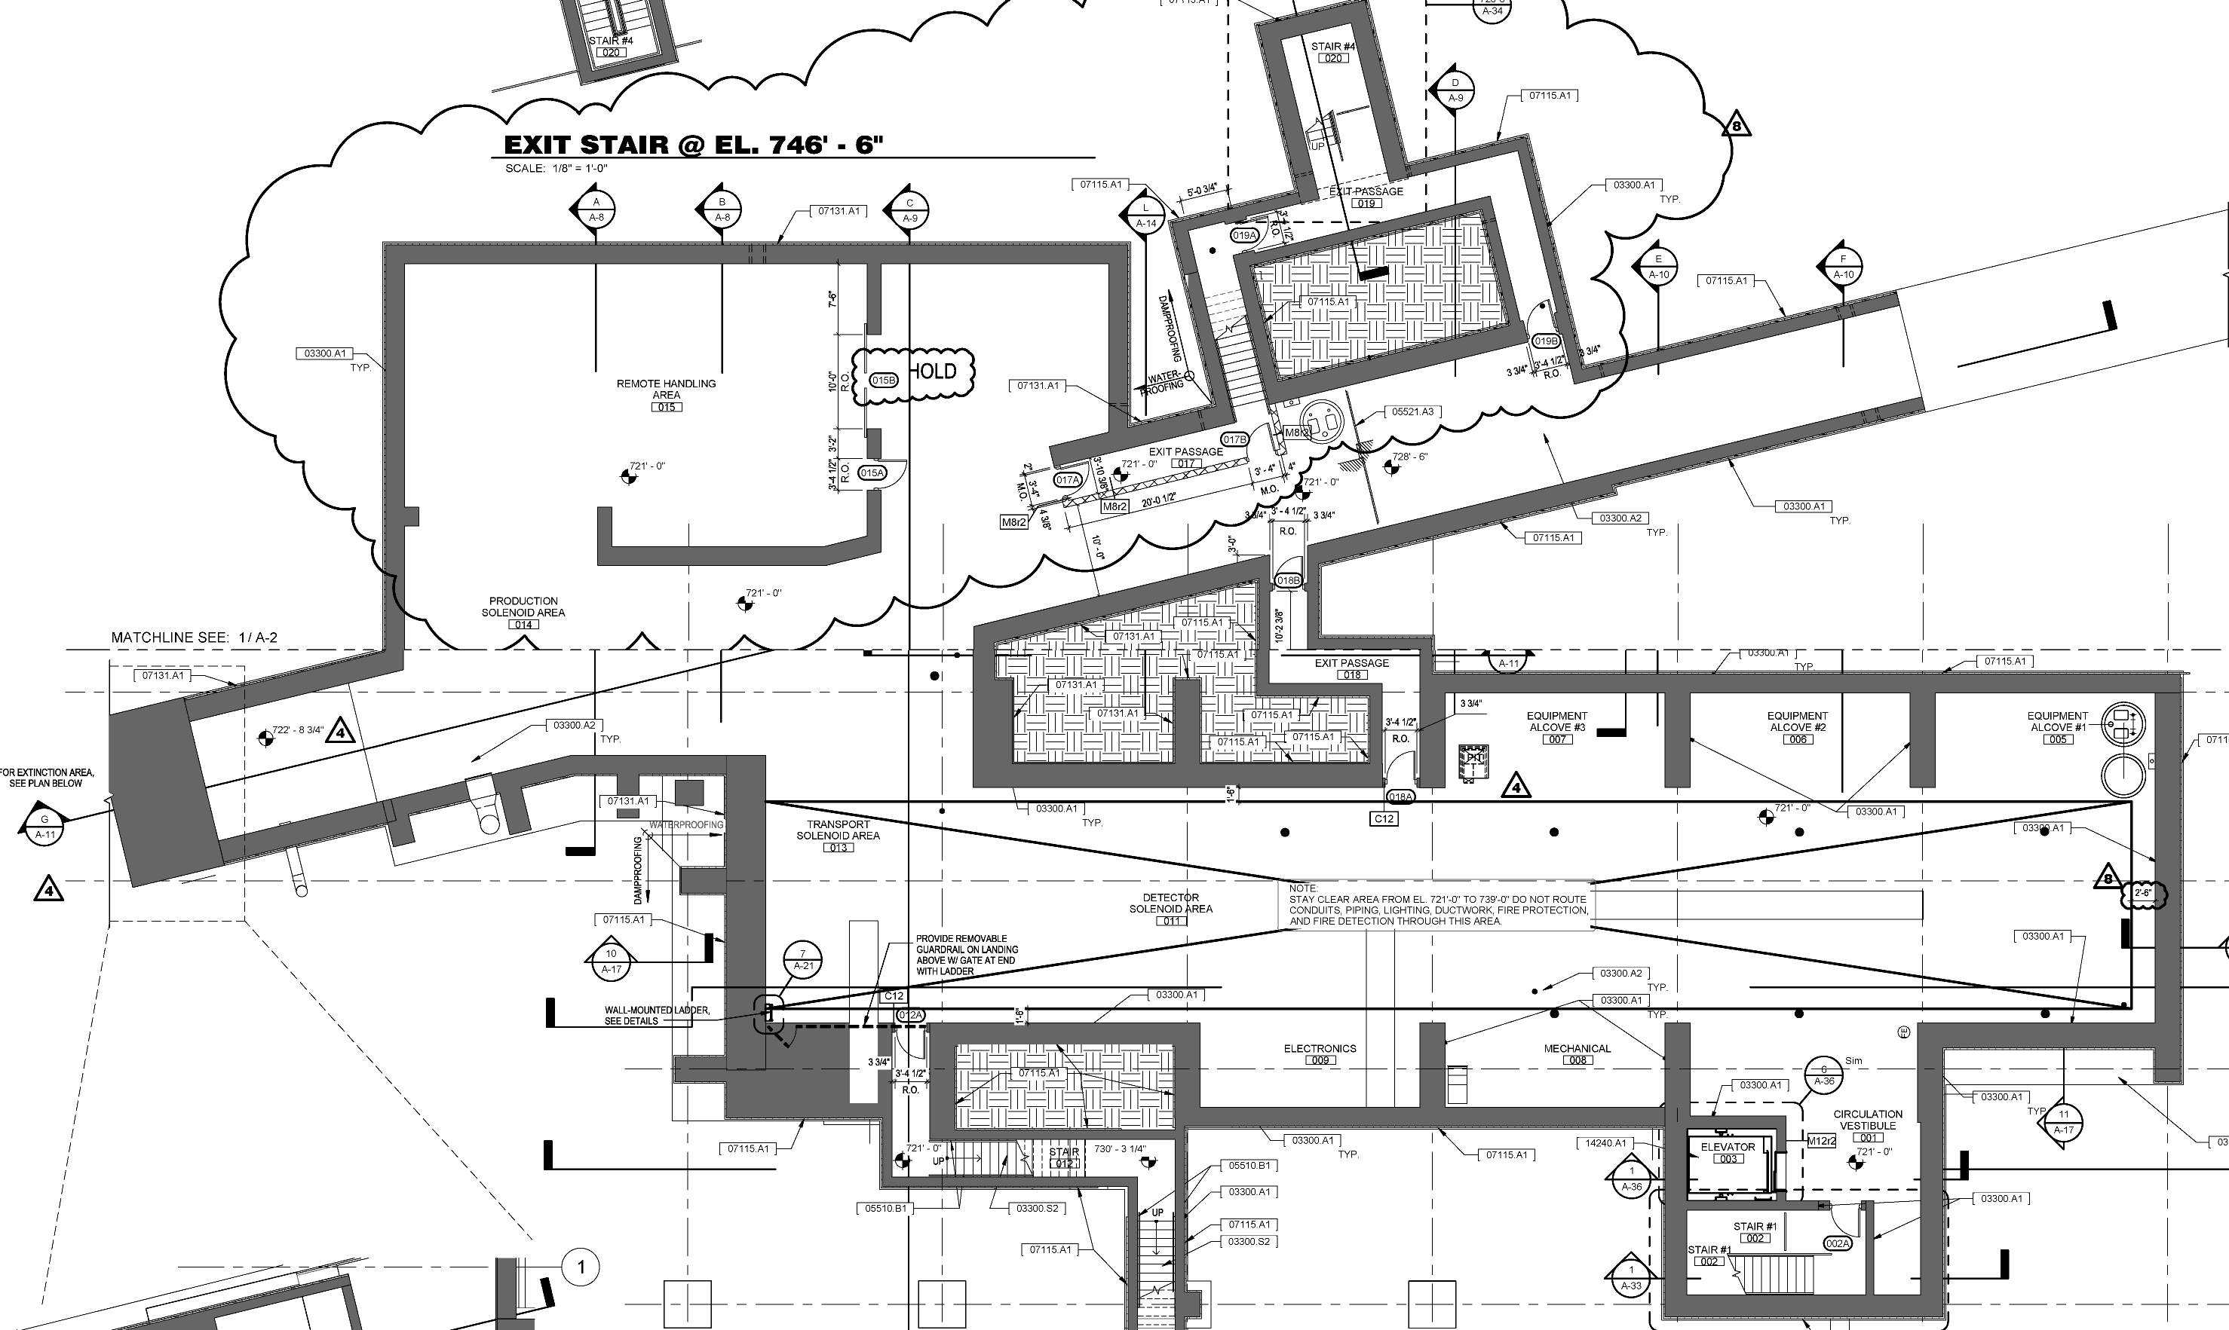
Input for Charge question 4
ODH Sources
Production Solenoid
Transport Solenoid
Detector Solenoid
Cryo vacuum pumps
Others?
ODH Scenarios
Construction
Installation
Cooldown
Field mapping
HRS installation
Detector shielding installation
Final installation
Operation
ODH issues
Determination of ODH classification
PPE for personnel access
ODH exhaust fan enabling/disabling and transition between beam on/beam off
Location, lifetime, and type of ODH monitors wrt beam shower
Is the ODH fan permanently disabled once access to the PS room is no longer possible?

Slide 20
Input for Charge question 5 – Friskers, Wallflowers, Air Monitors
Friskers, Wallflowers, and an Air Monitor deployment and Exit Stairway Locations
We have planned for electric power to be installed at indicated monitor locations
See Mu2e doc.db 3730-v6 for details
exit stairway locations | Frisker | Wallflower
Delivery Ring Extraction Enclosure Emergency Exit | 0 | 0
M4 line exit (near drop hatch) | 1 | 1
Extinction Enclosure Exit | 0 | 0
Exit Stariway near Transport Solenoid | 0 | 0
Detector Hall Exit Stairway | 1 | 1
Air monitor locations | Air Monitor
Extraction Enclosure Air Exhaust Stack | 1

Slide 21
Input for Charge question 6
In tunnel shielding at 3 locations:
  AP30 extraction region
    Supplemental shielding required at the slow resonant extraction region during Mu2e operation
      Reduces effective dose rate in the AP30 service building
      Minimizes effective dose rate due to skyshine
  M4 line upstream shield wall
  Temporary shield wall to be installed near the upstream end of the M4 beam line enclosure during the first Muon g-2 run
    Permits construction of the M4 beam line during Muon g-2 operation
  M4 line shield wall at Diagnostic Absorber
    The M4 line upstream labyrinth concrete is to be relocated to the vicinity of the diagnostic absorber
    Permits 6 W single turn and 170 W resonantly extracted beam to diagnostic absorber during PS, TS, DS construction activities

Slide 22
Input for Charge question 6 - AP30 extraction region
MARS simulation described in Mu2e doc 3719-v2 and 3719-v3
Simulation results reported in the Muon Campus PSA
  Beams doc.db 4513-v7
Muon Campus PSA was reviewed and approved
  Mu2e doc.db 4313-v1
Material for the mechanical design and review of AP30 in tunnel shield are found at Mu2e doc6152-v1:
  Final Design & Proposed Installation Plan.pdf
    Reviewed by AD MSD:
      MSD Engineering Review Closeout Letter.pdf
    Reviewed by FESS:
      ADMSD14-001 FESS Review.pdf

Slide 23
Input for Charge question 6 - AP30 extraction region

Slide 24
Input for Charge question 6 - AP30 extraction region
One caveat on the MARS simulation:
  The MARS simulation was done for an earlier inside-out extraction scheme
  The extraction system design has changed to outside-in
  The extraction septa (2) lengths have changed
  C magnet, quad, and Lambertson magnet designs have changed
We will repeat the simulation when the extraction design is finalized
We expect no significant change in performance of this shield
The new simulation result would be reported in the Final SA

Slide 25
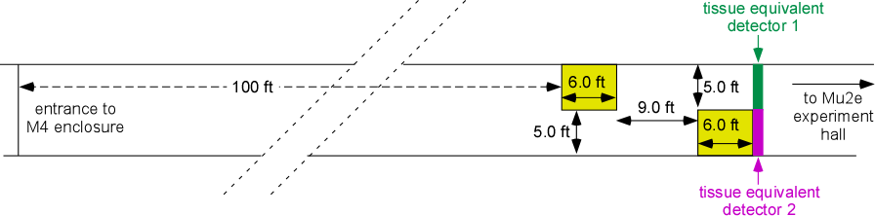
Input for Charge question 6 - M4 line shield wall
M4 line upstream shield wall is considered in:
  The Muon g-2 PSA (GM2 doc 403-v2)
  MARS simulation was reported in GM2-doc 624-v2
  Muon g-2 PSA was reviewed and approved by AD ES&H
  (GM2 doc 403-v2)

Slide 26
  Input for Charge question 6 - M4 line shield wall at Diagnostic Absorber
M4 line shield wall at Diagnostic Absorber
  MARS simulation is described in detail in Mu2e doc 3308-v3
Simulation results reported in the Muon Campus PSA
  Beams doc.db 4513-v7
Muon Campus PSA was reviewed and approved
  Mu2e doc.db 4313-v1

Slide 27
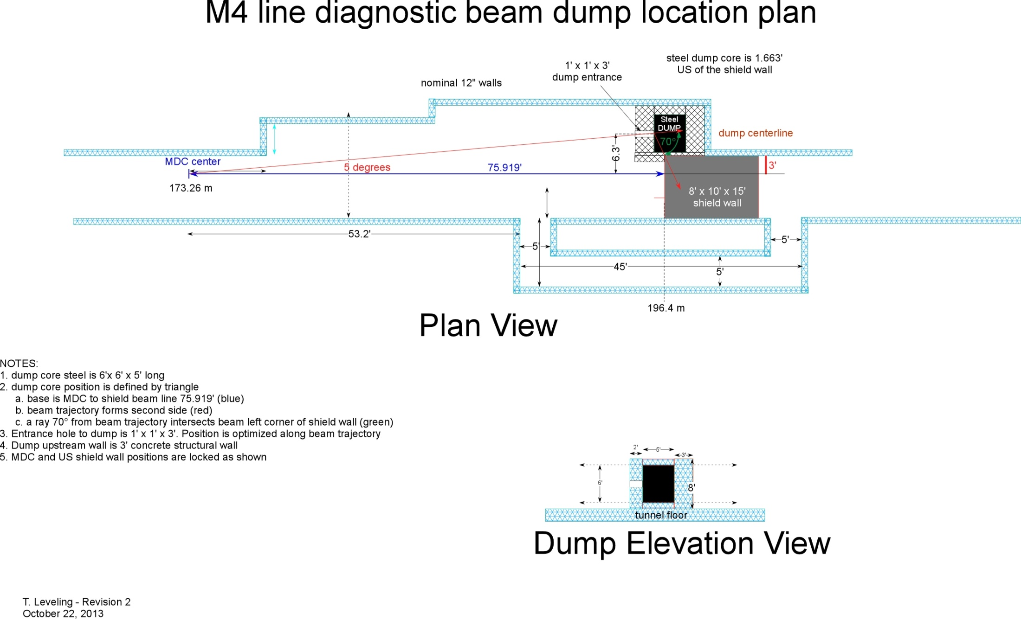
Input for Charge question 6 - M4 line shield wall at Diagnostic Absorber
The shield wall to be built within Radiation Safety Improvements scope

Slide 28
MARS Simulations
A set of MARS simulations was conducted in CY 2015 to answer questions related to target handling and associated radiological issues (Mu2e doc 5746-v3)
  Several of the simulation results and subsequent analysis triggered additional simulations and corrective actions on these topics:
    Surface water activation downstream of the Production Solenoid
    Prompt effective dose rate at north wall
    Prompt effective dose rate on shielding berm
    Air activation in the target hall due to beam operation

Slide 29
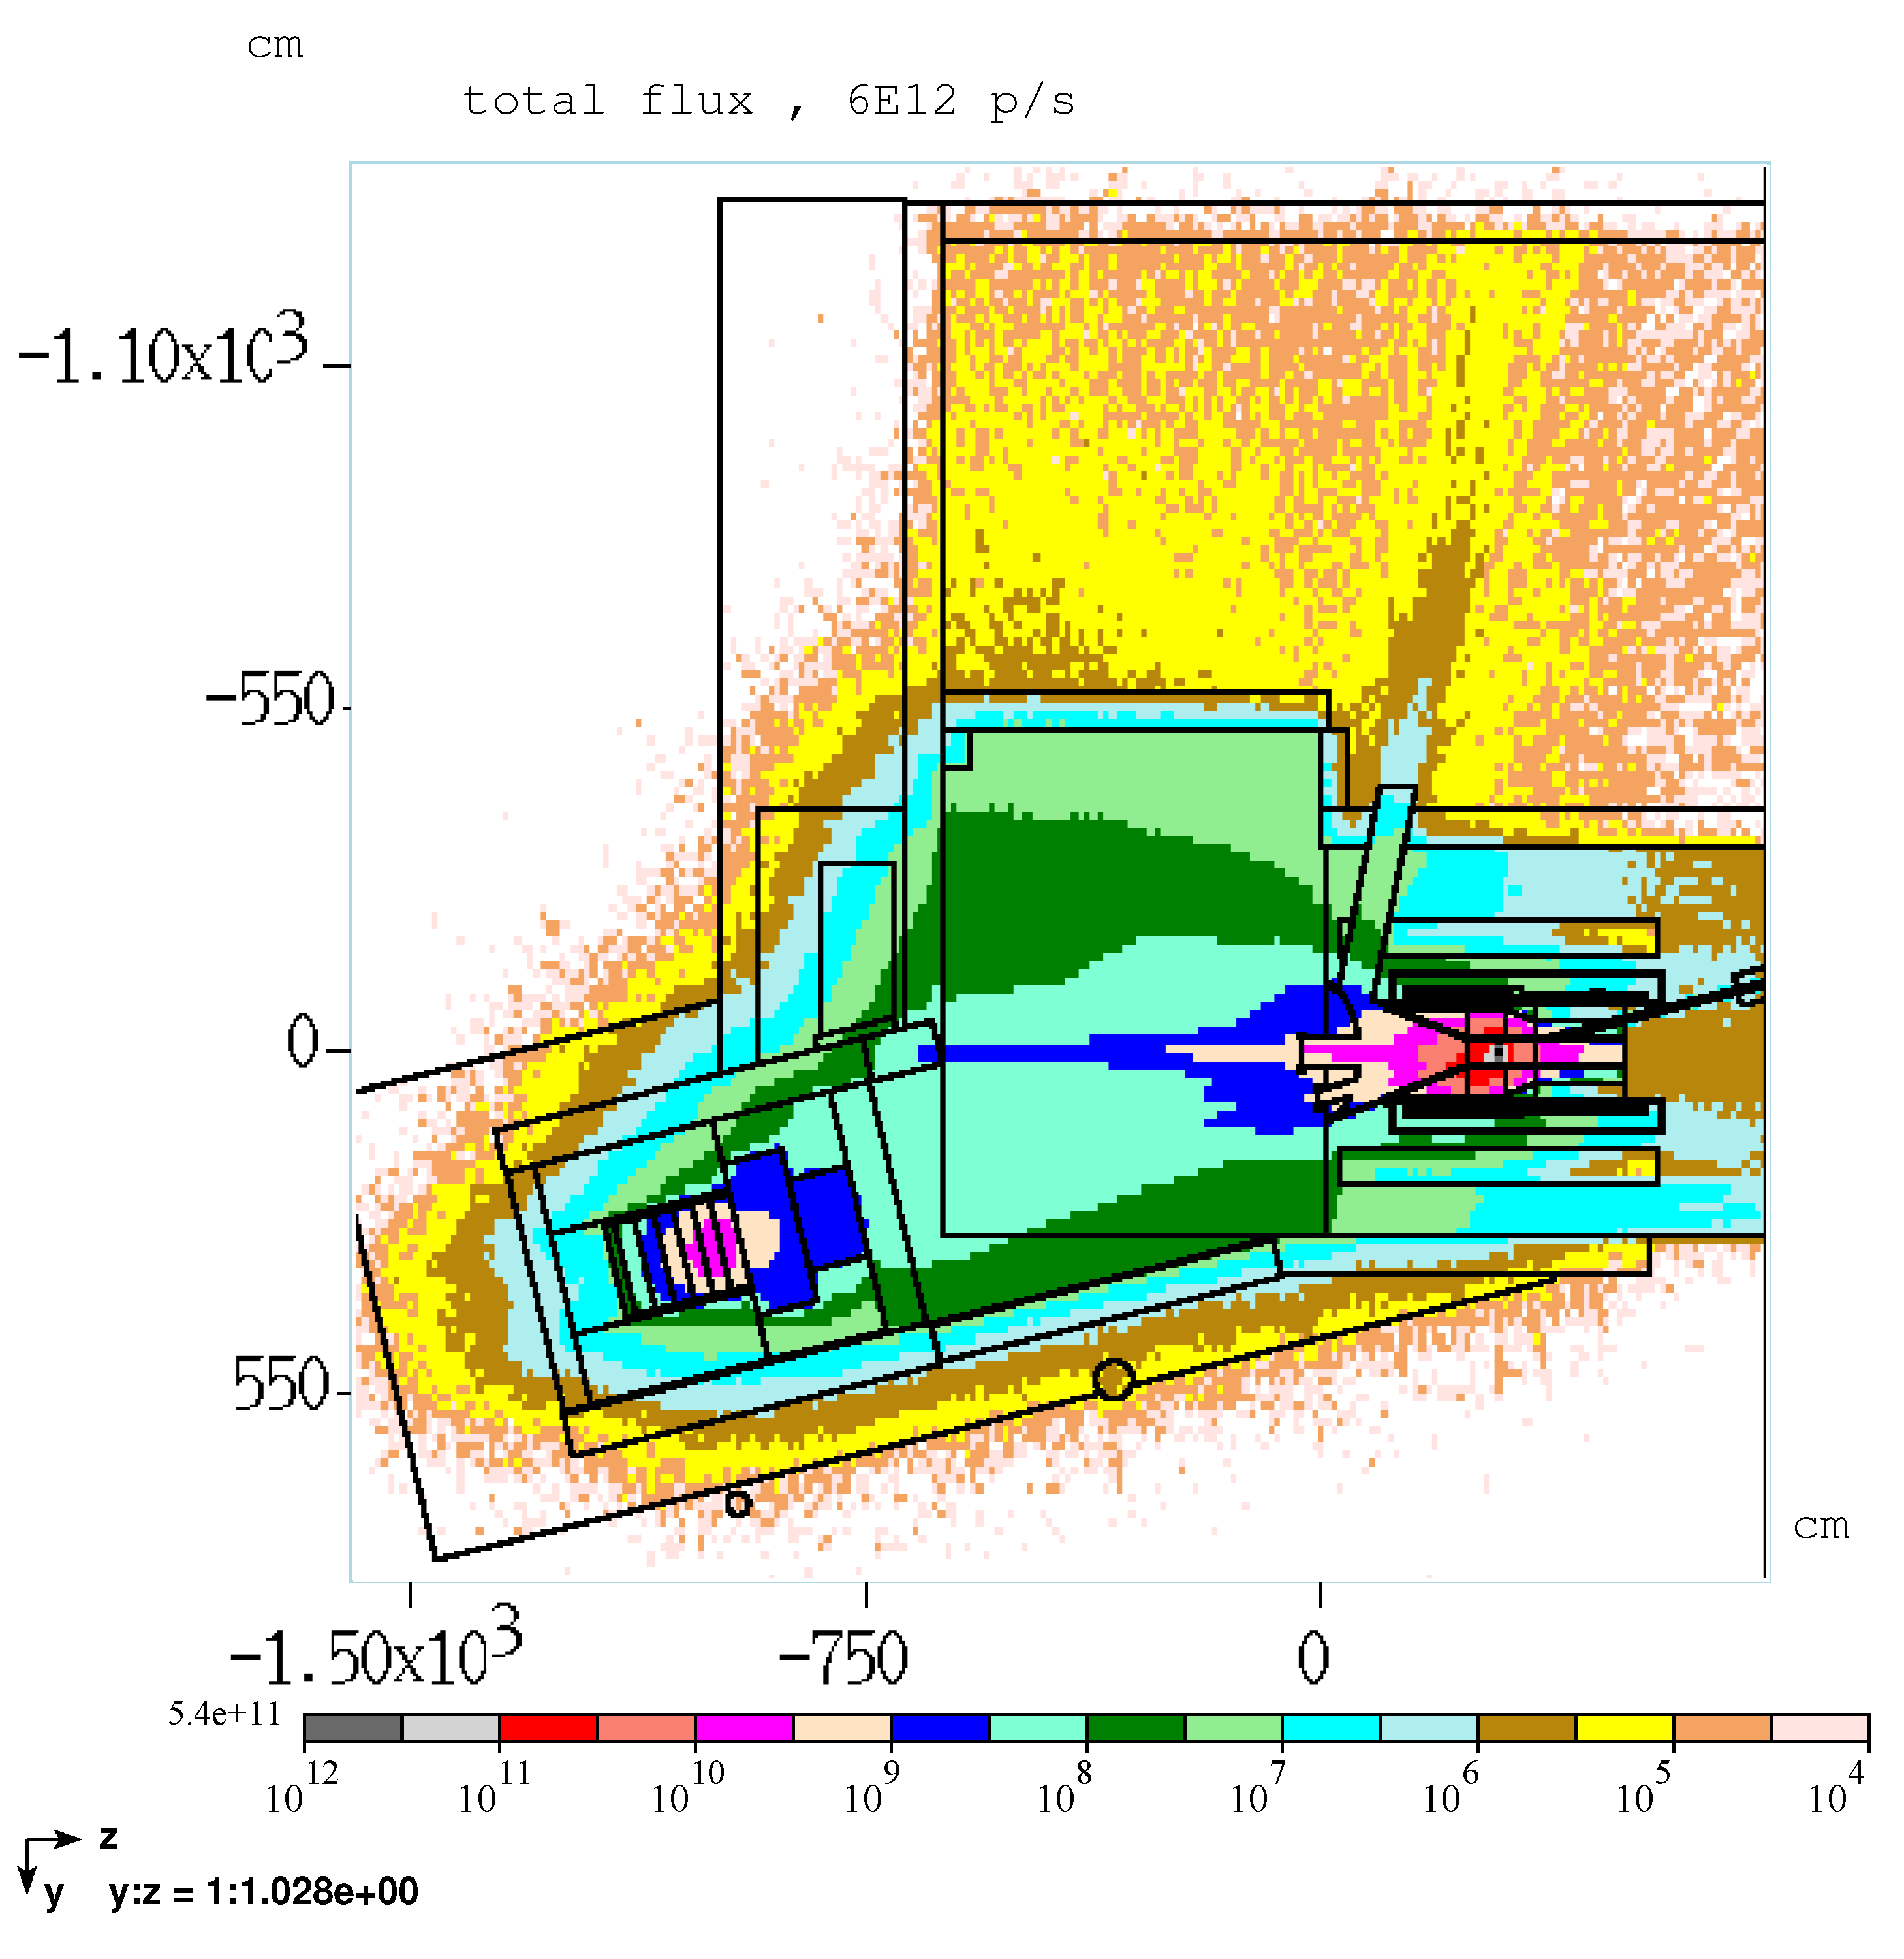
    MARS Simulations - Surface water activation downstream of the Production Solenoid
Indicated secondary flux appeared to contribute to prompt effective dose rate on berm surface (discussed below)
Surface water and groundwater activation were then scrutinized
  Independent simulations indicated groundwater was OK but surface water activation was significant
  A concrete monolith was designed and constructed to prevent surface bound water movement through the activating flux in the region of concern
Concrete monolith

Slide 30
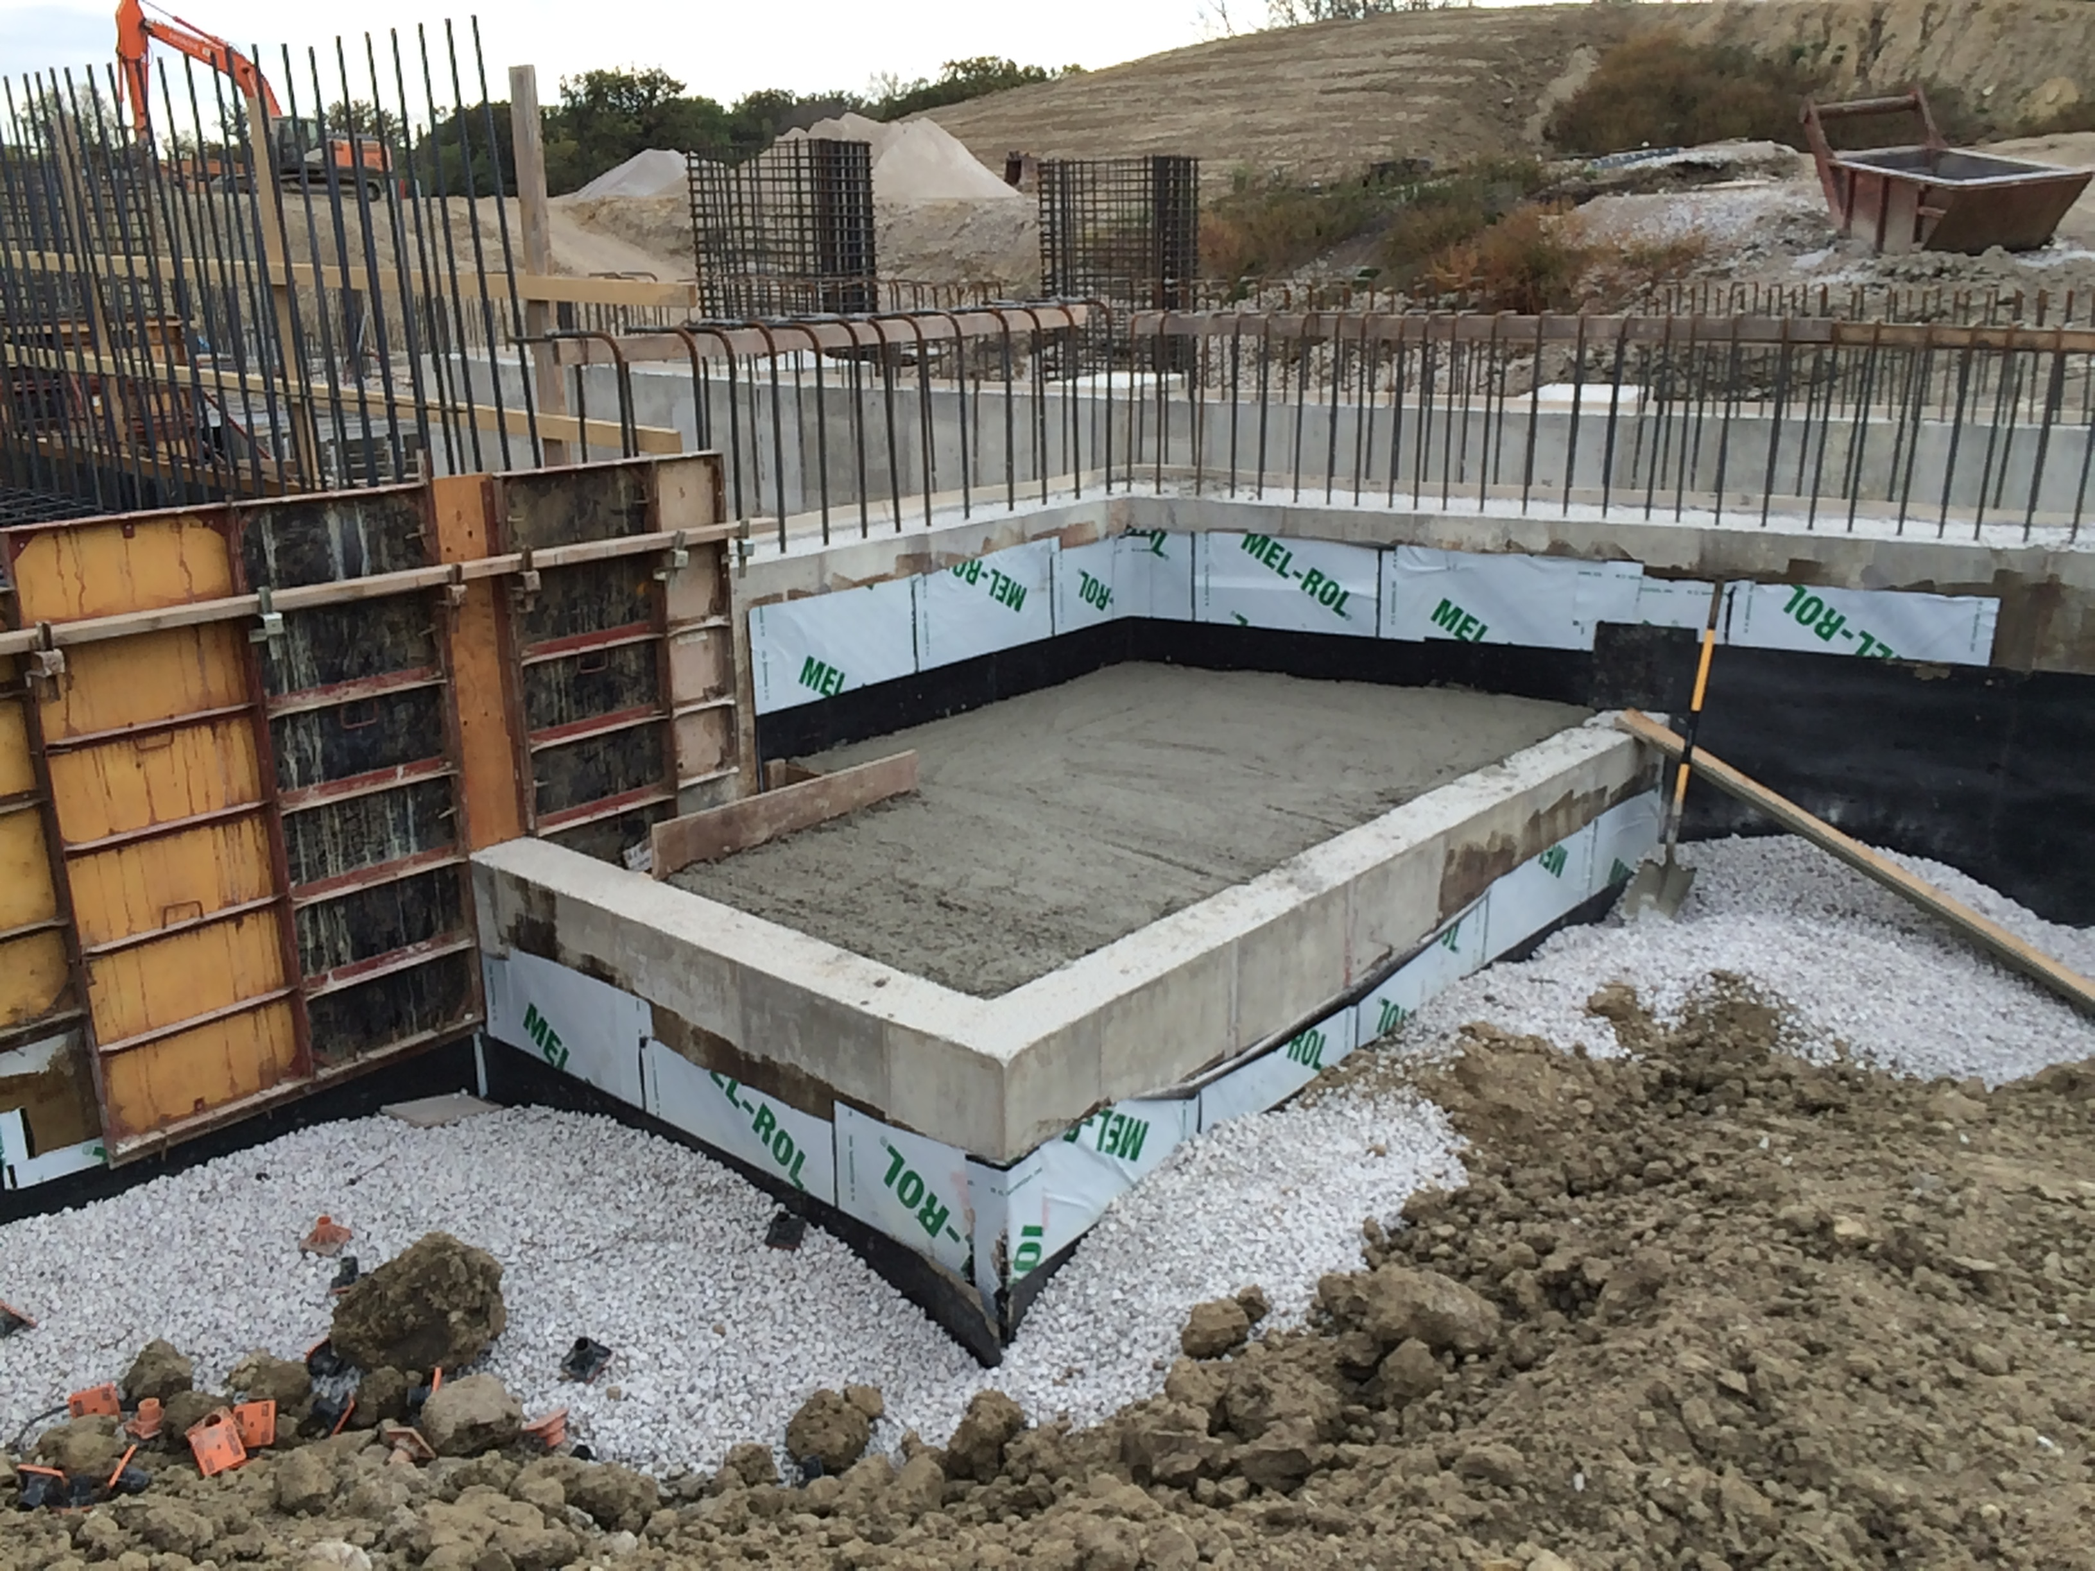
MARS Simulations - Surface water activation downstream of the Production Solenoid

Slide 31
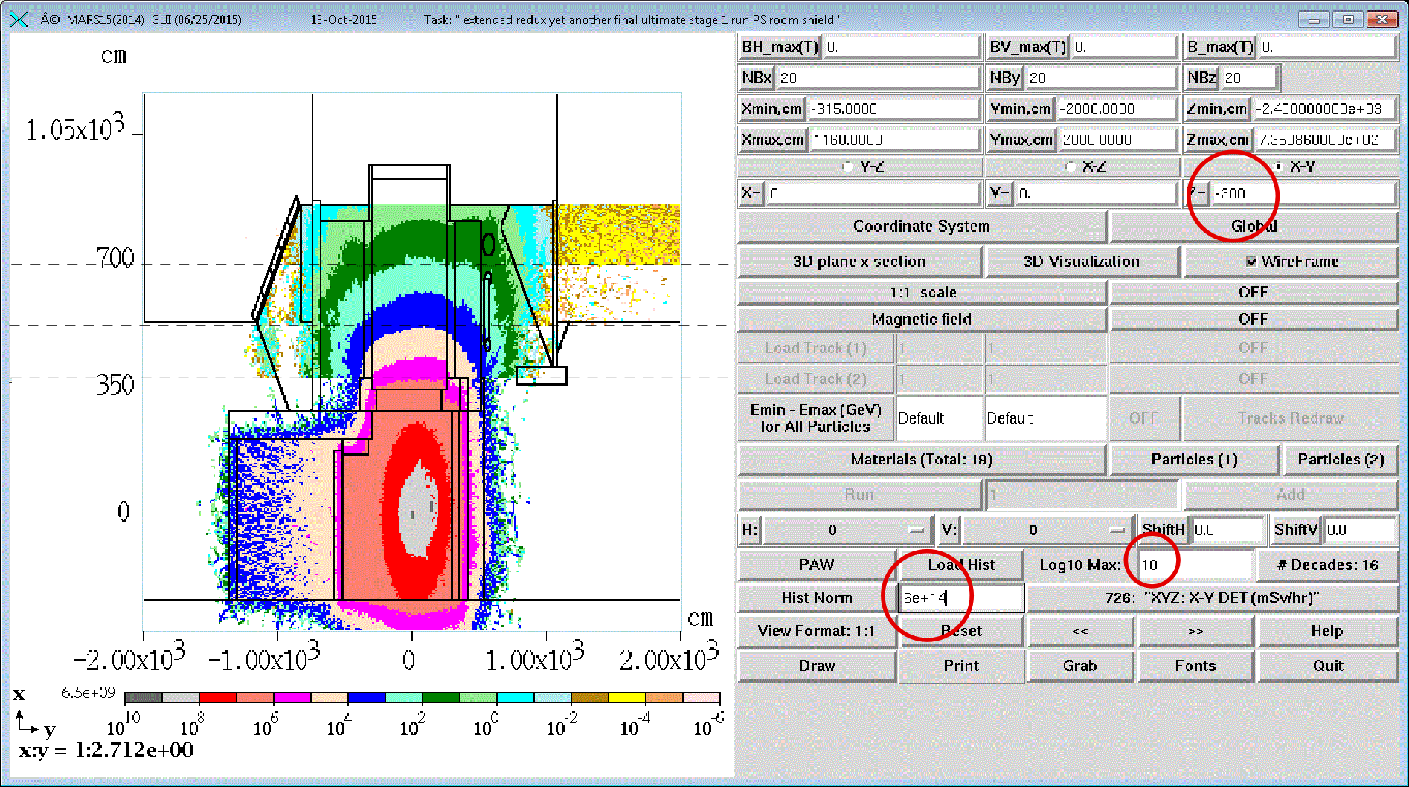
MARS Simulations – North Wall Prompt Rates, z=-300cm
proposed supplemental earth shield
mrem/hr
Up
Stage 4
N
Stage 3
Stage 2
Stage 1

Slide 32
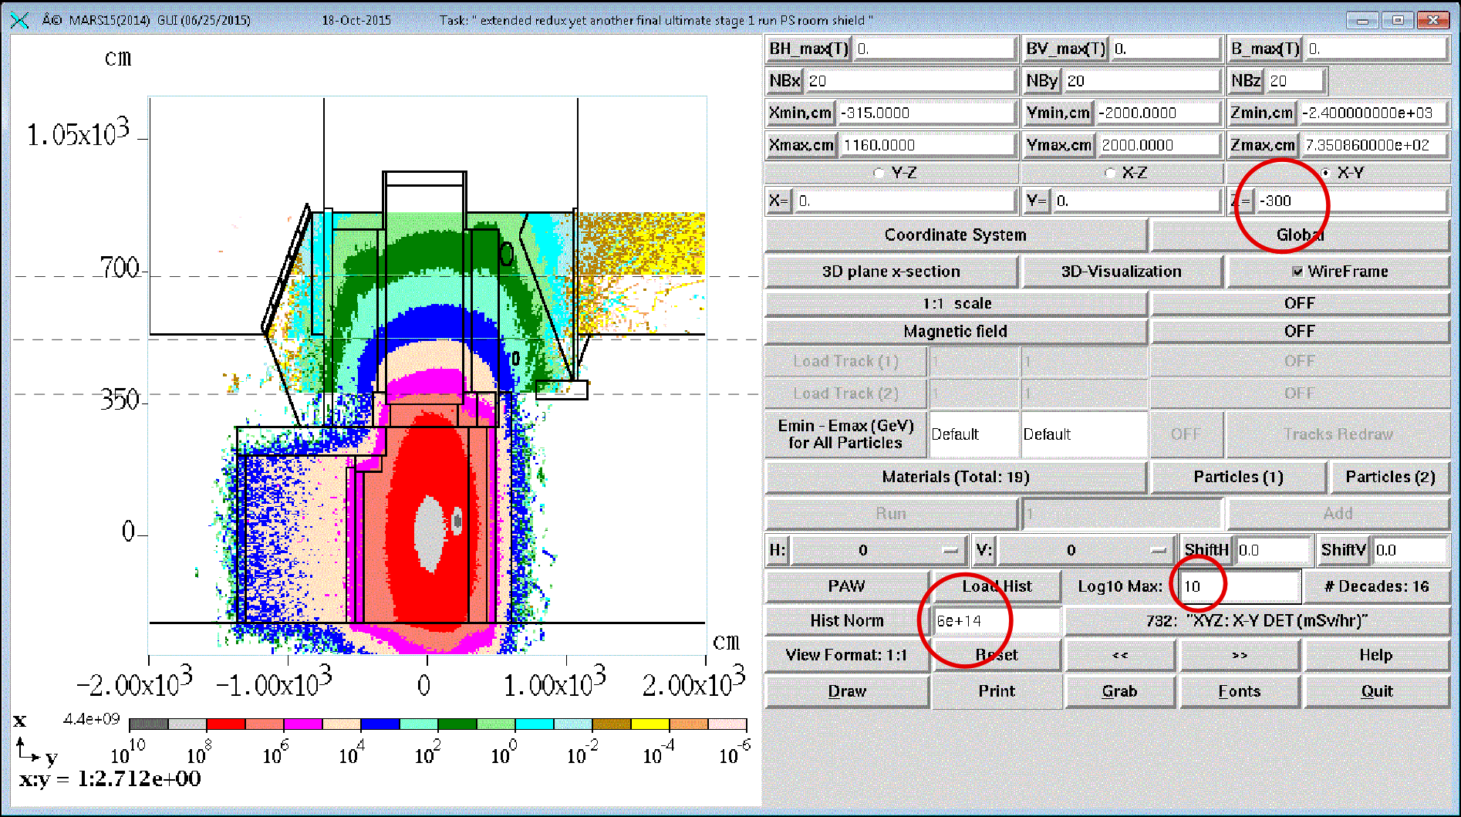
MARS Simulations – North Wall Prompt Rates, z=-600cm
proposed supplemental earth shield
mrem/hr
Up
Stage 4
N
-6
Stage 3
Stage 2
Stage 1

Slide 33
MARS Simulations – North Wall Prompt Rates
Prompt effective dose rate at the north wall appear in the range of 1 to 4 mrem/hr
FESS has suggested a shielding berm could be added
The berm could be installed after mobile crane footprint area is no longer required
This would be added after project completion

Slide 34
MARS Simulations – Shielding Berm Prompt Rates
Prompt dose rates were reported in the Mu2e Experimental Area PSA at 50 mrem/hr
Since the Mu2e Experimental Area PSA was written, numerous changes to the facility were made, e.g.,
  RHR enlarged
  Shielding steel was added over the beam absorber
    Also, considered backfill density in MARS simulations is greater than actual backfill used for backfilling around tunnel structures
      This would lead to under estimation of prompt rates by factor of 2
We noted the FRCM design criteria for new facilities is < 5 mrem/hr
Some effort was made to understand the source term leading to higher than desired prompt effective dose rates and to make a correction
Shielding steel is ultimately being placed in the excavation to supplement earth berm shielding

Slide 35
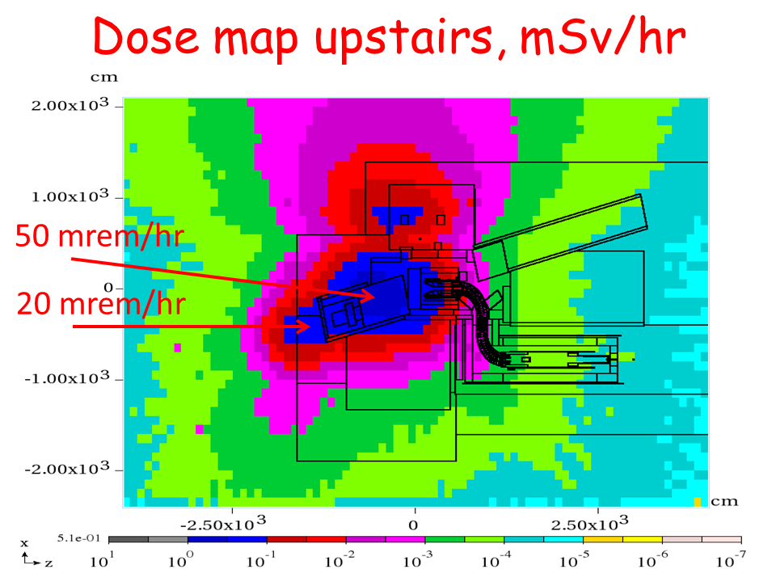
MARS Simulations – Shielding Berm Prompt Rates
(As reported in the PSA)
From Mu2e Experimental Area PSA
- V. Pronskikh
- Y. Eidelman
Backfill in this model was a mixture of soil and concrete
Shielding has been improved since PSA submittal. Dose rates are presently approximately an order of magnitude lower.
Plan view
N

Slide 36
MARS Simulations – field measurement of backfill density
Nominal density of soil backfill in MARS simulations is 1.9 g/cc
We determined density of CA7 backfill is 1.64 g/cc
Latest MARS simulations consider approximate backfill volumes using CA7
Factor of 2x increase in prompt rates at berm surface as a result of this consideration
5 gallon pail of | gross lb | net lb | gm | volume cm³ | density
empty pail - tare | 2.2 | 0 | 0.0 |  | -
ca6 - compacted | 75.3 | 73.1 | 33227.3 |  | 1.94
ca7 - compacted | 63.7 | 61.5 | 27954.5 |  | 1.64
ca7 - compacted with water | 80.8 | 78.6 | 35727.3 |  | -
pail of water | 39.8 | 37.6 | 17090.9 | 17090.9 | 1.0

Slide 37
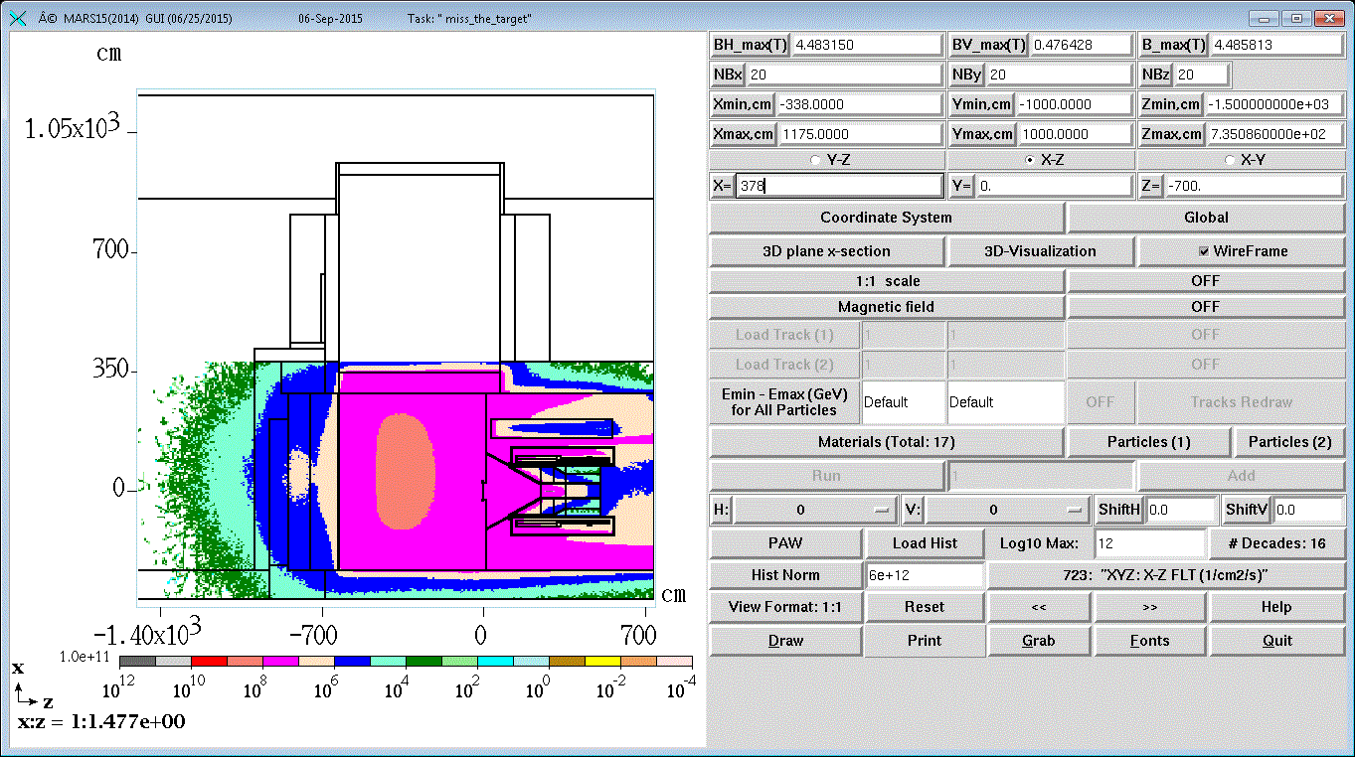
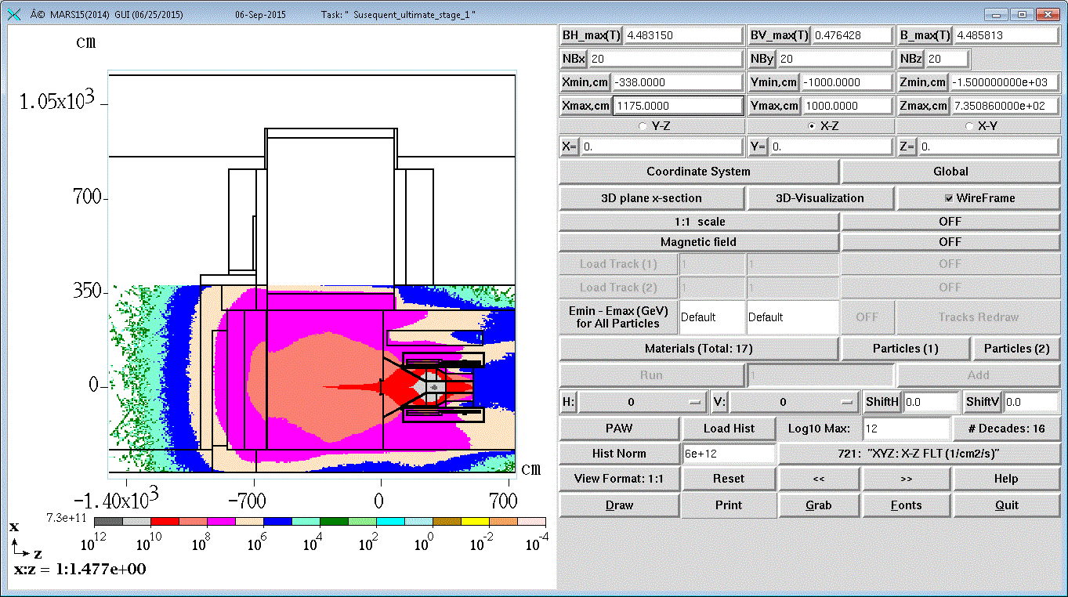
Elevation view – total flux at y = 0 cm
Beam on target
Beam misses target
Up
W

Slide 38
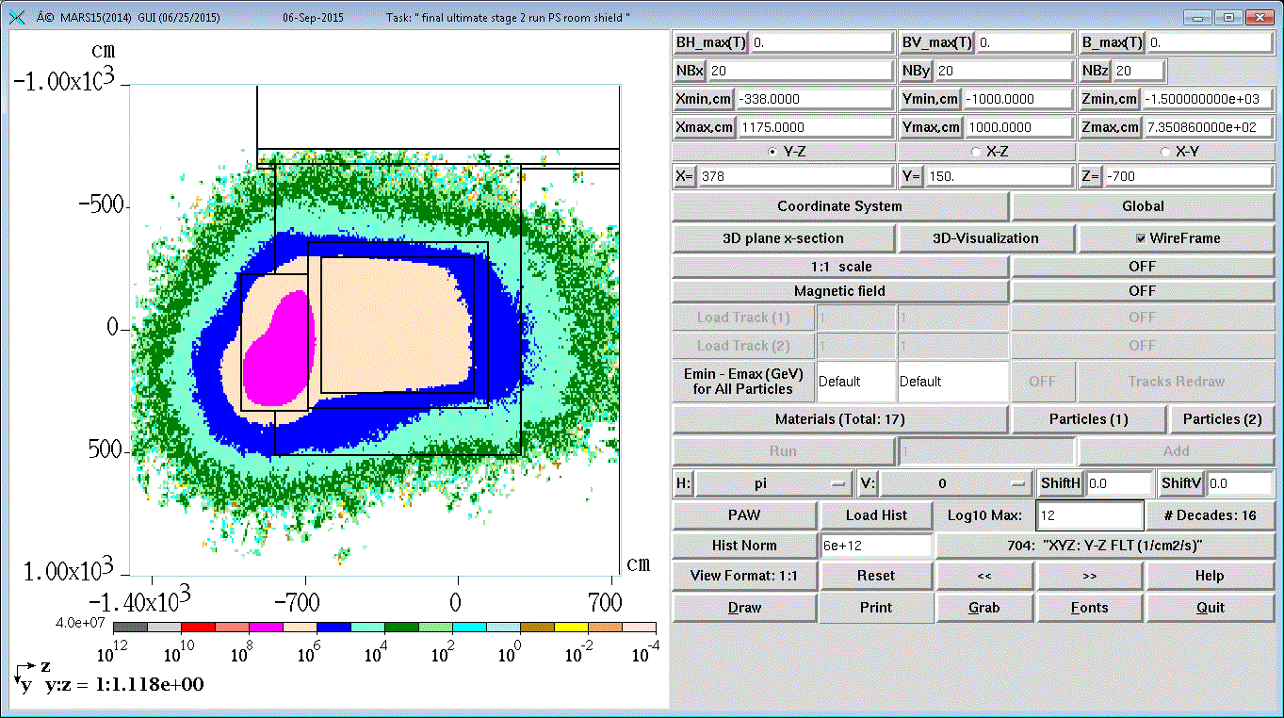
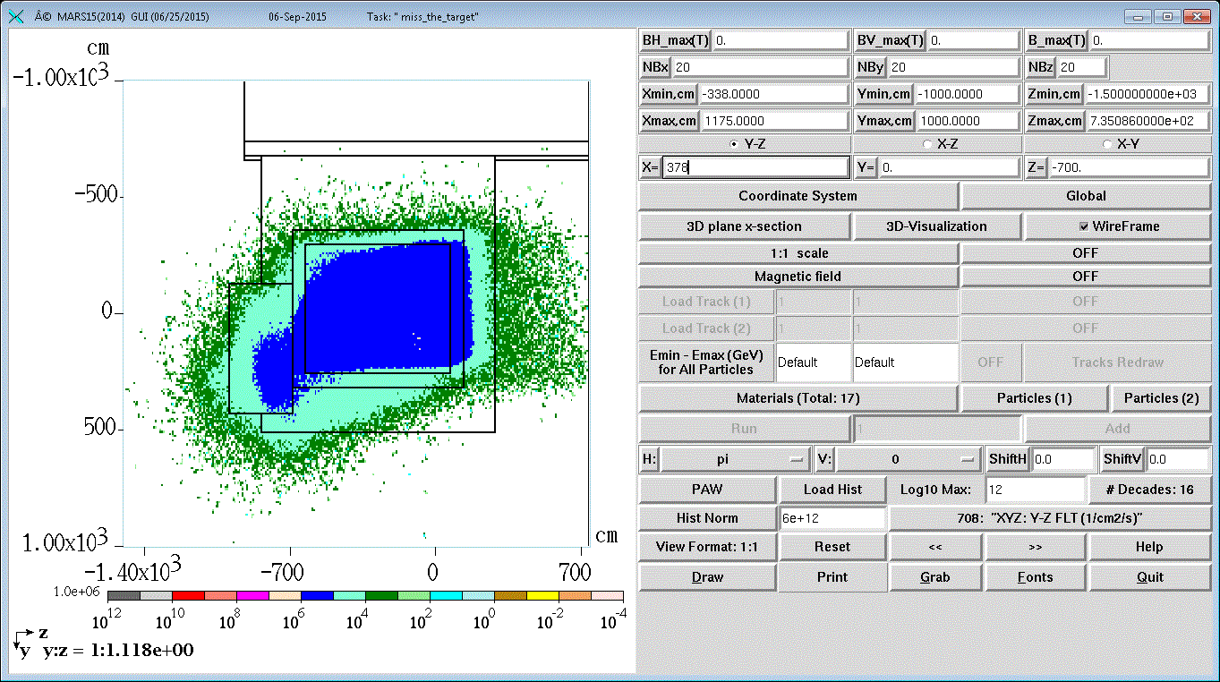
Plan view top of PS ceiling concrete – total flux at 378 cm
N
Beam on target
Beam misses target
W

Slide 39
Supplemental steel shielding
This shielding steel has been located and is being prepared for installation
  2/3 of plates have been cut
  Drilling and tapping holes for lifting fixtures
  Painting

Slide 40
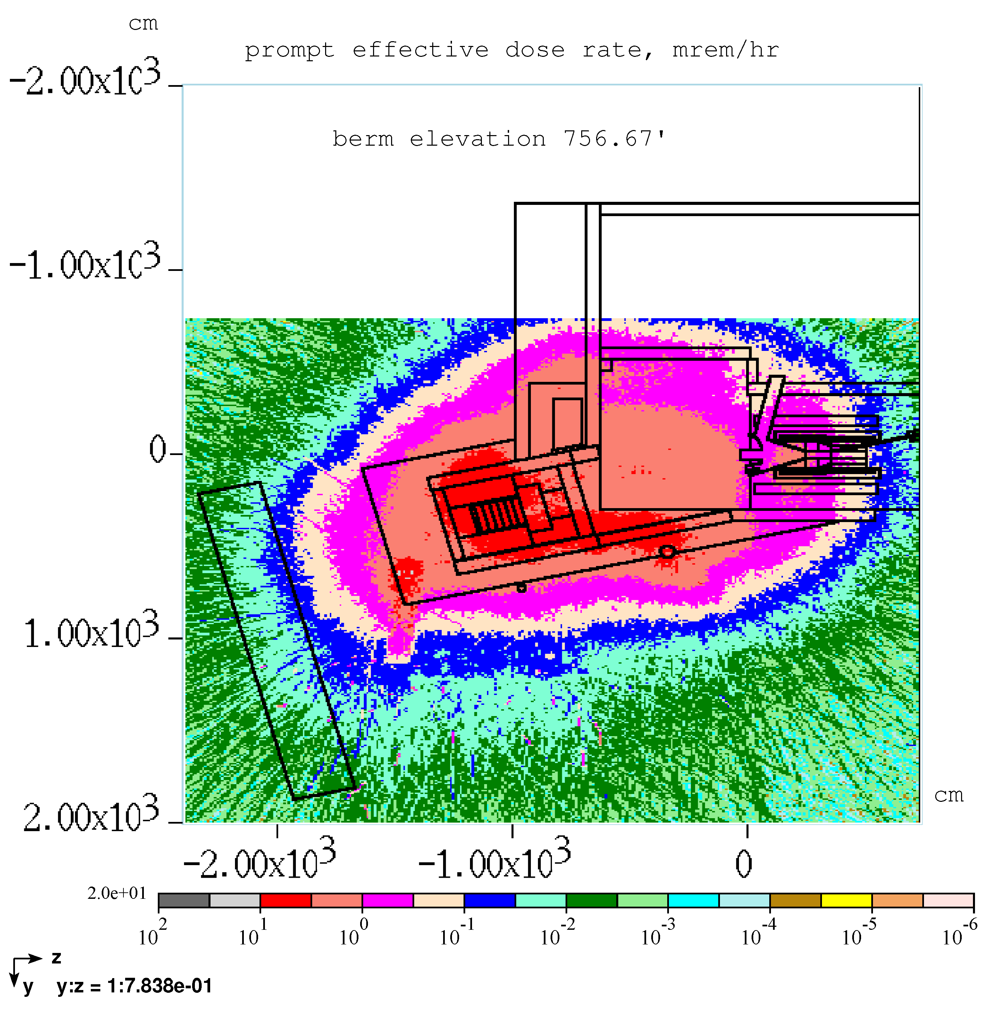
MARS Simulations – Shielding Berm Prompt Rates
Wireframe is shown at PS centerline
Plan view
N

Slide 41
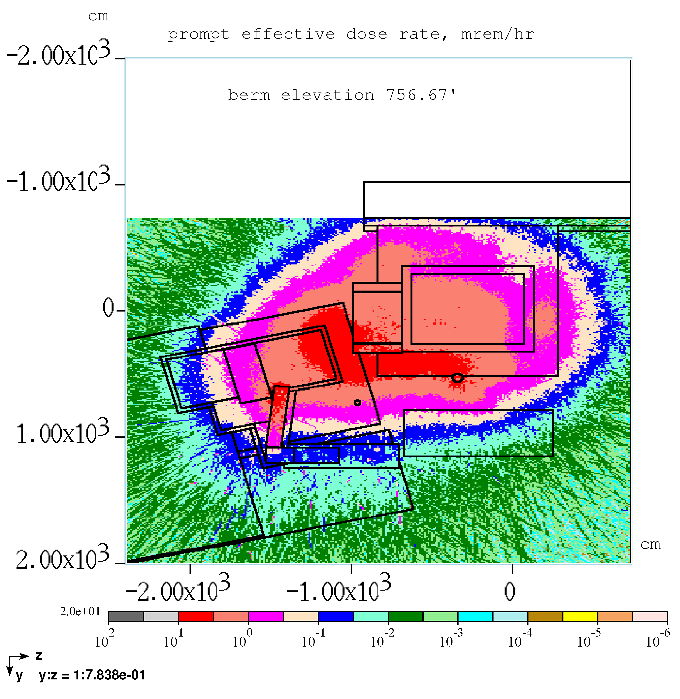
MARS Simulations – Shielding Berm Prompt Rates
Wireframe is shown at 4 m above PS centerline
Plan view
N

Slide 42
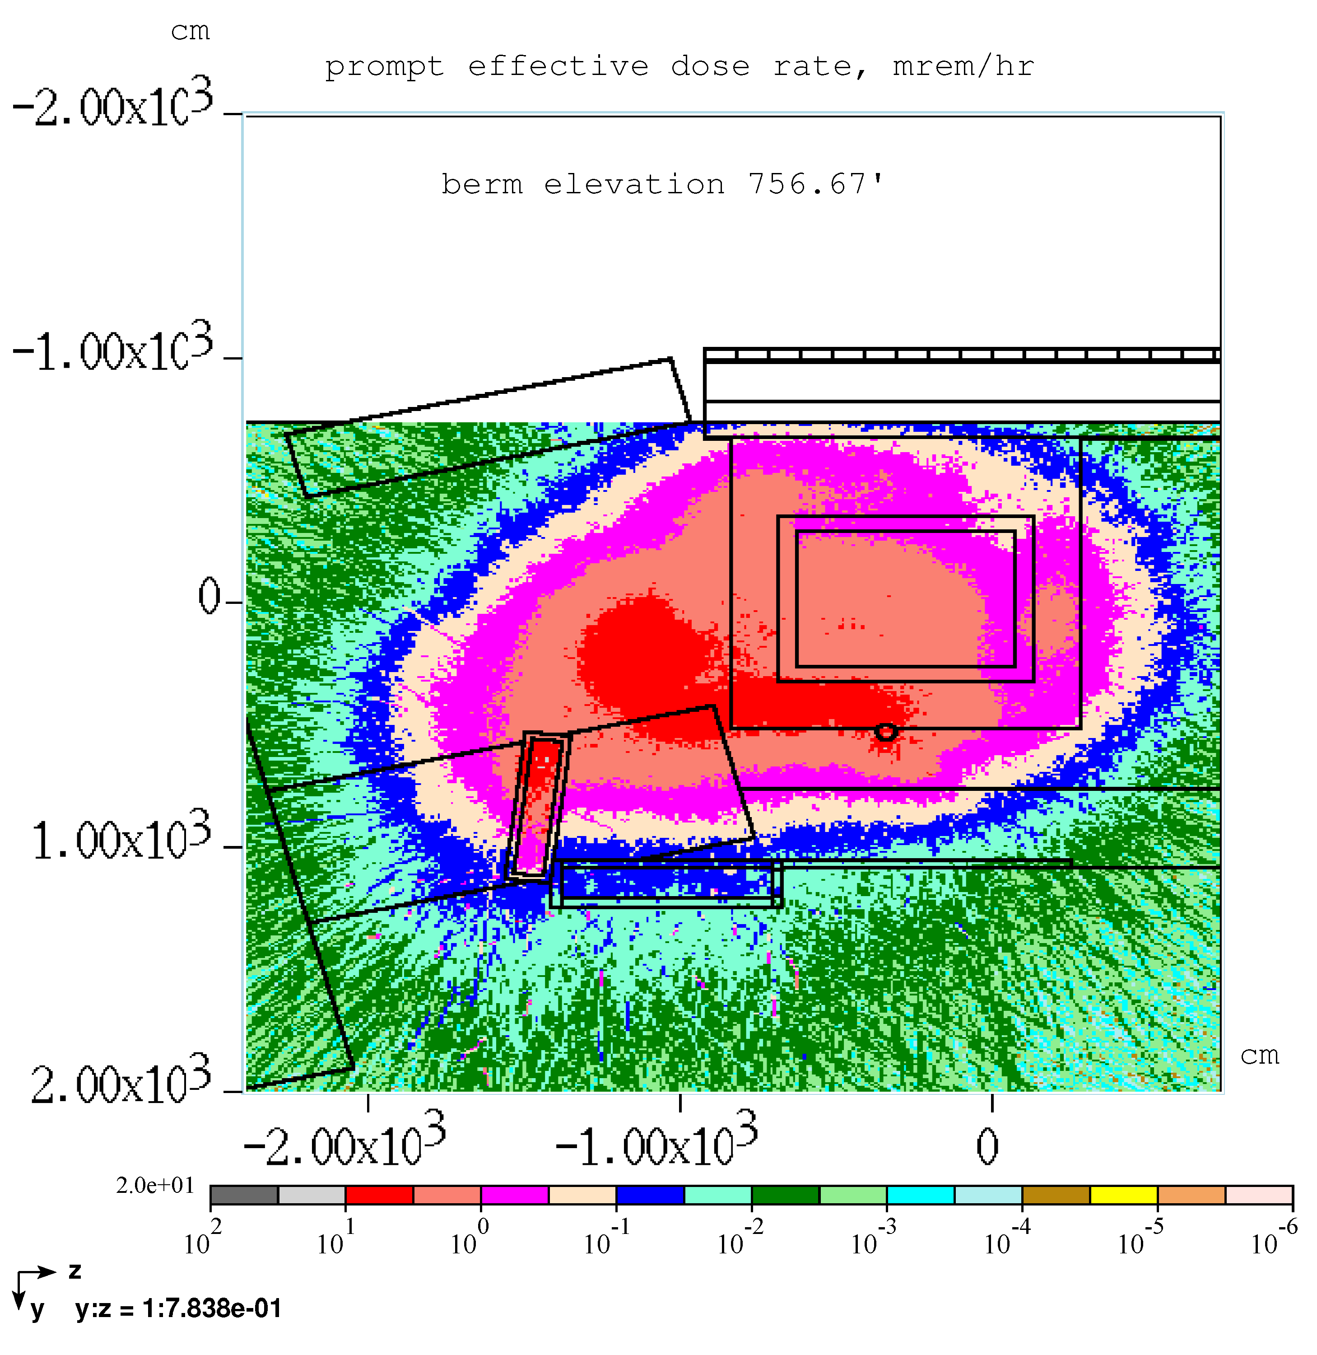
MARS Simulations – Shielding Berm Prompt Rates
Berm surface
3 to 5 mrem/hr
Wireframe is shown at 7 m above PS centerline
Exit stairway
0.14 mrem/hr
Extinction room
drop hatch
7 mrem/hr
Plan view
N

Slide 43
MARS Simulations – Shielding Berm Prompt Rates
PS drop hatch loading was evaluated by Middough and was determined to hold up to 19’ of concrete blocks
Extinction room drop hatch effective dose rate could be reduced further with additional concrete

Slide 44
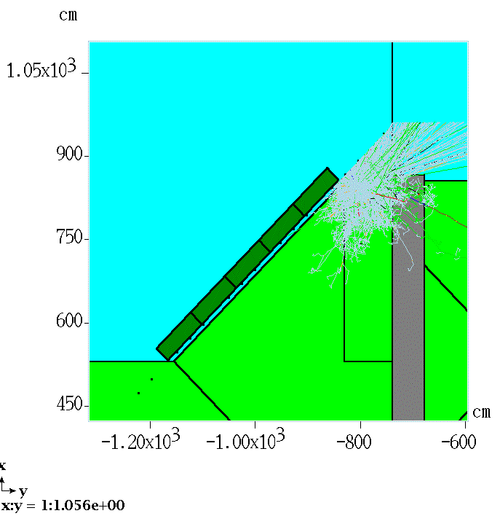
MARS Simulations - Radiation Skyshine
Radiation Skyshine is calculated from a particle source crossing planes indicated by the red lines.
The shield includes the north wall supplemental earth shield and 19’ of concrete in the PS drop hatch
Temporary proton source was used to check efficacy of crossing surface
Up
N

Slide 45
MARS Simulations - Radiation Skyshine
Approximate location of Wilson Hall wrt source

Slide 46
MARS simulations – Air Activation
Air activation calculated in a MARS simulation and reported at Mu2e doc.db 5569-v4
  Production of isotopes was simulated by three methods
    Involved but straight-forward calculations
  Calculation of transit time for radioactive decay is also straight-forward when working with a finite list of known parameters (tunnel cross sections, lengths, fan speeds)
Minimizing the annual release of radioactivity requires
  Making the stack exhaust fan flow rate ALARA
  Stack exhaust fan flow rate must be sufficiently high to remove
    Exhaust air volume from dump cooling system (165 to 250 cfm)
    All other sources of inward air leakage along the air decay path, essentially, but not limited to, the M4 line

Slide 47
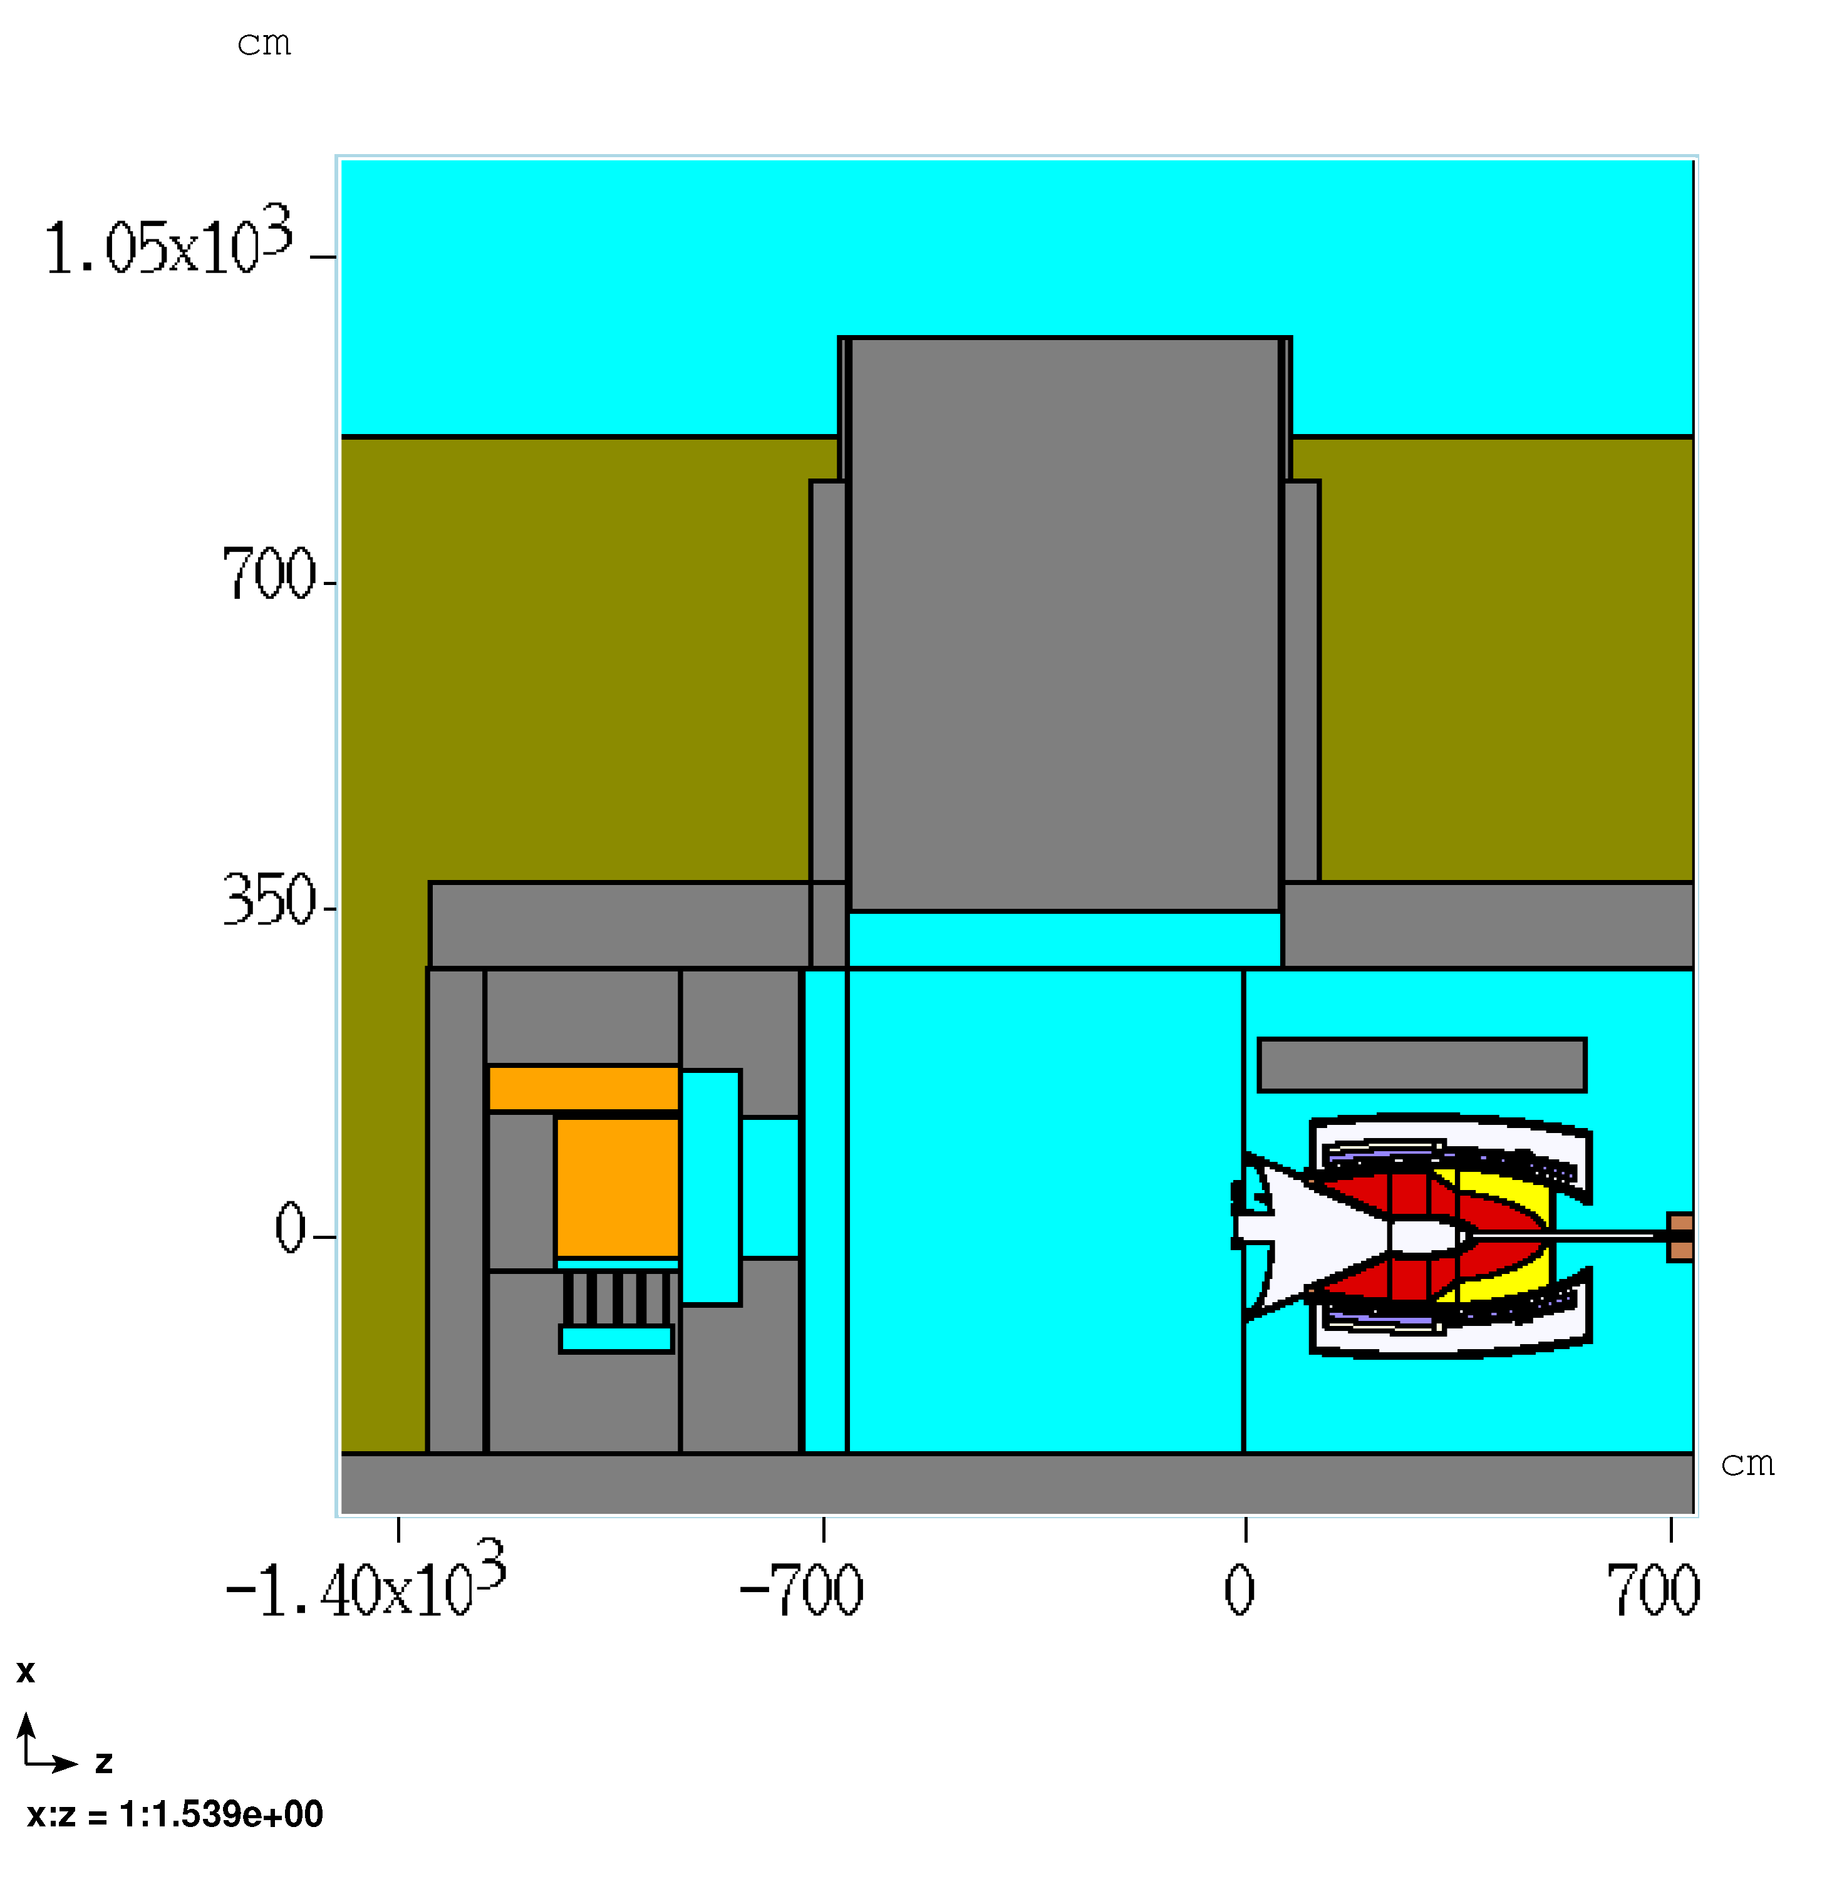
MARS simulations – Air Activation
Air volume regions and IM numbers
  20 – air volume beneath PS hatch
  14 – dump entrance
  17 – irregular region at dump entrance
  12 – main PS room volume
  13 – concrete yoke air and US region
  21 – end cap
17
21
20
14
12
15
13

Slide 48
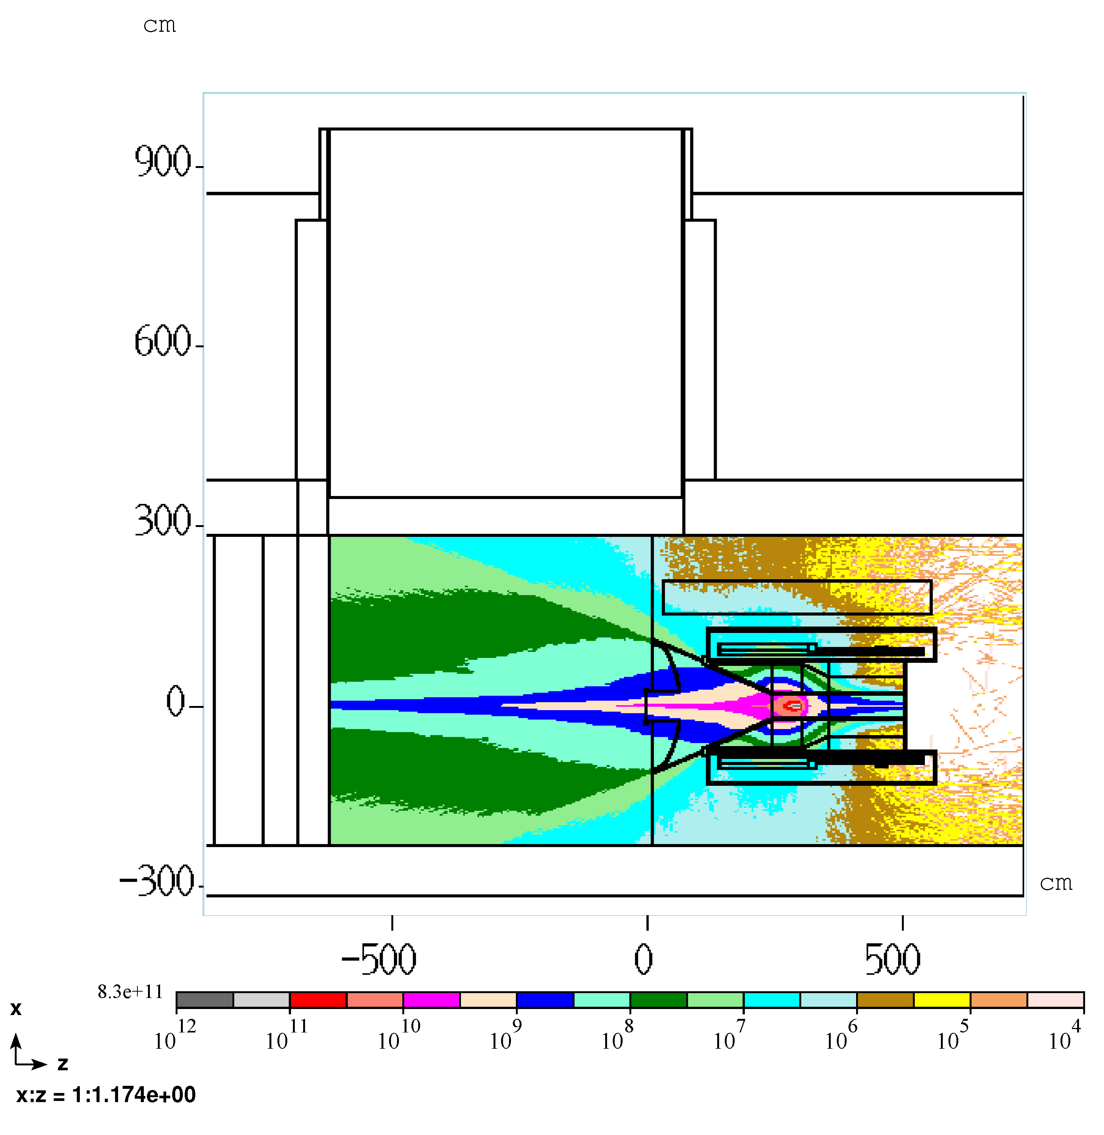
MARS simulations – Air Activation
Elevation view
Hadron flux >30 MeV

Slide 49
MARS simulations – Air Activation, relative abundances
IM | Name | Description | Volume (cc) | Be7 Bq/sec/volume subdivided run | Be7 Bq/sec combined volume run
12 | PS room main volume | Box volume between PS and west wall | 2.5E+08 | 725
13 | Yoke air | Box volume surrounding PS, yoke, and upstream of PS | 1.77E+08 | 9
14 | Dump entrance | Reentrant volume | 8.59E+06 | 114
15 | Dump cooling air ducts | Duct work beneath dump | 2.33E+04 | 0
16 | Dump cooling air channels | Layer of air outside of dump steel | 2.37E+06 | 143
17 | Dump/PS air | Irregular volume between 12 & 14 | 3.51E+07 | 127
18 | RHR air | Air volume of RHR | 4.96E+08 | 1
20 | PS drop hatch void | Air volume under PS hatch | 2.05E+07 | 3
21 | Dish air | Air volume in end cap | 1.07E+06 | 31
Total |  |  | 9.85E+08 | 1155 | 941

Slide 50
MARS simulations – Air Activation

Slide 51
MARS simulations – Air Activation
Stack Exhaust
Source

Slide 52
MARS simulations – Air Activation
Sources of inward air leakage:
  Electrical conduits
  Doorways
  enclosure underdrain pipes at sump locations
  drop hatches (3)
  detector room boundary leaks
  M5 line sources (limited by M5 line air barrier)
  Delivery Ring sources (limited by extraction enclosure air barrier)
  Others?

Slide 53
MARS simulations – Air Activation
What are we doing?
  We have an air handling working group formed after the target handling review conducted in early March 2015
    A summary of the effort is documented in Mu2e doc.db 5768-v1
    We have a list of penetrations
      New candidates are being added as they are discovered
  We are working to define boundaries of the PS room for air containment
    A number of possibilities are under consideration
  We also consider the possibility of substituting air volume of the largest source (volume 12) with helium or a contained air volume

Slide 54
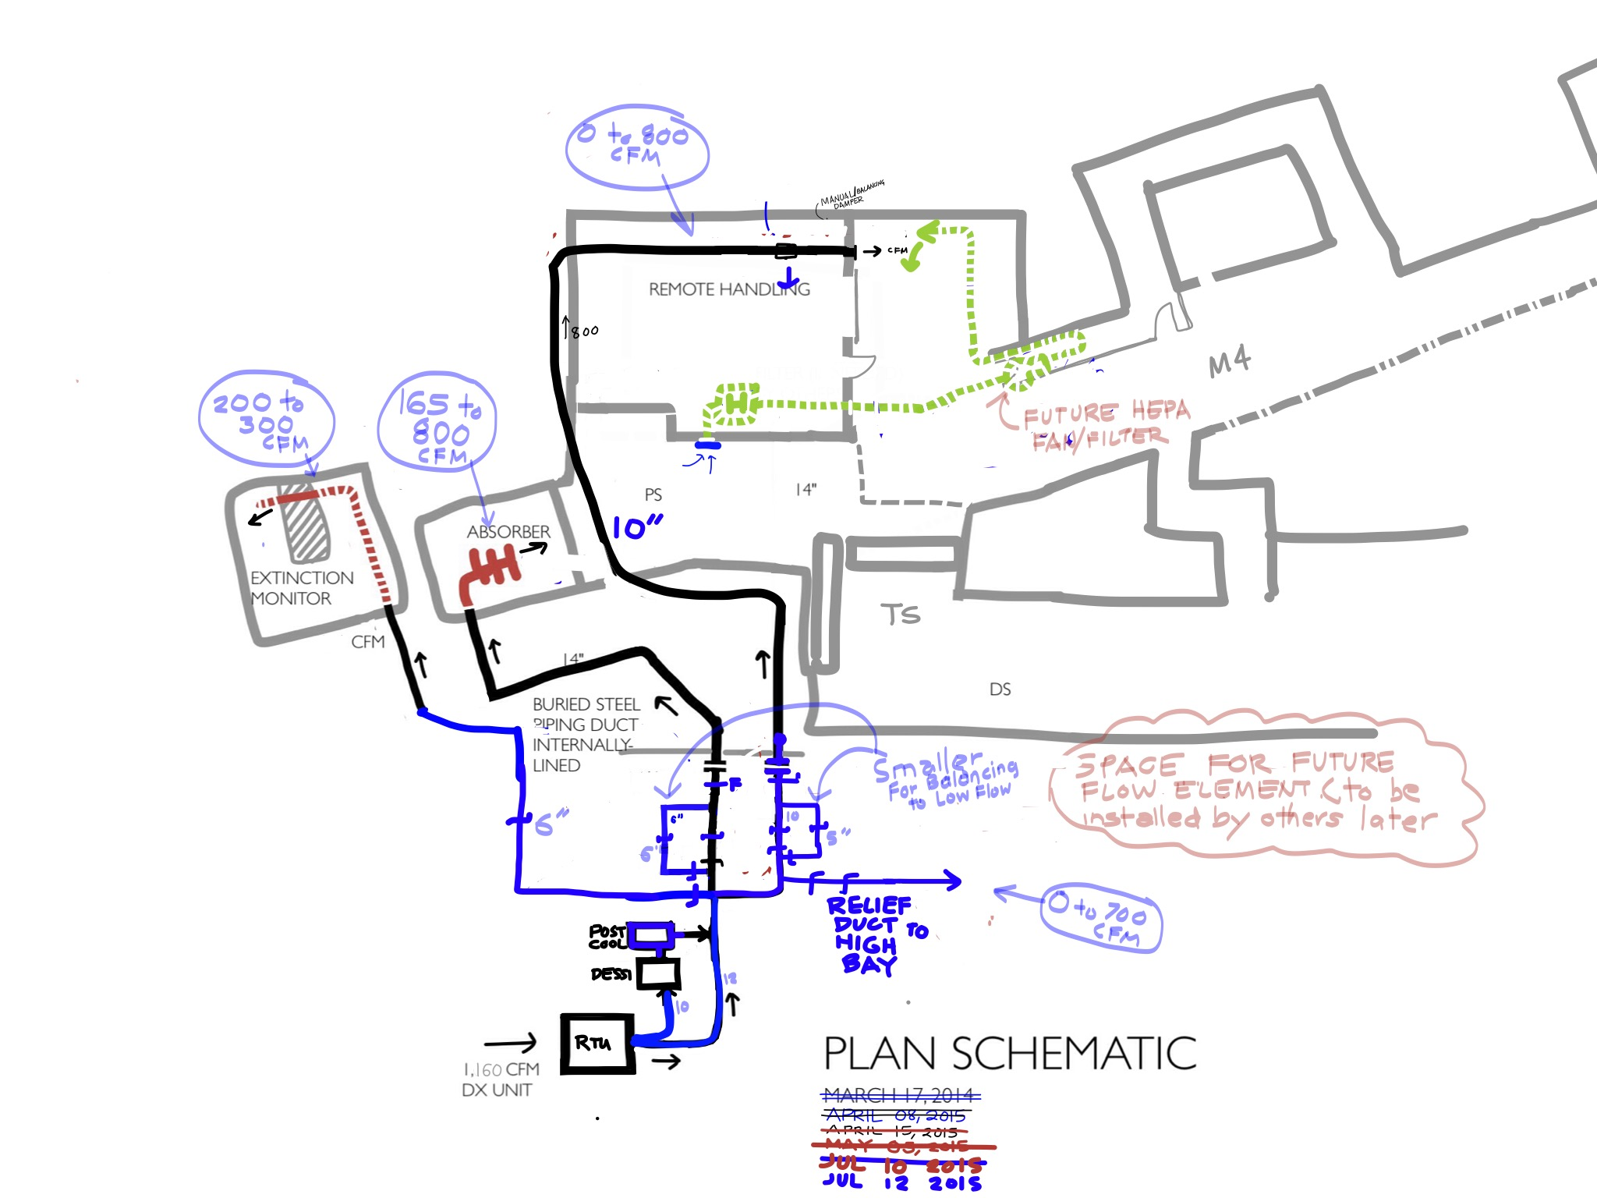
MARS simulations – Air Activation

Slide 55
MARS simulations – Air Activation
Possible air barrier locations under consideration at the PS room and Detector Room
We are exploring these possible solutions

Slide 56
MARS simulations – Air Activation
  An ANYSYS analysis of the beam dump cooling air flow rate requirement has been revisited
    Documented in Mu2e doc.db 5855-v4
    The range of acceptable flow is now 165 to 250 cfm (was 800 cfm)
  Ultimately, the effort to seal up sources of inward air leakage cannot be completed until facility construction is complete and all equipment, shielding, and air barriers have been installed
  This activity will remain after completion of the Mu2e Project

Slide 57
End of Materials for Review Panel

