Slide 1
Mu2e Heat and Radiation Shield MARS15 Modeling
Vitaly Pronskikh
Mu2e Target, Remote Handling, and Heat & Radiation Shield Technical Review
November 16-18, 2015

Slide 2
Mu2e Heat and Radiation Shield Optimization
Main optimization goal:
Maximize useful particle production, minimize background particle yields
Issues:
Quench: power density and dynamic heat load of superconducting (SC) coils.
Integrity and lifetime of critical components: integrated dose in organic materials, i.e. epoxy, insulator.
Radiation damage to superconducting and stabilizing materials: atomic displacements (DPA), integrated particle flux
Safety aspects: shielding, nuclide production, residual dose.

Slide 3
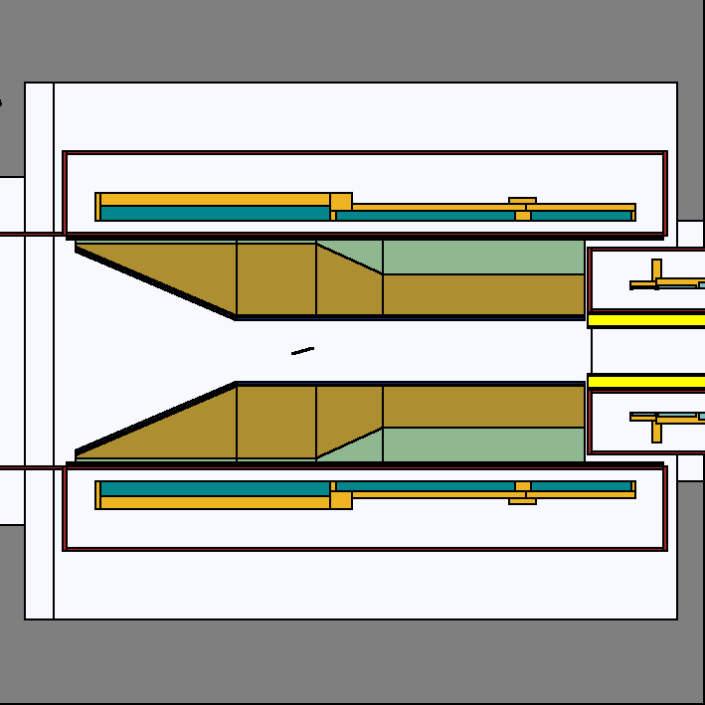
Mu2e Heat and Radiation Shield
Heat and Radiation Shield
(Absorber) is intended to prevent
radiation damage to the magnet
coil material and ensure quench
protection and acceptable heat
loads for the lifetime of the
experiment
Quantities simulated:
  Total dynamic heat load on the coils
  Peak power density in the coils
  Peak radiation dose to the insulation and epoxy
  Displacements Per Atom (DPA) to describe how radiation affects the electrical conductivity of metals in the superconducting cable

Slide 4
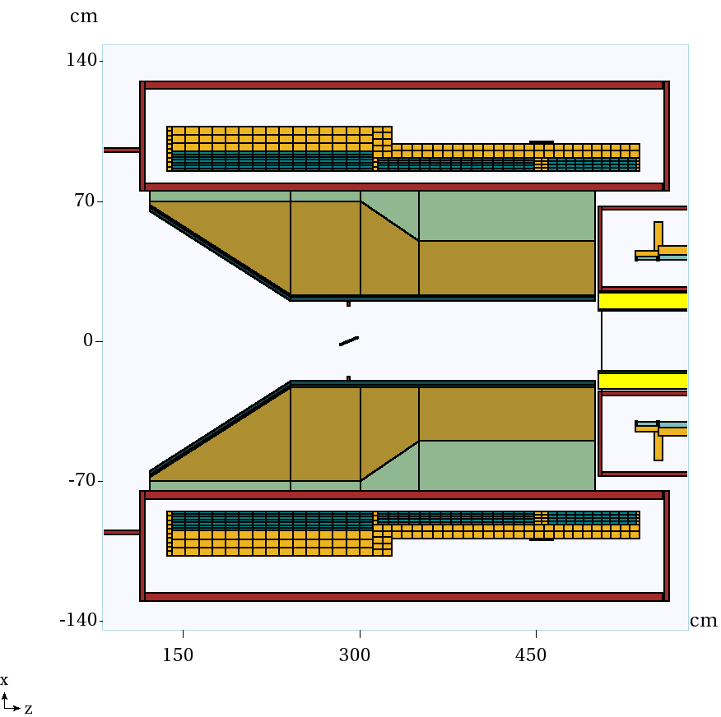
HRS and solenoid MARS15 model
High-resistivity
bronze C63200,
7.64 g/cm³,
~33 tonnes
Coil materials: 8.35% NbTi 8.35% Cu 17.33% G10 65.97% Al
Coils: Al stabilizer +
NbTi+Al+ insulation.
Homogeneous model
In MARS15.

Slide 5
Mu2e HRS Dose Limits
Quantity | DPA, 10⁻⁵ | Power density, µW/g | Absorbed dose, MGy/yr | Dynamic heat load, W
Specs | 4-6 | 30 | 0.35 | 100
DPA damage we can get so that RRR degrades from ~600 to 100. After this RRR reduction we must warm-up and anneal Al (once a year).
The cooling requirements lead to limits on peak power density calculated based on the heat map
Dynamic heat load limit depends on cooling system

Slide 6

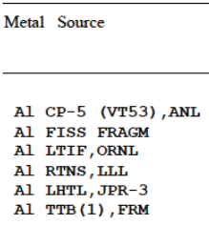


DPA model (simplified) and Residual Resistivity Ratio
Norgett, Robinson, and Torrens (NRT)
NRT model: ν= 0.8/(2 · Ed)
MARS15 model for neutrons:
ν= η · 0.8/(2 · Ed)
MARS15 DPA model:
; η = 0.357 – 0.535
scales NRT to experiment
$∆ρ$ – from KEK measurement
(Mu2e requirement)

Slide 7
Residual Resistivity Ratio as a function of DPA
Range 4-6E-5

Slide 8
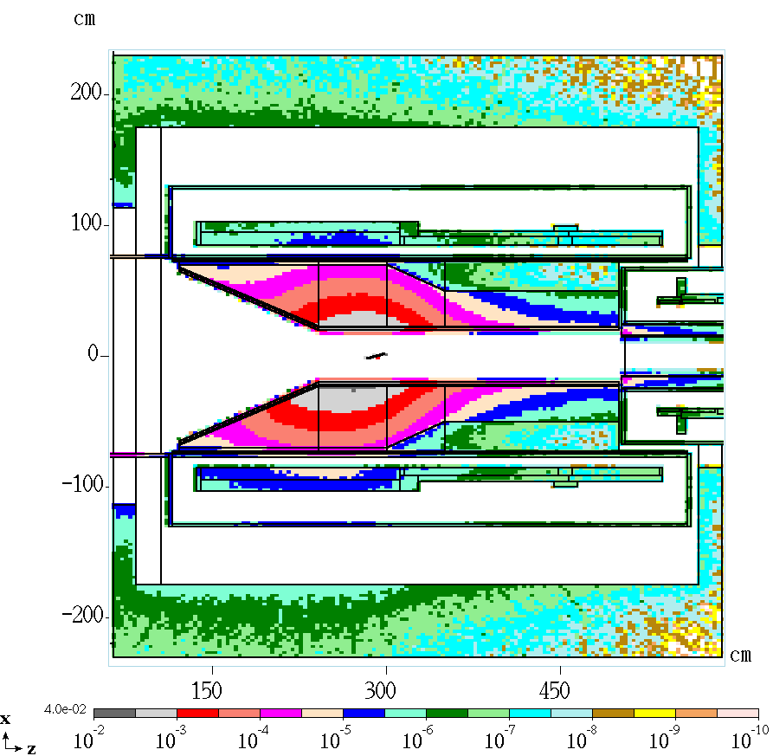
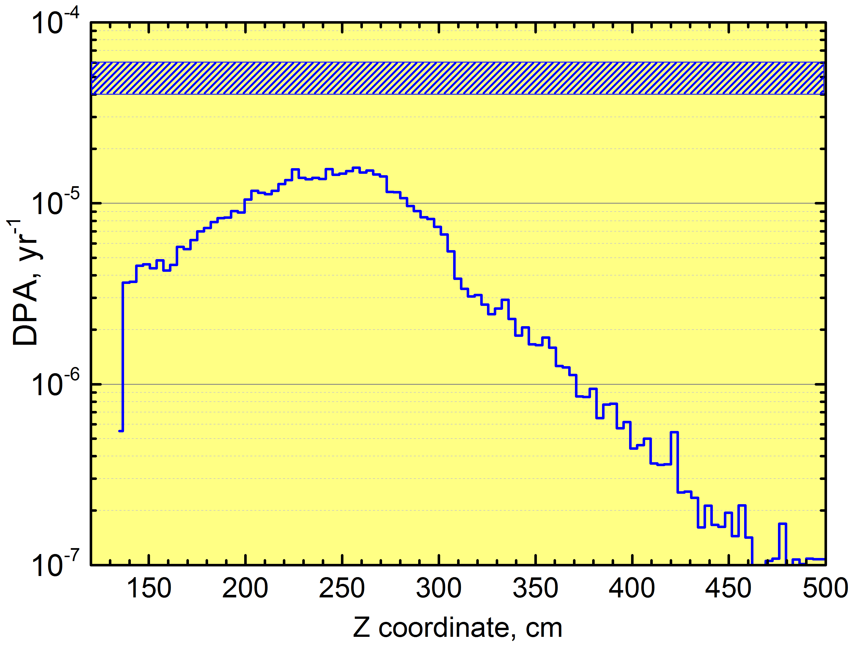
DPA distribution in the coils
4-6E-5
Distribution in slice: +-10 cm in Y, 6 cm in X (thickness)

Slide 9
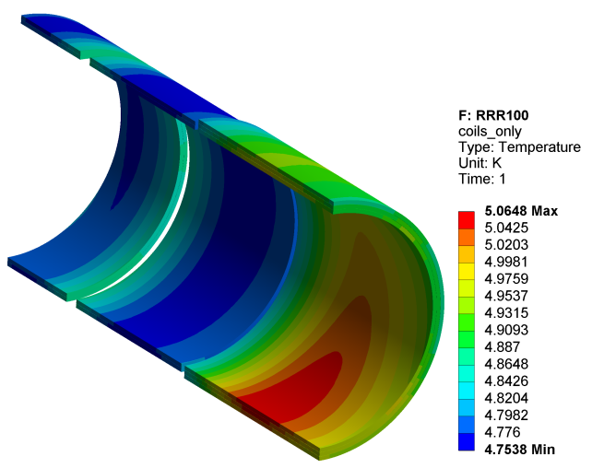
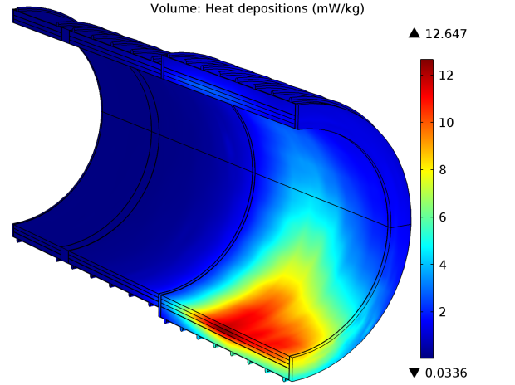
Peak power density map and limit
Volume temperature, K
Surface power deposition, µW/g
p
5 K
p
T plot for T₀ =4.7K (liquid He temp)
T_{c} = 6.6K; (supercond+field)
T_{peak} = T_{c}-1.5K = 5.1K.
Peak coil temperature starts to violate allowable value based on 1.5 K thermal margin and 5 T field above 30 µW/g
Thermal analysis by Vadim Kashikhin

Slide 10
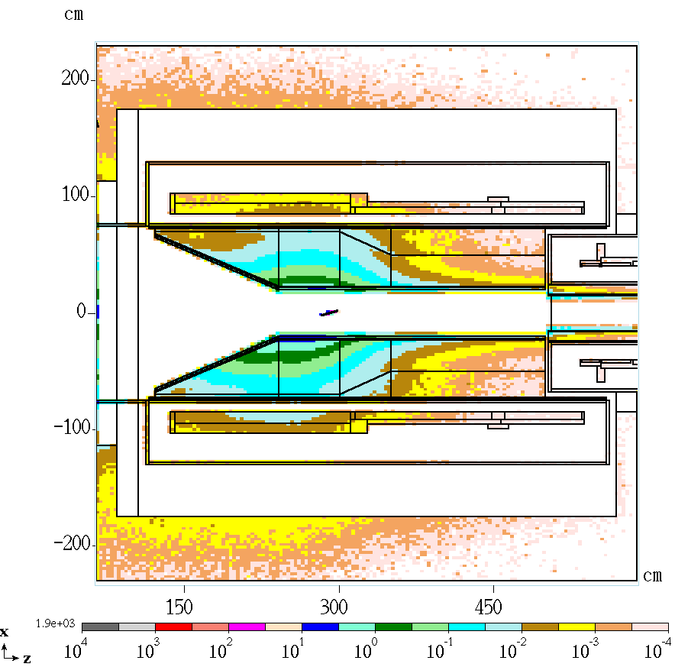
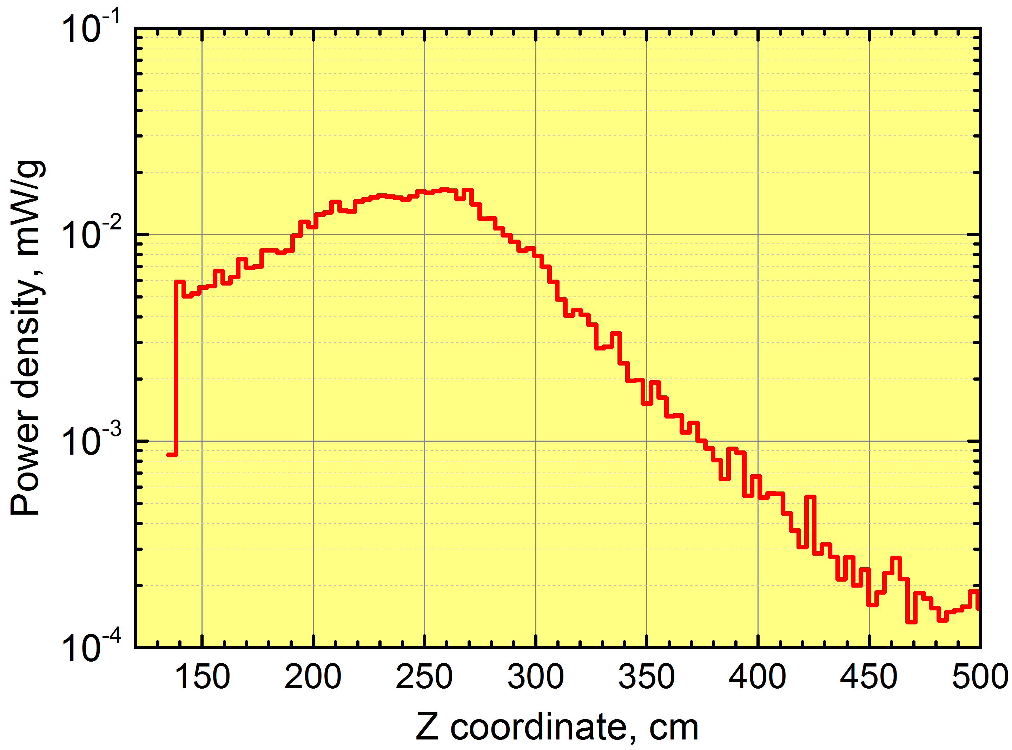
Power density distribution in the coils
0.03
Distribution in slice: +-10 cm in Y, 6 cm in X (thickness)

Slide 11
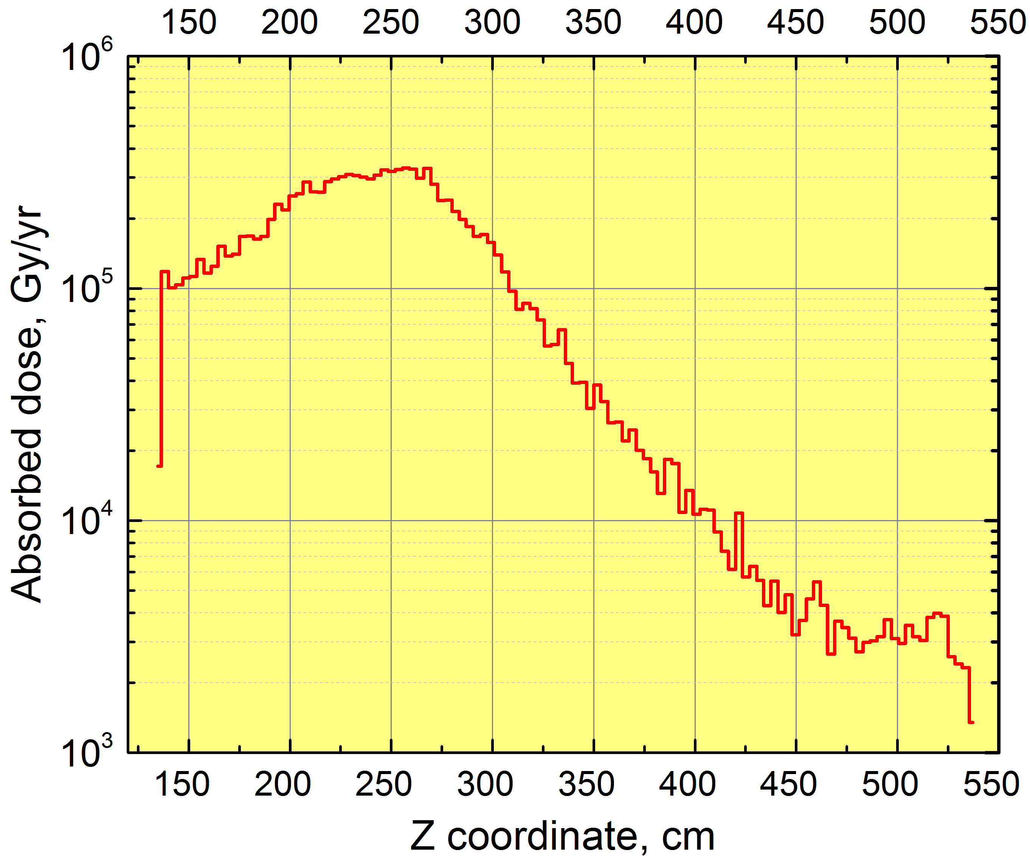
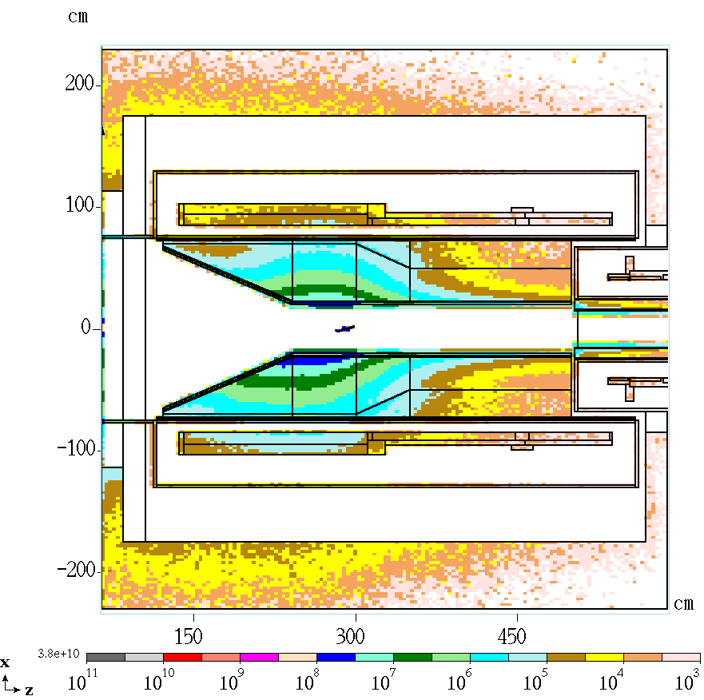
Absorbed dose distribution in the coils
350000
Distribution in slice: +-10 cm in Y, 6 cm in X (thickness)

Slide 12
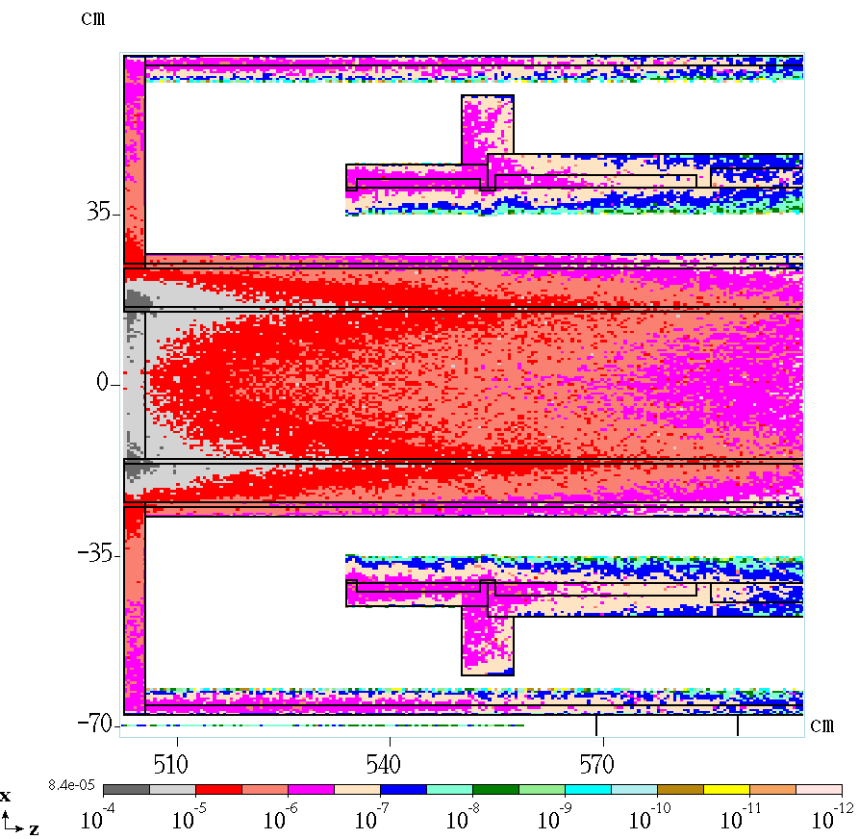
Transport Solenoid (TS1) coils
Coil material:
NbTi 8.27%, Cu 9.51%, G10 15.53%, Al 66.69% Stabilizer Al 5083
Quantity | MARS15 | Limit | Units
Peak DPA | 10⁻⁶ | 1.5·10⁻⁵ | yr⁻¹
Peak power density | 1 | 10 | µW/g
Total heat load | 0.05 | 0.5 | W
see doc-db 1092-v15 for requirements
Absorbed dose ~ 20 kGy/yr

Slide 13
Summary
Quantity | MARS15 | Limits
Peak Total Neutron flux in coils, yr⁻¹ | 5.2*10²⁰
Peak Neutron flux > 100 keV in coils, yr⁻¹ | 2.0*10²⁰
Peak Power density, µW/g | 17 | 30
Peak DPA, yr⁻¹ | 1.4*10⁻⁵ | 4-6*10⁻⁵
Peak DPA (TS1), yr⁻¹ | 1.0*10⁻⁶ | 1.5*10⁻⁵
Peak absorbed dose, MGy/yr | 0.33 | 0.35
Dynamic heat load, W | 28 | 100
Heat load in the HRS volume, kW | 3.3
Current Mu2e HRS radiation design solutions are safe during the lifetime of the experiment.

Slide 14
Spare slides

Slide 15
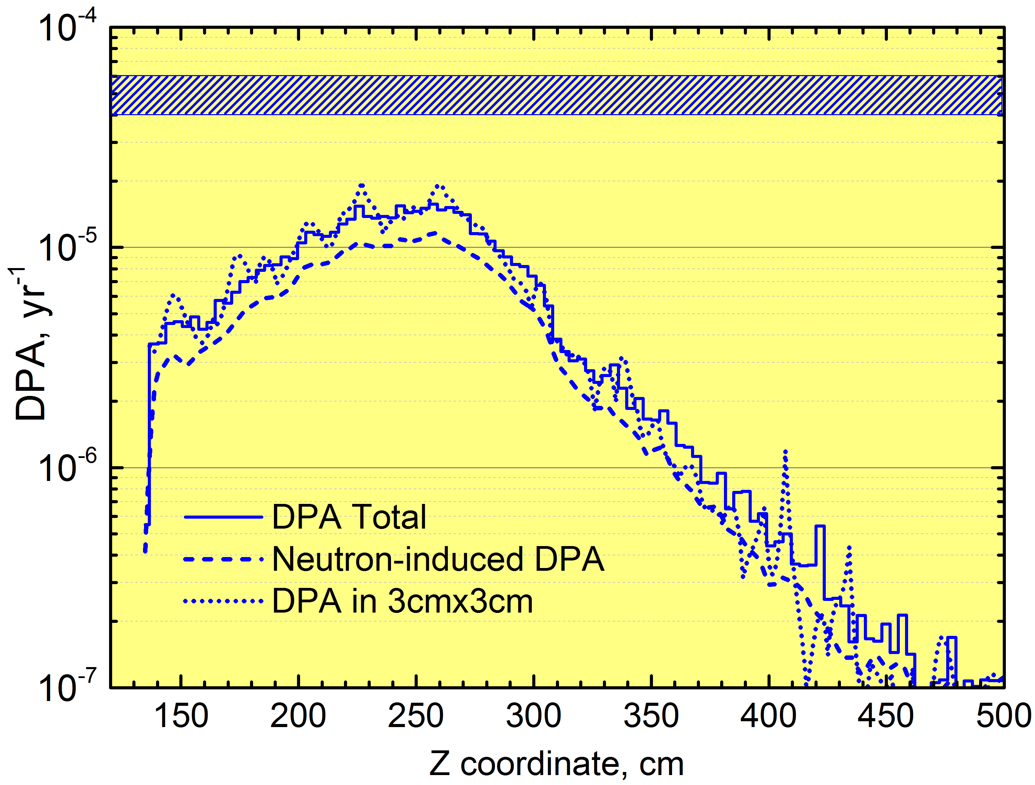

Slide 16
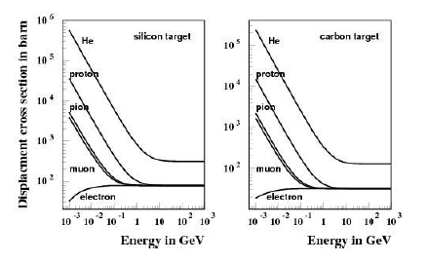
DPA modeling in MARS15
Damage cross section:
E – projectile kinetic energy,
T – kinetic energy transferred to the recoil,
Td – displacement energy,
Tmax – highest (kinematic) energy,
Damage function:
= 0 (T<Td)
= 1 (Td<T<2.5Td)
= k(T)Ed/2Td (2.5Td<T)
Ed – “damage” energy in elastic collision
Td – function of atomic number
k(T) – displacement efficiency (R.E.Stoller)
Projectile energy 1 keV to 10 TeV
Primary knock-on atom (PKA)
created in nuclear collisions can
generate a cascade of atomic
displacements.
Kinchin-Pease model:

Slide 17
DPA modeling (contd)
from MARS
particle flux
damage cross section
Radiation damage is displacement of atoms from their equilibrium position in a crystalline lattice due to irradiation with formation of interstitial atoms and vacancies in the lattice.
Example:

Slide 18
MARS15 DPA model development
Al
Broeders, Konobeyev, 2004
Based on ENDF/B-VII, calculated for 393 nuclides
NRT (industry standard) corrected for experimental η
η – ratio of number of single interstitial atom vacancy pairs (Frenkel
pairs) produced in a material to the number of defects calculated using
NRT model

