Slide 1
Target, Remote Handling, Heat & Radiation Shield Overview
Rick Coleman
L3 Manager Target Station
16-18 November 2015

Slide 2
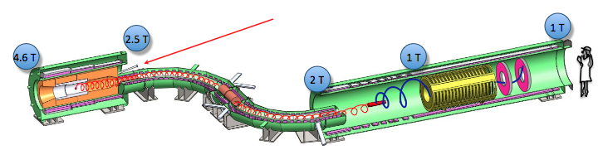
Target Station
The Target Station
  proton beam production target
  heat and radiation shield (HRS)
  target remote handling system
  proton beam absorber
  protection collimator
There is a WBS task for each of above, plus one for simulations and one for technical documentation (& general support)

Slide 3
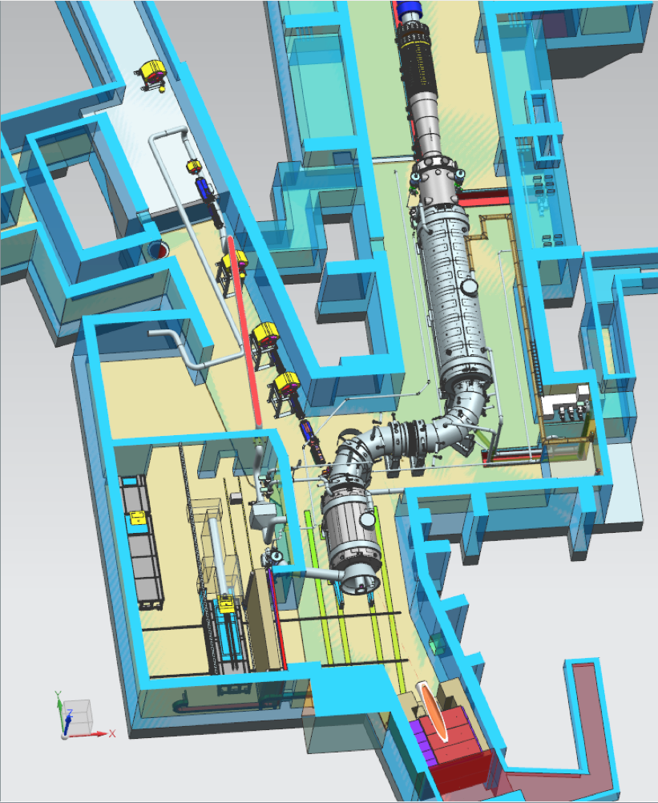
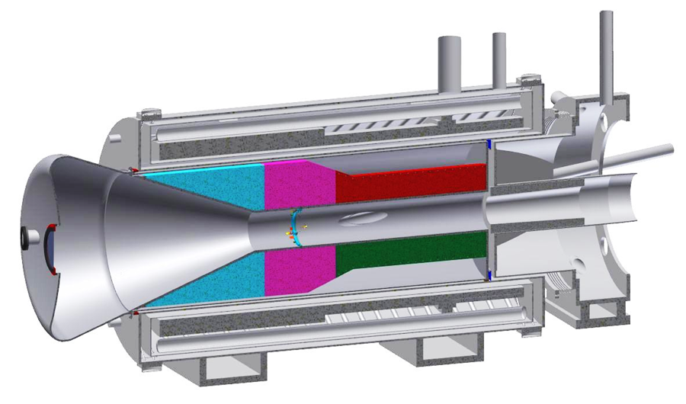
Overview
Proton Beam
Production
Solenoid
(target, HRS)
Remote Handling
Room
Proton Beam Absorber

Slide 4
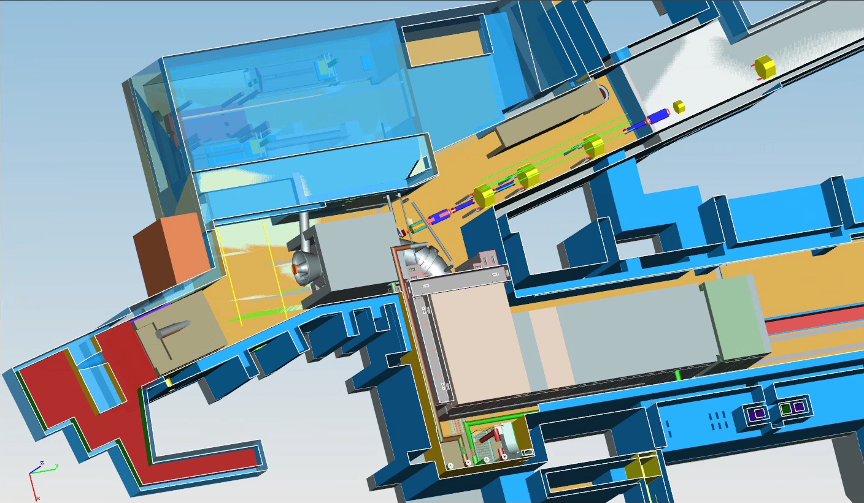
Layout with Shielding

Slide 5
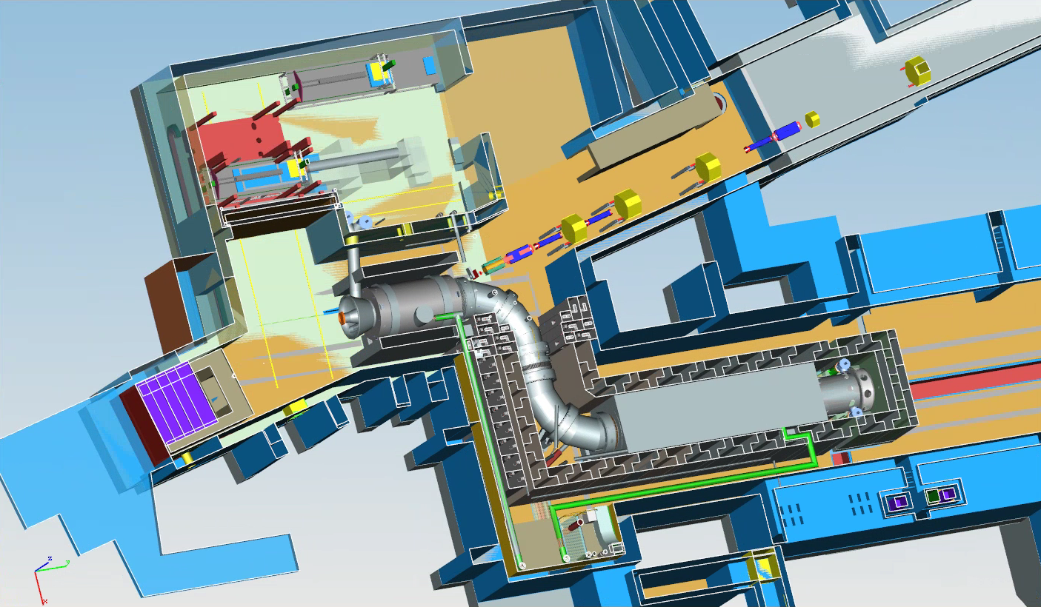
Layout with Shielding- 2nd view

Slide 6
Organization
WBS 475.02.09
Target Station
R. Coleman
R. Schultz (deputy)
WBS 9.3
Remote Handling
M. Campbell
AD/FNAL
WBS 9.4
HRS
L. Bartoszek
Bartoszek
Engineering
WBS 9.5
Proton Absorber
A. Stefanik
PPD/FNAL
WBS 9.6
Protection
Collimator
A. Stefanik
PPD/FNAL
WBS 9.7
PS Hatch
Blocks
Transfered
WBS 9.1
Simulations
R. Coleman
V. Pronskikh
AD/FNAL
WBS 9.2
Fabricate Target
C. Densham
Rutherford
Labs
WBS 9.8
Technical
Doc.
R. Coleman
AD/FNAL

Slide 7
Organization
WBS 475.02.09
Target Station
R. Coleman
R. Schultz (deputy)
WBS 9.3
Remote Handling
M. Campbell
AD/FNAL
WBS 9.4
HRS
L. Bartoszek
Bartoszek
Engineering
WBS 9.5
Proton Absorber
A. Stefanik
PPD/FNAL
WBS 9.6
Protection
Collimator
A. Stefanik
PPD/FNAL
WBS 9.7
PS Hatch
Blocks
Transfered
WBS 9.1
Simulations
R. Coleman
V. Pronskikh
AD/FNAL
WBS 9.2
Fabricate Target
C. Densham
Rutherford
Labs
WBS 9.8
Technical
Doc.
R. Coleman
AD/FNAL
Review
Completed
Feb. 23, 2015
Review
Scheduled
Dec. 14, 2015
This Review

Slide 8
Target Station Team
Steve Werkema, Vladimir Nagaslaev, Mike Campbell - L2 Manager, Deputy and Engineer
Rick Coleman, Ryan Schultz- L3 Manager, Deputy
Target- Rutherford High Power Targetry Group- Chris Densham, Peter Loveridge, Joe O'Dell, Roger Bennett, Otto Caretta, Tristan Davenne
Remote Handling- Ryan Schultz, Mike Campbell, Dave Pushka, Patrick Hurh, Peggy Jones
Heat and Radiation Shield- Bartoszek Engineering- Larry Bartoszek, Dez Deshpande
Proton Beam Absorber and Protection Collimator- Andy Stefanik
Simulations
  MARS- Vitaly Pronskikh, N. Mokhov, Y. Eidelman, Tony Leveling
  Heating Calculations- Ang Lee
  Primary Beam Transport & Targetting- University Collaborators- Jim Popp, Kevin Lynch
Radiation Safety – Tony Leveling, Tony Busch, Mike Geelhoed
ES&H – Madie Wolters, Dee Hahn
Project Mechanical Engineer & Integration – Kurt Krempetz
Muon Beamline L2 Manager & Integration- George Ginther

Slide 9
Requirements - Beam & Target
Mu2e Proton Beam Requirements
  3.6 x 10²⁰ protons on target over 3 years to obtain sensitivity
  Repeat period > 864ns (lifetime of muons in aluminum stopping target)
  6 x 10¹² protons/sec at 8 GeV delivered every 1.33 seconds, 0.3 duty factor
  Transverse Spot Size 0.5 to 1.5 mm (rms), Divergence < 4 mr (rms)
  For alignment & target scans +/- 1 cm and +/- 0.8 °
  Low intensity for commissioning and special calibration runs
Production Target Requirements
  Maximize number of stopped muons (high Z material, small radius target and minimize target support structure material to reduce pion reabsorption)
  Target Lifetime > 1 year to minimize interruptions to experiment, since target replacement time ~ 1 month
  Target-Beam Alignment < 0.5 mm transverse, < 10 mr angle

Slide 10

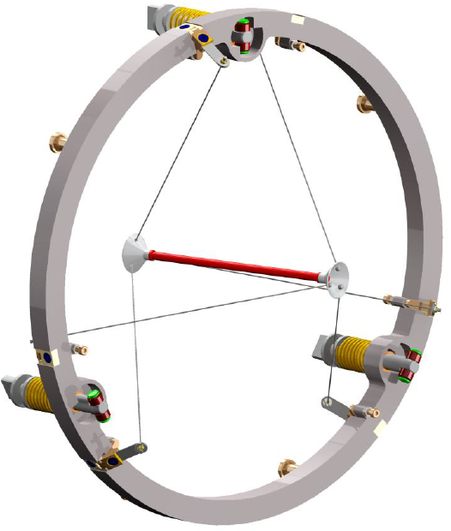
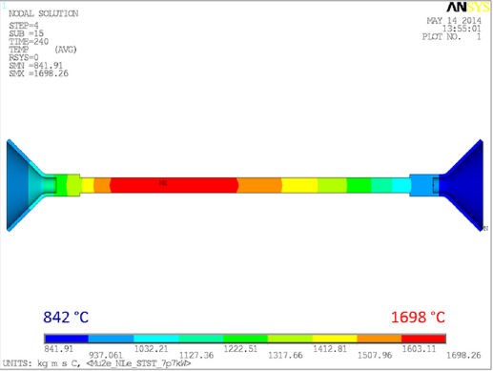
Target Design
L=16 cm r=3.2 mm Tungsten Rod

Slide 11
Reason for a high Z target
Au
W
Relative Stopped Muon Yield
Cu
Al
C
Z

Slide 12
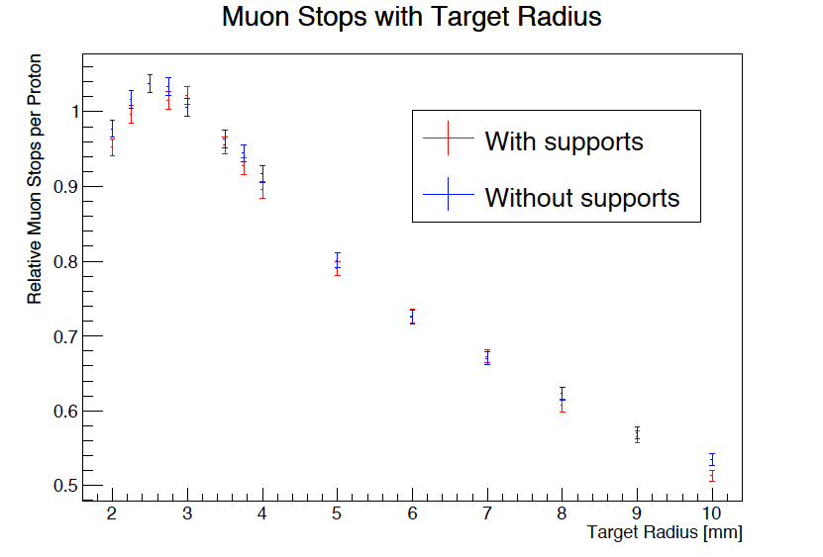
Target Radius
K.Lynch

Slide 13
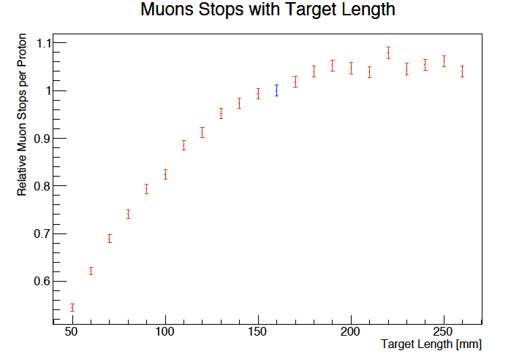
Target Length
Lynch & Popp

Slide 14
Requirements – HRS- Protect the PS coils
Mu2e Production Solenoid (PS) Heat and Radiation Shield (HRS) Requirements (Mu2e-doc-1092- G. Ambrosio, R. Coleman, V. Kashikhin, M. Lamm, M. Lopes, N. Mokhov, J. Popp, V. Pronskikh)
  Production Solenoid (PS) Heat Load Limit
    Limit the overall dynamic heat load to less than 100 W.
    Limit the instantaneous heat load in any coil of the PS to less than 30 μW/gm.
  Limit radiation damage to PS
    Limit dose rate to the superconductor insulation and epoxy to less than 350 kGy/year (~20 year lifetime).
  Maintain electrical conductivity of superconducting cables and normal conducting quench stabilizing matrix in PS
    Limit the DPA †experienced by the component metals of any PS superconducting cable to less than 4 to 6 ×10⁻⁵ DPA/year.
➔ RRR*> 100 , Annual warm-up to anneal
†DPA = Displacements per Atom
*

Slide 15
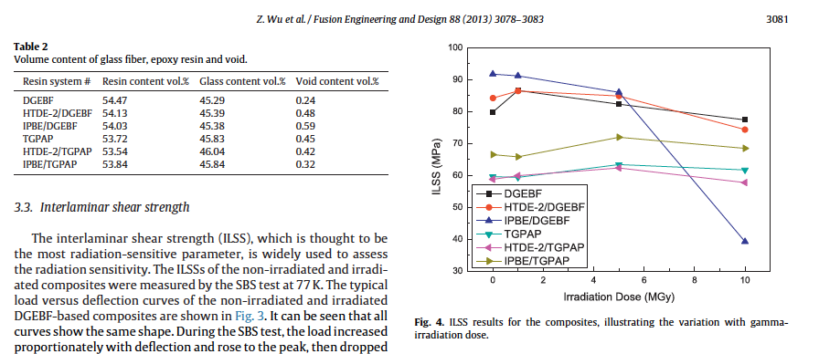
Radiation impact on insulation
Vertical line - PS after 20 years
DGEBF planed for PS

Slide 16
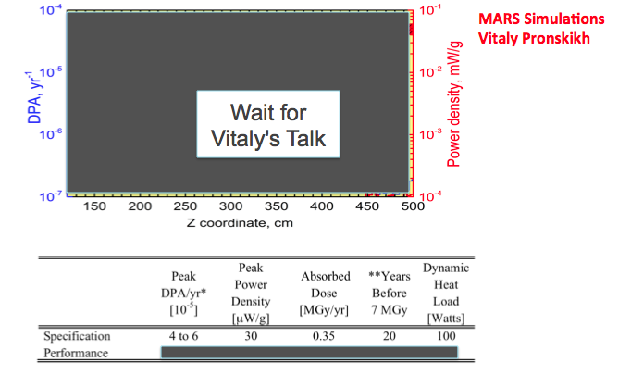
HRS Performance in Protecting PS

Slide 17
Requirements – HRS (continued)
  Geometry
    The heat shield must have sufficient inner aperture to preserve the muon yield
  Production Solenoid(PS) Field Quality should not be degraded by materials used in the HRS
    The magnetic permeability must be less than 1.10
  PS forces during quench should be minimized by choices of HRS material
    The HS electrical resistivity must be high to limit forces from eddy currents during a quench (> 1 x 10⁻⁷ Ω-m)
  Transport Solenoid (most upstream coils must be protected)
    The heat shield must have sufficient inner aperture to preserve the muon yield
  HRS thermal cooling system should limit the temperature of the surface of the HRS
  The inner surface holds the target support. The outer surface is adjacent to the PS cryostat and in contact in a few locations
  Design must avoid any line-of-sight cracks from target
  Materials used in HRS should not limit vacuum quality ( 1 x 10⁻⁵ torr is required)

Slide 18
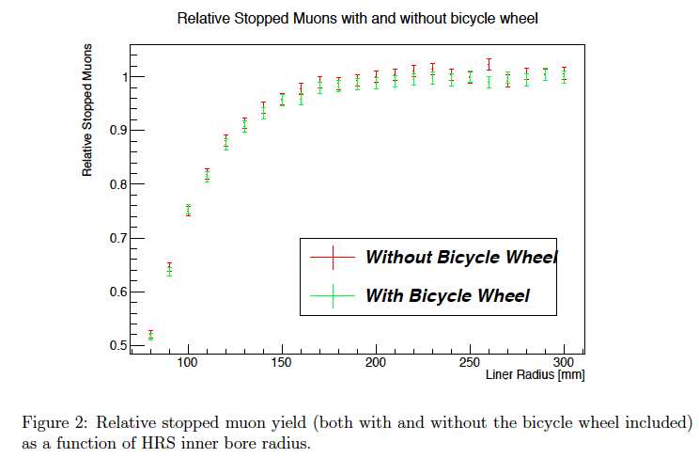
Stopped Muon Yield vs HRS Bore radius

Slide 19
Bronze permeability
V. Kashikhin measurement of sample from Scot Forge Co.
Design value

Slide 20
Stainless steel permeability

Slide 21
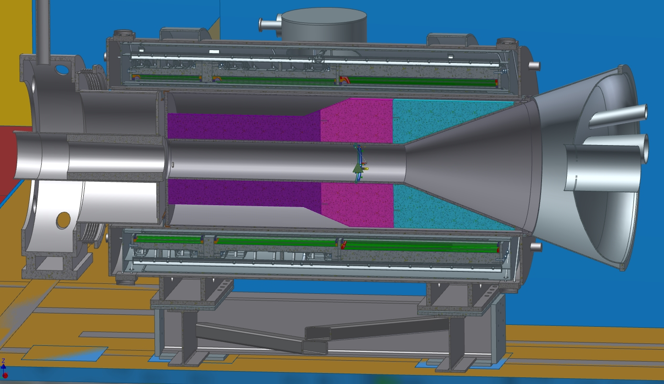
Heat & Radiation Shield Design
Bartoszek Engineering
Larry Bartoszek
Pbar absorber
Target
Vacuum end cap
Water volume
Heat and Radiation Shield (HRS)

Slide 22
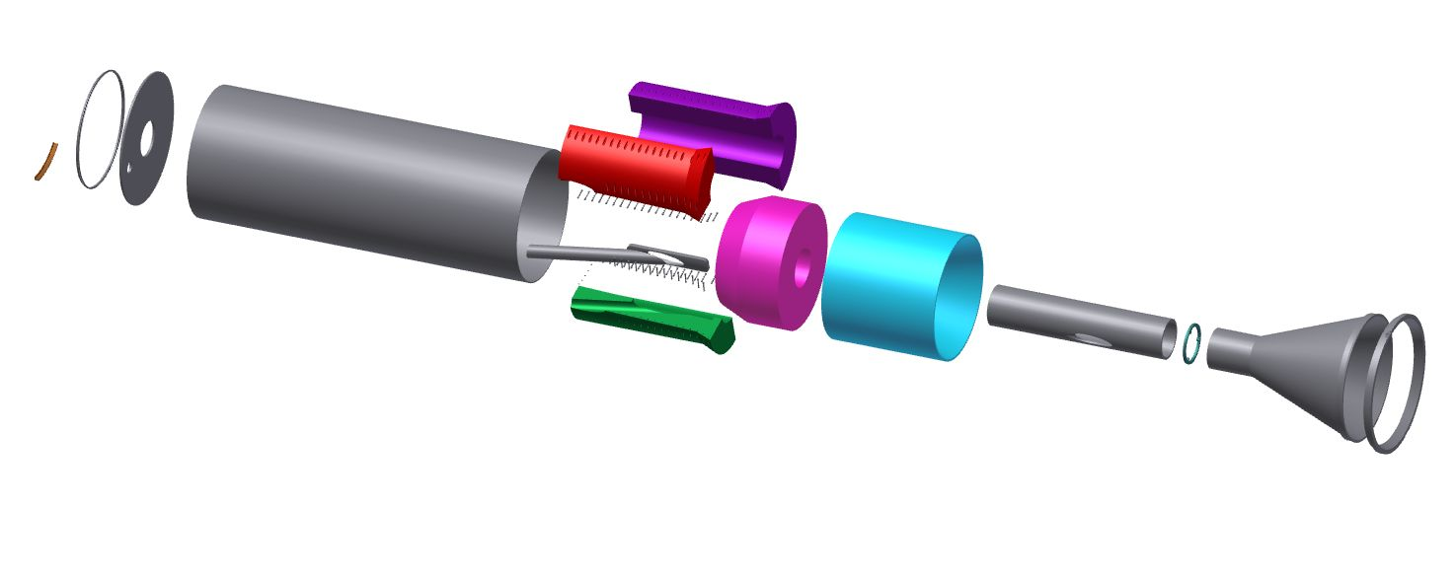
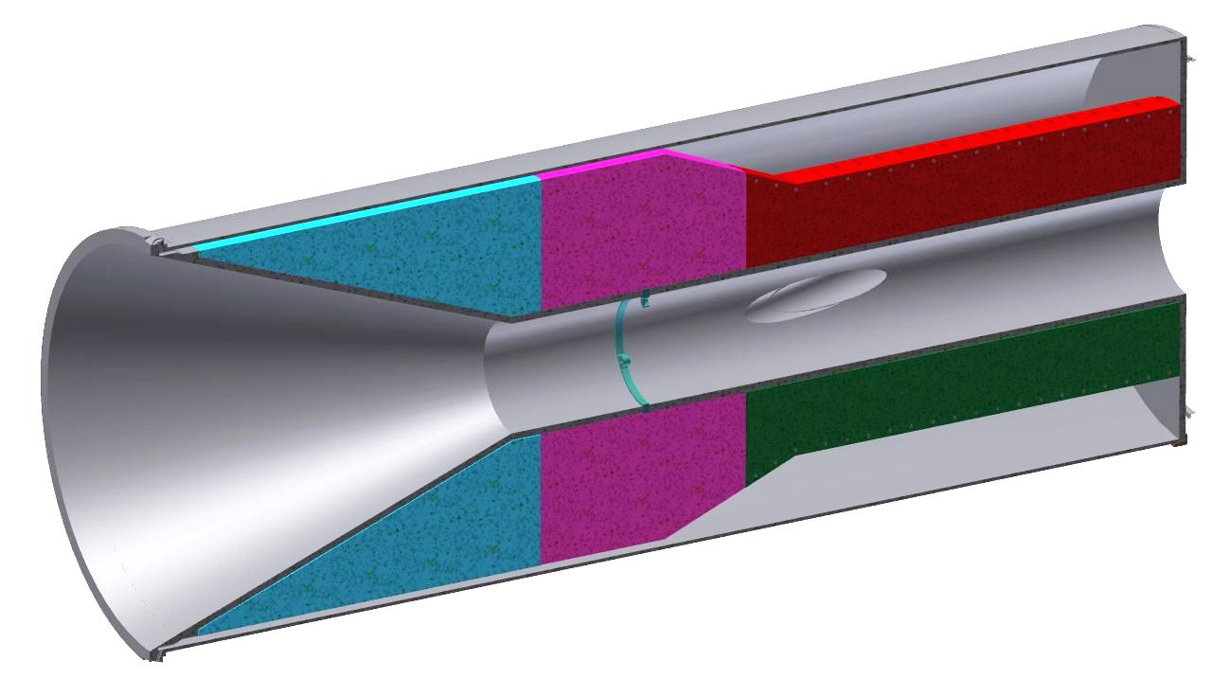
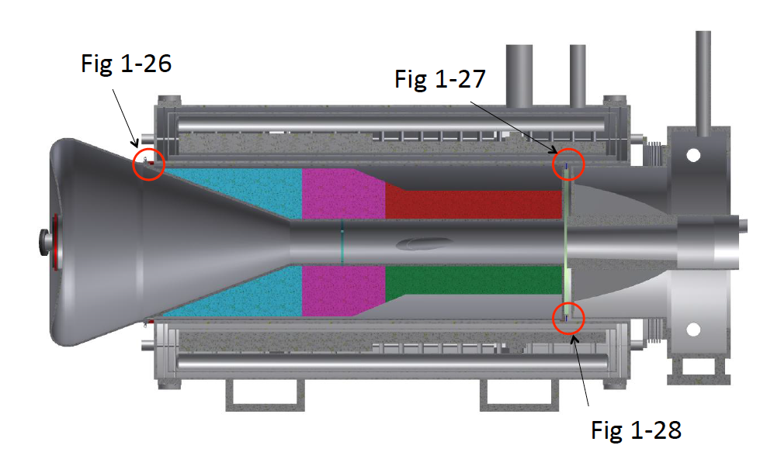
Heat & Radiation Shield Design
Figure 4.179
Figure 4.180
Figure 4.181

Slide 23
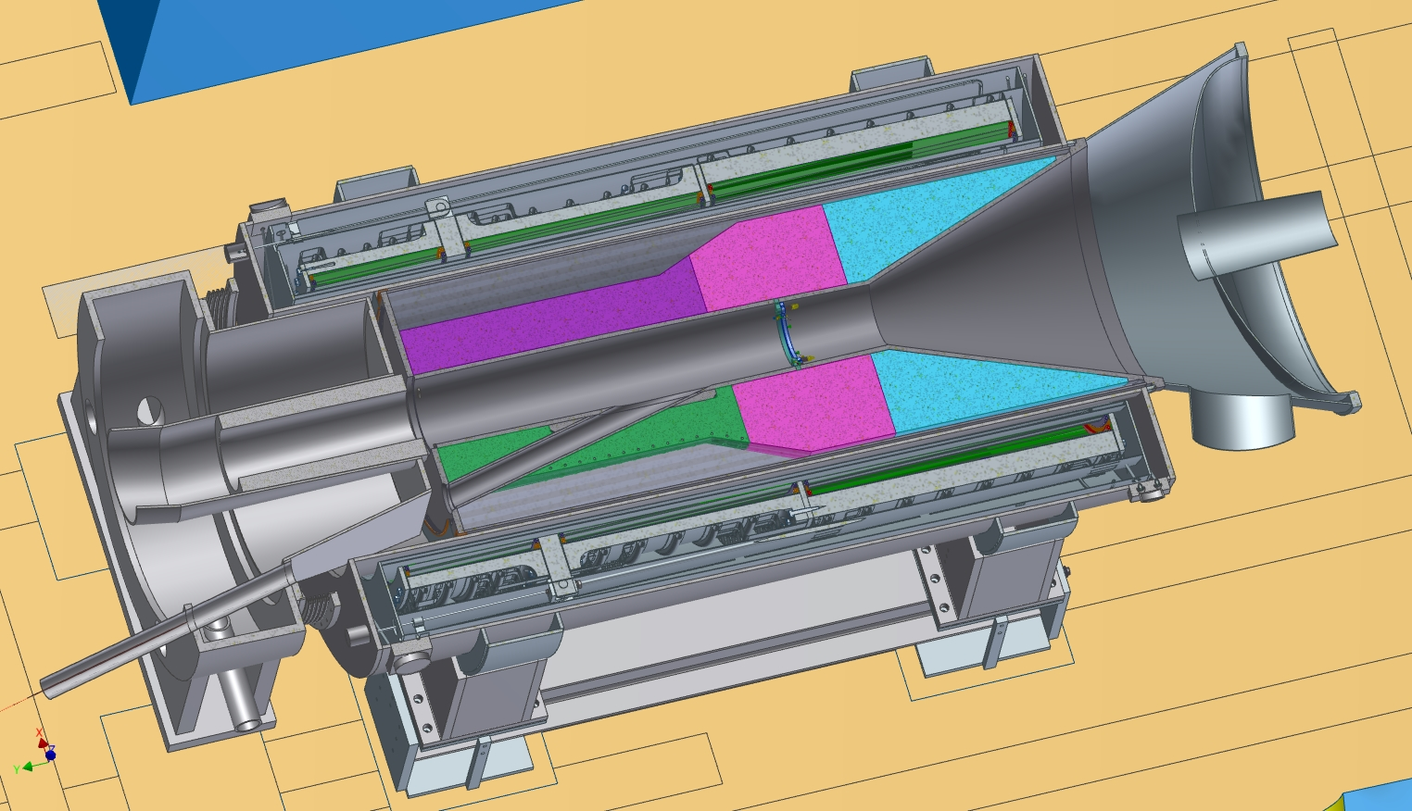
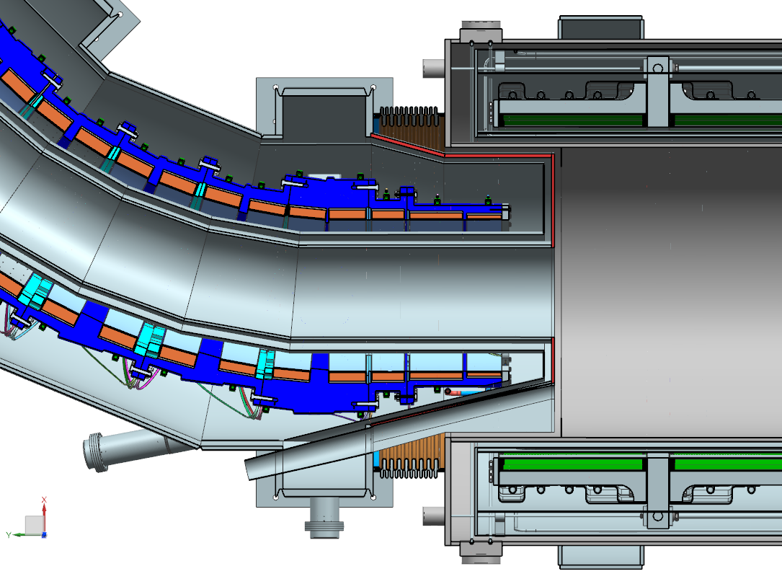
Proton Beam Trajectory
extinction
protons to absorber

Slide 24
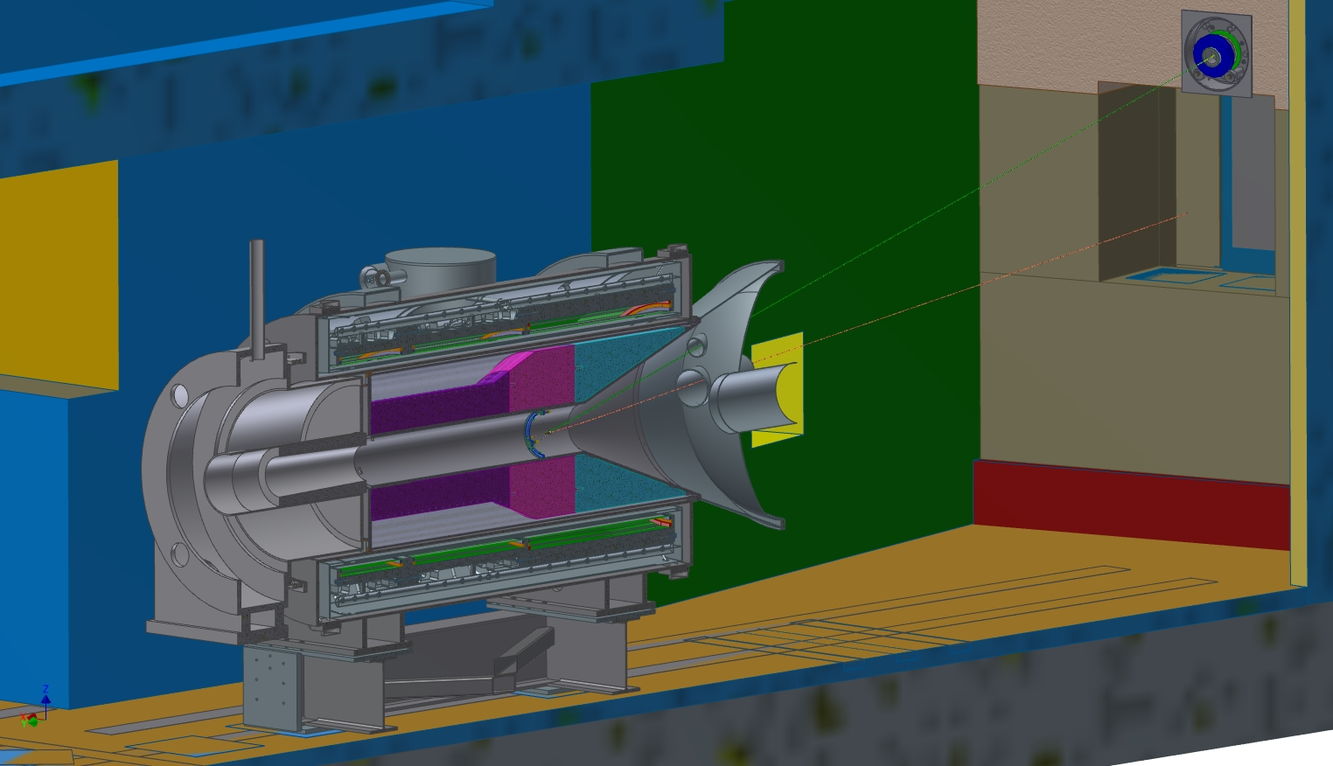
Proton Beam Trajectory
extinction
protons to absorber

Slide 25
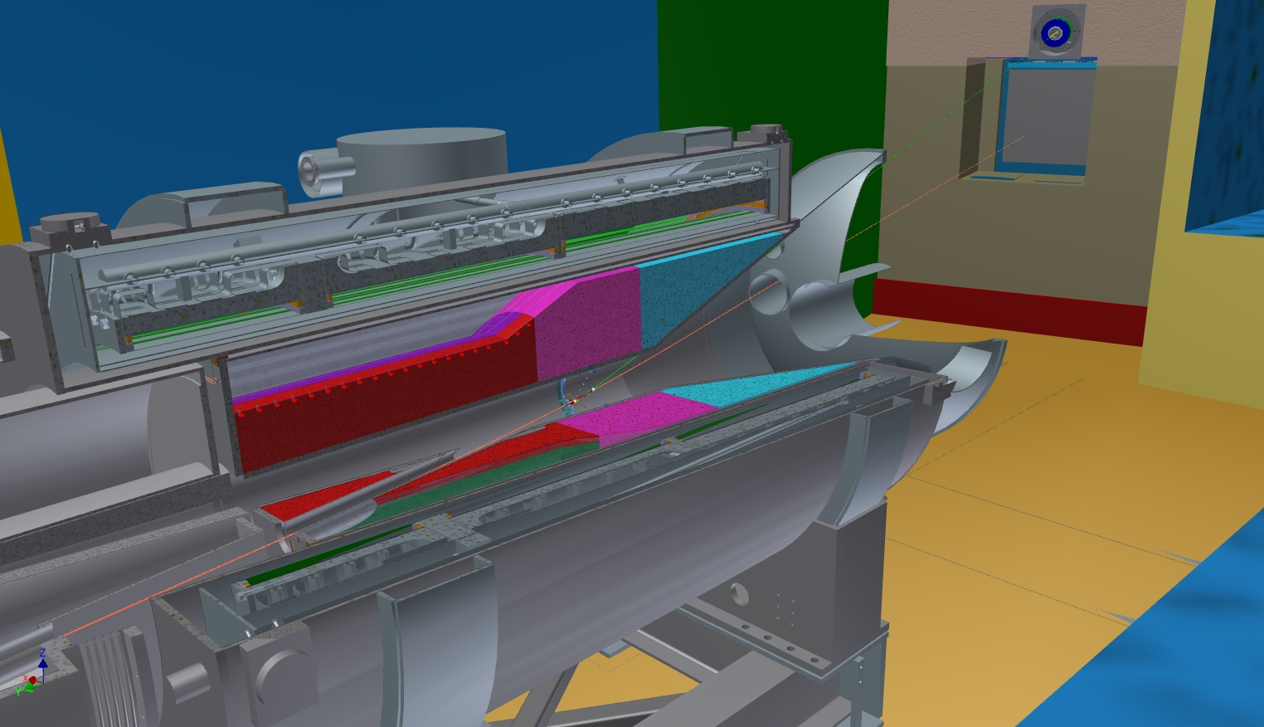
Proton Beam Trajectory
extinction
protons to absorber

Slide 26
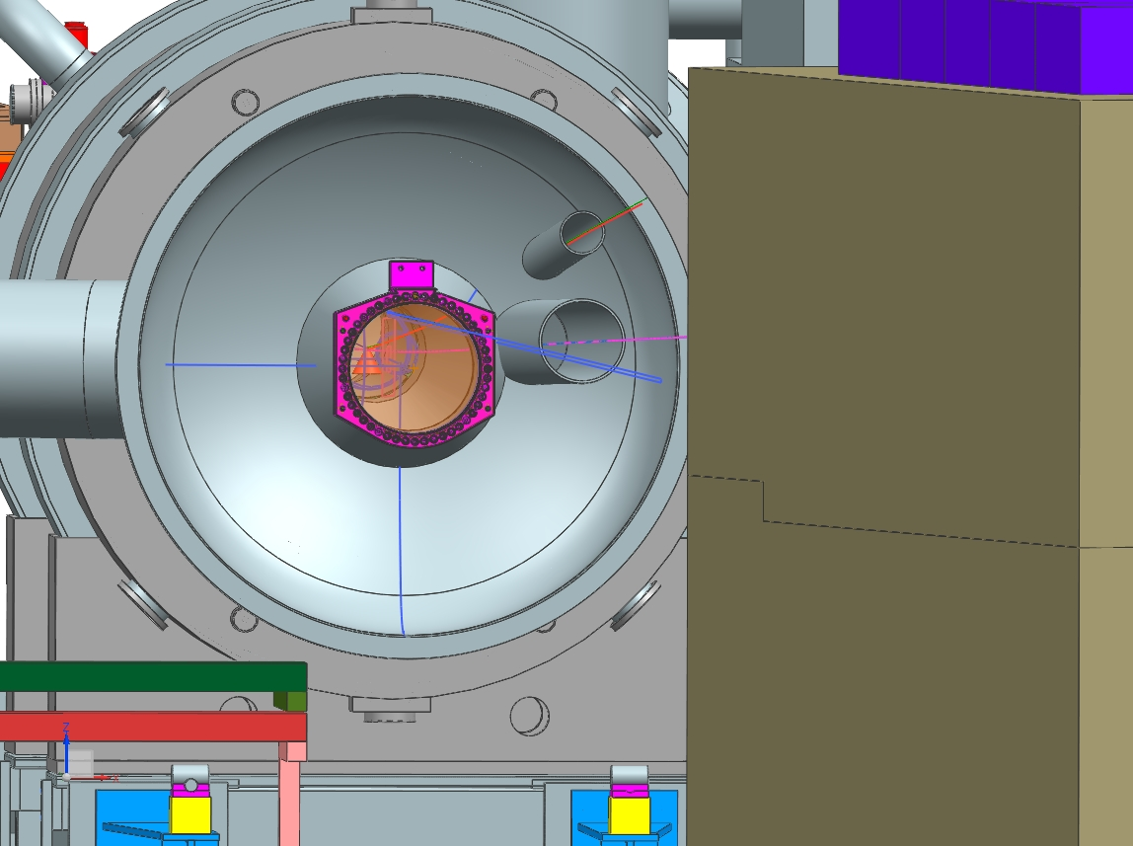
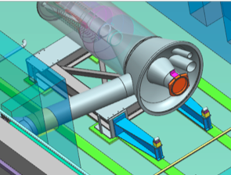
Production Solenoid Vacuum "Endcap"
Head Thickness ¼" Stainless Steel 316L
Central Access Port Window 20" dia. 0.014" thick Titanium
Proton Beam Window 12"dia. 0.010" thick Titanium
Extinction Monitor Window 4"dia. 0.010" thick Titanium

Slide 27
Remote Handling Requirements
General
  The remote handling shall provide safe handling methods, equipment, and facilities to support target hall component installation, replacement, and short-term storage.
  The remote handling shall incorporate ALARA (As Low As Reasonably Achievable) principles into equipment and procedures.
  The remote handling shall be integrated into the infrastructure of the complex both underground and above ground
Devices
  Production Target
  Vacuum Windows (3)
  Anti-Proton Absorber
Timing
  Target replacement must be performed in less than one month, and may occur on a yearly basis.

Slide 28
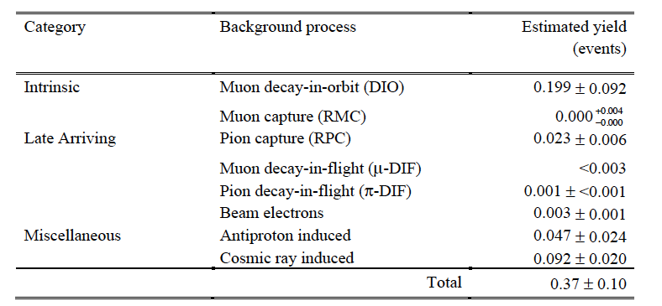
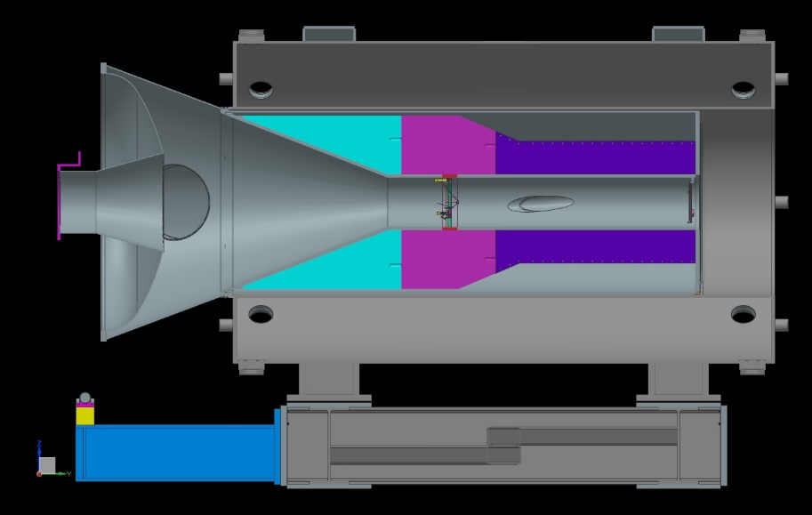
Antiproton Backgrounds/Absorber
Backgrounds
from TDR
Pbar Absorber
250 um Al
Slightly smaller
radius than HRS
ie not a vacuum
window
HRS 40 cm diameter
First collimator 30 cm

Slide 29
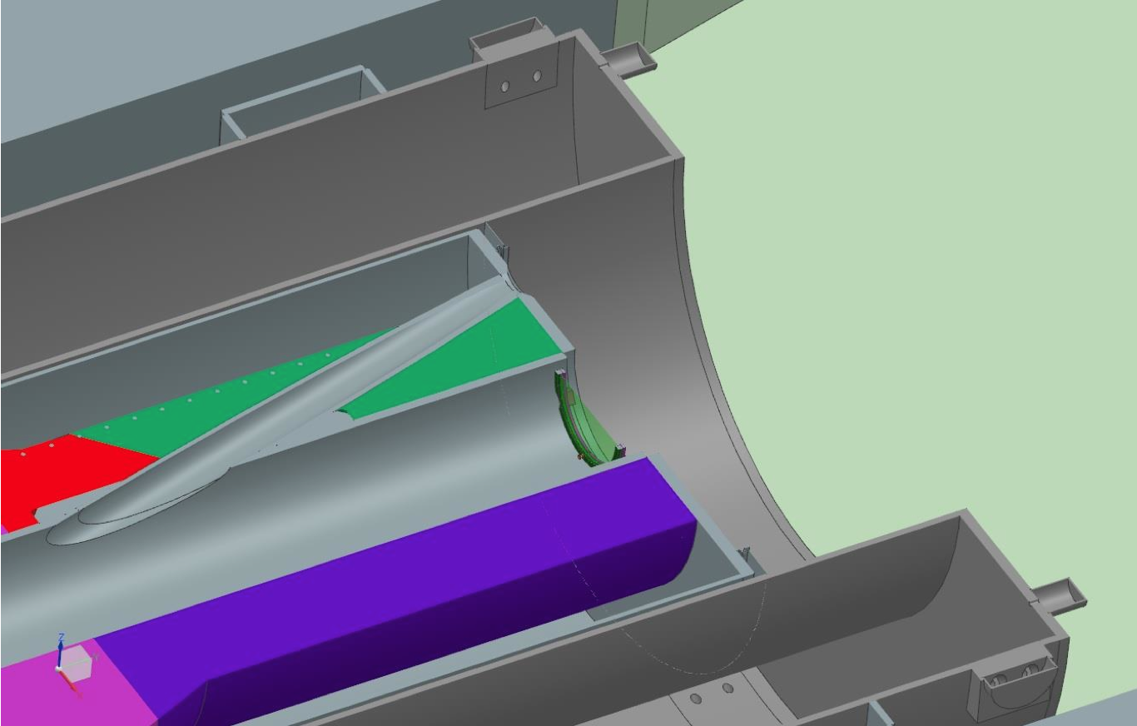
Antiproton absorber location and mount in detail

Slide 30
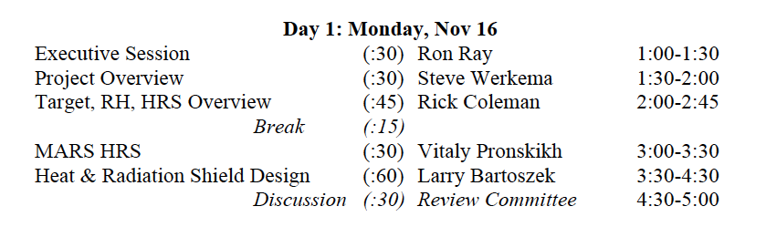
Next Talks

Slide 31
Backup Slides

Slide 32
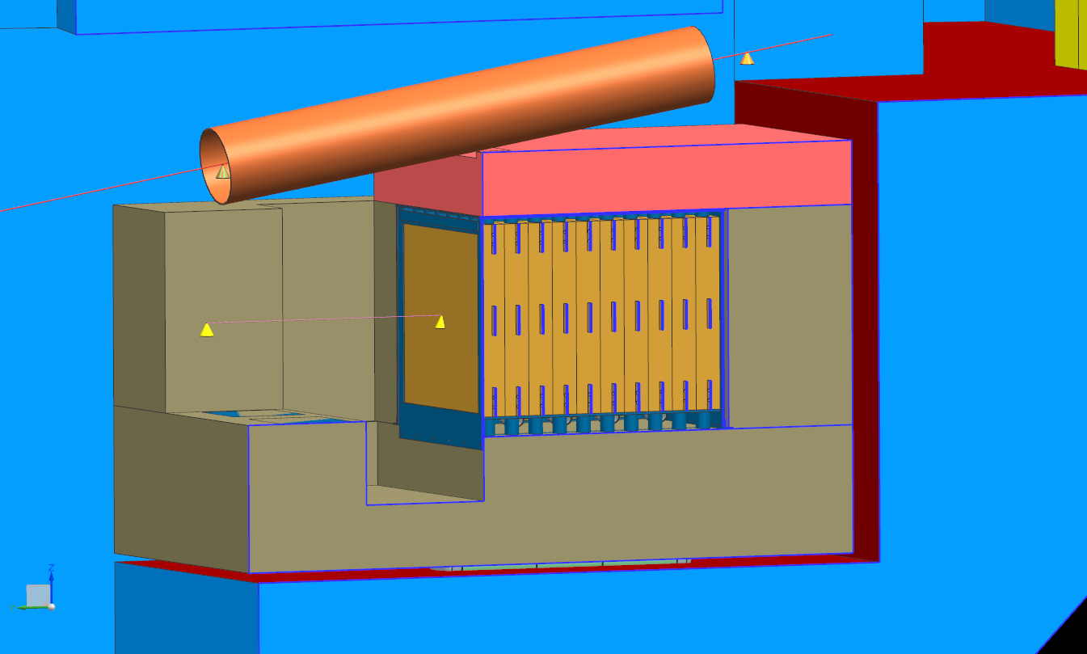
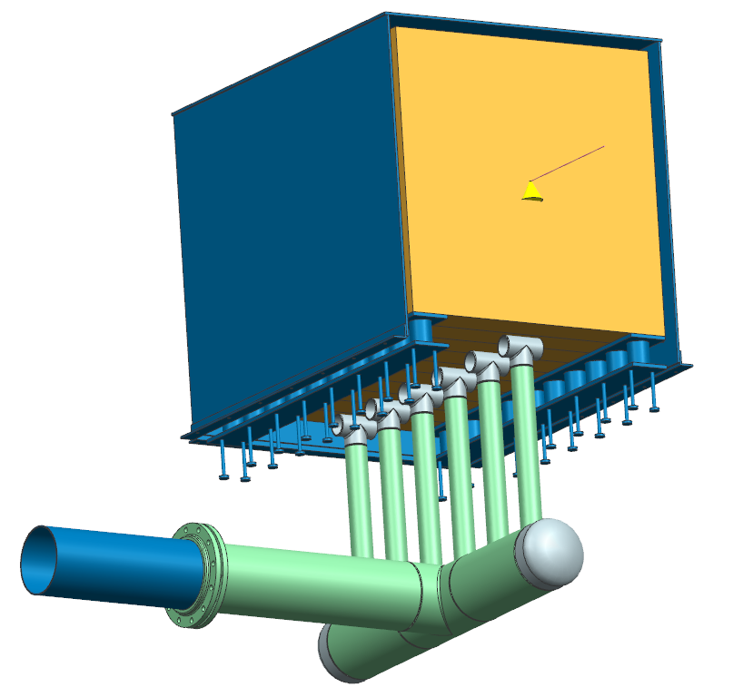
Proton Beam Absorber

Slide 33
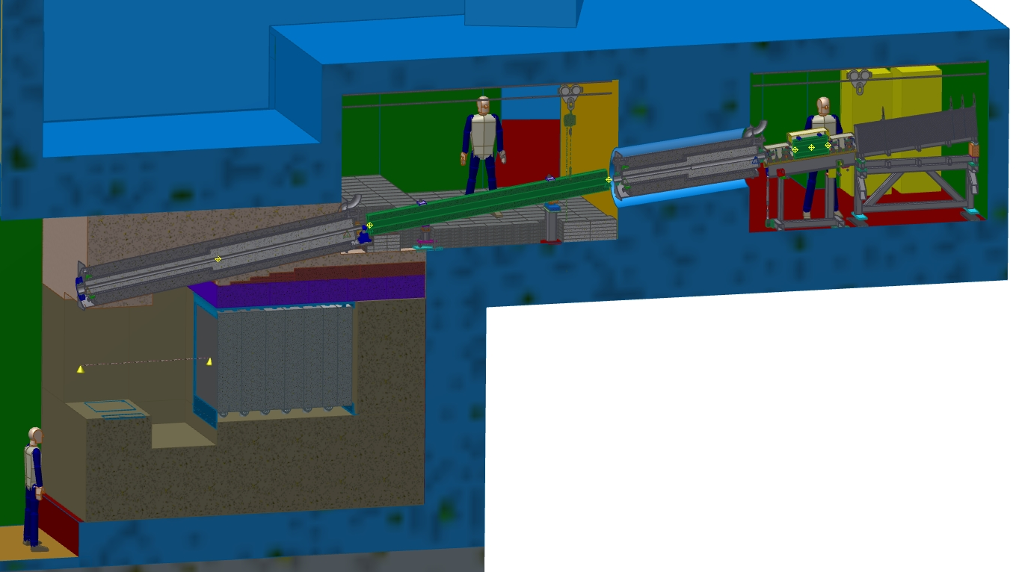
Cross section overview through the Extinction Monitor
Extinction Monitor Filter
Extinction Monitor Detectors
Proton Absorber

Slide 34
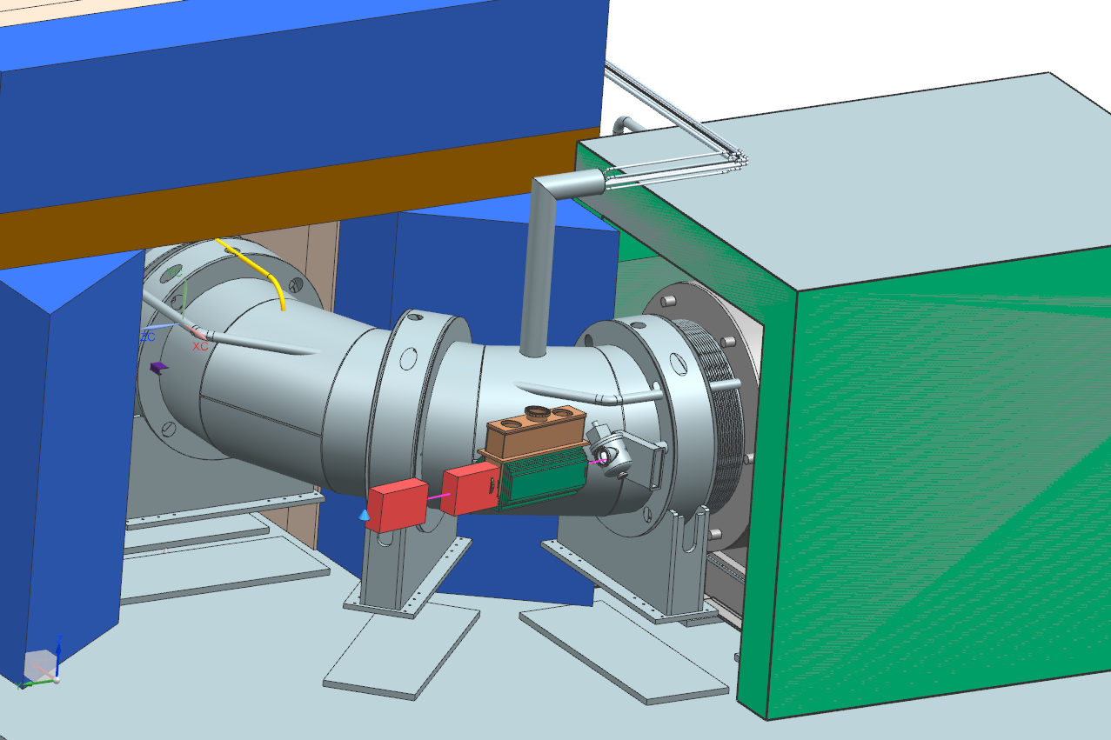
Primary Collimator

Slide 35
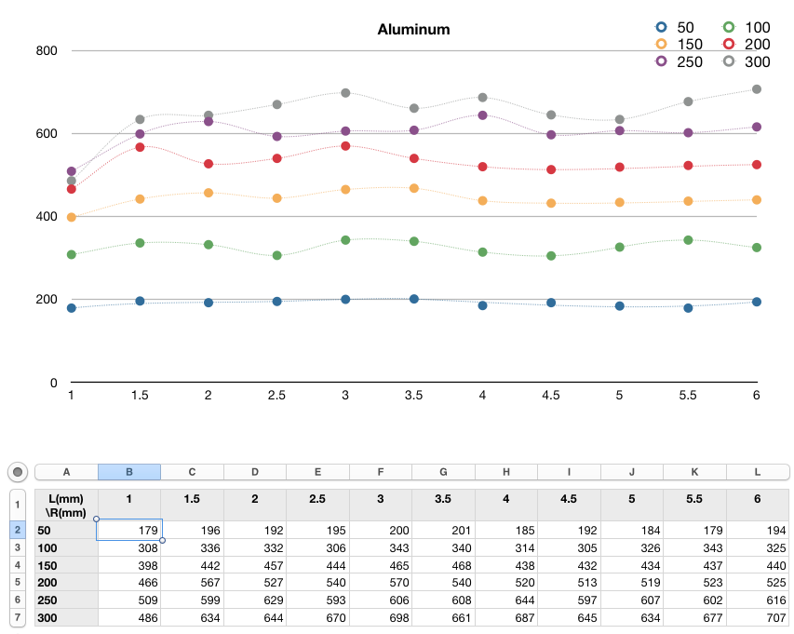
Example of Target Material Calculation vs Yield

Slide 36
Target Alignment/Tolerances Summary
Target dimension tolerances
Target Length = 16 cm ±2 mm
Target Radius = 3 mm ±0.1 mm
Alignment of target with respect to PS/HRS
Replacement target positioning repeatability: ±0.25 mm
Transverse placement w/resp. to PS axis: ±5 mm
Longitudinal placement along PS axis: ±10 mm
Alignment of target with respect to the proton beam:
Transverse beam positioning requirement: ±0.5 mm
Horizontal and vertical angle alignment: ±0.2°

Slide 37
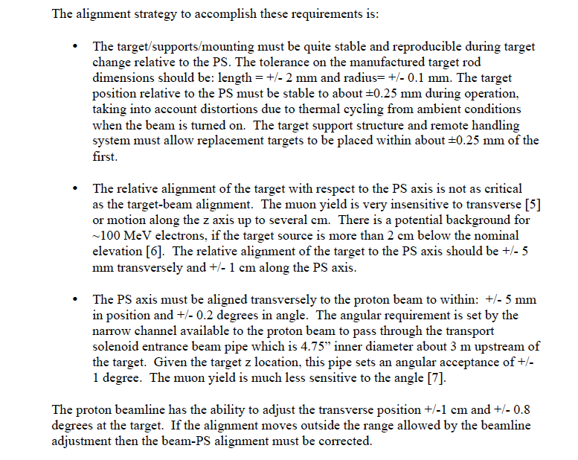
Alignment Details

Slide 38
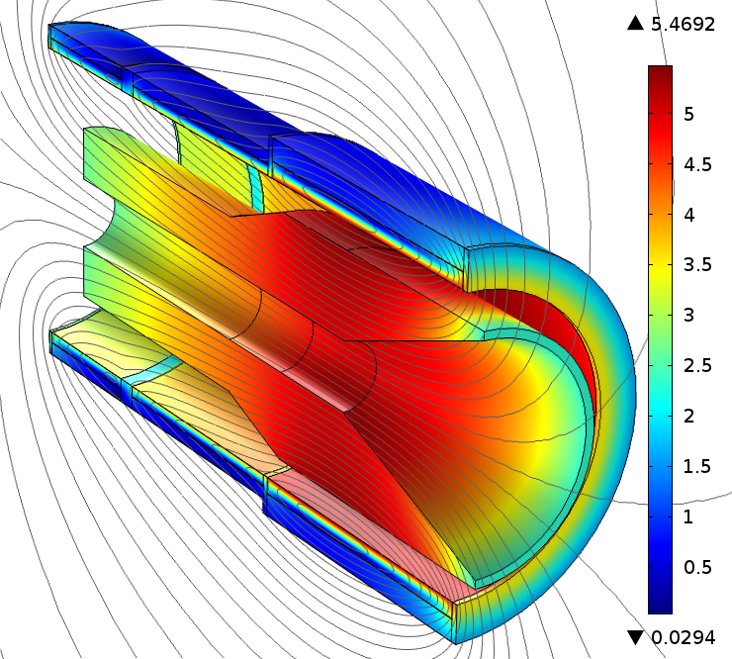
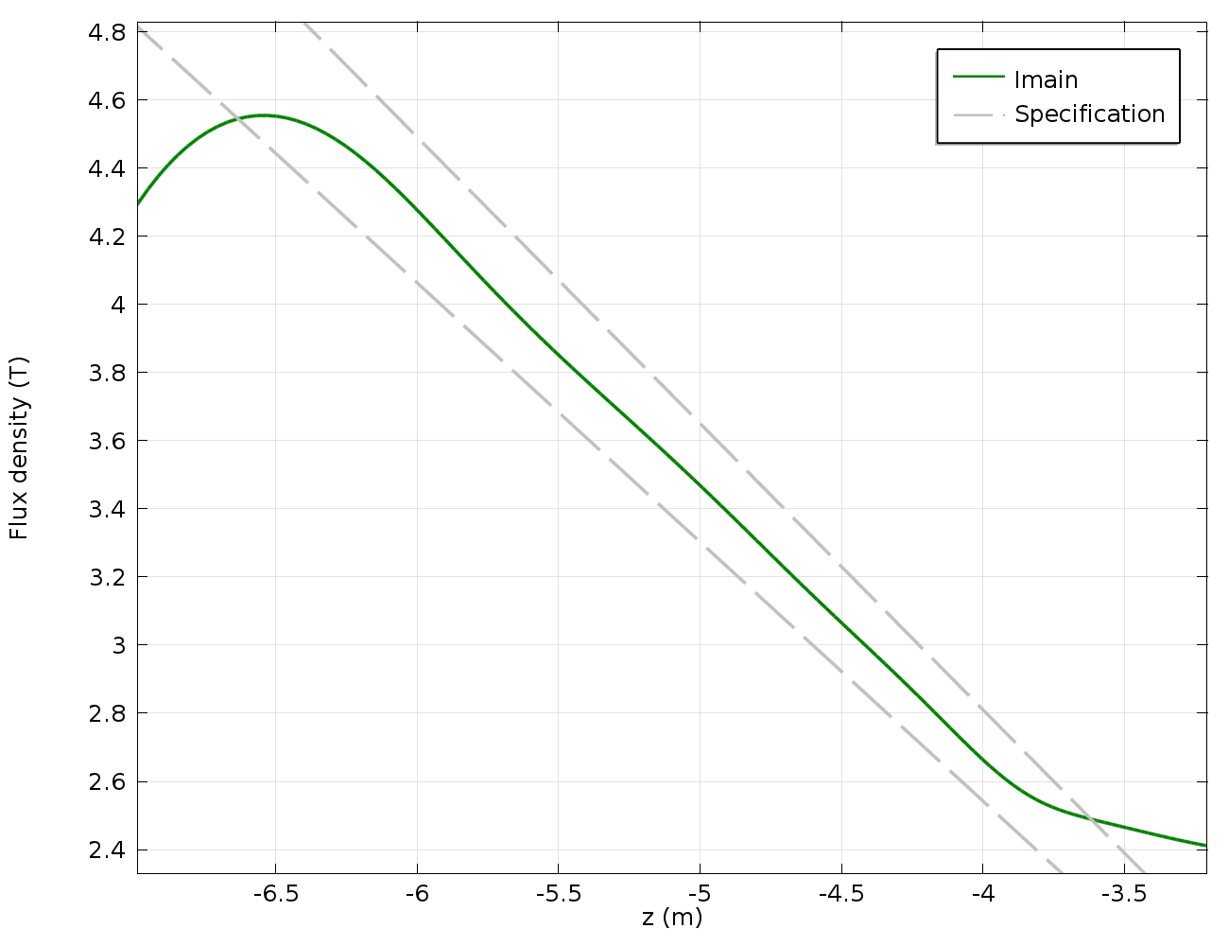
Magnetic field
No trim current variation;
Radiation shield (shown) is made of high-resistivity bronze (magnetic permeability of ≤1.10).

Slide 39
Forces

Slide 40
Quench forces
The HRS is made of a high-resistivity bronze to minimize quench eddy currents;
The peak dynamic axial force on the cold mass due to interaction with the HRS is 115 kN, in the direction opposite to the static PS-TS force;
The 2-way axial support system shall be designed to intercept forces in both directions.

Slide 41
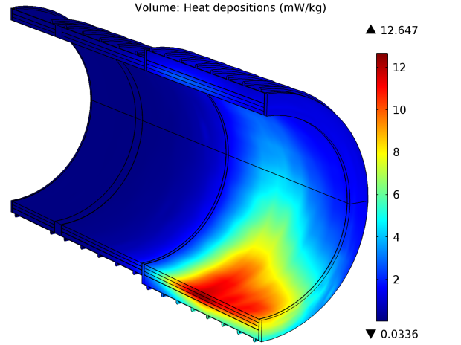
Heat loads

Slide 42
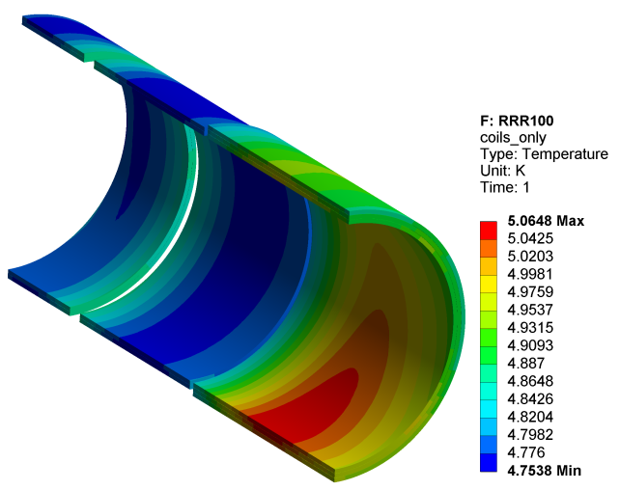
T₀=4.7 K, static+dynamic heat load

Slide 43
  PS Field Quality should not be degraded by materials used in the HRS

Slide 44
Mu2e Accelerator Schedule
S. Werkema
CD-2/3b
CD-3c
Beam to Diagnostic Absorber
CD-4
M4 Enclosure
BO
Resonant Extraction Design
Fabrication & Installation of Res. Extr. ESS, Magnets, Power Supplies, & Electronics
Install ESS
Commission Res. Extr.
External (M4) Beamline Design
Beamline component and pwr supply procurement and fabrication
Extinction & M4DA Section Installation
Hbend Section Installation
Final Focus Section Installation
Target Station Design
Target Prototype Work
Target Fabr.
RH Prototyping
RH Procure & Assembly
RH Install & Test
HRS Procurement & Assembly
HRS
HRS Assembly & Installation
Extinction Design
AC Dipole, Pwr Supply & Collimator Procurement, Fabrication & Install
Extinction Monitor Procurement, Assembly & Install
Instrumentation & Controls Design
Instrumentation & Controls Implementation
Radiation Safety Design
Radiation Safety Procurements, Fabrication & Installation
Delivery Ring RF Design
Delivery Ring RF Procurements, Fabrication & Installation
Beam Operations:
g-2 Beam Operations
M4 Commissioning with single turn Beam
Q3 | Q4 | Q1 | Q2 | Q3 | Q4 | Q1 | Q2 | Q3 | Q4 | Q1 | Q2 | Q3 | Q4 | Q1 | Q2 | Q3 | Q4 | Q1 | Q2 | Q3 | Q4 | Q1 | Q2 | Q3 | Q4 | Q1 | Q2 | Q3 | Q4 | Q1 | Q2 | Q3 | Q4
FY14 FY15 FY16 FY17 FY18 FY19 FY20 FY21

