Slide 1
Radiation Cooled Target Design
Peter Loveridge
STFC/RAL
Mu2e Target, Remote Handling, and Heat & Radiation Shield Review
Nov 16-18 2015

Slide 2
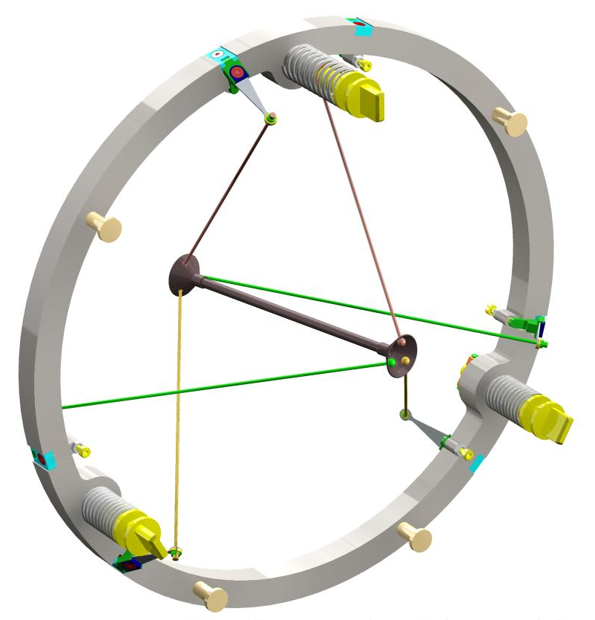
Radiation Cooled Target Concept
Advantages:
No coolant plant required. Eliminates costs associated with design, hardware, plant room space, maintenance, etc.
Eliminating the need for an active coolant greatly simplifies the remote target exchange process.
Eliminates the risk of coolant leaks.
Minimise material for pion production
Remote Handling Features
Mounting ring
Disadvantages:
Limited experience of high temperature target operation.
Oxidation / chemical attack by residual gasses in the target environment
Alignment stability across a wide temperature range.
Creep of the target / support structure
Limited scope for potential future beam upgrades
Tungsten target
End hub
Leaf Spring
Tie rod (spoke)
Tensioning mechanism

Slide 3
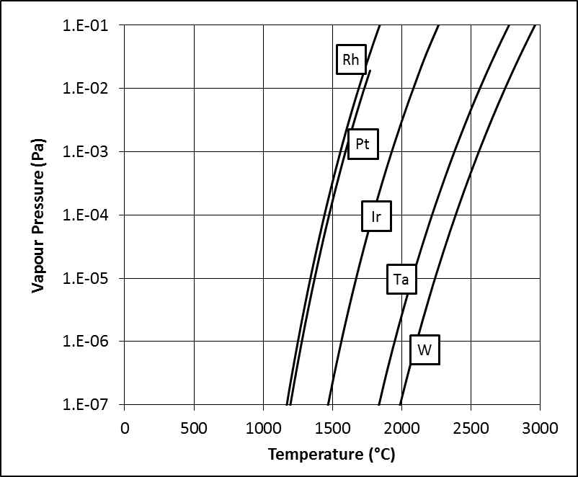
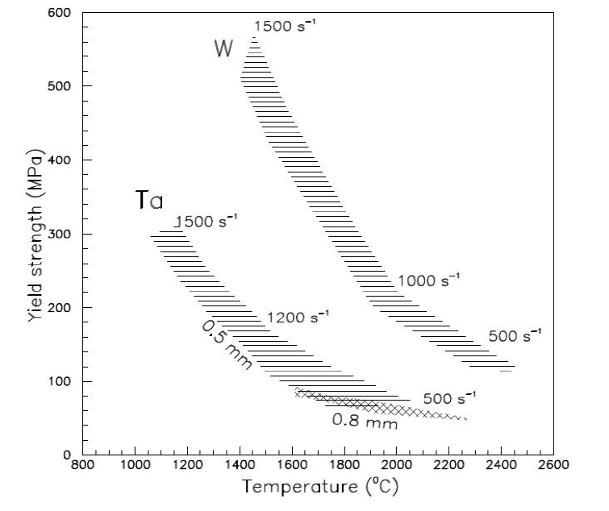
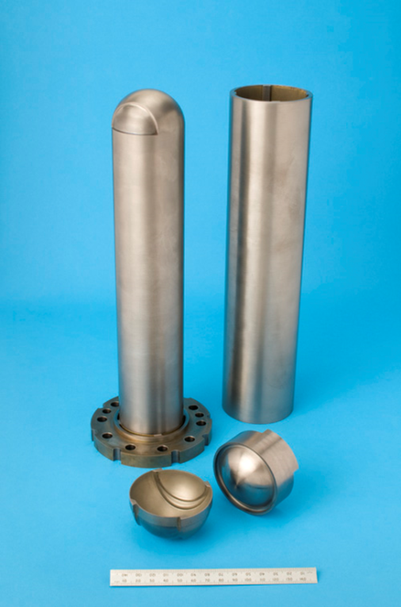
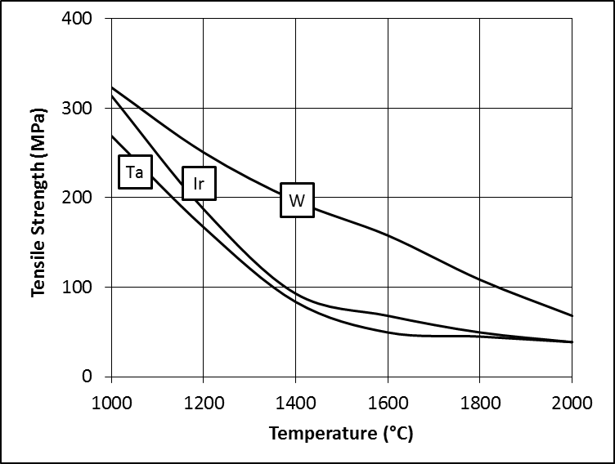
Why Tungsten?
W T_{melt} = 3400°C
Favourable mechanical properties at elevated temperature
Highest Melting Temperature, lowest Vapour Pressure and lowest CTE of all refractory metals
High Z – good for producing pions
Spallation neutron target material of choice
Have run tungsten targets at ISIS for many years
Excellent lifetime under cyclic thermal loading indicated by High temperature shock wire test programme of Bennett et. al.
Ultra-High Temperature Materials, Vol 1, IL Shabalin, Springer, 2014
A Tungsten ISIS Target
J.R.J. Bennett et al., Nucl. Instr. Meth. A (2011).
BL Mordike and CA Brookes, Platinum Metals Review, Vol. 4, pp. 94-99, 1960.

Slide 4
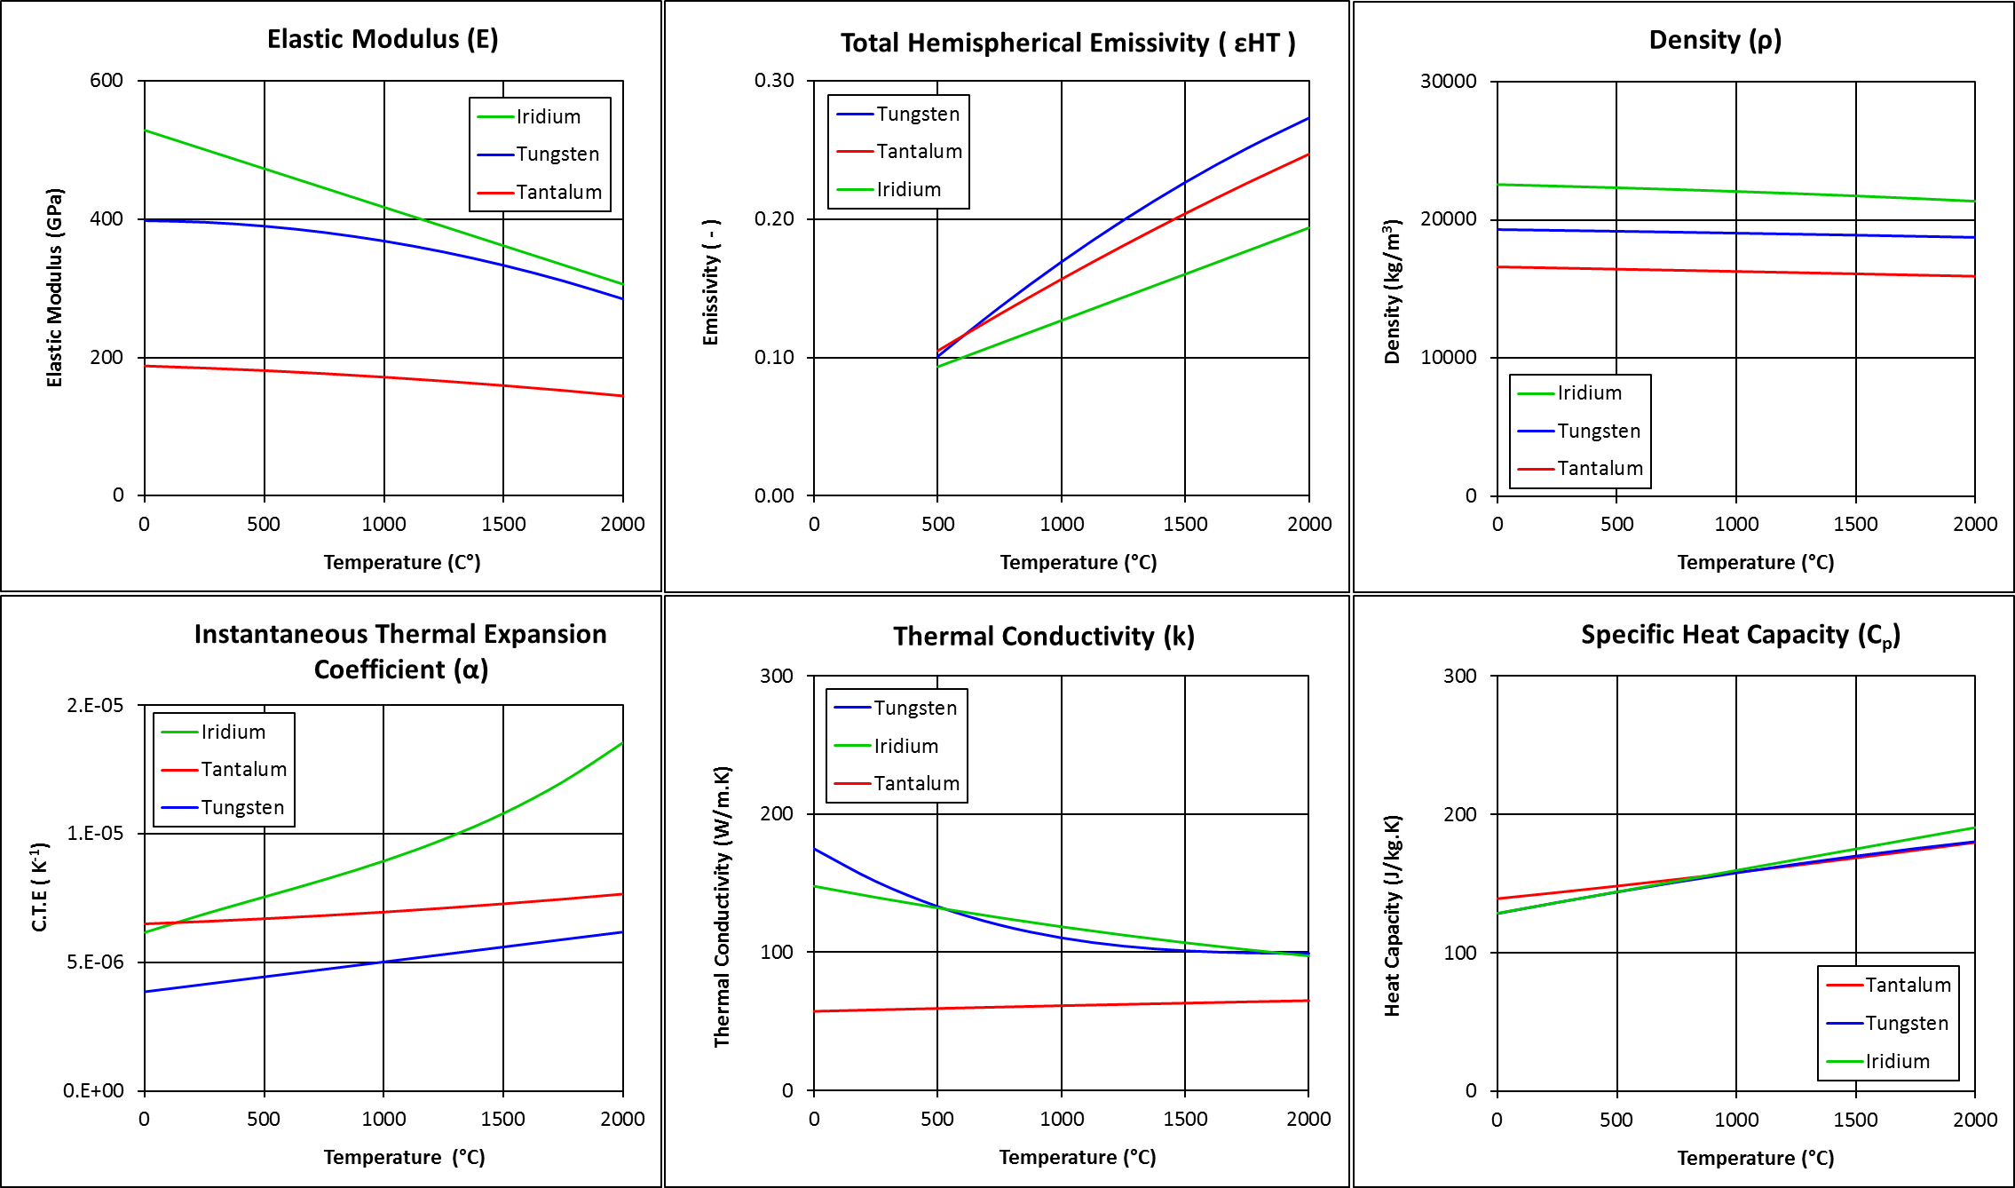
Material Property Data: W, Ta, Ir

Slide 5
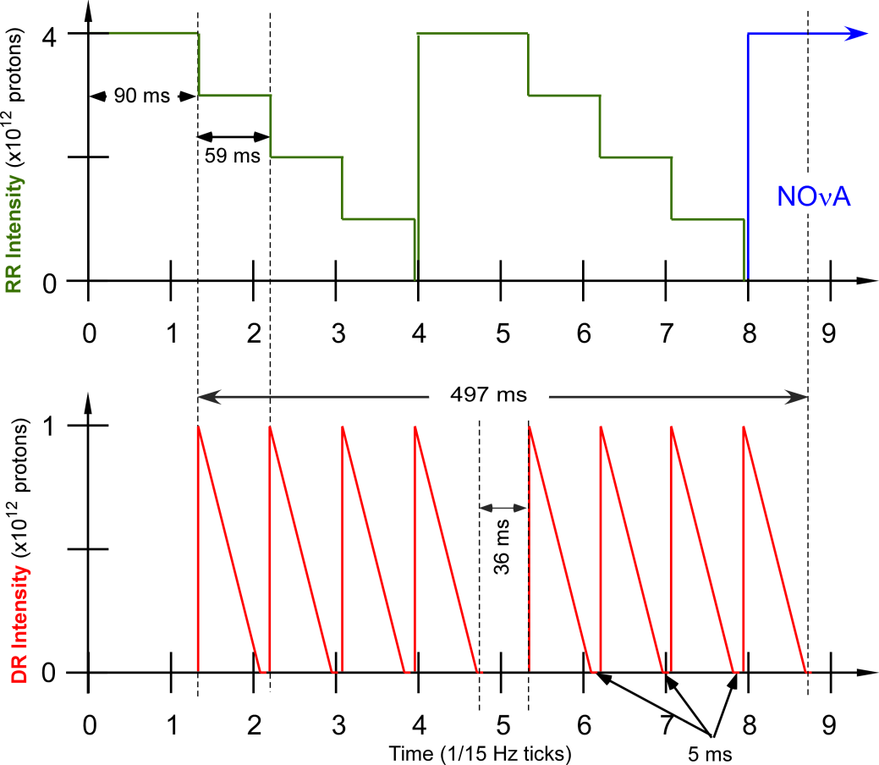
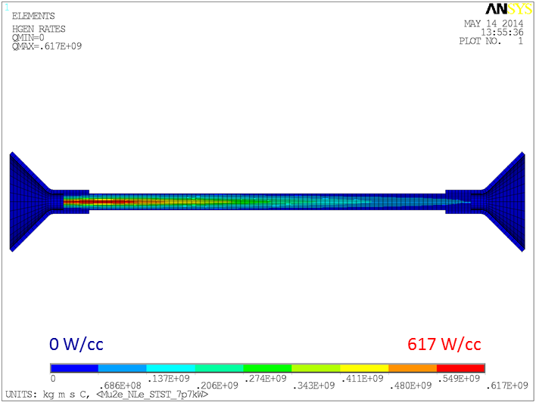
Beam Parameters and Deposited Energy
Beam kinetic energy | 8 GeV
Beam spot shape | Gaussian
Beam spot size | σx = σy = 1 mm
Main Injector cycle time | 1.333 sec
Number of spills per MI cycle | 8
Duration of Spill | 54 msec
Number of protons per spill | 1 Tp
Duty Factor | 32 %
Average Beam Power | 7.7 kW
Average Beam Current | 1 μA
This figure shows the first eight Booster ticks of a Main Injector cycle. The top graph shows the Recycler Ring beam intensity as a function of time. The bottom plot shows the Delivery Ring beam intensity as a function of time.
Ref: “Mu2e Technical Design Report,” doc-db #4299, October 2014.
For a beam power of 7.7 kW, 580W is deposited as heat in the target (FLUKA)

Slide 6
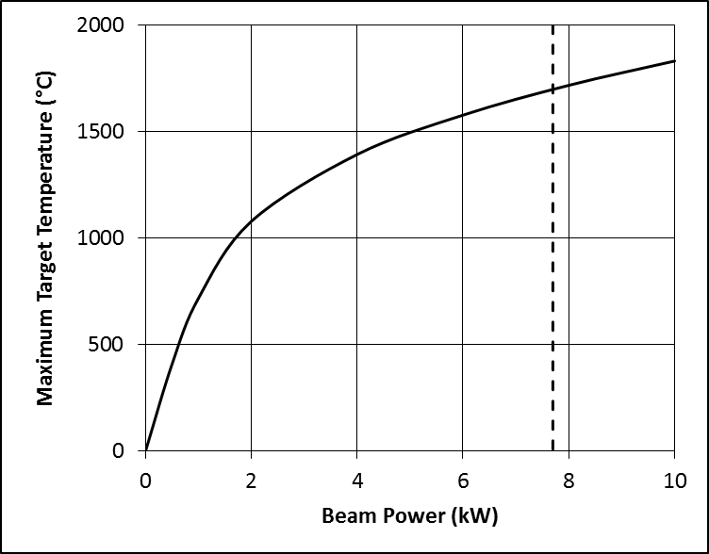
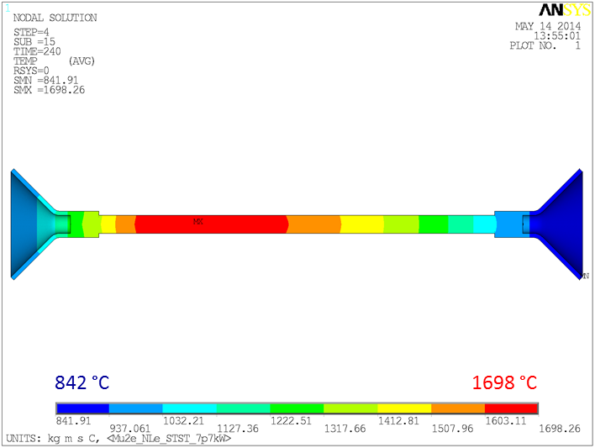
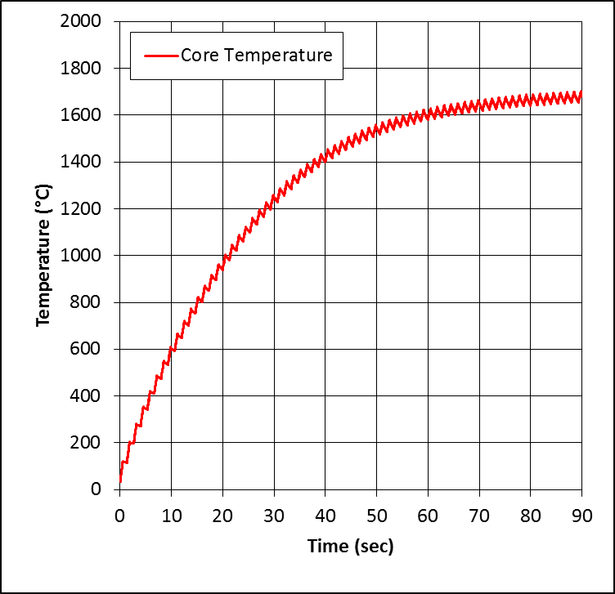
Target Temperature
Heat transfer dominated by thermal radiation
Q = A ε(T) σ (T_{hot}⁴ - T_{cold}⁴)
When beam is on target heats up until it is able to dissipate the deposited power
That “equilibrium temperature” depends on heat load, emissivity and surface area.
±20% in heat load equates to ±100°C in operating temperature
Equilibrium temperature distribution assuming 580W and ε(T ) from the literature

Slide 7
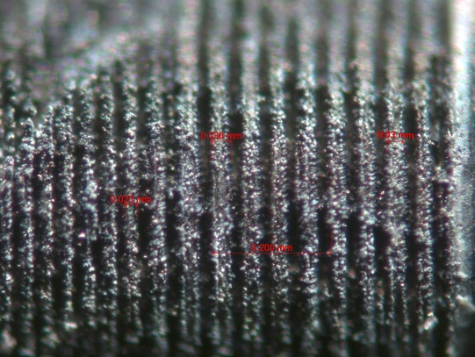
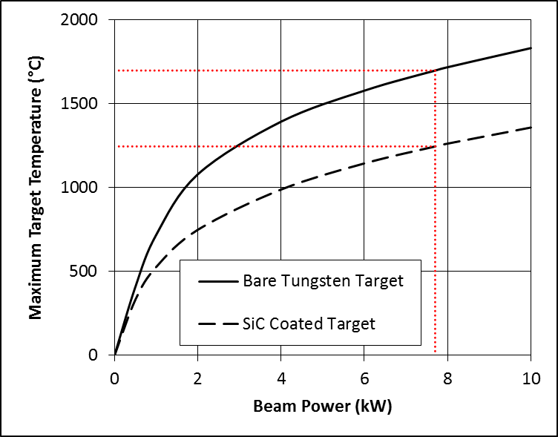
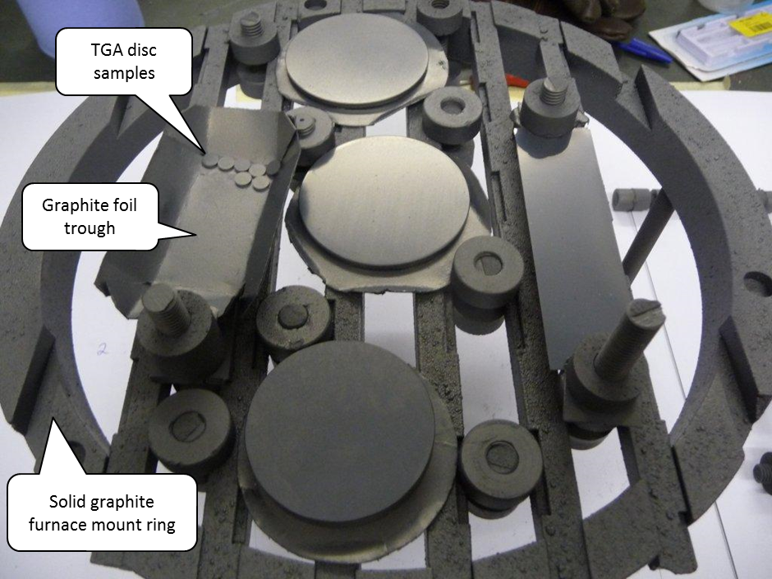
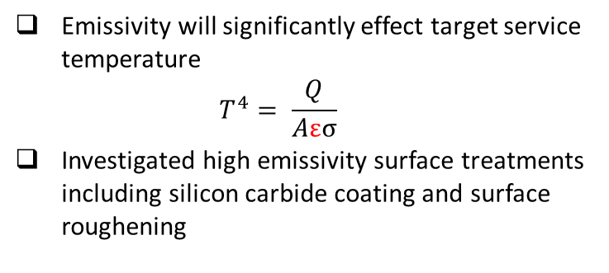
Target Emissivity
Emissivity will significantly effect target service temperature
$T^{4}= \frac{Q}{Aεσ}$
Investigated high emissivity surface treatments including silicon carbide coating and surface roughening
25 μm wide grooves laser machined
into a tungsten surface
1700°C
1250°C
Tungsten samples after CVD coating with silicon-carbide

Slide 8
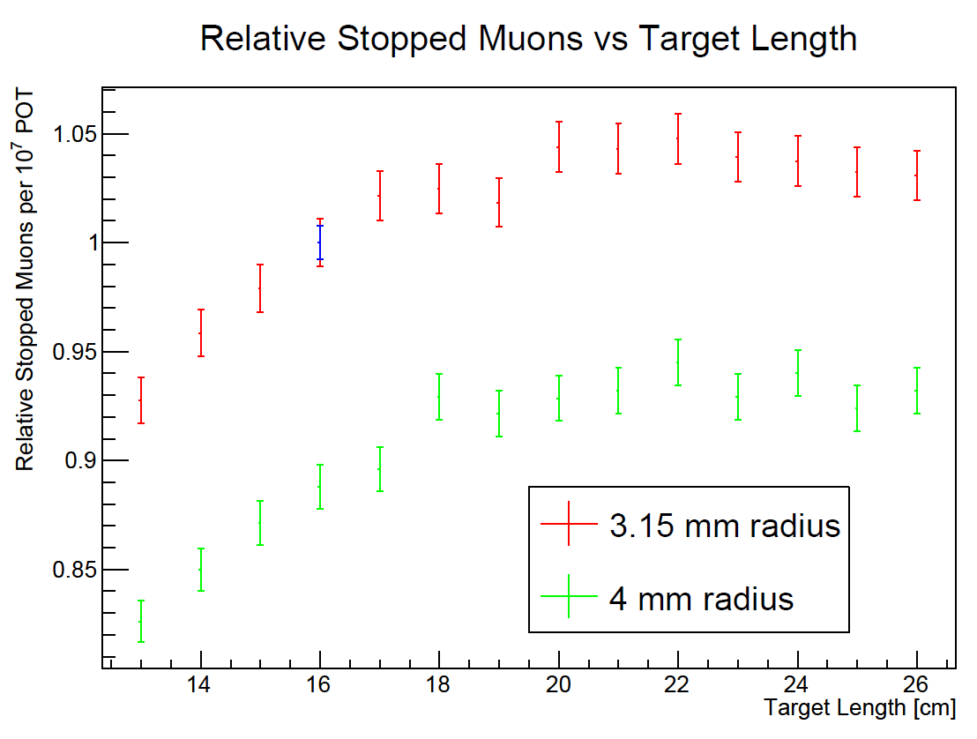
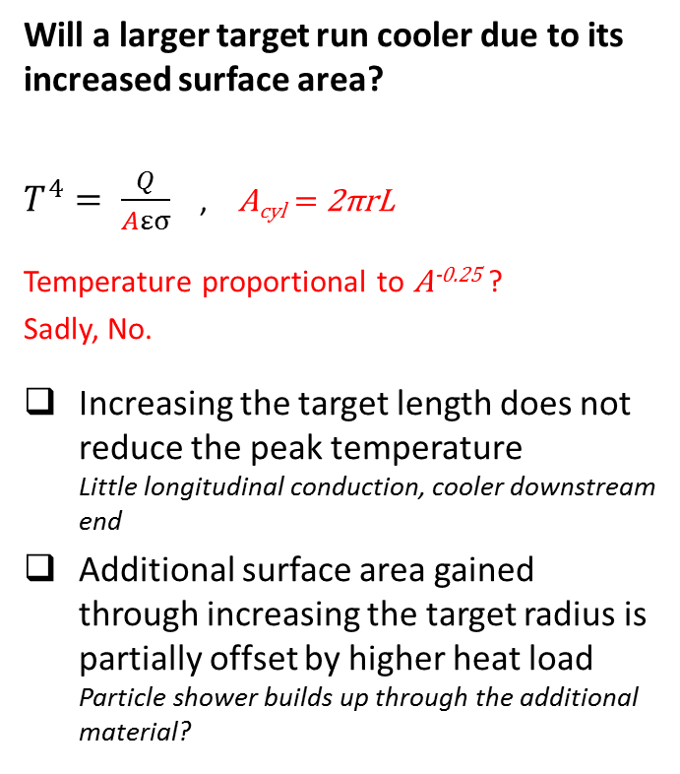
Target Surface Area
Will a larger target run cooler due to its increased surface area?
$T^{4}= \frac{Q}{Aεσ}$ , A_{cyl} = 2πrL
Temperature proportional to A^{-0.25} ?
Sadly, No.
Increasing the target length does not reduce the peak temperature
Little longitudinal conduction, cooler downstream end
Additional surface area gained through increasing the target radius is partially offset by higher heat load
Particle shower builds up through the additional material?
Particle yield optimisation suggests radius ≈ 3mm, i.e. r ≈ 3σ
Ref: KR Lynch and JL Popp, Mu2e doc-db #3752, 15 January 2014.
 | Baseline | “Longer” | “Fatter”
Radius (mm) | 3.15 | 3.15 | 4
Length (mm) | 160 | 220 | 160
Heat Load (W) | 580 | 610 | 700
Surface Area cm² | 31.7 | 43.5 | 40.2
T_{max} (°C) | 1698 | 1698 | 1671
Heat Load (FLUKA) as a function of target size

Slide 9
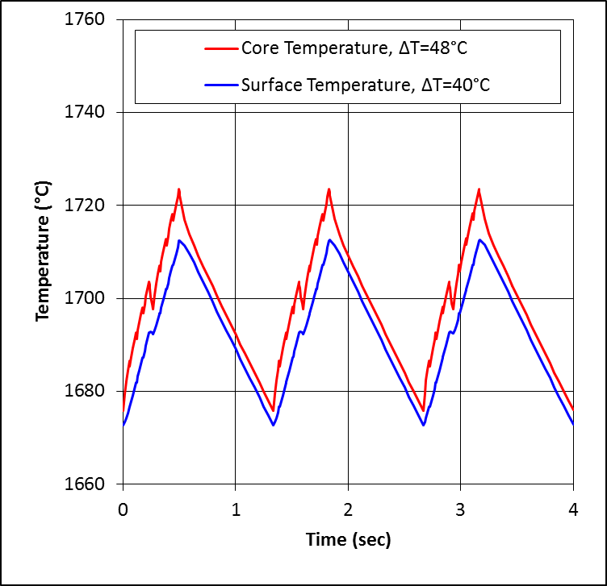
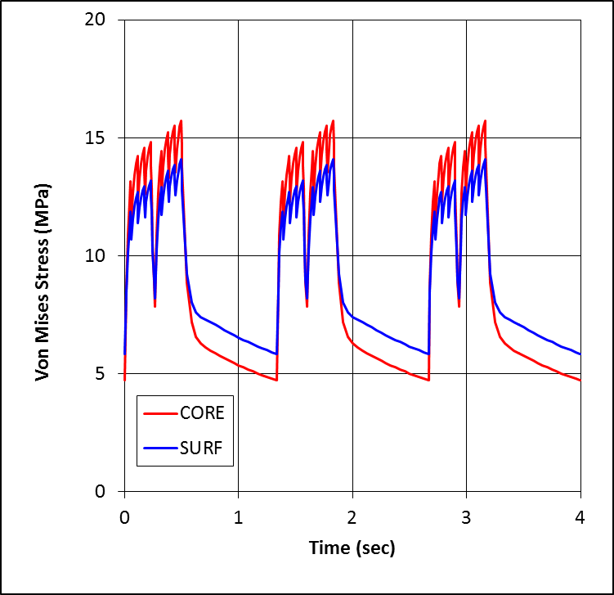
Thermal Stress in the Target
The beam cycle causes transient thermal stresses in the target rod
Thermal stress generated by radial temperature gradients in the rod
When beam is “on” radial temperature gradient and thermal stress increase because heat deposition is biased towards the centre of the rod
When beam is off the heat spreads by thermal conduction and the thermal stress decreases
Tensile stress at the surface, compressive stress in the core
~24 Million cycles per year of continuous running on a 1.333 sec cycle time
Temperature (above) and Von-Mises Stress (below) at a Z slice near the shower-max

Slide 10
Off-Centre Beam Effects
Can a misaligned target/beam lead to distortion of the target?
Target radius ≈ 3σ
Worst case for bending is found for an offset of ≈2σ (i.e. 2mm)
2mm Offset Condition:
Heat load reduced by ≈20%
Equilibrium temperature reduces accordingly to about 1600°C
Little change in maximum stress
Very little bending, about 20μm, is of the same order as radial thermal expansion of the rod
Heat Loads (FLUKA) for the well centred case (above) and 1mm offset case (below). There is no significant change in local peak, but the integrated heating is ~20% lower in the 2mm offset case.

Slide 11
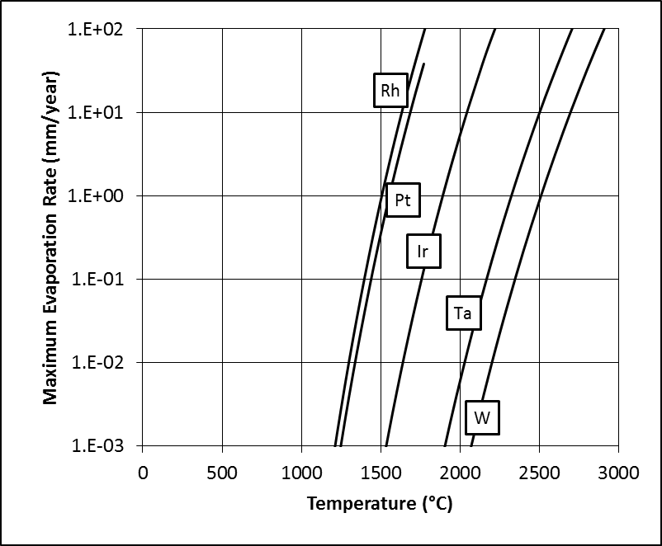
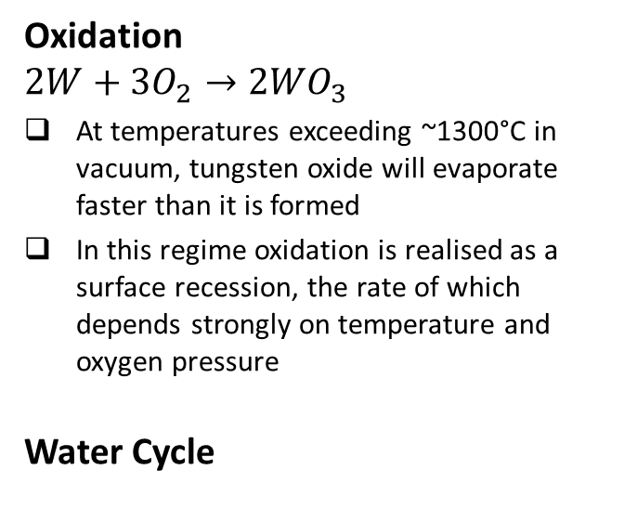

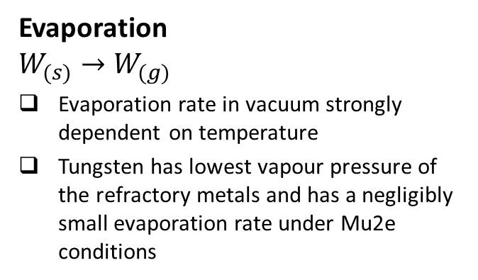


Evaporation / Chemical Attack of the Target
Evaporation
$$W_{(s)}→W_{(g)}$$
Evaporation rate in vacuum strongly dependent on temperature
Tungsten has lowest vapour pressure of the refractory metals and has a negligibly small evaporation rate under Mu2e conditions
Oxidation
$${2W+3O}_{2}→{2WO}_{3}$$
At temperatures exceeding ~1300°C in vacuum, tungsten oxide will evaporate faster than it is formed
In this regime oxidation is realised as a surface recession, the rate of which depends strongly on temperature and oxygen pressure
Water Cycle
$$2H_{2}O→2H_{2}+O_{2}$$
water dissociates at
the hot tungsten
$$WO_{3}+3H_{2}→W+{3H}_{2}O$$
$$2W+{3O}_{2}→2WO_{3}$$
The oxide is then reduced by the freed hydrogen
the free oxygen then reacts with the hot tungsten
Vacuum evaporation rates for several pure metals calculated from their vapour pressure using kinetic theory

Slide 12
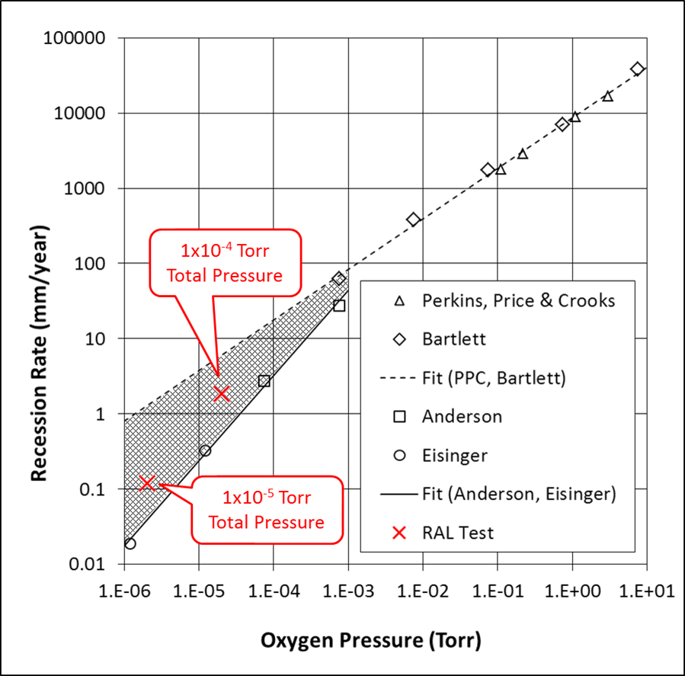
Target Oxidation Lifetime
Surface recession of initially cylindrical tungsten rods heated in a low oxygen pressure. Reproduced from Perkins, Price and Crooks, “Oxidation of Tungsten at Ultra-High Temperatures,” Lockheed Missiles and Space Company, November 1962.
Must prevent Oxygen coming into contact with hot target
Good quality vacuum
Reduce target temperature – adopt forced convection cooling, helium or water
Apply oxidation resistant coating
Above: Literature data on recession rate of tungsten as a function of oxygen pressure @ 1700°C. Note the RAL test data highlighted in red.
Baseline: need good vacuum quality, at least 10⁻⁵ Torr, to permit a long target life
Recall 1-2mm diameter spokes, 1-2 mm thick hub, 6mm diameter target rod

Slide 13
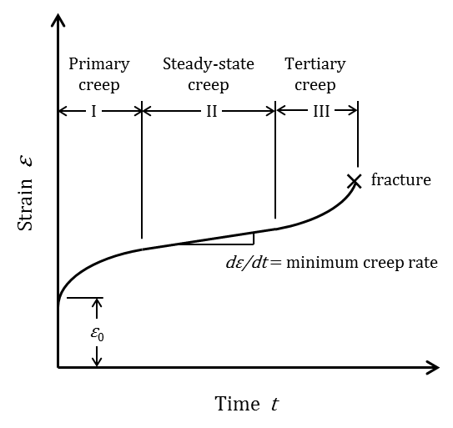
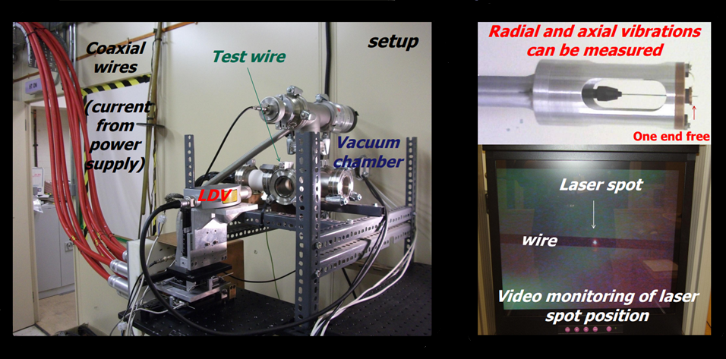

Creep / Sag in the Target Rod
As a rule-of-thumb creep tends to become significant at temperatures beyond T_{melt}/2, ~1840K in tungsten
Self-weight could result in an unwanted permanent “sag” in the target rod
Some literature data for Mu2e-like conditions although not fully conclusive
The little wires tested by Bennett and Skoro at RAL were subject to similar bending stress and “did not suffer from creep”
Steady-state creep relation proposed by Purohit et al:
$\dot{ε}=1.3×{10}^{3}\left[e^{\frac{−53370}{T}}\right]×σ^{3.53}$ [h⁻¹]
range σ ≤ 20MPa, 1500 ≤ T ≤ 2900 K
Suggests only ~10μ-strain /year for Mu2e target
A. Purohit et al, development of a steady state creep behavior model of polycrystalline tungsten for bimodal space reactor application, Argonne National Lab., Argonne, Illinois, February 1995.

Slide 14
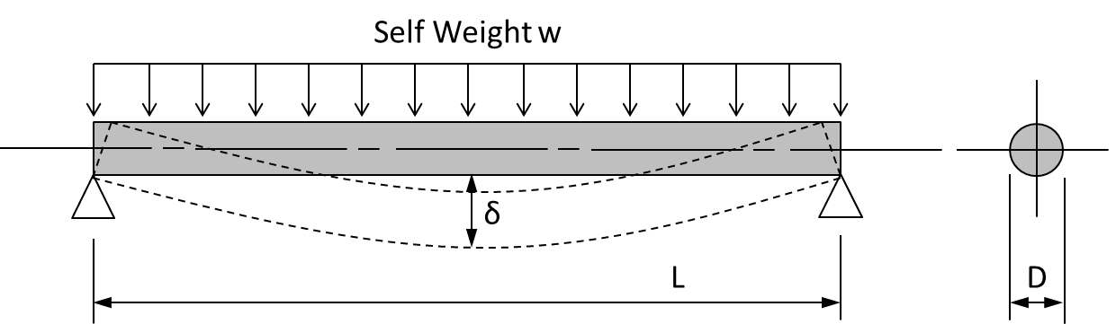



Creep / Sag in the Target Rod
Propose a test to quantify the expected creep rate under “Mu2e-like” conditions
Design “Handles”
Increase target diameter
Reduce target length
Move supports inboard
LaO₂ doped “Anti-sag” tungsten
Reduce operating temperature through high emissivity surface treatment
$$w=\frac{πD^{2}ρg}{4} I=\frac{πD^{4}}{64}{ M}_{max}=\frac{wL^{2}}{8}$$
$$σ_{max}=\frac{M_{max}y}{I}=\frac{L^{2}ρg}{D} ⇨Stress (and Strain)∝ {L^{2}}/D$$
$$δ_{max}=\frac{5wL^{4}}{384EI}=\frac{5ρgL^{4}}{24ED^{2}} ⇨Deflection∝ {L^{4}}/{D^{2}}$$

Slide 15
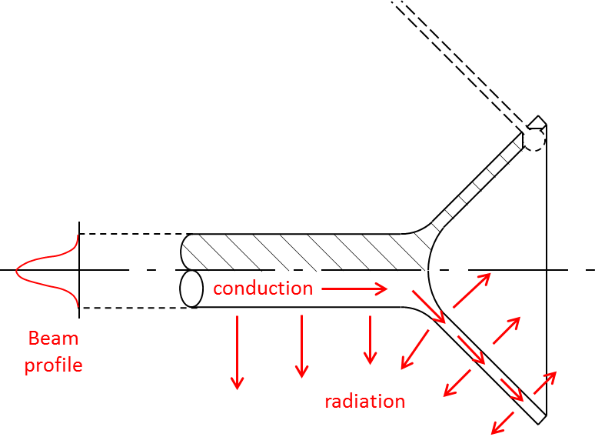
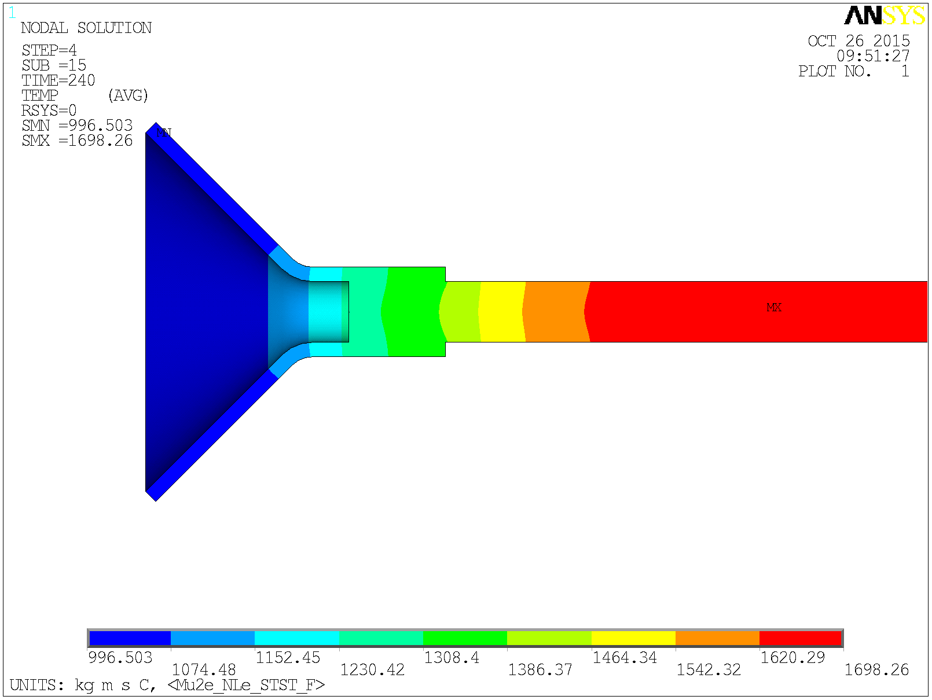
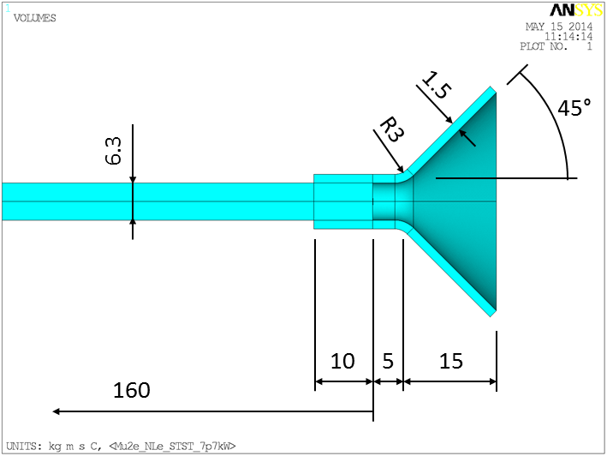
The Hub
The hub provides the mounting point for the tie rods (AKA spokes)
No direct beam heating in the conical part
Thin cone wall limits heat conduction from the hot target rod towards the spoke mounts
Heat radiates away from the cone surfaces
Limits the maximum spoke temperature to ~1000°C
Plan to make target and hub as one integral part
997°C
1698°C

Slide 16
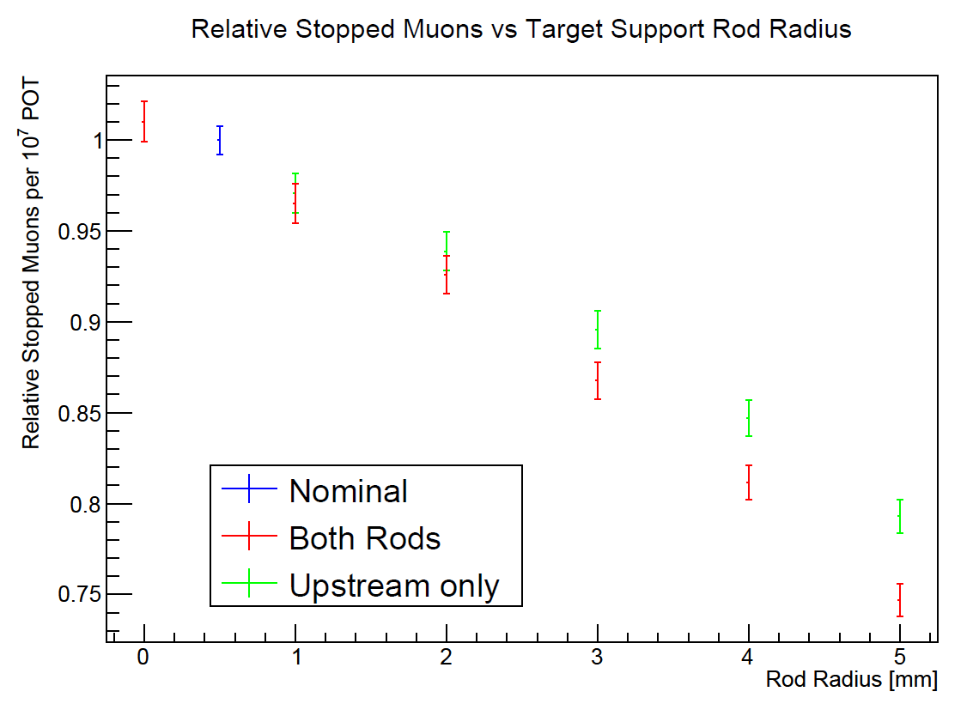
The Tie Rods (A.K.A Spokes)
Six tie rods act as the spokes of the “bicycle wheel” structure, connecting the target to its support ring
Minimum number of spokes for a statically determinate system
Spokes can be tungsten or tantalum
A spoke diameter in the range 1 – 2 mm is proposed. Compromise based on:
  Large diameter more robust, lower tensile stress, margin for chemical erosion, ease of manufacture
  Small diameter for efficient particle production
Ref: KR Lynch and JL Popp, Mu2e doc-db #3751, 15 January 2014.
Note: “Zero-Mass” support structure for optimum physics performance.

Slide 17
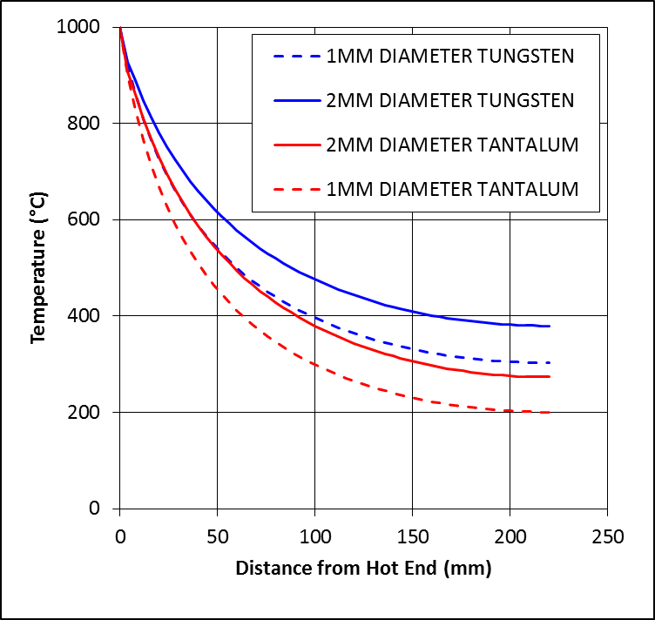
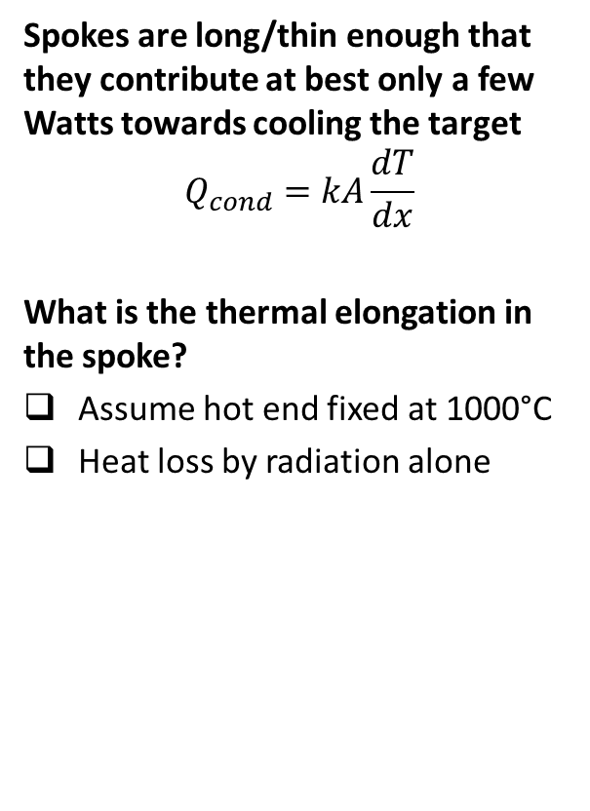
Spoke Temperature
Spokes are long/thin enough that they contribute at best only a few Watts towards cooling the target
$$Q_{cond}=kA\frac{dT}{dx}$$
What is the thermal elongation in the spoke?
Assume hot end fixed at 1000°C
Heat loss by radiation alone
Diameter
1 – 2 mm
L=220mm
Diameter (mm) | 1 | 2 | 1 | 2
Length (mm) | 220 | 220 | 220 | 220
Material | W | W | Ta | Ta
T hot (°C) | 1000 | 1000 | 1000 | 1000
T cold (°C) | 303 | 379 | 201 | 274
ΔL (mm) | 0.39 | 0.46 | 0.48 | 0.59
Temperature distribution along a spoke assuming a worst case where no heat is conducted from the cold end into the support ring, i.e. Qc=0

Slide 18
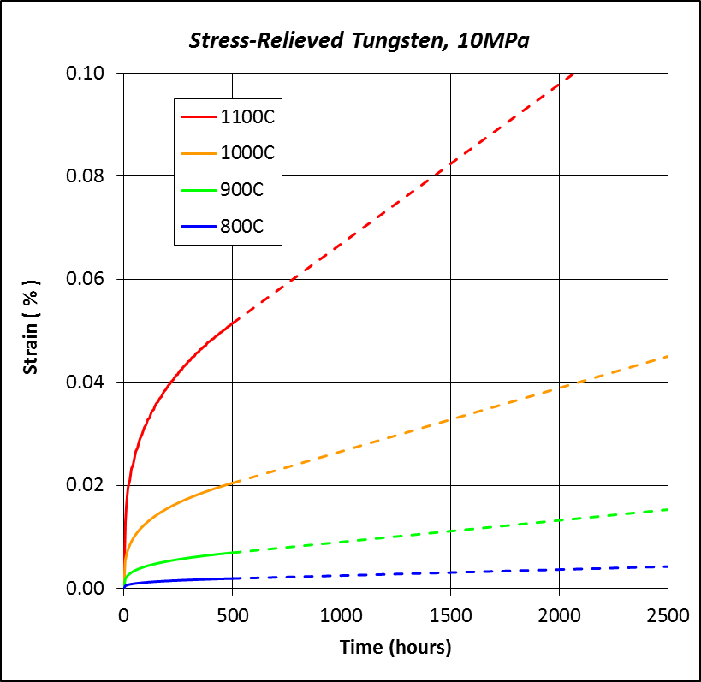
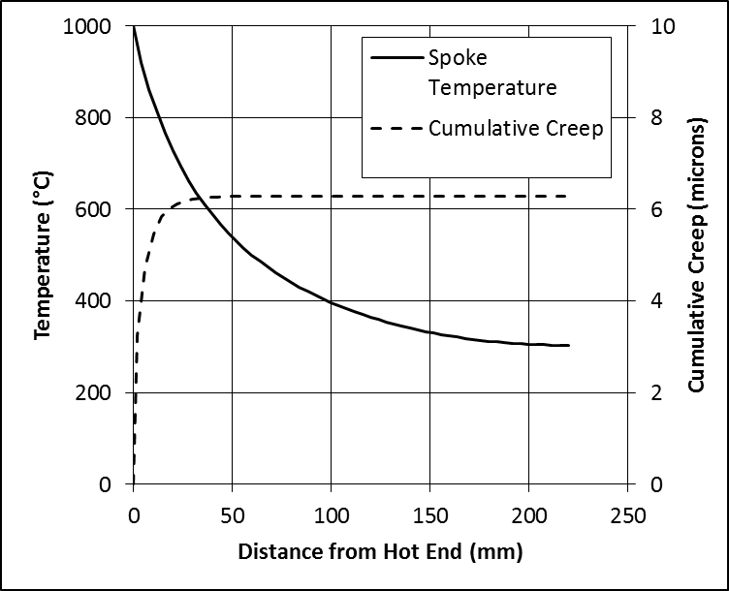
Creep in the Spokes
“Bicycle wheel” structure relies on maintaining spoke tension for its stability
Any creep (elongation) of the spoke must be taken up by the spring pre-load
Plan to limit the spoke maximum temperature to 1000°C to avoid creep issue
Temperature profile (solid line) and cumulative creep (dashed line) for 1 year at 10 MPa in a 1mm diameter 220mm long stress-relieved tungsten spoke
Extrapolated creep law plots for stress-relieved tungsten under 10MPa applied stress
[Ref Gallet et al]
D Gallet, J Dhers, R Levoy, “Creep Laws for Refractory Metals and Alloys at Temperatures Between 900 and 1100°C,” Tungsten, Hard Metals and Refractory Alloys, vol. 5, pp. 189-196, 2000.

Slide 19
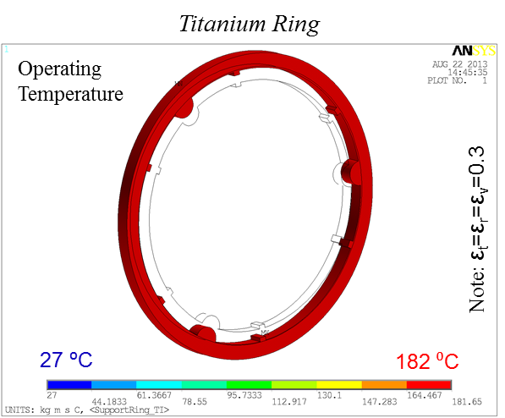
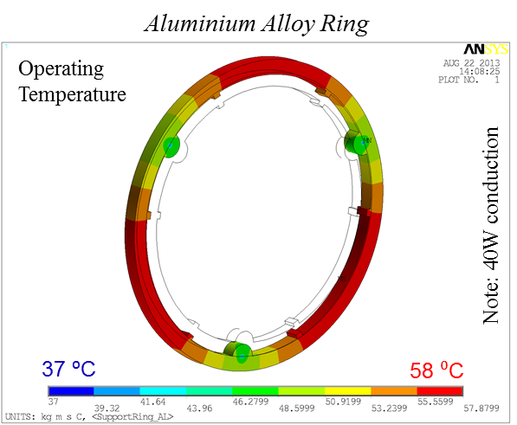
The Support Ring
Concept 1 ✔
Titanium Support Ring
Can operate without conduction link between support ring and water-cooled vessel
Ring heat-load transferred to vessel by thermal radiation
Ring material needs low CTE, high working temperature. Can tolerate poor thermal conductivity - Titanium
Concept 2 ✘
Aluminium Alloy Support Ring
Requires a conduction link between support-ring and water-cooled vessel
Deposited heat is conducted through the ring to the mounts and into the vessel
Ring material needs high Thermal conductivity. Can tolerate high CTE due to low working temperature – Aluminium Alloy

Slide 20
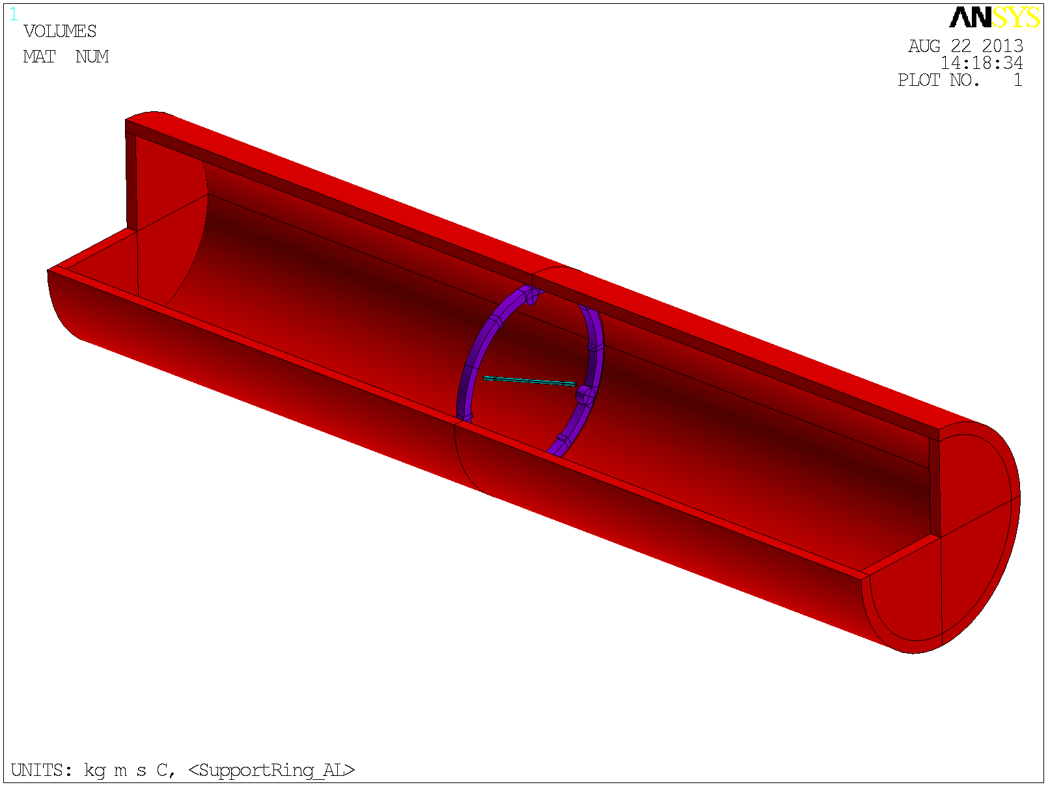
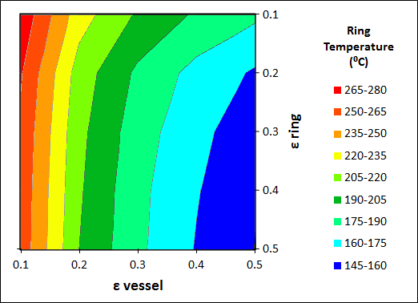

Support Ring Temperature
Radiated Heat Balance
$Q_{net}=Q_{incident}−Q_{reflected}−Q_{emitted}$
$Q_{i} Q_{i}\left(1−ε\right) εσT^{4}$
$direct indirect$
At thermal equilibrium $Q_{net}=zero$
ANSYS radiation heat transfer FE model
Support Ring Heat loads
Thermal Radiation | 10W < Q_{rad} < 100W
Secondary Particle Heating | 10W uniformly distributed
Conduction Along Spokes | 6x0.5=3W

Slide 21
Dimensional Stability of the Target Assembly
How does the structure respond when the beam is switched on?
Spoke tension increases
Spring mounts prevent over tension of spokes
Target axis angled by 13° with respect to solenoid (mounting) axis - Need 4 “long” spokes and 2 “short” spokes
This asymmetry in the structure leads to a lateral displacement of target ends of the order ±100 microns when beam is on
Longitudinal displacements negligible compared to thermal elongation of the target
ANSYS finite element model of the target support structure.
A spring rate of 10N/mm and a pre-extension of 1mm are assumed.

Slide 22
Stiffness of the Target Assembly
A longitudinal 10N force applied at the target rod results in a displacement of 1mm.
Providing we have sufficient spring pre-tension the first mode is a bulk translation of the target rod at ~48 Hz
We can tune the spring rate and pre-tension to avoid “60Hz”
No significant change in 1st mode frequency between beam on/off scenarios
Mode 1 driven by spring rate
Modes 2 & 3 driven by spring pre-tension and spoke diameter

Slide 23
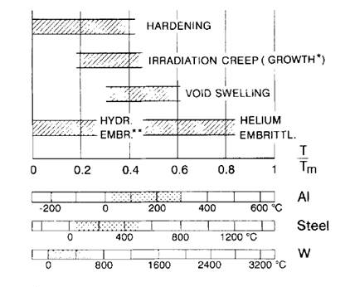
Radiation Damage Considerations
Mu2e peak flux at target face is similar to existing ISIS targets
DPA rate 10x faster for Mu2e
But ISIS targets typically operate for about 5 years and are replaced only when instrumentation fails. Recall 1 year Mu2e target life.
Much higher service temperature for Mu2e radiation cooled target means that damage effects could be different
 | ISIS | Mu2e
Beam kinetic energy (GeV) | 0.8 | 8
Average Beam Current (μA) | 200 | 1
Average Beam Power (kW) | 160 | 8
Beam shape | Gaussian | Gaussian
Beam sigma (mm) | 16 | 1
Peak Flux on target front face (μA/cm²) | 12.4 | 15.3
Peak DPA / year * | 27 | 260
Helium Gas Production (appm/DPA) * | 10 | 20
Typical Target life (years) | 5+ | 1
* Brian Hartsell mars calculation for the RADIATE collaboration, www.radiate.fnal.gov
H Ullmaier and F Carsughi, Nucl. Inst. And Meth. In Phys. Res. B, Vol. 101, pp. 406-421, 1995.

Slide 24
Summary of Technical Challenges
Challenge | Approach Taken | Potential Further Mitigation
Oxidation / chemical attack by residual gasses in the target environment | Literature data and test programme to quantify the problem. Require good vacuum quality for a long target life. | Chemical resistant coating Operate the target below ~500°C. Requires a forced convection cooling loop, e.g. water or helium.
Alignment stability across a wide temperature range | Symmetrical structure. Low CTE materials. | re-design support ring to achieve equal length spokes.
Relaxation (creep) in the spokes | Material choice. Limit spoke max. temperature. Spring load spokes to reduce applied stress. | Increase spoke diameter to reduce tensile stress.
Sagging (creep) of the target rod | Material choice. Target dimensions. | Increase target diameter, reduce unsupported length. Lanthanum doped tungsten. High emissivity coating / surface treatment such that target runs cooler.
Cyclical thermal stresses due to beam duty factor | Target material choice. Test programme to demonstrate lifetime. | High emissivity coating / surface treatment such that target runs cooler. Increase beam duty factor.
Radiation Damage | Tungsten widely used as a spallation target material. | Larger beam spot. Reduced beam power. More frequent target change.
Limited scope for potential future beam upgrades | Beam power upgrade not considered. | Would require helium or water cooled target.

