Slide 1
Target Introduction
Chris Densham
STFC/RAL
Mu2e Target, Remote Handling, and Heat & Radiation Shield Review
Nov 16-18 2015

Slide 2
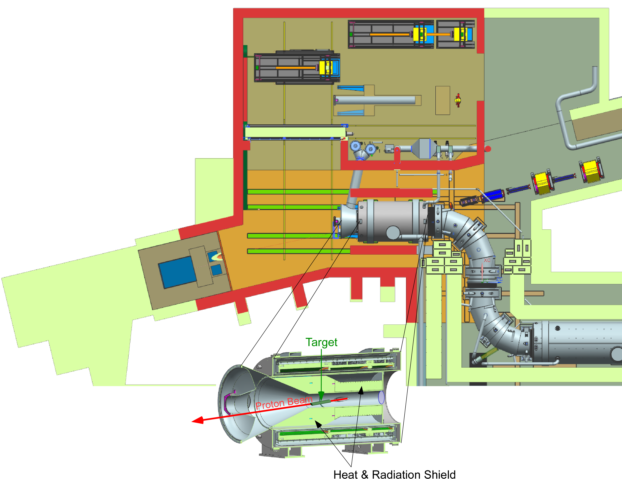
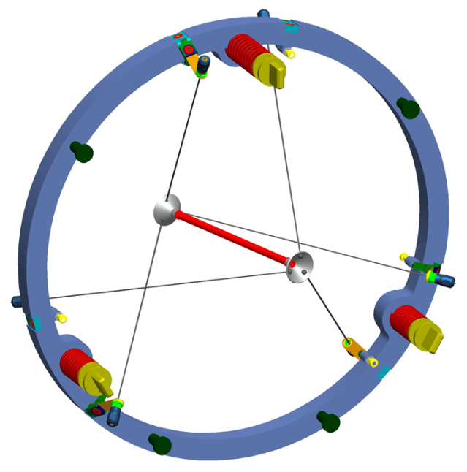
Mu2e Proton Target Station
Target – located inside the Production Solenoid (PS)
M4 Beamline
PS
Proton Absorber
Target

Slide 3
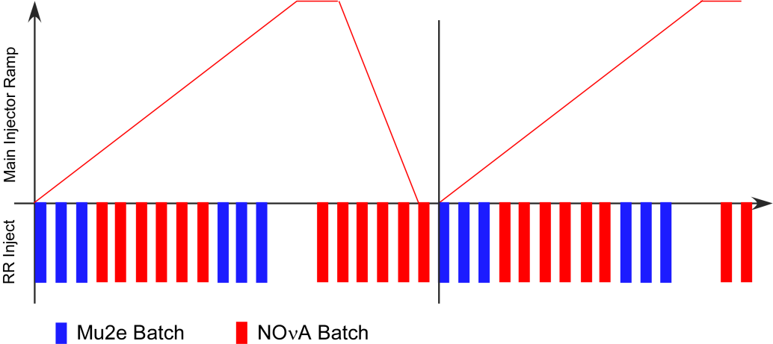
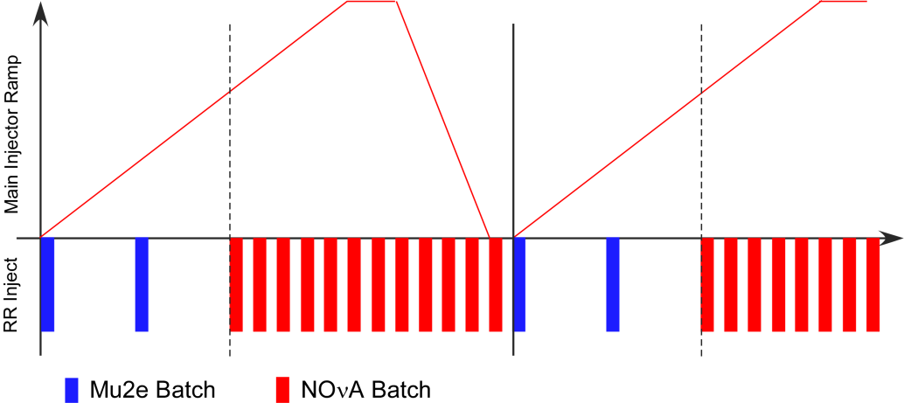
Some history: descope from IDR -> CDR, TDR
Item | IDR | CDR, TDR
Average Beam Power | 25 kW | 8 kW
Booster batches per MI cycle | 6 | 2
Proton Stacking | Accumulator (3 batches) | None
Bunch Formation | Accumulator (2.5 MHz RF + BB) | Recycler
Target | Gold/Water cooled | Tungsten/Radiation cooled
Proton Absorber Cooling | Water | Air
HRS | Tungsten + bronze | Bronze only
Radiation Safety | Service Building Shielding, Fences, … | TLMs, Internal Shielding
Timeline change ⇓
No longer need the Accumulator Ring
IDR
(old MI cycle)
CDR
(new MI cycle)
Notes:
There are also significant changes to the scope of the accelerator upgrades on the Mu2e project
2) These changes were primarily driven by costs. The determination which project performs which part of the upgrades is driven by schedule. The items required to be complete for g-2 running were assigned to the AIP and the g-2 project.

Slide 4
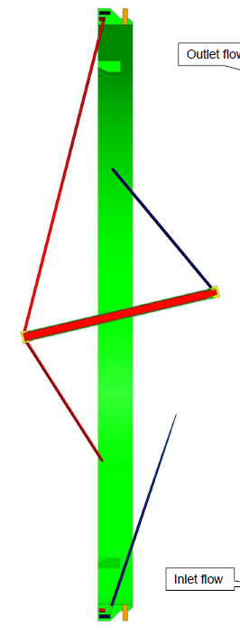
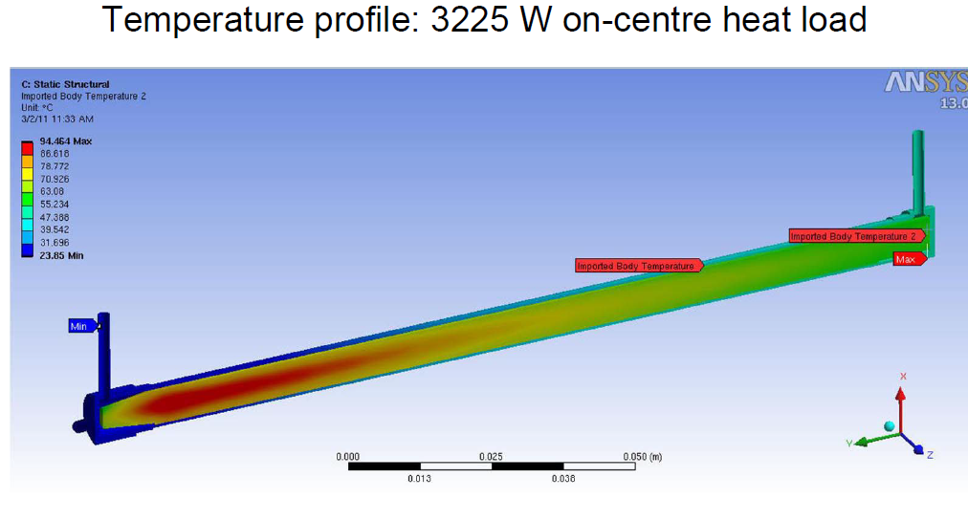
‘Historical’ 25 kW design: water cooled gold
Water cooling streamlines

Slide 5
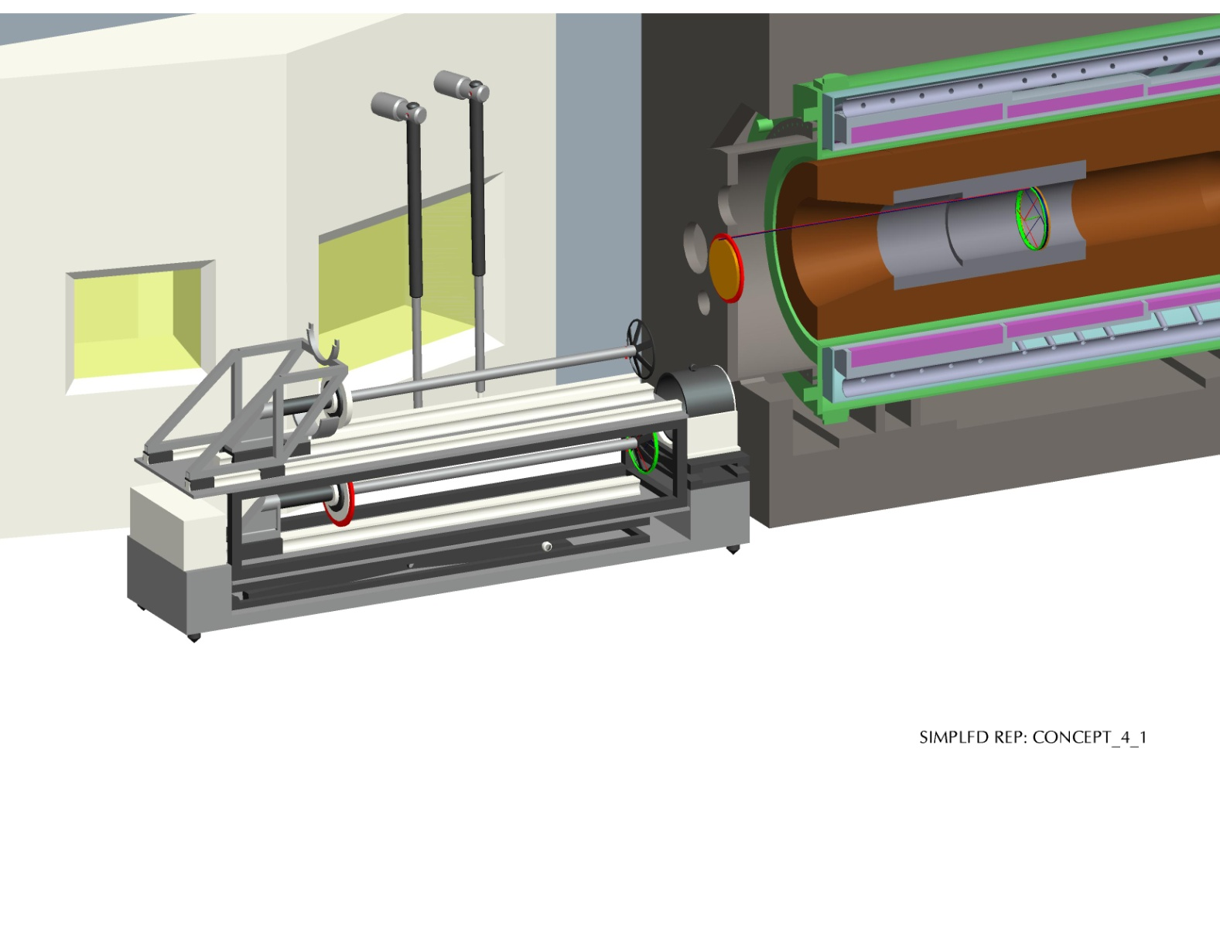
Convectively cooled target station - early remote handling concept

Slide 6
Why move to a Radiation Cooled Target?
Target rod directly radiates the beam induced heat load to its surroundings without the need for an active coolant.
Advantages Over Forced Convection Cooling:
The cost of an active cooling circuit is avoided
- no plant room, circulation plant, or maintenance required
Remote target exchange process is greatly simplified
- fewer operations = lower risk, smaller assembly
Disposal of spent targets is simplified
- e.g. no active water, smaller target assembly/cask
The potential for coolant leaks in the high-radiation target environment is eliminated

Slide 7
Issues with Radiation Cooled Target
High Temperature Operation
- Temperature dependent on deposited heat load and emissivity
- Limited material options (tungsten or graphite)
  Graphite excluded for poor pion yield
- Are target material properties sufficient at elevated temperature?
- Will target suffer from chemical attack from impurities in vacuum?
- Will target material evaporate and contaminate inside of HRS?
- potentially worse than coolant leak
Beam-induced Thermal Cycling
- Will target have sufficient lifetime (>1 year) from creep-fatigue?
Support Structure
- Can we design a support structure that is stable enough at target temperature?
- What material / manufacturing options are available?
→ Research program required

Slide 8
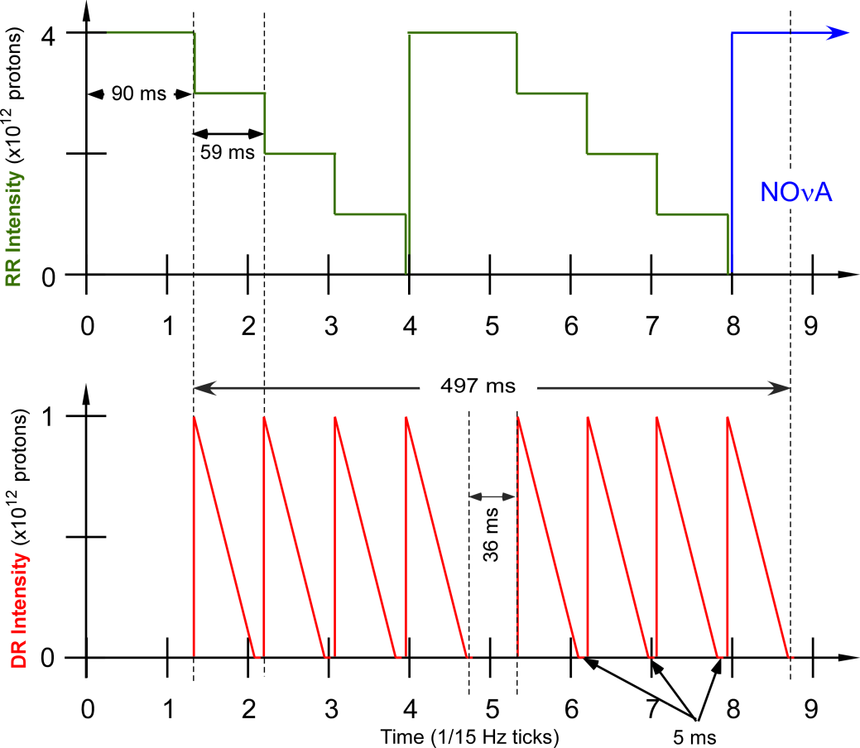
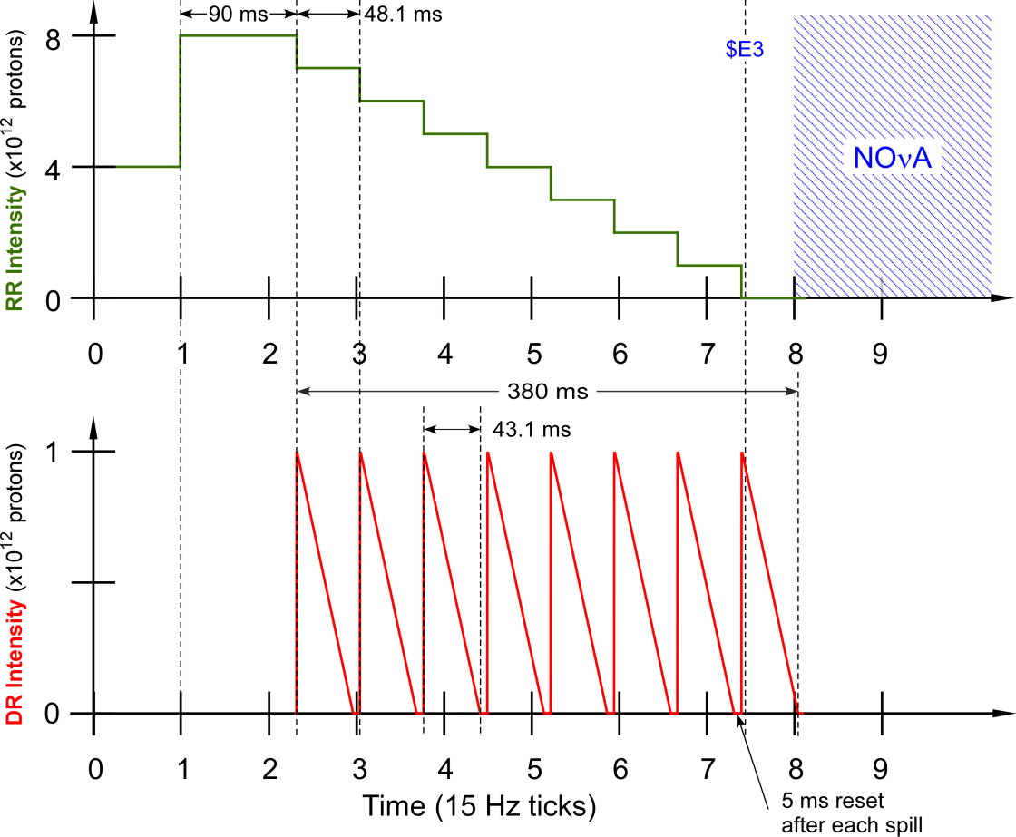
‘Study’ bunch structure
New bunch structure
This figure shows the first eight Booster ticks of a Main Injector cycle. The top graph shows the Recycler Ring beam intensity as a function of time. The bottom plot shows the Delivery Ring beam intensity as a function of time.
Ref: “Mu2e Technical Design Report,” doc-db #4299, October 2014.
 | ‘study’ | new
Integrated beam power | 7.7 kW | 7.7 kW
Duty factor | 37% | 28%

Slide 9
Key target parameters
 | TDR | New (if different)
Beam kinetic energy | 8GeV
Beam spot shape | Gaussian
Beam spot size | σx = σy = 1 mm
Main Injector cycle time | 1.333 sec
Number of spills per MI cycle | 8
Duration of spill | 54 ms | 43 ms
Protons per spill on target | 10¹²
Average Beam Power | 7.7 kW
Target radius | 3 mm
Target length | 160 mm
Average Power in Production Target | 600 W (FLUKA) | 690 W (MARS)

Slide 10
Target design & development program status
Contract | Dates | Scope | Deliverables
1a | Oct 2010 to Jul 2011 | Water cooled target concept for 25kW beam Cooling plant concept design Remote handling concepts | 1st Intermediate Report, Apr 2011 Doc-db #1477 2nd Intermediate Report, Jul 2011 Doc-db #1746
1b | Aug 2011 to July 2012 | Radiation cooled target concept for 8kW beam Remote handling concepts | Final Report, Jul 2012 Doc-db #2406
2 | Jan 2013 to June 2014 | Preliminary target design Emissivity measurements Pulsed heating lifetime tests Prototype spoke manufacture | Final Report, Jun 2014 Doc-db #4305
3 | Aug 2014 to Sep 2016 | Oxidation lifetime test in vacuum / leak Test silicon-carbide coatings Helium cooled “backup” target concept for 8kW beam Test iridium coatings Creep testing of target components Optimisation/prototyping of mounting components | Interim Report, Jul 2015 Doc-db #5937 Final Design Report, Sep 2016
4 | Oct 2016 to Dec 2017 | Detail design of target, fiducials and dummy mount Manufacture and thermal test of full prototype | 1st full prototype target
5 | Jan 2018 to Sep 2018 | Manufacture 1st complete production target | Deliver 1st production target

Slide 11
Schedule for RAL Contract 3

Slide 12
Schedule for RAL Contract 3
Contract 3
Phase 1
Design & Test
Emissivity measurements
Pulsed lifetime test
Silicon-Carbide coatings
Vacuum/leak test
Intermediate report
Contract 3
Phase 2
Design & Test
Alternative coating technology
Creep/sag tests
Creep/sag tests
Helium cooled target concept
Prototype springs
Optimise + prototype target mount system
Final Report

