Slide 1
Target Test Program
Peter Loveridge
STFC/RAL
Mu2e Target, Remote Handling, and Heat & Radiation Shield Review
Nov 16-18 2015

Slide 2
Target Test Program
The Mu2e target test program aims to:
identify “show-stoppers”
quantify the technical challenges
investigate potential technology solutions
Topics:
Emissivity Measurements
Thermal Fatigue Tests
Vacuum / Leak Test
Sag / Creep Test
SiC Coating Development
Iridium Coating Development

Slide 3
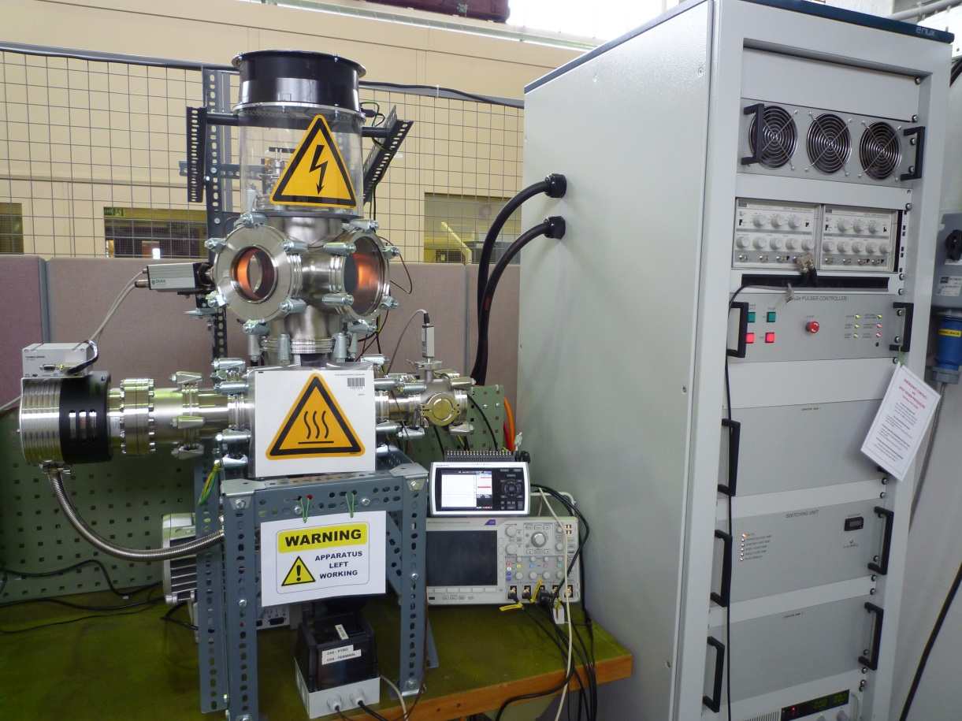
Mu2e Target Test Rig
A multi-purpose test rig for high temperature target applications
Air-cooled vacuum vessel with feedthroughs for power and thermocouples
Observation windows
Power supply rack
Pulse mode:
1 msec long half-sine wave pulses 0 - 2.5 kA peak
1 - 50 Hz repetition
DC mode:
0-300A constant current
Vacuum gauges
Digital Pyrometer
300 l/s Turbo pump
System interlocks
vessel over-temp
coolant flow
sample over-temp
vacuum level
Backing pump
Data logger
4-channel digital oscilloscope

Slide 4
Emissivity
Single Wavelength Method
Energy Balance Method

Slide 5
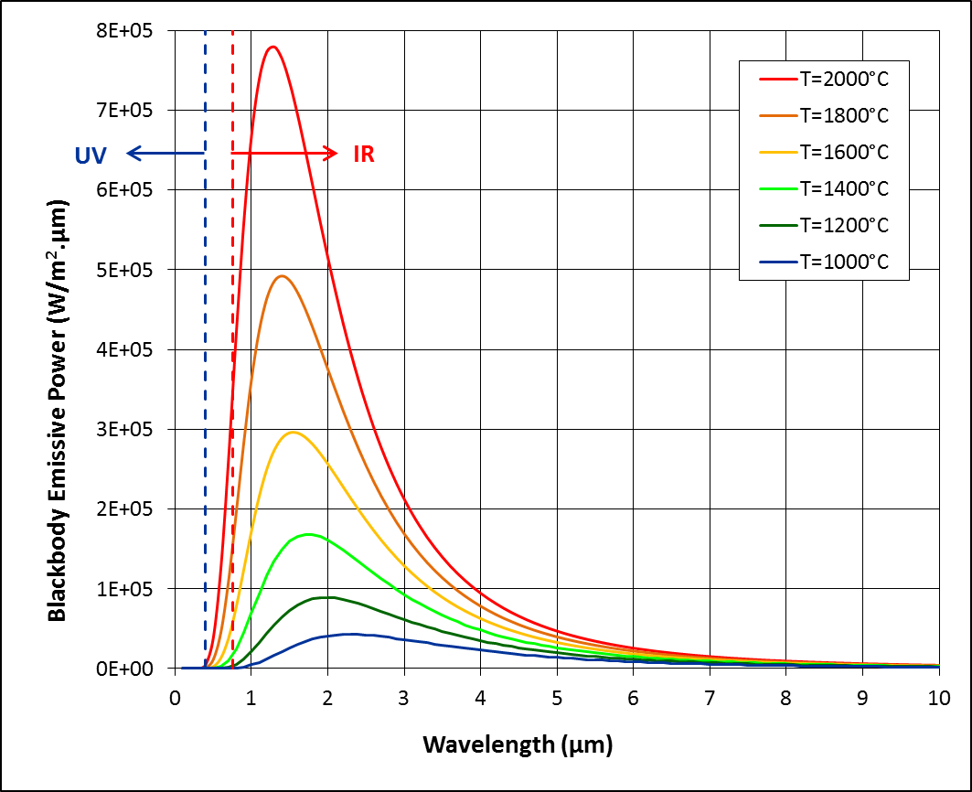
Emissivity Definitions
Monochromatic emissivity (ελ)
Widely quoted as it is used in optical pyrometry
Useful for relative comparison, effect of surface roughness, etc
Total hemispherical emissivity (εHT)
Gives the full picture for radiative heat transfer
Black-body emissive power versus temperature of a black body
Monochromatic emissivity of tungsten as a function of temperature and wavelength

Slide 6
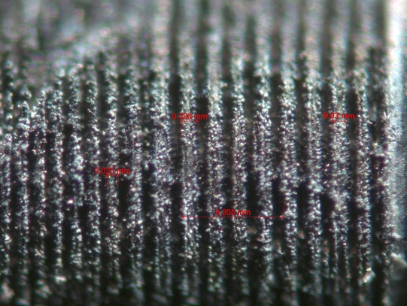
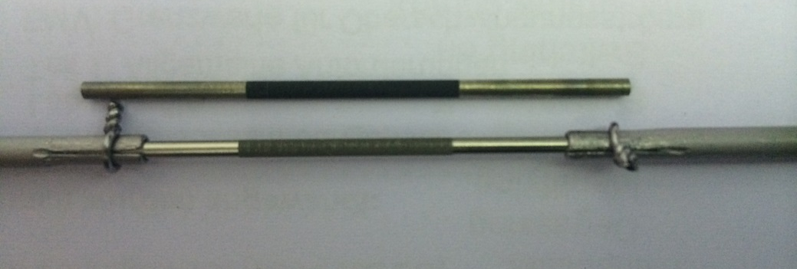
Monochromatic Emissivity Measurement Concept
Hollow cylindrical sample with a little hole in one wall, heated with D.C.
Use an Optical Pyrometer to:
  Measure black body temperature (T_{true}) by looking through the little hole
  Measure surface temperature (T_{obs})
Calculate the emissivity by rearranging Planck’s radiation law to the form:
Various surface treatments:
Polished, Ground, EDM, micro-grooves, SiC coated
Close-up view of 25 micron wide laser machined groves
Micro-ridged tungsten emissivity samples
before (above) and after (below) heating

Slide 7
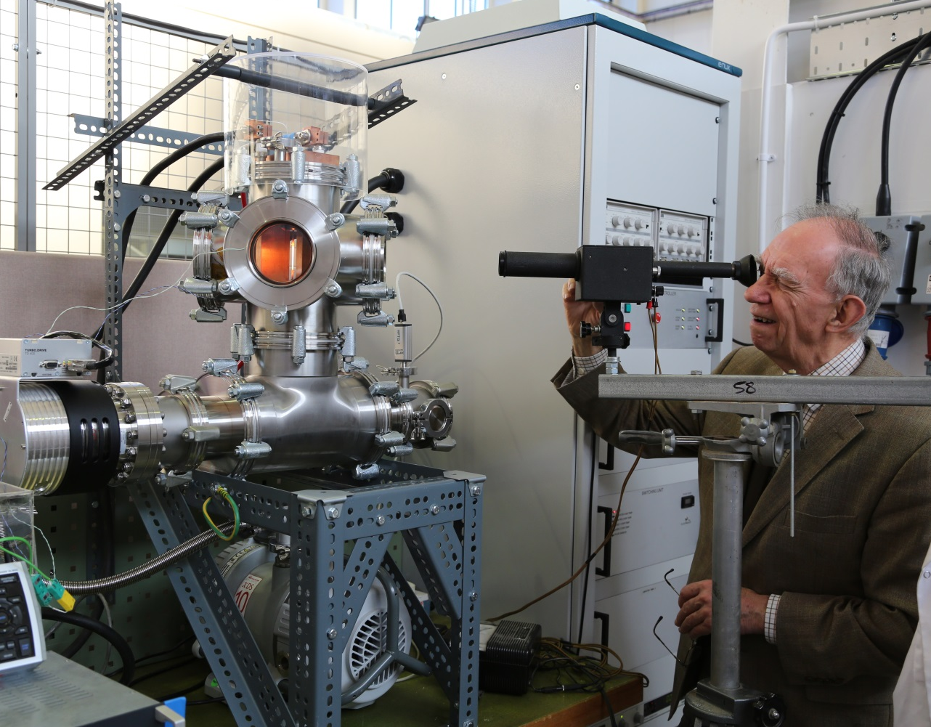
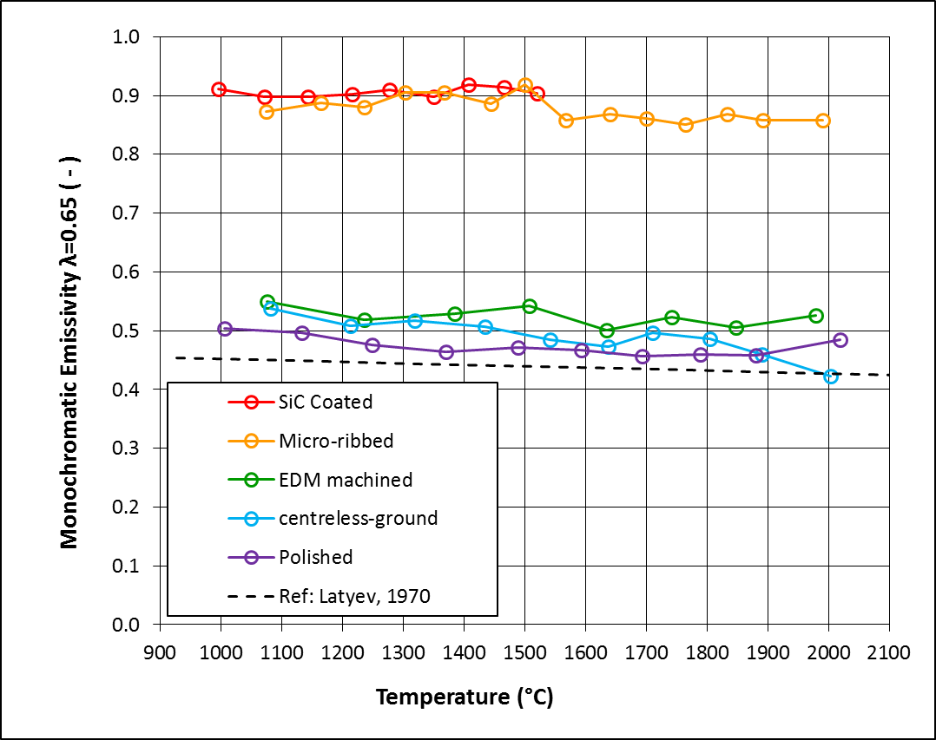
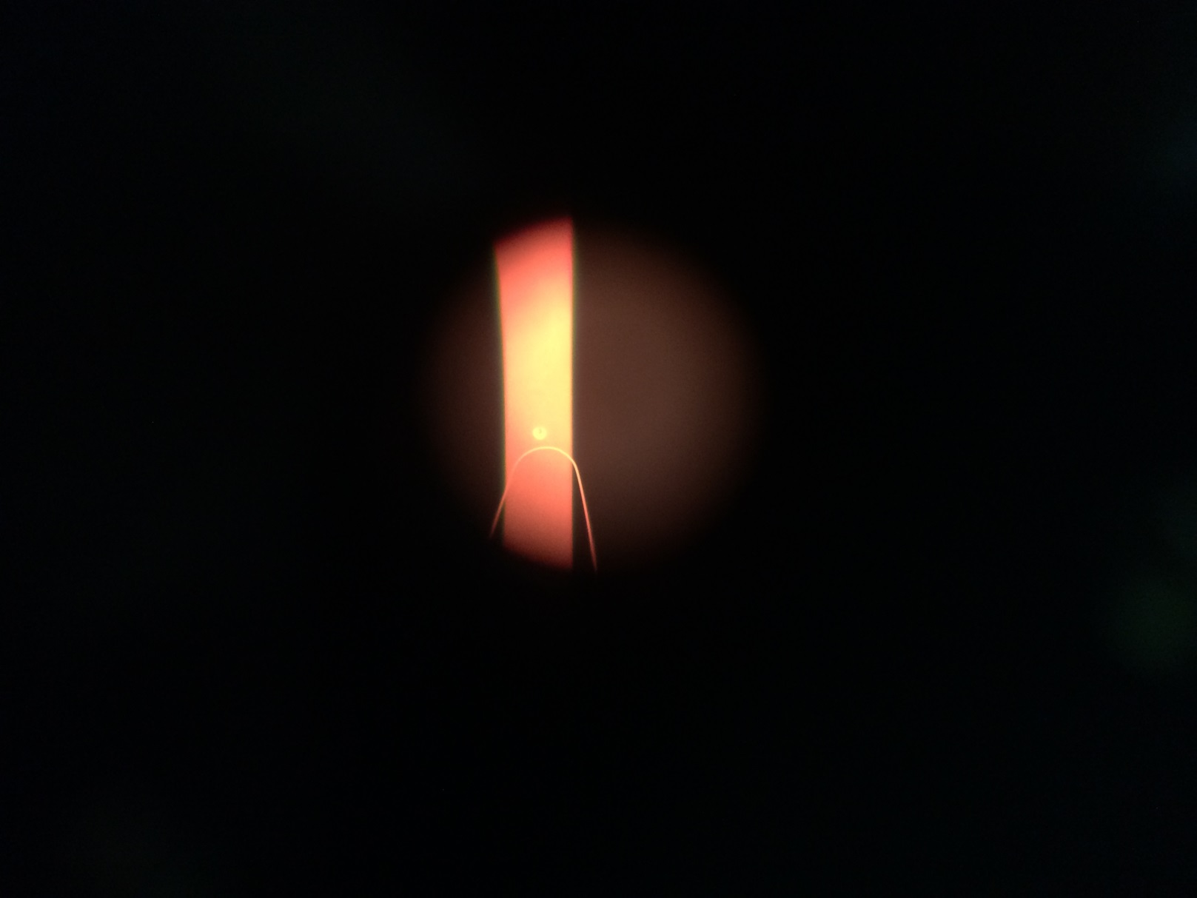
Monochromatic Emissivity Results
Results in order of highest emissivity:
(1) micro-ribbed
(2) SiC coated
(3) EDM machined
(4) Ground
(5) Polished
Above: operating the optical
pyrometer
Right: view down the
telescope
Left: tungsten sample
measurements

Slide 8
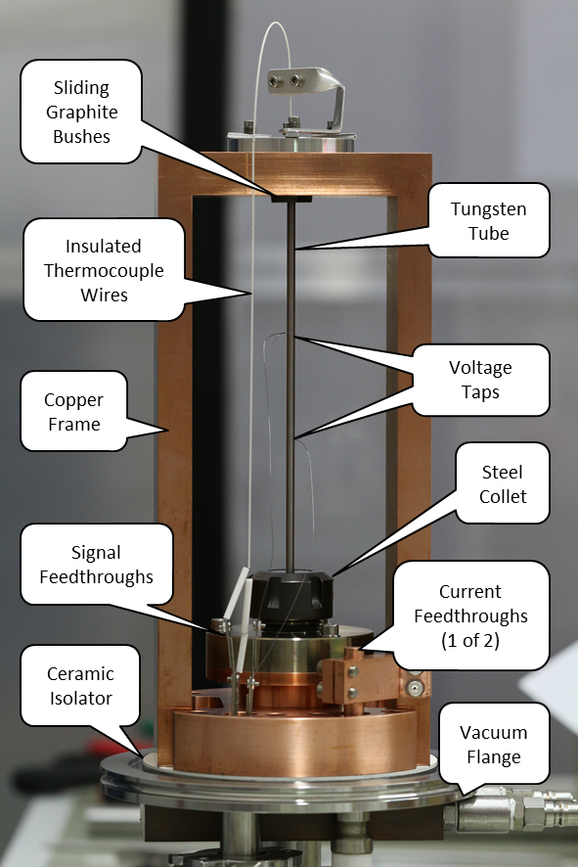
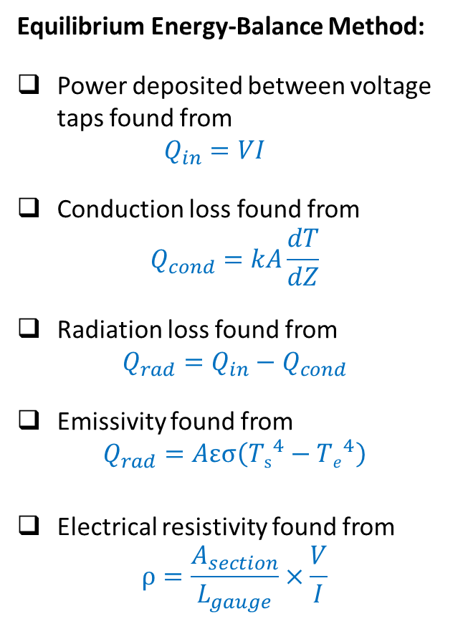
Total Hemispherical Emissivity Measurement Concept
Equilibrium Energy-Balance Method:
Power deposited between voltage taps found from
$Q_{in}=VI$
Conduction loss found from
$Q_{cond}=kA\frac{dT}{dZ}$
Radiation loss found from
$Q_{rad}=Q_{in}−Q_{cond}$
Emissivity found from
$Q_{rad}=Aεσ\left({Ts}^{4}−{Te}^{4}\right)$
Electrical resistivity found from
$ρ=\frac{A_{section}}{L_{gauge}}×\frac{V}{I}$

Slide 9
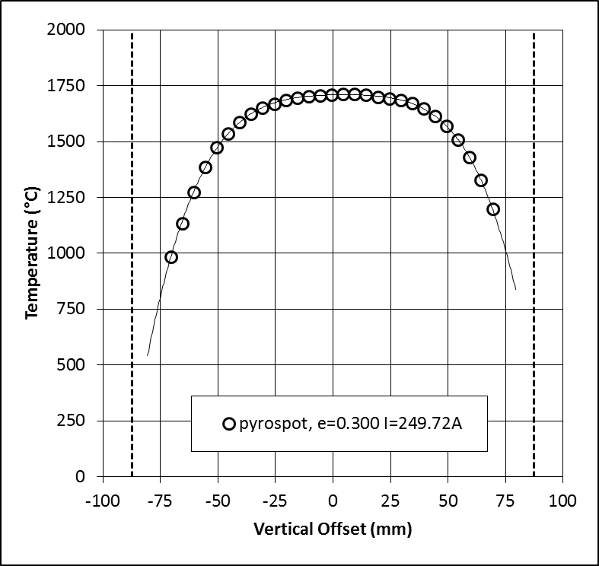
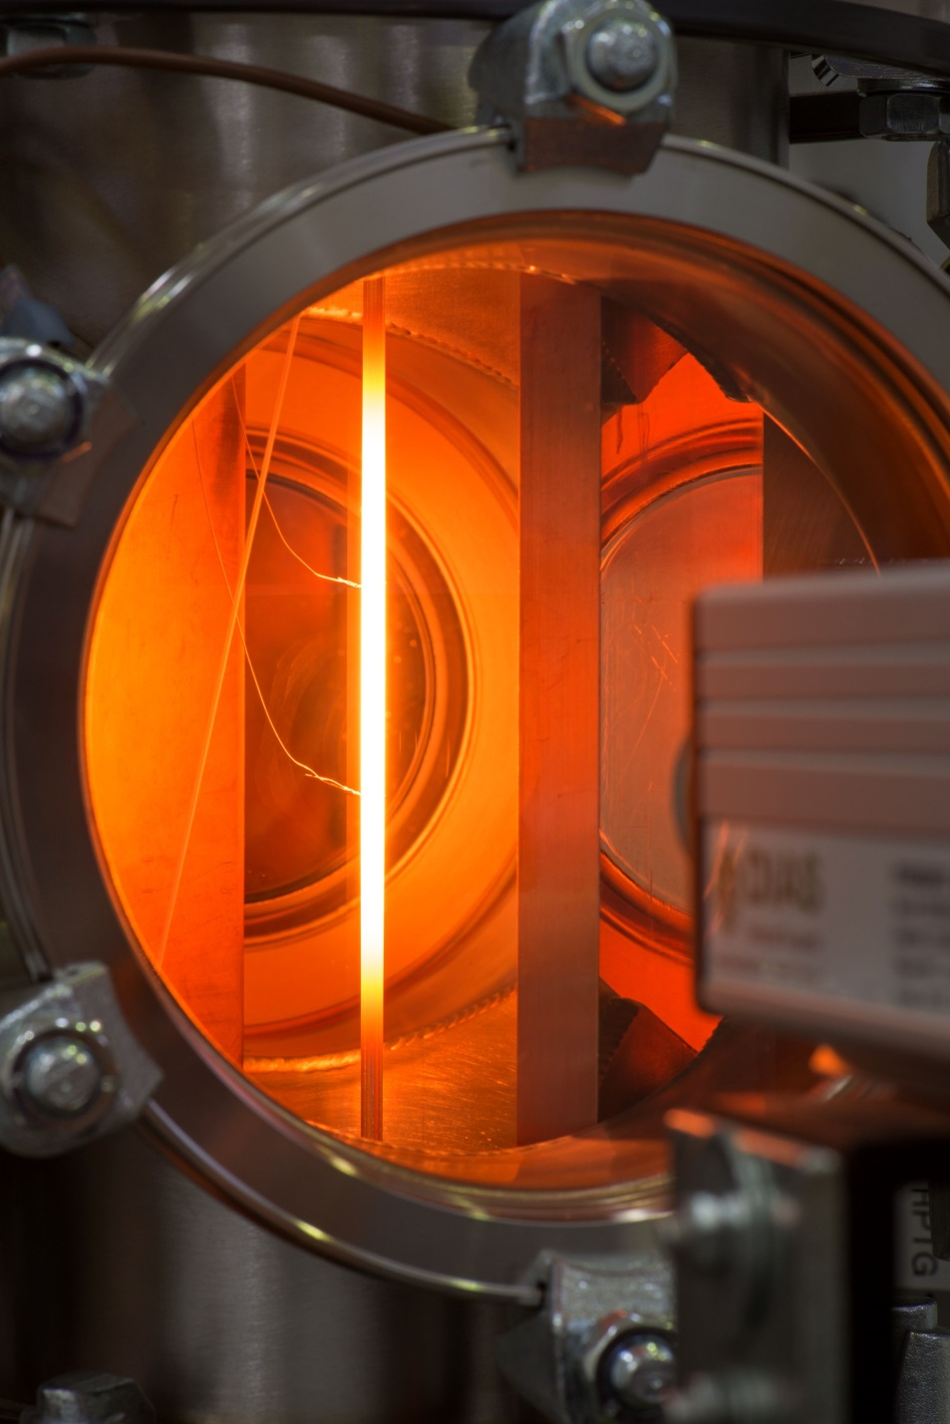
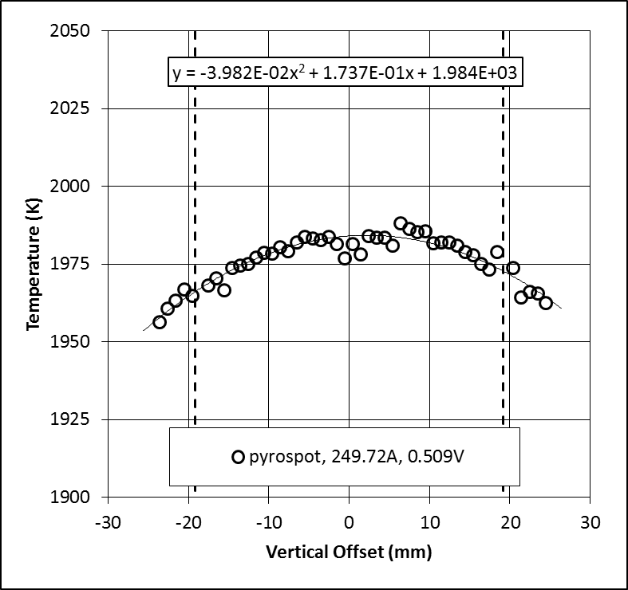
Typical Digital Pyrometer Measurements
Temperature distribution along the tungsten tube
View through the optical window
Temperature distribution between the voltage taps

Slide 10
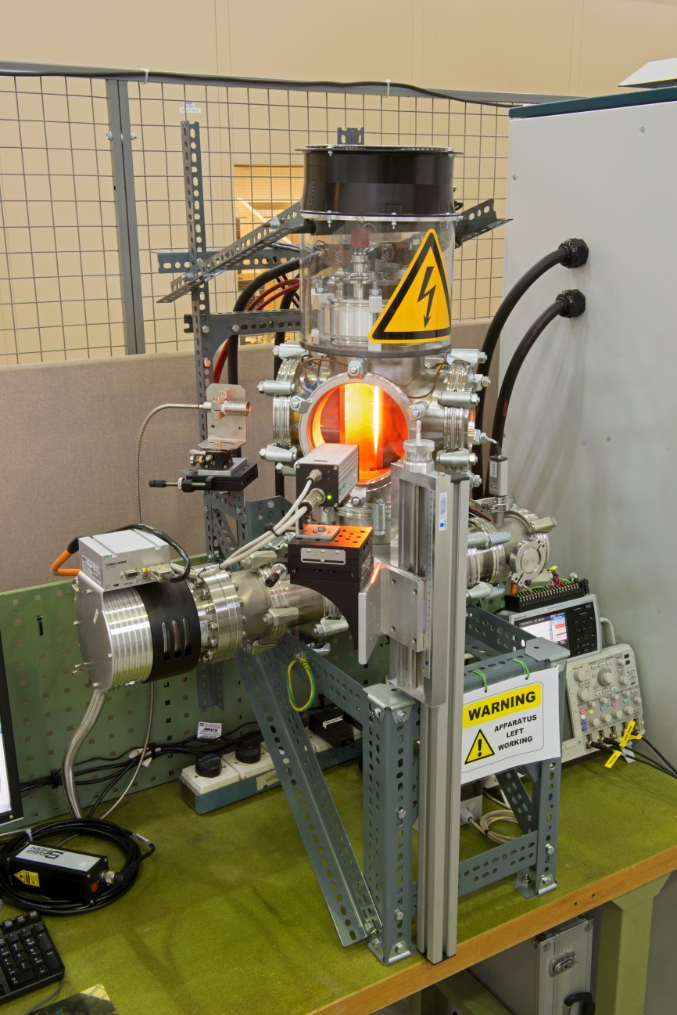
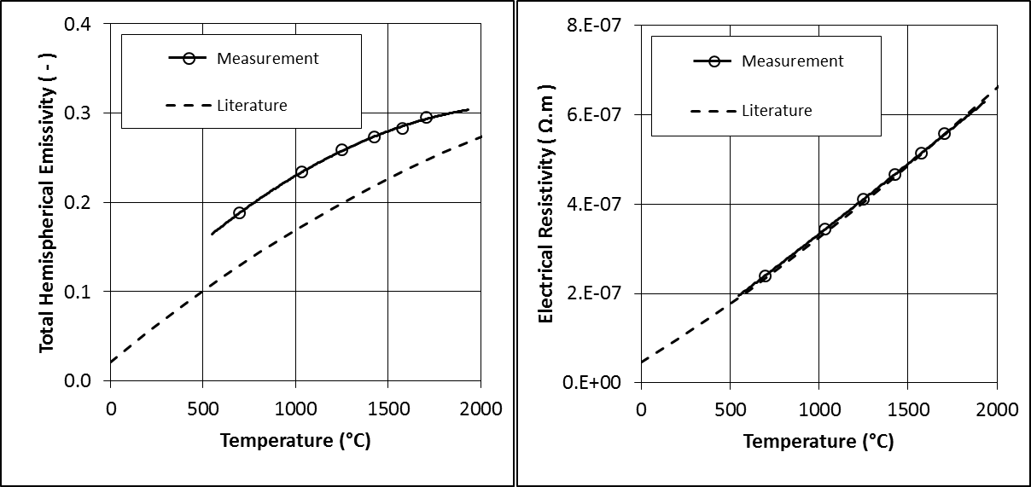
Total Hemispherical Emissivity Results
Results for centreless-ground tungsten:
Digital Pyrometer
I (Amps) | T (°C) | Q tot (W) | Q con (W) | Q rad (W) | ε ( - )
125 | 699 | 13.6 | 9.1 | 4.5 | 0.188
150 | 1031 | 28.0 | 9.6 | 18.4 | 0.234
175 | 1251 | 45.7 | 7.7 | 38.0 | 0.259
200 | 1425 | 68.0 | 5.8 | 62.2 | 0.273
225 | 1575 | 94.6 | 4.2 | 90.5 | 0.283
250 | 1706 | 127.1 | 2.9 | 124.2 | 0.295
Linear vertical Slide

Slide 11
Thermal Fatigue Test

Slide 12
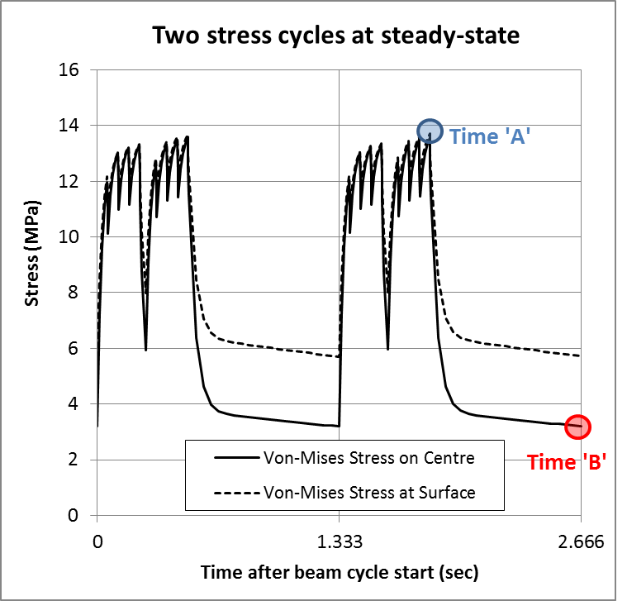
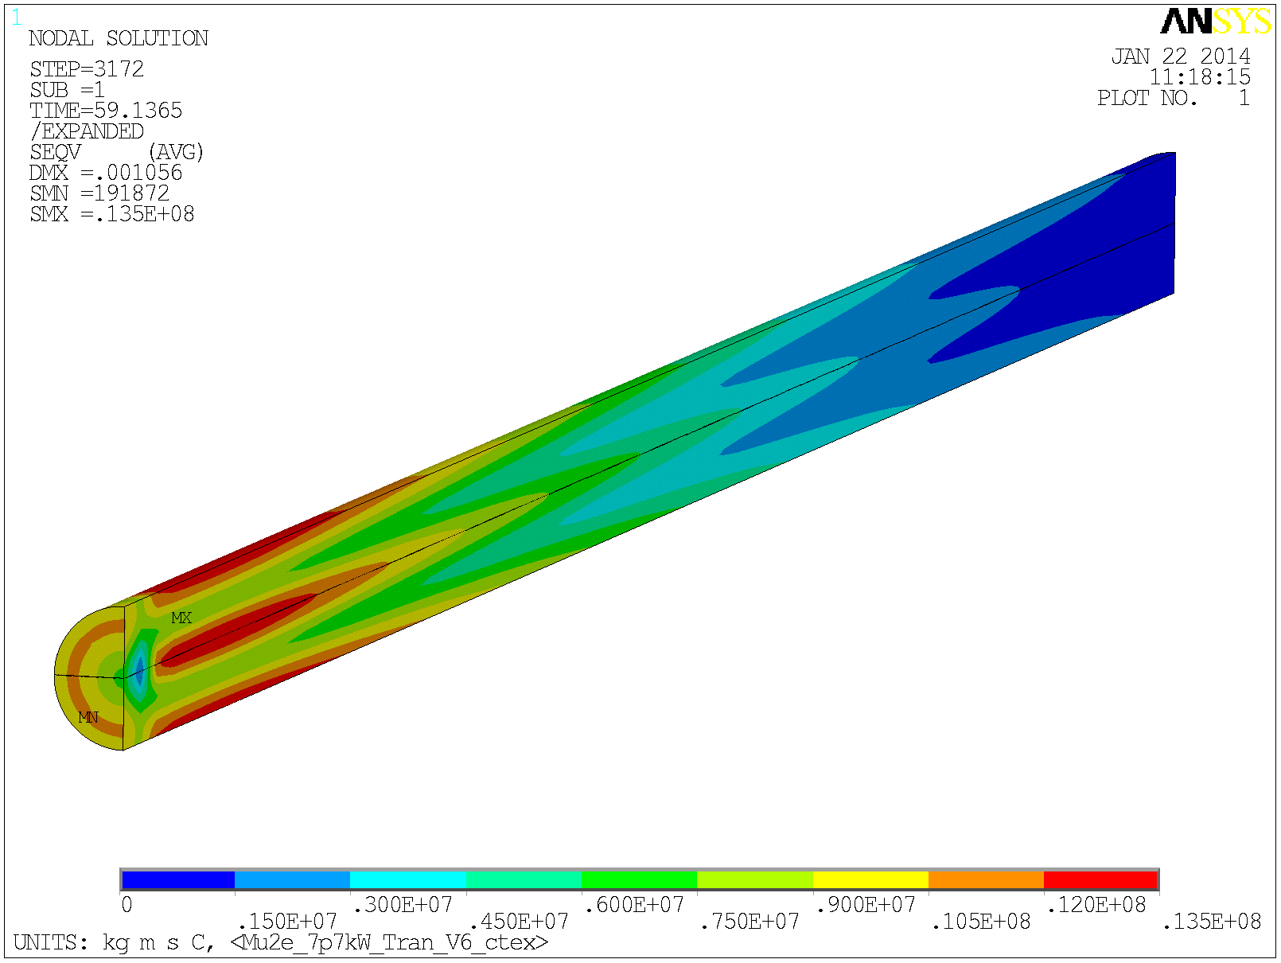
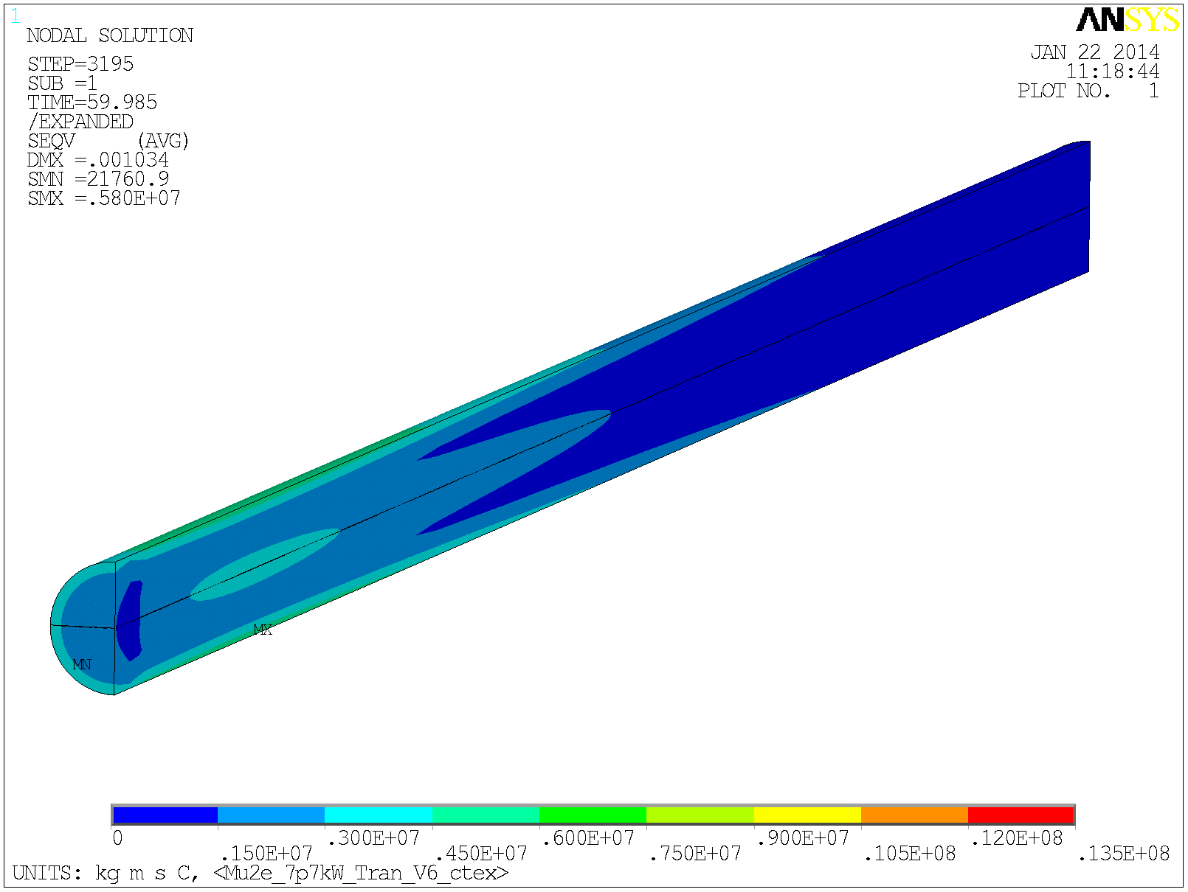
Cyclic Thermal Stress in the Target Rod
The radial temperature gradient generates a thermal stress in the target
The thermal stress falls away between pulses as thermal conduction acts to equalise the temperature
Von-Mises Stress at time ‘A’
Von-Mises Stress at time ‘B’
Tension
Compression
0 MPa
13.5 MPa
0 MPa
13.5 MPa

Slide 13
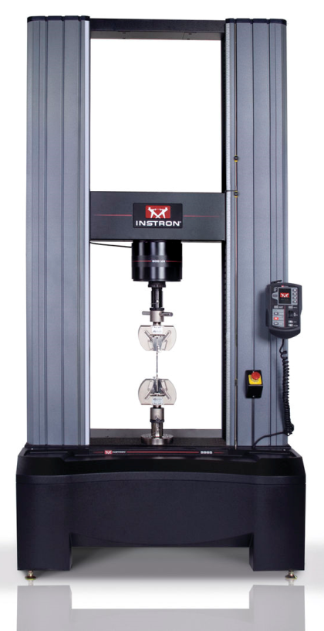
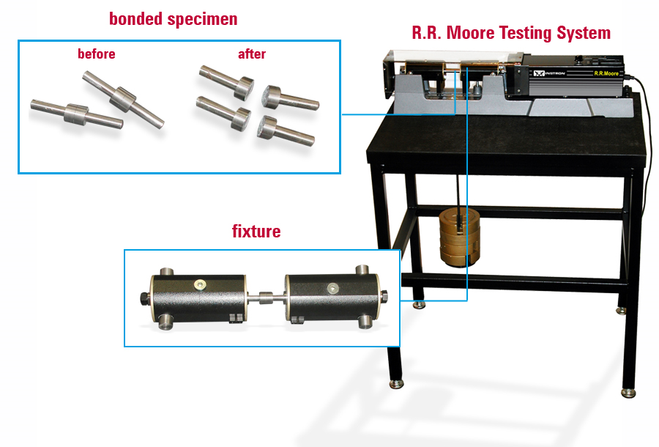
Conventional Fatigue Testing
Little high-temperature fatigue data for tungsten exists in the literature
High cycle fatigue tests are typically performed in either a rotating beam fatigue setup such as the popular ‘R.R.Moore’ system, or via uni-axial loading according to a force cycle waveform.
There are commercially available fatigue machines that, using split furnace type heaters, can go up to around 1000°C and there is a standard, BS3987, that specifies dogbone specimens and covers testing up to 1200°C.
However these conventional systems are not designed to test samples in the ultra-high temperature range of interest to Mu2e (1000 – 2000°C) or in vacuum.

Slide 14
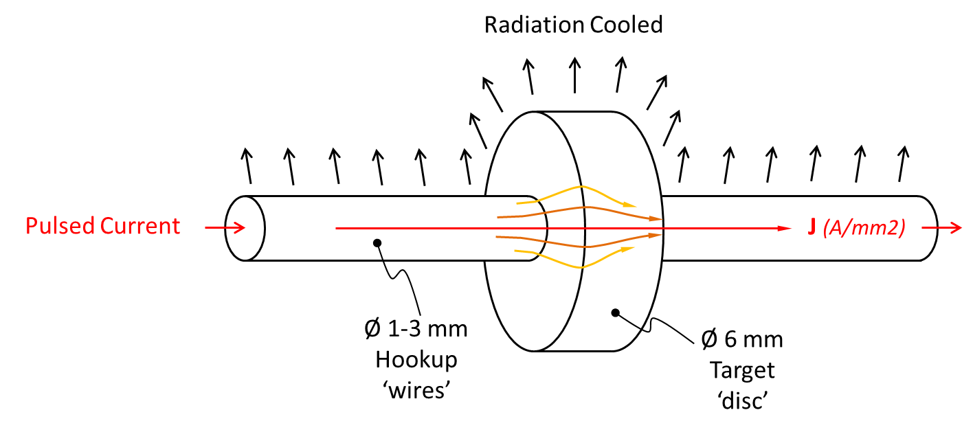
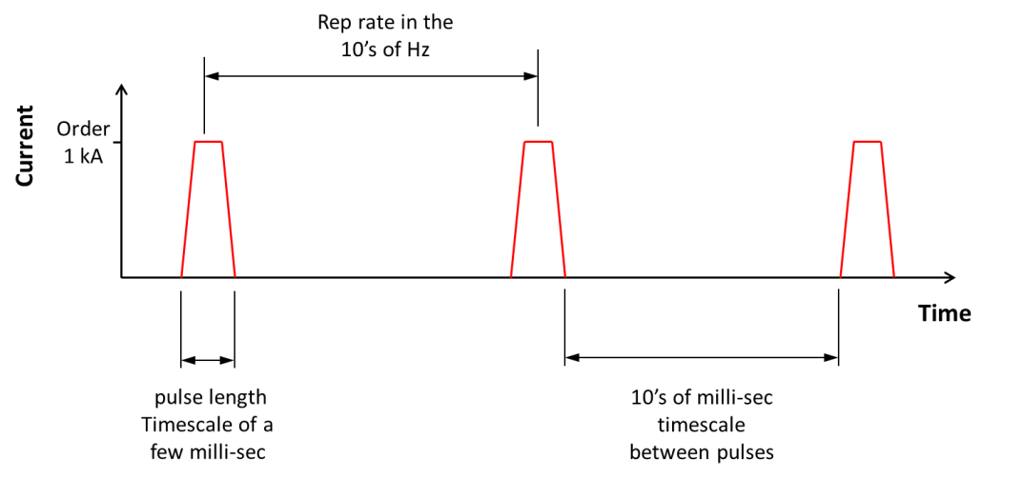
A Novel Thermal Fatigue Test for Mu2e
Operating Principle:
Use a pulsed power supply to heat specially shaped samples in a vacuum environment
Control the pulse repetition rate to achieve the desired operating temperature
This system has the advantage that stresses in the sample are generated by temperature gradients (in much the same way as they are in the real target) and not via mechanical means as is the case in the standard test methods

Slide 15
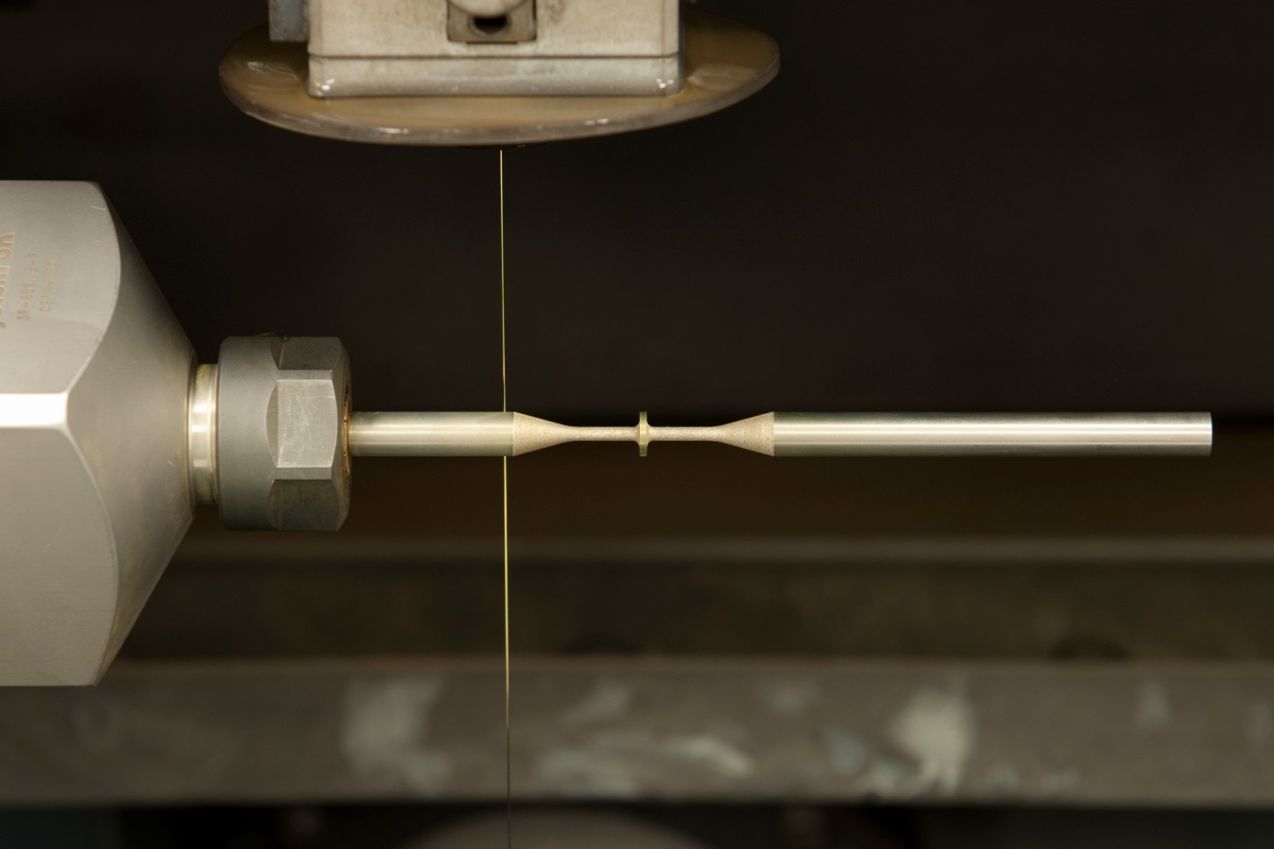
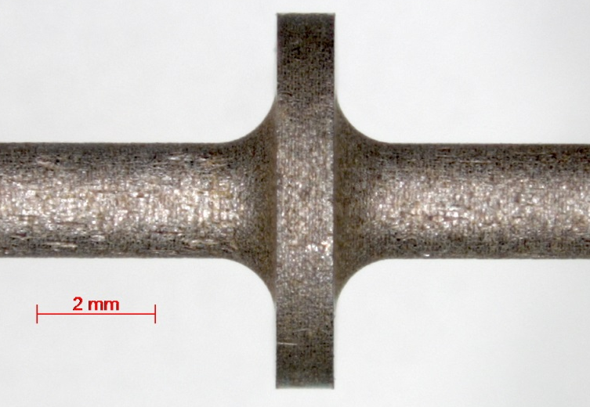
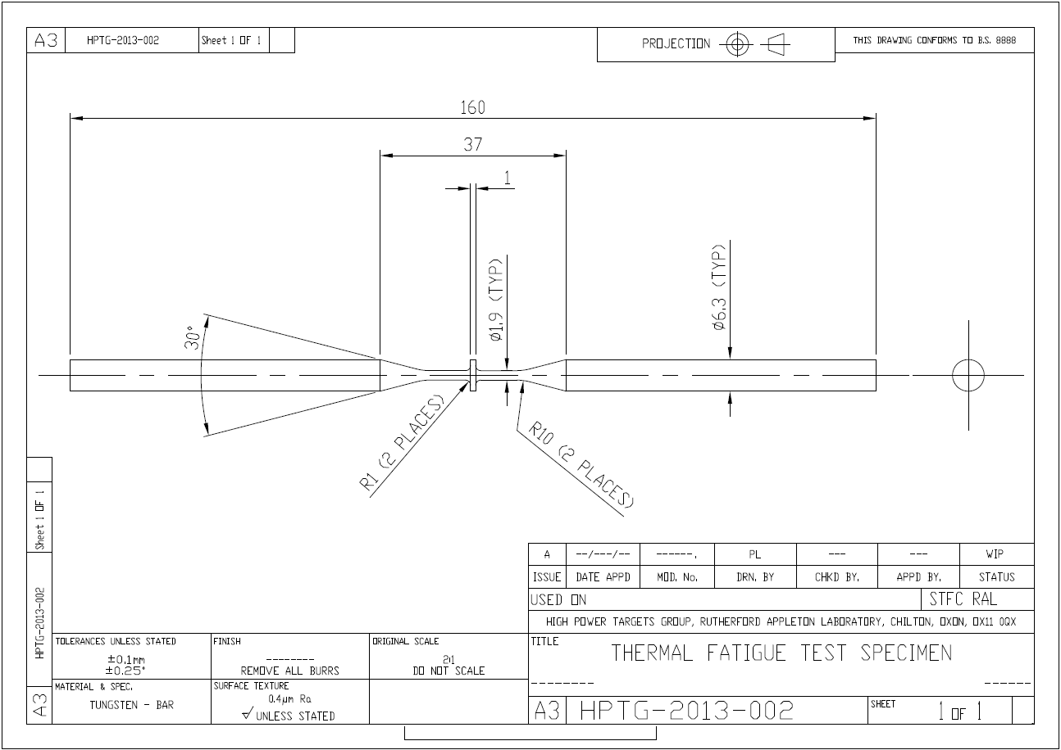
Tungsten Lifetime Test Samples
How to make the samples?
“Turn and Burn” wire EDM process at RAL precision development facility

Slide 16
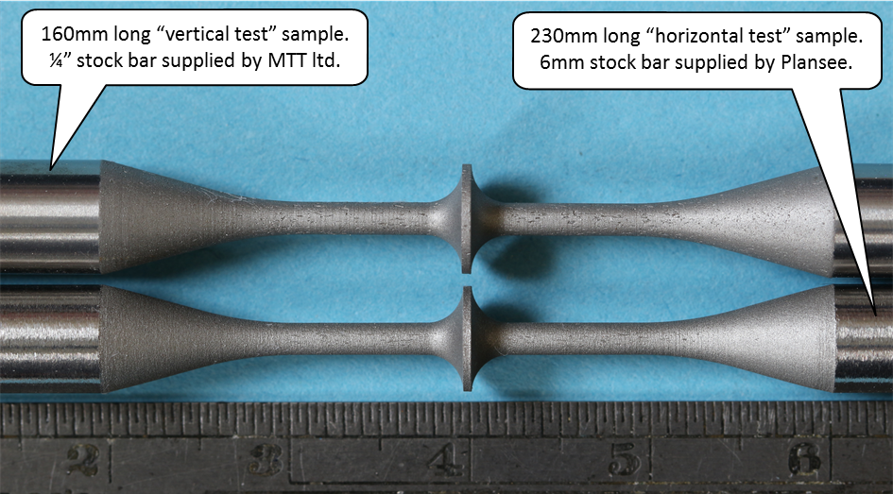
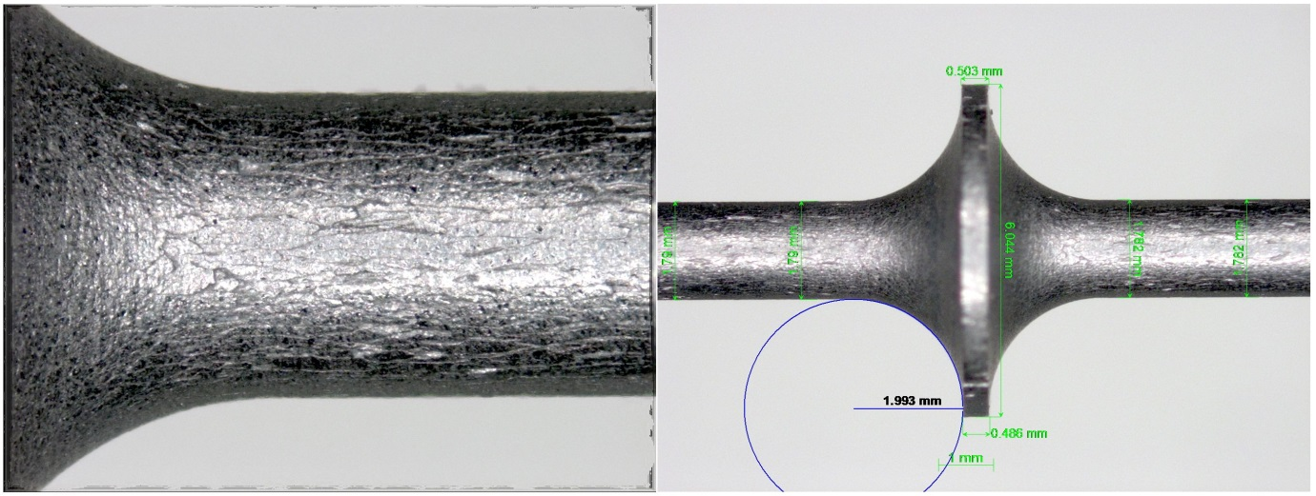
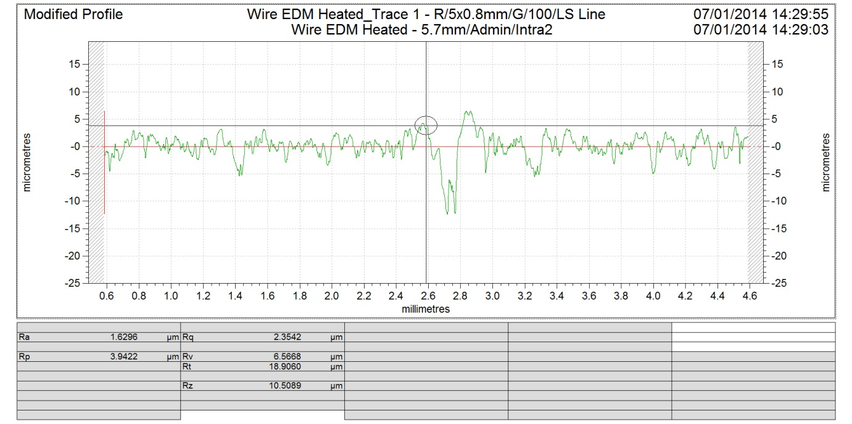
Sample Condition Pre-Test
Checked dimensions and form
Surface roughness Ra ~1.6 microns
Surface texture post EDM

Slide 17
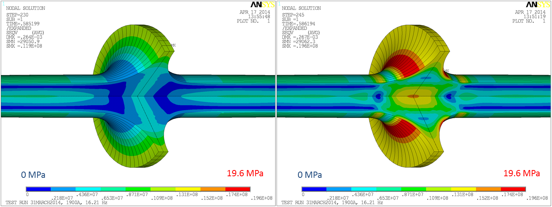
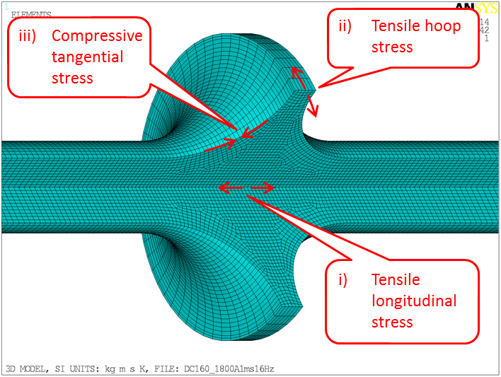
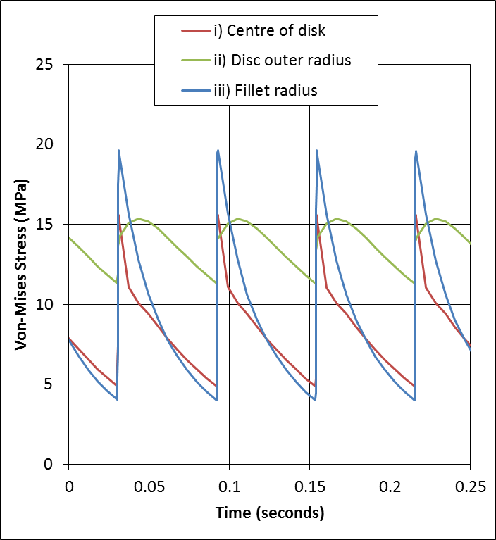
Calculated Stresses in the Sample
Von-Mises stress distribution before (left) and after (right) a current pulse
Stress in the sample
Stress in the target

Slide 18
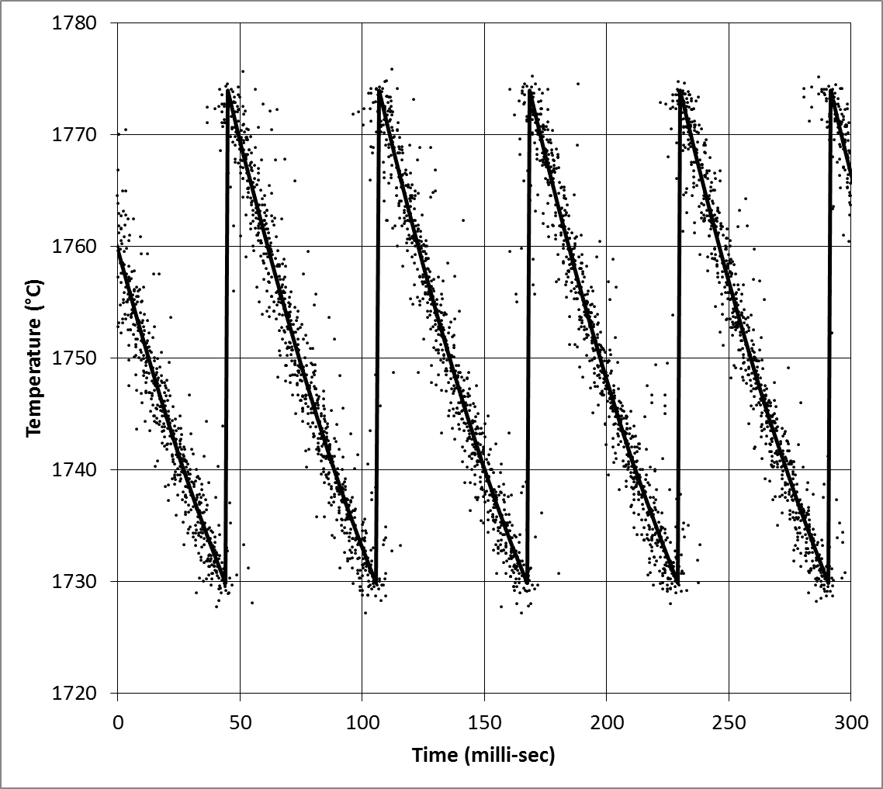
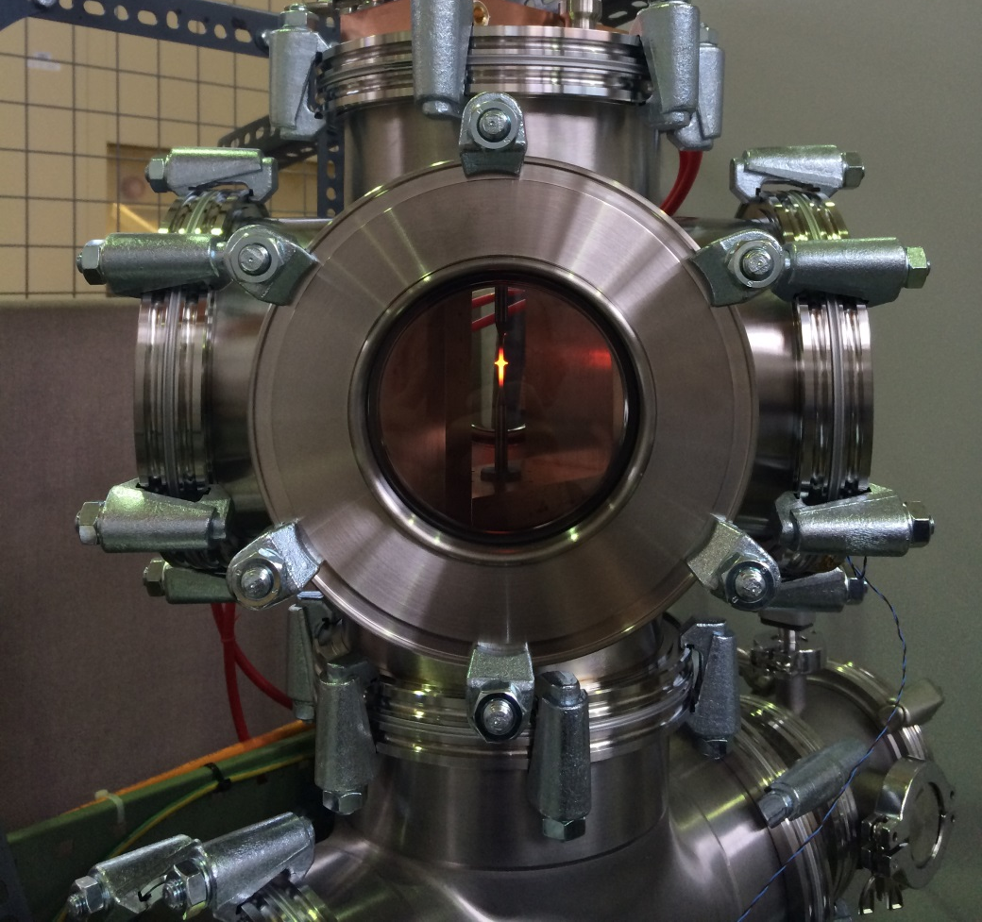
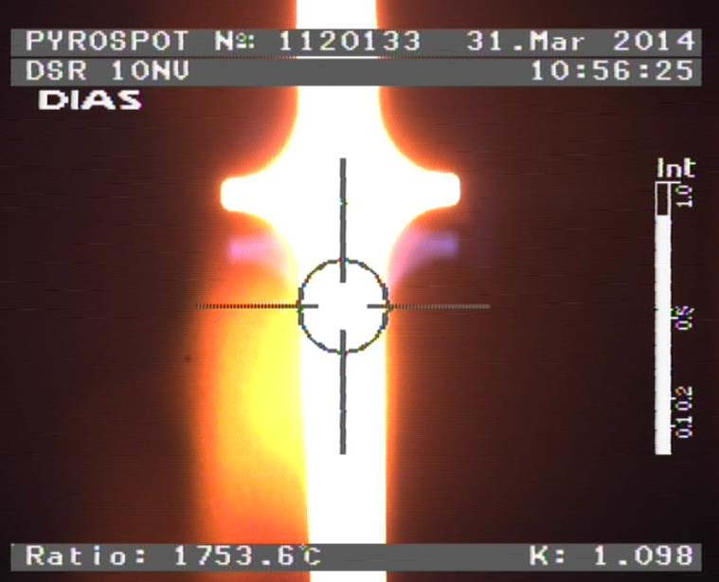
Test Parameters
Test designed to mimic the target operating conditions
Peak Current (A) | Repetition Frequency (Hz) | ‘mean’ operating temperature | ΔT at surface (°C) | Number of Cycles Run | Failure?
1900 | 16.2 | 1750°C | 44 | 100 Million | No
Above: data from the digital pyrometer
Right: a fatigue sample inside the vessel
Inset: pyrometer software

Slide 19
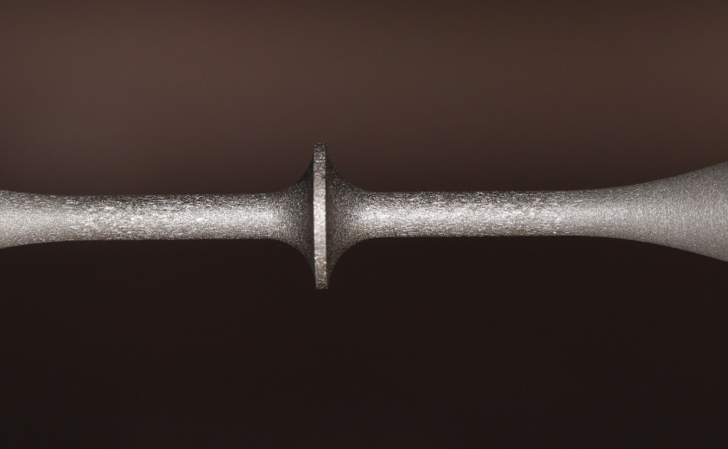
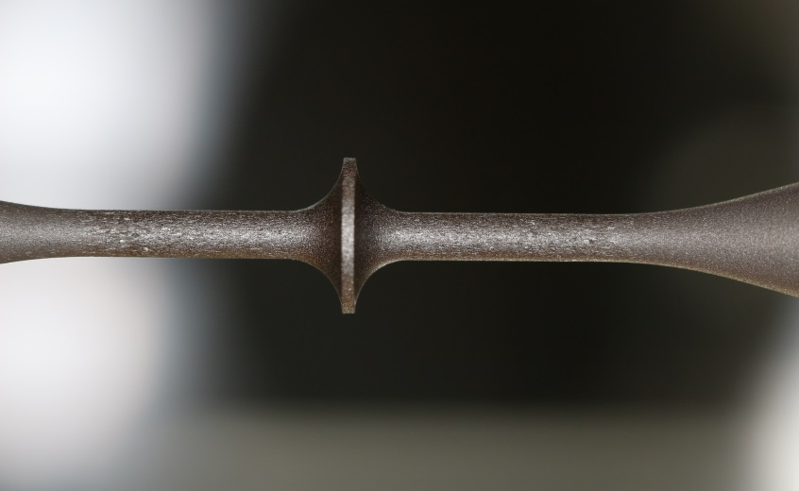
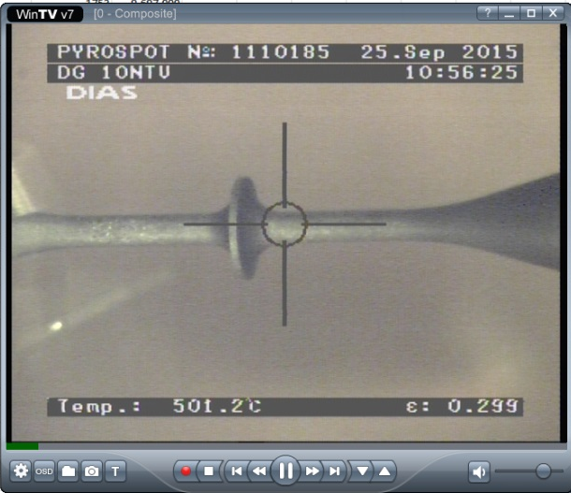
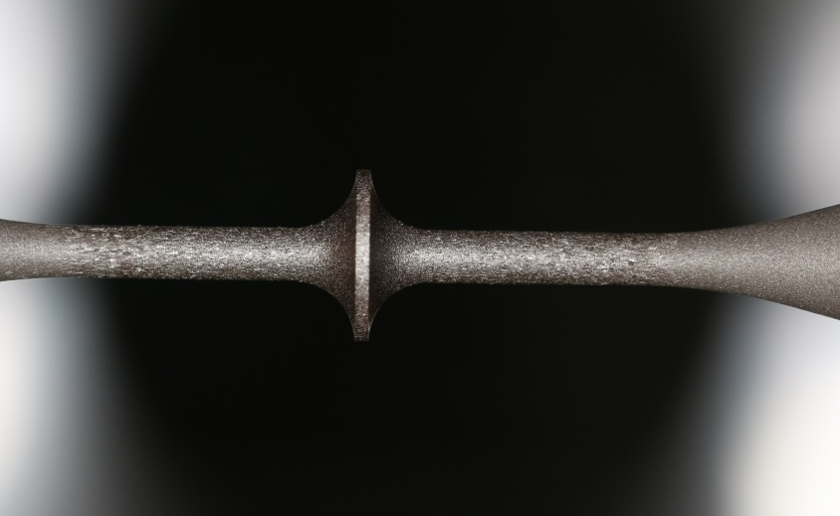
Horizontal Configuration
It was suggested that the pulsed heating test could be made more representative of Mu2e target conditions if the samples were mounted and tested in a horizontal (rather than vertical) configuration
The test rig was reconfigured to allow the sample fixture to be plugged in horizontally
A new sample was tested up to 95 million pulses (~4 yrs at Mu2e) without failure
After 26 Million Pulses
After 56 Million Pulses
After 95 Million Pulses

Slide 20
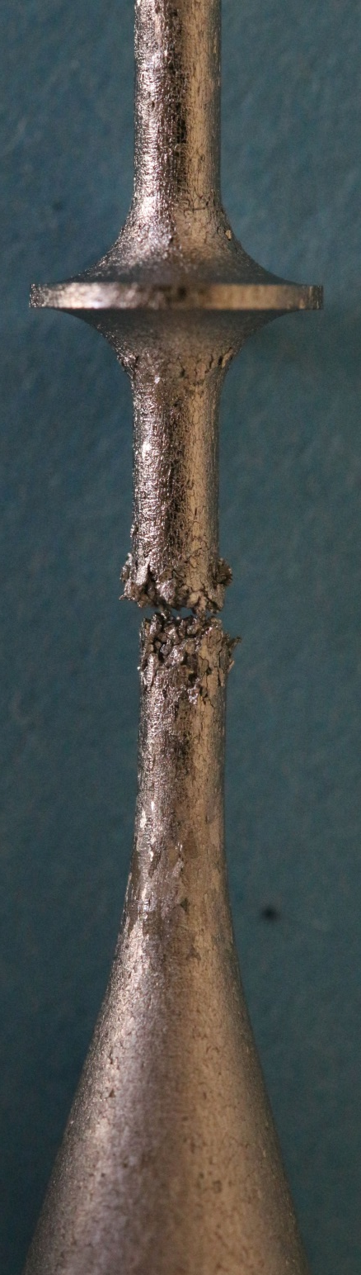
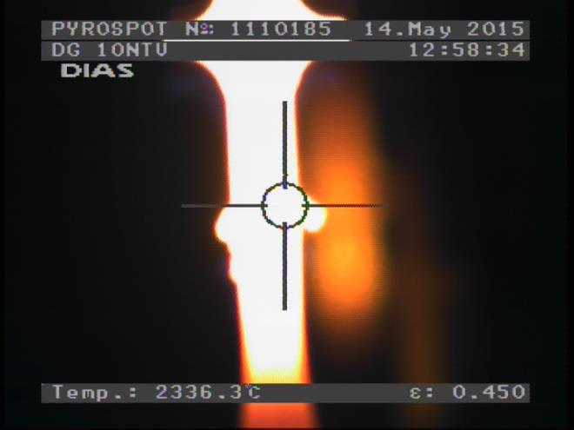
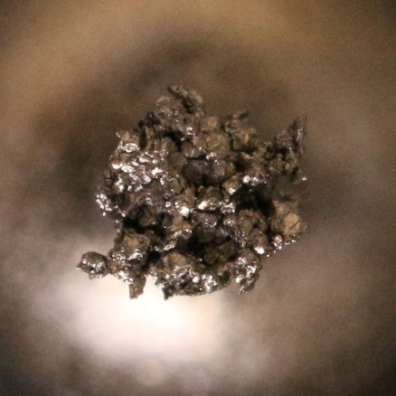
However…
After 100 Million cycles (equivalent to 4 years operation at Mu2e) under temperature and stress conditions closely representing Mu2e target operation the sample had not failed.
The test conditions were then made more severe to see if we could induce a failure.
I_{peak} 1900 A → 2300 A
ΔT_{surf} 44 °C → 73 °C
T_{mean} 1750 °C → 2000 °C
The sample survived a further 37 million cycles before the failure (pictured) was observed.

Slide 21
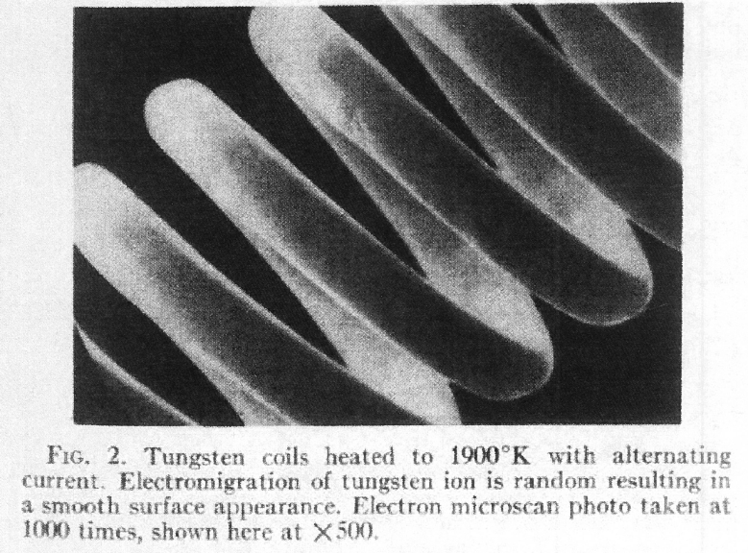
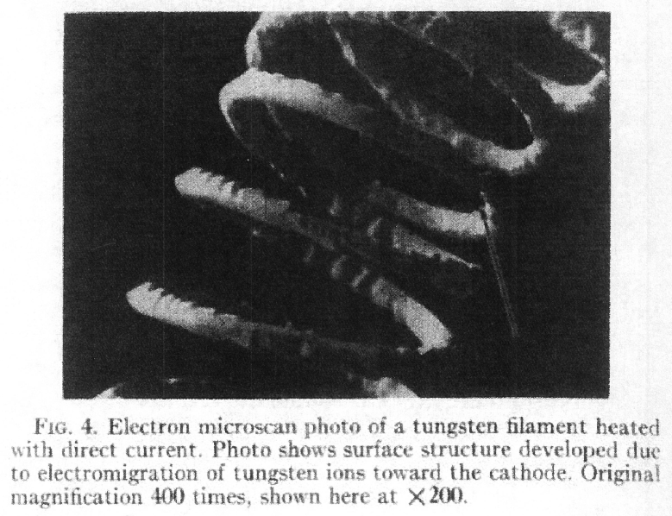
Discussion: Failure Mechanism
Could electro-migration be a contributing factor?
A.C.
When an electric field is applied to a metal, in addition to the transport of electrons, a relatively small transport of the metal ions also occurs
This process of mass transport of metal ions is referred to as electro-migration or electro-diffusion
Rate of mass transport depends on temperature and current-density
Can be the lifetime limiting factor in DC tungsten filament lamps
D.C.
Figures reproduced from:
J. Appl. Phys., Vol. 36 No. 9, 1965

Slide 22
Vacuum / Leak Test

Slide 23
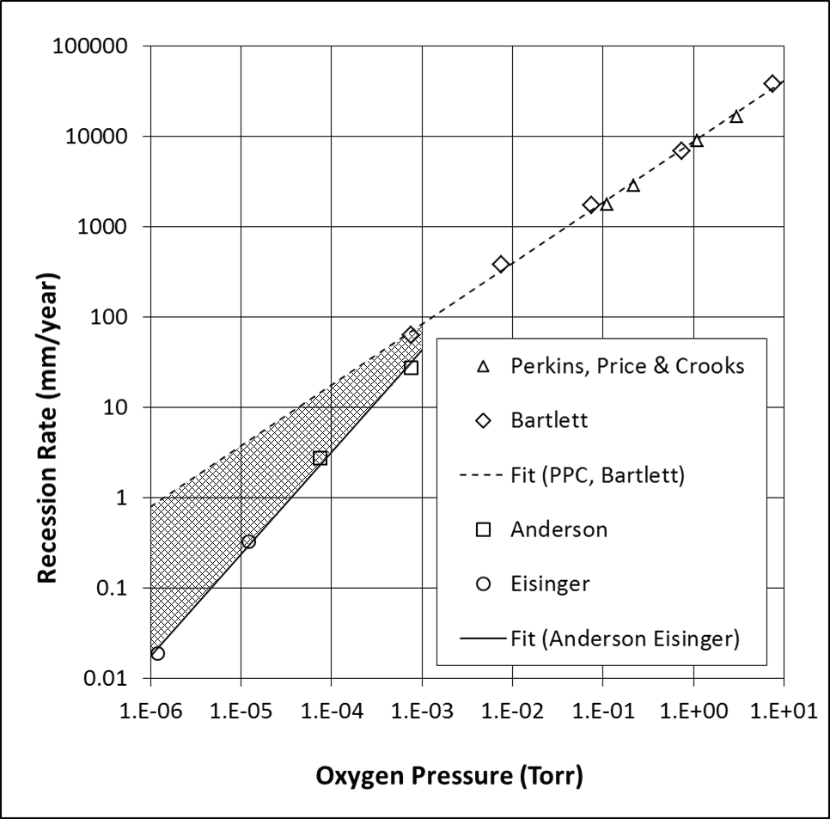
Motivation for Vacuum / Leak Test
At temperatures exceeding ~1300°C in vacuum, tungsten oxide will evaporate faster than it is formed. In this regime oxidation is realised as a surface recession, the rate of which depends strongly on temperature and oxygen pressure.
Surface recession of initially cylindrical tungsten rods heated in a low oxygen pressure
Literature data on recession rate as a function of oxygen pressure @ 1700°C

Slide 24
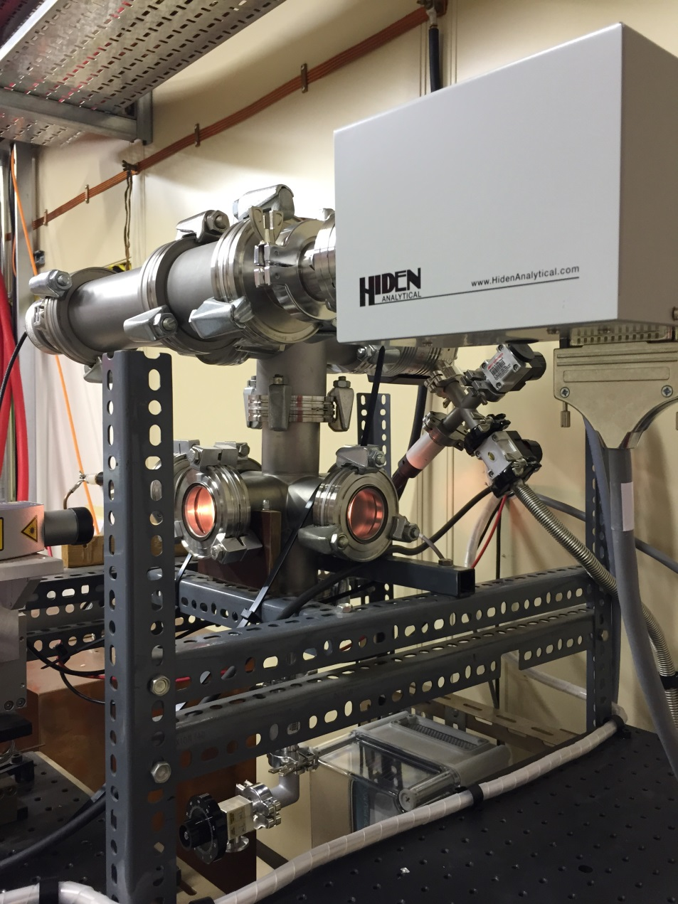
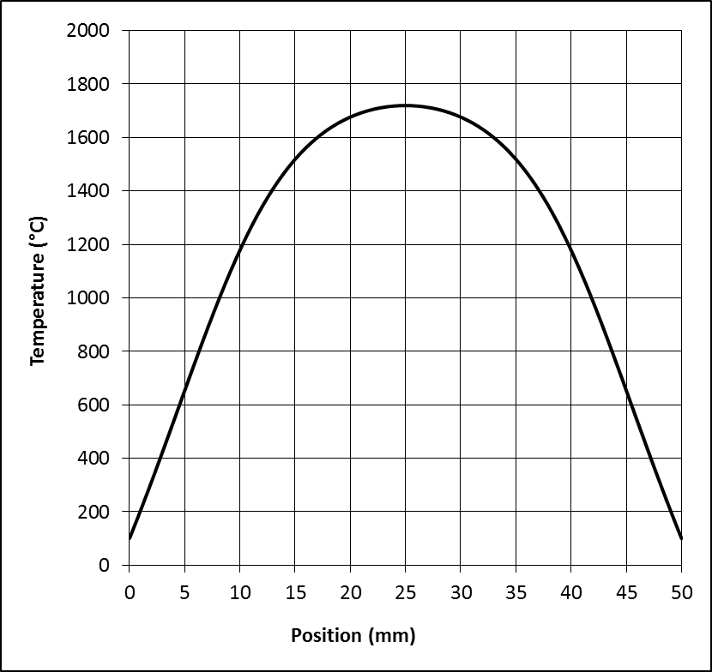
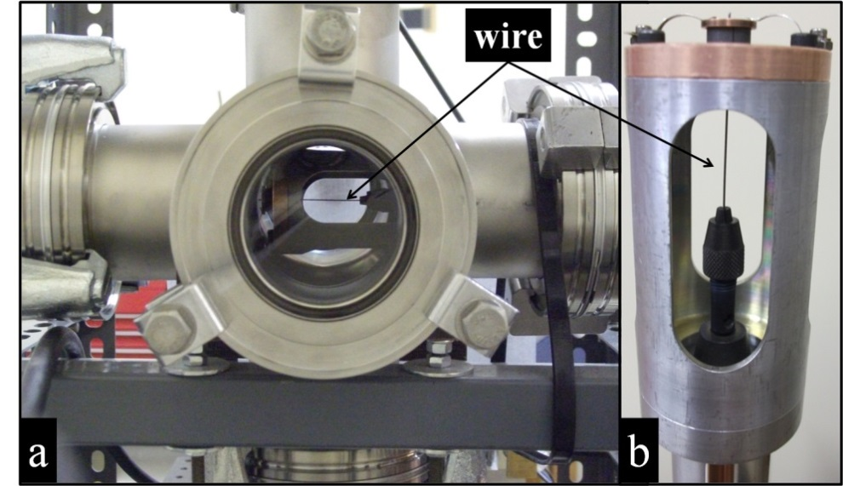
Leak Test Setup
Vacuum Gauge
Residual Gas
Analyzer
Turbo Pump
Leak Valve
Calculated temperature profile along a 0.5mm diameter 50mm long tungsten wire carrying 12A DC and with ends fixed at 100°C
0.5mm diameter tungsten wire

Slide 25
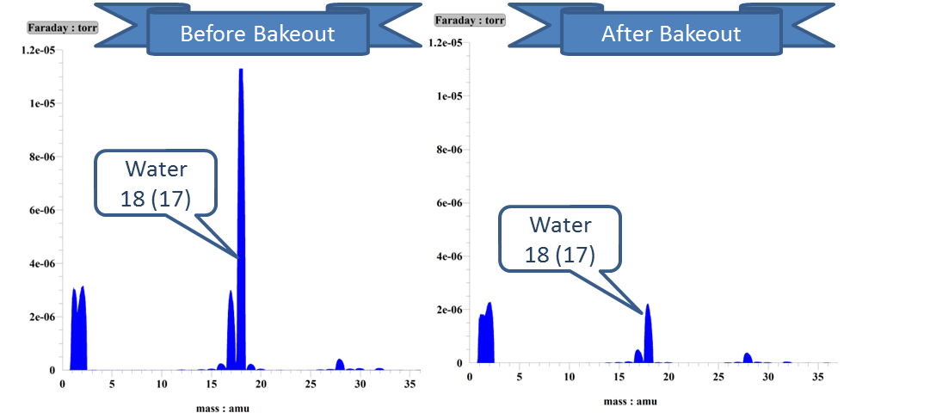
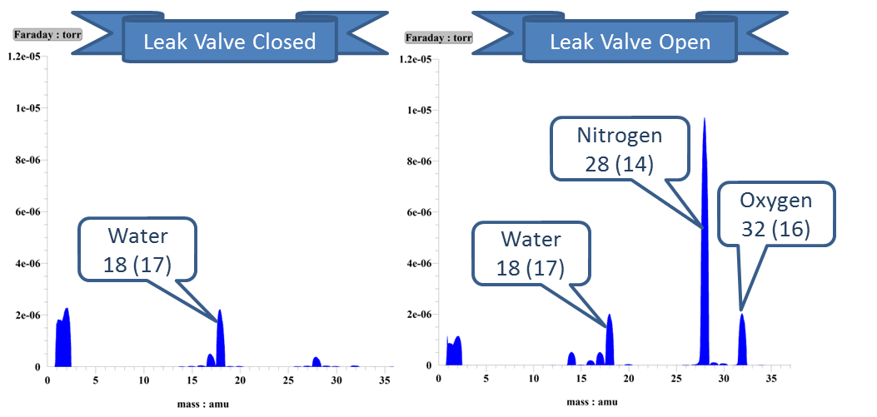
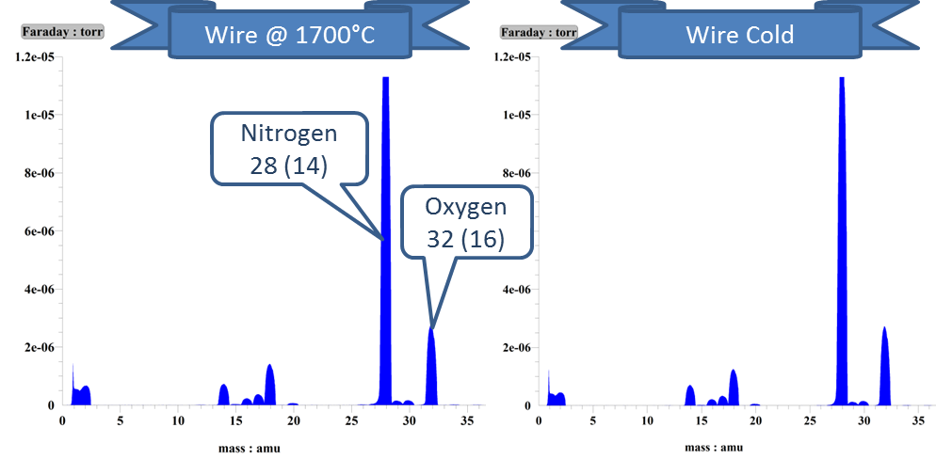
RGA Data
Bakeout:
Gradually increase the wire temperature while the pumps run.
Note - residual gasses dominated by water.
Start of Run:
With the wire fully up to temperature we open the leak valve.
Note: residual gasses dominated by air.
Effective Pumping of the Wire is Negligible:
Cool the wire down with the leak valve open.
Note - no change in residual gasses.

Slide 26
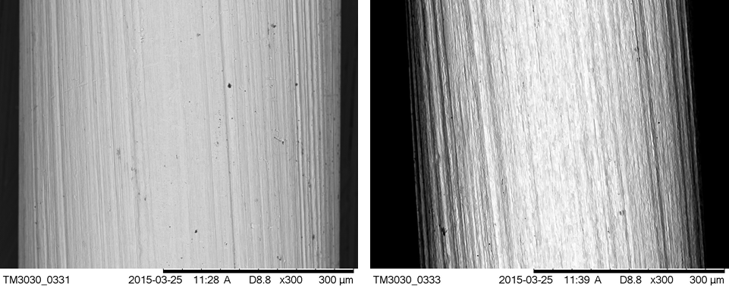

SEM Images of the Tungsten Test Wires
Tungsten wire before heating
Tungsten wire after testing at 1700°C

Slide 27

Vacuum/Leak Test Measurements
Mass loss measured on a four figure balance
Change in wire diameter measured using a micrometer

Slide 28

Vacuum/Leak Test Summary: Bare Tungsten @ 1700°C
Total Pressure (Torr) | Recession Rate (mm/year)
1×10⁻⁶ | Few Microns
1×10⁻⁵ | 0.12
1×10⁻⁴ | 1.8
At 10⁻⁵ Torr total pressure and 1700°C the erosion rate looks to be tolerable
Recall 1-2mm diameter spokes, 1-2mm thick hub, 6mm diameter target rod

Slide 29
Sag / Creep Test

Slide 30


Sag/Creep Test
Test under preparation
Aim to quantify the expected level of creep/sag in the Mu2e target rod
First results soon
Vacuum Vessel
Heated Tungsten Bar
Fiducial Post
Alignment Telescope

Slide 31
Silicon-Carbide Coatings

Slide 32


SiC Coating by Chemical Vapour Deposition (CVD)
The ideal target coating would have a high emissivity, excellent high temperature chemical stability, a thermal expansion coefficient that is well matched to tungsten (the substrate), and excellent radiation damage tolerance.
From a number of candidate commercially available coating systems, Silicon Carbide (SiC) was singled out for further investigation as a potential target coating material.
SiC is very “black”. Breaks down at temperatures above 1500°C.
SiC coatings can be generated using Chemical Vapour Deposition (CVD), a process where gaseous precursors react to form a solid coating on a heated substrate.
Highly pure and fully dense SiC can be produced by CVD. Coatings of 100μm or more are possible.
Above:
50 μm SiC coating on a 1.6mm diameter tungsten tube
Right:
50 μm Tungsten samples mounted to the furnace fixture prior to coating at Archer Technicoat, UK

Slide 33



Thermal Cycling Tests
Samples:
Diameter 1.6mm x 0.5mm wall tungsten tubes CVD coated with silicon-carbide
Ends polished back to bare tungsten (with some difficulty - SiC is very Hard!)
Lateral pyrometer hole laser machined through one wall
Samples heated in good (10⁻⁷ mbar) vacuum by a DC current
Test for adhesion of coating / substrate under thermal cycling:
No damage observed after several cycles between room temperature and 1500°C

Slide 34



Monochromatic Emissivity Measurement and Long Bake-Out
Very high emissivity ελ_{0.65}=0.9
Long bakeout at 1250°C in good (10⁻⁷ mbar) vacuum
After an initial fall the emissivity appeared to recover and stabilise
No apparent damage to the coating
Monochromatic emissivity of the SiC coated tube on first heating
Average monochromatic emissivity vs time during a long bakeout
The sample (cold) after 40 days bake-out

Slide 35


High Cycle Pulse testing
Following on from the long bakeout a high cycle pulse test was performed on the same sample in order to mimic the thermal cycling of the Mu2e target.
the coated sample was connected to the pulsed power supply which was adjusted to supply a 1.8kA pulses at 2Hz. This resulted in a mean temperature of about 1250°C with a pulsed ΔT of 40°C.
After 1 million cycles the test was stopped. No visible damage to the coating had occurred.
Left:
Predicted temperature fluctuations in a SiC coated tungsten Mu2e target
Right:
The sample under test at 1250°C

Slide 36





Thermogravimetric-Analysis (TGA)
In House Test At RAL
RT – 1000°C , Tested in air
Oxidation in bare tungsten takes off at ~500°C
Coated sample shows little/no response
Test At Netzsch (external company)
RT – 1650°C - RT, Purge in argon/air mix
Part of the coating broke away exposing the bare tungsten substrate
Significant mass loss beyond 1300°C
Right:
Microscope image showing a chip in the coating following the Netzsch TGA test
Substrate
Before Coating
After Coating
Coating
6mm diameter x 1mm thick tungsten disks

Slide 37




SiC Coated Wire Preparation for Vacuum/Leak Test
SEM image of a SiC coated wire prior to heating
Sample preparation, note the coated central portion and bare ends
Close-up photograph of the 50 μm thick silicon-carbide coating
SEM image of a bare tungsten wire before coating

Slide 38



Vacuum/Leak Test of SiC Coated Wire
Wire heated to T_{max}=1300°C in 10⁻⁴mbar air
Much greater heating power required compared to bare tungsten!
The test was stopped after 5 days. A white deposit had built up in places.
SiC coated tungsten wire shortly before heating
SiC coated tungsten wire shortly after first heating to 1250°C
SiC coated tungsten wire after 5 days at 1250°C in 10⁻⁴mbar air
Note the white deposits

Slide 39


SEM Images (Post Heating)
Silicon
Silicon
Carbon
Carbon
Oxygen
Aluminium
Aluminium
Centre of Wire (Appears Black)
White Patch (Near End)

Slide 40

Likely Scenario
The white substance is most likely silica (SiO₂)
High Temperature oxidation of silicon carbide can apparently occur in either a “Passive” or an “Active” mode
Neither mechanism is desirable
Passive Oxidation ⇨ The black coating turns white!
Forms a protective (white) oxide film which limits further attack of the SiC
$$SiC\left(s\right)+{\frac{3}{2}O}_{2}\left(g\right) \underset{→}{ } SiO_{2}\left(s\right)+CO\left(g\right) \\ SiC\left(s\right)+{2O}_{2}\left(g\right) \underset{→}{ } SiO_{2}\left(s\right)+CO_{2}\left(g\right)$$
Active Oxidation ⇨ The coating rapidly erodes away!
Forms a volatile oxide and may lead to recession of the SiC layer
$$SiC\left(s\right)+O_{2}\left(g\right) \underset{→}{ } SiO\left(g\right)+CO\left(g\right) \\ SiC\left(s\right)+{\frac{3}{2}O}_{2}\left(g\right) \underset{→}{ } SiO\left(g\right)+CO_{2}\left(g\right)$$

Slide 41


Test to Failure
A second coated wire was mounted in the vacuum/leak test rig. After bakeout it was run at about 1250°C in good (about 10⁻⁷ mbar) vacuum for three weeks. No noticeable degradation of the coating occurred.
Then the air leak was opened and adjusted to run at a total pressure of 10⁻⁴ mbar. During the next few days a gradual build-up of white deposits along the full length of the wire was observed. After 1 week the coating had almost completely disappeared leaving behind a shiny tungsten wire running at about 1700°C.
BEFORE
AFTER

Slide 42
Silicon-Carbide Coatings Summary
The silicon carbide coatings performed very well in a good vacuum of
10⁻⁶ mbar or better…
high emissivity ✔
survived thermal cycling between room temperature and 1500°C ✔
survived long bakeout 10 weeks ✔
survived 1 million 40°C pulses at 1250°C T_{mean} ✔
…but quickly failed when the vacuum quality was reduced to 10⁻⁴ mbar ✘
For this reason the silicon carbide cannot be recommended as an oxidation resistant target coating

Slide 43
Iridium Coatings

Slide 44

Oxidation Recession Rates for Tungsten and Iridium at 1700°C
Tungsten
Iridium
RA Perkins, WL Price and DD Crooks, “Oxidation of Tungsten at Ultra-High Temperatures,” Lockheed Missiles and Space Company, November 1962.
RW Bartlett, “Tungsten Oxidation Kinetics at High Temperatures,” Transactions of the Metallurgical Society of AIME, vol.230, p.1097, 1964.
H U Anderson, “Kinetic studies of the reactions occurring between tungsten and gasses at low pressure and high temperature,” PhD Thesis, University of California Lawrence Laboratory, UCRL-10135, Apr 1962.
J Eisinger, “Adsorption of Oxygen on Tungsten,” Journal of Chemical Physics, vol.30, p.412, 1959.
H Jehn, R Volker and MI Ismail, “Iridium Losses During Oxidation,” Platinum Metals Review, Vol.22, Issue 3, p.92, 1978.
RT Wimber, SW Hills, NK Wahl and CR Tempero, “Kinetics of Evaporation / Oxidation of Iridium”, Metallurgical Transactions A, Vol.8, p.193, 1977.
⇨ Would like ~100μm thick iridium
coating for 1 year life

Slide 45

Iridium Coatings
In early stages of investigation…
Potential iridium coating processes include sputter coating, electro-deposition from molten salts, and chemical vapour deposition
Chemical Vapour Deposition (CVD)
Coatings of 100μm or more possible
UK company developing iridium coatings for ESA
Metal-organic precursor, niobium substrate, 300 – 400°C deposition temperature
Have not tried tungsten substrate yet
W and Ir are compatible - have deposited tungsten coatings on iridium substrates in the past
Sputter Coating
Generally very thin coatings on optical elements
Fermilab have produced 5 μm iridium coating on a 0.5mm diameter tungsten wire
Rotating sample fixture to achieve uniform coating

Slide 46




SEM Images of the Iridium Sputter Coating
Bare Tungsten Wire
Wire + 5 μm Iridium Coating

