Slide 1
Target Summary/Status
Chris Densham
STFC/RAL
Mu2e Target, Remote Handling, and Heat & Radiation Shield Review
Nov 16-18 2015

Slide 2
Schedule for Target Program
Contract 3
Phase 1
Design & Test
Emissivity measurements
Pulsed lifetime test
Silicon-Carbide coatings
Vacuum/leak test
Intermediate report
Contract 3
Phase 2
Design & Test
Alternative coating technology
Creep/sag tests
Creep/sag tests
Helium cooled target concept
Prototype springs
Optimise + prototype target mount system
Final Report

Slide 3
Target Research Status (I)
☺ Emissivity measurements for tungsten
  Operating temperature determined for plain target at 7.7 kW beam power ✔
  Micro-fins enhance emissivity (lower T) but questions over fatigue life ✔
☺ High T pulsed fatigue performance of tungsten test samples
  Sufficient for > 1 year lifetime ✔
  Encouraging data at increased pulse intensity
😐 Sag/creep tests
  Tests underway
  Available data does not cause concern
  If there is a problem, design can be modified e.g. support from Airy points
😐 Radiation damage of tungsten – high DPA rate, He, H2 production
  c.10x faster rate than in ISIS targets, higher T may be better due to high diffusion
☺ ‘Bicycle’ wheel target concept
  Simple installation into HRS/ easy remote handling ✔
  Spoke manufacture ✔
  Spoke tensioning system (2 options) ✔

Slide 4
Target Research Status (II)
😐 Operating conditions of radiation cooled target vs requirements
  Vacuum level of 1e-5 torr expected by vacuum group
  Vacuum level of 1e-6 mbar known to result in minimal tungsten oxidation
  Uncertainty on target lifetime for actual operating conditions
☹ Oxidation -> contamination of HRS
☹ 😐 Target coating to mitigate oxidation
  ☺ SiC: strong, high emissivity coating (lower T), performs well at 1e-7 mbar
    ☹ Coating rapidly degrades at 1e-4 mbar, not suitable as anti-oxidation coating
  😐 Ir coating: much less reactive than W at high temperatures
    few µm layer achieved by sputter coating
    c.100 µm required for evaporation/diffusion tolerance
      CVD being investigated, promising
😐 Backup options: convective cooling to eliminate oxidation
  Water or helium feasible
  ‘Back door’ kept open to incorporate cooling system

Slide 5
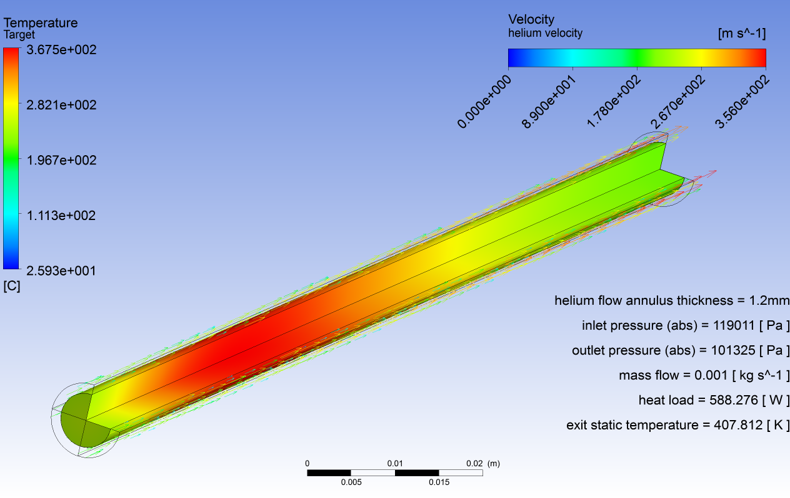
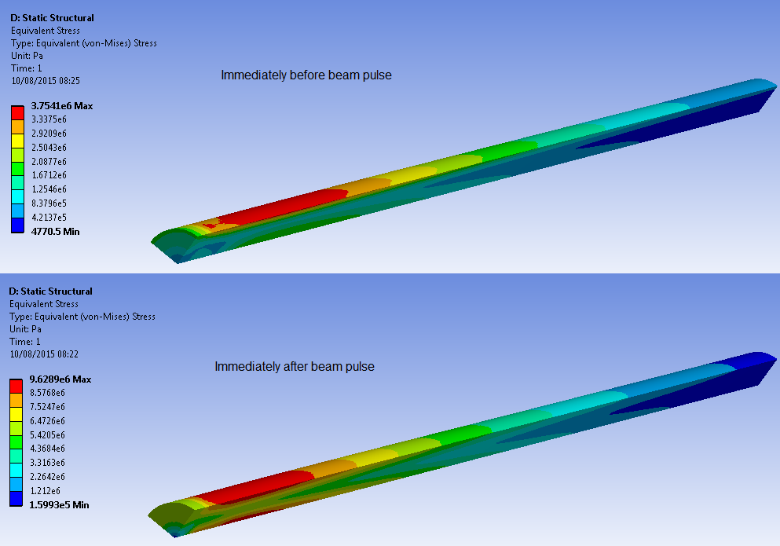
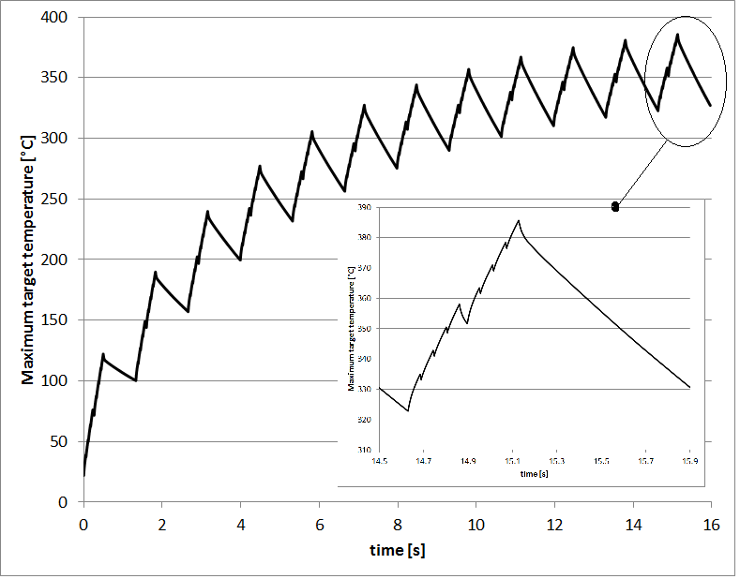
Helium cooled target
proton beam : 8GeV 8kW 1mm sigma
heat load = 588W
helium mass flow = 1g/s
max helium velocity = 356m/s
pressure drop = 0.2bar
max tungsten temperature = 368°C
temperature variation per pulse = 58°C
max von Mises stress = 10MPa
stress fluctuation = 6MPa

Slide 6
Target research status (III) Convectively cooled back-up
 | Radiation cooled | Water cooled | Helium cooled
Material | Tungsten Graphite (low yield) | Gold Ta clad tungsten | Tungsten
Physics (yield) | ☺ | 😐 c.5% pion loss | ☺😐 c.1% pion loss
Chemistry | ☹ High temperature, poor vacuum | 😐 Some chemistry (W/H2O) | ☺ No chemistry
Operating temperature | High ☹ W properties ☺ Graphite | Low ☺ W properties 😐 Au properties | Low ☺ W properties
Ease of remote handling | ☺😐 | ☹ Water connections, pipes | ☹ Helium connections, pipes
Plant issues | ☺ None | 😐 Known tech. | ☹ Complexity, price
Diagnostics | ☹ None? | ☺ΔT, activity | ☺ΔT, activity
Contamination /activation | ☹ Ox. in poor vacuum 😐 OK in good vacuum | 😐 Water activation 😐 Issues with leaks | ☺ Low activation ☺ Low leak concerns
Experience, data | ☹ Little data | ☺Data on Ta clad W 😐 Little gold data | ☺ Data on pure W
Upgradeability | ☹ No | ☺ Yes | ☺ Yes

Slide 7
Radiation cooled target schedule (2 year float)

Slide 8
Radiation cooled target schedule (2 year float)
Mid FY 2018
Detail Design
Contract 4
Full Target Prototype
Manufacture Prototype Target
Intermediate Report
Thermal Testing of prototype
Final Report
Contract 5
Manufacture 1st Production Target
Manufacture And Assemble Parts
Ship to FNAL

