Slide 1
Mu2e Target Hall Remote Handling
- Overview
Ryan Schultz
Deputy L3 Manager Target Station
11/17/2015

Slide 2
Remote Handling Agenda
Ryan Schultz
  Overview, Building Layout, General Goals
Tony Leveling
  Radiological Issues
  Radiation rates, etc. described here
Dave Pushka
  Door & Cart design
Mike Campbell
  Modules, Procedure, End Of Arm Tooling
Ryan Schultz
  Contamination Control, Schedule, Conclusions

Slide 3
Remote Handling Requirements
General
  The remote handling shall provide safe handling methods, equipment, and facilities to support target hall component installation, replacement, and short-term storage.
  The remote handling shall incorporate ALARA (As Low As Reasonably Achievable) principles into equipment and procedures.
  The remote handling shall be integrated into the infrastructure of the complex both underground and above ground
Devices
  Production Target
  Vacuum Windows (3)
  Anti-Proton Absorber
Timing
  Target replacement must be performed in less than one month, and may occur on a yearly basis.

Slide 4
Remote Handling Review in March
Areas we have improved
  Facility
    Can accommodate convectively cooled target if necessary
    Larger door between Remote Handling Room and PS Room
    Hatch is separated from Remote Handling Room
  Mechanical Design
    Removed telescoping arm for target replacement
  Radiological Design
    Decontamination area inside Remote Handling Room
    Specific containment vessel for target
    HEPA filter located in Remote Handling Room

Slide 5
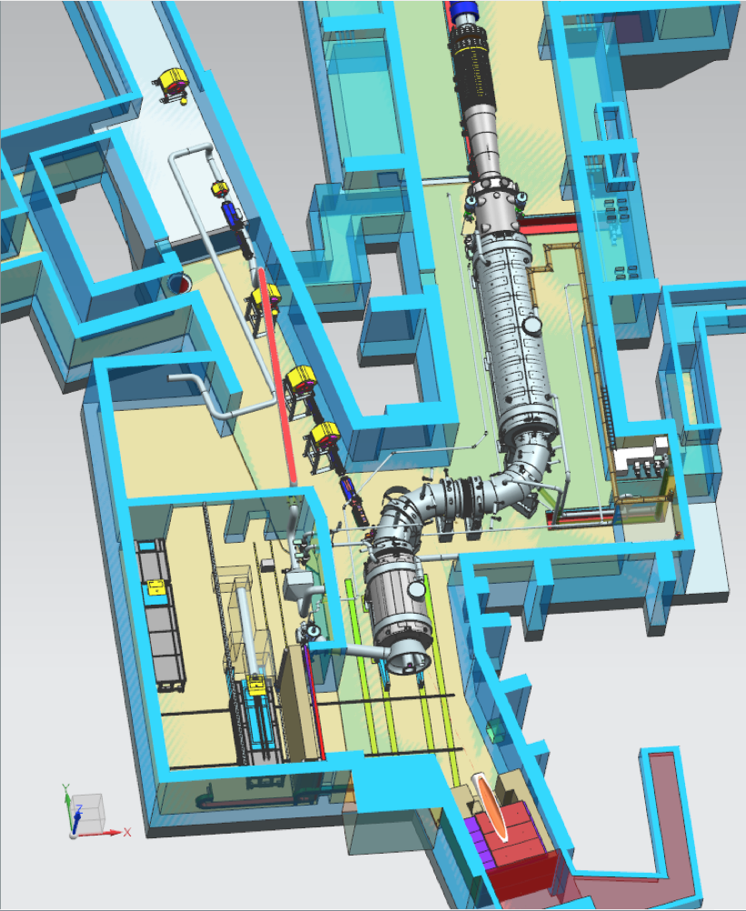
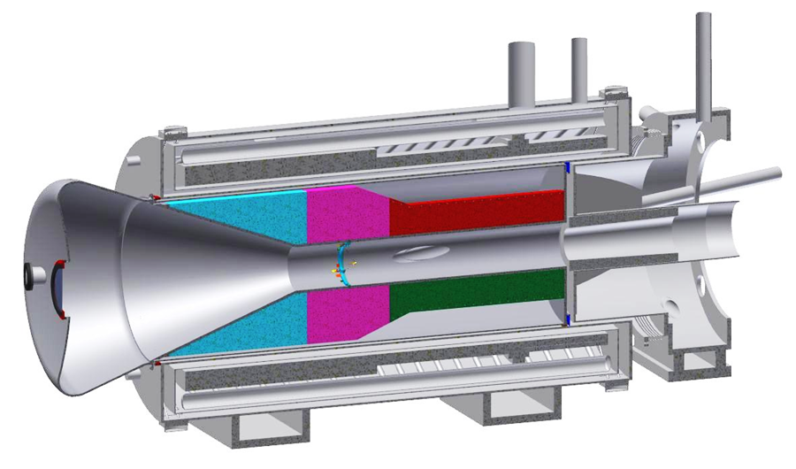
Facility Overview
Proton Beam
Production
Solenoid
(target, HRS)
Remote Handling
Room
Notes:
Zoom in

Slide 6
Facility Overview
Remote Handling
Room
RH Hatch
Room
M4 Beamline
Production Solenoid
Room

Slide 7
Facility Overview
Contamination
Controls
Area
Not
Contaminated
RHR is bigger to accommodate equipment, including CC target
Hatch is separated from contamination area(s)
Door allows equipment to enter room parallel with PS
HEPA system in RHR
Contaminated
Area
Notes:
Green area defined by AD Rad Safety during operations

Slide 8
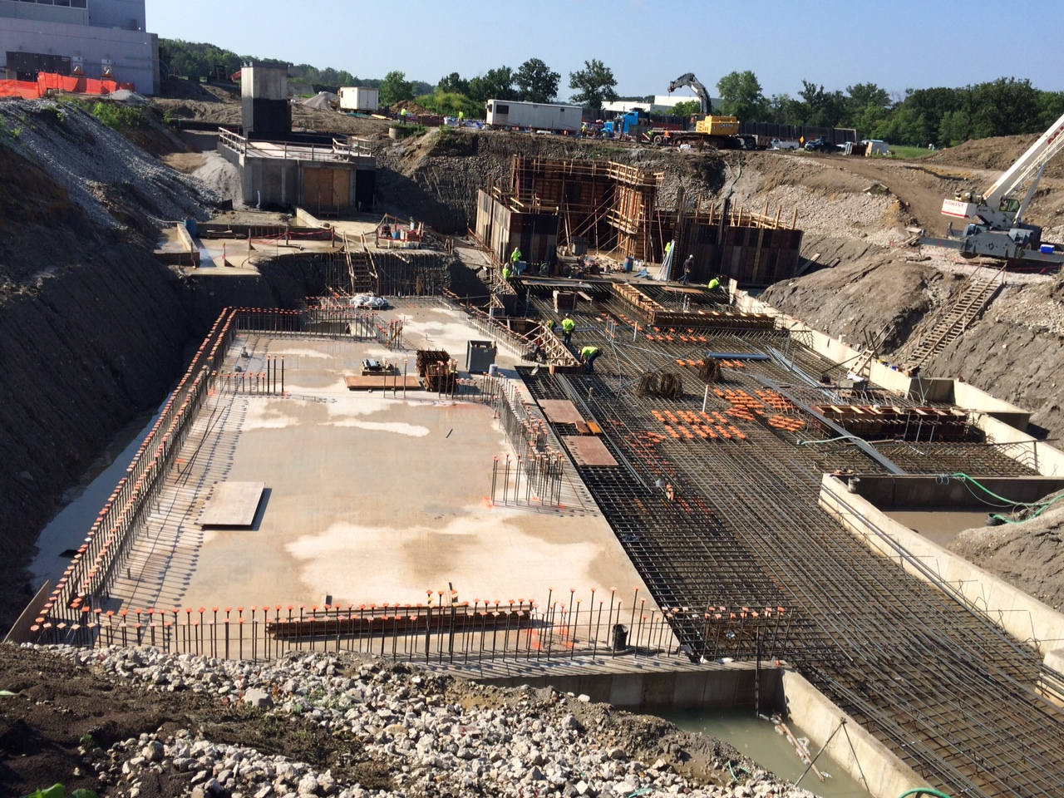
July 2015

Slide 9
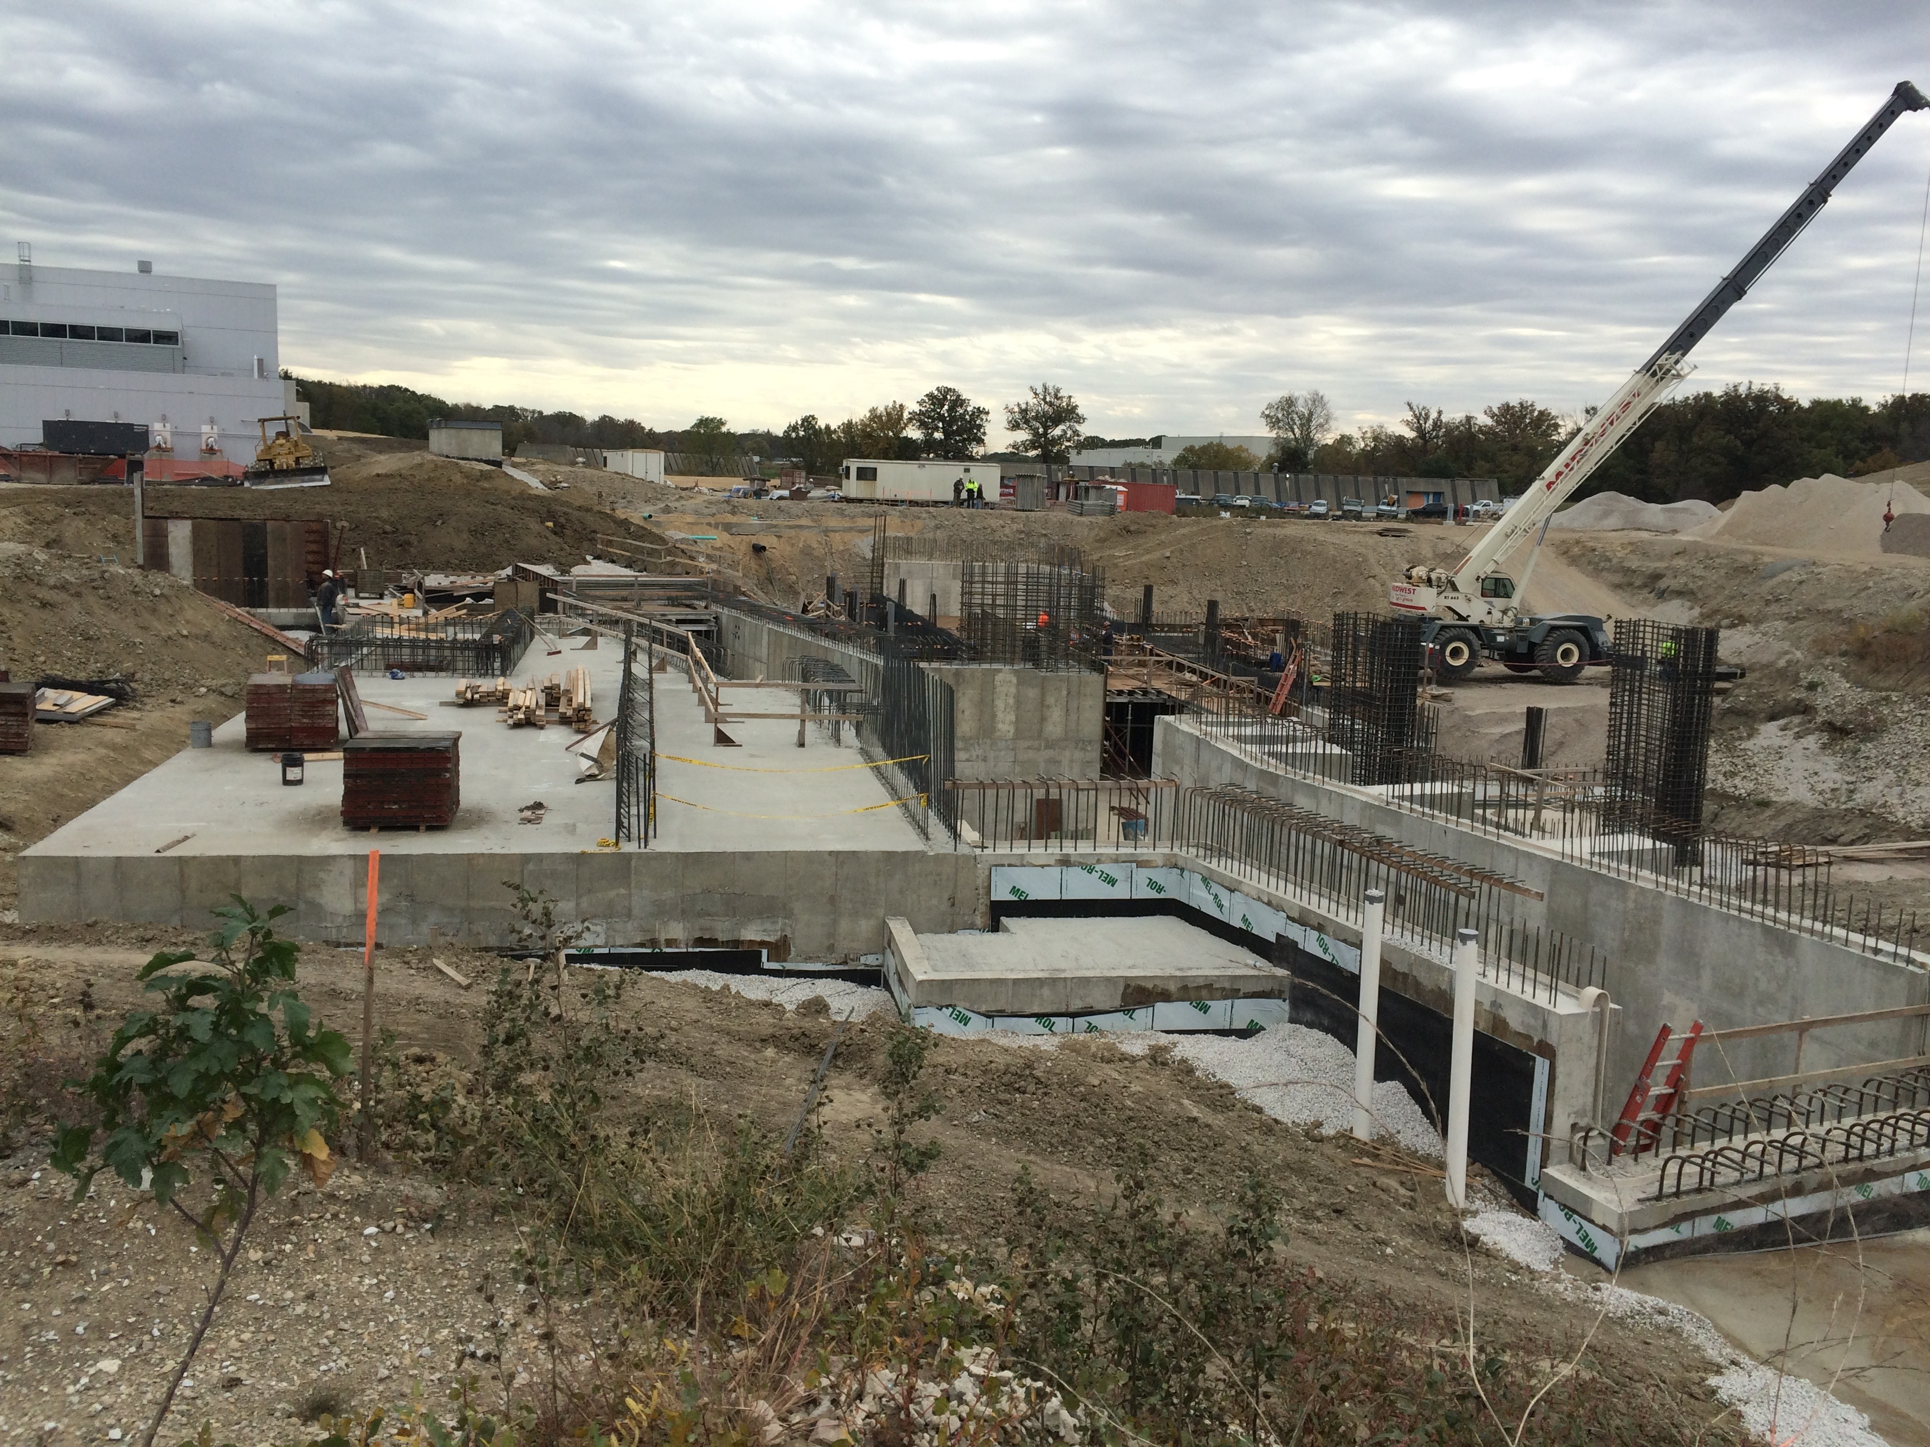
10/15/15

Slide 10
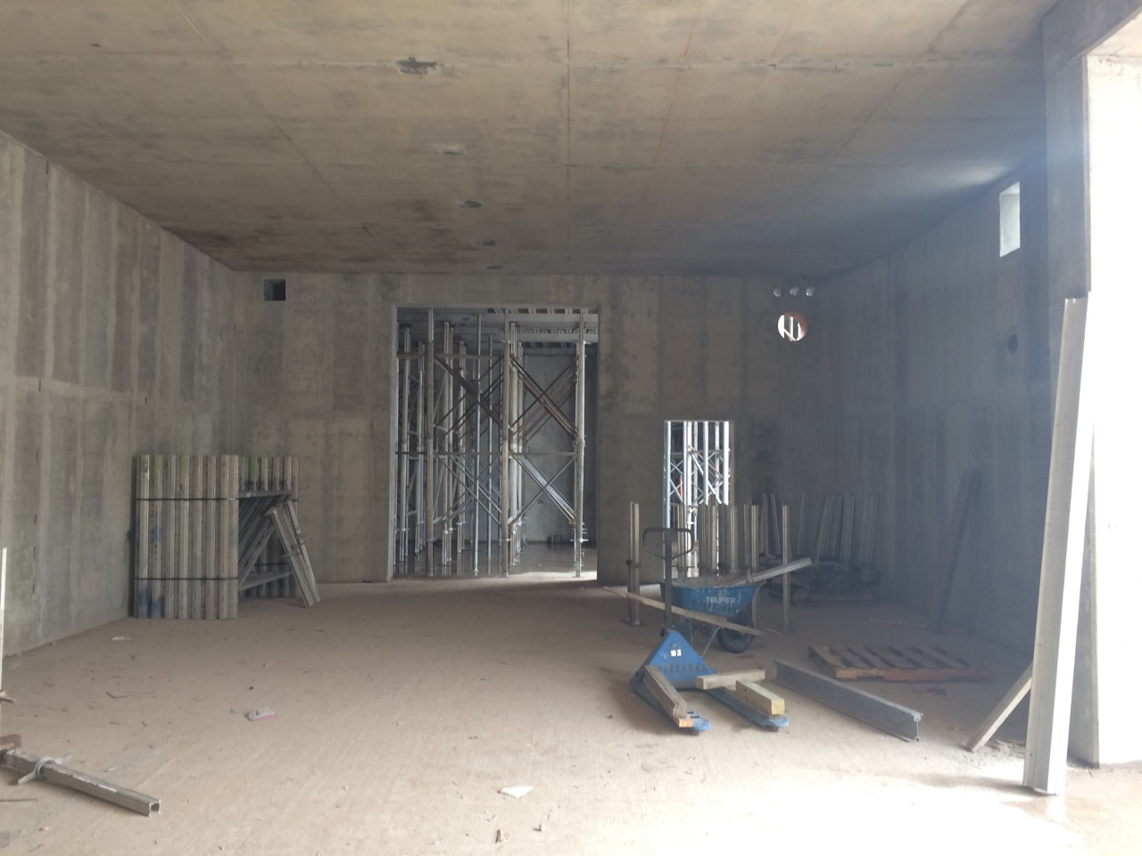
10/15/15
10-21-15

Slide 11
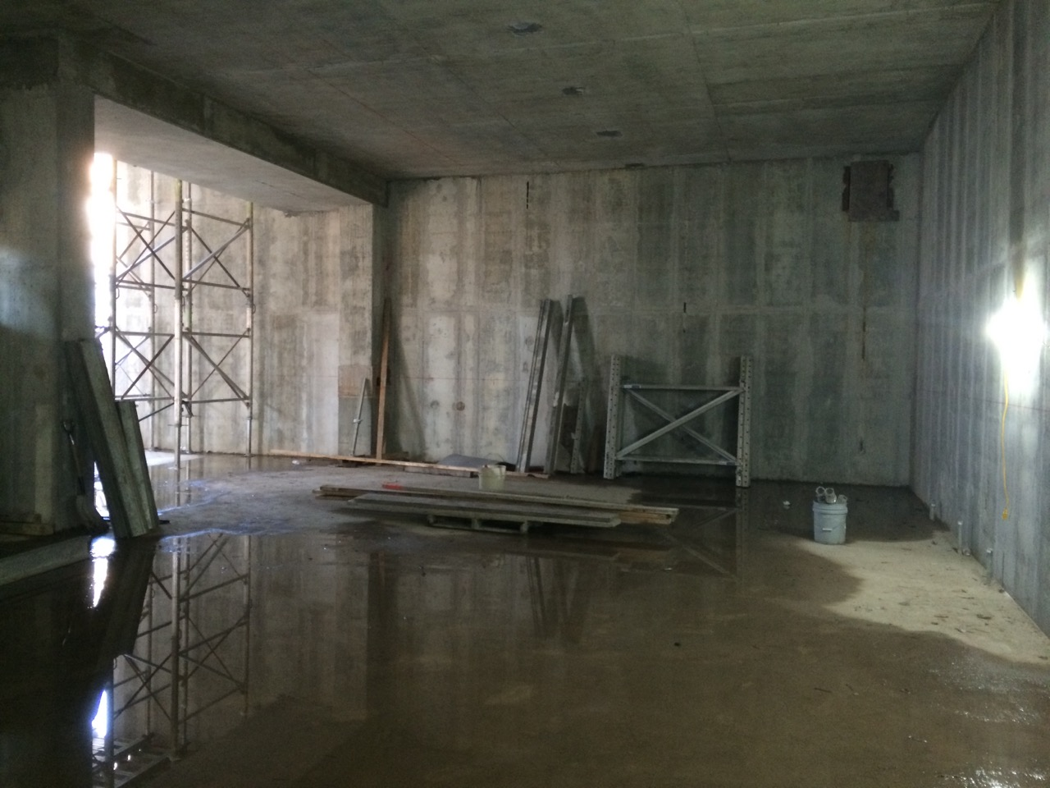
10/15/15
11-11-15

Slide 12
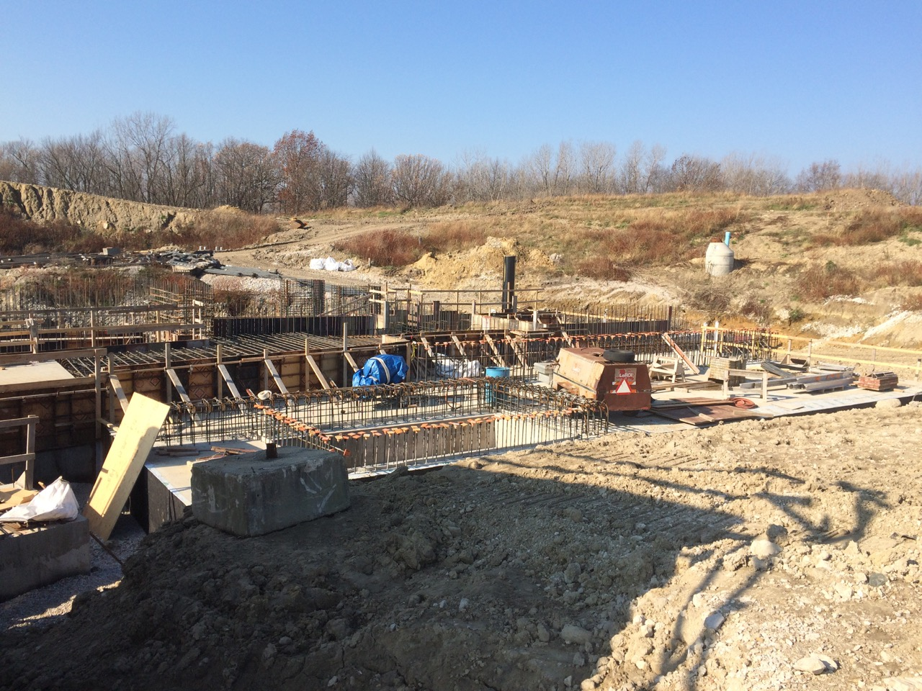
PS Hatch
RH Room
RH Hatch
11/11/15

Slide 13
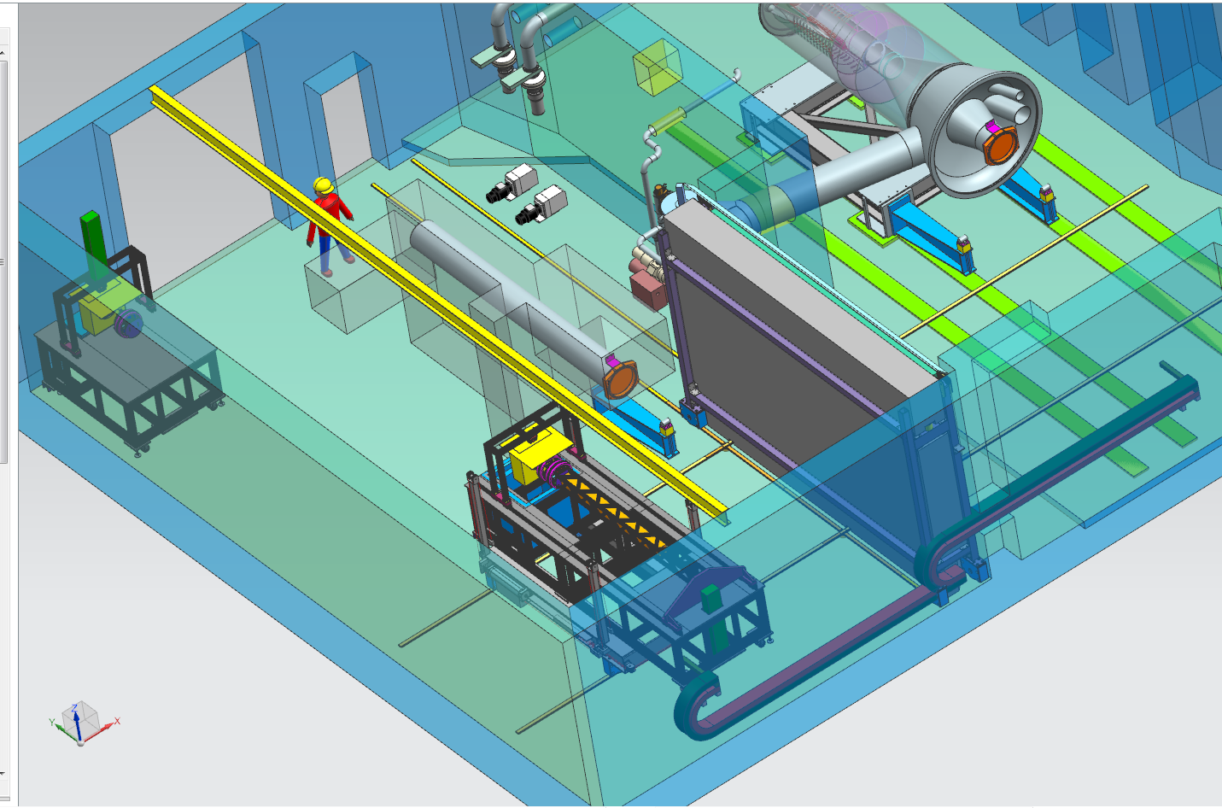
Remote Handling Room Layout
Module
Storage
Calibration
& Testing
Area
Rails between
RH & PS Rooms
10T
Monorail

Slide 14
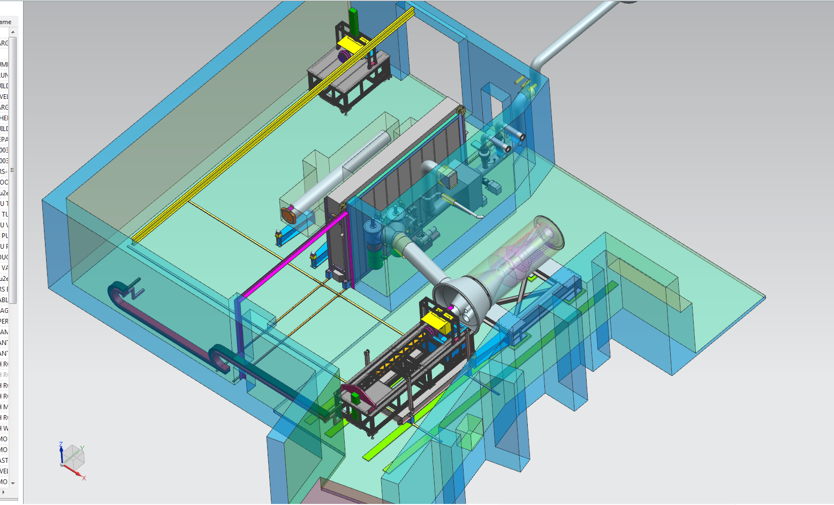
Remote Handling Room Layout
Vacuum Pumps
& HEPA Filter
Area
Big Door
Rails

Slide 15
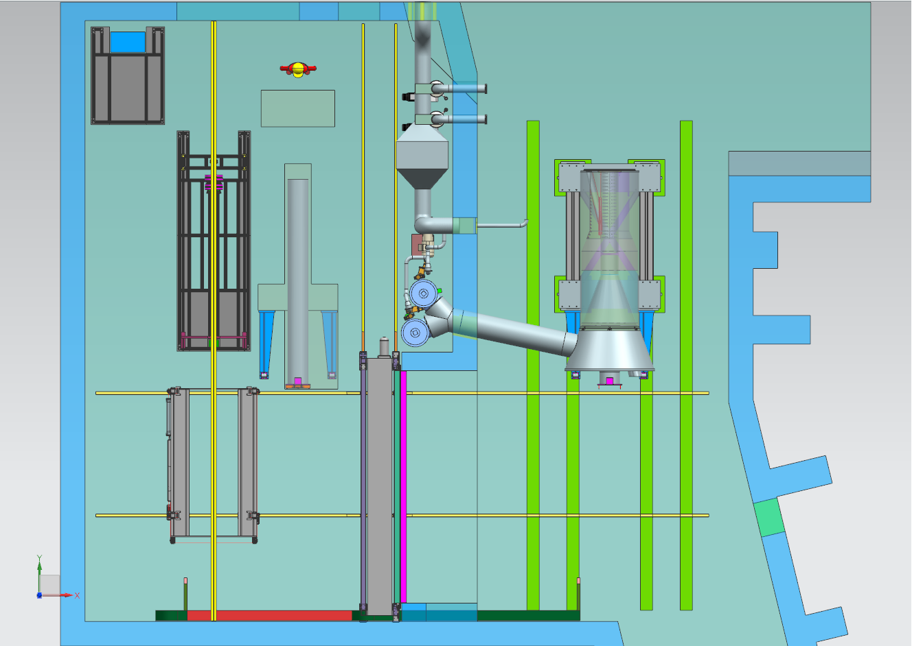
Roll module under
monorail

Slide 16
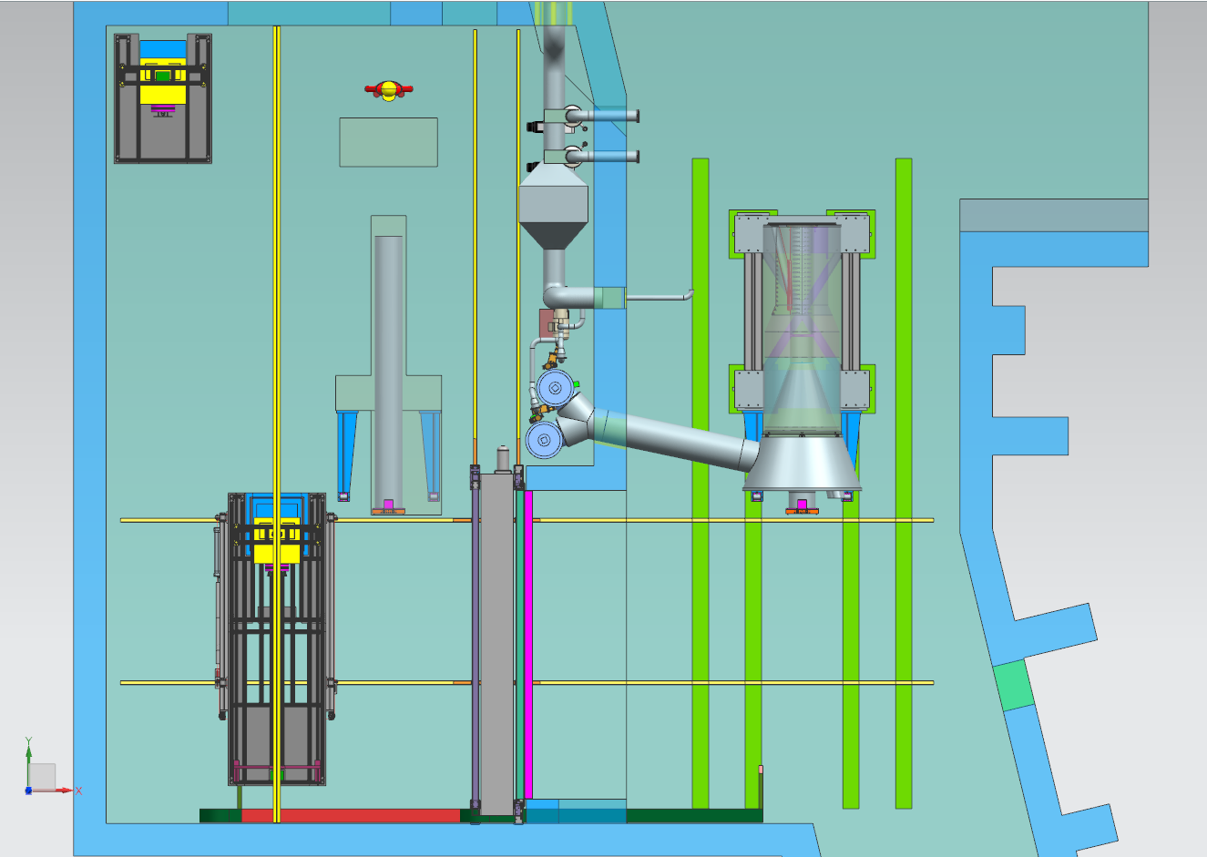
Load Module
& Cask onto Cart

Slide 17
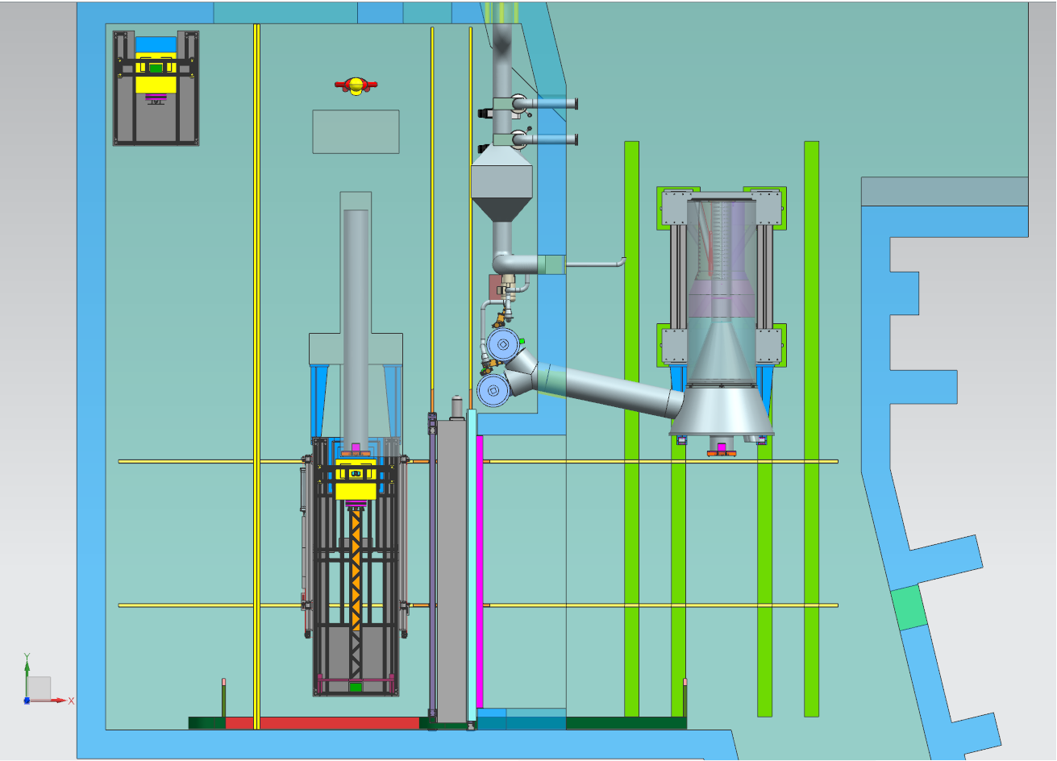
Practice & Calibration

Slide 18
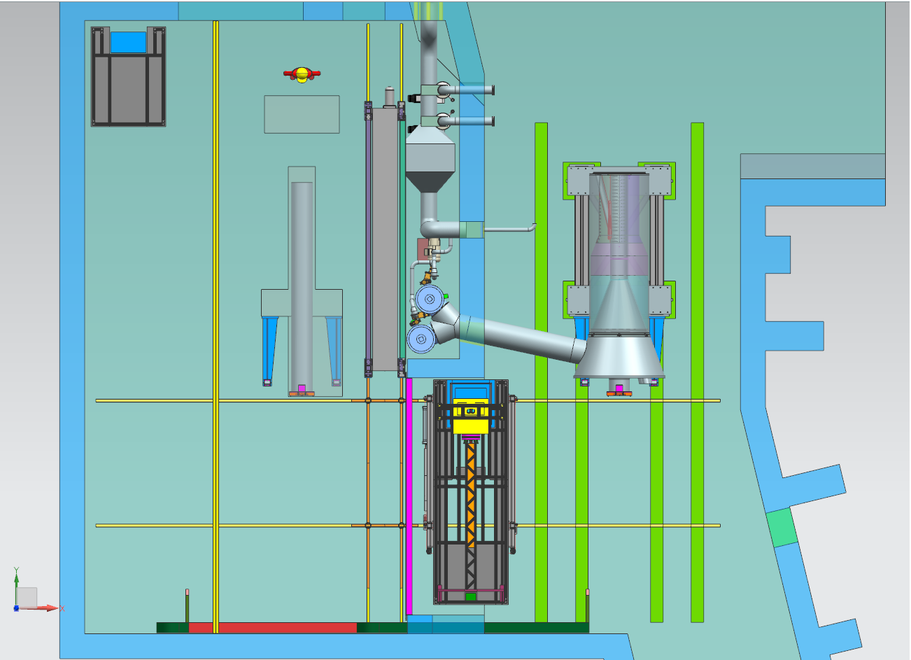
Through the Big Door

Slide 19
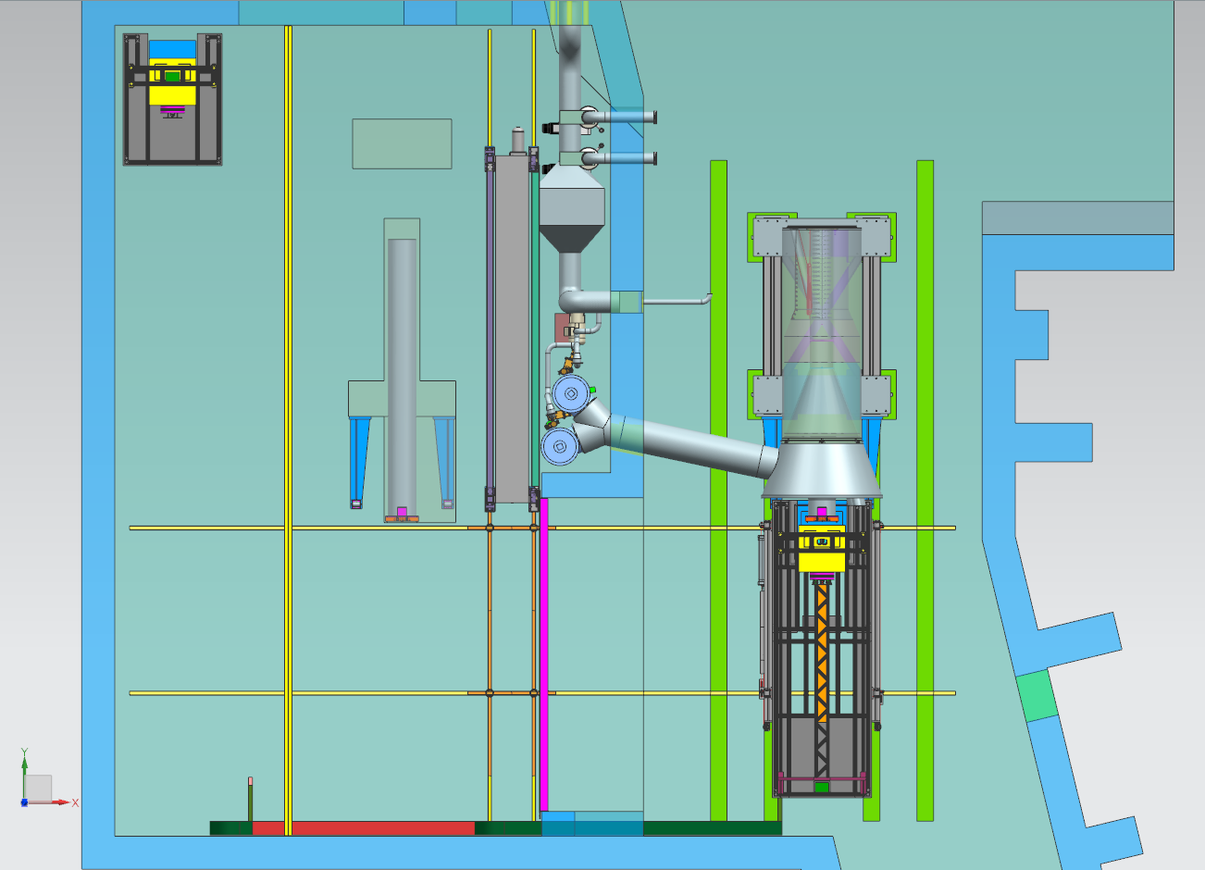
Main operation
in front of PS
Close Door
as necessary

Slide 20
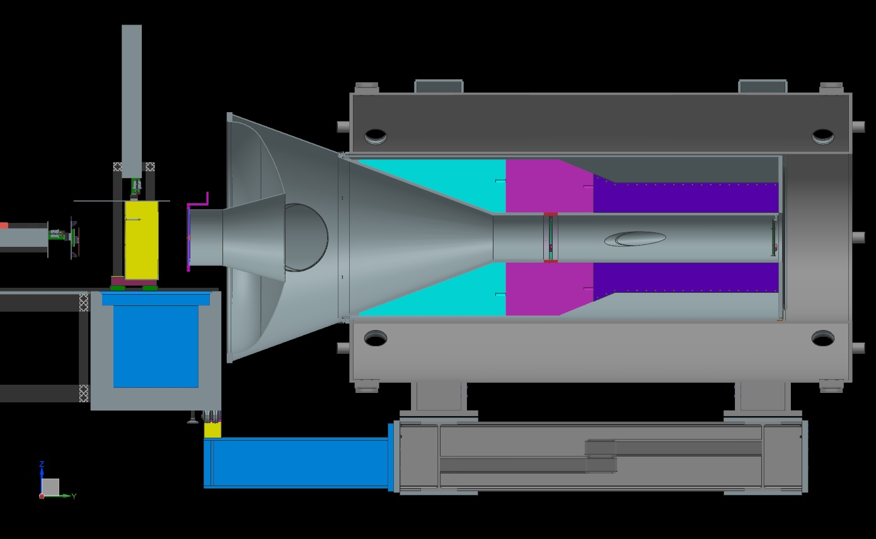
Cross Section of PS
Target
Pbar
Absorber
12’-6”
6’-8”

Slide 21
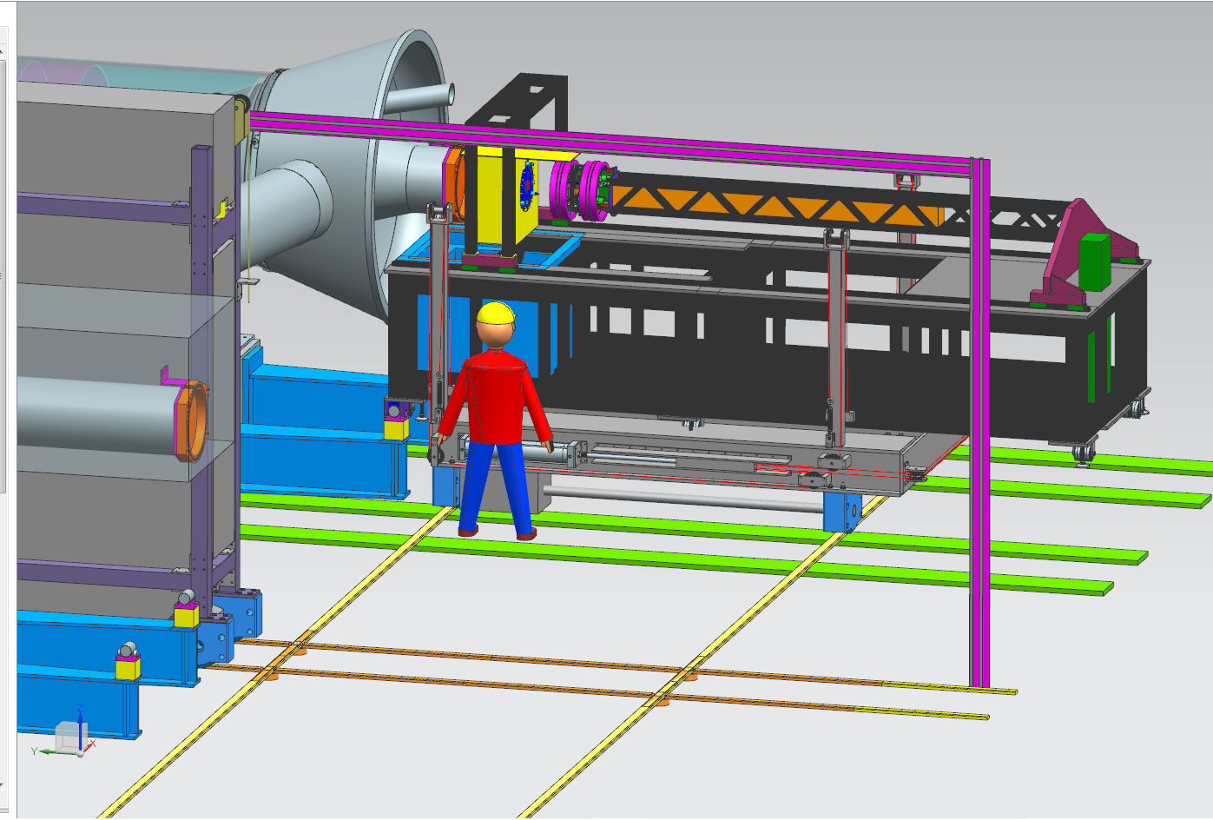

Slide 22
Contamination Control Goals
Contain TARGET material at the source – at the PS Window
  Keep target material in either
    PS end cap
      OR
    Containment Vessel
      OR
    Cask
  EOAT will be disposable
    Disconnect and leave in containment vessel

Slide 23
Notional Cartoon

Slide 33
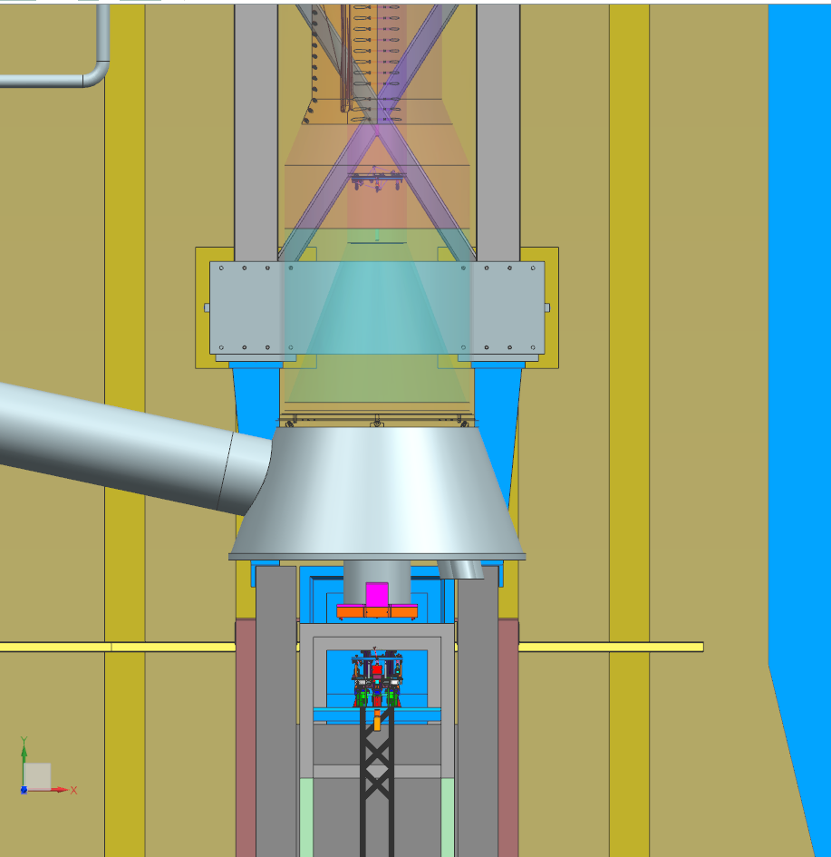

Slide 34
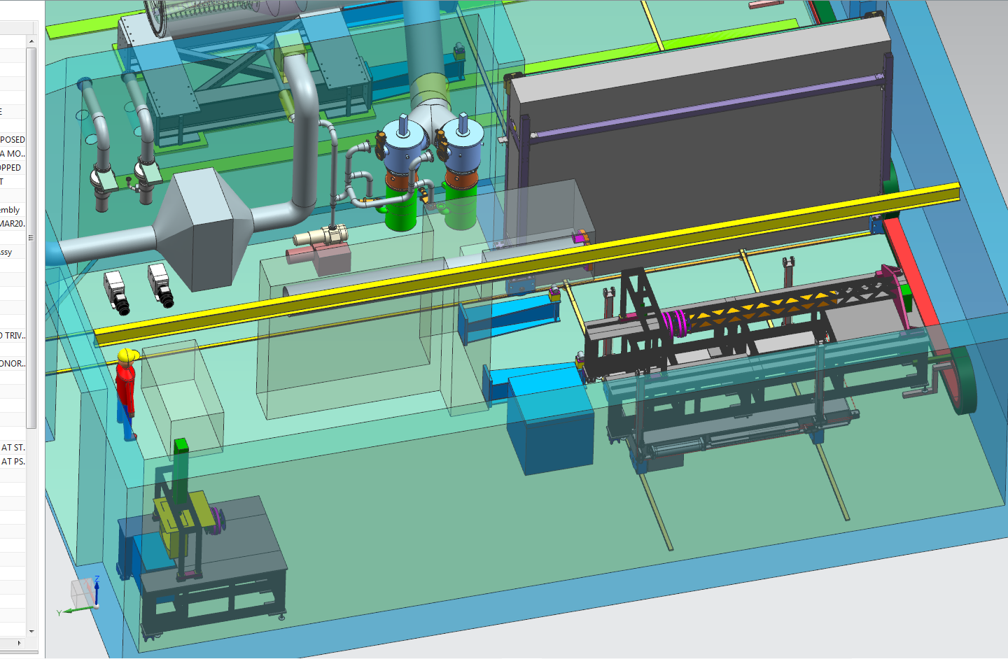
Decontamination
& Removal of Cask

Slide 35
Summary
Facility was designed to do the following:
  Component replacement
    Target
    Pbar absorber
    Windows
  Mitigate Radiological Concerns
    Air Handling
    Contamination Control
    Dose to workers
  Meet the Remote Handling Requirements
Subsequent talks will go into more detail
  Radiological Issues – Tony Leveling
  Mechanical Design – Dave Pushka & Mike Campbell

