Slide 1
Mu2e Remote Handling Review
Radiological Issues
A. Leveling
Mu2e Target, Remote Handling, and Heat & Radiation Shield Review
November 16-18, 2015

Slide 2
Outline
PS Room and RHR Layout
Facility Radiation Dose Rates from Major Sources
RHR effective dose rate with target removed from PS
Facility radiation dose rates (sans major sources)
  PS Room surface contact dose rates
  Remote Handling Room surface contact dose rates
Air flow
  During operations
  During remote handling operations
Contamination sources
Radiation Protection – entry controls
Summary
Note: All dose rates are based upon 365 days irradiation, 7 days cooling, 7.7 kW beam
power
Leveling | Radiological Conditions During Mu2e Target Change Out

Slide 3
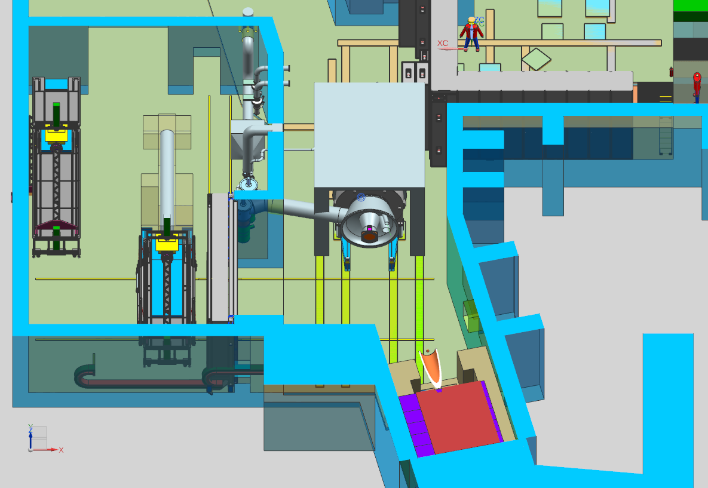
Production Solenoid and Remote Handling Room Layout
doorways
HEPA filter system
Concrete yoke
PS vacuum pumps
N
Production Solenoid
ODH duct
Primary beam absorber
Vacuum port
RHR concrete door
Leveling | Radiological Conditions During Mu2e Target Change Out

Slide 4
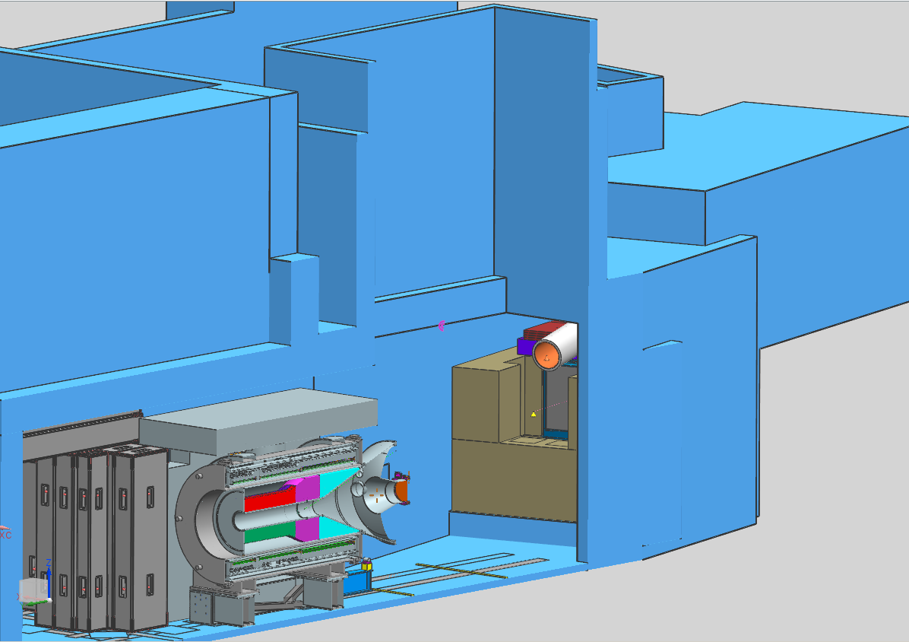
Elevation View
19’
Drop
hatch
Transport
Solenoid
(not shown)
Production
solenoid
17’
Beam
Dump entrance
9.3’
7.6’
21’
Leveling | Radiological Conditions During Mu2e Target Change Out

Slide 5
Facility radiation dose rates major sources
Source document: mu2e doc.db 5188-v1
Source document: mu2e doc.db 5471-v4
Source document: mu2e doc.db 5629-v1
Leveling | Radiological Conditions During Mu2e Target Change Out

Slide 6
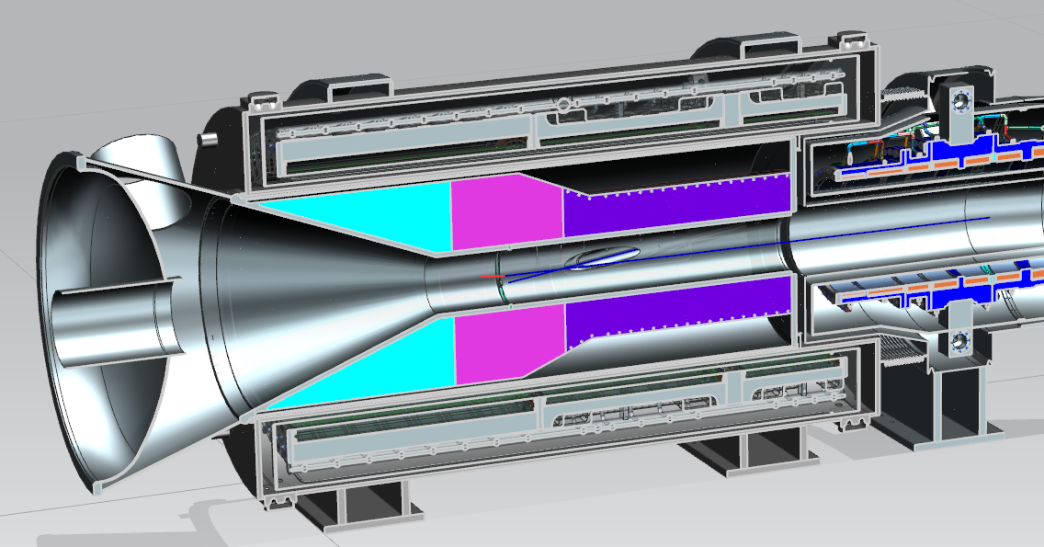
Major Sources – tungsten target
Source: V. Pronskikh
MARS
Tungsten target
460 Ci (1.7E13 Bq)
1350 isotopes
330,000 rem/hr (3.3 kSv/hr) @ contact
210 rem/hr (2.1 Sv/hr) @ 1 foot
19 rem/hr (0.19 Sv/hr) @ 1 meter
In situ
Tungsten target is well shielded by the HRS
Small dose contributor to end cap region
Little to no effect on dose rates in the PS room
Leveling | Radiological Conditions During Mu2e Target Change Out

Slide 7
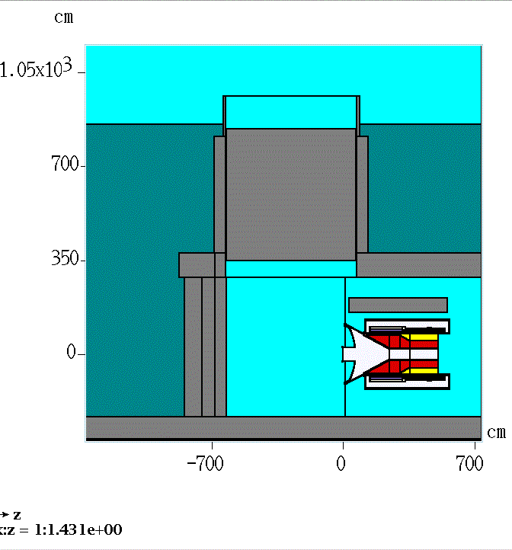
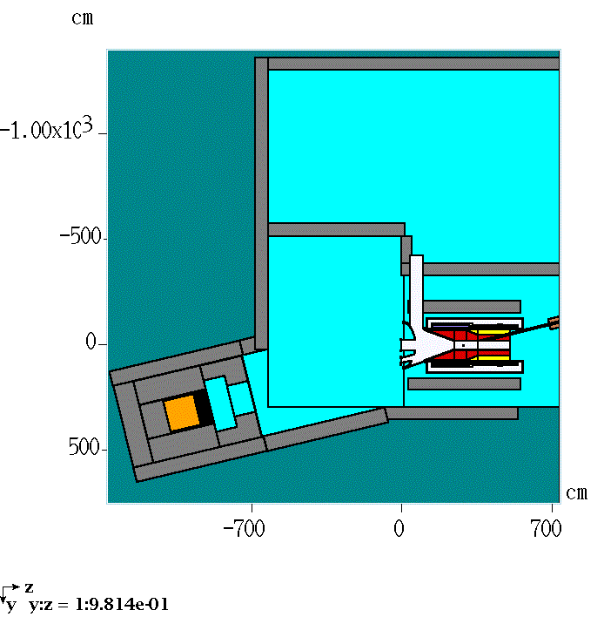
Major Sources – Target, Endcap, and Beam Dump
MARS/DETRA used to determine isotope content of:
  25 components comprising target, endcap, HRS
  25 absorber beam dump core volumes comprising the beam dump
Elevation view
Plan view
Leveling | Radiological Conditions During Mu2e Target Change Out

Slide 8
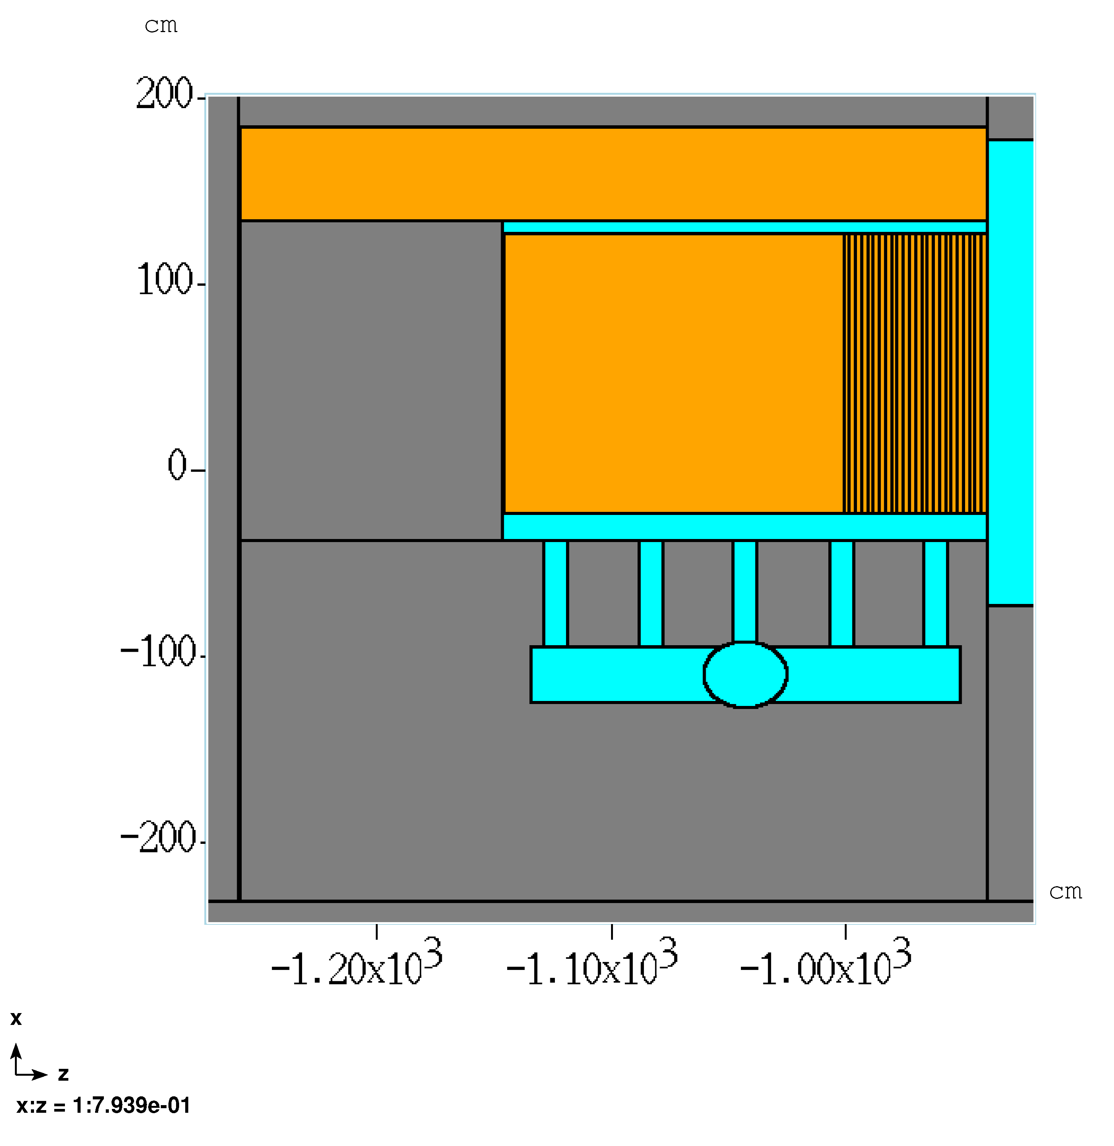
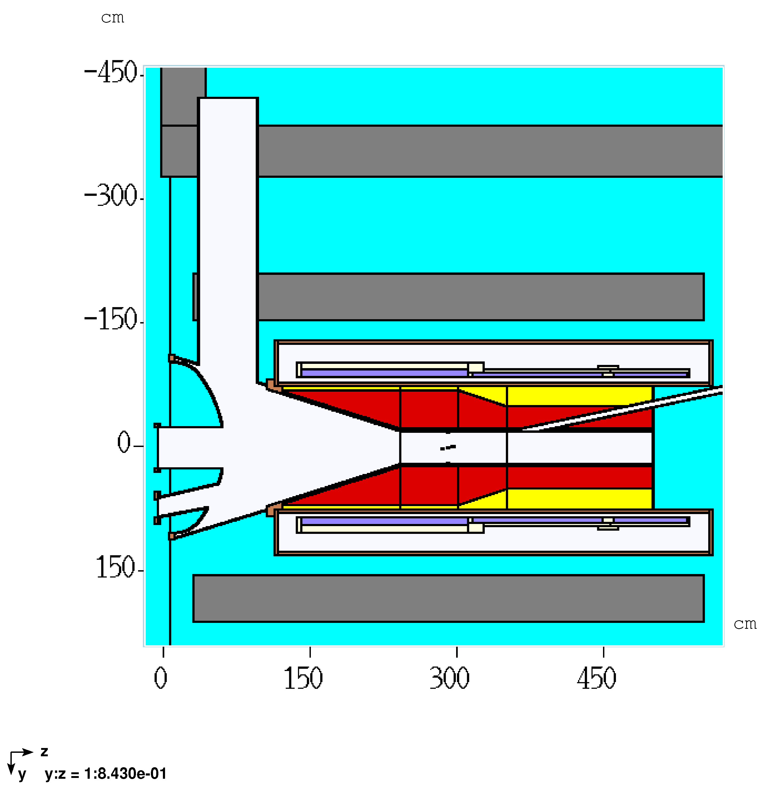
Major Sources – Target, Endcap, and Beam Dump
50 sources were conservatively distributed in their points of origin
Subsequent MARS Simulation used photon emitting isotopes as source term
Results in radiation dose rate contours in the PS room
Beam Dump Elevation view
PS Plan view
Leveling | Radiological Conditions During Mu2e Target Change Out

Slide 9
Major Sources – Target, Endcap, and Beam Dump
50 sources were conservatively distributed in their points of origin
Subsequent MARS Simulation used photon emitting isotopes as source term
Results in radiation dose rate contours in the PS room
Beam Dump Elevation view
PS Plan view
Leveling | Radiological Conditions During Mu2e Target Change Out

Slide 10
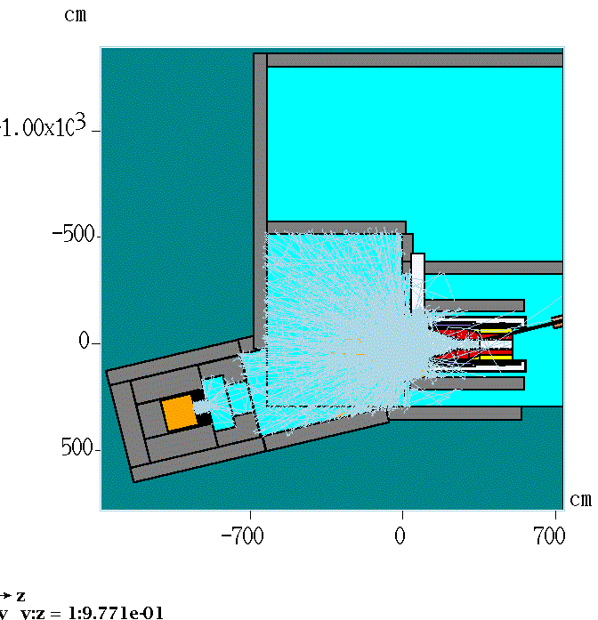
Major Sources – Target, Endcap, and Beam Dump
Photon tracks indicate source
term for the 50 sources
Leveling | Radiological Conditions During Mu2e Target Change Out

Slide 11
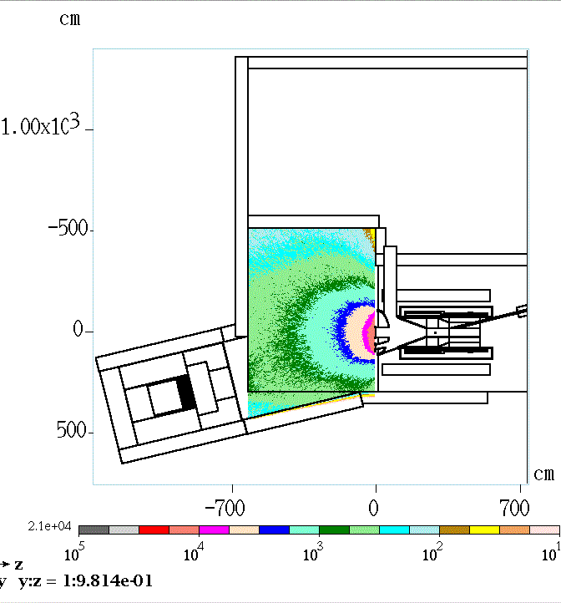
Major Sources – Target, Endcap, and Beam Dump
10 k
7 k
3 k
1 k
2 k
2 k
Plan view, mid plane of PS - mrem/hr
3 k
Leveling | Radiological Conditions During Mu2e Target Change Out

Slide 12
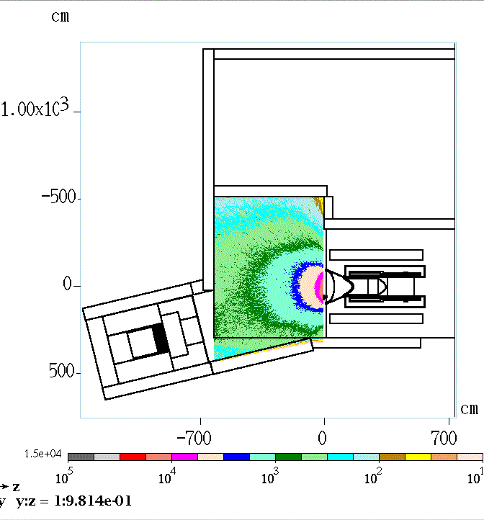
Major Sources – Target, Endcap, and Beam Dump
Plan view, mid plane of beam dump - mrem/hr
Leveling | Radiological Conditions During Mu2e Target Change Out

Slide 13
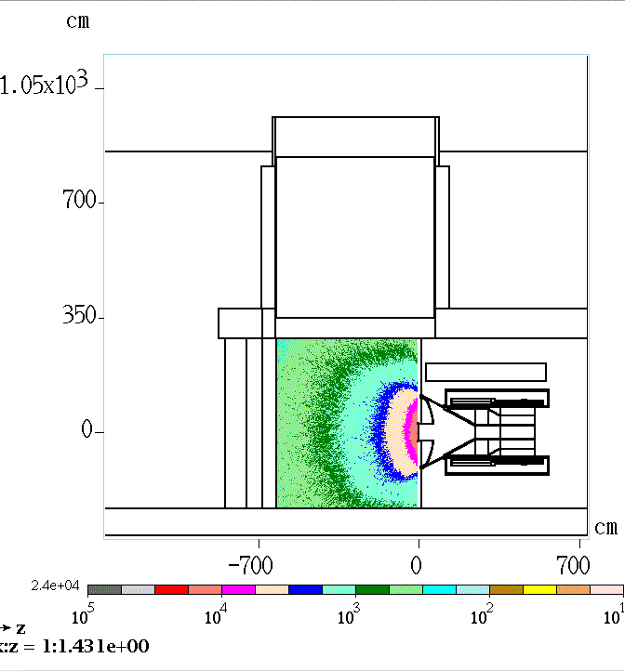
Major Sources – Target, Endcap, and Beam Dump
Elevation view, mid plane of PS - mrem/hr
Leveling | Radiological Conditions During Mu2e Target Change Out

Slide 14
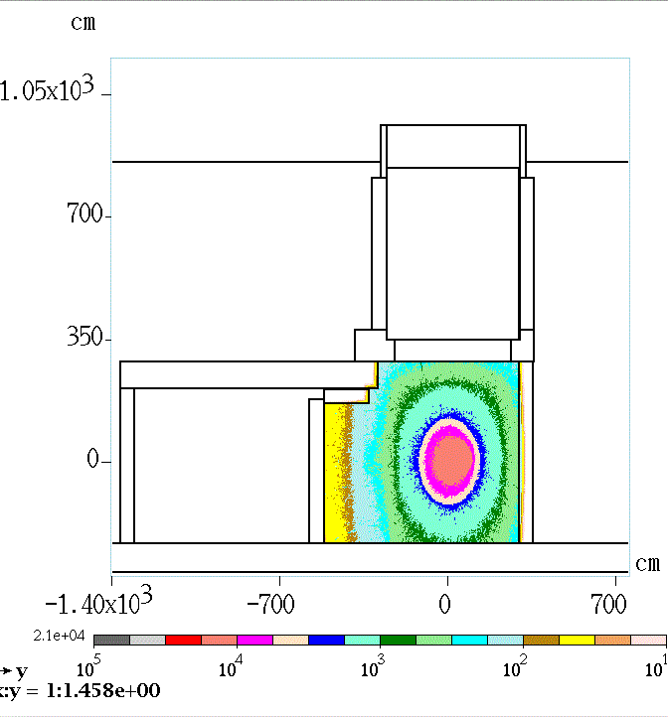
Major Sources – Target, Endcap, and Beam Dump
Elevation view, at end cap – mrem/hr
Leveling | Radiological Conditions During Mu2e Target Change Out

Slide 15
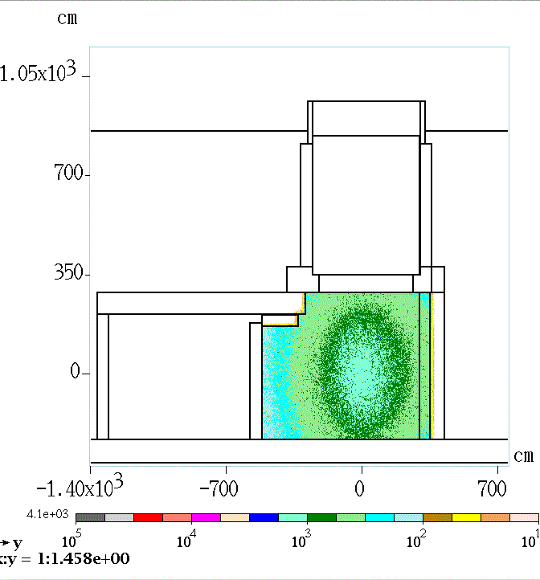
Major Sources – Target, Endcap, and Beam Dump
Elevation view, 10’ from end cap – mrem/hr
Leveling | Radiological Conditions During Mu2e Target Change Out

Slide 16
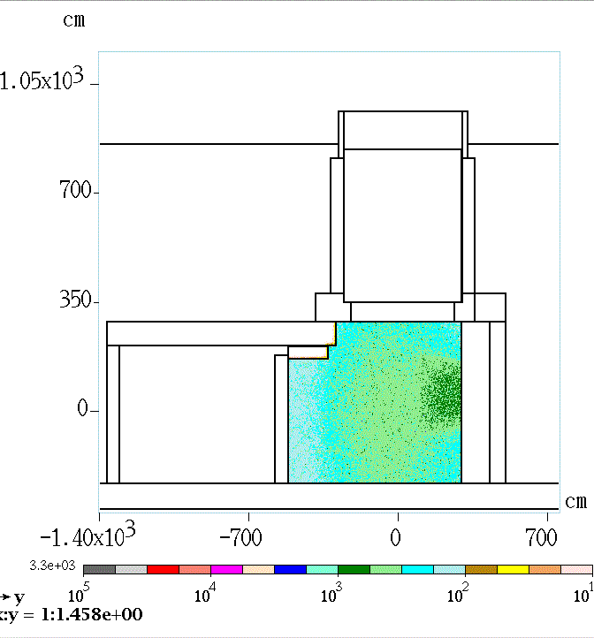
Major Sources – Target, Endcap, and Beam Dump
Elevation view, 20’ from end cap – mrem/hr
Leveling | Radiological Conditions During Mu2e Target Change Out

Slide 17
Major Sources – Target, Endcap, and Beam Dump
Conclusions for personnel occupying the RHR:
  PS /end cap/ target assembly is the dominant source in the PS room
  Primary beam absorber is reasonably well isolated and shielded
Leveling | Radiological Conditions During Mu2e Target Change Out

Slide 18
Radiation dose rate at RHR doorway during target change out
Mu2e doc.db 5543-v1
Leveling | Radiological Conditions During Mu2e Target Change Out

Slide 19
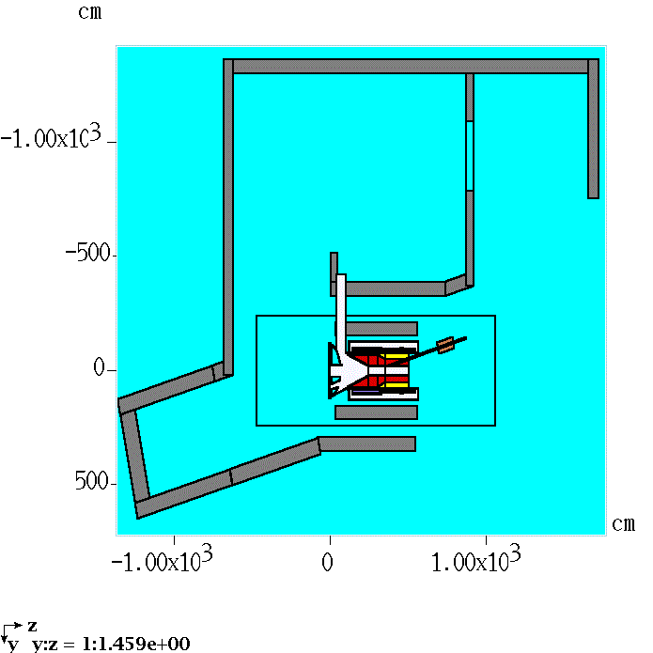
PS room and RHR plan view – histogram locations
RHR door, open position
Exit of RHR doorway
Exit of PS room
Target, out of PS
Leveling | Radiological Conditions During Mu2e Target Change Out

Slide 20
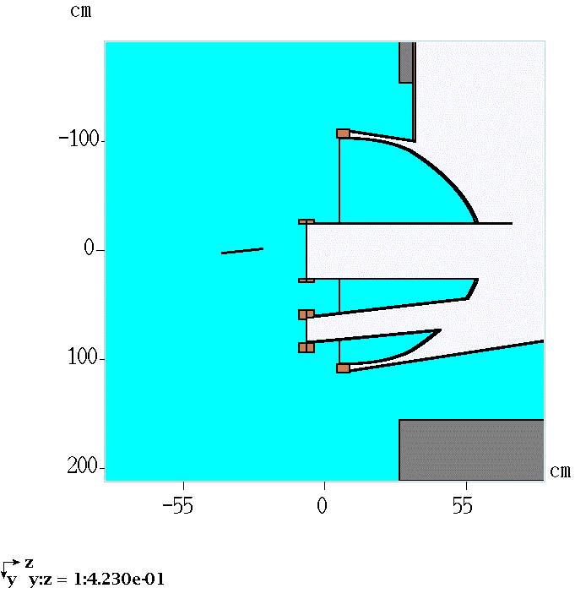
Model details – plan view at end cap with target removed from the PS
Target source includes
  Photons over 100 keV
Leveling | Radiological Conditions During Mu2e Target Change Out

Slide 21
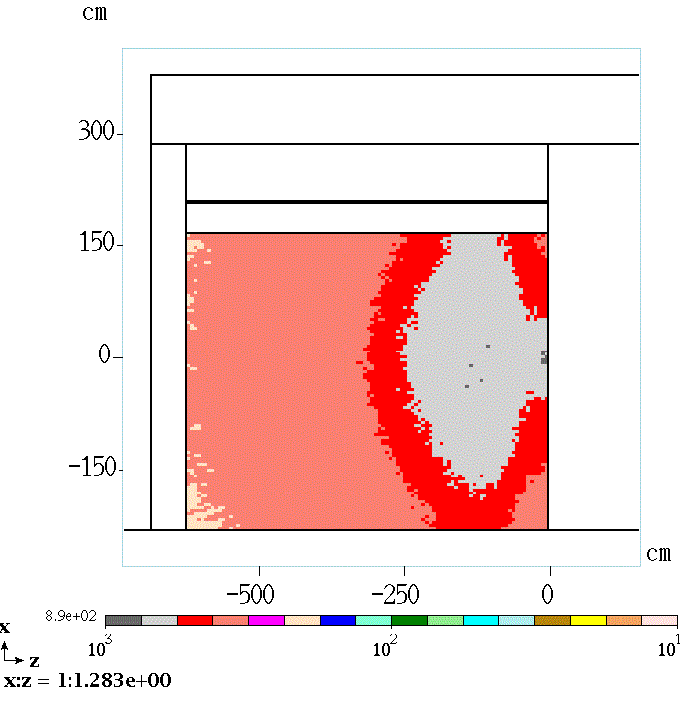
RHR doorway Simulation results
peak dose rate at 890 mrem/hr
Leveling | Radiological Conditions During Mu2e Target Change Out

Slide 22
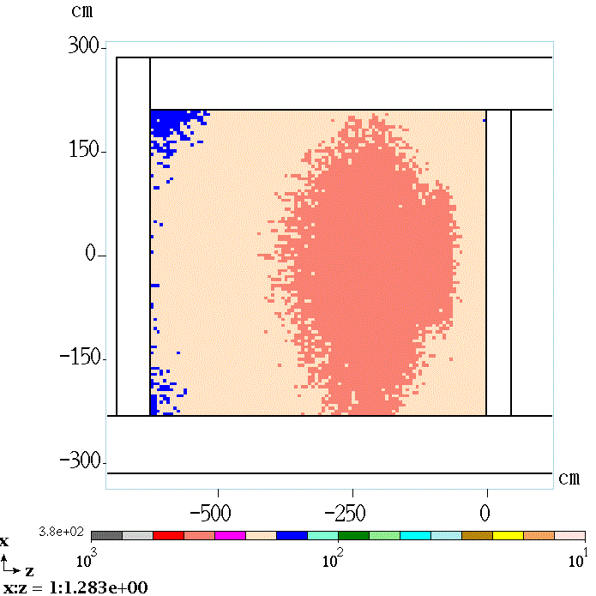
RHR doorway Simulation results
peak dose rate at 380 mrem/hr
Conclusion
  Doorway could be left open
  Entry controls required to limit personnel exposure
Leveling | Radiological Conditions During Mu2e Target Change Out

Slide 23
Facility radiation dose rates
(sans major sources)
Source document: mu2e doc.db 5572-v4
Leveling | Radiological Conditions During Mu2e Target Change Out

Slide 24
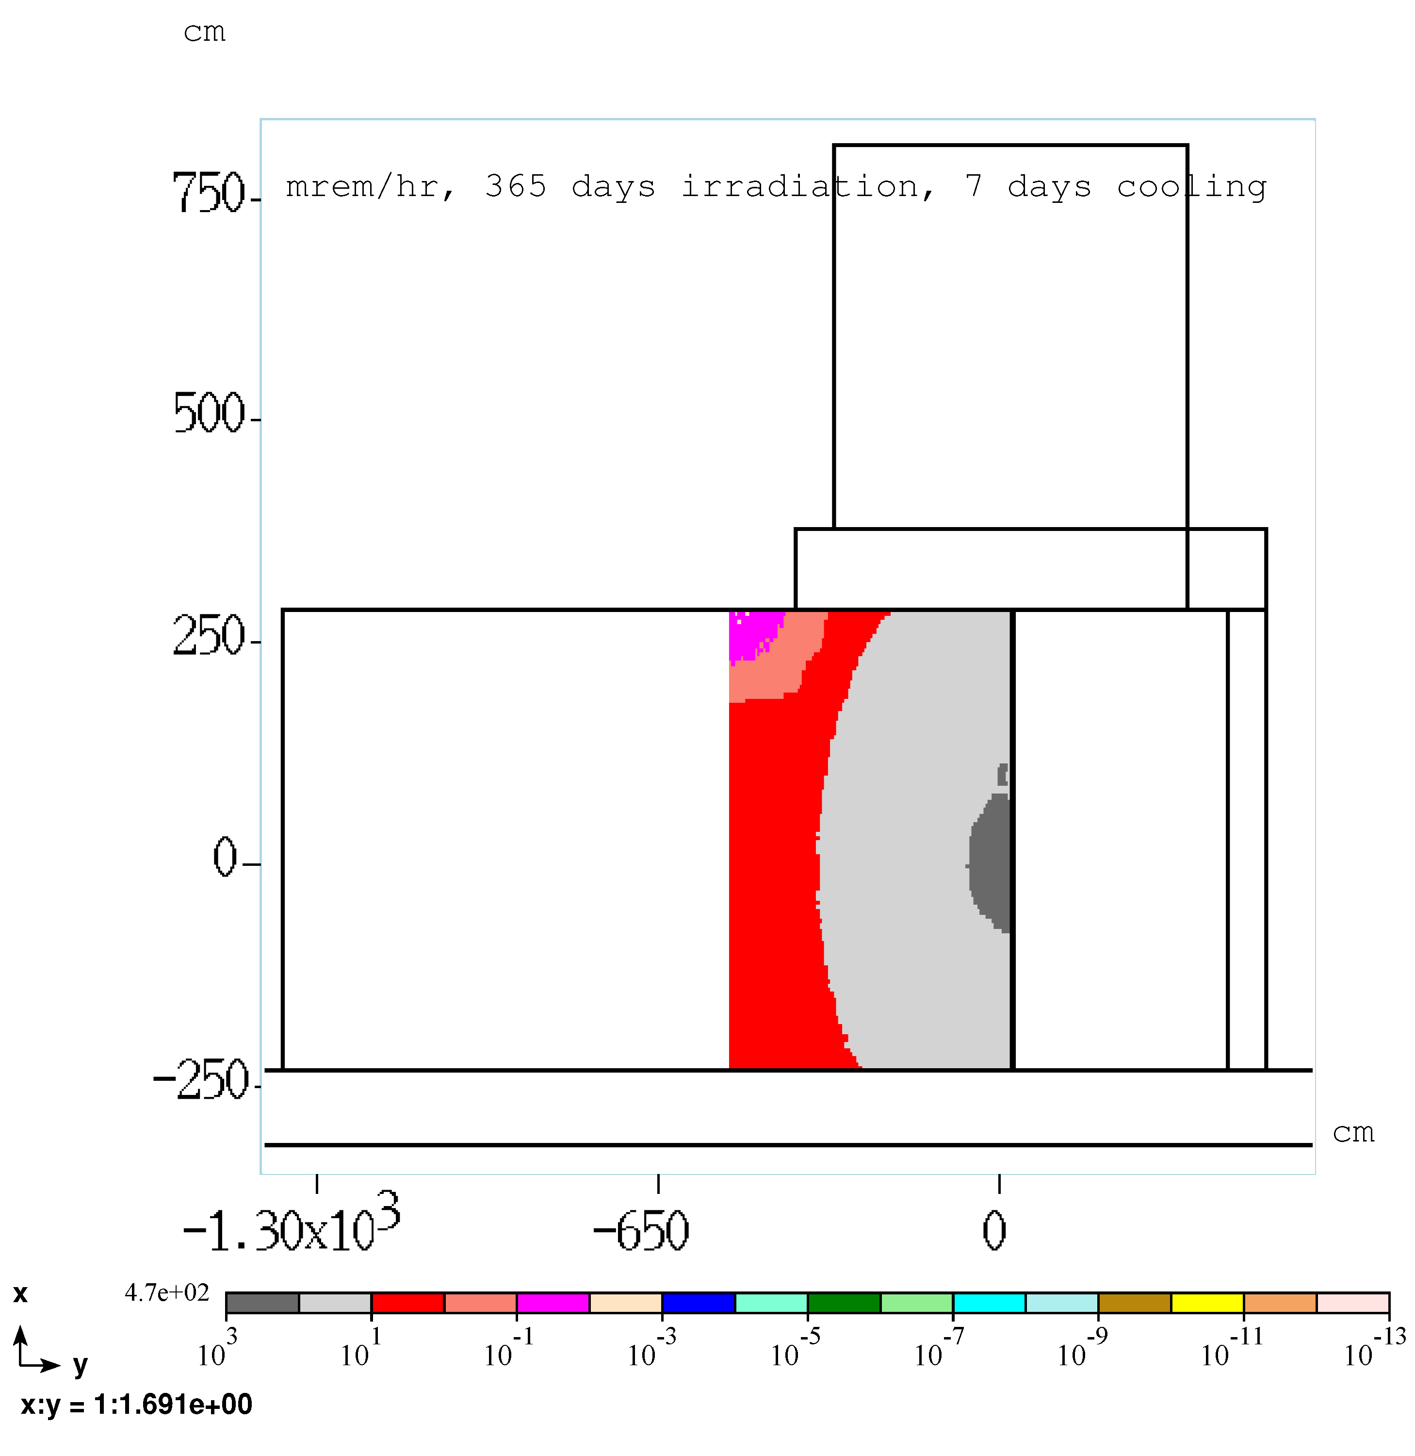
PS room residual dose rate, 365 days irradiation, 7 days cooling
PS room west wall
Peak dose rate: 470 mrem/hr
Leveling | Radiological Conditions During Mu2e Target Change Out

Slide 25
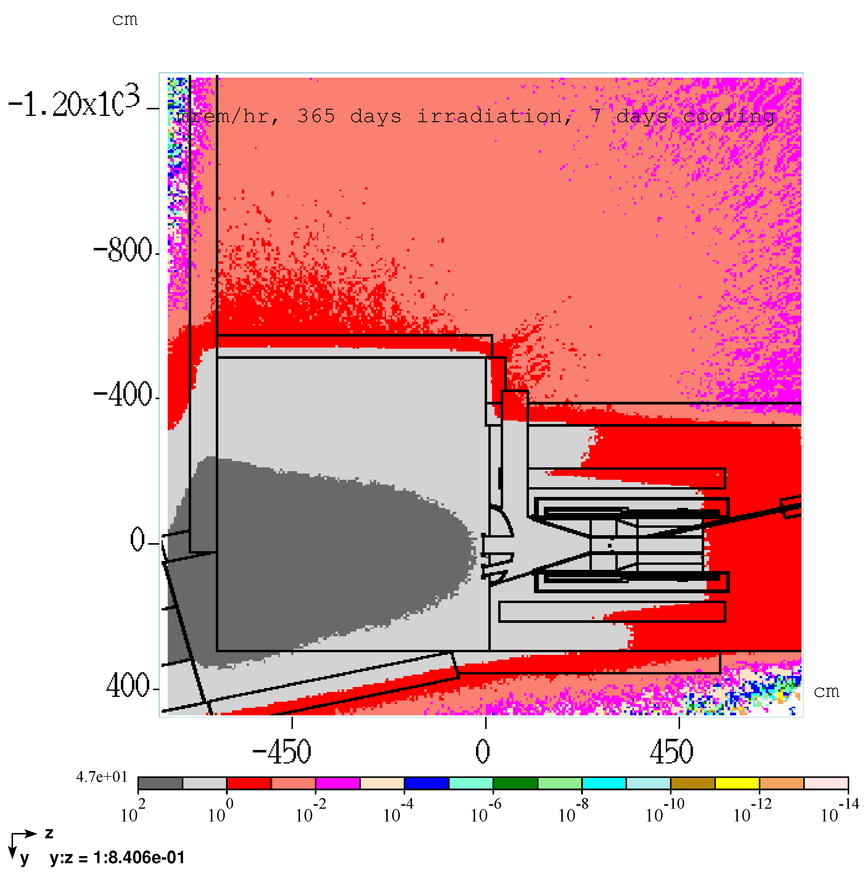
PS room residual dose rate, 365 days irradiation, 7 days cooling
PS room and RHR floor
Peak dose rate: 47 mrem/hr
Leveling | Radiological Conditions During Mu2e Target Change Out

Slide 26
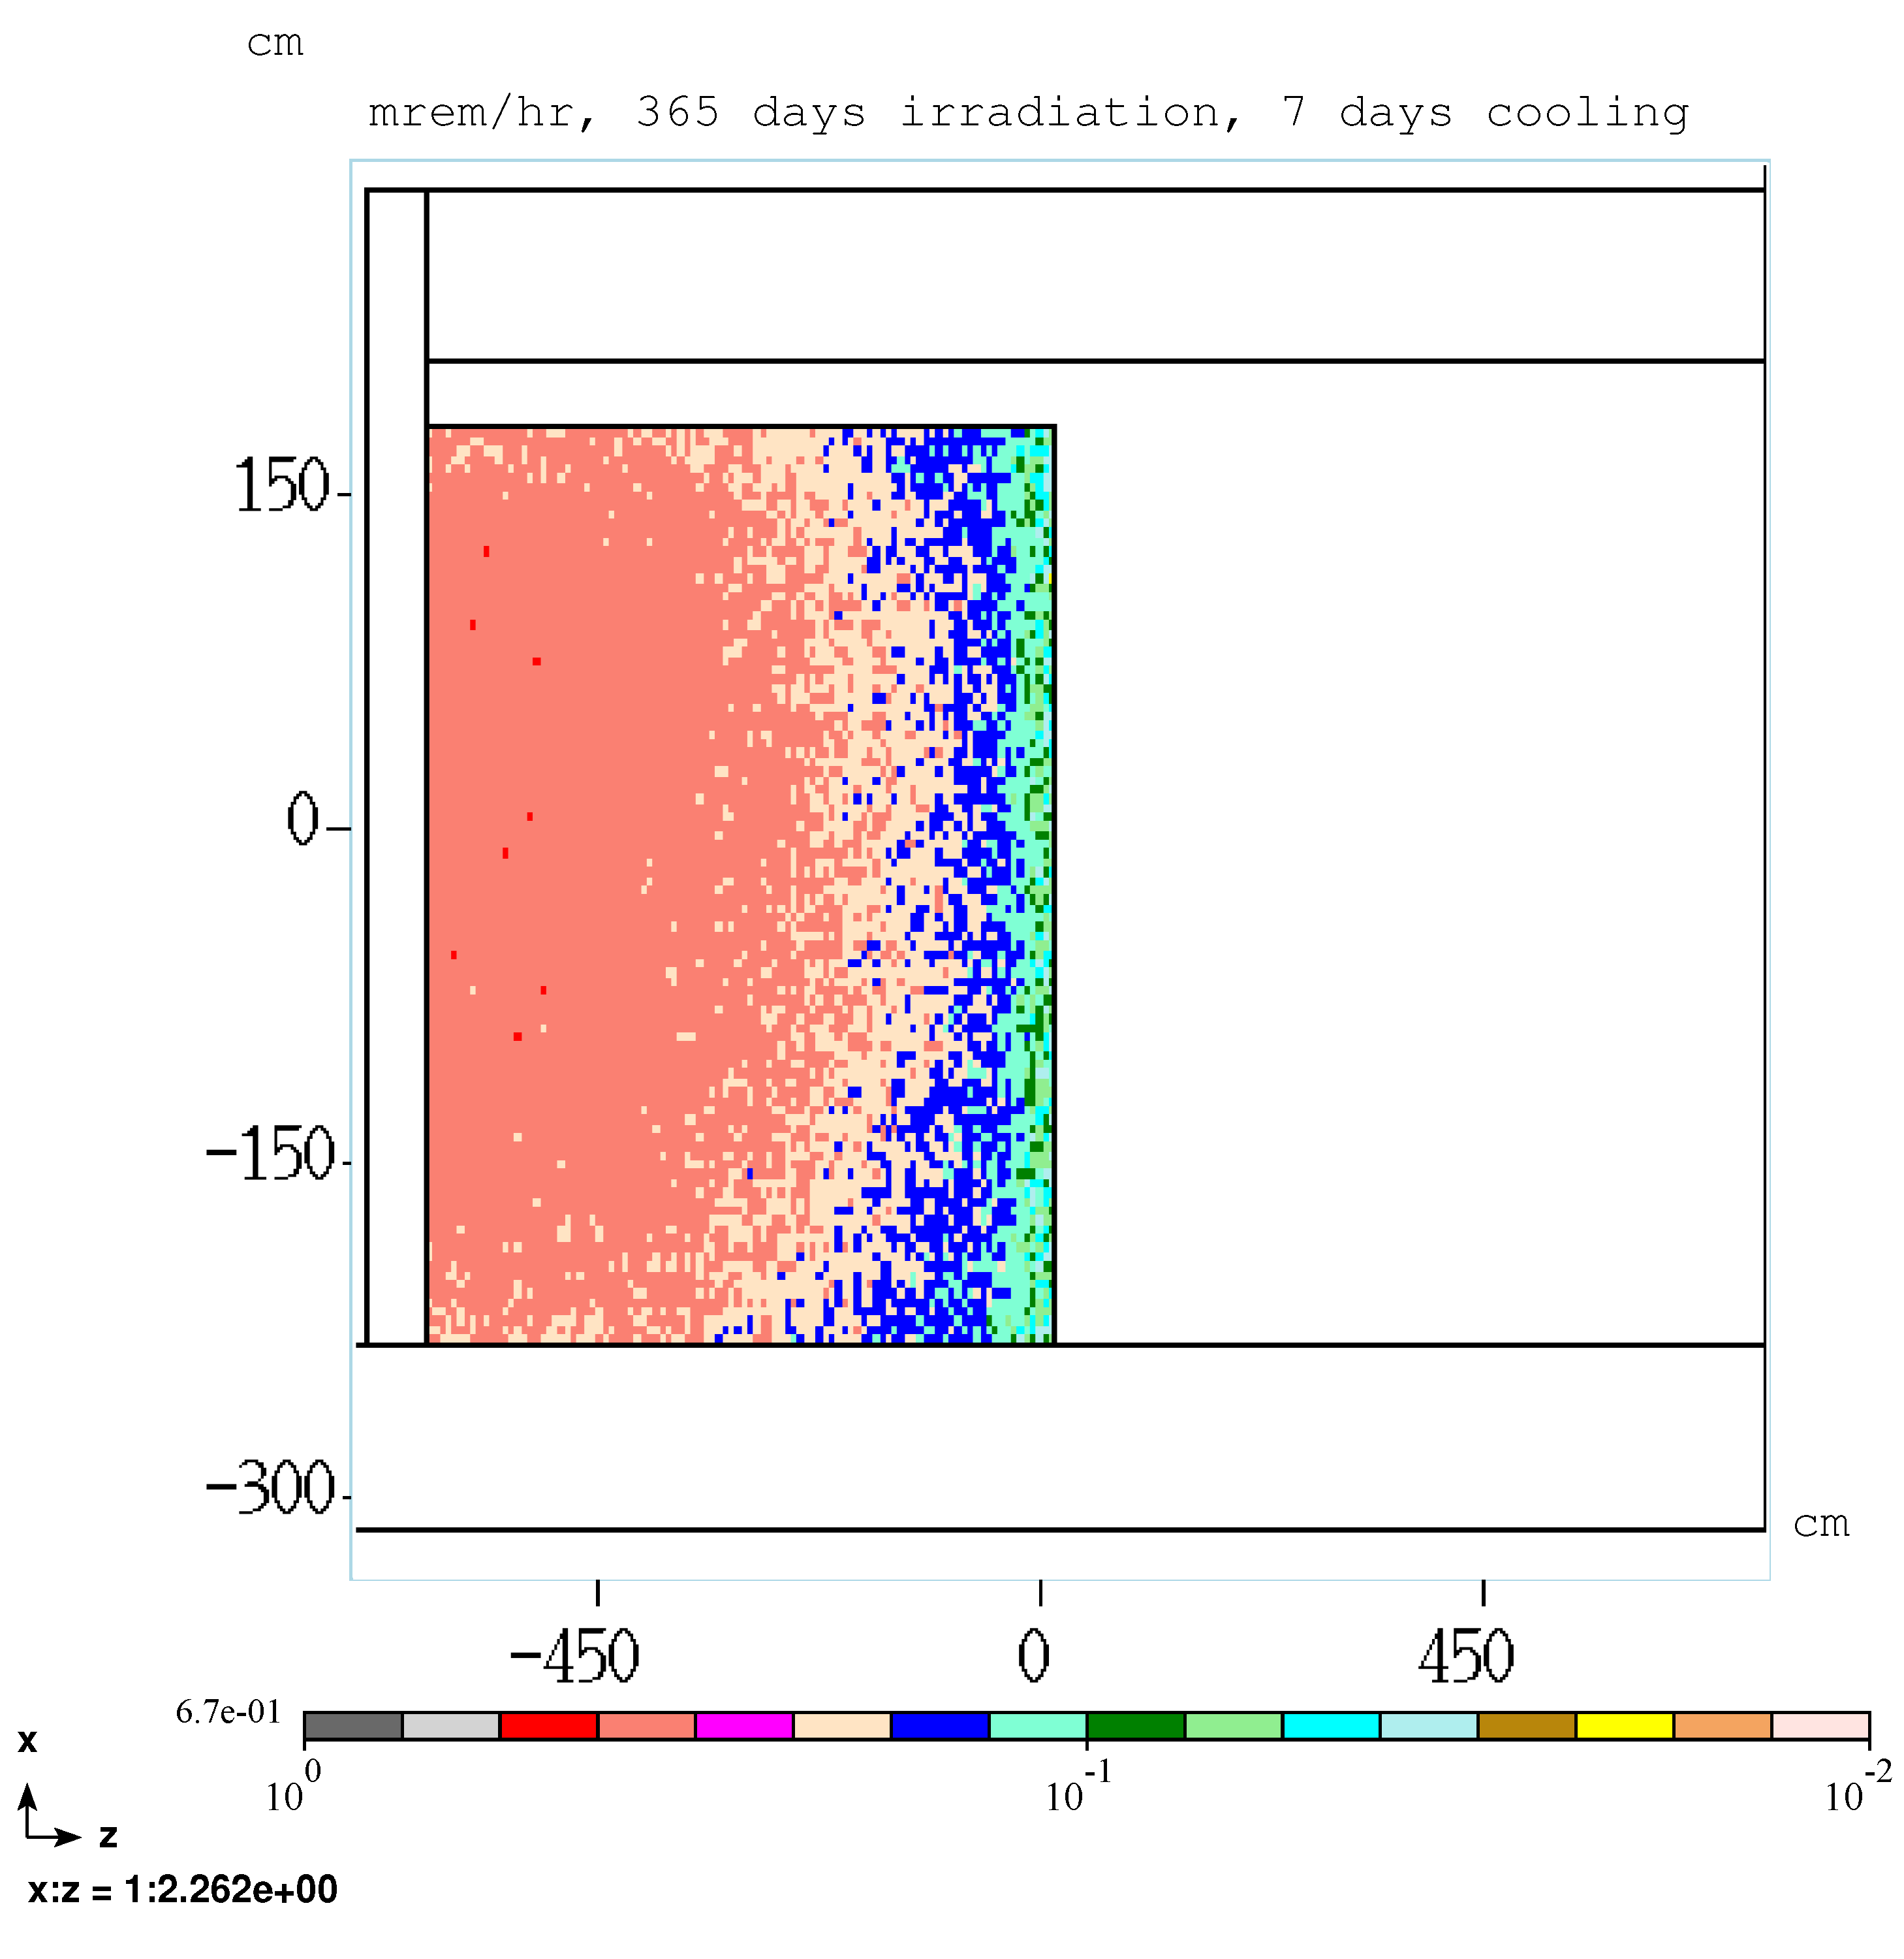
RHR room residual dose rate, 365 days irradiation, 7 days cooling
RHR door, RHR side
Peak dose rate: 0.7 mrem/hr
Leveling | Radiological Conditions During Mu2e Target Change Out

Slide 27
Air flow
Mu2e doc.db 5768-v1
Leveling | Radiological Conditions During Mu2e Target Change Out

Slide 28
Air flow during beam operation
Doorways and air dams
HEPA filtered air exhausts to M4 beam line
DS room press > PS room press
0 cfm supply
air to RHR
N
Leakage
paths
165 to 250 cfm
Leveling | Radiological Conditions During Mu2e Target Change Out

Slide 29
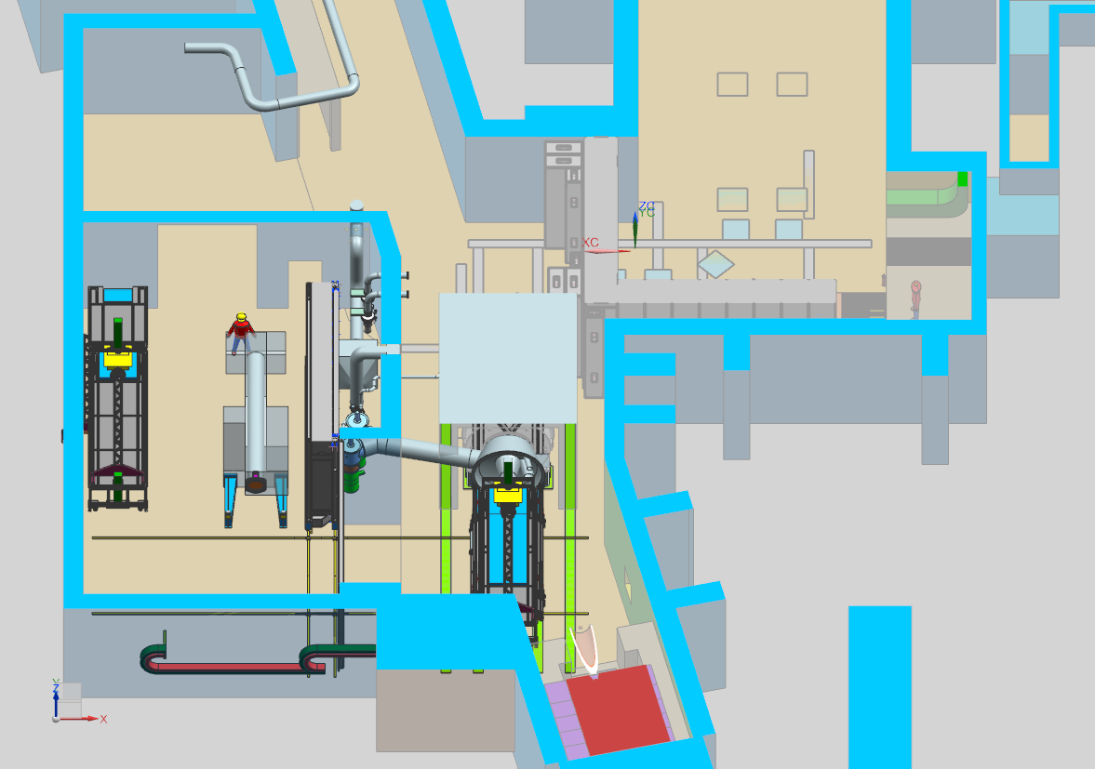
Air flow during target handling operation
HEPA filtered air exhausts to M4 beam line
DS room press > PS room press
150 cfm supply
air to RHR
N
Beam dump cooling air flow is stopped and air damper is shut
X
Leveling | Radiological Conditions During Mu2e Target Change Out

Slide 30
Sources of Contamination
Mu2e doc.db 5569-v4
Mu2e doc.db 5599-v3
Leveling | Radiological Conditions During Mu2e Target Change Out

Slide 31
Surface Contamination Sources
Look for contamination where significant beam showers occur
  Target
  HRS bore
  PS end cap
  PS room air
    Leads to surface contamination of PS room floor and equipment by fallout
  PS room west wall
  Primary beam dump
  PS vacuum system
  HEPA filter system
Action level for surface contamination is 0.45 nCi/100 cm²
Leveling | Radiological Conditions During Mu2e Target Change Out

Slide 32
Surface Contamination Sources - Target
460 Ci (1.7E13 Bq) after 1 year of operation
  Mass of target is ~ 100 g
Target specific activity
  4.6 uCi/ug
Special care required to control surface contamination during target handling
Leveling | Radiological Conditions During Mu2e Target Change Out

Slide 33
Surface Contamination Sources - HRS bore
vacuum surface
Activated surfaces would become minor source of contamination
Bore becomes contaminated primarily by target outgassing and target detritus
  4.6 uCi/ug
The bore is reasonably well contained by the PS end cap
Leveling | Radiological Conditions During Mu2e Target Change Out

Slide 34
Surface Contamination Sources - PS endcap (including 3 vacuum window ports)
Inner surface
  Similar to HRS bore
Outer surface
  Several nCi/100cm² based on similar target station experience
  Transfer by physical contact
Leveling | Radiological Conditions During Mu2e Target Change Out

Slide 35
Surface Contamination Sources – PS room air
Production of radioisotopes in PS room air during beam operation has been calculated (MARS/DETRA)
Primary isotopes produced are:
  C11
  N13
  O15
  Other short-lived isotopes
  Ar41
  Be7
Leveling | Radiological Conditions During Mu2e Target Change Out

Slide 36
Surface Contamination Sources – PS room air
irradiation time (days) | N | Bq - no ventilation | lambda decay (sec⁻¹) | lambda ventilation 800 cfm | λ' | Bq - with ventilation
1.00 | 5.36E+14 | 8.07E+07 | 1.51E-07 | 7.74E-04 | 7.74E-04 | 1.57E+04
10.00 | 5.06E+15 | 7.62E+08 | 1.51E-07 | 7.74E-04 | 7.74E-04 | 1.48E+05
53.22 | 2.06E+16 | 3.11E+09 | 1.51E-07 | 7.74E-04 | 7.74E-04 | 6.06E+05
106.44 | 3.10E+16 | 4.67E+09 | 1.51E-07 | 7.74E-04 | 7.74E-04 | 9.10E+05
159.66 | 3.62E+16 | 5.45E+09 | 1.51E-07 | 7.74E-04 | 7.74E-04 | 1.06E+06
212.88 | 3.88E+16 | 5.85E+09 | 1.51E-07 | 7.74E-04 | 7.74E-04 | 1.14E+06
266.10 | 4.01E+16 | 6.04E+09 | 1.51E-07 | 7.74E-04 | 7.74E-04 | 1.18E+06
319.32 | 4.07E+16 | 6.14E+09 | 1.51E-07 | 7.74E-04 | 7.74E-04 | 1.20E+06
372.54 | 4.11E+16 | 6.19E+09 | 1.51E-07 | 7.74E-04 | 7.74E-04 | 1.21E+06
Be7 activity loading in PS hall air for
various beam dump cooling air flow
steady state operation at 7.7 kW
Radioactive decay constant λ
Ventilation removal constant – r
Activity is calculated as a function of
irradiation time in DETRA
To account for activity dilution by ventilation,
Multiply by:
λ‘ = λ/(λ+r)
Presumes Be7 remains suspended in air
- It does not
Leveling | Radiological Conditions During Mu2e Target Change Out

Slide 37
Surface Contamination Sources – PS room air
Most isotopes:
  gaseous and pass through the HEPA filter
  Remain suspended in air and eventually decay or are discharged at exhaust stack
  Short ½ life
Be 7
  53.3 day ½ life
  Fate
    HEPA filter
    Fallout on PS room surfaces, mainly floors
    No significant release to M4 line
Leveling | Radiological Conditions During Mu2e Target Change Out

Slide 38
Surface Contamination Sources – PS room air
JASMIN Result: Be7 Particle size distribution
Be-7
(T_{1/2}: 53.3d)
Mean diameter of Be 7 aerosol was determined at pbar target station
GMD: Geometric mean diameter

Slide 39
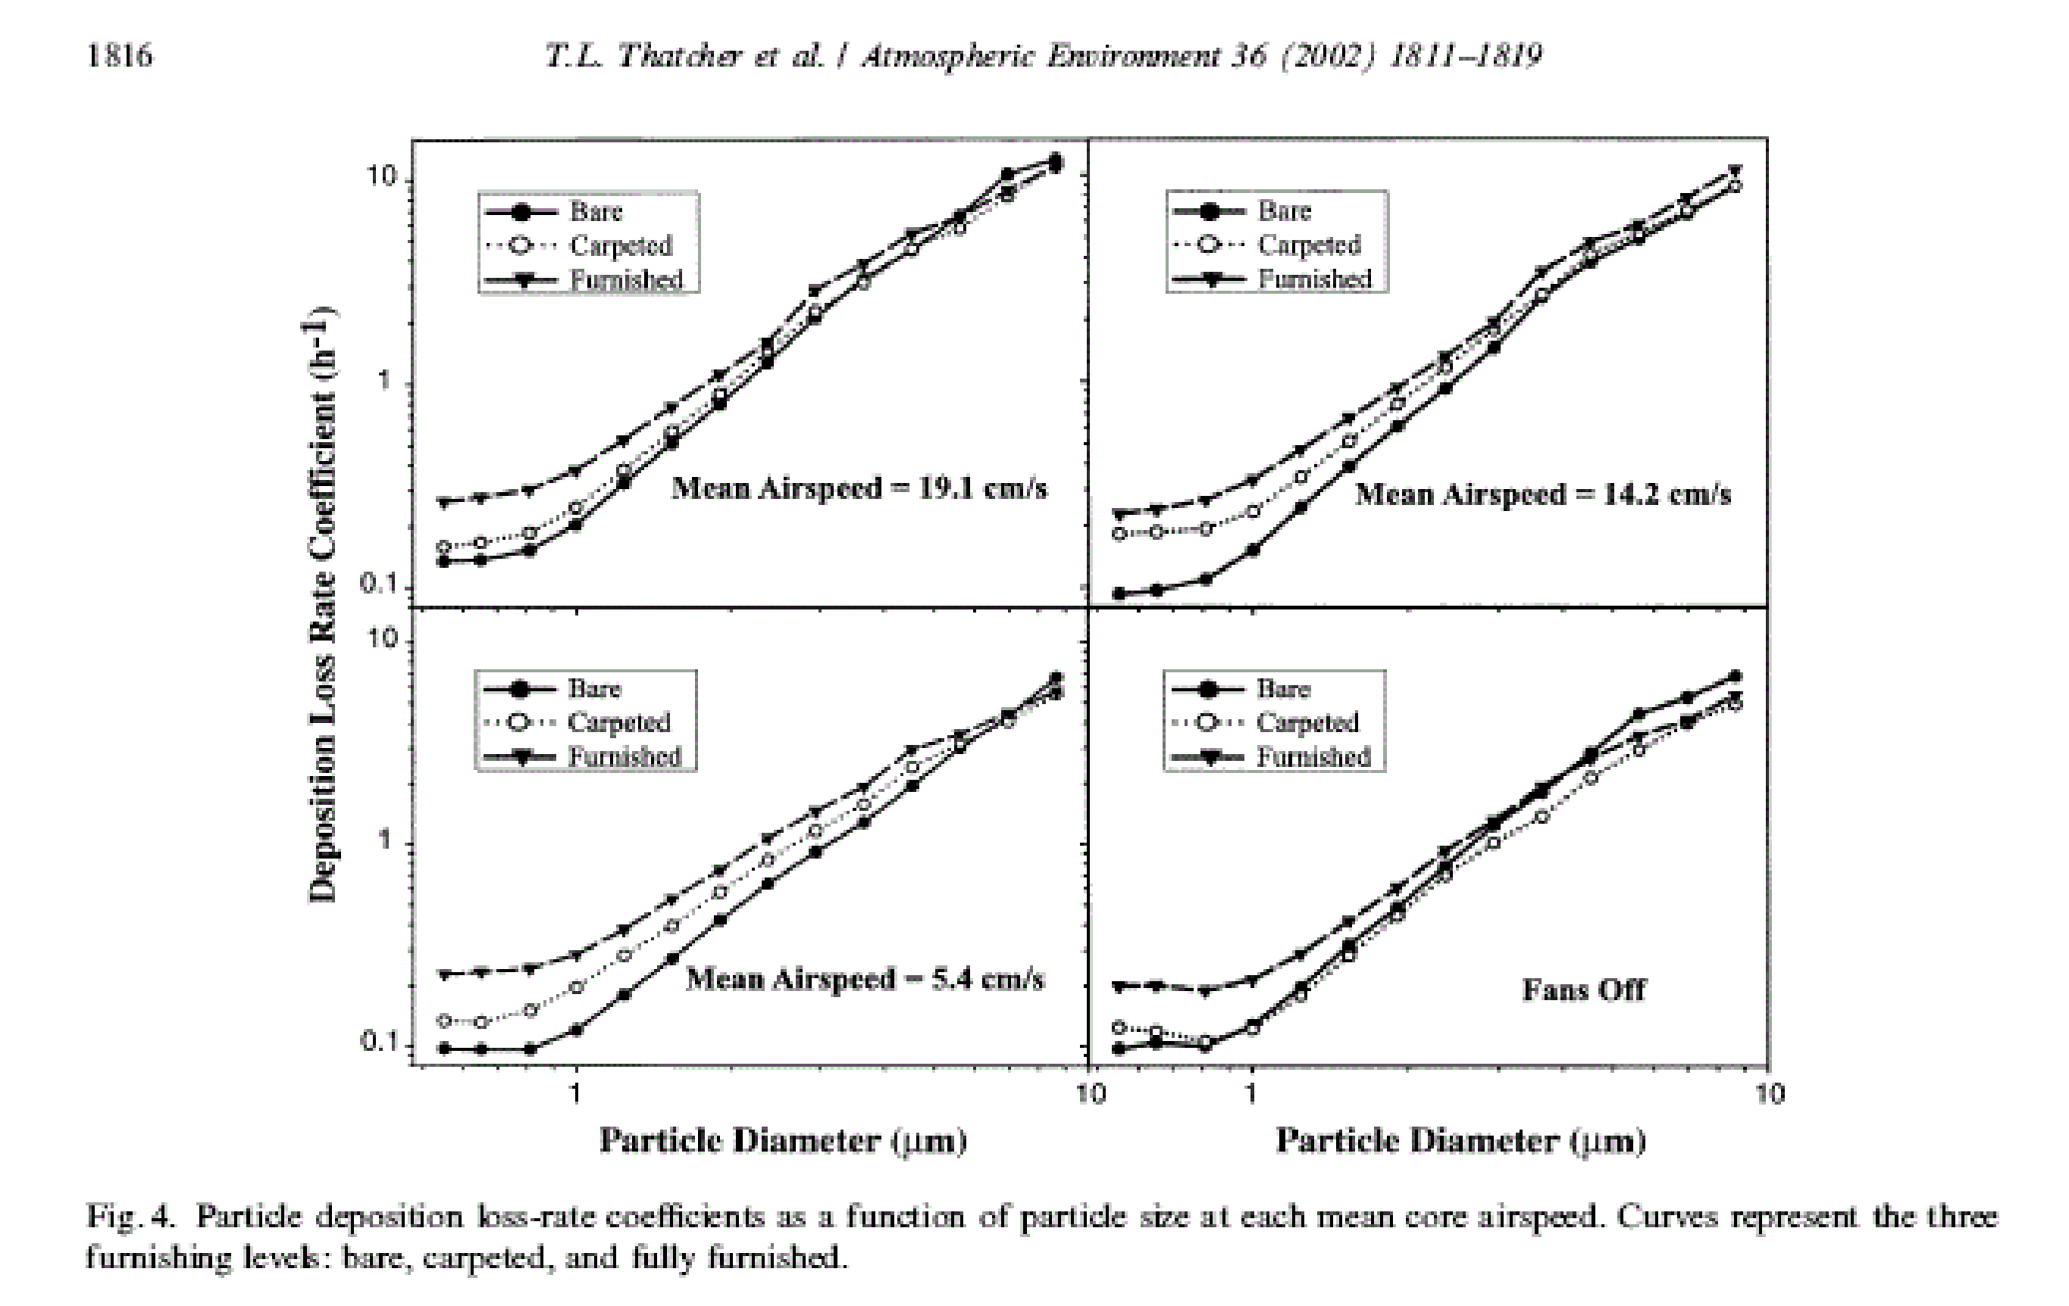
Surface Contamination Sources – PS room air
Effects of room furnishings and air speed on particle deposition rates indoors
The surface/volume coefficient for the bare room was 2.45 m²/m³
Lower surface to volume ratio should result in lower deposition rates
Surface to volume ratio for PS estimated 2<S/V<1 m²/m³
Leveling | Radiological Conditions During Mu2e Target Change Out

Slide 40
Surface Contamination Sources – PS room air
Airborne Be7 is removed by:
  HEPA filtered exhaust ventilation
  Fallout
The fraction of Be7 deposited in the PS room is given by:
f_{fallout}=λ_{fallout}/(λ_{fallout}+λ_{vent})
Leveling | Radiological Conditions During Mu2e Target Change Out

Slide 41
Surface Contamination Sources – PS room air
Daily production of Be7: 8.07E7Bq
Continuous Deposition over the target lifetime (1 year) can be approximated by a single deposition of total activity at midyear
Total annual production
  2.95E10 Bq
Fallout fraction
  0.15/hr
  Likely conservative!
Ventilation rate
  300 cfm
Area of PS room
  1E6 cm²
Average surface contamination level
  ~1,000 nCi/100 cm²
Leveling | Radiological Conditions During Mu2e Target Change Out

Slide 42
Surface Contamination Sources – PS room air
From Radiation Physics Note 146:
Be7 produces ~ 1cpm/0.45 nCi with Frisker
100 X the action level (100 cpm) is detectable with the Frisker
From 1x to 100 x the action level, Be7 is not observable with field instruments
Results in implementation of conservative control measures by Radiation Safety Group
  Step off pads
  Respirators
  PPE
Field detection level
~
~45 nCi
~
Action level
0.45 nCi
Typical counting laboratory detection level
~0.05 nCi
Leveling | Radiological Conditions During Mu2e Target Change Out

Slide 43
Surface Contamination Sources – PS room west wall
Beam shower develops well above the floor
Concrete dust activation mainly at the west wall
Based on residual dose rate at west wall, estimate a few nCi/100 cm²
Transfer is by physical contact
Leveling | Radiological Conditions During Mu2e Target Change Out

Slide 44
Surface Contamination Sources – beam dump
Supply air flow 165 to 250 cfm
Supply air is filtered and dehumidified
Air cooling flow is around the outside surfaces of the 1.5 m x 1.5 m x 2 m mass
Air mixing between steel plates is not prevented
  Main air flow is over surfaces with lowest specific activity
Dump steel is to be painted, no rusted surfaces
Entrance plate has SS sheet metal weldment to first plate
Peak temperatures should not lead to thermal degradation of paint
Albedo trap should provide fallout region for any air-entrained particulates
Conclusion: beam dump operation should not contribute significantly to surface contamination in the PS room
Leveling | Radiological Conditions During Mu2e Target Change Out

Slide 45
Surface Contamination Sources – PS vacuum system
PS vacuum system pumps are located in the RHR
Radiation cooled target will outgas
  Tritium
    5 Ci/year (MARS simulation result)
    Not detectable with field instruments
  Other isotopes
    noble gases and daughters
    Could be detectable with field instruments
Fate of vacuum system isotopes
  Entrained in vacuum pump oil
  Exhaust to air
    To be directed to M4 line monitored exhaust stack
Maintenance activities for vacuum system pumps will be with oversight by AD ES&H RSO
Leveling | Radiological Conditions During Mu2e Target Change Out

Slide 46
Surface Contamination Sources – HEPA filter system
HEPA filter system is located in the RHR
The collection of Be7 over a period of 1 year will lead to buildup of a significant
  Contamination
  Radiation dose rate due to 478 keV photon
It may be necessary to change the HEPA filter prior to beginning target change activities to reduce radiation dose rates in the remote handling operation station
Maintenance activities for HEPA filter system will be with oversight by AD ES&H RSO
f_{filter}=λ_{vent}/(λ_{fallout}+λ_{vent})
The HEPA filter compartment is the compliment of the fallout compartment
Estimated Be7 activity in the filter is 65 mCi (2.4E9 Bq)
Dose rate from 65 mCi point source of Be 7 is
  @ 1 meter ~ 2 mrem/hr
  @ 1 foot ~ 20 mrem/hr
$$A_{filter}=365days∗8.07E7Bq∗f_{filter}∗e^{−_{decay}∗182.5 days}$$
Leveling | Radiological Conditions During Mu2e Target Change Out

Slide 47
Radiation Protection Staff and Entry Controls
Leveling | Radiological Conditions During Mu2e Target Change Out

Slide 48
Radiation Protection - Entry controls for the RHR/PS Room
Once mu2e beam operations begin, entry into the RHR/PS room will be under the exclusive control of the AD ES&H department radiation protection group
Work will be controlled by
  radiation work permit
  or work procedure and radiation work permit
Work is planned by target station engineers
Approval of work is by AD RSO, or in exceptional cases, by the Fermilab Senior Radiation Safety Officer
Pace of work is controlled by mutual concurrence of AD ES&H and Target Station Group personnel
  ES&H ensures adherence to:
    radiological check points
    radiation dose control
    contamination control
    PPE requirements
Leveling | Radiological Conditions During Mu2e Target Change Out

Slide 49
Summary
Leveling | Radiological Conditions During Mu2e Target Change Out

Slide 50
Summary
Radioactive sources leading to residual dose rates and surface contamination have been identified
Radiological parameters for the mu2e facility are within the range of experience and expertise of the Fermilab staff
Leveling | Radiological Conditions During Mu2e Target Change Out

Slide 51
Extra Slides
Leveling | Radiological Conditions During Mu2e Target Change Out

Slide 52
Surface Contamination Sources – PS room air
Leveling | Radiological Conditions During Mu2e Target Change Out

Slide 53
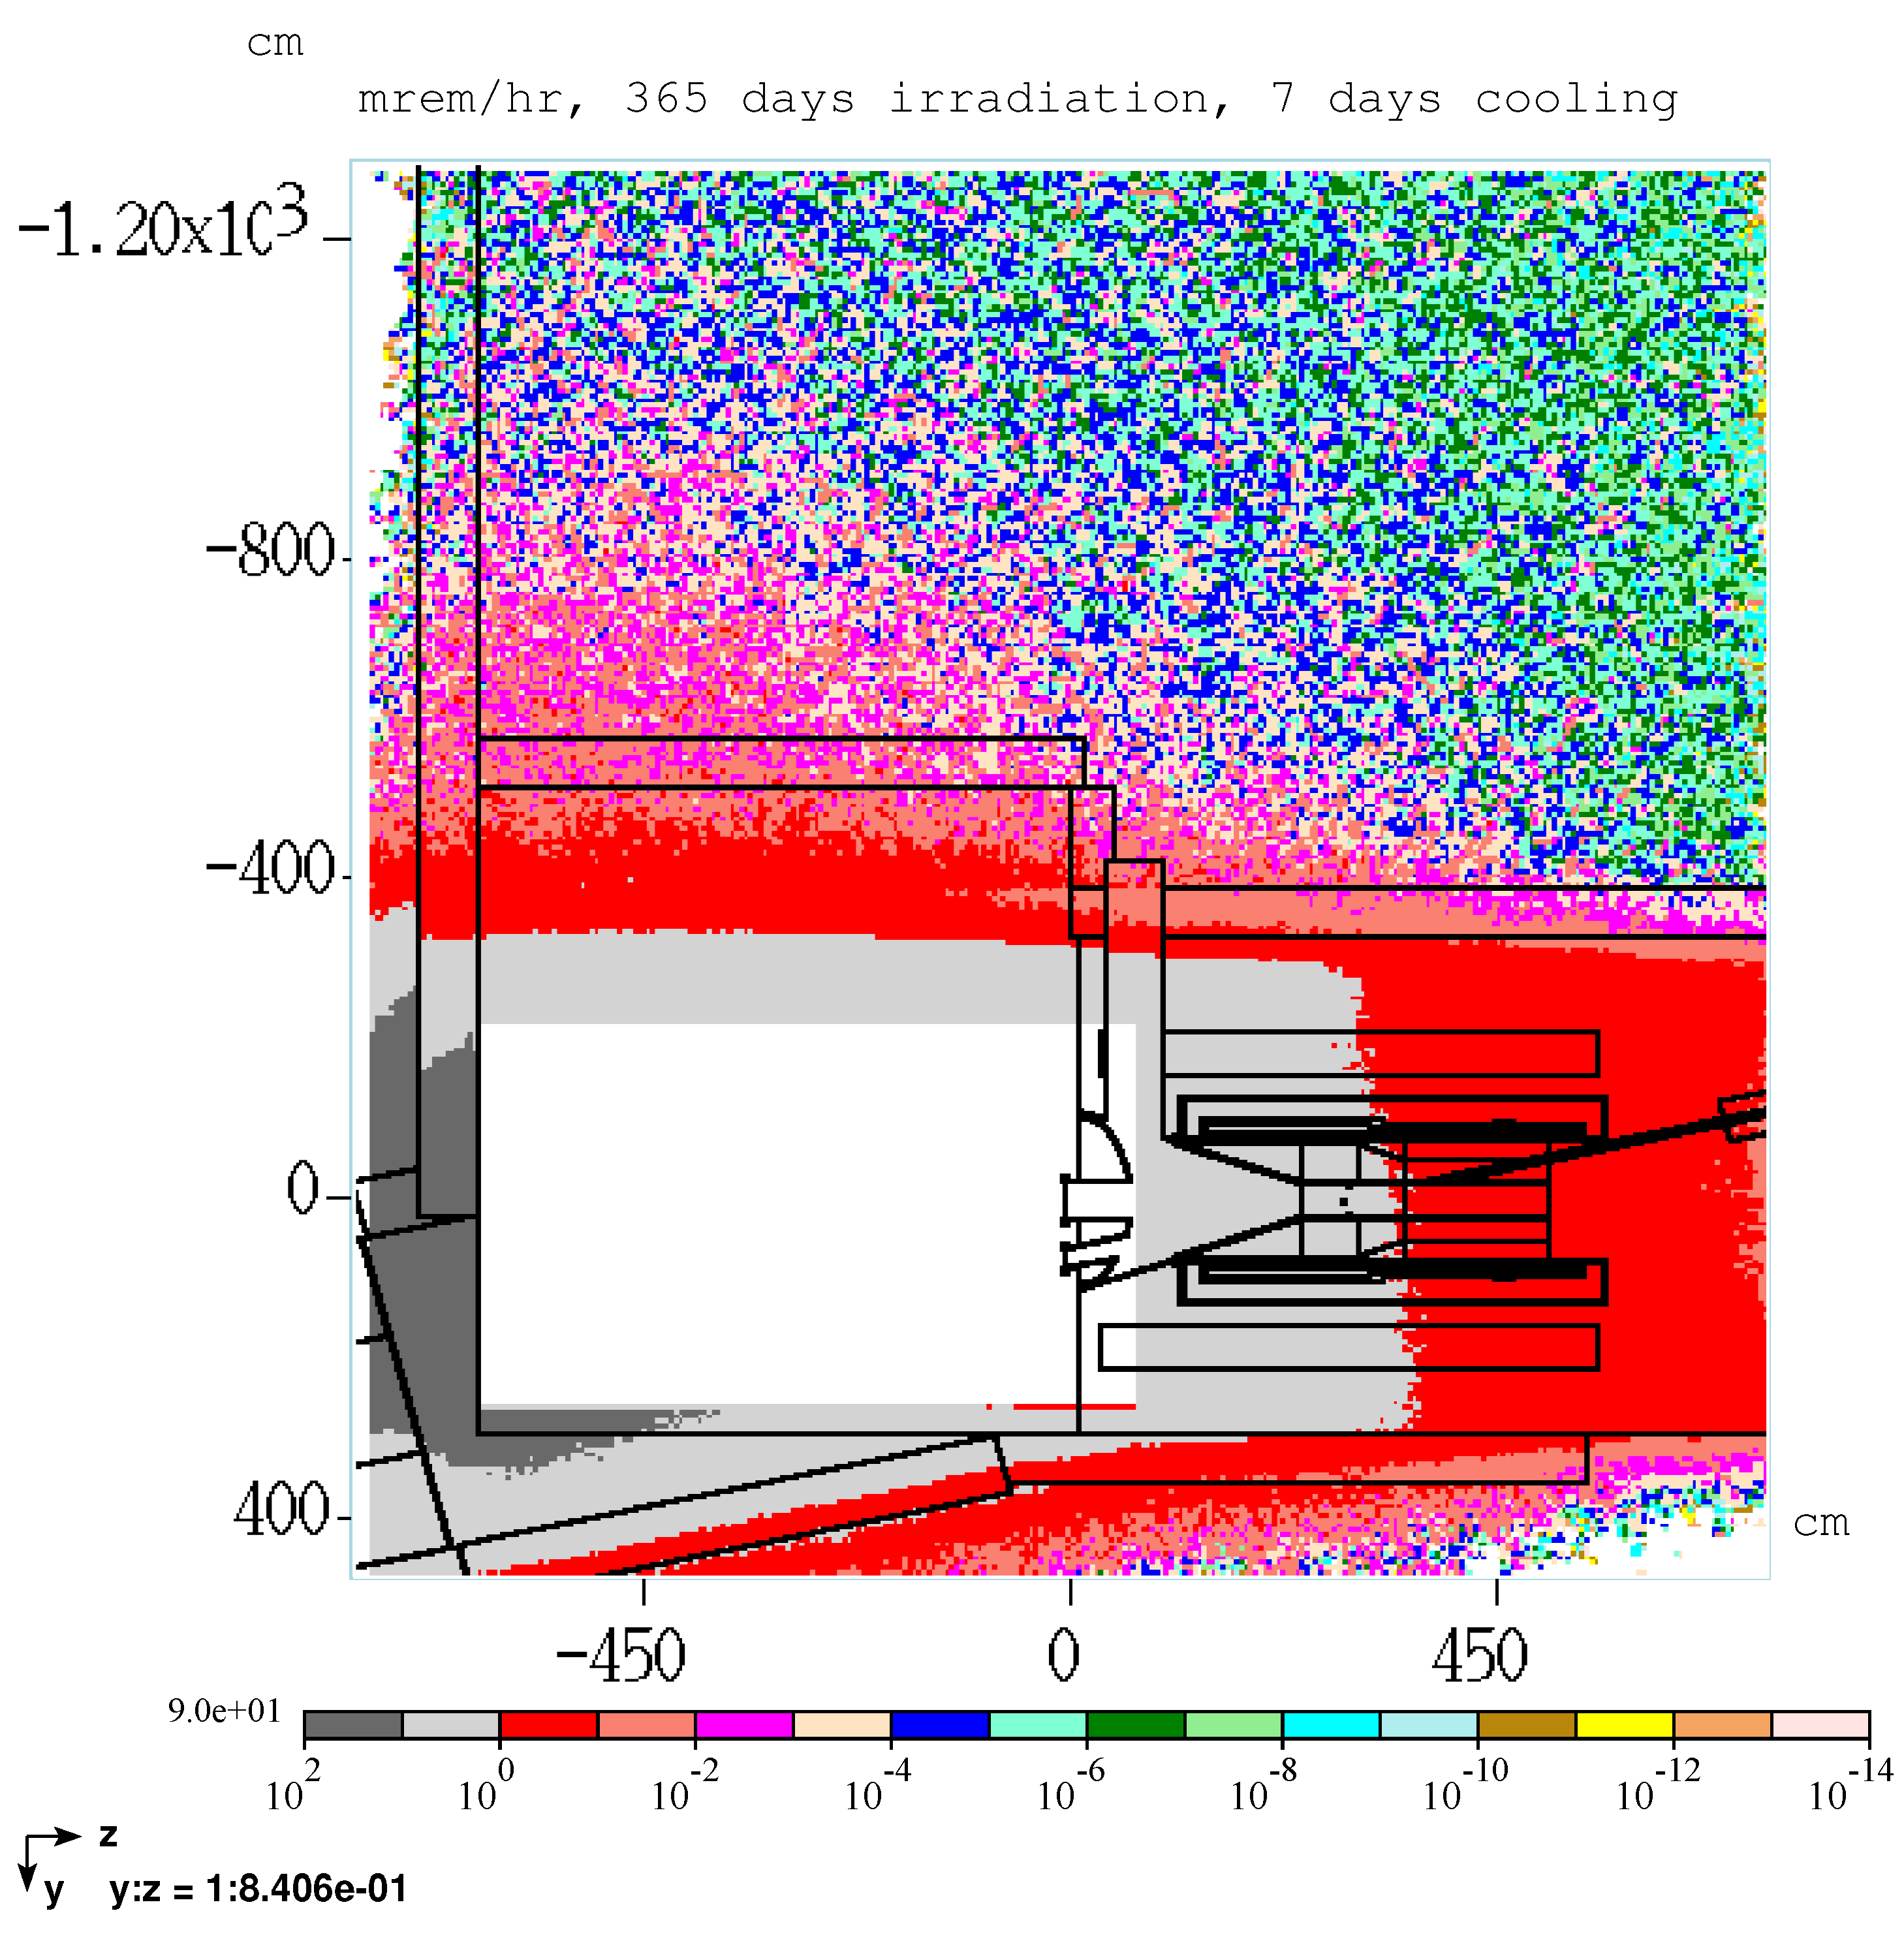
PS room residual dose rate, 365 days irradiation, 7 days cooling
PS room and RHR ceiling
Peak dose rate: 90 mrem/hr
Leveling | Radiological Conditions During Mu2e Target Change Out

Slide 54
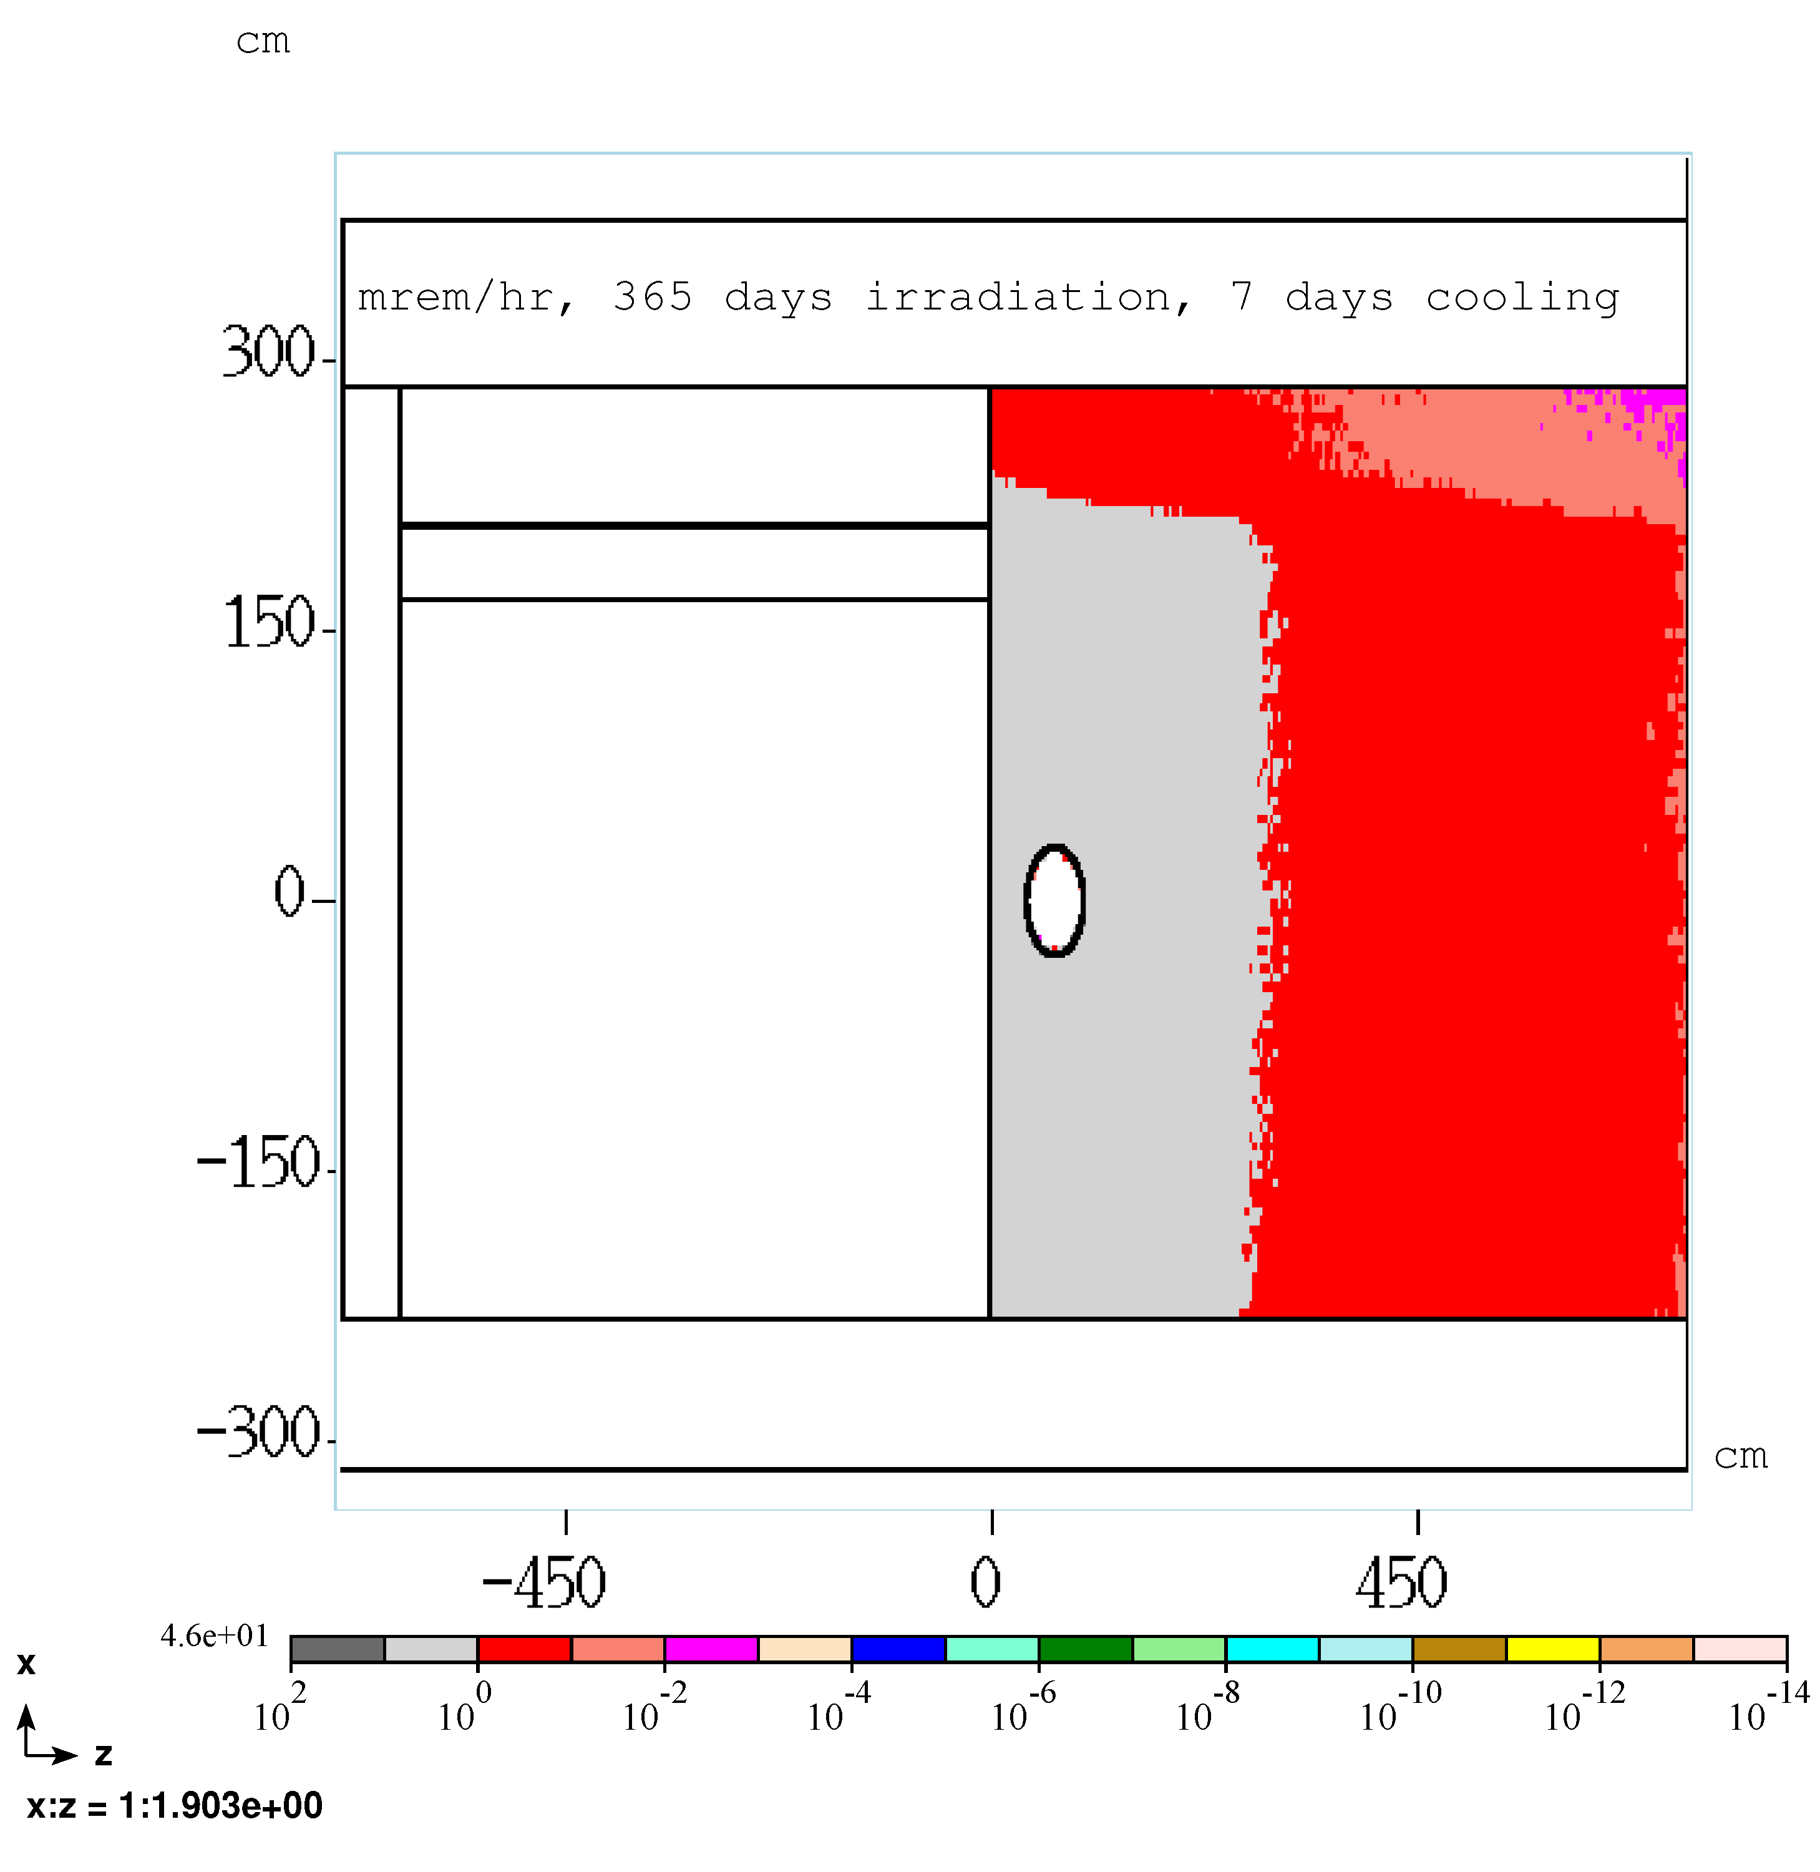
PS room residual dose rate, 365 days irradiation, 7 days cooling
RHR wall, PS room side
Peak dose rate: 46 mrem/hr
Leveling | Radiological Conditions During Mu2e Target Change Out

Slide 55
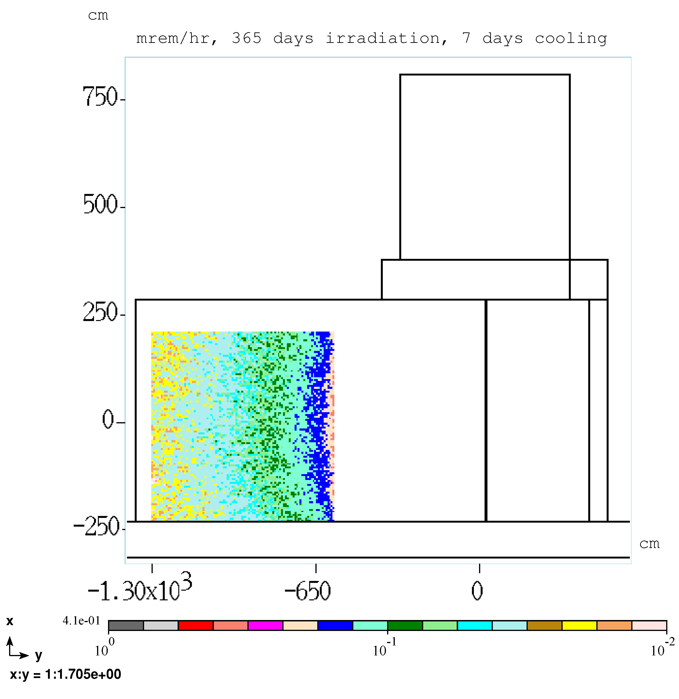
PS room residual dose rate, 365 days irradiation, 7 days cooling
RHR west wall
Peak dose rate: 0.4 mrem/hr
Leveling | Radiological Conditions During Mu2e Target Change Out

Slide 56
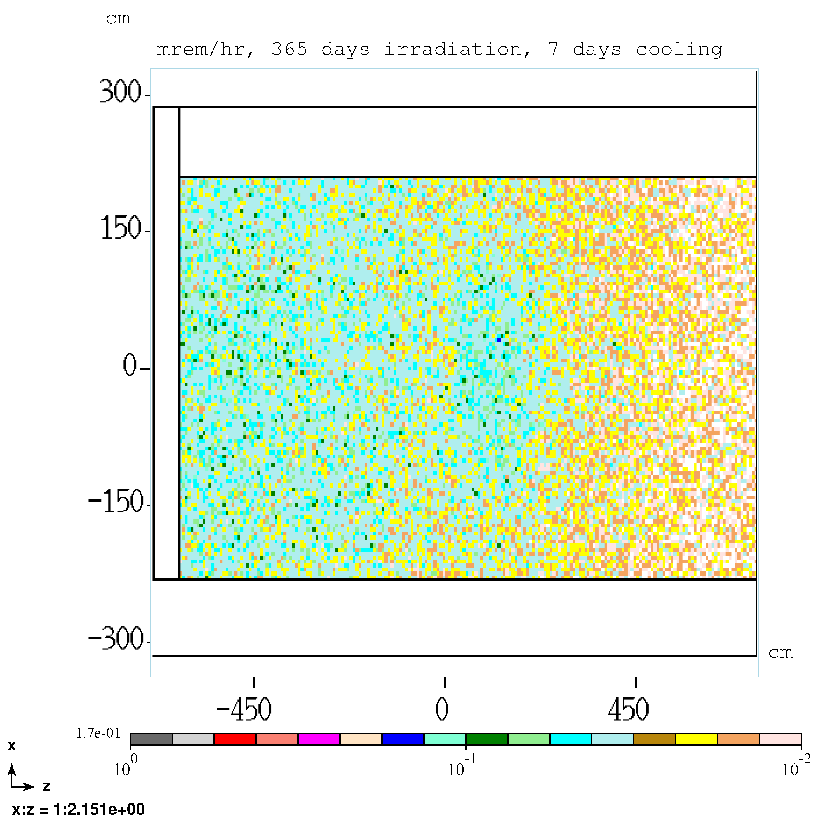
PS room residual dose rate, 365 days irradiation, 7 days cooling
RHR north wall
Peak dose rate: <0.2 mrem/hr
Leveling | Radiological Conditions During Mu2e Target Change Out

Slide 57
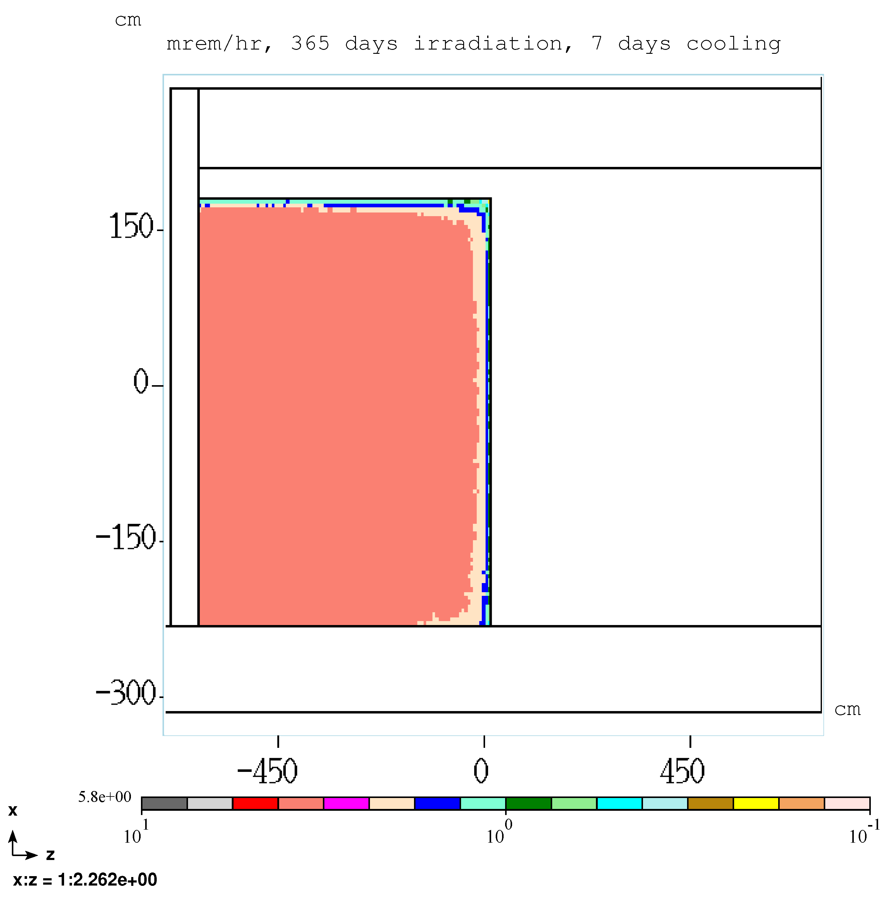
PS room residual dose rate, 365 days irradiation, 7 days cooling
RHR door, PS room side
Peak dose rate: 5.8 mrem/hr
Leveling | Radiological Conditions During Mu2e Target Change Out

Slide 58
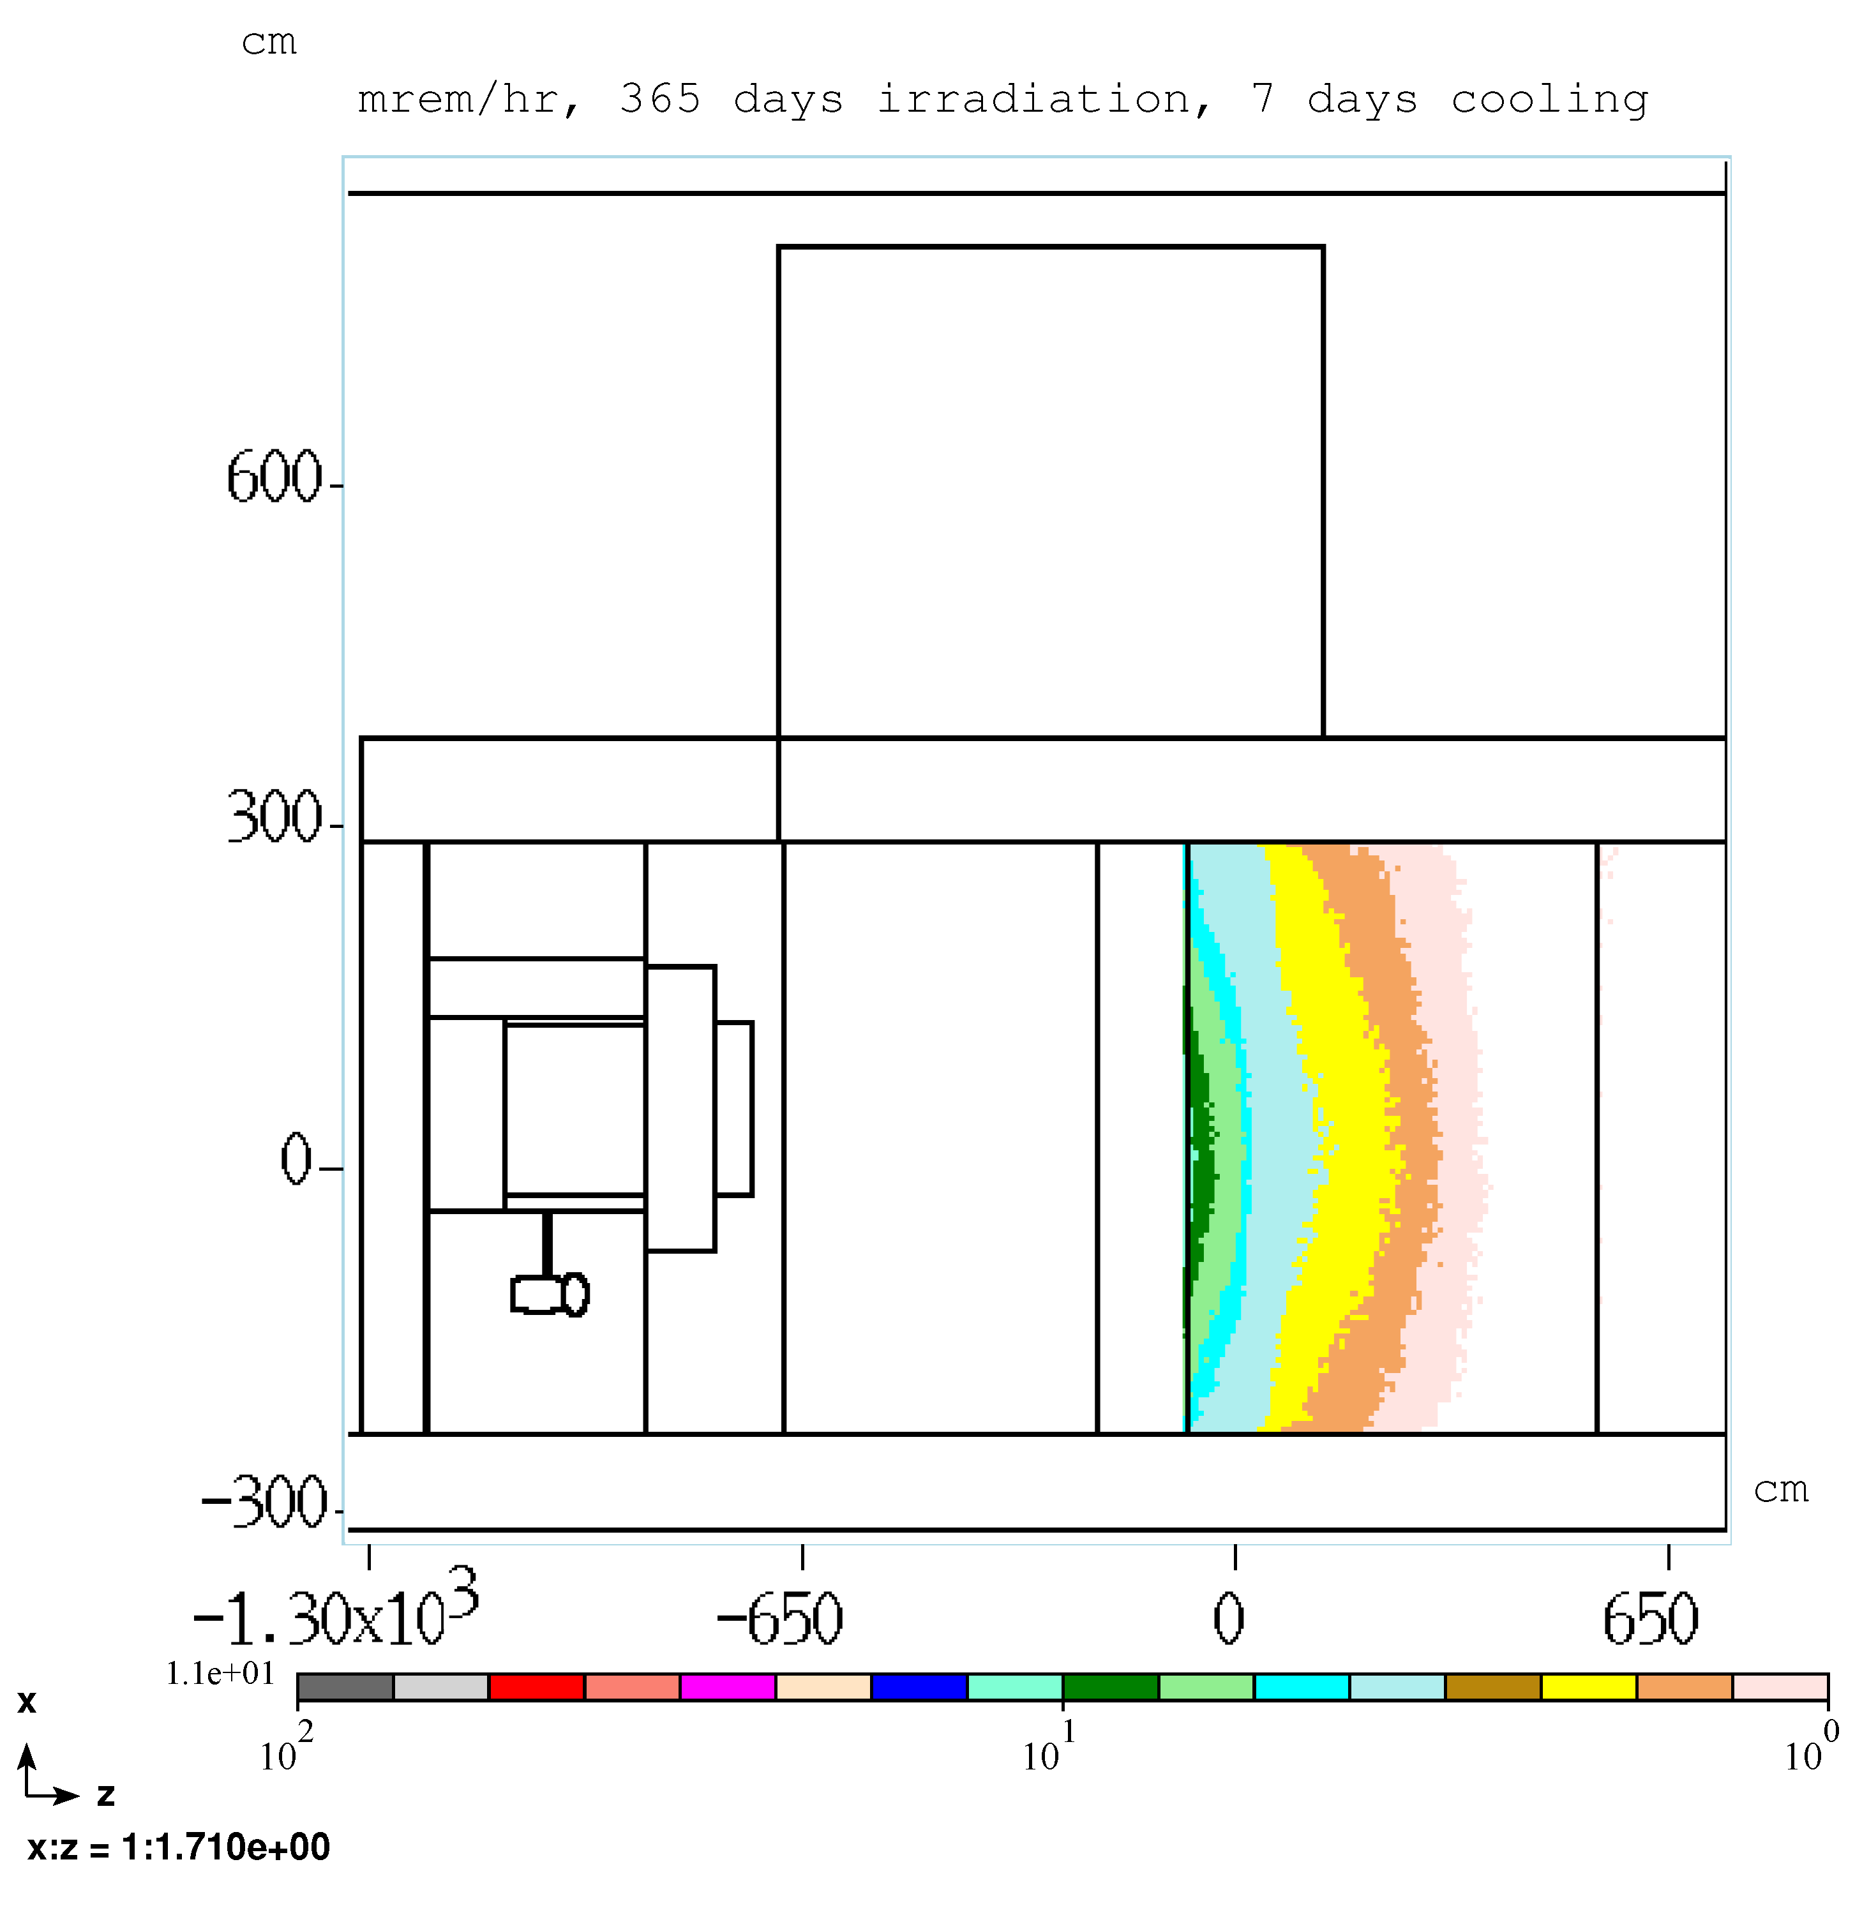
PS room residual dose rate, 365 days irradiation, 7 days cooling
PS room, south wall
Peak dose rate: 11 mrem/hr
Leveling | Radiological Conditions During Mu2e Target Change Out

Slide 59
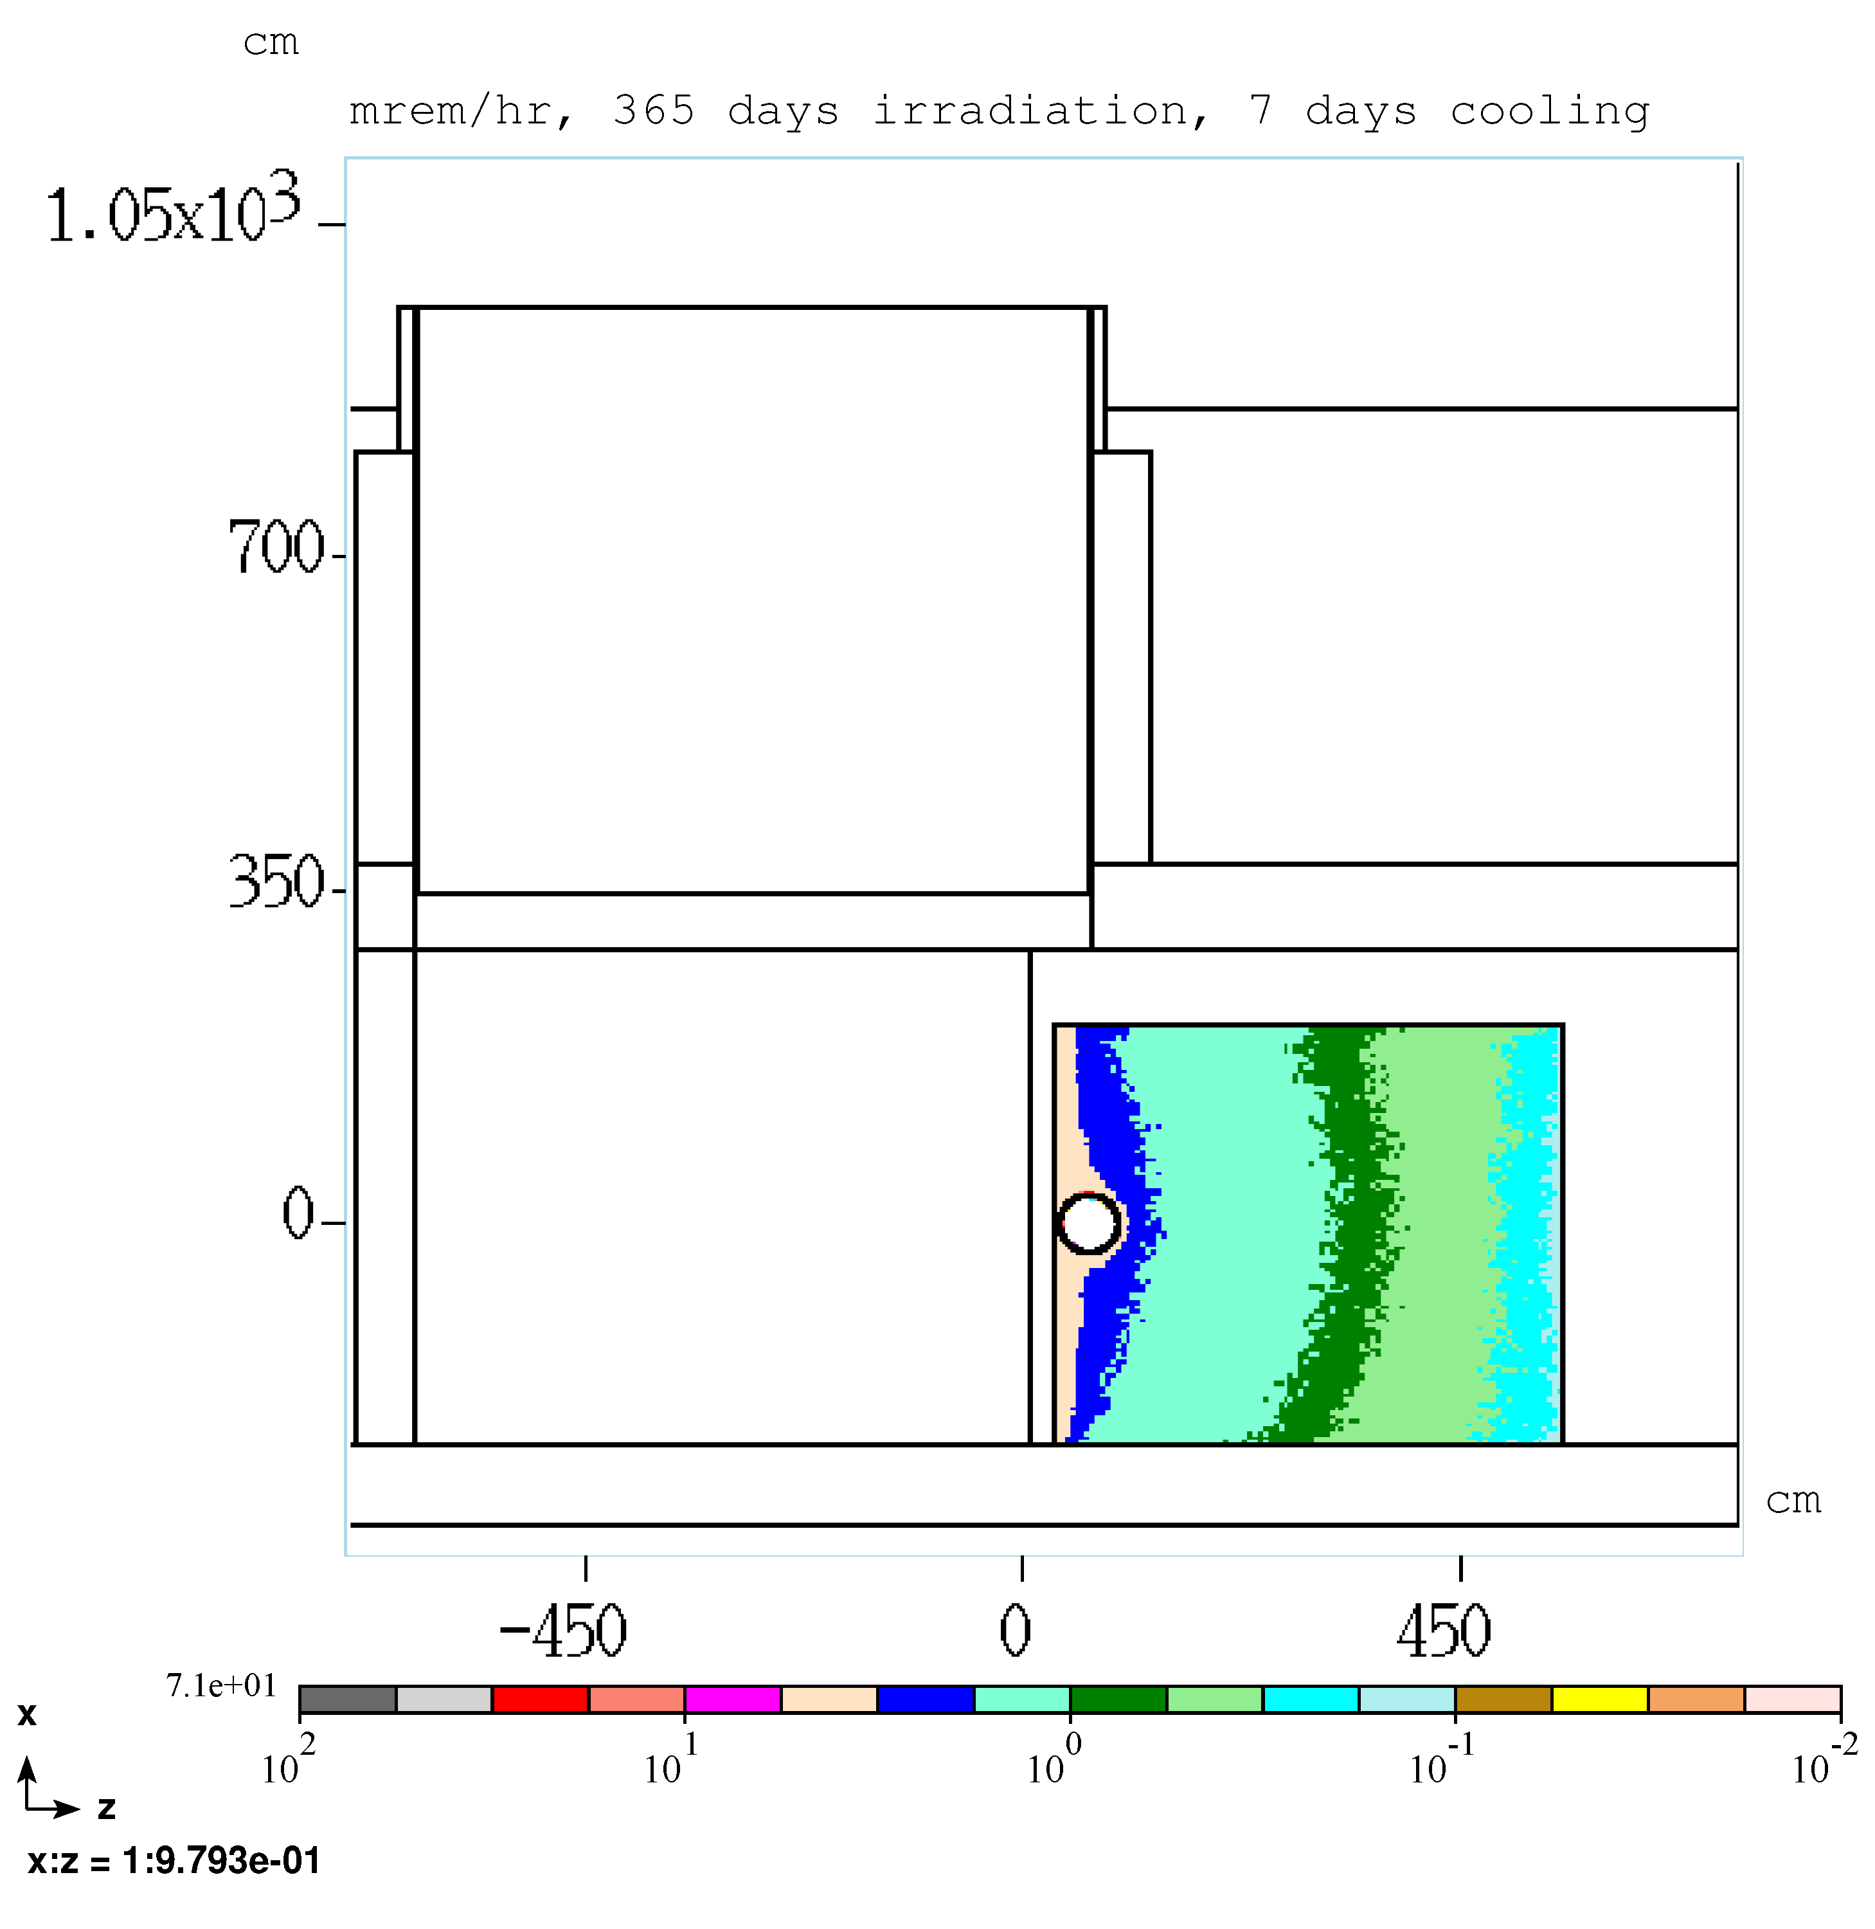
PS room residual dose rate, 365 days irradiation, 7 days cooling
North yoke wall, aisle side
Peak dose rate: 71 mrem/hr
Leveling | Radiological Conditions During Mu2e Target Change Out

Slide 60
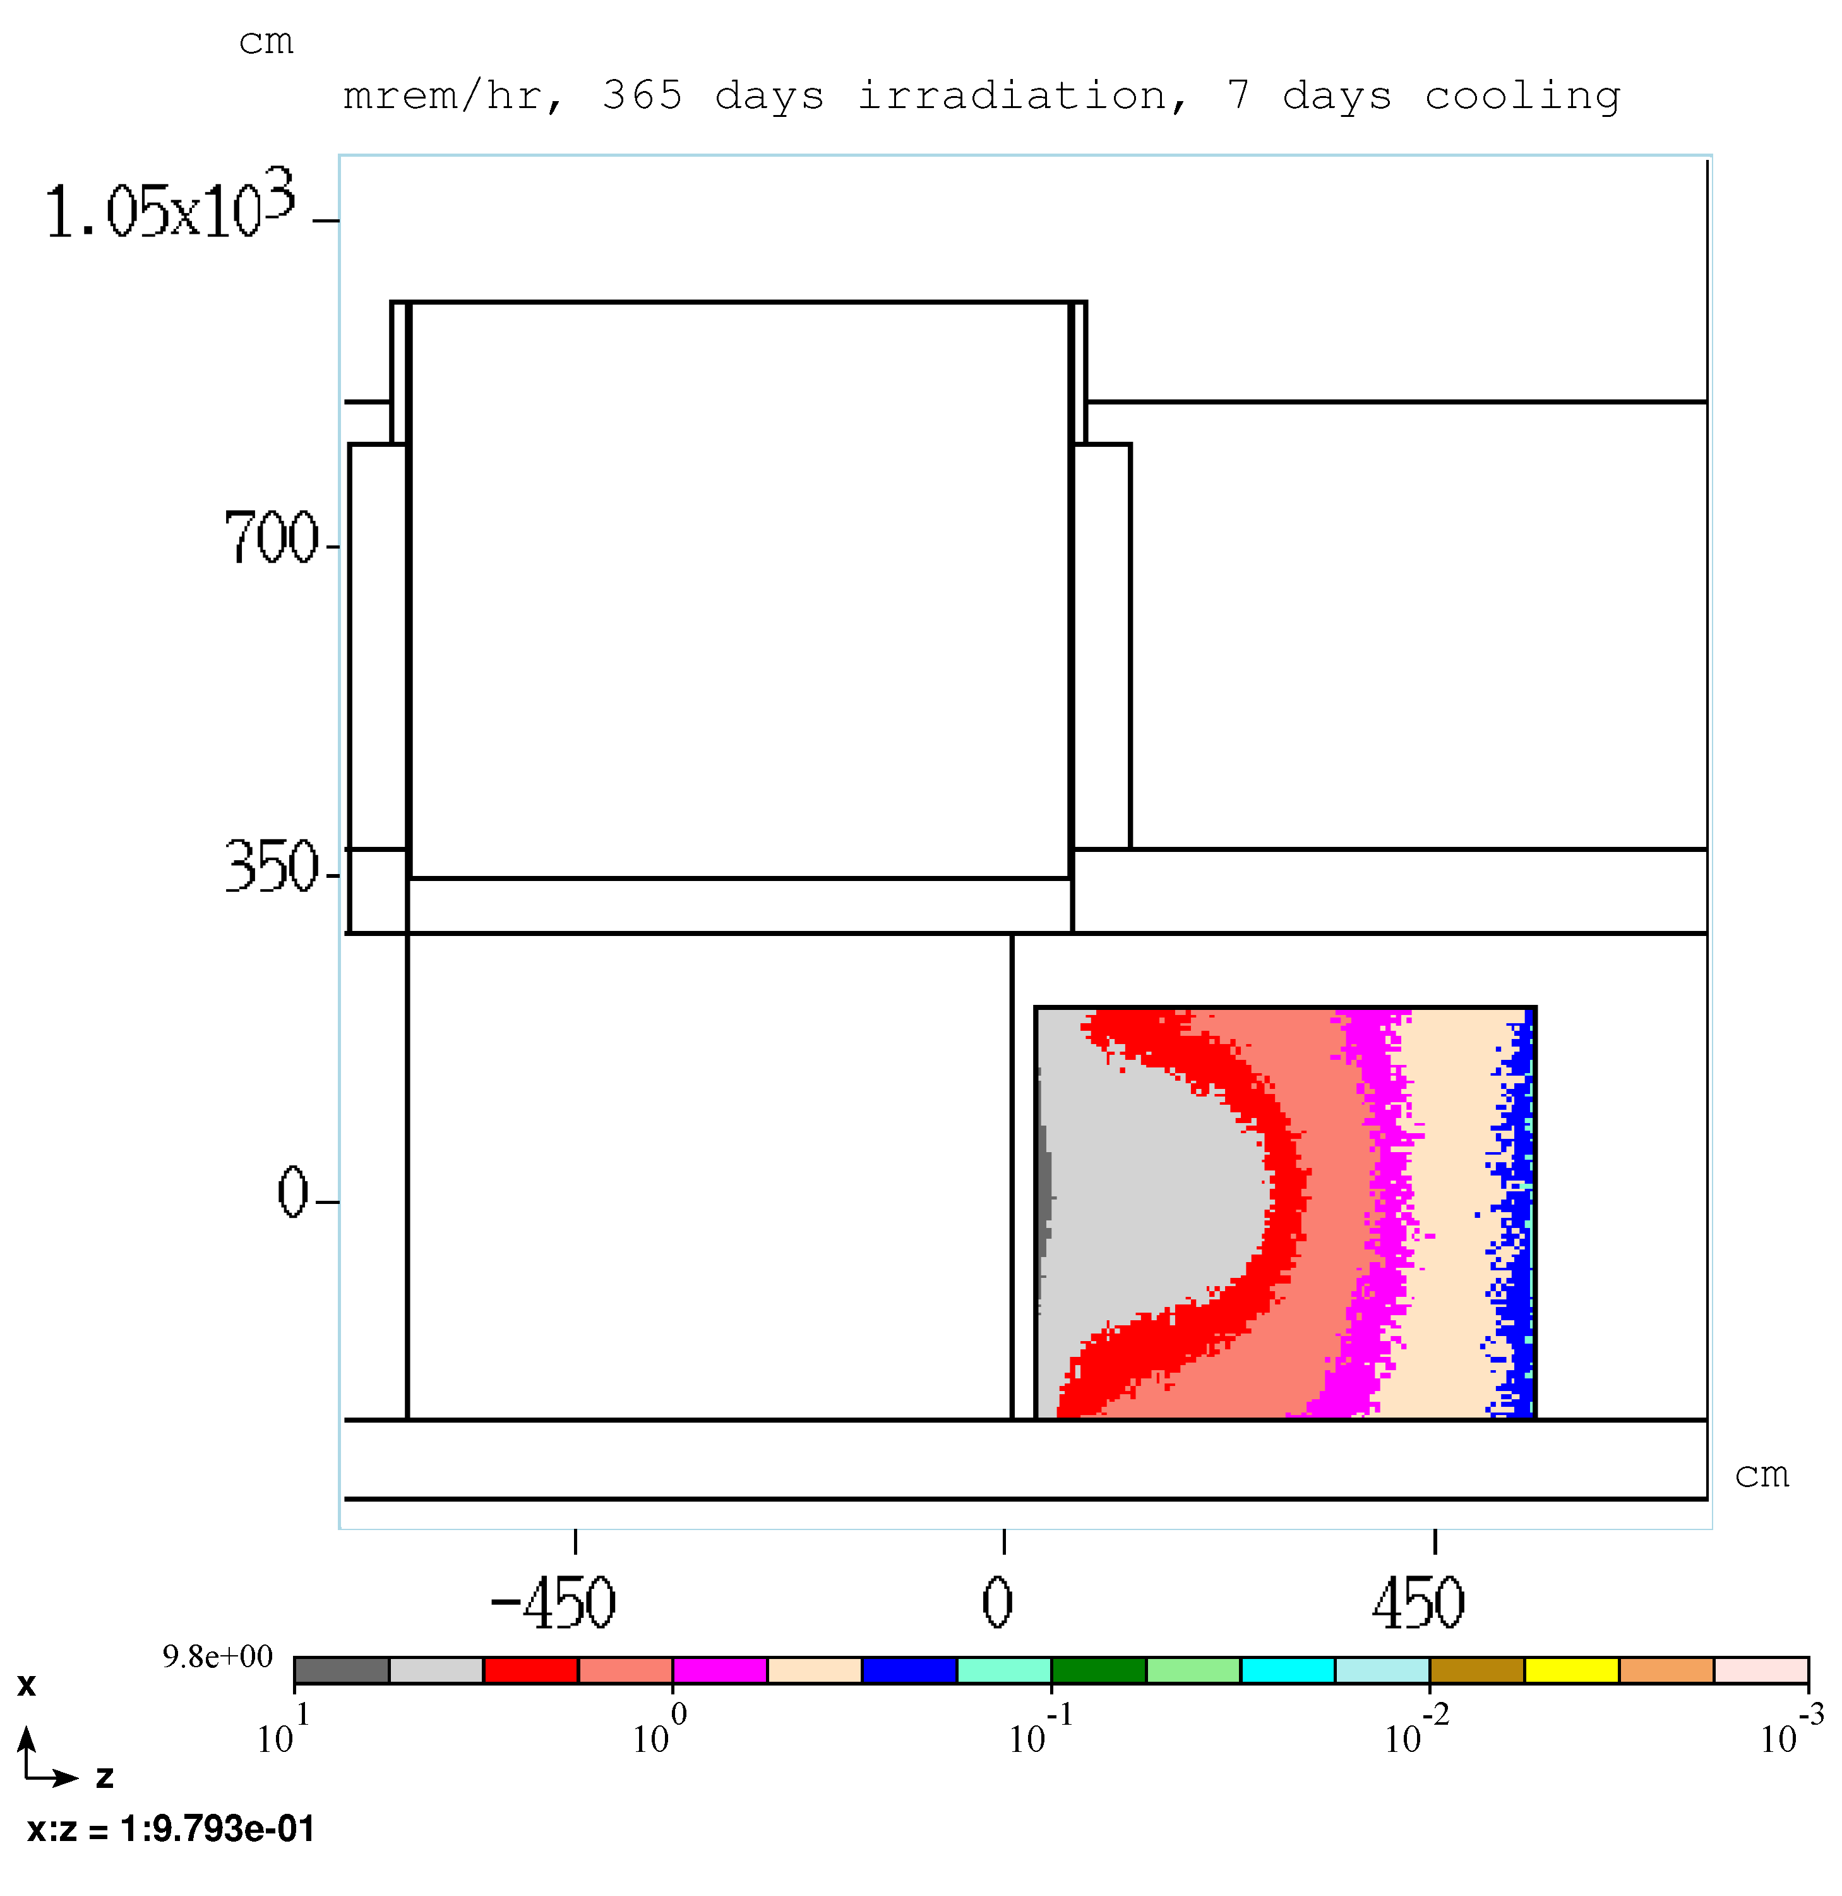
PS room residual dose rate, 365 days irradiation, 7 days cooling
South yoke wall, aisle side
Peak dose rate: 9.8 mrem/hr
Leveling | Radiological Conditions During Mu2e Target Change Out

