Slide 1
Mu2e Target Hall Remote Handling
- Contamination Control, Schedule, Risk & Conclusions
Ryan Schultz
Deputy L3 Manager Target Station
11/17/2015

Slide 2
Contamination Control Goals
Contain TARGET material at the source – at the PS Window
  Keep target material in either
    PS end cap
      OR
    Containment Vessel
      OR
    Cask
  EOAT will be disposable
    Disconnect and leave in containment vessel

Slide 3
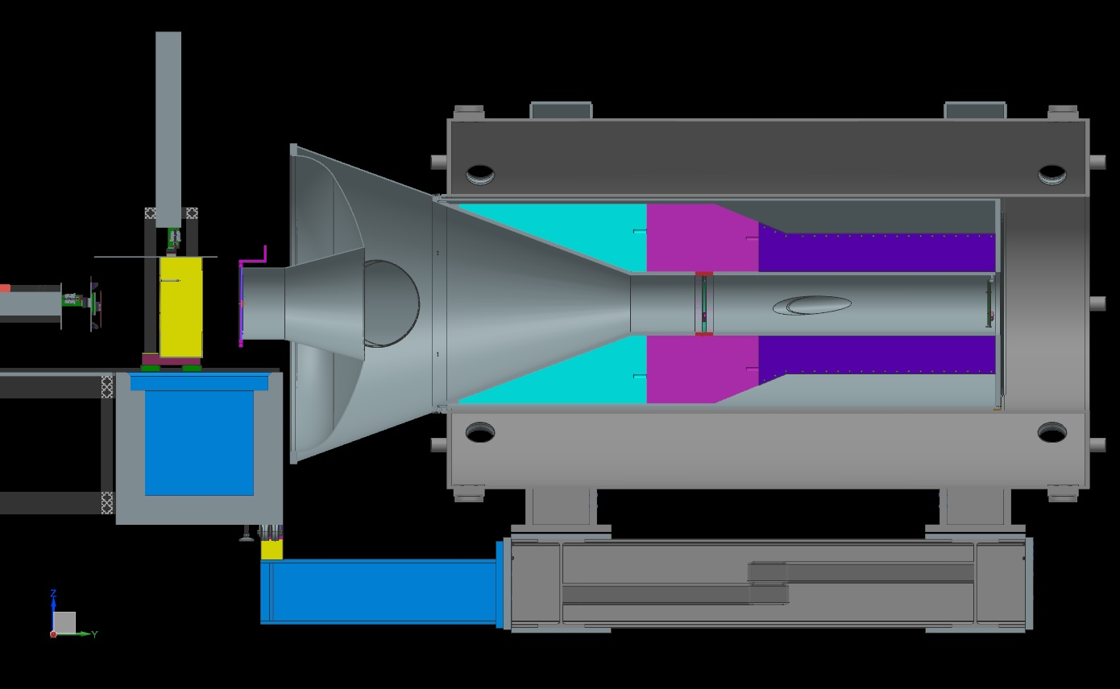
Cross Section of PS
Target
Pbar
Absorber
12’-6”
6’-8”

Slide 4
Radiation Protection - Entry controls for the RH Room
Entry into the Remote Handling room will be under the exclusive control of the AD ES&H department radiation protection group
Work is planned by target station engineers
Work will be controlled by radiation work permit
Approval of work is by AD RSO, or in exceptional cases, by the Fermilab Senior Radiation Safety Officer
Work is controlled by AD ES&H personnel
  ES&H ensures adherence to:
    radiological check points
    radiation dose control
    contamination control

Slide 5
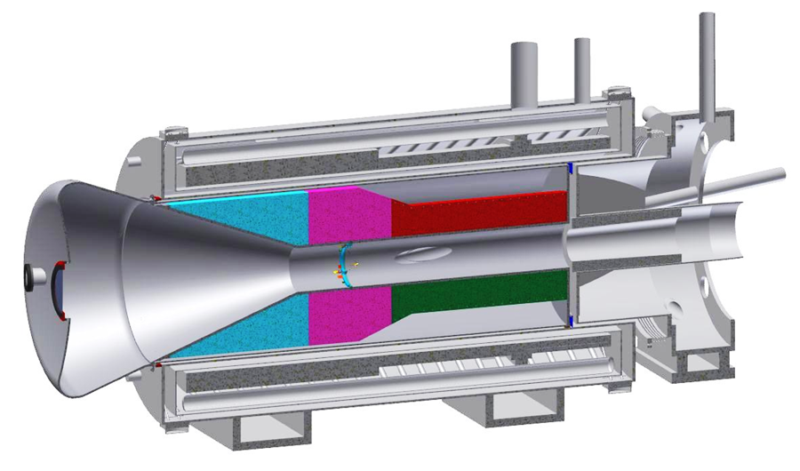
Facility Overview
Contamination
Controls
Area
Not
Contaminated
Contaminated
Area
Notes:
Green area defined by AD Rad Safety during operations

Slide 6
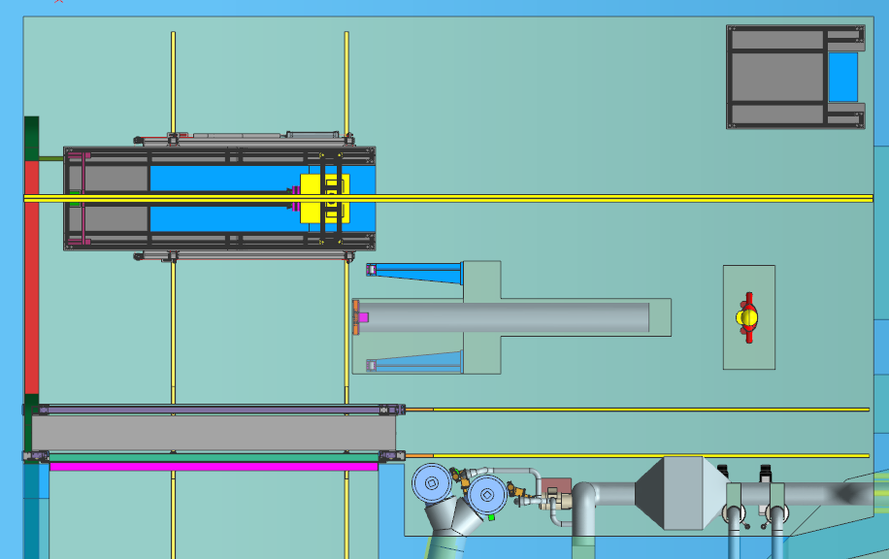
Radiological Controls in Remote Handling Room
Frisker
Module
Storage
Area
Step
Off
Pad
Step Off Pad
Contamination Control
Staging Area
Maintained
Clean Area
Step
Off
Pad
Step Off Pad
Activated Systems
Contaminated Area

Slide 7
Radiological Practices in Remote Handling Room
Contamination Control
  Use of “Good” Practices
  Lots of Plastic!!!
    Cover areas on modules, dispose of plastic afterwards
    Cover floor areas as necessary, dispose, etc.
    Cover/package parts as necessary
  Double coffin for Target
    7” inner cask may get contaminated on outside
    1” outer cask needs to be contamination free

Slide 8
Radiological Practices in Remote Handling Room
FESHM 11001, FRCM
  PPE
    Gloves, booties, suits
    Respiratory protection
  Air Monitoring
    Initial High Volume sample (3 min)
    Continuous sampling using AMS3, alarmed
  Procedural
    Supervised by AD RSO
    Pre-job briefing for High Contamination or Airborne Radioactivity Areas
    Personnel dose monitoring and limits
    Potential multiple step-off pads
    Labeled waste containers (PPE, parts, liquids, etc.)
    Detailed procedures approved by AD management

Slide 9
Remote Handling Schedule
Prototype Work
  Jan 2016 – Apr 2018
Procurement, Fab, Assembly
  Apr 2018 – Jan 2019
RH Installation & Test
  Spring 2020
RH Practice Runs in Target Hall
  Prior to Target Installation, mid-2021

Slide 10
Technical Risks for Remote Handing Design
Risk | Mitigation
Radioactive Contamination | Building – Three separate rooms Containment Box for Target Procedural using ALARA and past experience
Radioactive Dose to workers | Building design Procedural using ALARA and past experience
Target Assembly Coming Apart | End Cap re-designed
Mechanical Failure | Removed telescopic motion (target) - (Pbar absorber still requires one level) Manual redundancy where appropriate Emergency recovery where appropriate Prototyping & testing begins soon FMEA of design after complete Lengthy testing of full system prior to operation

Slide 11
Remote Handling Conclusions
Conventional Facilities
  RH area is designed and construction underway
Radiological
  Design within acceptable FRCM limits
  AD Radiation Safety
    has necessary experience
    has appropriate control procedures in place
  AD Target Systems Department
    has necessary experience
Remote Handling Mechanical Design
  Will begin prototyping in early 2016
  Need to do FMEA, add redundancy, emergency recovery, etc.
  Test, test, test!

