Slide 1
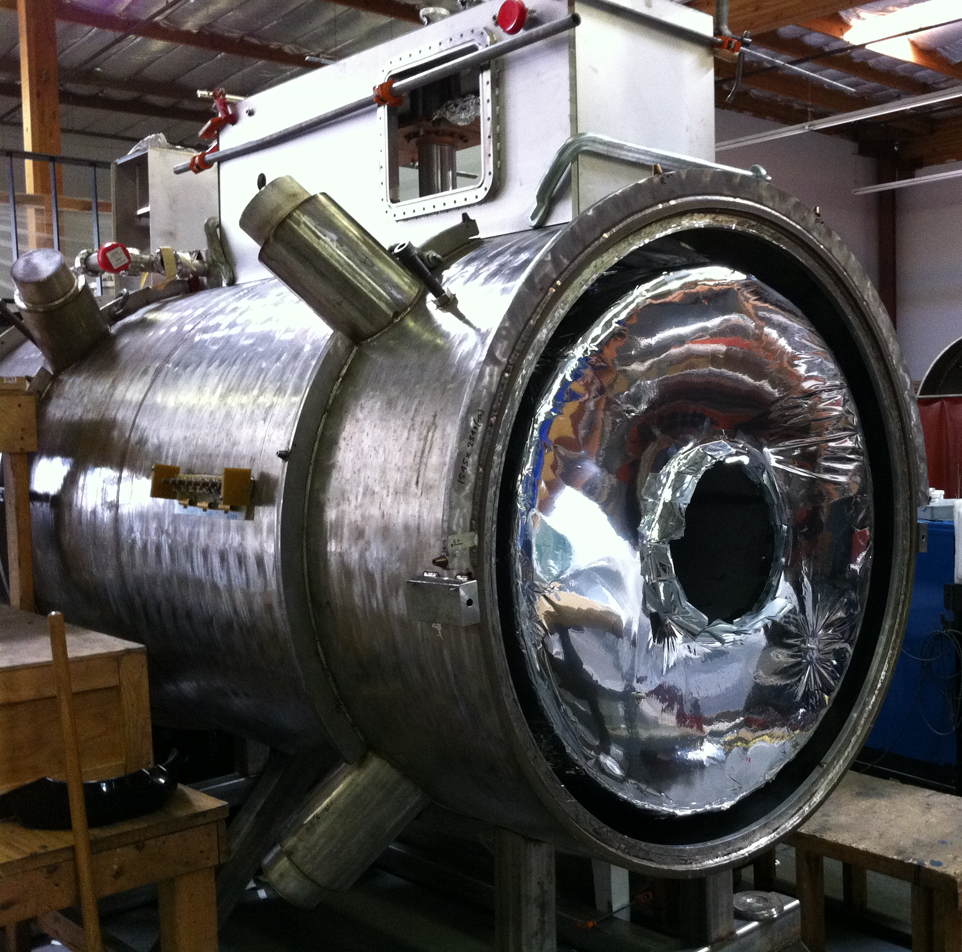
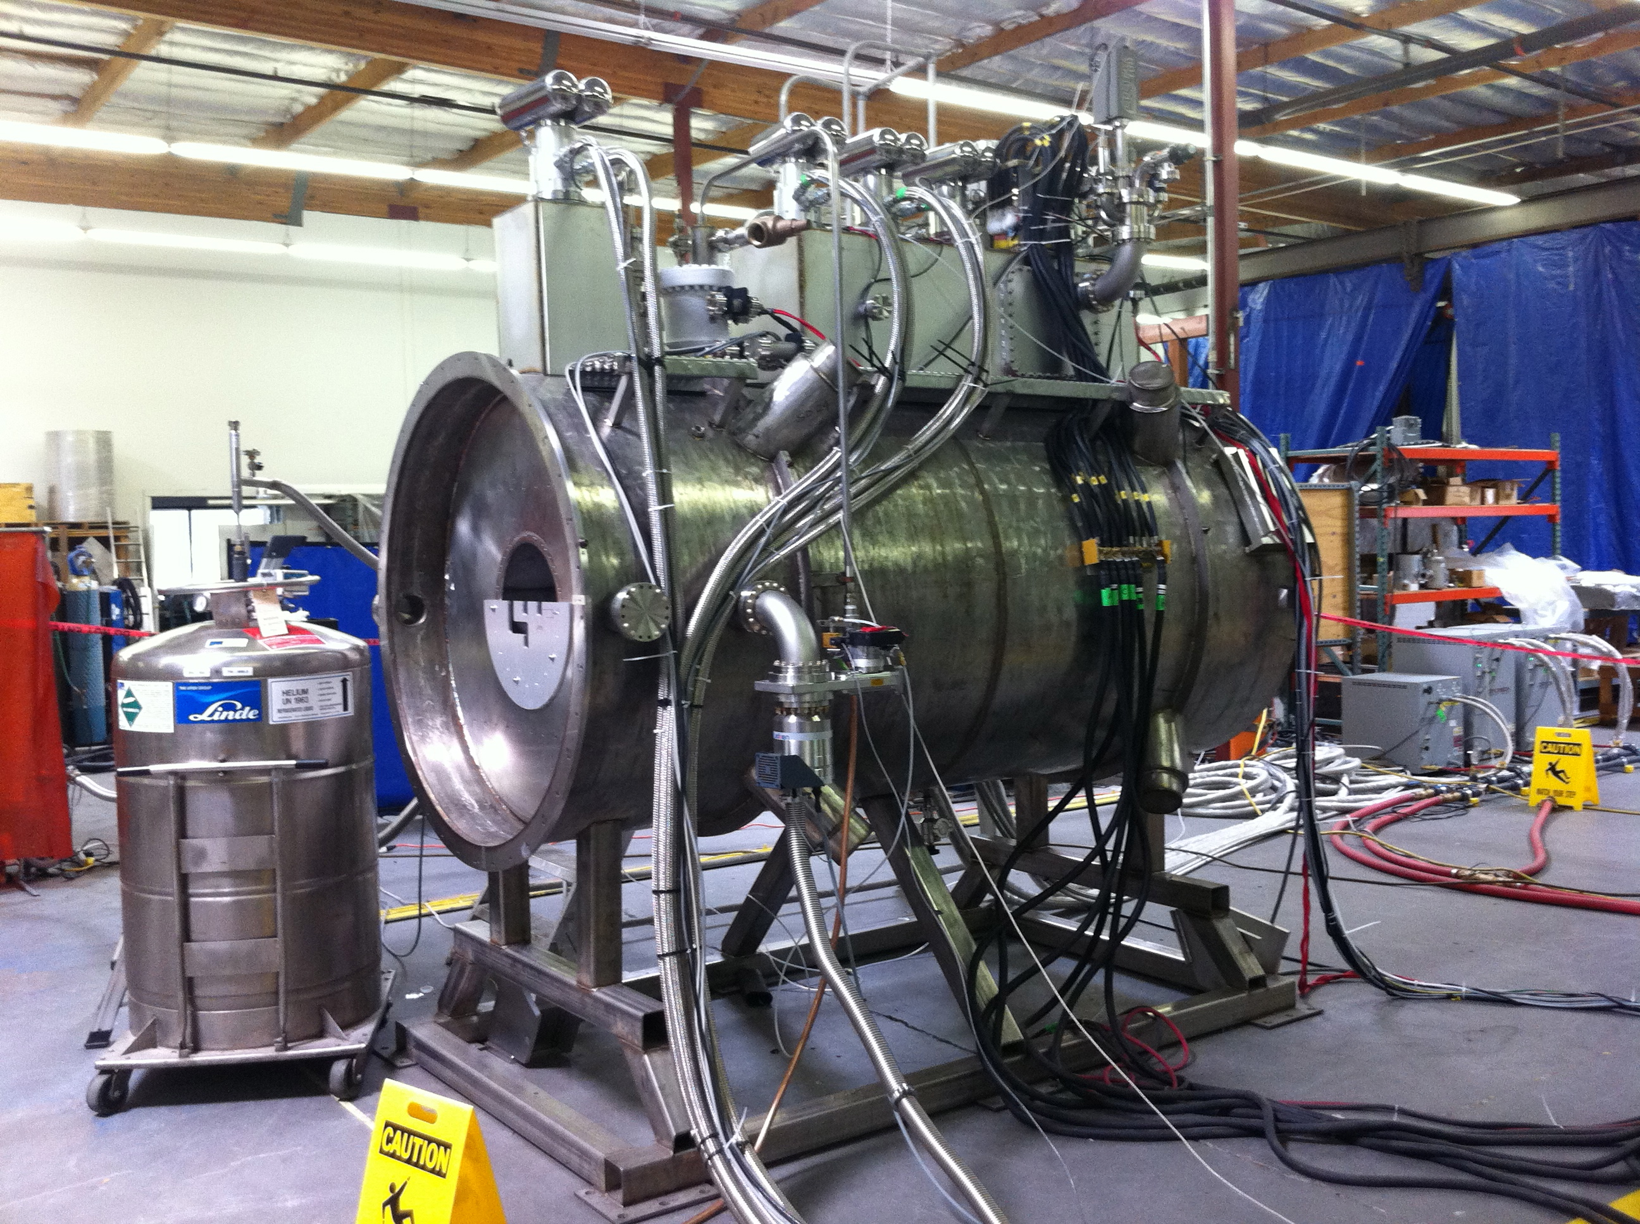
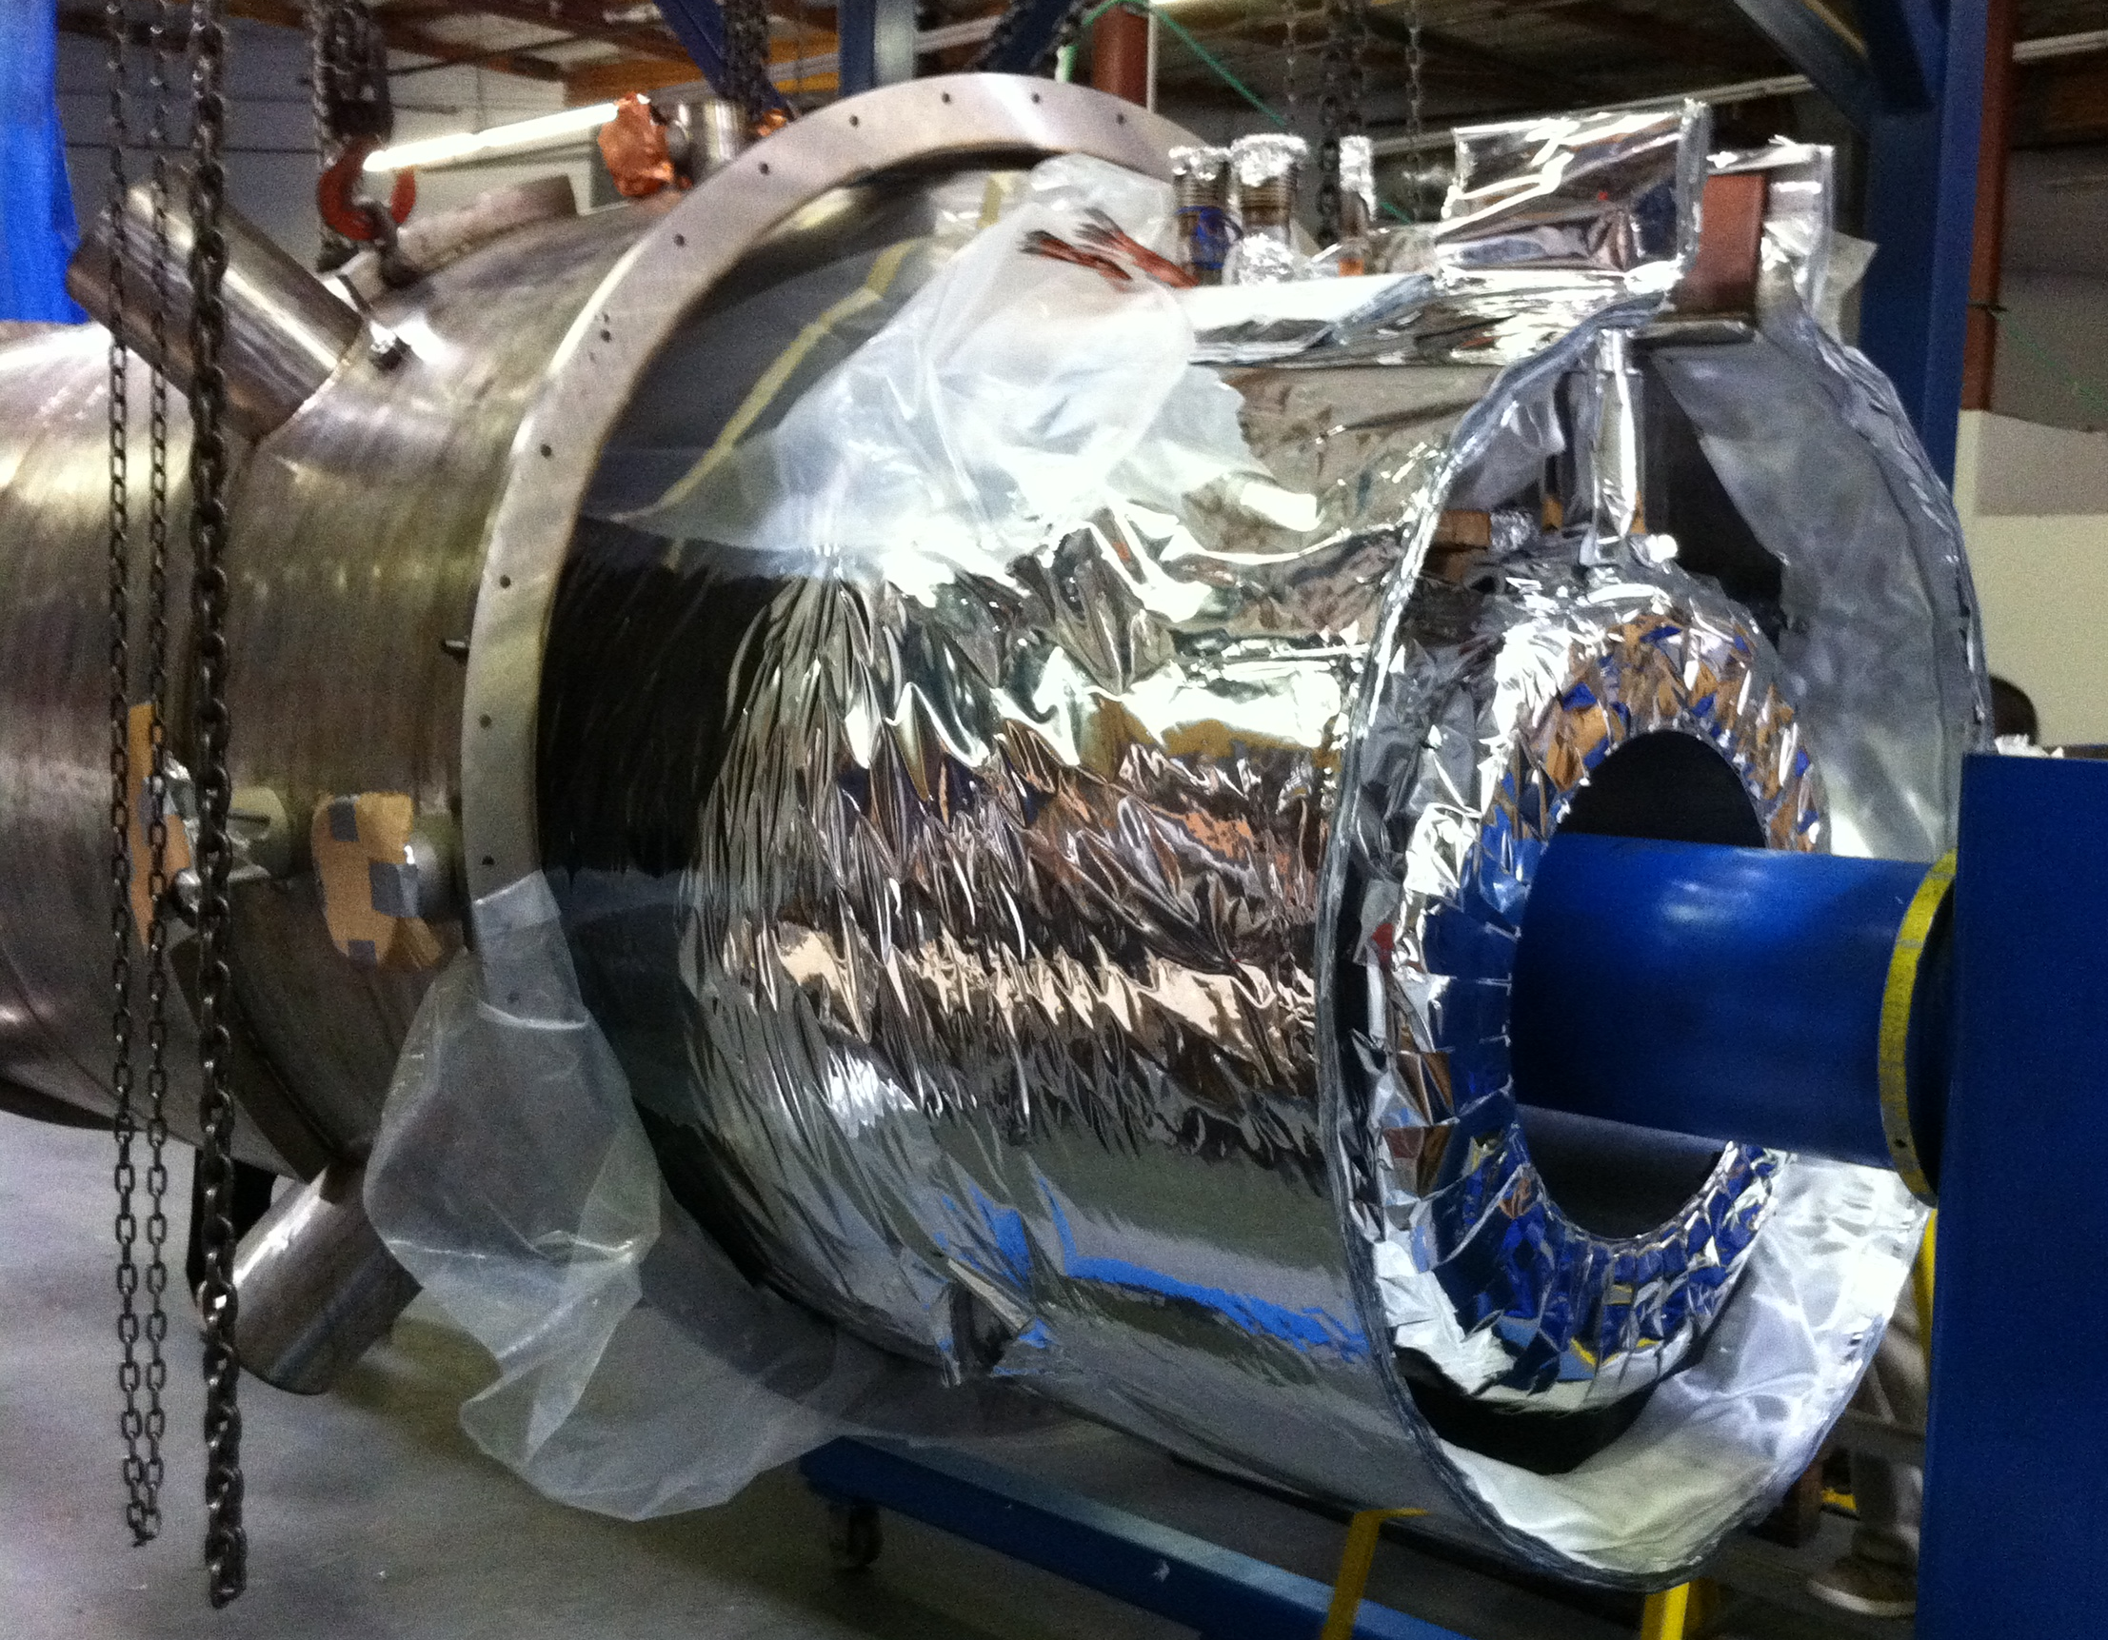
MICE Spectrometer Solenoid Design and Assembly

Slide 2
Magnet Design Features
5 coils on a single mandrel
200L LHe volume in cold mass
5 ea 2-stage cryocoolers for recondensing helium vapor and cooling the shield
Vapor and return LHe pass thru the same cooler tubes at the top of the cold mass
8 ea HTS leads feed the 5 coils
60K thermal shield made from series 1100 Al

Slide 3
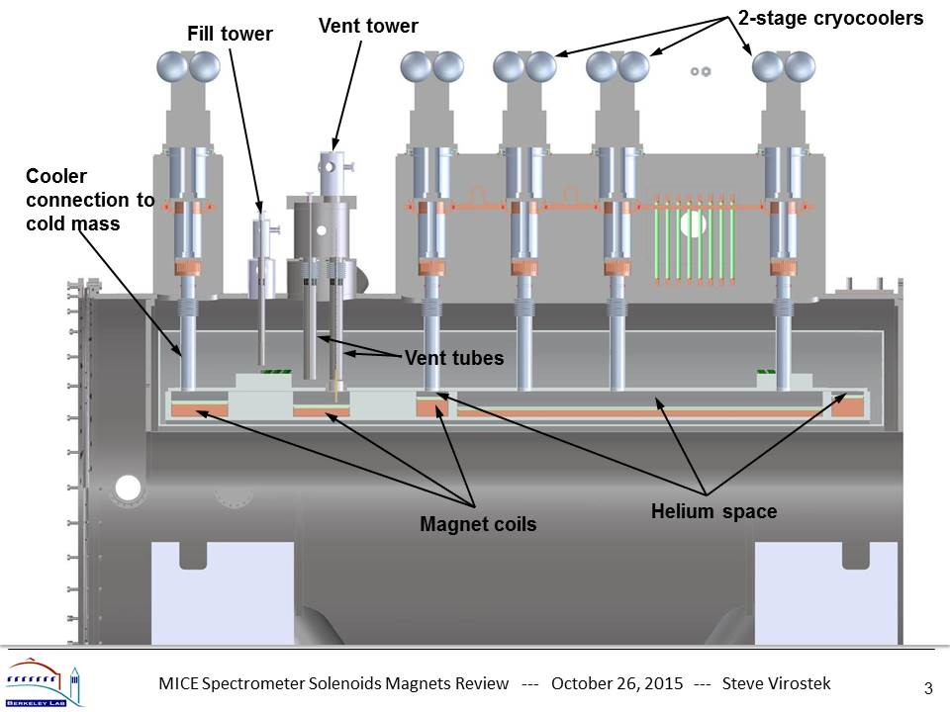
Internal Design Details

Slide 4
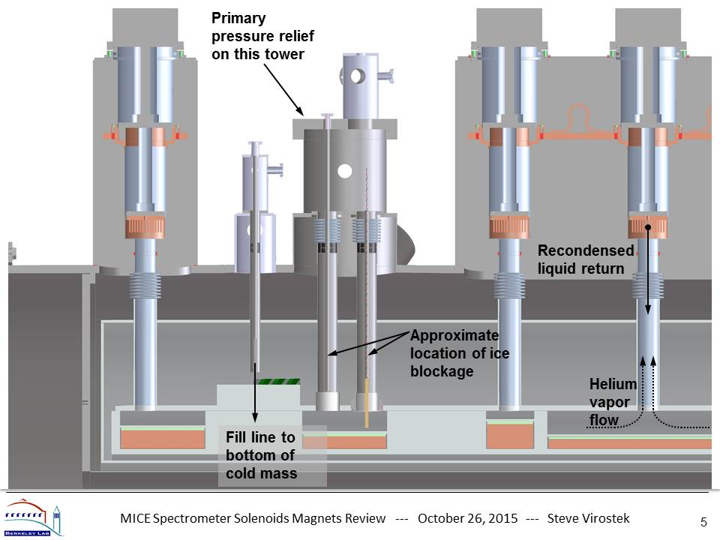
Internal Design Details

Slide 5
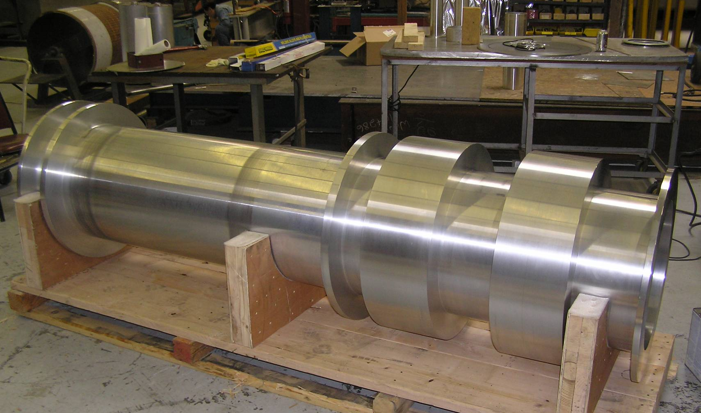
Coil Winding Mandrel
- 6061-T6 aluminum mandrel
- Forged tube, machined profile

Slide 6
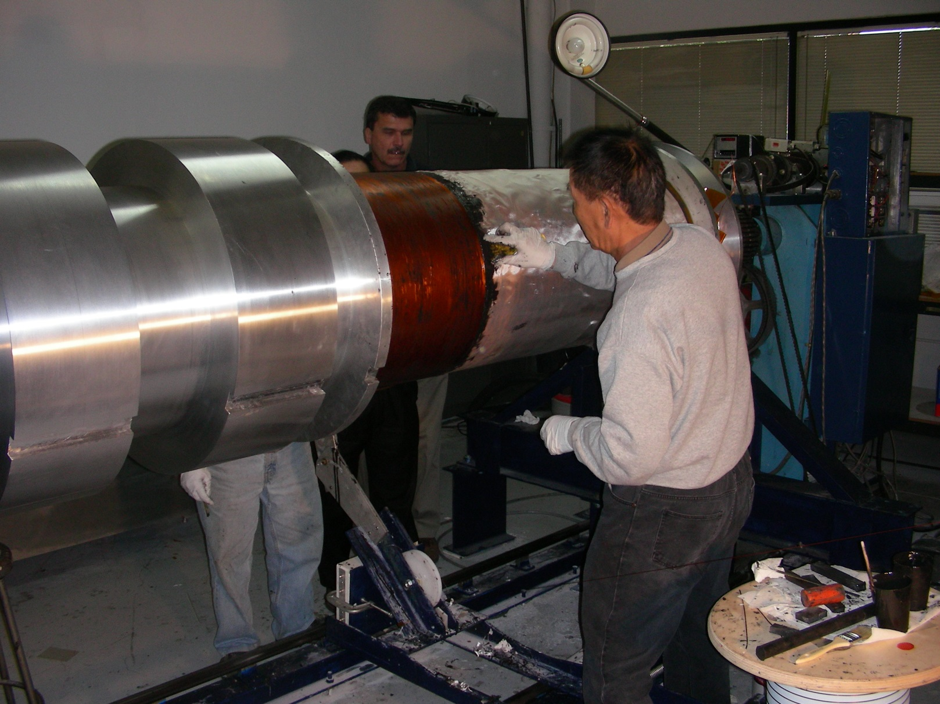
Coil Winding
- Stycast epoxy wet coil winding
- Fiberglass cloth between layers

Slide 7
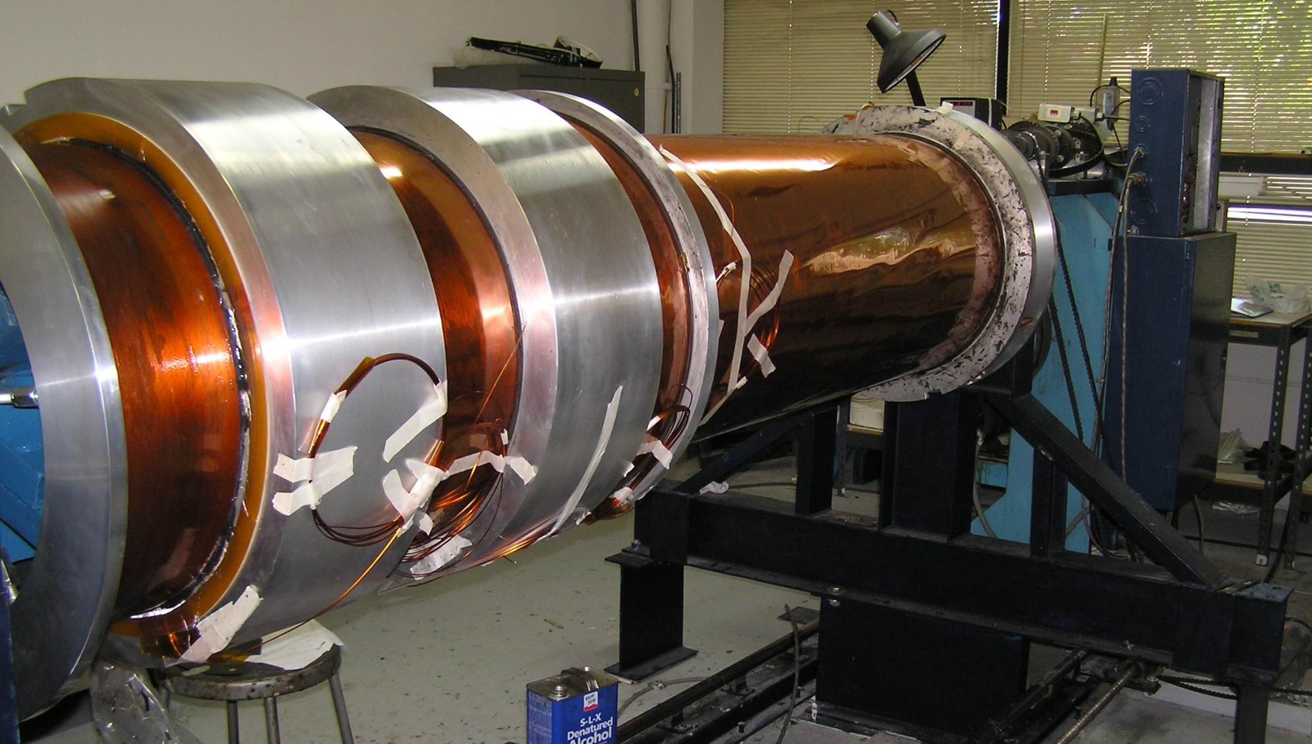
Completed Coil Windings
- 1.65 mm x 1.0 mm superconductor
- 222 Nb-Ti filaments, ~4:1 Cu/SC ratio

Slide 8
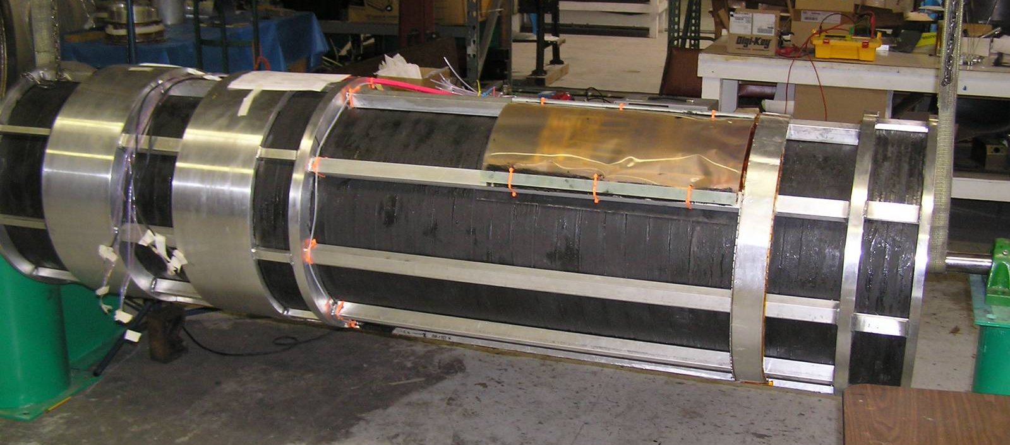
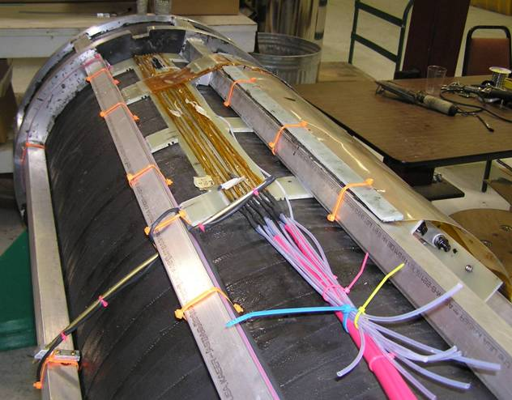
Banding and Axial Reinforcement
- Wound aluminum banding w/Stycast
- Welded aluminum axial stiffeners

Slide 9
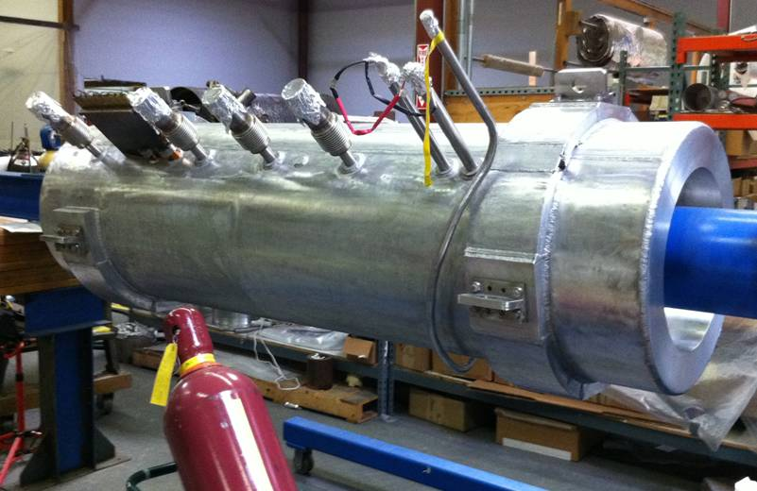
Completed Cold Mass
- Welded aluminum clamshell type cover
- ~200 liter cold mass interior volume

Slide 10
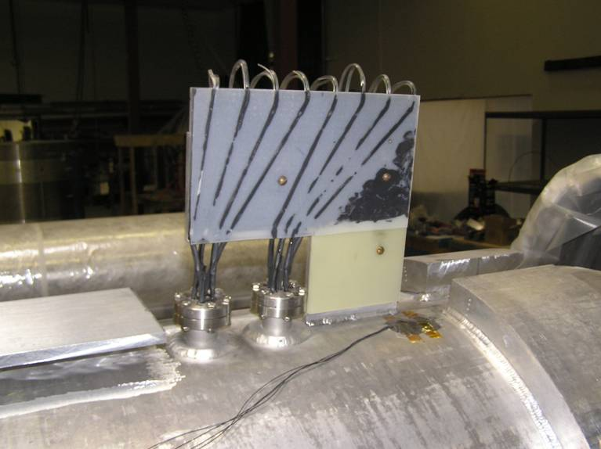
Vacuum Side Coil Leads
- LTS leads heat sinked to cold mass body
- Commercial ceramic feedthroughs

Slide 11
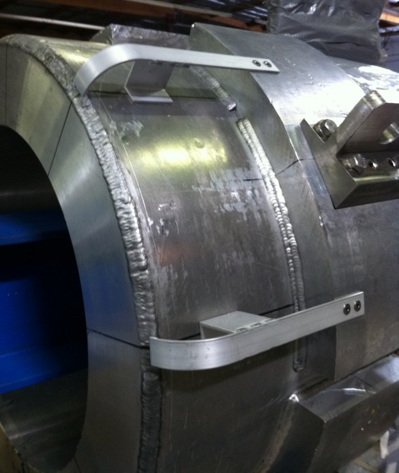
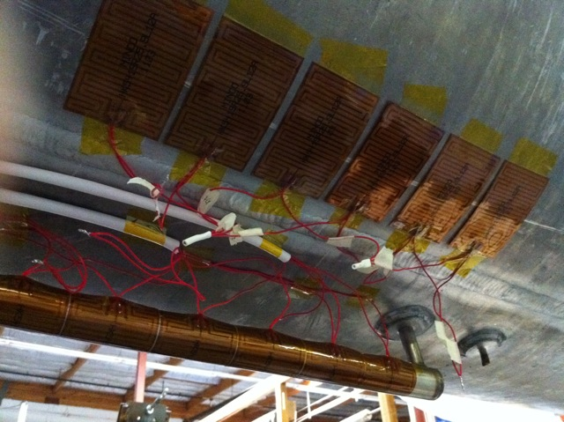
Cold Mass MLI Spacers & Heaters
- Spacers help prevent thermal shorts
- Heaters provide pressure regulation

Slide 12
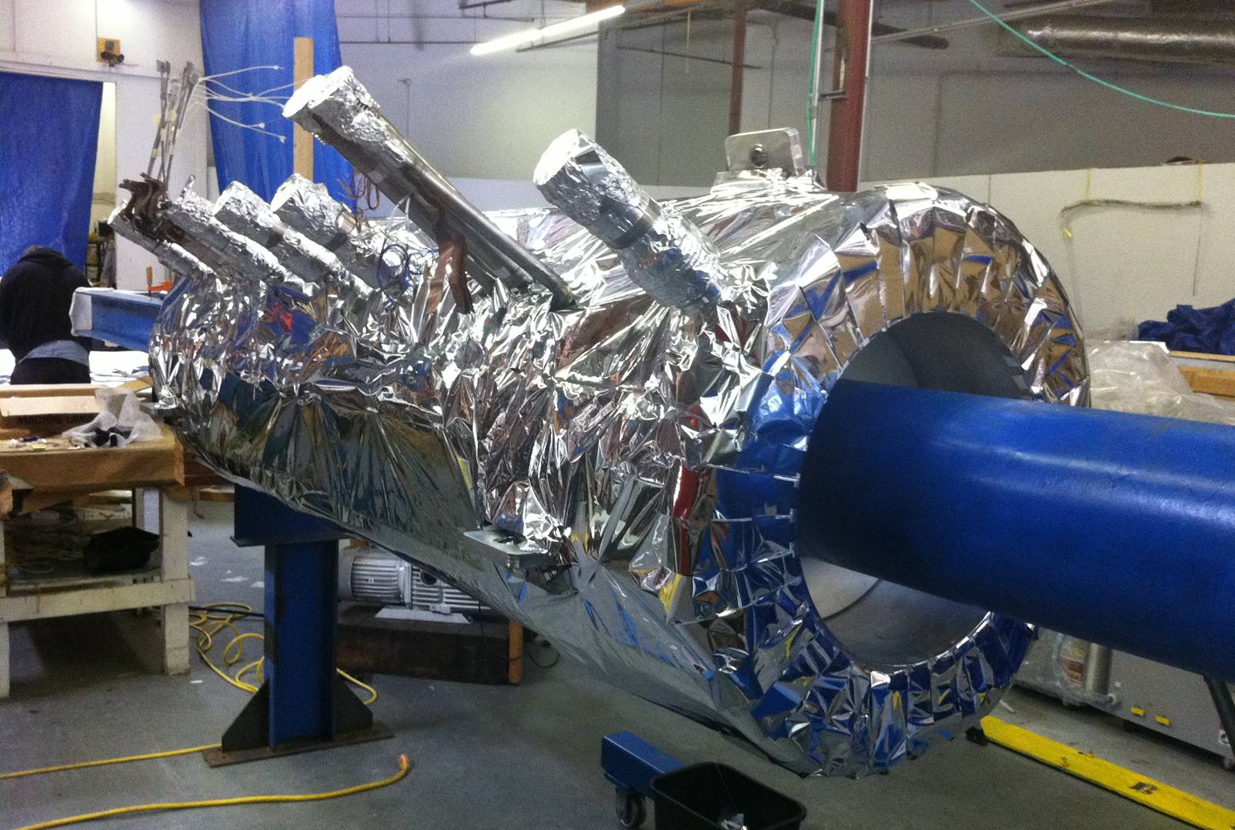
MLI Wrapped Cold Mass
- ~32 layers of aluminized Mylar MLI
- Interleaved joints, Mylar tape

Slide 13
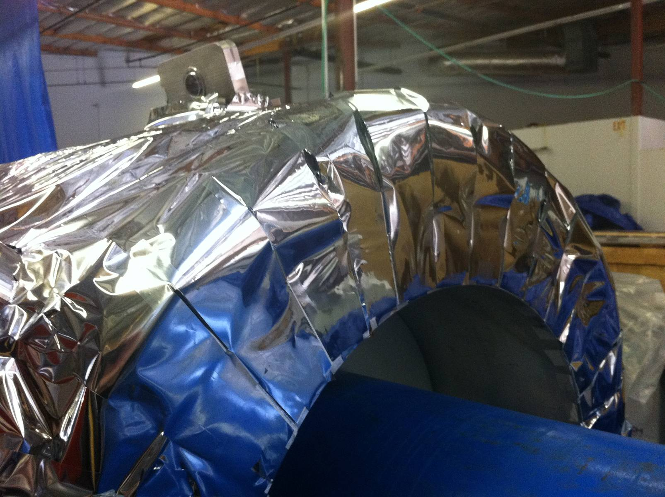
Cold Mass End Wrap Detail

Slide 14
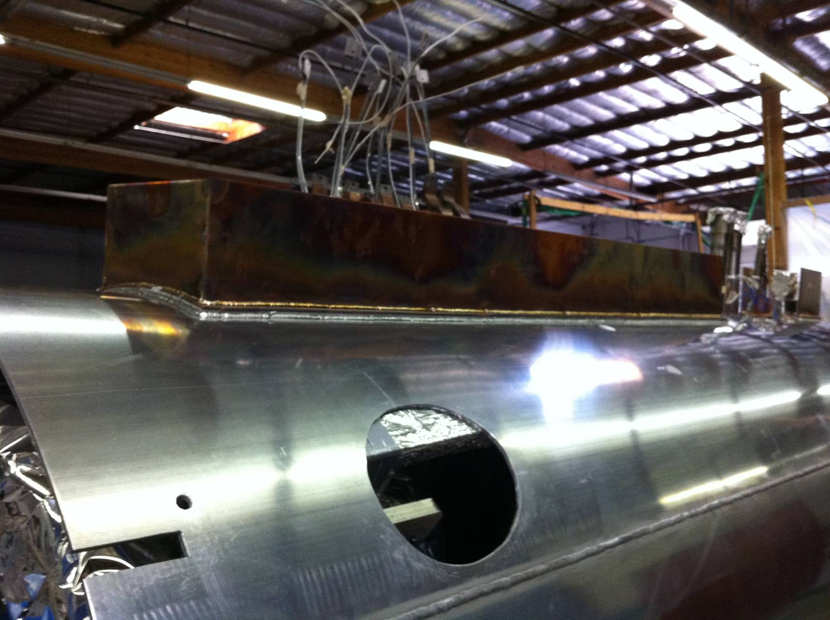
60K Shield Assembly
- Series 1100 aluminum thermal shield
- Copper transition for cooler connection

Slide 15
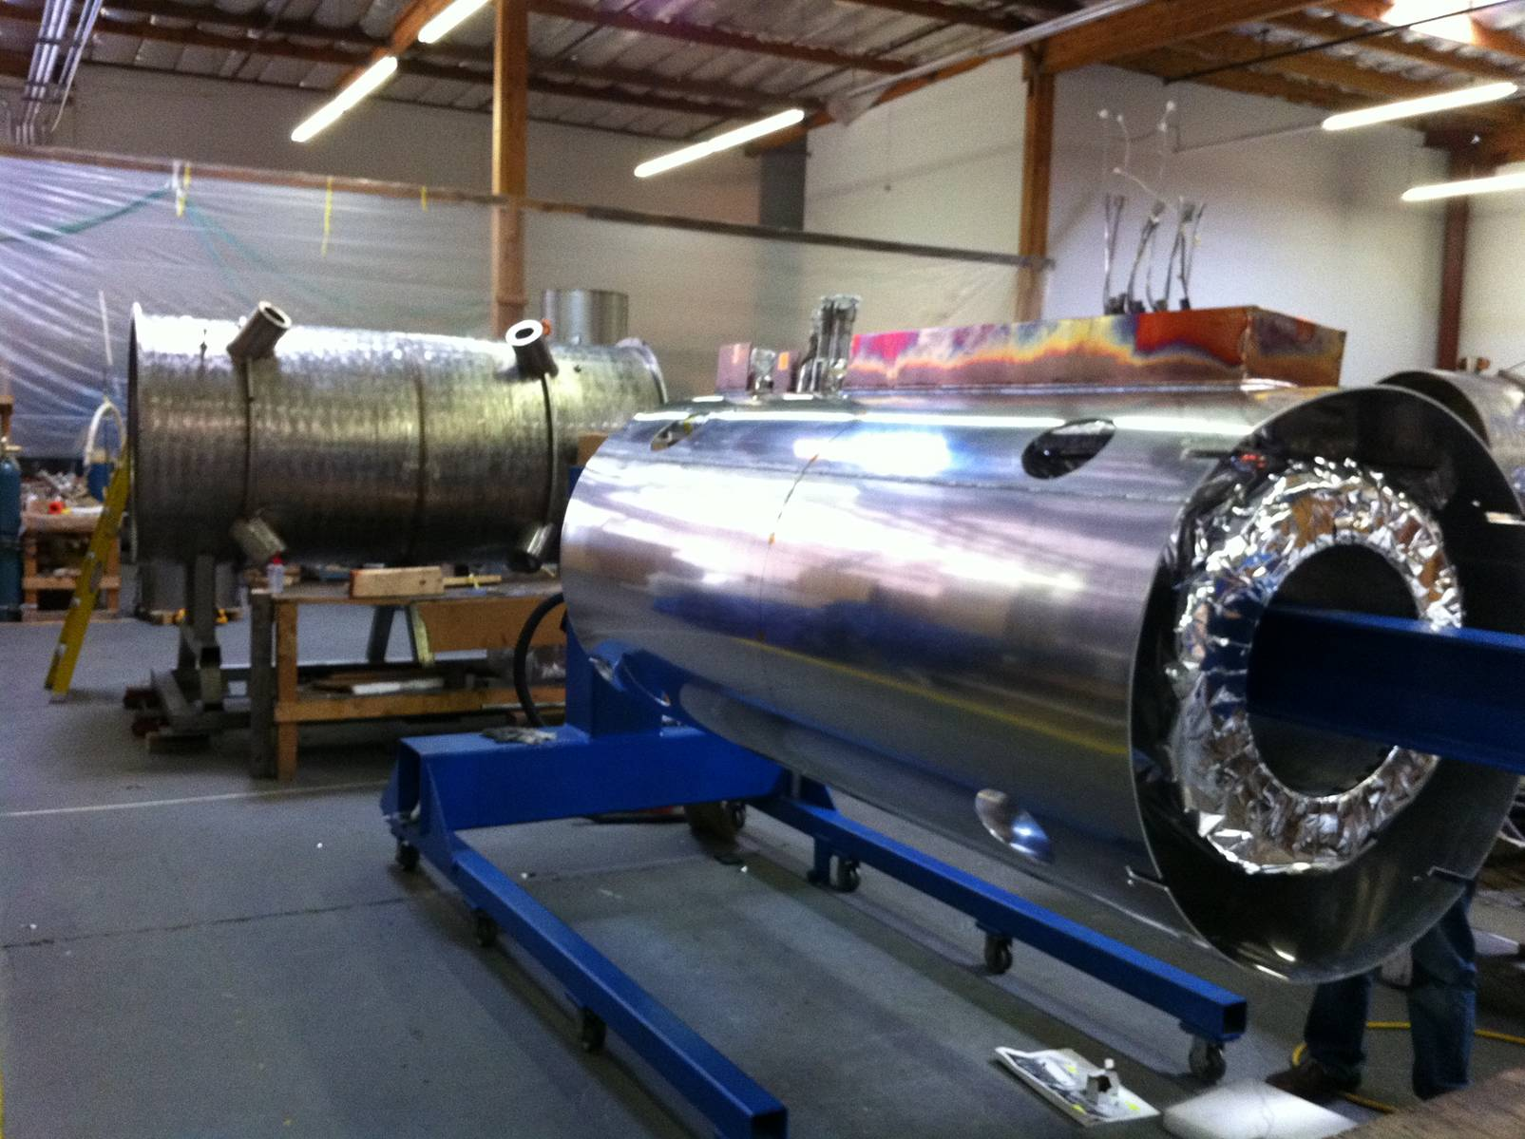
Nested Cold Mass/Shield
- Cold mass nested in shield before
installation in vacuum vessel

Slide 16
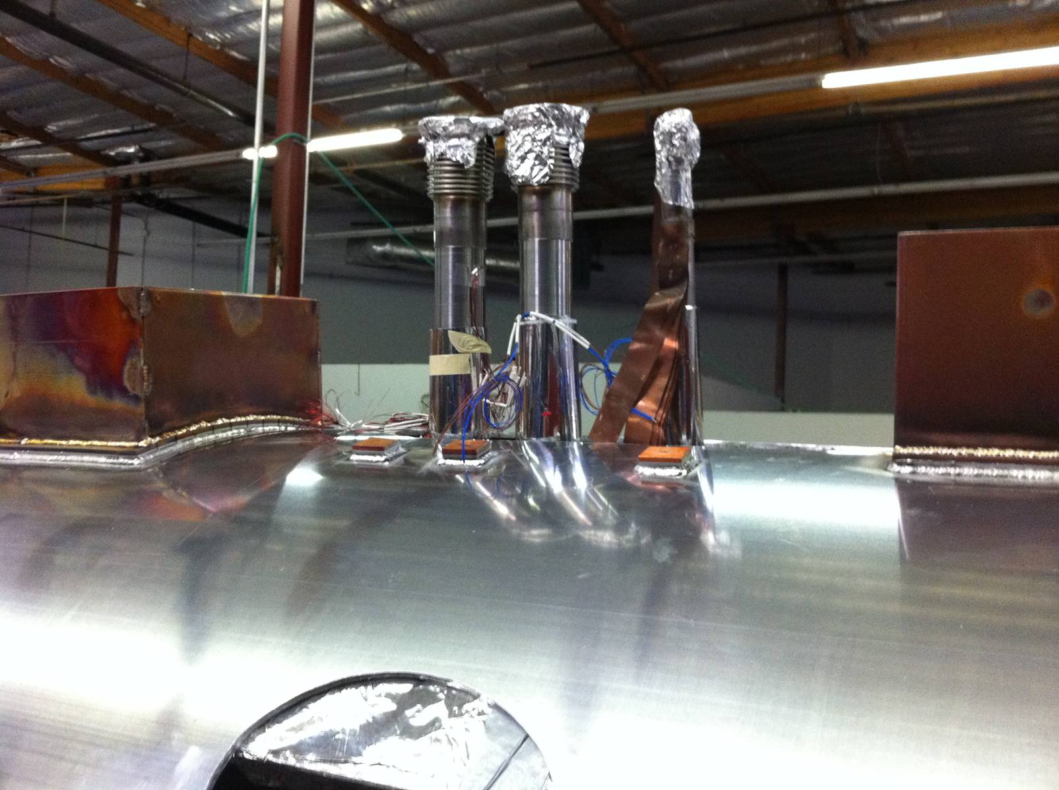
Cold Mass Vent and Fill Lines
- Fill and vent lines intercepted at shield
- Thinned out walls limit conduction

Slide 17
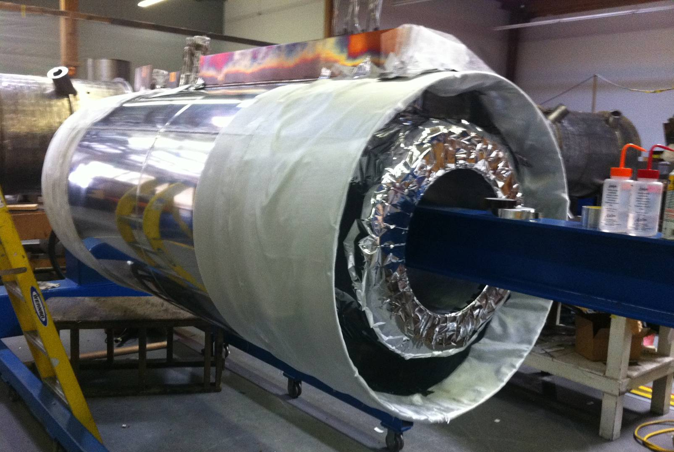
Shield Prep for MLI
- ~64 layers MLI on thermal shield
- Fiberglass cloth protects during welding

Slide 18
Shield/Cold Mass Installation

Slide 19
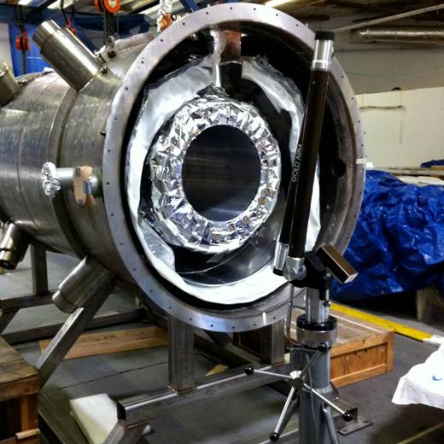
Cold Mass Alignment
- Cold mass alignment using portable CMM

Slide 20
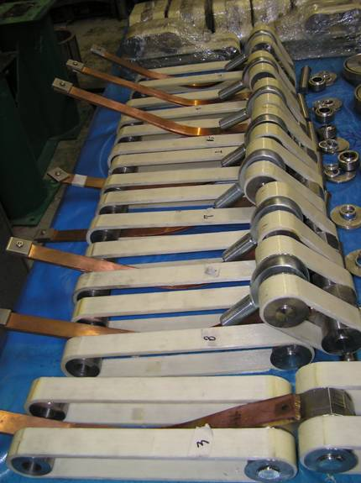
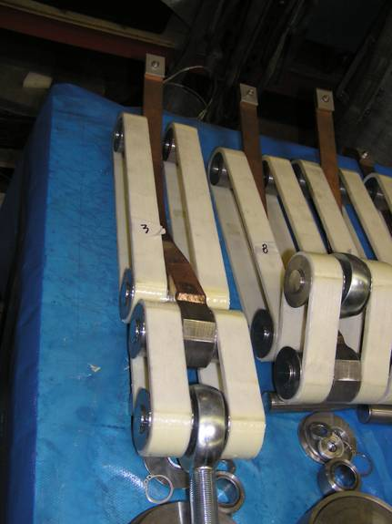
Cold Mass Support Bands
- Fiberglass bands for low heat leak
- Intermediate intercept at 60K shield

Slide 21
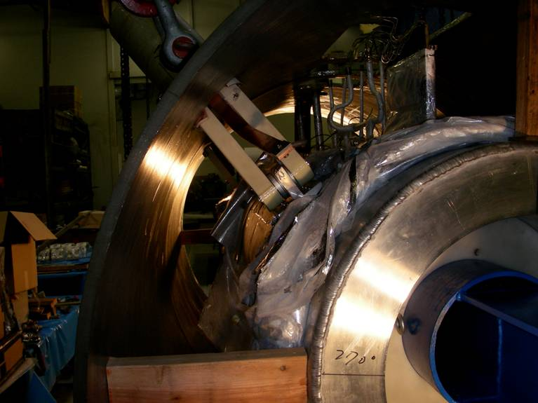
Mounting of Cold Mass Suppts
- Support bands are pre-tensioned
during cold mass alignment

Slide 22
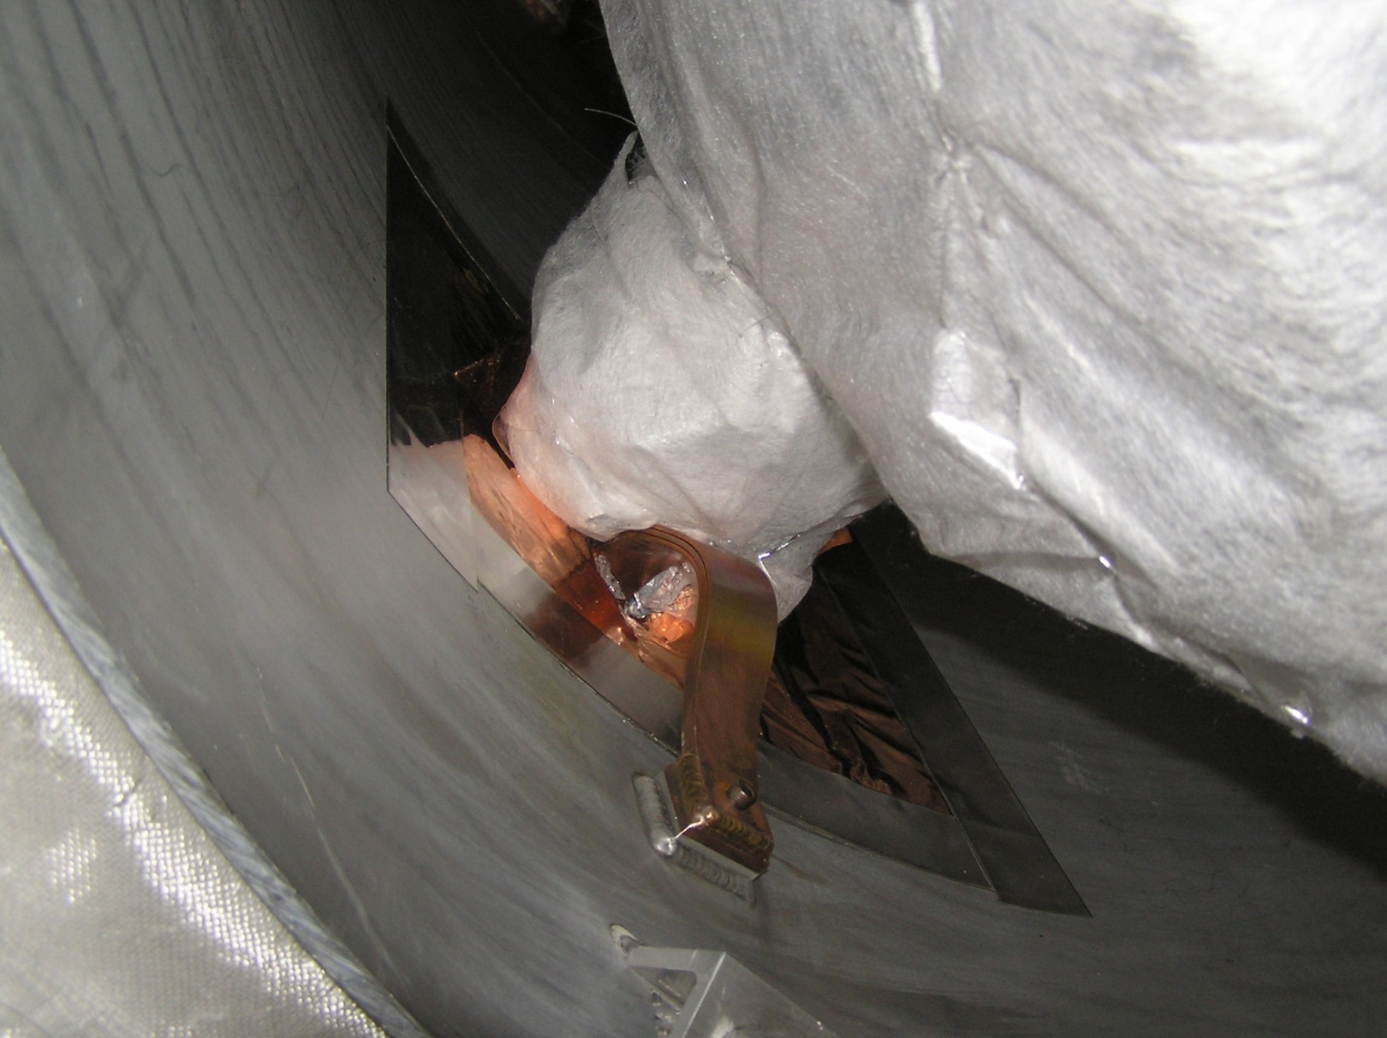
60K Support Band Intercepts

Slide 23
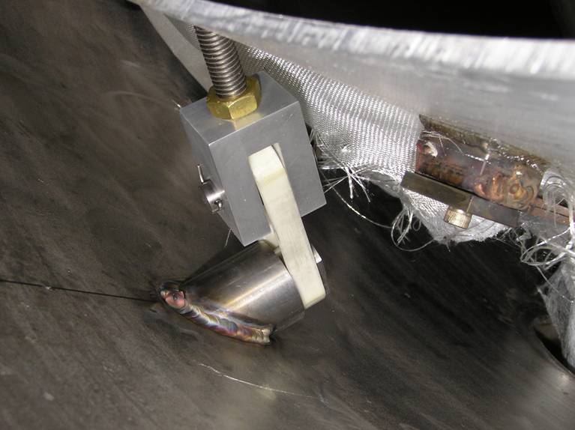
Thermal Shield Support Band
- Low heat leak fiberglass bands
support weight of thermal shield

Slide 24
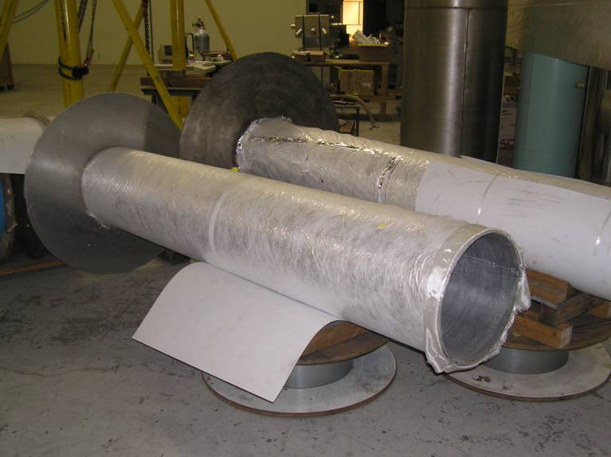
Thermal Shield Bore MLI Wrap

Slide 25
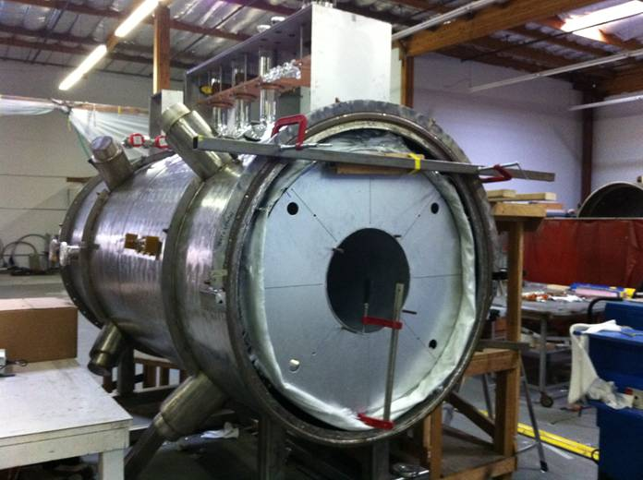
Shield End Plate Installation
- Shield end plates are welded to bore and outer tube
- Saw cuts in end plates minimize eddy currents

Slide 26
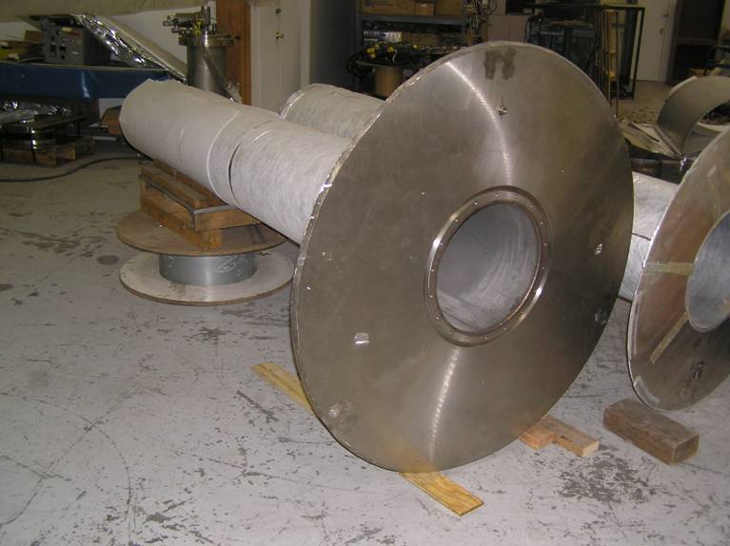
Vacuum Vessel End Wall/Warm Bore

Slide 27
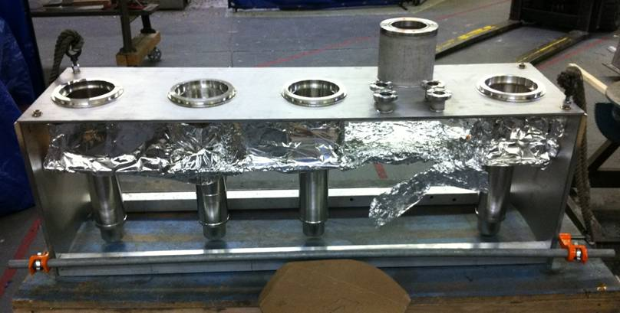
Benchtop Cooler Tower Assembly
- Drop in arrangement simplifies cooler installation
- Some heat leak in thin walled sleeves

Slide 28
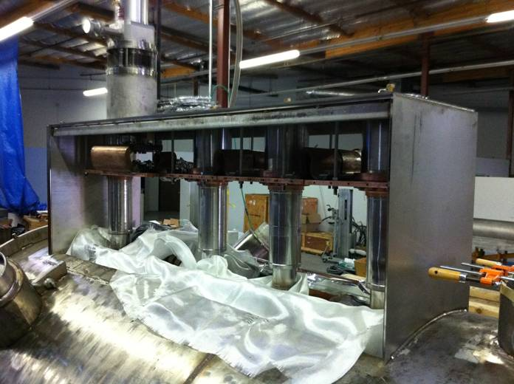
Cooler Tower Install on Vessel

Slide 29
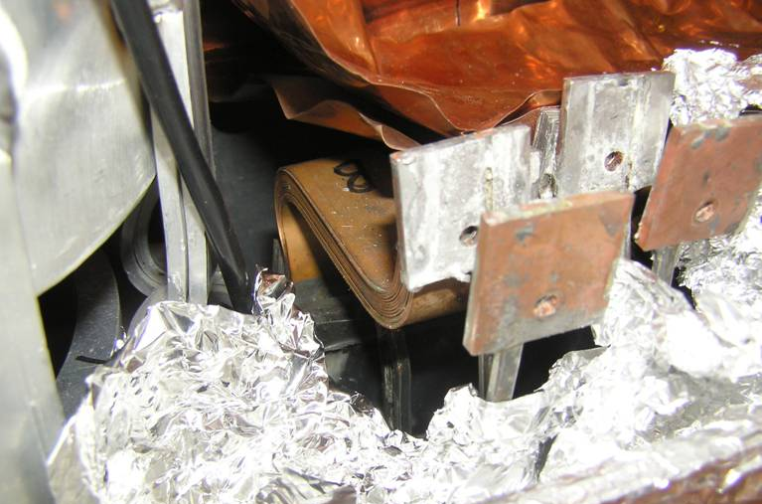
Thermal Intercepts for Lower HTS Leads
- Thermal intercepts to cold mass provide
cooling for bottom end of HTS leads

Slide 30
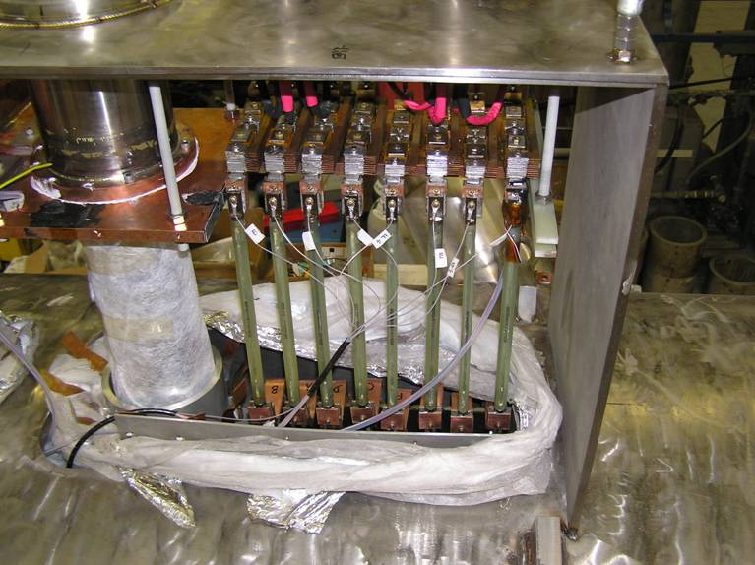
HTS Lead Installation
- HTS leads bolted and soldered at both ends
- Pre-installation tests ensure integrity

Slide 31
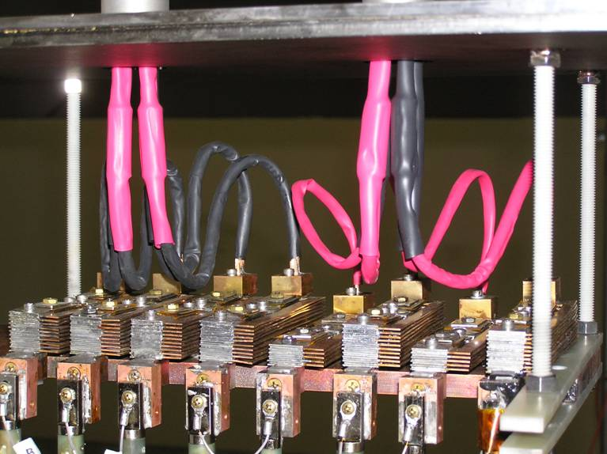
Warm Lead Configuration
- Warm leads optimized to balance
heat leak and resistive heating
- Heat intercepted at 1st stage plate

Slide 32
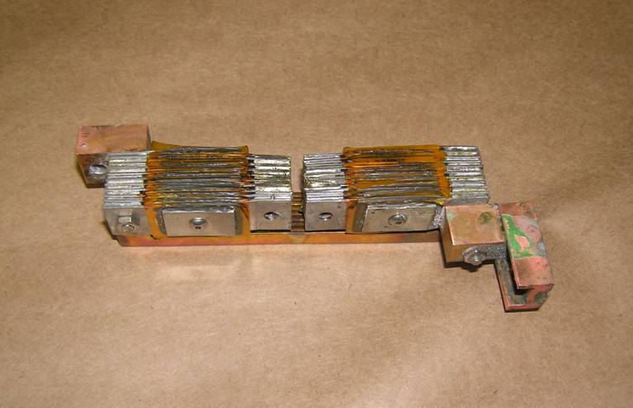
Upper HTS Lead Thermal Intercept
- Wang NMR designed double intercept
- Bypass leg provides current path

Slide 33
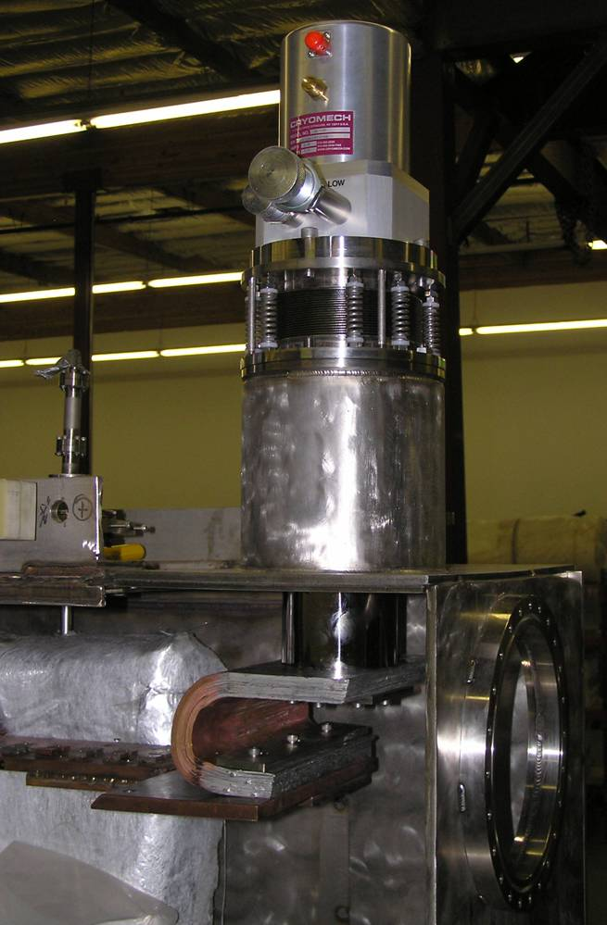
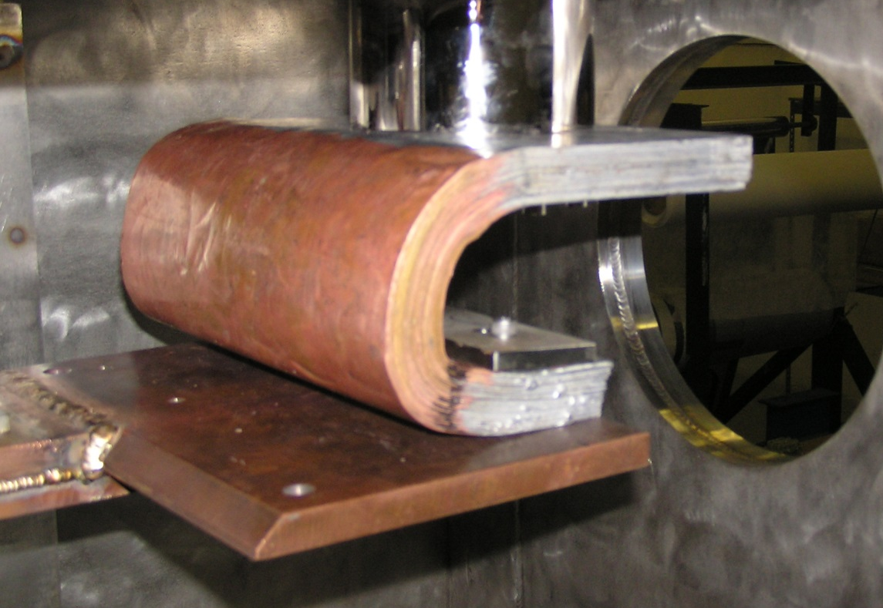
Single Stage Cooler for HTS Leads
- Single stage cooler directly protects HTS leads
- 175 W of cooling power at 55K

Slide 34
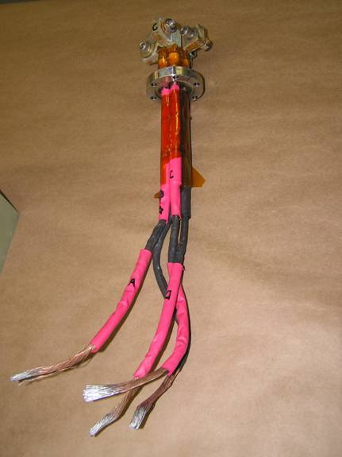
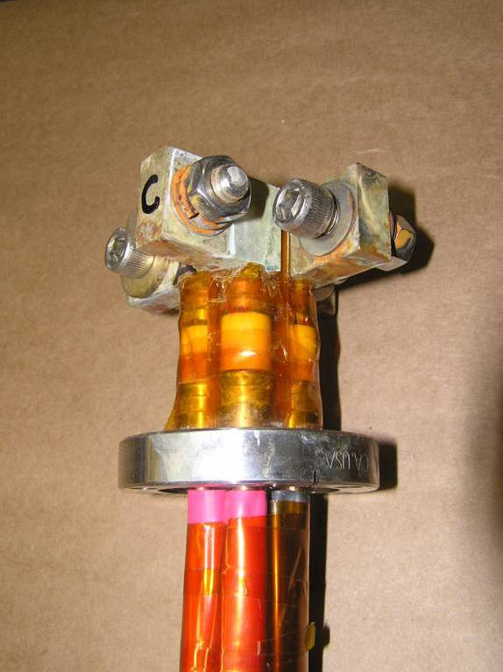
Warm Lead/Feedthru Assembly
- Ceramic feedthrus very fragile
- Technique developed for rapid replacement

Slide 35
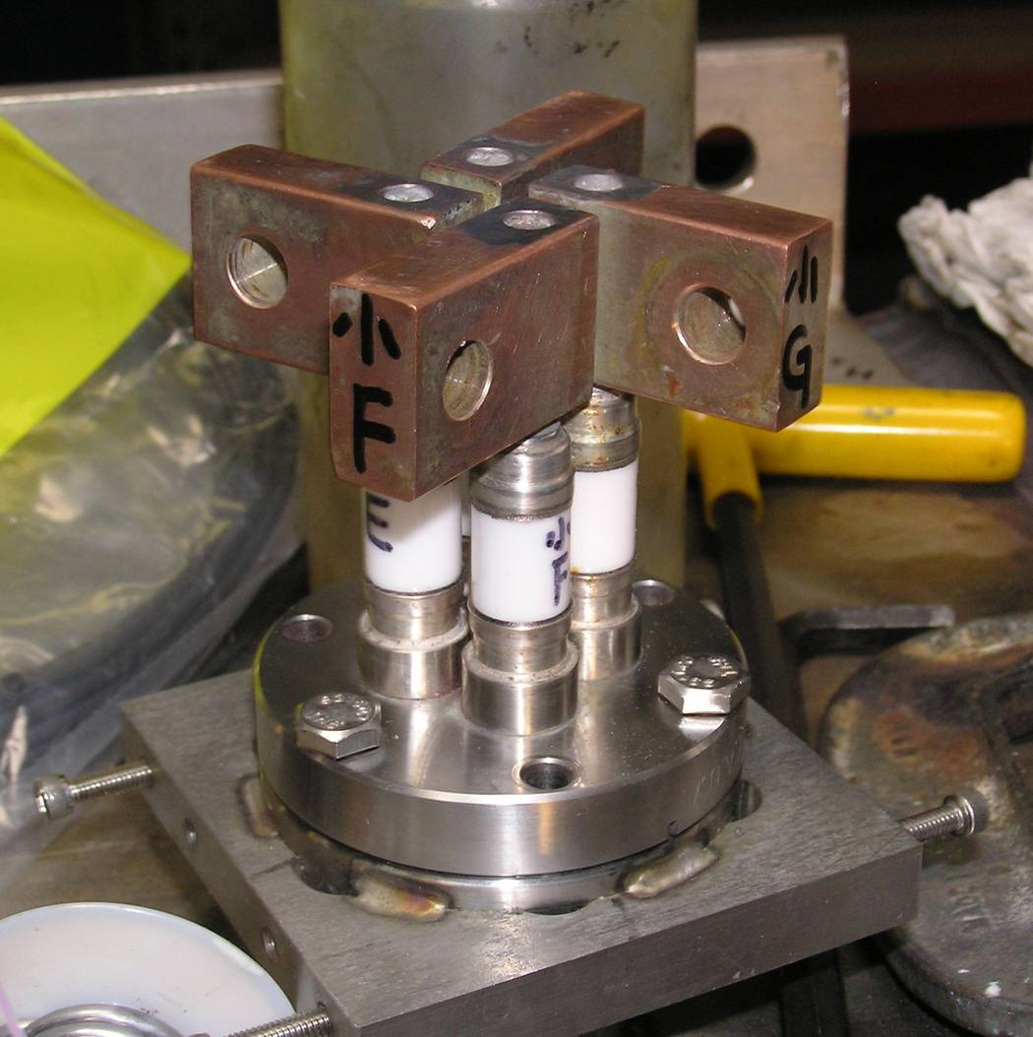
Power Feedthrus w/Copper Flags

Slide 36
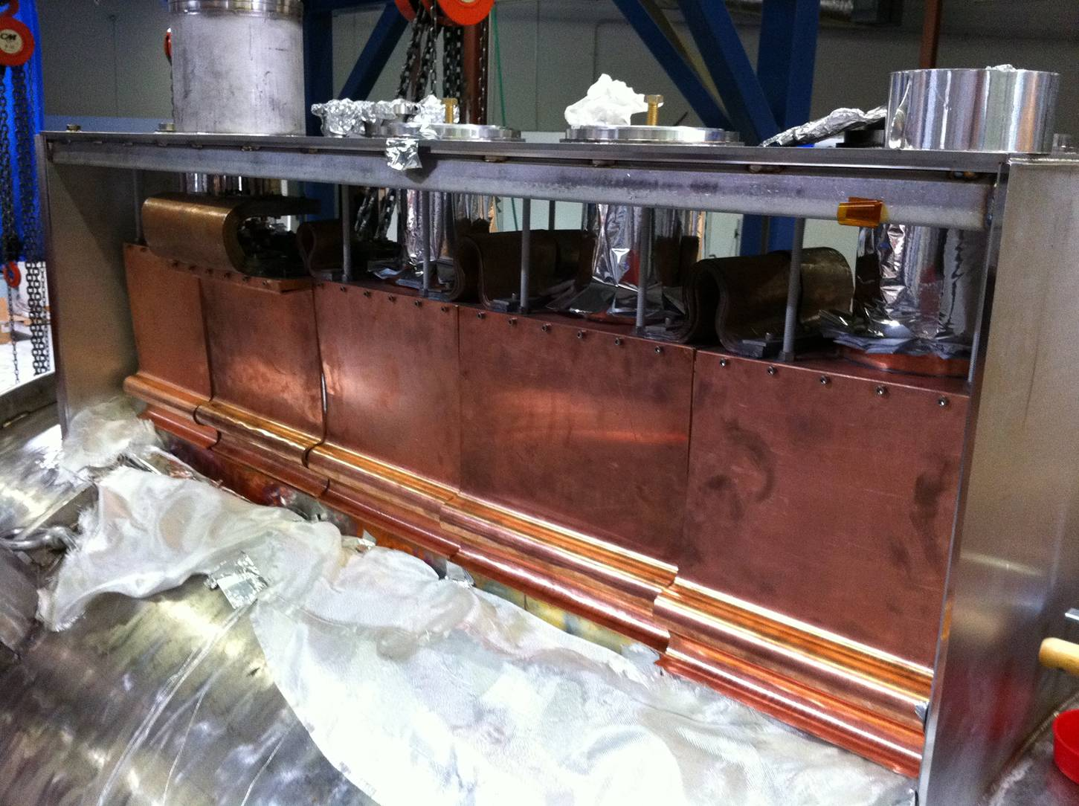
1st Stage Cooler to Shield Connection
- Layered copper sheets connect coolers to shield
- Also shields cooler sleeves from direct radiation

Slide 37
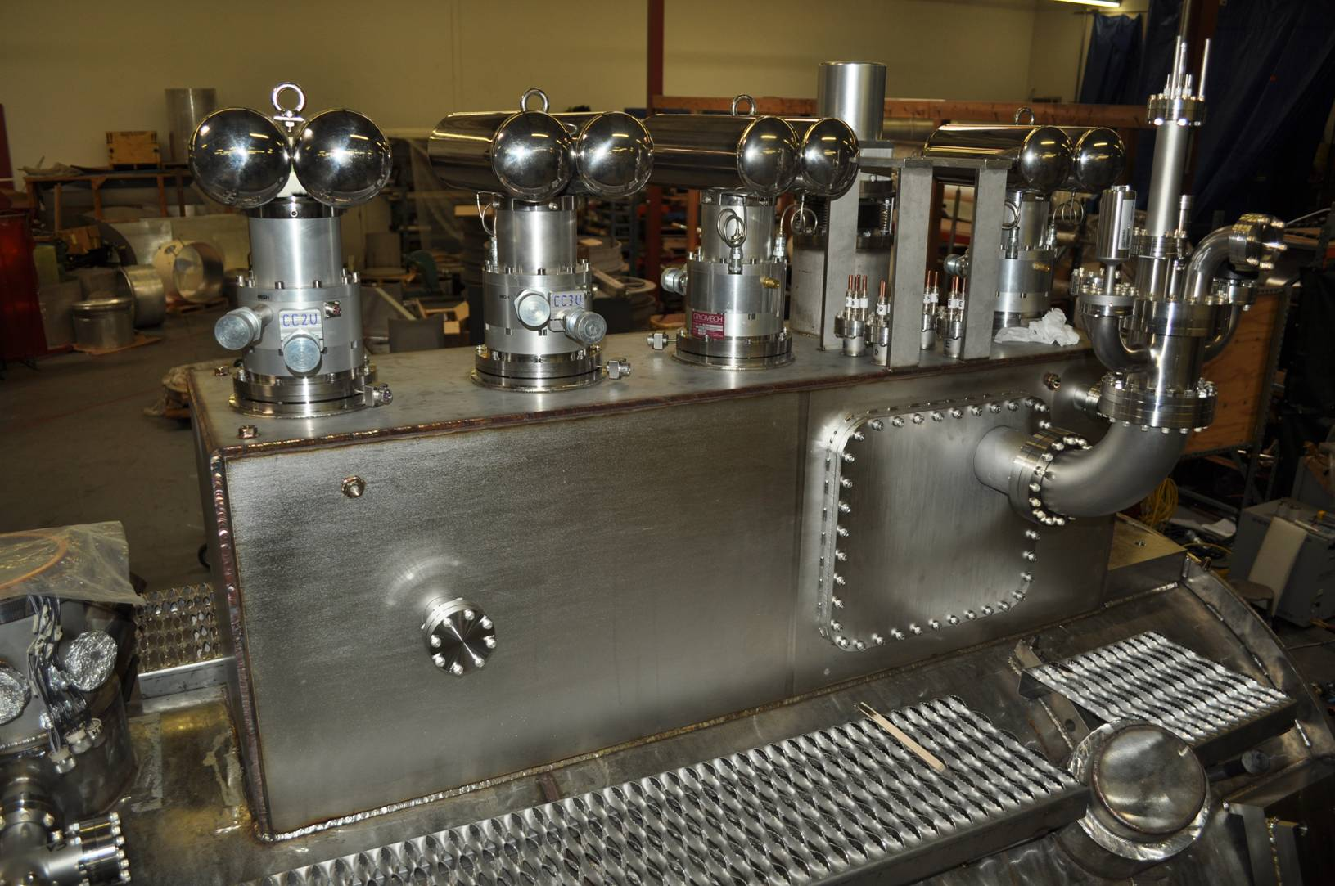
Completed Cooler Tower Assembly

Slide 38
Completed Magnet

Slide 39
Other Information
The two magnets shipped to RAL are virtually identical in design
SSU (1st magnet completed) performed better cryogenically than SSD
Wang NMR went thru several design iterations due to various performance deficiencies
LBNL and MICE collaborators took a lead role in the final design and assembly of the magnets

