Slide 1
Preliminary Schedule & Cost Summary for MICE ds Spectrometer Solenoid Magnet Repair
Peter H. Garbincius, Mark Palmer, Alan Bross, Rich Krull
MICE Spectrometer Solenoid Recovery Review
Fermilab
December 3, 2015

Slide 2
Balance Sheet - GOTTA FIX revised from Oct 15 RLS Review at RAL
Intended to use final carryover to support MICE Experiment Ops
does NOT include estimate for repair of ds Spectrometer Solenoid

Slide 3
Critical Assumptions
DOE support scheduled to end 30sept2017
Have SC wire – need to add glass insulation
Critical Path is Fabrication of new Cold Mass for downstream Spectrometer Solenoid
Continue to run MICE Step IV as long as possible without impacting critical path
Where will SS Repair work be done? at a US Lab or Industry or a combination?
The proposed plan of action will delay start of Final Cooling Demo by ~ 5+ months from Sept 6, 2017 to Feb 15, 2018

Slide 4
Estimates and Basis (page 1)
Warm-up, De-Install: $ 0 needed anyway, Step IV => Final Cooling
Transport RAL => ? Site $ 81 K
Remove Cold Mass from Cryostat $ 65 K LBNL estimate based on Wang experience adjust to FNAL Rates + 40% contingency
Fabricate New Cold Mass $ 1,679 K Fermilab TD estimate + 40% contingency
Re-Assemble $ 188 K LBNL est => Fermilab Rates + 40% cont

Slide 5
Estimates & Basis (page 2)
Transport: ? Site => RAL $ 75 K
Install, Pump, Cool, Train $ 0 needed anyway Step IV => Final Cooling
Power Systems modifications $ 90 K
Total Estimate = $ 2.175 M
Available Contingency = $ 1.942 M planned to be used for MICE Exp Ops
Estimated Shortfall = $ 233 K

Slide 6
Personnel Needs ~ 5 person-yrs

Slide 7
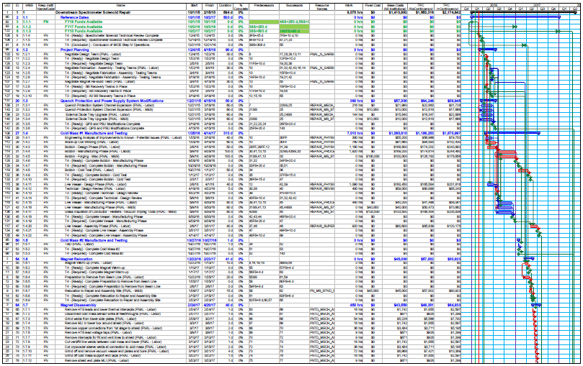
RLS – 15-12-01-MAP-SS-Repair2-1515 -page 1 of 2

Slide 8
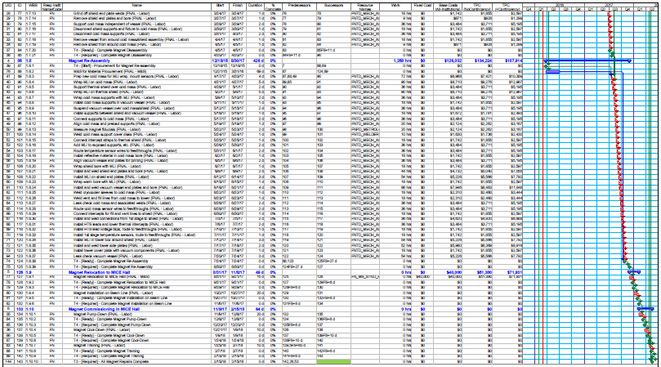
RLS – 15-12-01-MAP-SS-Repair2-1515 page 2 of 2

Slide 9
Preliminary Timeline Summary
2/15/2018
4/17/2017
full size E2 coil winding test - $ 132 K
need to procure shorter Al bobbin
not incl costs & time for cold testing
in parallel, don’t delay final design
duration estimate
time uncertainty, typically 40%

Slide 10
Waterfall Chart 15-12-01-MAP-Milestones-Waterfall-Repair2
The End!

