Slide 1
SSD Failure and Analysis
Alan Bross
Fermilab
December 3, 2015

Slide 2
Outline
Brief overview of spectrometer solenoids
Powering design
Power delivery – current leads/buses
Coil failure description
Diagnosis and analysis

Slide 3
MICE Spectrometer Solenoids
These magnets have had a long history and I will make NO attempt to review it in any detail here.
  Steve and Soren will fill in some of the details later
Both magnets met the full specification at the vendor and were fully mapped.
  Cryogenic operation was very good. Both magnets had significant cooling headroom (SS2 more than SS1)
SS2 (in upstream position of the beam line – SSU) has reached full operating current at RAL, but full training (soak, solenoid mode) has not been completed.
SS1 (in downstream position – SSD) had a lead failure during training.
I will review our analysis of the failure

Slide 4
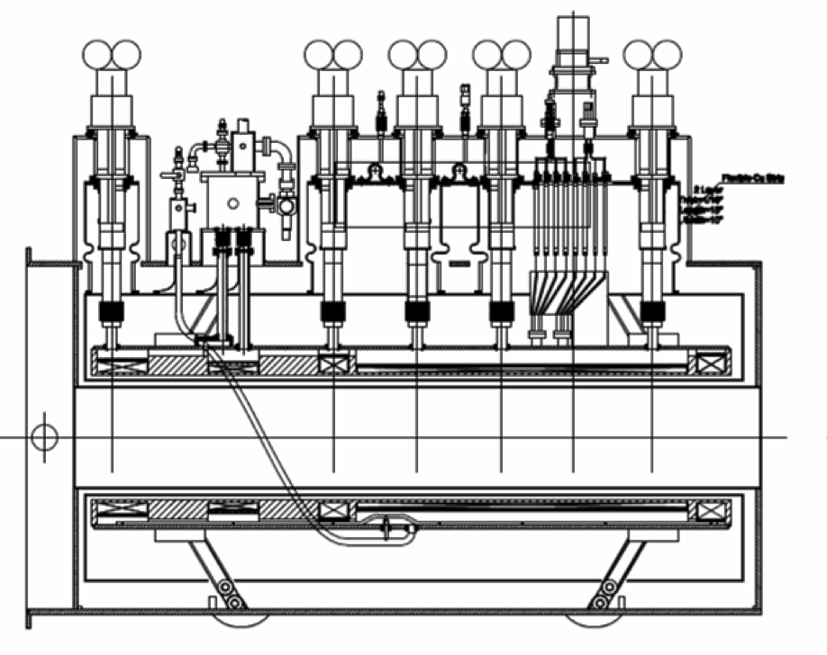
Reminder: Basic Design
5 2-stage CCs
1 single-stage CC
5 Coils
Max current ~300A
High inductance 10-40H
M1
M2
E1
C
E2

Slide 5
Power System

Slide 6
Power Delivery System
2 Vacuum feed throughs bring power into vacuum space
  One for ECE, one for M1 and M2
Copper leads to HTS
  IL/A = 3.6 X 10⁶ A/m
HTS:
  HTS-110 500A (M1, M2, C) and 250A E1 and E2
LTS:
  Vacuum feed through: Proprietary Wang design based on SSC superconductor
  Inside He space: Cu stabilized conductor

Slide 7
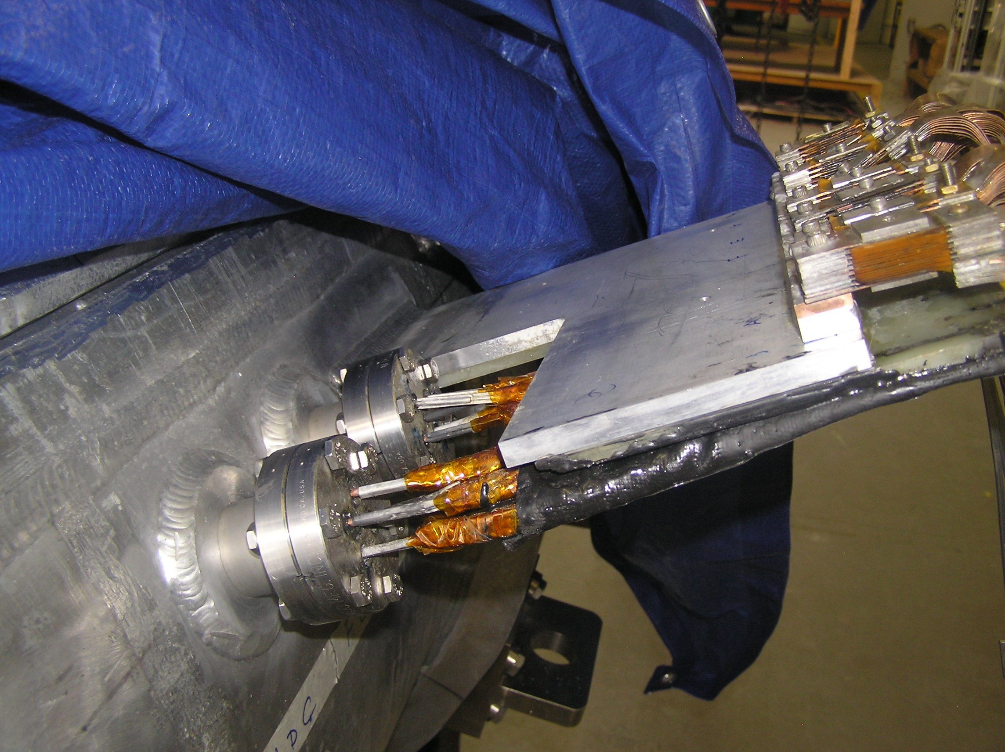
LTS Leads (Vacuum)

Slide 8
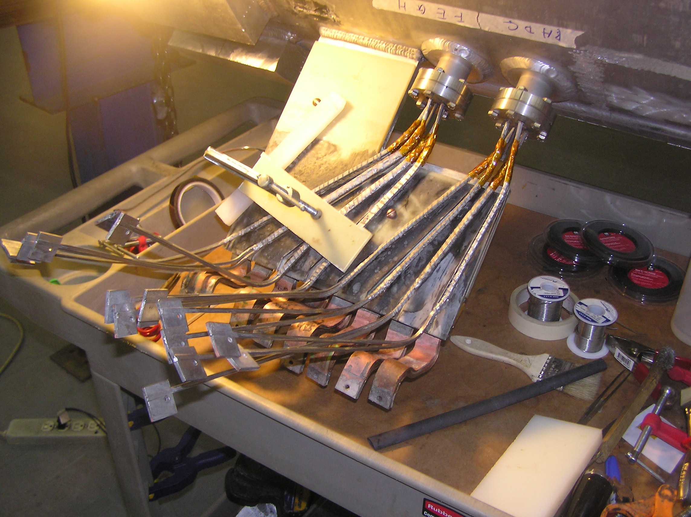
LTS Leads (Vacuum) Prep

Slide 9
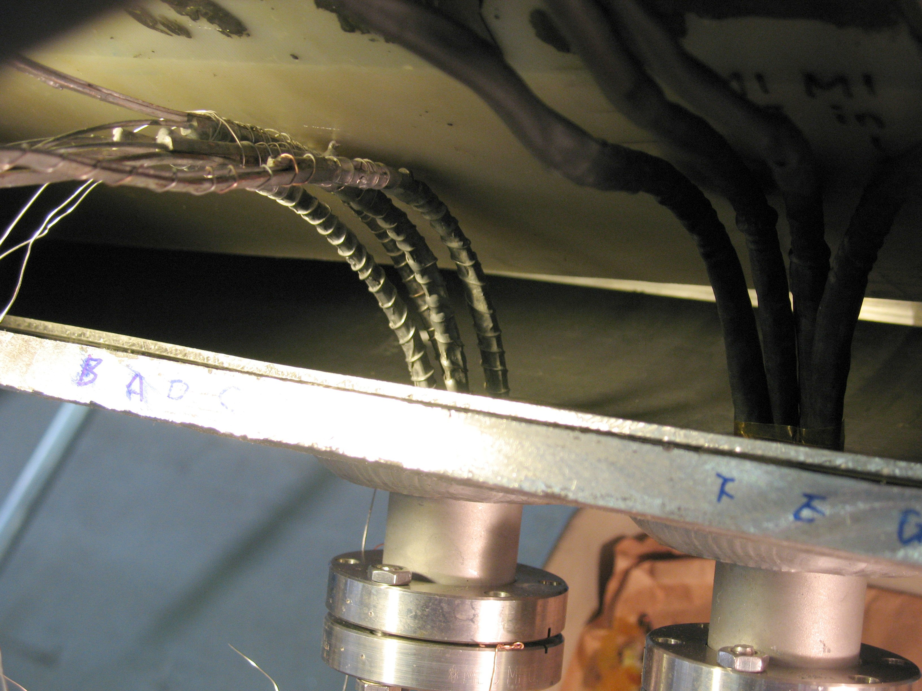
LTS Leads in He Volume

Slide 10
Training SSD
SSD has been a bit problematic at RAL
  Some vacuum issues
  Lost voltage tap on LTS lead of M2 coil
In the training run of September 13th, 2015 all was going very well
  Implementation of additional QP for the M2 lead had not yet been done, so a decision was made to ramp only M1 and ECE
  A quench occurred at ~ 260A in ECE (much higher than expected, next slide)
QP system performed as expected, nothing outwardly unusual except for the large current

Slide 11
Training History

Slide 12
Lead Failure
However, upon entering the hall the odor of burnt FR4/G10 was extremely strong. Strongest at He relief valve
A great deal of electrical analysis has now been done:
  DC measurements on all coils and voltage taps
    Both 2-wire and 4-wire
  AC measurements on all coils
  Measurements were done both at normal conducting temperature (~30K) and superconducting (4K)

Slide 13
Analysis
We now believe that (see diagram on next slide):
  One leg of M1 dead shorted to ground. This is LTSA lead.
  LTSB lead not connected to coil (open), but connected to LTSA with ~ 2.4 kΩ resistance.
  M2 coil OK.
  No damage seen anywhere else.
    However, M2 coil has 1.3 kΩ resistance to M1 (& ground)
  AC measurements show that QP on M1 not active indicating a break in the internal QP circuit. Most likely point is indicated in the figure on the next slide (x next to diodes) because there is another short to ground on this leg of the circuit.
  All other coils OK (including their QP circuit).

Slide 14
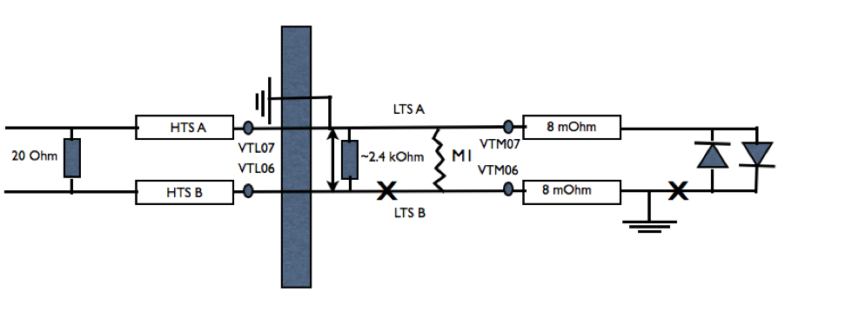
M1 Circuit After Fault
Diagram of the M1 circuit. Resistance (four wire and two wire)
measurements revealed:
i) Lead A has hard short to ground,
ii) LTSB is shorted to LTSA through 2.4 kΩ and LTSB is not connected
to the M1 coil on the Lead B side.

Slide 15
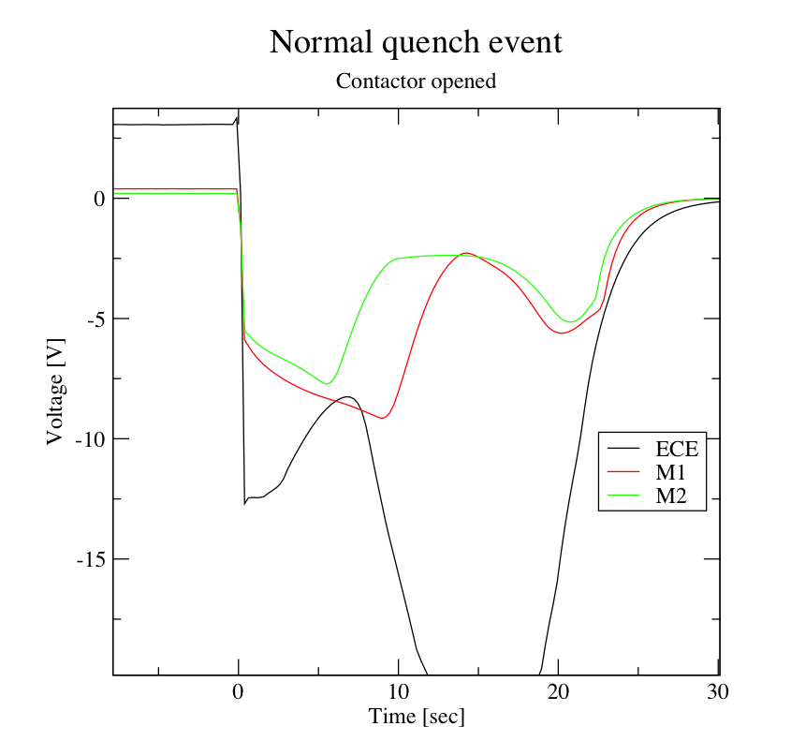
Normal Quench
These are data from a normal quench
  All coils ramping together to their design current
  NOTE: In this case, the quench occurred as the currents were ramping down
ECE initiated the quench (QP system detected and sent trigger to open contactors)
M2 followed, then M1
  As predicted.

Slide 16
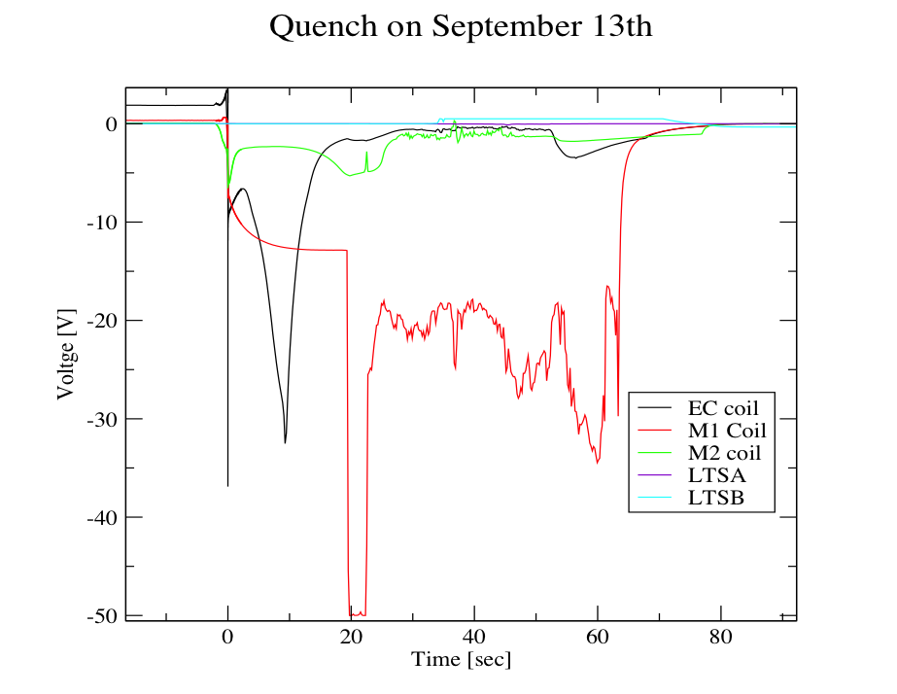
QP Data – M1

Slide 17
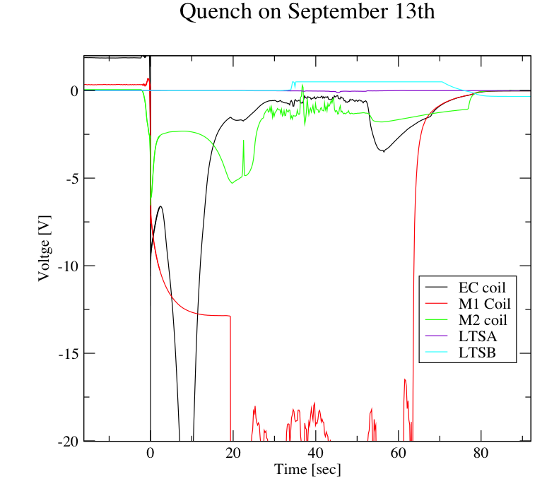
QP Data – M1
Expanded V Scale

Slide 18
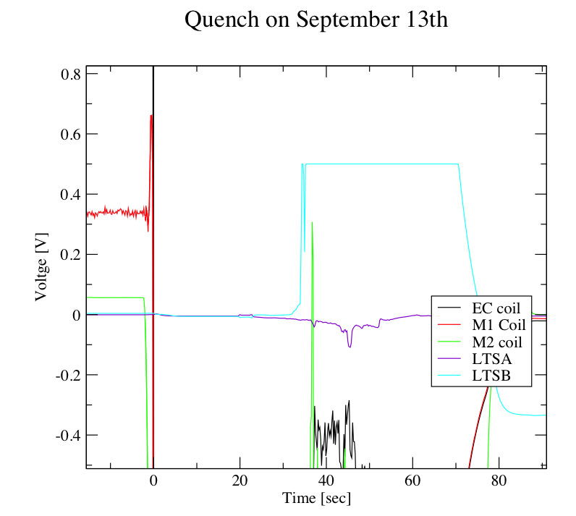
QP Data – M1
Expanded V Scale II

Slide 19
Analysis
Quench initiated on ECE and initially proceeded normally
  There is no evidence that any LTS leads were involved initially
At ~ 20 sec, a connection to the internal diode pack for coil M1 failed
  The voltage on the coil increased rapidly and, it appears, that an arc at the LTS power feed through (from vacuum to LHe volume) occurred which burned out the lead and affected M2 (the power leads for M1 and M2 utilize the same 4 pin feed through).
What caused the QP failure?

Slide 20
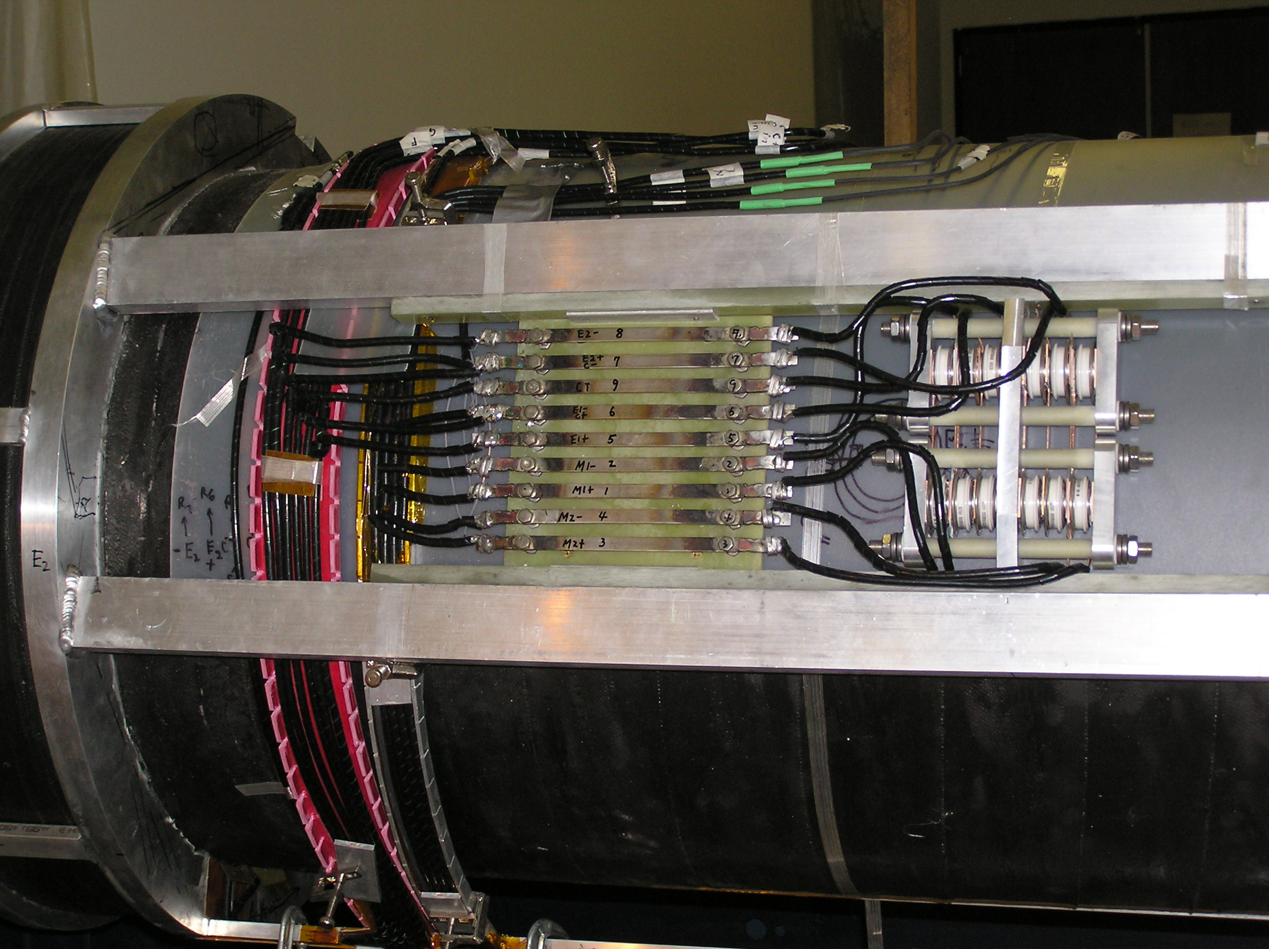
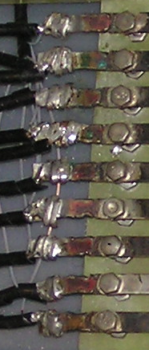
Internal QP
Original Wang Configuration

Slide 21
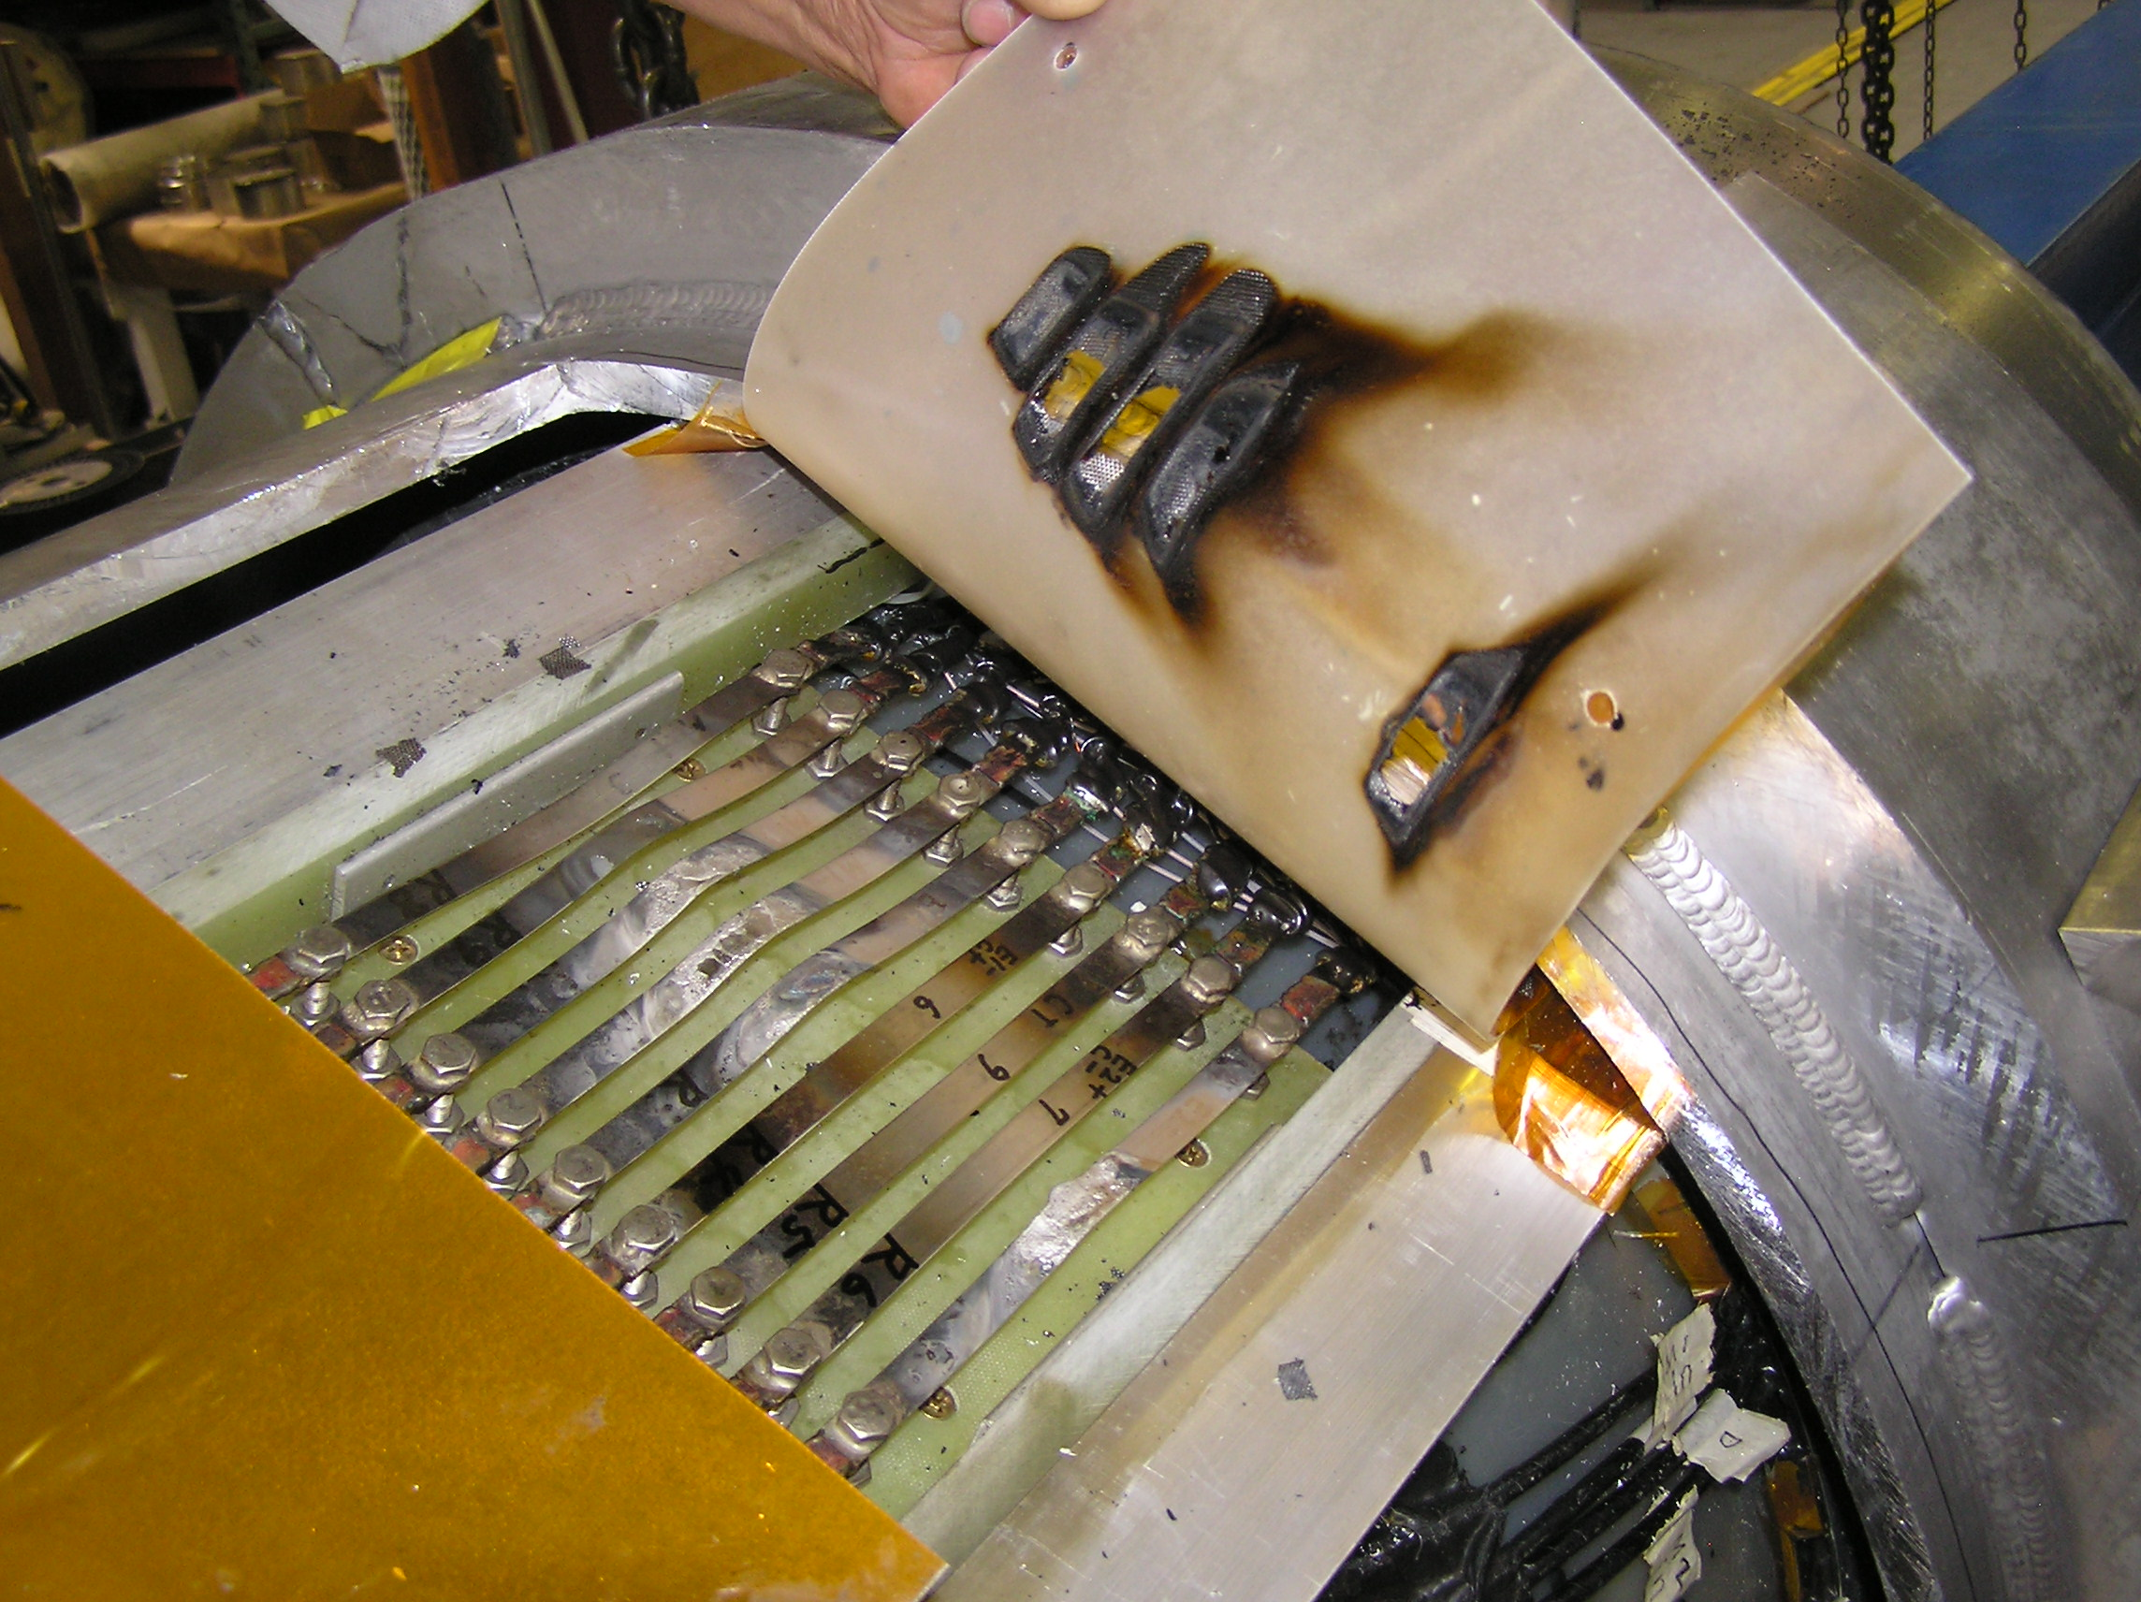
We have had previous issues

Slide 22
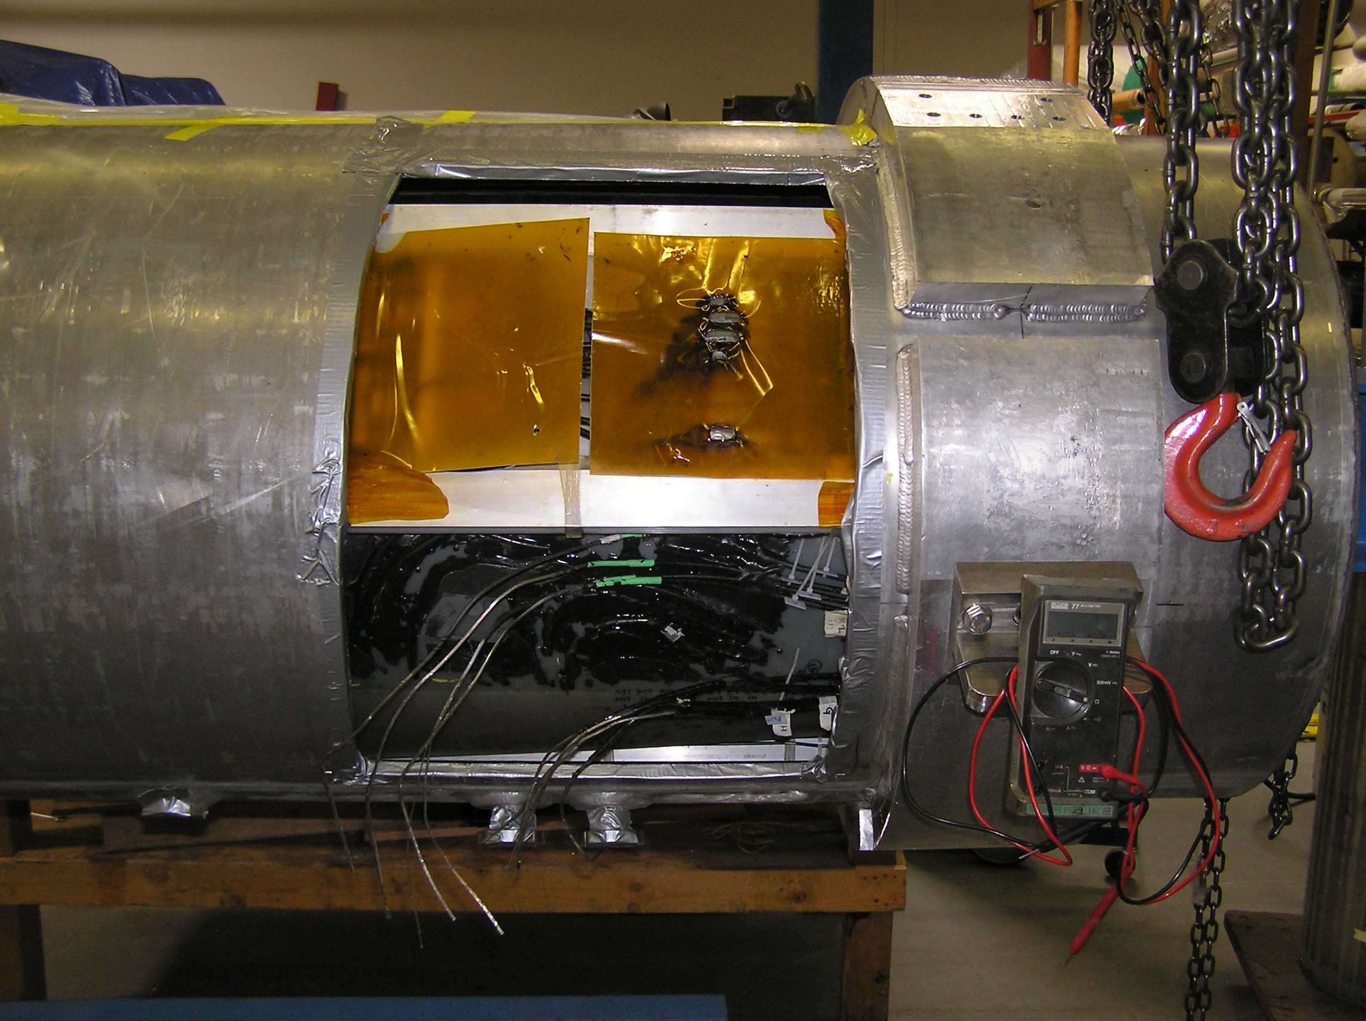

Slide 23
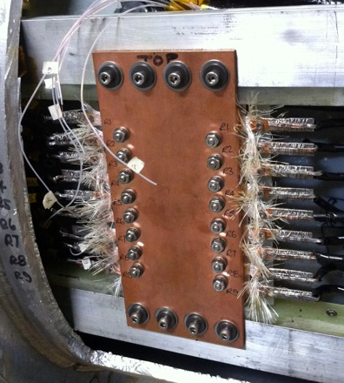
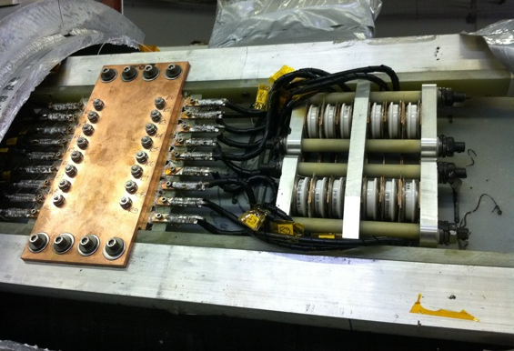
LBNL Re-design
Picture of final configuration for SS2/SSU
Conductively cooled resistors
Quench protection circuitry
Diode Pack

Slide 24
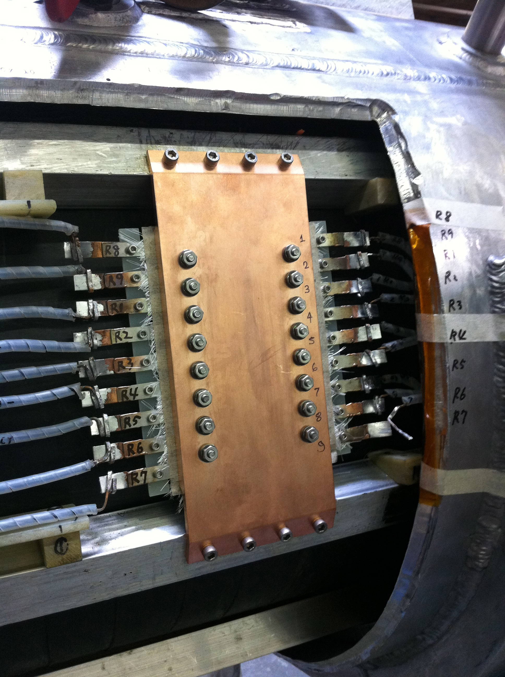
SS1/SSD
This is a photo of the QP pack for SSD/SS1. What is not known at this time is exactly how the terminations were made. Wang did not appear to follow the procedures used on SSU/SS2.
Diode Pack

Slide 25
Normal Quench
These are data from a normal quench
  All coils ramping together to their design current
  NOTE: In this case, the quench occurred as the currents were ramping down
ECE initiated the quench (QP system detected and sent trigger to open contactors)
M2 followed, then M1
  As predicted.

Slide 26
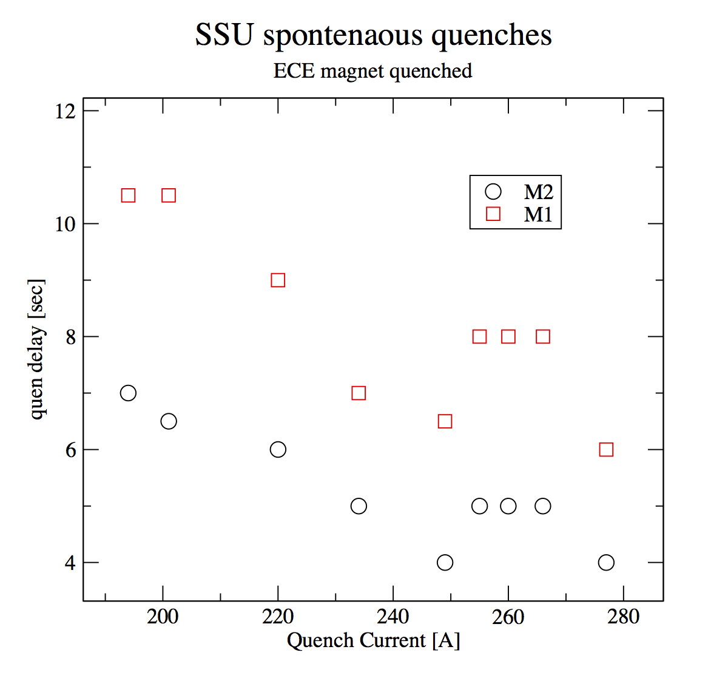
Quench Delay
M1 & M2

Slide 27
Quench Propagation Analysis Without M2 Powered
Case I
Case II
Compared the results with (Case I) and without (Case II) M2 powered.
Quenches were initiated in E2 in both cases.
The quench current in Case I is 265 A in all coils.
In Case II, the quench currents in ECE and M1 are 260 A and 250 A, respectively.

Slide 28
Quench Delay
Time to Q for M1 increased by ~ 2X
However, overall scale in simulation does not agree with data
  There is a qualitative understanding
    LHe & gas not modeled exactly
    The thermal properties of the mandrel + insulation between coils and the bobbin are not precisely known
    The starting location of the quench will affect the heat propagation from the hot spot to the mandrel, this will cause time difference. The model is always set so that the innermost layer initiates the quench.
Given the above, there is qualitative agreement:
  The quench delay of M1 increased by ~2X, from 10 seconds to 20+ seconds.

Slide 29
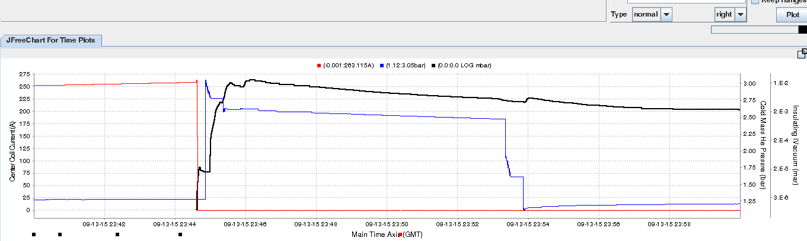
Pressure “burp”
Pressure rise in vacuum space was the largest we have ever seen
  P reached ~ 1 X 10⁻² mbar
  Typically go into the 10⁻⁶ to 10⁻⁵ range
Indicative of significant heating of the feed through
  Cu gasket conflat flange

Slide 30
Moving Forward
Can obtain lattice to allow MICE Step IV running without SSD M1 coil. However, limits momentum scan
Harder when RF is added
  Impossible?
However, risk that a M2 lead will fail must be considered high at this point
  M2 has been powered at low current (5A) and all looked good.
Risk that there is a catastrophic failure of the LTS power feed through is also high
  Unrecoverable total magnet failure. Must then repair.

