Slide 1
MICE Spectrometer Solenoid
Electrical System
Soren Prestemon
FNAL, Dec. 3, 2015
Most of the content has been gathered from
work/slides by John Joseph, Heng Pan, Vladimir Kashikin

Slide 2
Outline
General electrical layout
  Original design
  Modifications in the last years
Magnet protection design
  Review of protection strategy
  Strengths and weaknesses
Modeling of protection scenarios
  Model assumptions and limitations

Slide 3
Simplified PS System Block Diagram
Slow Control Functions
  Ramp Rates
  Contactor switching for ramp cycles
  Status Monitoring
    Voltage
    Current
    Temperature
  Direct control of all PS Units
QDS Functions
  Real time Quench Detection
  Contactor switching for fast discharge
  Real time system status monitoring
Power Supply Slow Control System
Magnet Coil Power Supply
Rack
Power Supplies
for the
Center Coil &
Matching Coils
Quench Detect System

Slide 4
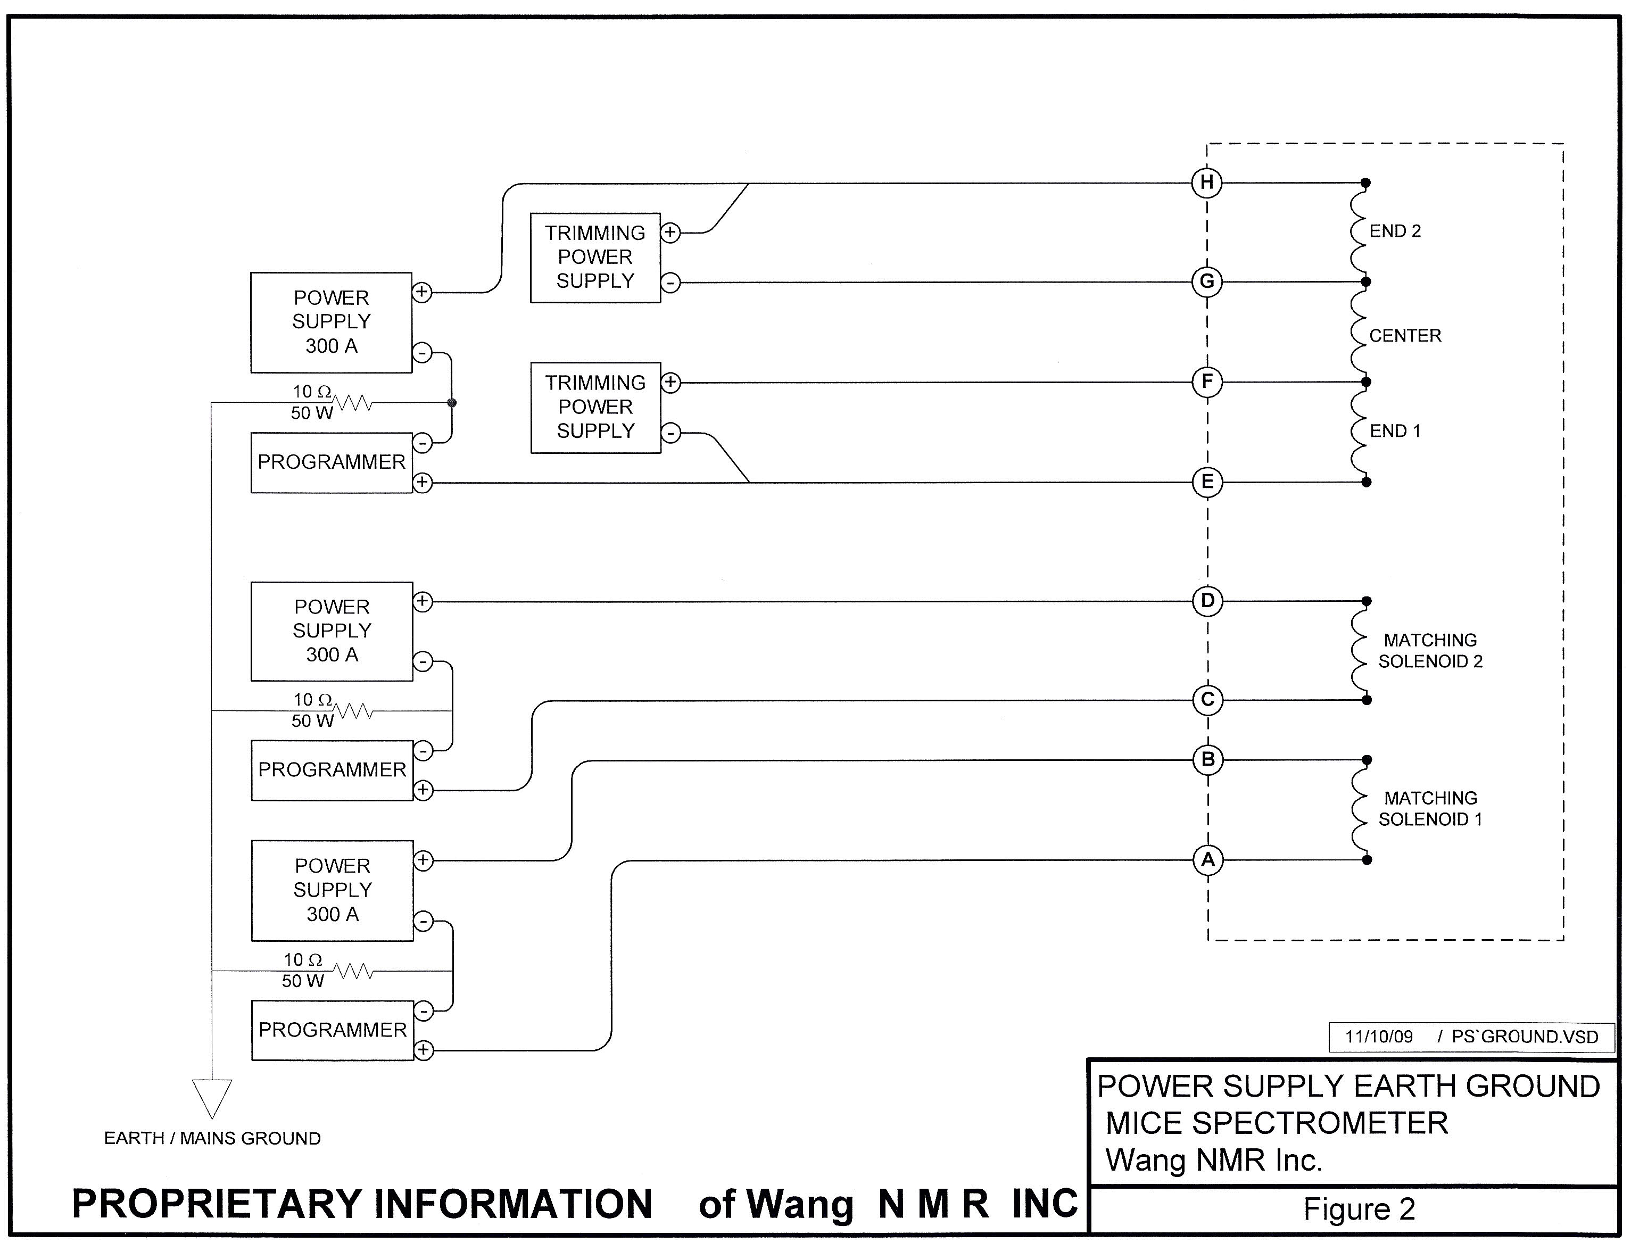
Primary PS Rack Components and Loads

Slide 5
LBNL/MICE: DC PATH - Simplified
Added 5 contactors to system
  HTS Lead protection during fast discharge

Slide 6
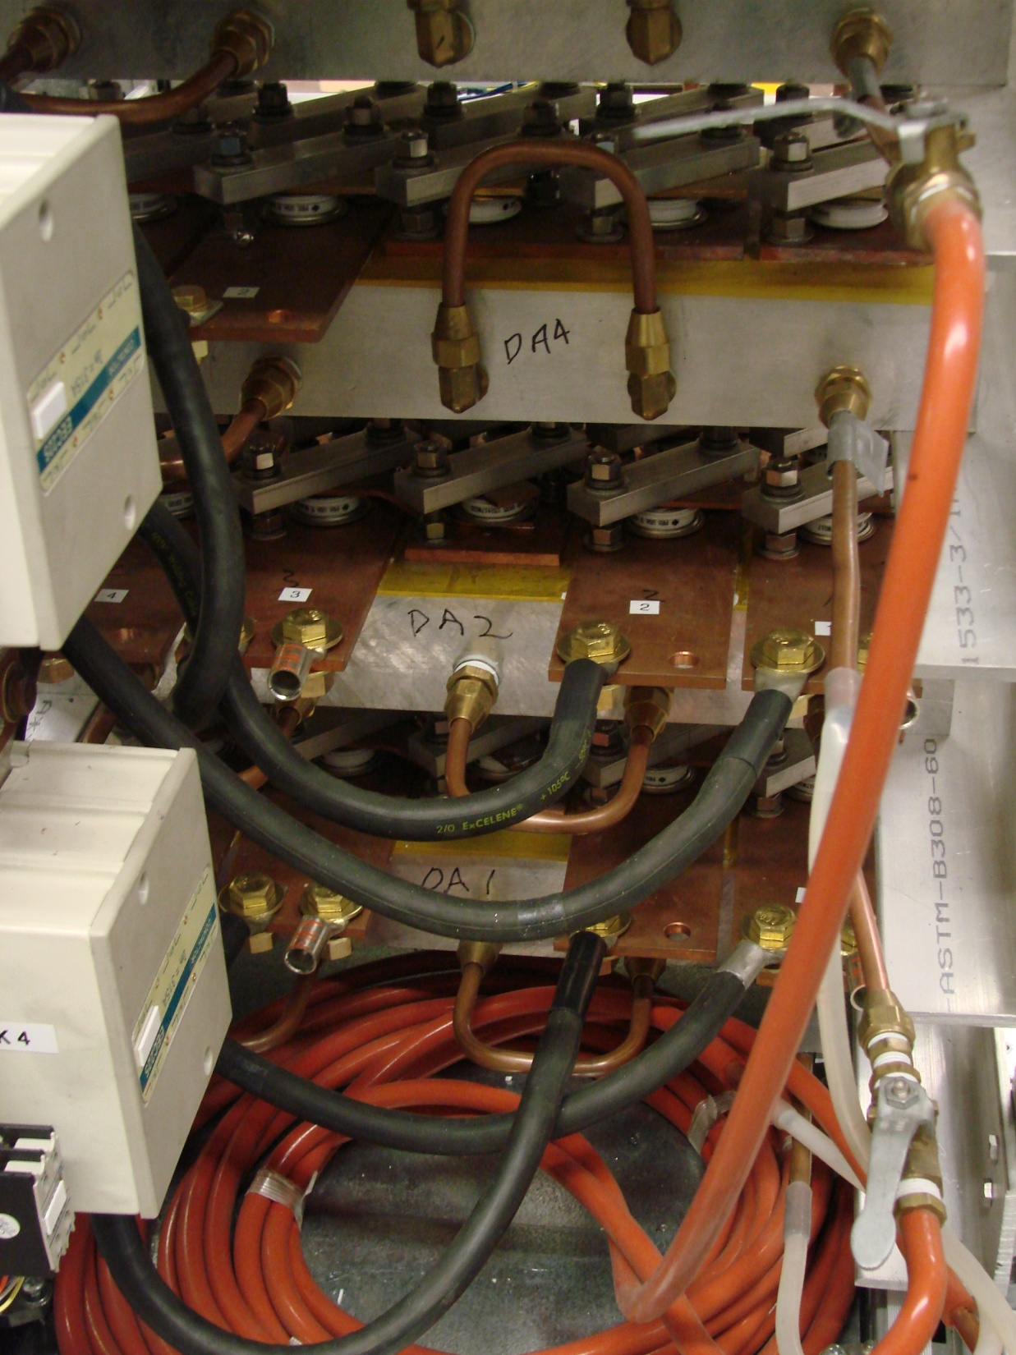
Energy Absorber Assemblies
Plumbing for Water Cooling of Energy Absorbers
4 Energy Absorbers
  Required for slow ramp down of coils
  2 diode assemblies per absorber circuit
    1 DA always dissipating power into air & water
  2 water circuits available for cooling

Slide 7
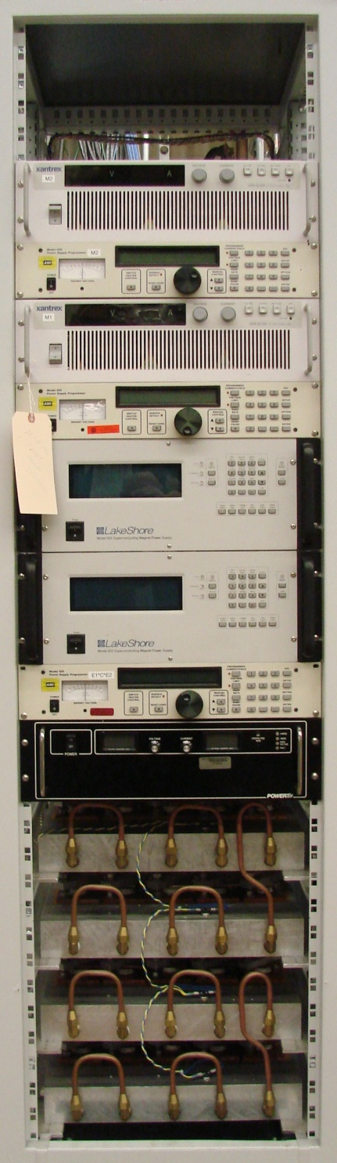
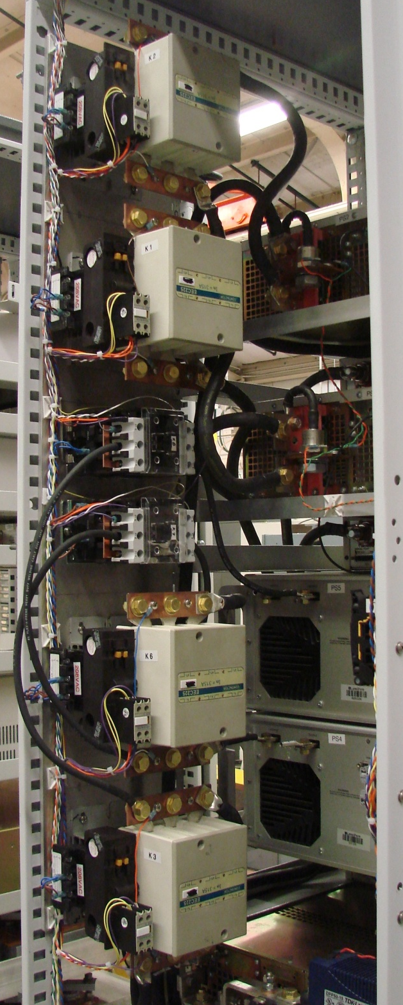
POWER SUPPLY RACK CONFIGURATION
FRONT VIEW
K2
MS2 300A PS
MS1 300A PS
K1
EC1 60A PS
K7
EC2 60A PS
K8
CS 300A PS
K3
EA - DA3
EA - DA4
EA - DA2
K6
EA - DA1

Slide 8
Summary of Changes Implemented @ LBL
Redesigned system to improve HTS Lead protection
  Additional contactors to isolate coils from power supplies during fast ramp down and enable in-cryo coil protection
  Adding 2nd Solid State Relay to handle increased Contactor pickup current
Reconfigured rack to optimize DC cabling
  Improved physical separation of AC and DC wires
  All Contactors physically close to associated supplies
Moved all AC wiring above water cooling circuits
Replacing 15 VDC PS with 24 VDC PS for interlock circuits
Replaced all control and monitoring wiring
  Bundled twisted pair

Slide 9
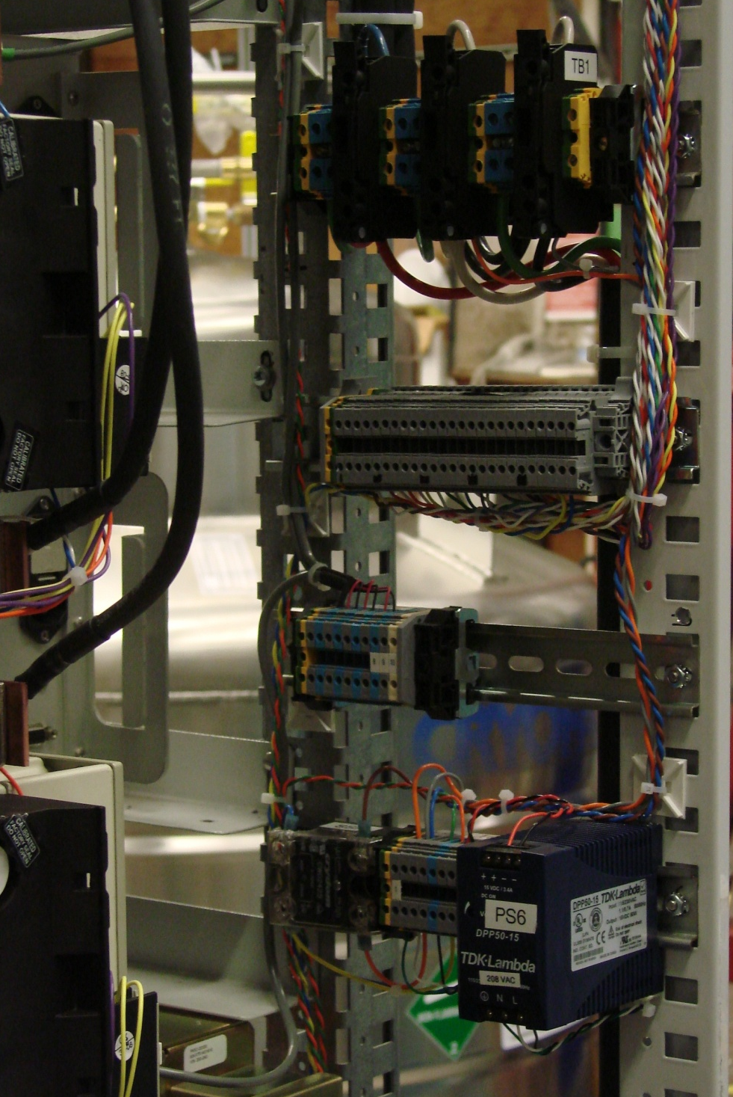
Power Entry, Control, and Monitoring
TB1
208 VAC 3-PHASE
Power Entry
TB4
Status Monitoring
K1 - V_{DROP}
K2 – V_{DROP}
K3 – V_{DROP}
K4 - V_{DROP}
K5 - V_{DROP}
K6 - V_{DROP}
K7 - V_{DROP}
K8 – V_{DROP}
CONTACT STATUS
PS TEMP SENSORS
TB4
Status Monitoring
TB2
PS Voltage Monitoring
SSR, TB3, PS6
Interlock & Contactor Control

Slide 10
Magnet Protection

Slide 11
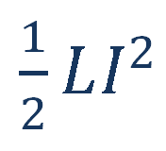
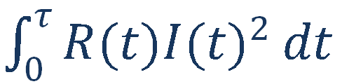
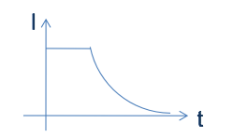
Magnet Protection: basic scenarios
Magnetic energy
Quench
Normal zone growth
Detection
Converted to heat by Joule heating
Power supply switched off
Trigger protection options
Protection heaters
Extraction
Quenchback
Current decay in the magnet
The faster this chain happens the safer is the magnet

Slide 12


Current decay/Hot spot correlation: the concept of MIITs
Basic energy conservation
  Energy deposited by Joule heating inducing an increase in temperature based on the specific heat of the materials
  With the assumptions that:
    Joule heating only produced by stabilizer (Cu)
    Heat capacity of conductor and insulation
    Adiabatic condition: no longitudinal heat transfer
By evaluating the MIITs from the current decay, we obtain an estimate of the hot spot temperature T_{max}

Slide 13
MIITs calculations:
Weak points are where leads/busses lack stabilization
If busses stabilized as described in design documents, they are OK
Limiting components are feedthrus, unstabilized sections

Slide 14
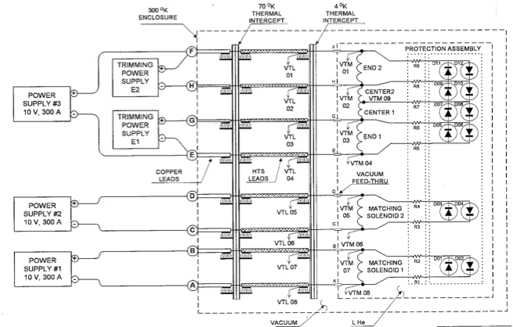
Original Spectrometer protection circuit

Slide 15
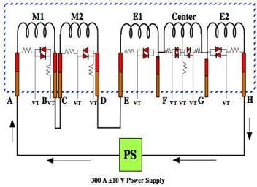
Protection circuit: test condition example
Circuit with most stored energy
If a quench occurs in E1:
  Current shunts via diode+resistor across E1
  Coil current in E1 decays
  Coil currents in neighboring coils increase
    Due to mutual inductance
    Generate bypass currents
  Other coils either…
    Quench - very likely, due to quenchback
    Remain superconducting
      Unlikely except for very low-current quench, when
        significant margin is available
        Energy in quenched coil is insufficient to boil off stored helium
      Current continues to decay due to bypass resistance, but with very long time constant

Slide 16
Review of Spectrometer protection circuit
System is passive
  No “need” to trigger any circuitry
  Bypass resistors allow each coil / coil section to decay at their own speed
  Reduces hot –spot temperatures, peak voltages
But…
  No direct ability to initiate quenches(!)
  Bypass resistors cannot serve as full energy absorbers
    They “buy us some time” for quenchback to occur
What we want:
  A system that protects coils well during quenches (e.g. training)
  A system that avoids damage to the cold mass during serious faults

Slide 17
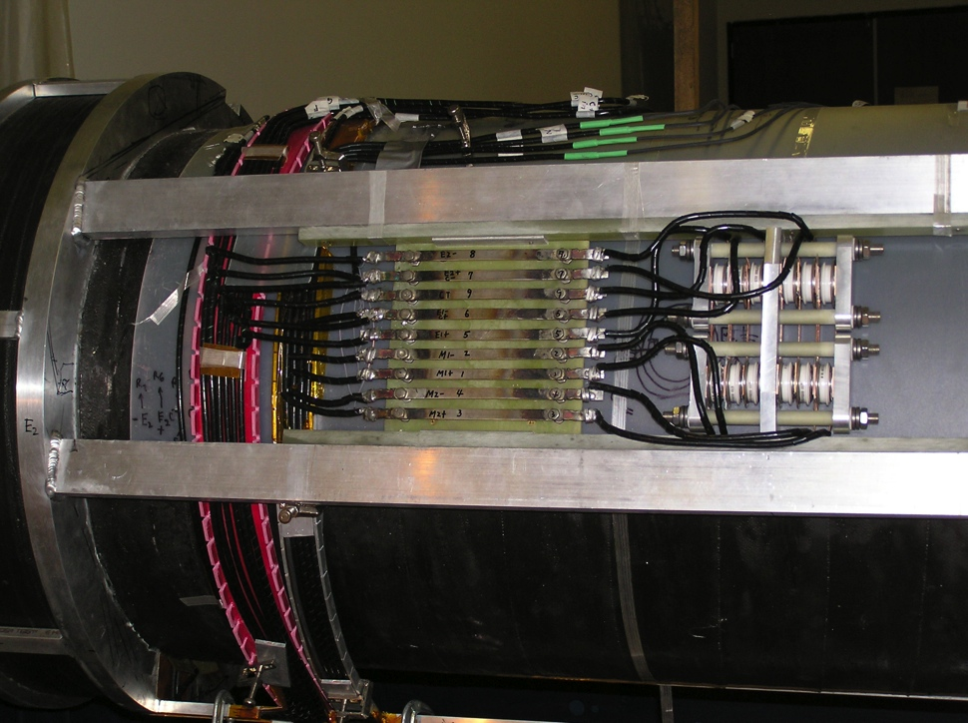
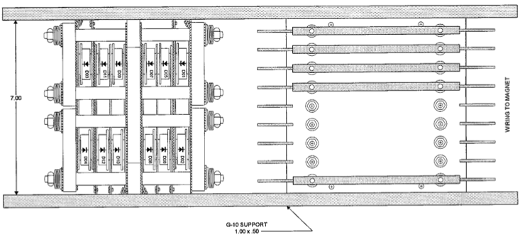
Protection circuit: diodes+resistors
>3V forward voltage drop (needs to be measured cold)
  Forward voltage drop decreases as temperature of diodes increases
Resistor: strip of Stainless Steel
  Designed to comfortably support bypass current during “normal” quench decay (~6s)
  Temperature rise during ~6s decay is <~300K

Slide 18
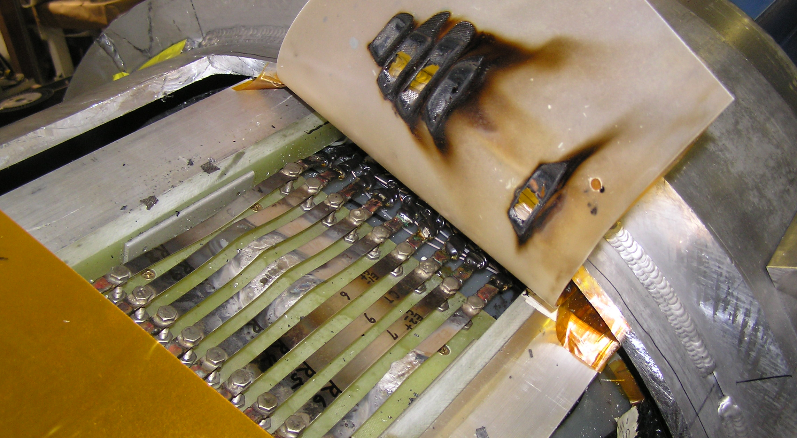
Previous issue (see Alan Bross talk)

Slide 19
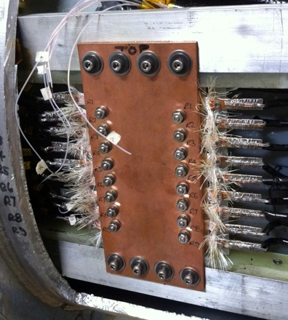
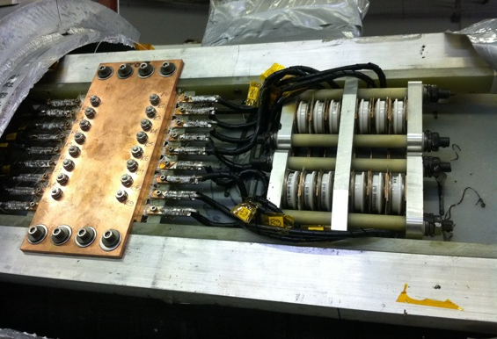
Updated Quench Resistor Heat Sinking
Provide a path for thermal transport from resistors to cold mass:
  Simple design that minimizes risk to resistors
    Avoid shorts
    Avoid significant deformations
    Allow resistors to flex
  Capable of transferring ~1.5kW DC with “reasonable” dT
    Example: dT=300K, Cu plate, 15cm long =>A=15cm²

Slide 20
HTS leads
Protection concept:
  First: avoid quench by providing margin!
    No energizing until high-end temp. sufficiently low
  Second: trigger spin-down if issue arises
    Interlock PS to high-end temperature
    Interlock PS to voltage drop
  Third: make access to HTS leads “reasonable”
    And design protection to avoid damage to cold-mass in case of such faults

Slide 21
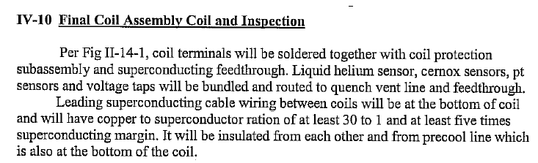

Potential areas of weakness
Busses (e.g. coil to protection)
Feedthrus (esp. entering Lhe space)
Bypass resistors
Diode assemblies
Solder joints
Should have Cu:SC>30, Jop<Jc/5
Note: protection resistors cannot serve as a dump! They can only serve to provide some time delay for quenchback to occur.
Joint area of potential concern

Slide 22
Quench modeling

Slide 23
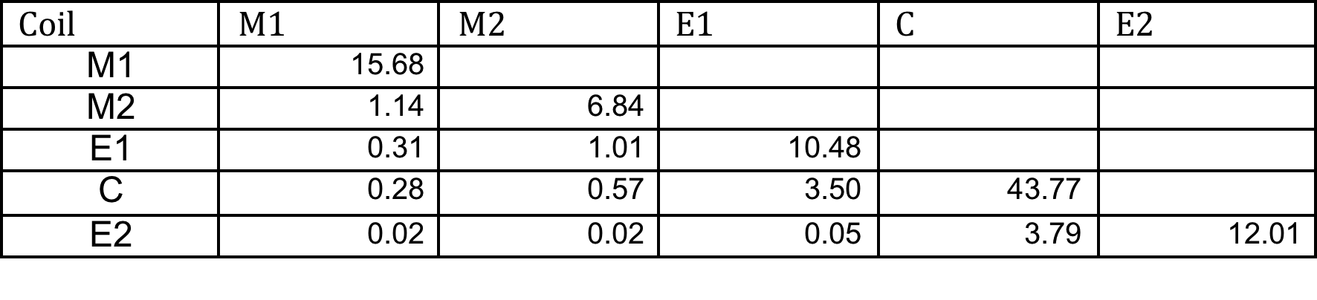
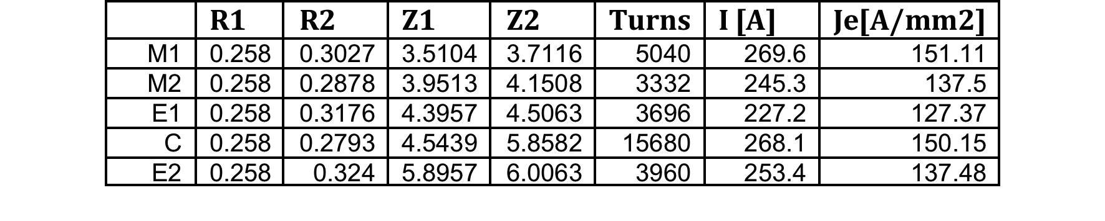
Simple Wilson-code calculations
Basic input parameters:
  Cu:SC=3.9
  Fractional areas: Copper: 69%; SC: 17.7%; insulation: 13%
  Area of unit cell (1 turn): 0.0178 cm²
  Relative transverse propagation velocities: 1%
Turn and geometry info
Inductance matrix

Slide 24
Wilson code results
Note: transverse propagation was “tweaked” to ~match 5s decay time for case “C alone”
  Sensitivity of derived values, e.g. Tmax and Vmax, is not strong
  Peak dI/dt~40A/s

Slide 25
3D simulations
Limitations of “Wilson code” simulation:
  Does not consider mutual coupling and full electric circuit
  Does not take into account quenchback from mandrel heating
  Does not provide means of determining turn-to-turn or layer-to-layer voltages
Vector Field Quench module:
  Provides for mutual coupling and full electric circuit
  Provides for quenchback from mandrel heating
  Can use “Wilson-code” for validation on simple system (e.g. single coil with no quenchback)

Slide 26
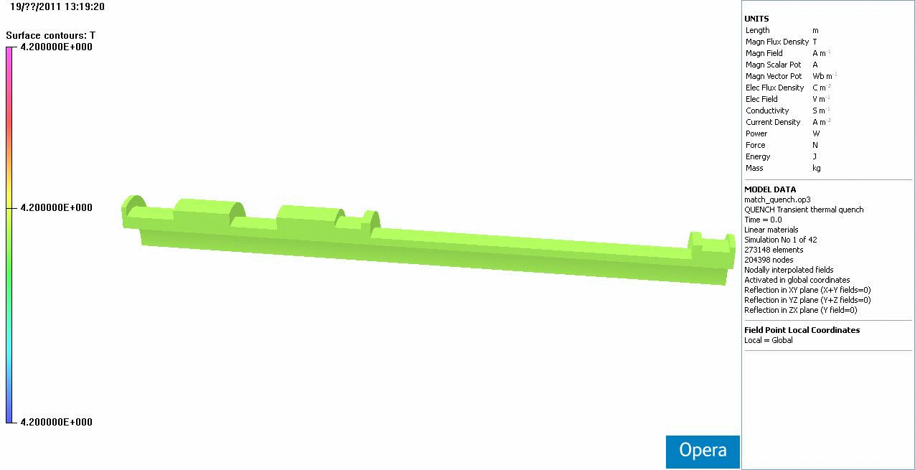

Simulations
Evaluate current fluctuations, decay, voltages, hot-spot temperature throughout circuit:
  Dependence on quench current
  Evaluate role of quench-back from mandrel:
    Temperature rise and distribution in mandrel during a coil quench
Electric circuit for series test configured
  Allows diodes + resistors
  Various models have been tried
Independent analysis from:
  Heng Pan (LBNL)
  Vladimir Kashikhin (FNAL)
Some cross checks highlighted:
  Importance of mesh (space and time) refinement
  Some insight into sensitivity (or lack thereof) with respect to properties

Slide 27
Electric circuit definition
From Kashikhin

Slide 28
Simulations: validation
Code validation:
  Comparison with Wilson code yield reasonable agreement of coil normal zone growth
Wilson code
LBNL VF model

Slide 29
Simulations
Current evolution for a central solenoid quench
  LBNL model, 265A initial current

Slide 30
Quench Scenarios at Different Currents
LBNL model

Slide 31
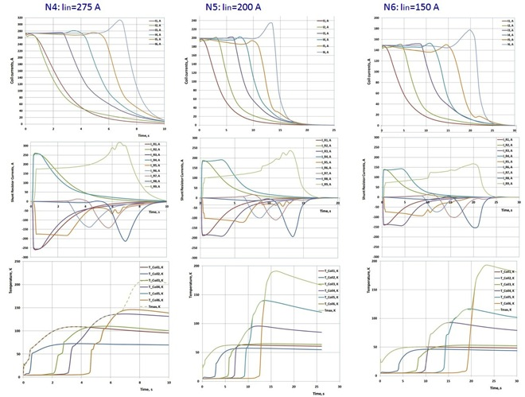
Quench Scenarios at Different Currents
FNAL model
N4: The initial current is 275 A. All currents drop to 10 A levels after 10 s. Coil 6 which far away from the quenched Coil 1 will be heated in 7 s to the peak temperature of 140 K. The R9 shunt resistor will carry current ~ 275 A during 8s.
N5: The initial current is 200 A. The current in the Coil 6 drops to zero after 18 s. The Coil 6 hot spot temperature is 180 K. The R9 shunt resistor will carry current ~ 200 A during 15 s.
N6: The initial current is 150 A. The current in the Coil 6 drops to zero after 25 s. The Coil 6 is on the opposite side of solenoid and sees the largest “quench back” delay time. The Coil 6 hot spot temperature is 190 K. The R9 shunt resistor will carry current ~ 150 A during 22 s.

Slide 32
Quench Scenarios at Different Currents:
Model differences
Main differences:
  FNAL model yields longer delay between quenchback of coils further away
  FNAL model yields higher hotspot temperatures
Expected sources of differences:
  FNAL model needs further time-step reduction
  FNAL model includes insulation layer
All models assumed contact between coil and mandrel at all interfaces; this may not be valid under all operating conditions.

Slide 33
Compared the results with (case I)and without (case II) M2 quench.
Quenches were initiated in E2 in both cases.
The quench current in case I is 265A in all coils.
In case II, the quench currents in ECE and M1 are 260A and 250A, respectively.
Case I
Case II
The quench back is slowed down without the quench in M2 by > 3 seconds.

Slide 34
Appendix: bypass resistors
Typical temperature behavior at 100A (limited by the power supply used in the test). In the experiment the stainless resistors had a resistance of ~0.04Ohm, twice that of the actual system. A similar test on the same resistor without the Copper thermal connection resulted in burnout of the resistor in less than 30 seconds.

Slide 35
Goals of simulations: Voltages
Turn-to-turn voltages:
  Remains negligibly small throughout quenches (<1 volt)
Layer-to-Layer voltages:
  Maximum in Central solenoid
  Reaches ~450V - occur in outer layers!
Coil-to-ground voltages:
  Maximum in Central solenoid
  Reaches ~1.3kV (~2kV resistive)
  Values are lower than Wilson code
    Segmentation and Quenchback help
  Note: Coil hi-potted to 5kV

Slide 36
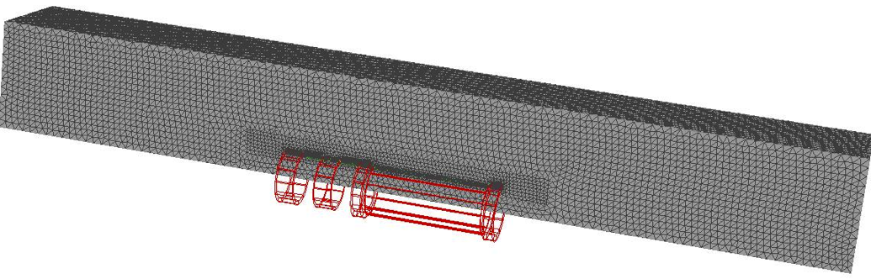
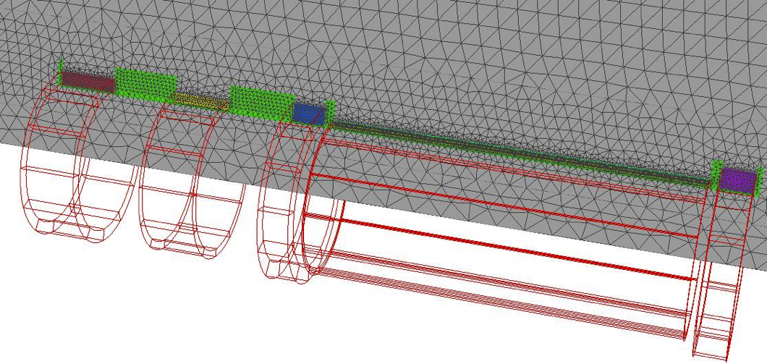
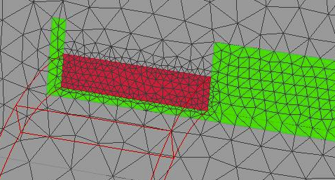
Model mesh (LBNL)

Slide 37
Hot-spot temperature and Peak internal voltage
Code limitations:
  No quench back
  Transverse propagation “fit”
  “Lumped” stored energy; real quench events more complicated
    Actual hot spot temp significantly lower, due to bypass current
  No detailed information on size of resistive zone, voltage gradients

Slide 38
Simulations: Issues and Caveats
General model differences:
  LBNL model:
    No separate baseplane insulation layer is modeled
    No separate modeling of the aluminum banding is provided
  FNAL model:
    1mm baseplane G10 is meshed
    Aluminum banding is modeled/meshed
  Expect some difference in quenchback time
  Other: central coil split in z (FNAL), in r (LBNL)

Slide 39
Simulations: Issues and Caveats
Material properties:
  Some strange VF code issues were discovered independently by FNAL and LBNL
    Problem with interpolation of Jc(B,T) table
  Some differences (~10-20%) in material properties used by LBNL and FNAL were found to have similar affects on key parameters (e.g. hot-spot temperatures) when run on the same model
  No highly sensitive parameter has been found

Slide 40
Simulations: Issues and Caveats
Model resolution:
  Model mesh refinement has been performed:
    Results show mesh is sufficiently refined
  Temporal resolution:
    Significant differences have been found if time-step is not sufficiently small
      Tests are ongoing to verify that time-step used in current results are sufficient

Slide 41
Simulations: temporal resolution
Model resolution (LBNL):
  Time steps of 0.01 vs 0.005 => sufficiently time resolved

Slide 42
Simulations
Current evolution for an M1 solenoid quench
  LBNL model, 265A initial current

Slide 43
Simulations: Issues and Caveats
General model differences:
  LBNL model: quarter model, heater “surface”
    Effectively 2D axisymetric propagation
  FNAL model: full 3D model, localized heater
  Direct comparison of results using the two models on a quench scenario show differences do not significantly affect later temporal evolution or the hot-spot temperature

Slide 44
Simulations: model comparison
Expect difference in start-time of second coil quench to stem from timestep size (0.01 (2D) vs 0.05 (3D)

Slide 45
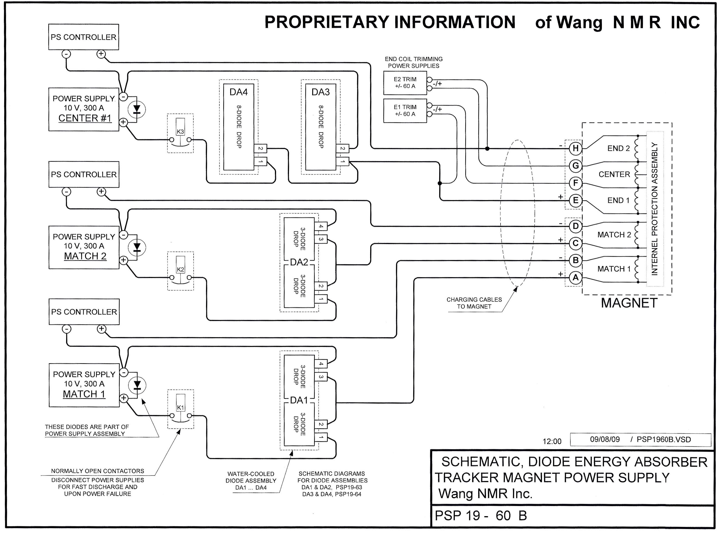
Wang NMR System: DC SIGNAL PATH & Control

Slide 46
Schematics – “Specified”

Slide 47
Schematics as-operated

