Slide 1
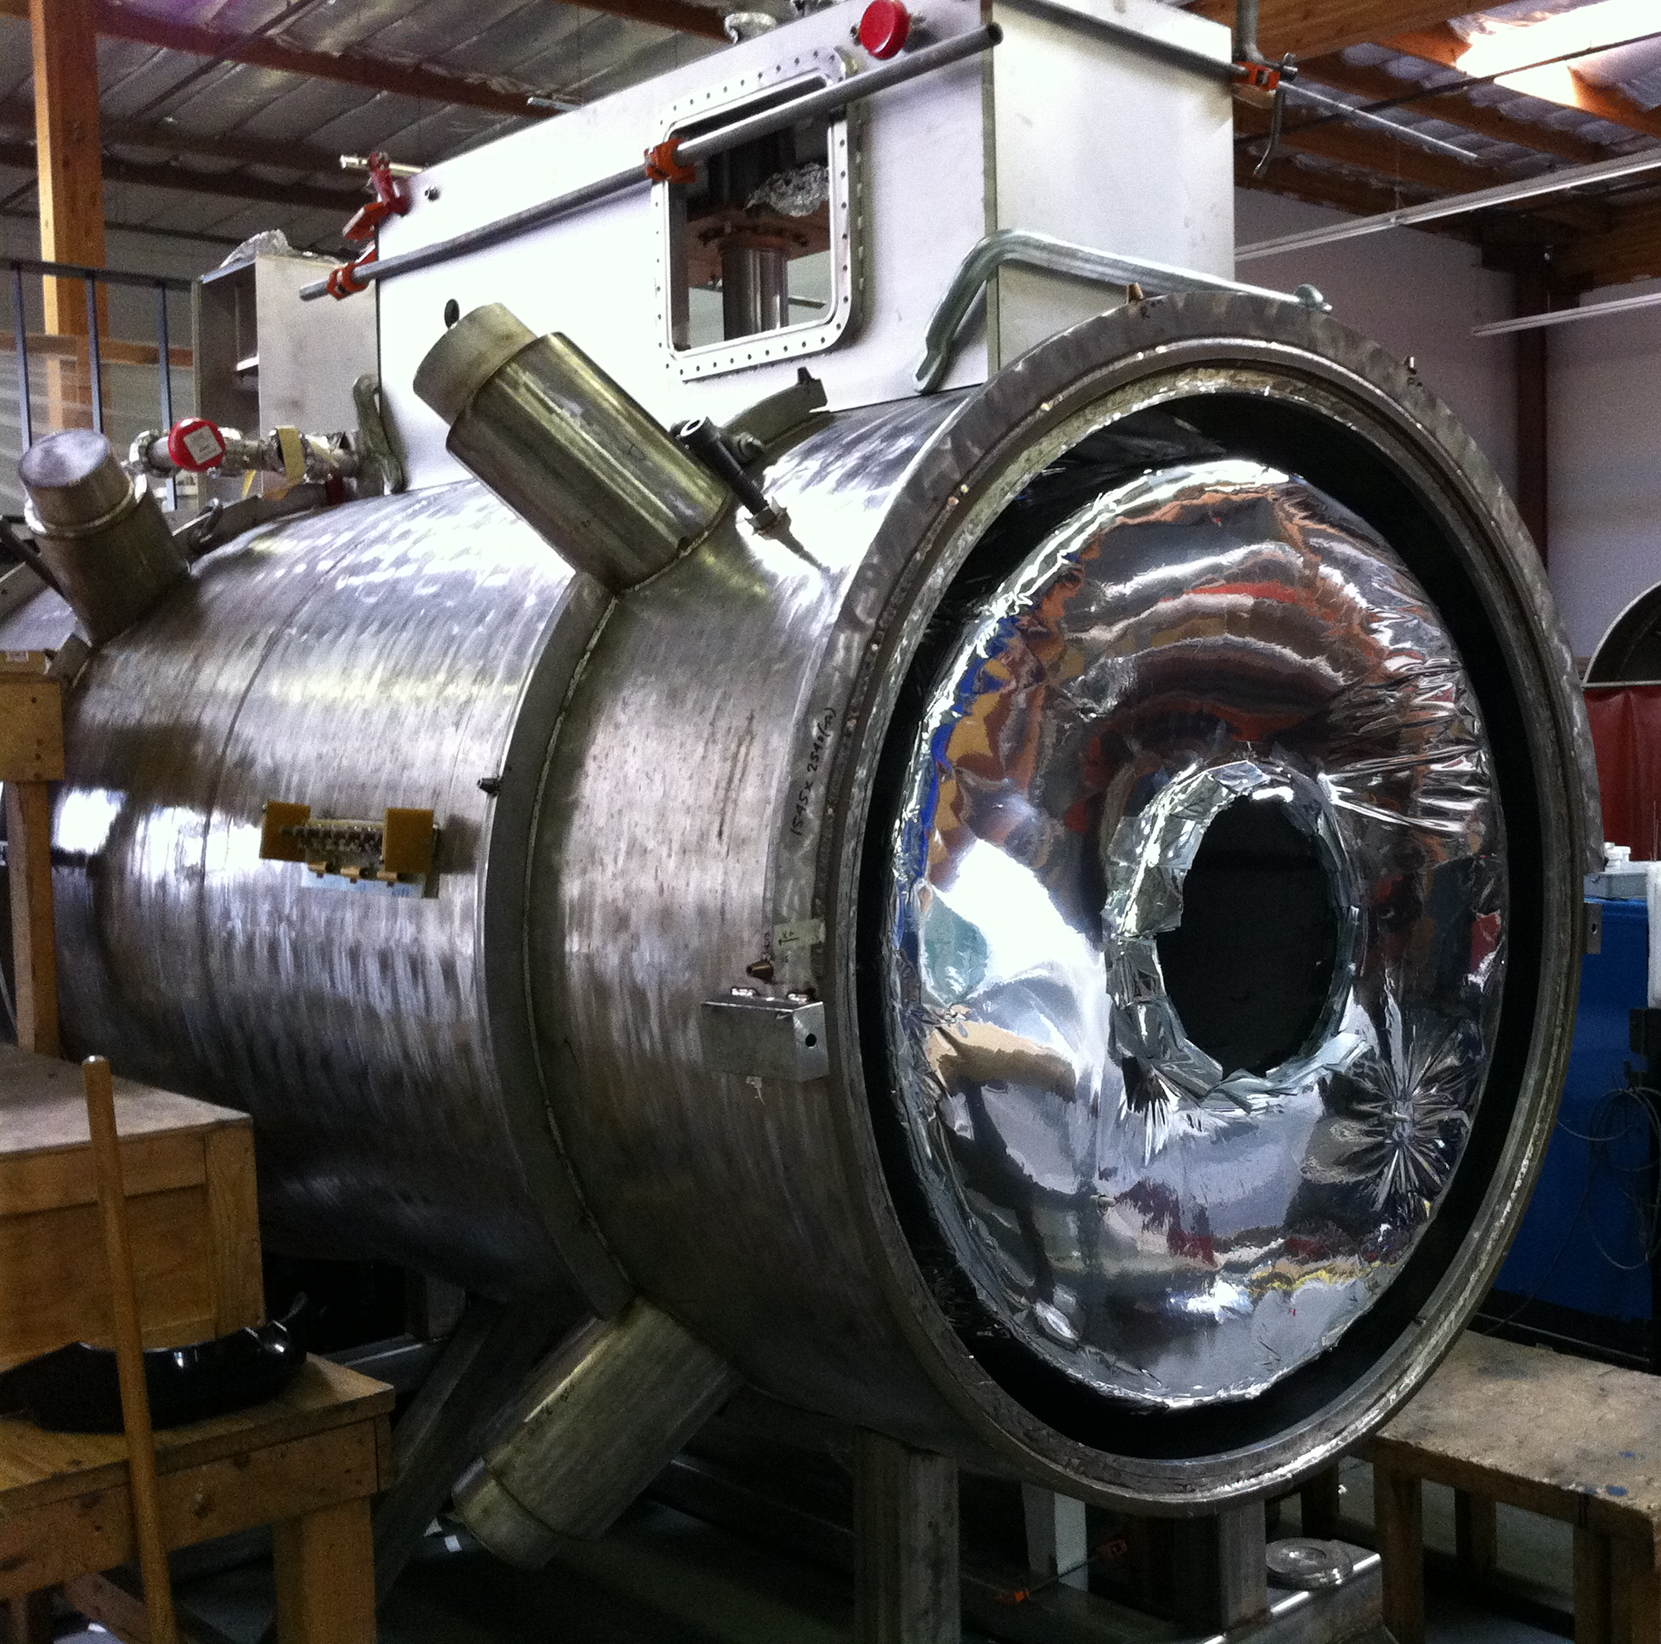
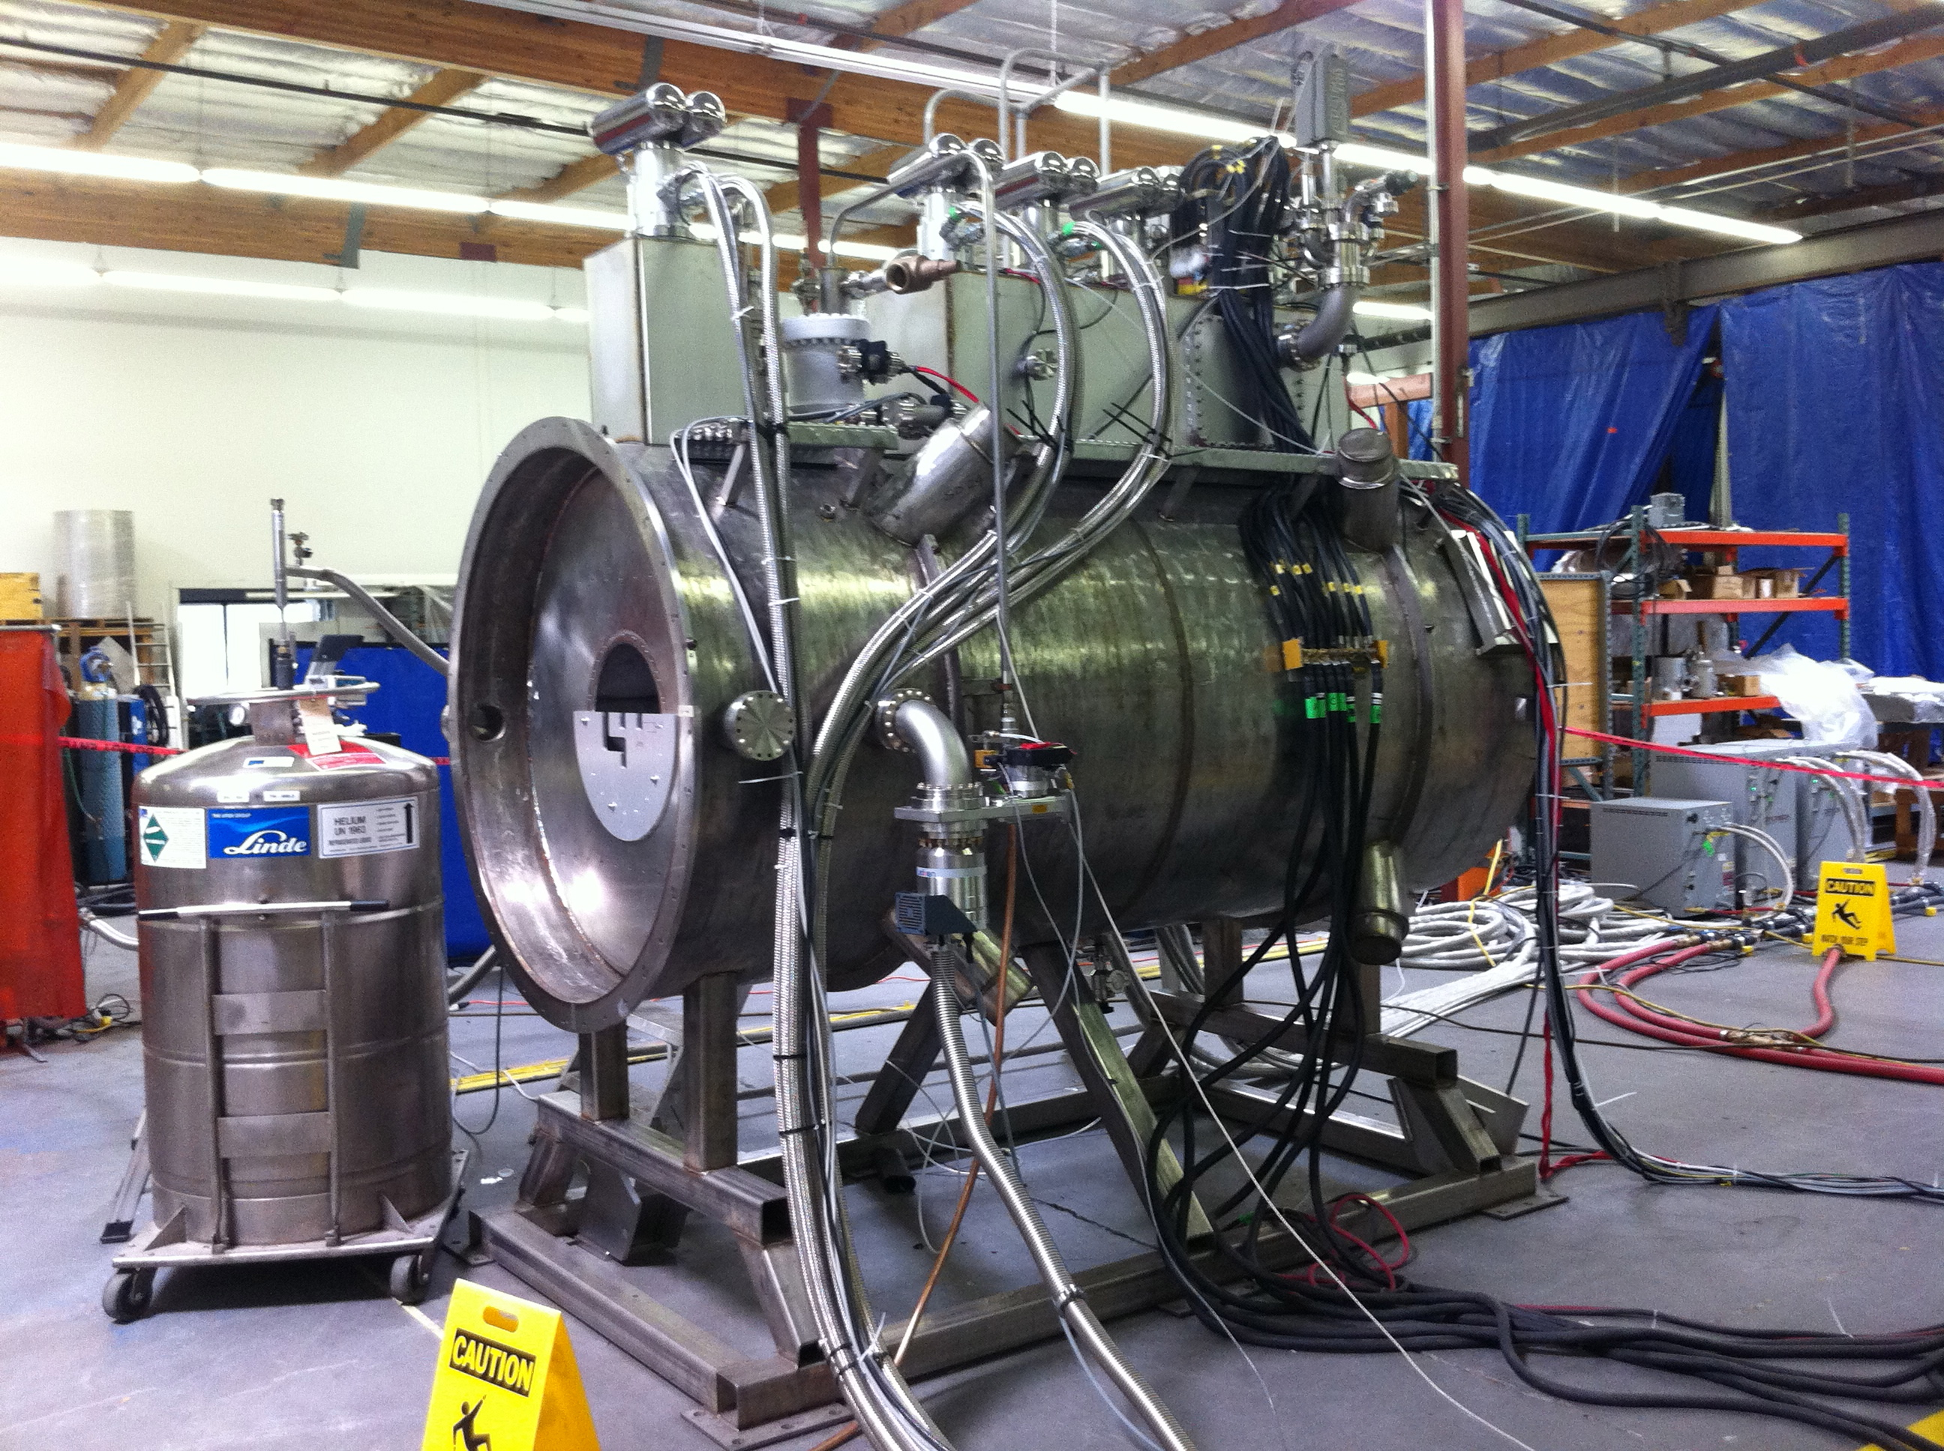
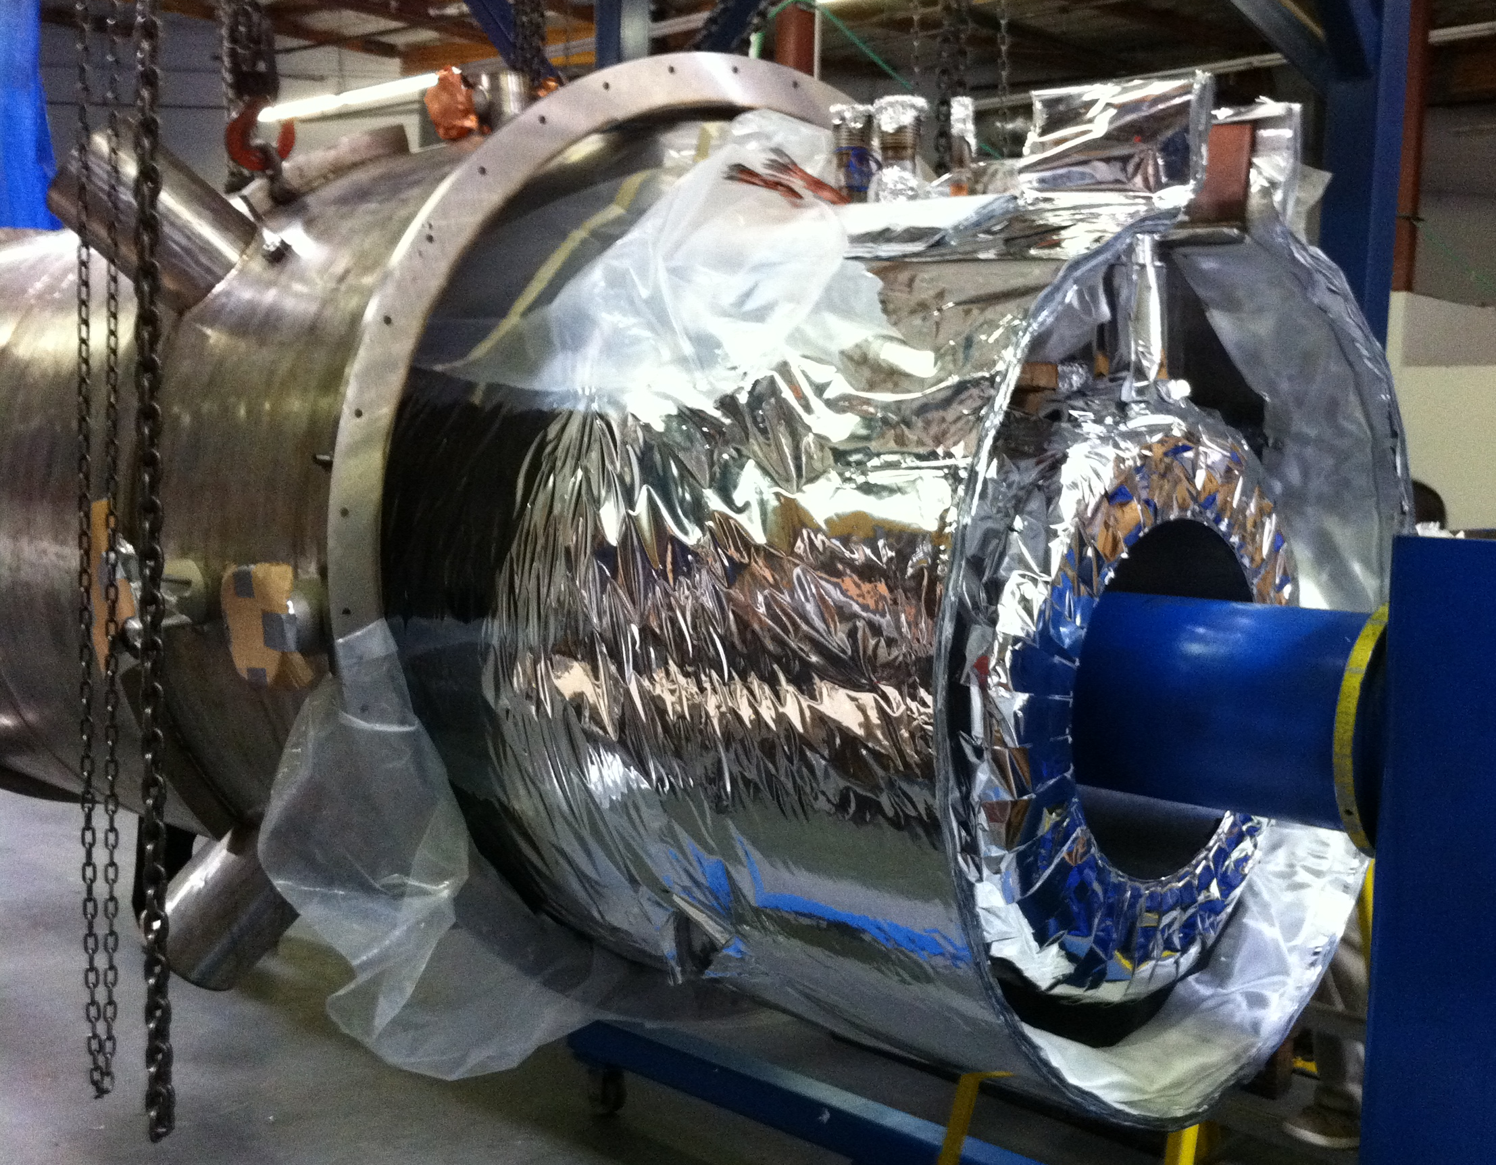
Spectrometer Solenoid Design - Question Responses -

Slide 2
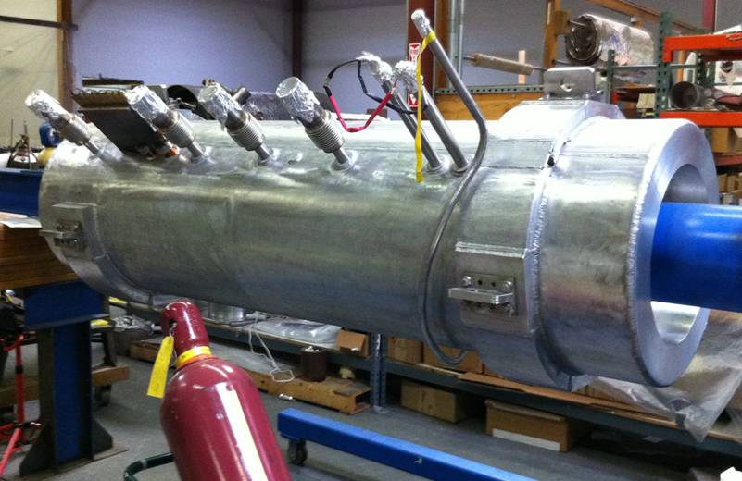
Cold Mass Fill Level
200L LHe volume in cold mass
Cold mass was filled to close to 100% level for the majority of the training runs at Wang NMR
Cold mass was approximately 90% full for the training runs at RAL

Slide 3
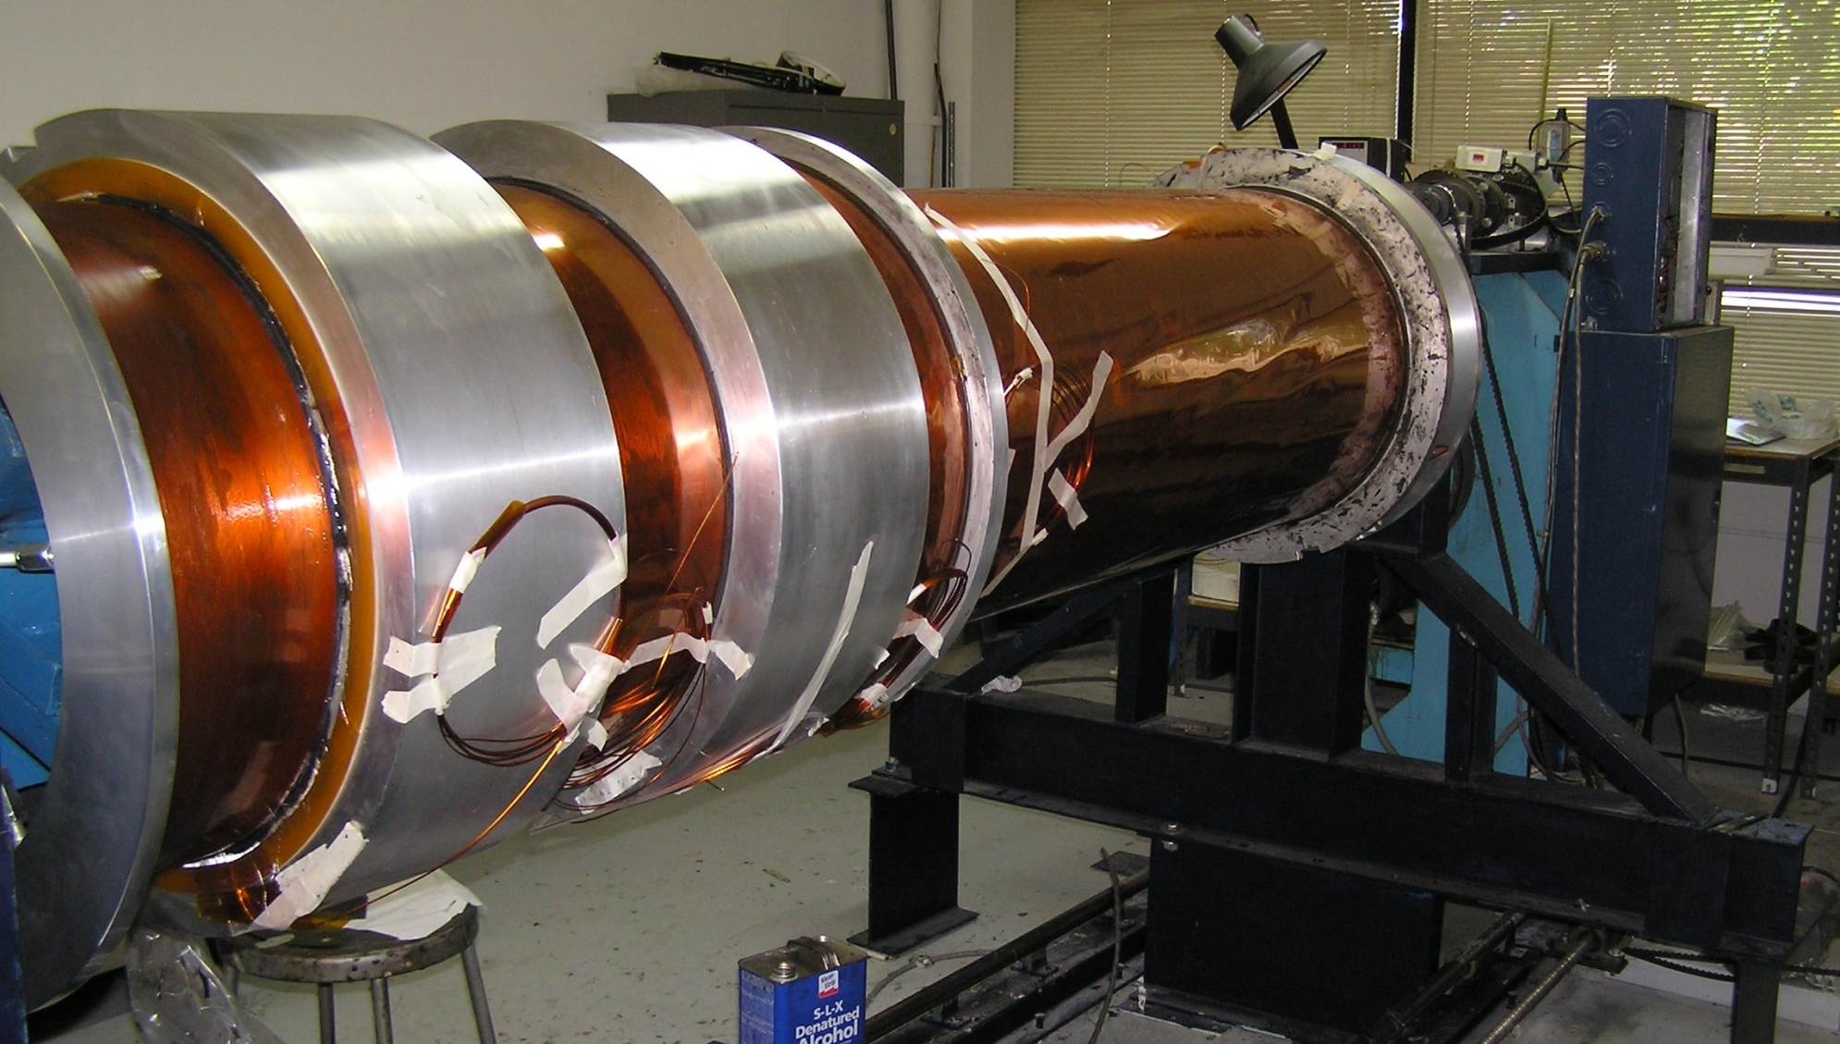
Completed Coil Windings
Coils are wound over G-10 bonded to mandrel at coil ID and sides

Slide 4
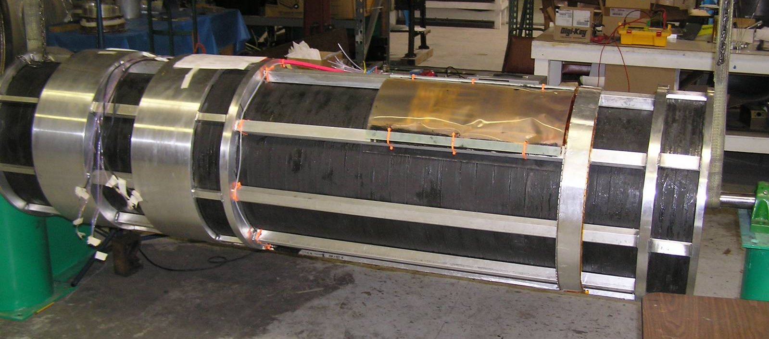
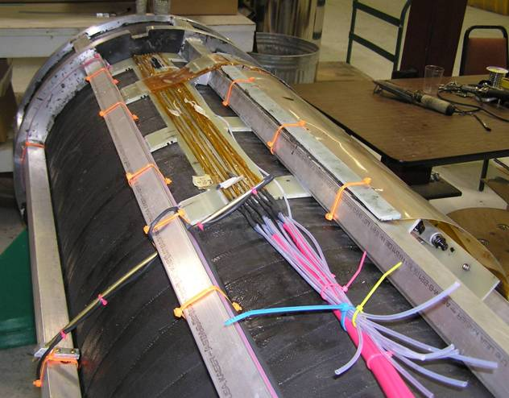
Resistor/Diode Location
Passive quench resistor/diode assemblies are located approximately 45° above the horizontal plane

Slide 5
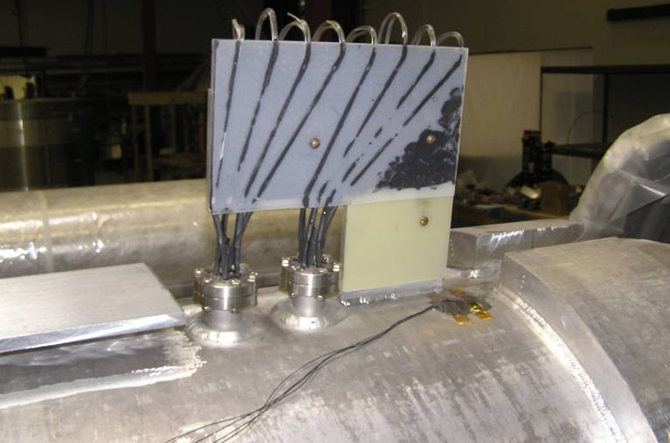
Cold Mass Power Feedthroughs
Feedthroughs are a proprietary Wang NMR design
Lead assemblies are thermally cycled and leak checked prior to installation on cold mass
Design spec or test results for voltage standoff not provided by vendor

Slide 6
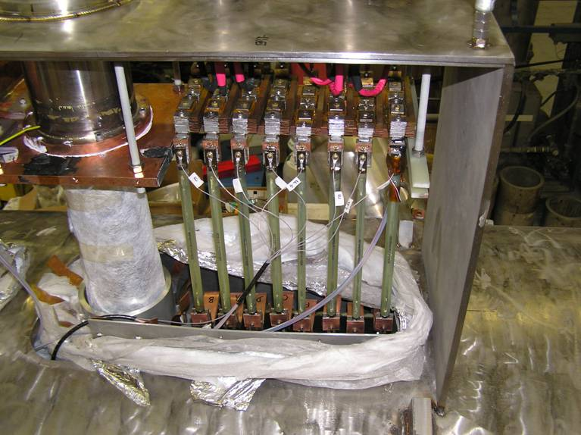
HTS Lead Testing
- All HTS leads are tested off line prior to installation in the magnet
- Voltage drop measurements are carried out at LN temperature at 100 A to insure integrity

Slide 7
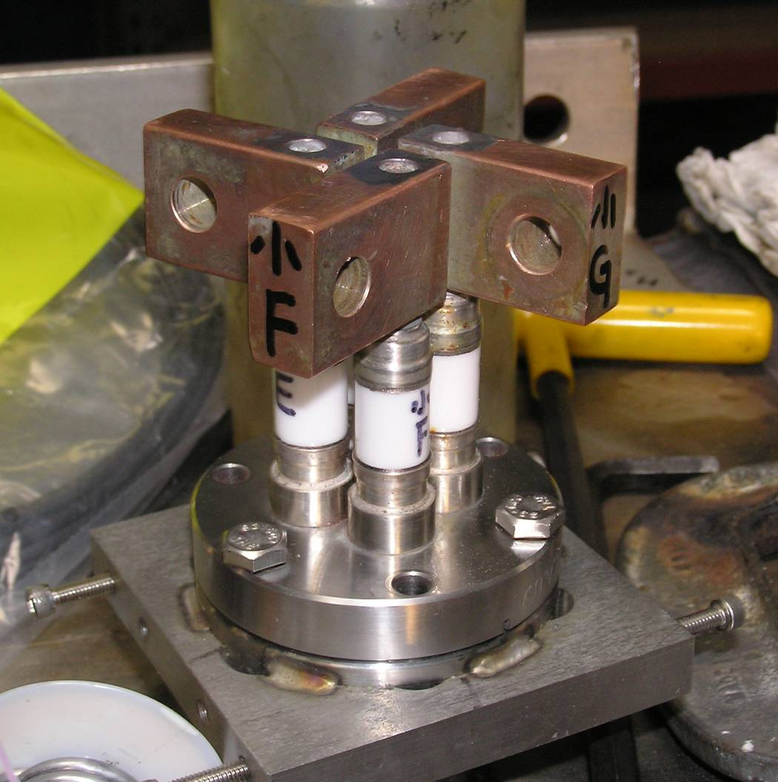
Power Feedthrus w/Copper Flags
- Feedthrus are fragile – ceramic braze joint susceptible to moisture and/or mechanical loads
- Feedthrus are solid copper rods rated at 175 A, two in parallel for primary coil feeds

Slide 8
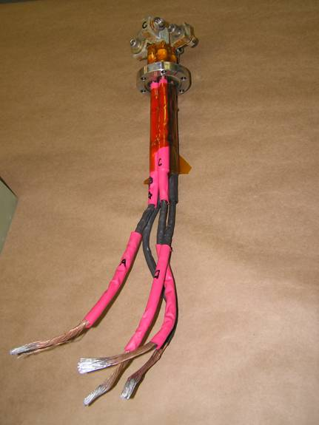
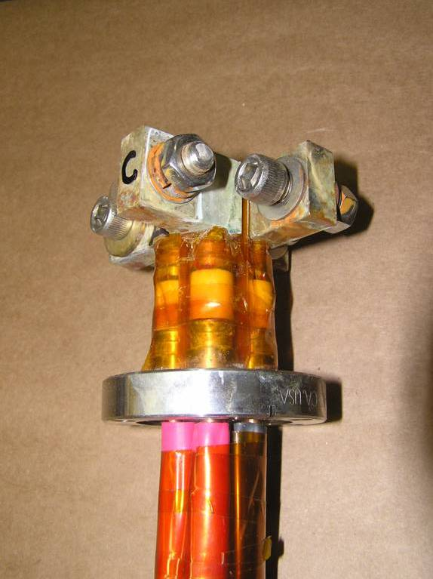
Warm Lead/Feedthru Assembly
- Copper sleeves soldered to welding cable are soldered to feedthru rods
- Insulation voltage rating is not known

Slide 9
Other Design Information
Wang NMR went thru several design iterations due to various performance deficiencies
  Thermal siphon cooling abandoned for direct cryocooler connection
  Single stage cooler added to direct cool HTS leads
  Two stage cryocoolers added for more 4K cooling power in order to maintain LHe in cold mass
  Other improvements:
    Better thermal shield and connections
    Improved MLI wrapping
    HTS lead installation method
    Control, data logging and quench systems

