Slide 1
Comprehensive (extensive) Nucleon decay mode list
Maury Goodman
Lisa Lin

Slide 2
Mission
The goal is to make a (hopefully) comprehensive look at nucleon decay modes to identify those modes (vis-à-vis water counters) for which a high resolution liquid Argon detector has a competitive advantage, using simplifying assumptions on ε, backgrounds, etc.
Those modes would then be candidates for full simulations.

Slide 3
Assumptions
The only relevant “competition” is Super-Kamiokande which will continue to run.
ε_{recon} = 1, zero background for now
The nuclear efficiency for a mode with n pions is ε^{n}_{1π}, (ε_{1π} = 0.54 in Ar from Bueno paper)
Ar has 2.7 10³² p and 3.3 10³² n per kT

Slide 4
Exposure
Dune starts with 10 kT in 2022, 40 in 2026
Duty Cycle λ_{SK} = 0.8; λ_{D} = 0.9
T_{DUNE} = (y-2022)*10 kT*λ_{D} [for y>2022]
+ (y-2026)*30 kT*λ_{D} [for y>2026]
T_{SK} = 149.2 + (y-1995.79)*22.5*λ_{SK}
Intersect in 2052

Slide 5
Modes
We’ve identified 91 exclusive modes that conserve spin. (Counting neutral kaon modes is a bit of an art.)
Will add inclusive modes, n-nbar and dinucleon decays
In the 2014 RPP, Super-K only had the best limit for 14 modes (!) but they probably have the best real limits for most of the 91.

Slide 6
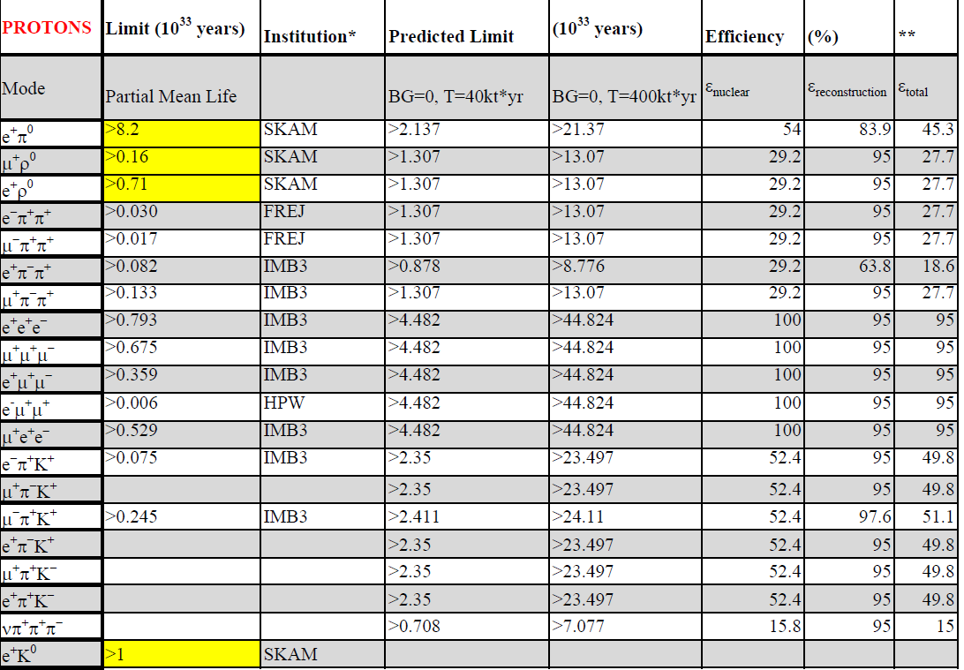
Top of the list

Slide 7
Docdb-679 v1
PROTONS | Limit (10³³ years) | Institution* | Predicted Limit | (10³³ years) | Efficiency | (%) | **
Mode | Partial Mean Life |  | BG=0, T=40kt*yr | BG=0, T=400kt*yr | e_{nuclear} | e_{reconstruction} | e_{total}
e⁺p⁰ | >8.2 | SKAM | >2.137 | >21.37 | 54 | 83.9 | 45.3
m⁺r⁰ | >0.16 | SKAM | >1.307 | >13.07 | 29.2 | 95 | 27.7
e⁺r⁰ | >0.71 | SKAM | >1.307 | >13.07 | 29.2 | 95 | 27.7
e⁻p⁺p⁺ | >0.030 | FREJ | >1.307 | >13.07 | 29.2 | 95 | 27.7
m⁻p⁺p⁺ | >0.017 | FREJ | >1.307 | >13.07 | 29.2 | 95 | 27.7
e⁺p⁻p⁺ | >0.082 | IMB3 | >0.878 | >8.776 | 29.2 | 63.8 | 18.6
m⁺p⁻p⁺ | >0.133 | IMB3 | >1.307 | >13.07 | 29.2 | 95 | 27.7
e⁺e⁺e⁻ | >0.793 | IMB3 | >4.482 | >44.824 | 100 | 95 | 95
m⁺m⁺m⁻ | >0.675 | IMB3 | >4.482 | >44.824 | 100 | 95 | 95
e⁺m⁺m⁻ | >0.359 | IMB3 | >4.482 | >44.824 | 100 | 95 | 95
e⁻m⁺m⁺ | >0.006 | HPW | >4.482 | >44.824 | 100 | 95 | 95
m⁺e⁺e⁻ | >0.529 | IMB3 | >4.482 | >44.824 | 100 | 95 | 95
e⁻p⁺K⁺ | >0.075 | IMB3 | >2.35 | >23.497 | 52.4 | 95 | 49.8
m⁺p⁻K⁺ |  |  | >2.35 | >23.497 | 52.4 | 95 | 49.8
m⁻p⁺K⁺ | >0.245 | IMB3 | >2.411 | >24.11 | 52.4 | 97.6 | 51.1
e⁺p⁻K⁺ |  |  | >2.35 | >23.497 | 52.4 | 95 | 49.8
m⁺p⁺K⁻ |  |  | >2.35 | >23.497 | 52.4 | 95 | 49.8
e⁺p⁺K⁻ |  |  | >2.35 | >23.497 | 52.4 | 95 | 49.8
np⁺p⁺p⁻ |  |  | >0.708 | >7.077 | 15.8 | 95 | 15
e⁺K⁰ | >1 | SKAM
e⁺K_{s} | ??? | N/A | >2.218 | >22.176 | 100 | 47 | 47
e⁺K_{L} | ??? | N/A | >0.222 | >2.218 | 1 | 47 | 0.47
m⁺K⁰ | >1.6 | SKAM
m⁺K_{s} | ??? | N/A | >2.203 | >22.034 | 100 | 46.7 | 46.7
m⁺K_{L} | ??? | N/A | >0.22 | >2.203 | 1 | 46.7 | 0.467
e⁺g | >0.670 | IMB3 | >4.624 | >46.239 | 100 | 98 | 98
e⁺gg | >0.1 | FREJ | >4.482 | >44.824 | 100 | 95 | 95
e⁺h⁰ | >4.20 | SKAM
e⁺w⁰ | >0.320 | SKAM | >0.708 | >7.077 | 15.8 | 95 | 15
m⁺g | >0.478 | IMB3 | >4.624 | >46.239 | 100 | 98 | 98
m⁺p⁰ | >6.60 | SKAM | >2.114 | >21.138 | 54 | 83 | 44.8
m⁺h⁰ | >1.30 | SKAM
m⁺w⁰ | >0.780 | SKAM | >0.708 | >7.077 | 15.8 | 95 | 15
nK⁺ | >2.30 | SKAM | >4.709 | >47.088 | 97 | 99.8 | 96.8
nr⁺ | >0.162 | IMB3 | >1.307 | >13.07 | 29.2 | 95 | 27.7
nK^{*+} | >0.051 | IMB3 | >2.420 | >24.205 | 54 | 95 | 51.3
np⁺ | >0.016 | SOU2 | >1.977 | >19.77 | 54 | 77.6 | 41.9
e⁺K^{*0} | >0.084 | IMB3 | >2.420 | >24.205 | 54 | 95 | 51.3
e⁺p⁰p⁰ | >0.147 | IMB3 | >1.307 | >13.07 | 29.2 | 95 | 27.7
m⁺p⁰p⁰ | >0.101 | IMB3 | >1.307 | >13.07 | 29.2 | 95 | 27.7
e⁺nn | >0.017 | IMB3 | >4.482 | >44.824 | 100 | 95 | 95
m⁺nn | >0.021 | FREJ | >4.482 | >44.824 | 100 | 95 | 95
NEUTRONS
e⁺r⁻ | >0.217 | IMB3 | >1.597 | >15.974 | 29.2 | 95 | 27.7
e⁻r⁺ | >0.062 | IMB | >1.597 | >15.974 | 29.2 | 95 | 27.7
m⁺p⁻ | >1 | SKAM | >2.958 | >29.584 | 54 | 95 | 51.3
m⁻p⁺ | >0.049 | IMB | >2.584 | >25.836 | 54 | 83 | 44.8
m⁺r⁻ | >0.228 | IMB3 | >1.597 | >15.974 | 29.2 | 95 | 27.7
m⁻r⁺ | >0.007 | IMB | >1.597 | >15.974 | 29.2 | 95 | 27.7
ng | >0.028 | IMB3 | >5.479 | >54.786 | 100 | 95 | 95
ngg | >0.219 | IMB3 | >5.479 | >54.786 | 100 | 95 | 95
np⁰ | >0.112 | IMB3 | >2.601 | >26.009 | 54 | 83.5 | 45.1
nK⁰ | >0.086 | KAMI
nK_{s} | >0.260 | SKAM | >5.479 | >54.786 | 100 | 95 | 95
nK_{L} | ??? | N/A | >0.548 | >5.479 | 1 | 95 | 0.95
nh⁰ | >0.158 | IMB3
nr⁰ | >0.019 | IMB | >1.597 | >15.974 | 29.2 | 95 | 27.7
nw⁰ | >0.108 | IMB3 | >0.865 | >8.650 | 15.8 | 95 | 15
nK^{*0} | >0.078 | IMB3 | >2.958 | >29.584 | 54 | 95 | 51.3
e⁺e⁻n | >0.257 | IMB3 | >5.479 | >54.786 | 100 | 95 | 95
m⁺e⁻n | >0.083 | IMB3 | >5.479 | >54.786 | 100 | 95 | 95
m⁺m⁻n | >0.079 | IMB3 | >5.479 | >54.786 | 100 | 95 | 95
e⁺p⁻ | >2 | SKAM | >2.561 | >25.605 | 54 | 82.2 | 44.4
nmmp |  |  | >2.958 | >29.584 | 54 | 95 | 51.3
neep |  |  | >2.958 | >29.584 | 54 | 95 | 51.3
nmep |  |  | >2.958 | >29.584 | 54 | 95 | 51.3
e⁻K⁺ | >0.032 | FREJ | >5.536 | >55.363 | 100 | 96 | 96
m⁻K⁺ | >0.057 | FREJ | >5.594 | >55.939 | 100 | 97 | 97
e⁺K⁻ | >0.017 | IMB3 | >5.594 | >55.939 | 100 | 97 | 97
m⁺K⁻ | >0.026 | IMB3 | >5.594 | >55.939 | 100 | 97 | 97
mppp |  |  | >0.865 | >8.650 | 15.8 | 95 | 15
eppp |  |  | >0.865 | >8.650 | 15.8 | 95 | 15
epK_{s} |  |  | >2.958 | >29.584 | 54 | 95 | 51.3
n4p
emmp |  |  | >2.958 | >29.584 | 54 | 95 | 51.3
eeep |  |  | >2.958 | >29.584 | 54 | 95 | 51.3
mmmp |  |  | >2.958 | >29.584 | 54 | 95 | 51.3
eemp |  |  | >2.958 | >29.584 | 54 | 95 | 51.3
nempp |  |  | >1.597 | >15.974 | 29.2 | 95 | 27.7
e⁺p⁻p⁰ | >0.052 | IMB3 | >1.597 | >15.974 | 29.2 | 95 | 27.7
m⁺p⁻p⁰ | >0.074 | IMB3 | >1.597 | >15.974 | 29.2 | 95 | 27.7
e⁺K⁰p⁻ | >0.018 | FREJ
e⁺K^{s}p⁻ |  |  | >2.958 | >29.584 | 54 | 95 | 51.3
e⁺K_{L}p⁻ |  |  | >0.296 | >2.958 | 0.54 | 95 | 0.513
e⁻p⁺ | >0.065 | IMB | >2.958 | >29.584 | 54 | 95 | 51.3
e⁻p⁺p⁰ | >0.029 | FREJ | >1.597 | >15.974 | 29.2 | 95 | 27.7
m⁻p⁺p⁰ | >0.034 | FREJ | >1.597 | >15.974 | 29.2 | 95 | 27.7
3n | >0.00000049 | KAMI
5n | ??? | N/A

Slide 8
Next steps
No conclusions yet
Extrapolate 14 Super-K limits with background subtraction to 2026, 2035 (Dune’s 40, 400 kT-y)
Find Super-K limits from theses, Conf.proc., papers since RPP2014
Guestimate Super-K sensitivity for modes not found
Include meson branching ratios and refine guestimates on DUNE ε_{recon}.
Identify modes where DUNE will have background in 40/400 kT-y.
Suggestions welcomed

