Slide 1
DUNE Software and Computing News and Announcements
Tom Junk
DUNE Software and Computing General Meeting
November 3, 2015

Slide 2
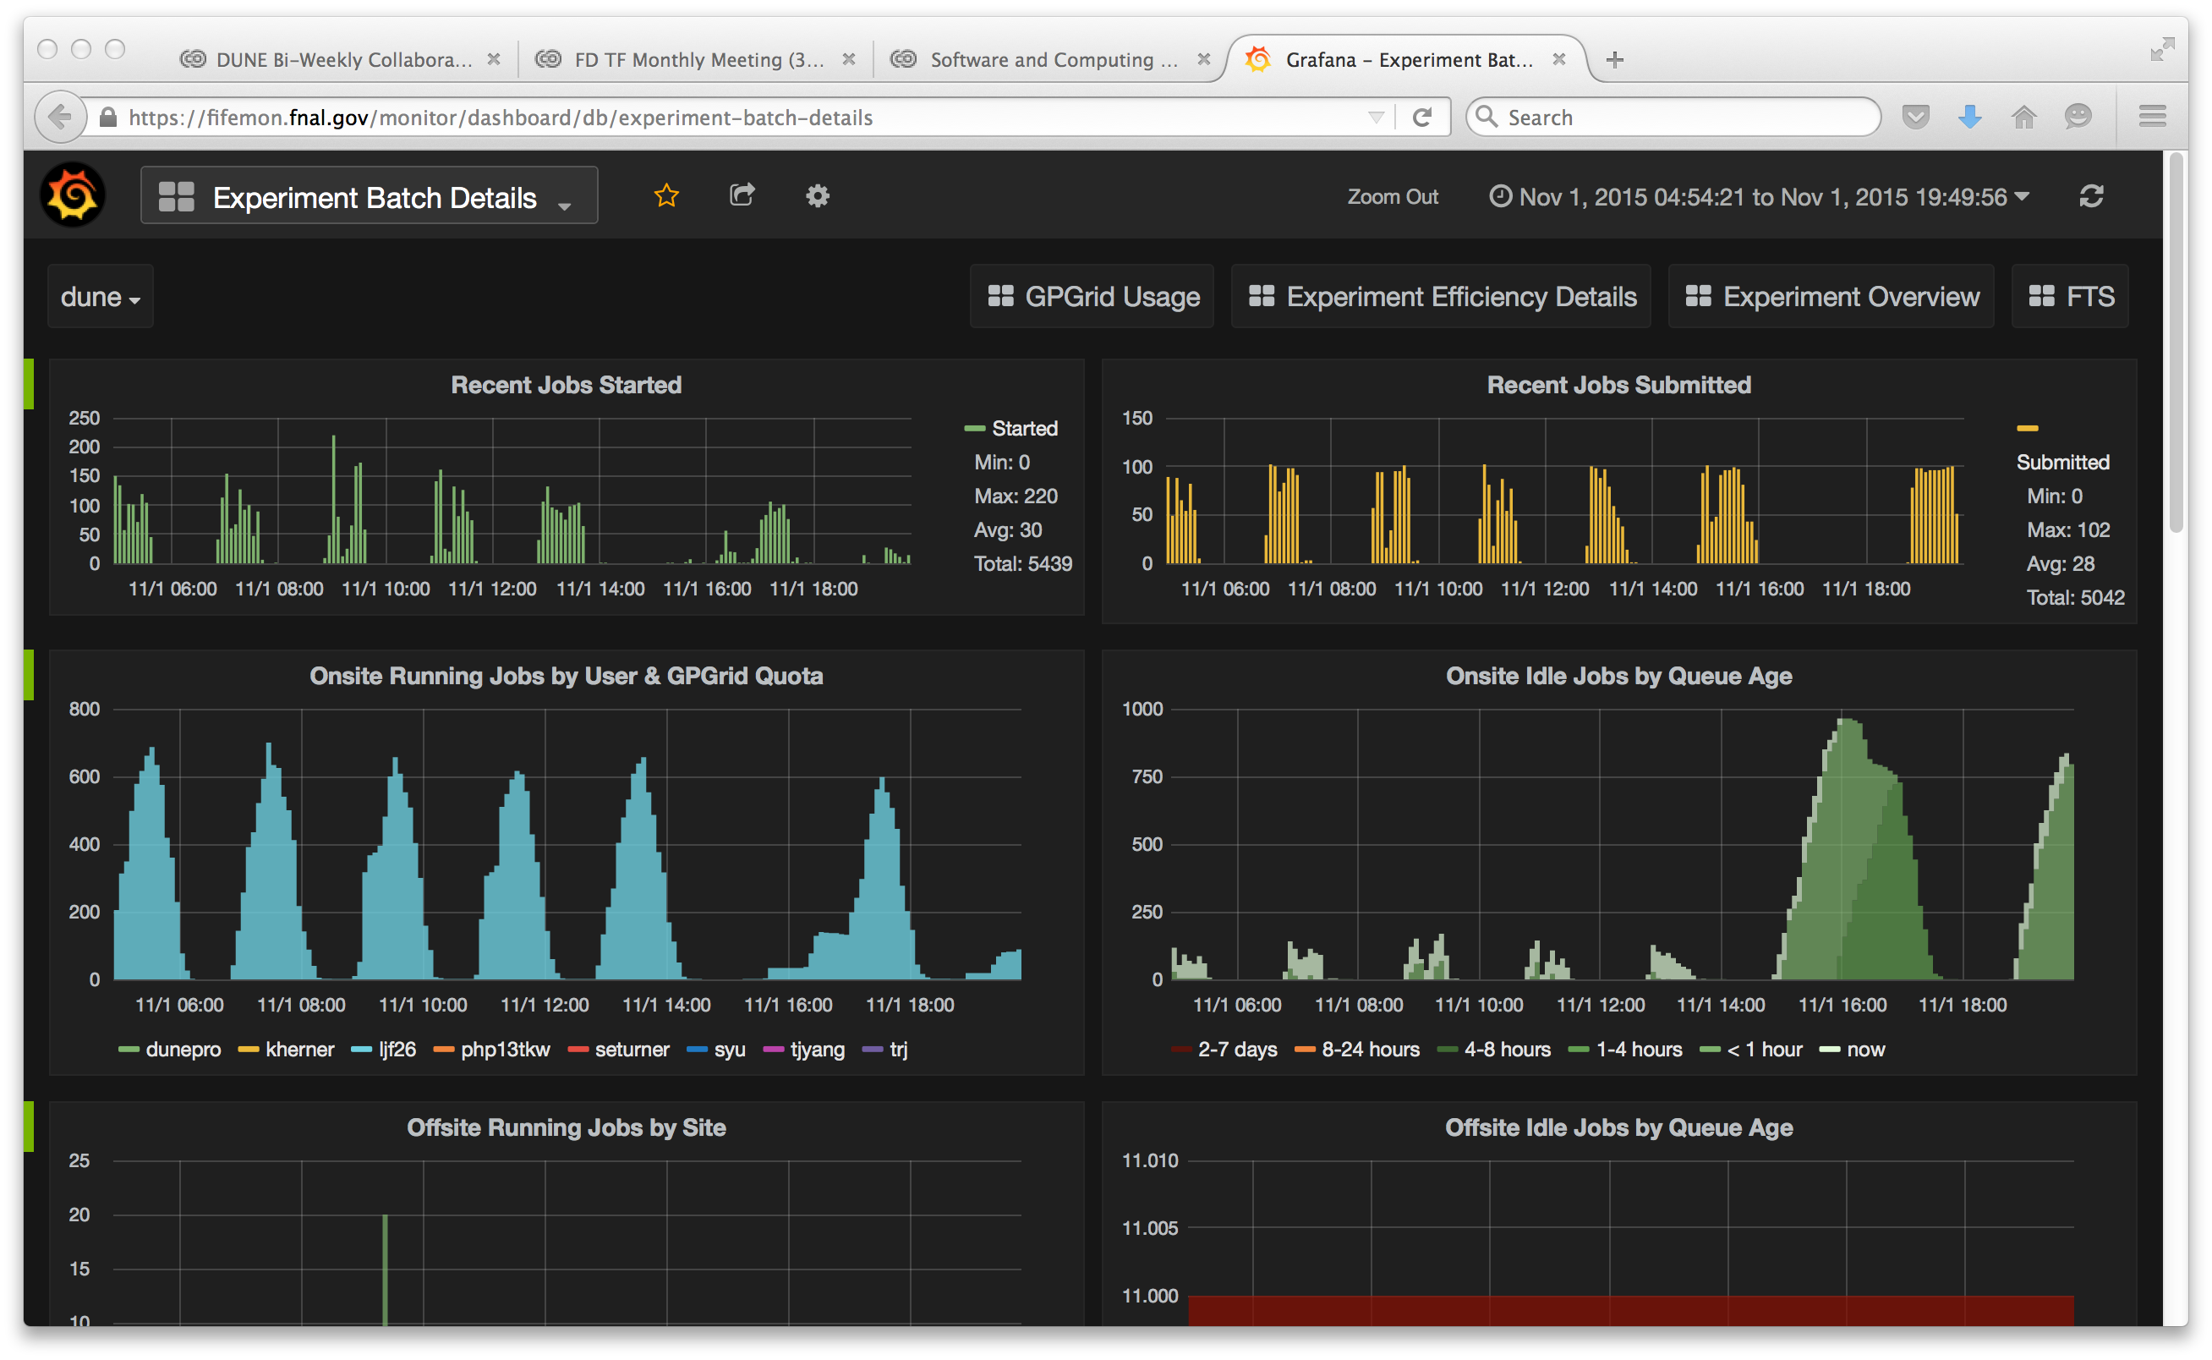
New FIFEMON
Sign in with your Fermilab Services credentials
https://fifemon.fnal.gov/monitor/

Slide 3
Fermigrid Batch Operations News
GUMS transition Sep. 29
jobs used to run as user lbneana (for the LBNE VO) and as
duneana (in the DUNE VO).
Now they run as the user (yay!). Files transferred back now owned by the user by default.
This helps esp. for users in many VO’s (LBNE and DUNE for example). Users had gotten used to making their output directories on BlueArc group writeable so that lbneana could write to them. But duneana is in a different group from lbneana’s group (!). World-write permission wouldn’t be great.
Also I was not fond of the lbneana account filling up its quota on
the BlueArc data areas /lbne/data and /lbne/data2
hard to tell who’s responsible and what files to clean up

Slide 4
Fermigrid Batch Operations News
Job limits being phased in
Jobs satisfying the following constraints will be put on Hold
if they use twice the requested memory (they’re being nice!)
use twice the requested disk space
get restarted 10 times
jobsub v1_1_7 went in – no one noticed, though perhaps stronger checking of xml files when submitting dags.

Slide 5
Migration away from AFS at Fermilab
We use it for
user home areas – migrate to NFS
shared web areas (but these have largely been migrated to NFS already. Added benefit of migrating away from old Solaris web servers.
Connecting to non-FNAL AFS cells (like /afs/cern.ch)
Andy Romero's talk Oct 14

Slide 6
dCache News
New Disk installed: 2.4 PBytes
We have 140 TBytes of persistent space in
/pnfs/lbne/persistent
which is shared with /pnfs/dune/persistent but which has a
separate namespace.
Not backed up!
Do we need to ask for more? We’ve used 11% already. Maybe ask next cycle, not this one.
dCache presentation to CS Liaisons Oct 14, 2015
A monitor page of who’s using what on the persistent dCache disks (Thanks, Stu!!)
http://fndca3a.fnal.gov/cgi-bin/du_cgi.py

Slide 7
Speaking of Disk Space ...
/lbne/app (= /dune/app) is now 90% full, of a total of 2 TBytes.
Some users had been storing data files.
Other users have left DUNE
But there is a lot of useful work in these files too.
Some of it can be archived (data disk, dCache, tape..)
In a pinch, there is an admin machine that has permission over all lbne files

Slide 8
KCA News
Kerberos Certificate Authority
certificates used for job submission and operation, and web authentication. Some ifdh commands need a KCA certificate obtatined with KX509.
Certificates have a lifetime of 7 days
Moving to SHA2 (SHA1 is being deprecated, concerns over the
integrity of the hash).
each experiment and each application needs to test the new certs (jobsub and ifdh have teams for development/testing)
KCA presentation to CS Liaisons

Slide 9
Fermigrid Job Efficiency Web Pages
Some jobs wait long times for i/o, occupying a slot that could be used for computing.
Important to chase down worst workflows and see how to improve the fraction of the time the job is doing useful work.
Daily, weekly, and monthly reports of low-efficiency jobs:
http://web1.fnal.gov/scoreboard/daily_reports/fife-efficiency.daily.latest
http://web1.fnal.gov/scoreboard/weekly_reports/fife-efficiency.weekly.latest
http://web1.fnal.gov/scoreboard/monthly_reports/fife-efficiency.monthly.latest
Can contact users and try to help them. Frequently they already know (“Why isn’t my job finishing faster?”)

Slide 10
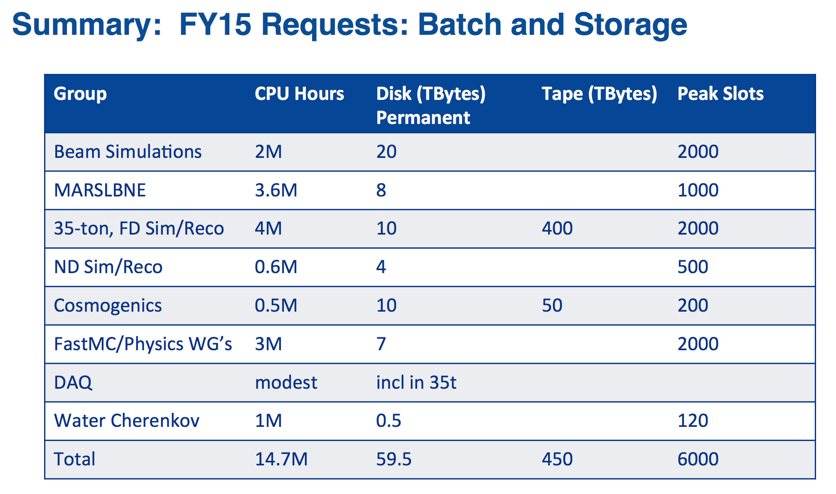
Upcoming SCPMT Requests
Will get a template and guidance for how to format the request
last year – CPU hours (not “slots”), though SCD was interested in the integrals of spikes: big demands in advance of conferences, etc.
Last Year's request
Need to make
new requests
for each group
and justify them.

Slide 11
Computing Model Document
Just got started:
Maxim Potekhin – main author
Amir Farbin
Tom Junk
https://github.com/DUNE/dune-computing-model
Timeline:
CD-3a (Early Dec.) Progress (LBNC’s wording). We interpret this to mean that a rough draft should be ready.
End of 2015: polished draft.
We will need reviewers!
Major Divisions:
Design and prototyping era (2015-2020)
DUNE experiment construction, commissioning, and operations

Slide 12
art News
art release 1.16.02, on which larsoft v04_27_00 (use
-q e9:prof or –q debug:e9 now) is built, has a bug in that art-formatted files written with earlier versions cannot be read.
Reason: there’s a new ResultsTree produced in the output file, and this version of art insists on its presence and chokes if it it absent.
The ResultsTree is now added so that trees, histograms, etc. can be stored in the art-formatted output file and not just in the TFileService-supported output file. This way you get provenance info for your ntuples and histograms, not just events.
Fixed in art release 1.17.02, on which larsoft v04_28_00 is built

Slide 13
art News
v1.18 is a “Technology Preview Release” built on ROOT6
https://cdcvs.fnal.gov/redmine/projects/art/wiki/Release_Notes_11800
Specifically, ROOT v5_34_32 -> v6_04_06
separate cpp0x package is now retired. art now assumes that the compiler used will be fully compliant with the standards required by that version. (We distribute appropriate compilers along with the larsoft/art bundle).
From the release notes page: there is a significant memory increase relative to 1.17.03 due to ROOT 6's autoparse facility. The exact amount will vary with experiment's configurations and data product use, but could be over 200MiB. We are confident we will be able to address this significantly in a future art release by taking steps to avoid triggering the autoparse behavior.

Slide 14
35t Computing News
Data Handling
Following instructions from Qizhong.
Tom has written simple scripts that obtain Kerberos authentication, scp files, and check the error codes and checksums of the copied files.
Tom has also received an example online database query python script from Jonathan Paley that takes as input the run number and returns the run mode, the configuration name, the component list, and the start and end times. Tom reformatted the string output so it fits in the JSON format from Qizhong but needs to integrate this script with Qizhong’s to get complete JSON files (an afternoon’s work)
To do – automatically upload metadata to SAM – Qizhong’s scripts provide examples. Tested on lbne35t-gatway02.
We have all the pieces – maybe a day’s worth of work to get it all put together.

Slide 15
35t Computing News
Online database filled by run control and replicated
offline. Tom has verified that the metadata extraction works using queries to this database.
OPOS (Offline Production Operations Service)
Tingjun, Karl, and Tom met with the OPOS group
https://cdcvs.fnal.gov/redmine/projects/offline_production_operations_service
Their job is to shepherd jobs through the batch system and check for proper completion and resubmit failed ones.
Tingjun and Karl demonstrated the project.py workflow to the OPOS team and they were pleased with how automated it is. Thanks to all of Herb Greenlee’s hard work!
MCC5 to be started in about 1 week. Single particles and neutrinos
http://indico.fnal.gov/getFile.py/access?contribId=1&resId=0&materialId=slides&confId=10676

Slide 16
SAM Tools for Analysis Users
Link to Andrew Norman's Presentation
Simplified tools for creating dataset definitions and archiving data
to tape.
Probably won’t use it for production work – project.py is already
interfaced to SAM via samweb commands. We already make
metadata JSON files for storing the raw data.
But ... users may be interested in a more lightweight dataset definition tool for managing their large sets of analysis ntuples.
See Andrew’s NOvA examples.

Slide 17
Cleaning up Old LArSoft Releases in /grid/fermiapp
e-mail from Erica Snider, Nov. 2
In order to free up space in the LArSoft products area on GPCF, /grid/fermiapp/products/larsoft, we plan to remove all releases prior to the v04 series — including production releases — on Nov 9 (next Monday!!). Note that this change will also be reflected in the releases available via cvmfs.
Per the LArSoft release retention policy, we need approval for removing the production releases, so please let us know if you are using any production release prior to v04.02.00.
Should the need arise, any production release that is removed can be restored upon request by any experiment

Slide 18
Simulations for Neutrinos Meeting Summary
https://indico.fnal.gov/conferenceDisplay.py?confId=10677
GENIE news G. Perdue
GEANT4 news K. L. Genser
Version 4.10.1p02 is the latest
Distributed as a scisoft.fnal.gov bundle
GEANT4 parameter sensitivity study – J. Yarba
GEANT4 validation data summary database H. Wenzel
NOvA simulation tuning real-world example: hadronic
recoil energy measurement is not simulated well and it
is “recalibrated” in the data – P. Vahle

