Slide 1
FY16 Program: MTest and MCenter
Mandy Rominsky, JJ Schmidt
FTBF Annual Review
09 November 2015

Slide 2
Notes on FTBF since January 2015
FTBF has hired Mandy Rominsky as the new facility manager. She would like to thank Aria Soha and JJ Schmidt for their dedication and great work in moving the test beam facility forward. (JJ now operates as deputy facility manager.)
The tech shop area is finished and has a door with locks to prevent use when Todd or people authorized by Todd are not around.
We are proposing to add modular in-plant offices in Meson West for the FTBF staff. Currently the staff occupies work rooms or control room seats needed by experimenters. This addition would greatly enhance our ability to do setup work for experimenters before they install. Offices would occupy current tech shop space and we would shift shop upstream (south).

Slide 3
MTest in FY16
Currently MTest is set to host 8 experiments for a total of 24 weeks. (Next summer shutdown in July – October, 2016.)
Split between general R&D, muon physics, collider physics and ion physics (RHIC)
MTest and MCenter beamlines will have a 4 week shutdown Jan 4 – Feb 5 for ICW upgrades to the lab infrastructure.
Will build in about 6 weeks of beam studies. The 4 week January shutdown will be used to improve the beamline instrumentation.

Slide 4
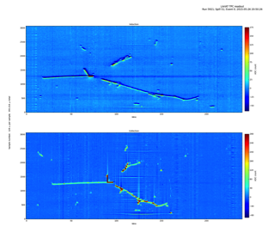
MCenter in FY16
LArIAT will continue to run this fiscal year.
The cryostat is currently open for minor upgrades to the TPC readout electronics and light collection system.
Recirculation system for liquid argon will not be installed in MC7 and LArIAT will continue to boil off argon from a dewar. Minor changes are being made to cryogenic system reduce amount of liquid argon used.
Will take physics data in February 2016
FY15 included a secondary user. If small, we can continue to have groups in during LArIAT’s run in FY16.

